Slide 1
On-Line Self Help Resources
css-cs.ca/resources/brochures
www.sleepfoundation.org
www.aasmnet.org
www.bettersleep.org
www.sleepresearchsociety.org
www.sleepandhealth.com
www.kidzzzsleep.org
Notes:
www.sleepfoundation.org
www.aasmnet.org
www.bettersleep.org
www.sleepresearchsociety.org
www.sleepandhealth.com
www.kidzzzsleep.org

Slide 2
Web Sites providing lists of free Sleep apps
https://positiveroutines.com/free-sleep-apps/
https://www.womenshealthmag.com/uk/health/sleep/g25458488/best-apps-insomnia/
https://www.goodhousekeeping.com/health/wellness/g26963663/best-sleep-apps/
https://www.wellandgood.com/best-sleep-apps/

Slide 4
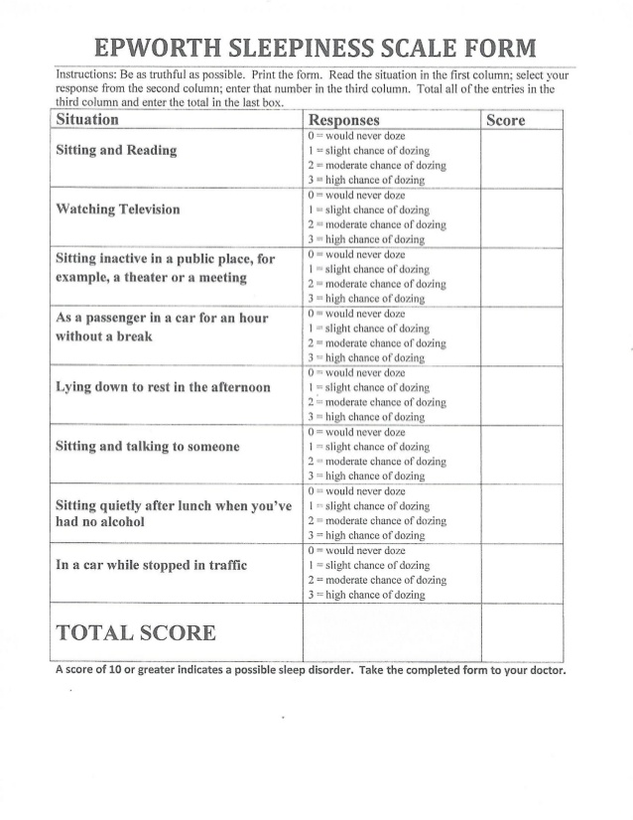

Slide 5
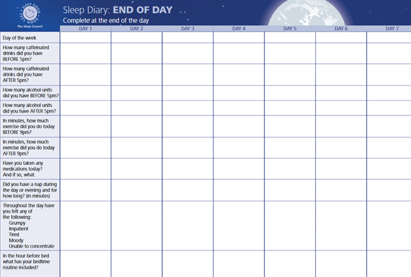

Slide 6
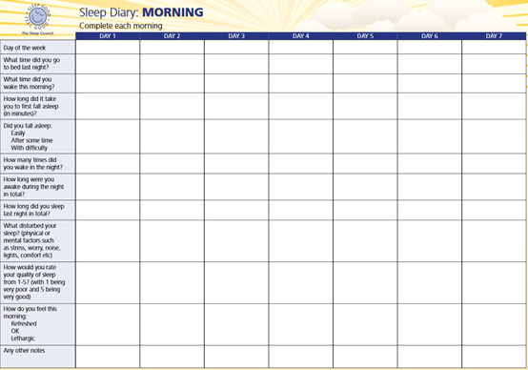

Slide 7
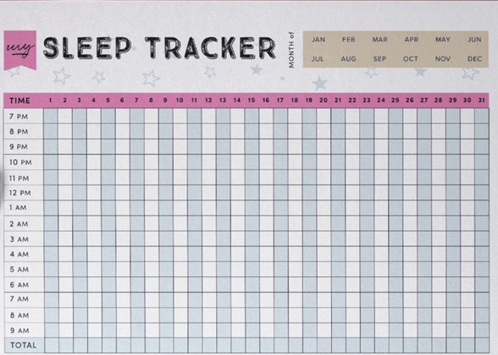

Slide 8
Things you can do to help your sleep
While there is no single thing you can do that will guarantee a good night’s sleep, doing some or all of these will help you to improve your sleep. But you need patience as some of these can take a week or two before you see their benefits
1) Maximise the time you spend in daylight during the day
2) Increase your physical activity during the day
3) Have a consistent bed time and bedtime routine
4) Create a cool, comfortable sleep friendly environment, including your mattress & pillows, and block out light and noise if it disturbs your sleep
5) Avoid using electronic screens (blue light) in the bedroom or in the hour before bed
6) Avoid caffeine, alcohol, large meals and strenuous physical activity in the 3 hours before bedtime
7) Use simple relaxation exercises such as 4-7-8 just before bed. Breathe out and then breathe in through your nose as you count to 4, hold your breath and count to 7, and exhale and count to 8. Repeat this 3 times.
8) Keep naps to a minimum – and for no more than 20 minutes
9) If you can’t get to sleep don’t fight it. Get up and do something relaxing and return to bed when you’re feeling sleepy
10) Eat 2 kiwi fruits before bedtime
11) Use prebiotics (during the day) – foods that contain them it (onions, leeks, garlic, green bananas, apples, oats, flax seeds, asparagus, Jerusalem artichokes) or capsules
MAKE SLEEP A PRIORITY IN YOUR LIFE AND ADJUST YOUR OTHER ROUTINES WHERE NECESSARY. DON’T ALWAYS SACRIFICE SLEEP TO ENABLE YOU TO MEET YOUR OTHER COMMITMENTS
Notes:
Things to Consider when Prescribing Drugs to Treat Insomnia
Use the minimal effective dose.
Avoid long half-life medications, including long half-life metabolites.
Be aware of potential interactions between drugs, including over-the-counter drugs.
Caution patients on these medications about interaction with alcohol.
Review potential side effects—in particular, daytime sleepiness.
Confer with the patient to determine an appropriate period of use.
Use a GABA agonist over other sedative-hypnotics for treatment of acute or short-term insomnia.
Look for rebound insomnia after discontinuation.
Consider intermittent or long-term use of hypnotic medications, depending on the clinical situation.
Consider consultation with a sleep specialist before starting long-term therapy with hypnotic medication.

