Slide 1
Title Slide
Escape the Office: The use of virtual reality escape room as an alternative teaching strategy for QI principles in medical education
Dr Kheira Jolin

Slide 2
COI – Presenter Disclosure (1)
Presenter Disclosure
Presenter: Dr Kheira Jolin-Dahel
Relationships with financial sponsors:
University of Ottawa: Director or Quality Improvement
Department of National Defense: Women Health Advisor
Jasen : Clinical Trial phase III : sub investigator
Pfizer: Clinical Trial phase II: Principal investigation and sub investigator

Slide 3
COI – Presenter Disclosure (2)
Disclosure of Financial Support
This program has received financial support from e-campus Ontario in the form of an educational grant
This program has received in-kind support from Department of Family Medicine, University of Ottawa in the form of human resources.
Potential for conflict(s) of interest:
None
Notes:
Where a program has received no external financial support (e.g., monies for food, logistics assistance such as registration, AV set-up, etc.), indicate No External Support.

Slide 4
Objectives
1. Explore gamification as an educational method in family medicine residency program
2. Participate a virtual reality escape room design to teach quality improvement principles
3. Recognize how gamification can be use to enhance skills outlined in the Can Med roles

Slide 5
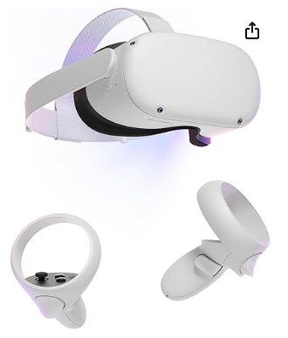
Gamification
Use of game strategies in non game setting
Trying to use gamification as a way to increase engagement of learners
Design an virtual reality escape room to test QI knowledge
Allows learners to develop team work, leadership and communication abilities.
Learners currently received didactic sessions on introduction to quality improvement before taking participating in the escape room.

Slide 6
Creating the escape room
Co designed with 2 medical students that received previous QI teaching
Identify QI principles we wanted to teach or reinforce
Brainstorm list of games including common puzzles seen in escape rooms but also computer games at table top games
Combined a QI concept with a game that reinforces the teaching point
Incorporated an interactive team work component to the puzzles
Our game has been translated to French

Slide 7
Objectives of the escape room
1- Review basic concepts of QI:
QI terminology
Identify a gap in care
“SMART” aim
Root cause analysis tools
Prioritizing change ideas
Basic understanding of run charts
2- CanMEDS roles:
Team work, communication & leadership while working to solve various puzzles.

Slide 8
ESCAPE ROOM PUZZLEs FLOWCHART
Puzzle 1.2
Puzzle 2.1
Puzzle 2.3
Puzzle 1
Puzzle 1.4
Puzzle 1.3
Puzzle 2.2
Puzzle 3.3
Puzzle 3.2
Puzzle 3.1
Need information from puzzle 3.1 to solve puzzle 3.2
TEAM WORK REQUIRED

Slide 9
ESCAPE THE OFFICE
It has been a long day at the office. As usual, the clinic ended up dragging longer than expected. In your dismay, you check your phone and realize that you must be home in one hour. You head to the door but notice in shock that you are locked in the clinic! You don’t remember the alarm code. You do recall that, in his infinite wisdom, the previous owner of the clinic, Dr. Kualee Tee, has spread clues in the office to be able to retrieve the alarm code. Gather the clues and escape the office on time...
…or be found buried under paperwork in the morning

Slide 10
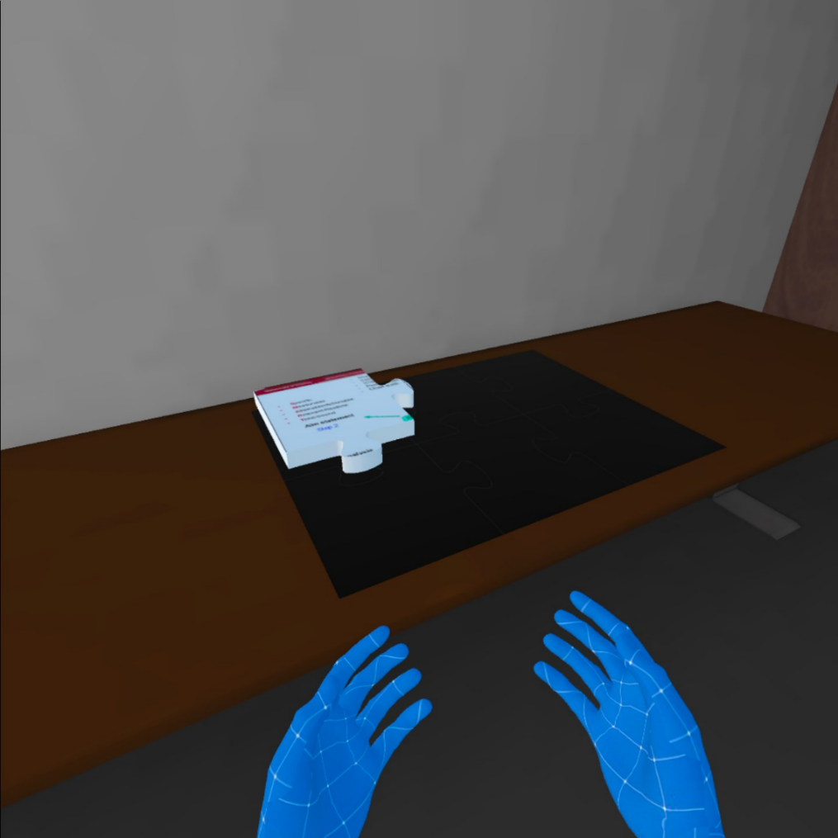
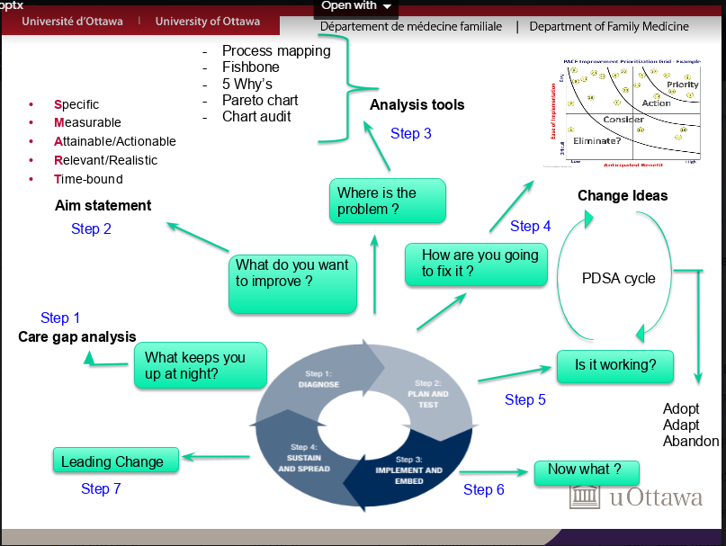
Puzzle 1.1- BUILD THE QI MAP
Get learners situated in the virtual reality context and practice with the controllers
Look around the room to find puzzle pieces to assemble the “QI map”

Slide 11
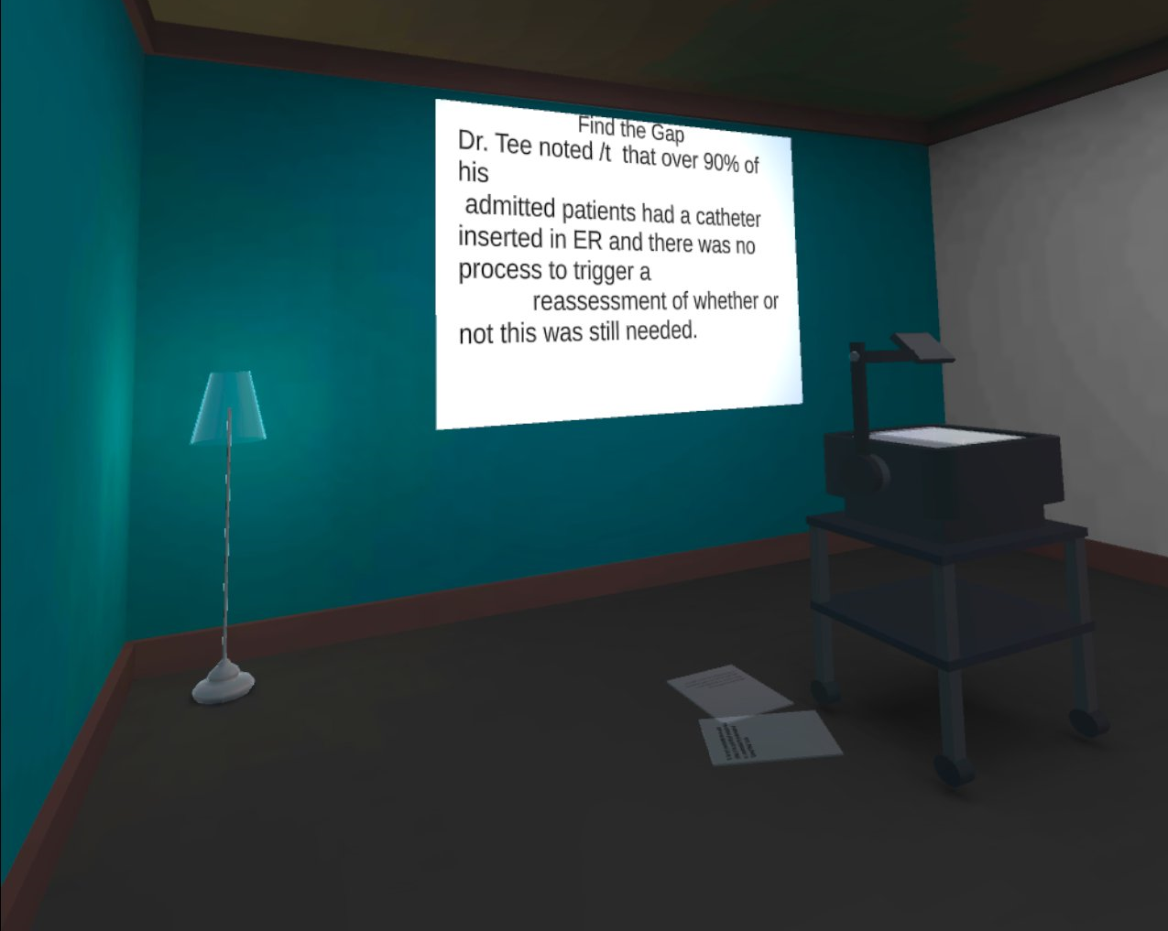
Puzzle 1.2- FIND THE GAP
Players are told to get the projector going
They must insert a light bulb into the projector
Find “papers” to put on the projector.

Slide 12
Puzzle 1.2 Find the Gap
The papers each displays a different texts:
GAP
GUIDELINE
CONSENSUS
Dr. Tee noted that over 90% of his admitted patients had a catheter inserted in ER. There is no process to trigger a reassessment of whether or not this is still needed. the answer key easily customisable?
Dr. Tee rarely uses docusate alone as a stool softener to treat opioid-induced constipation. This is based on a recommendation from palliative care from "Choosing Wisely" Canada.
As per the Canadian Task Force on Preventive Health Care, the task force strongly recommends against screening for thyroid dysfunction in asymptomatic nonpregnant adults. key easily customisable?

Slide 13
Puzzle 1.4
Puzzle 1
Puzzle 1.2
Puzzle 1.4
Puzzle 2.1
Puzzle 2.3
Puzzle 1.3
Puzzle 2.2
Puzzle 3.3
Puzzle 3.2
Puzzle 3.1
Need information from puzzle 3.1 to solve puzzle 3.2

Slide 14
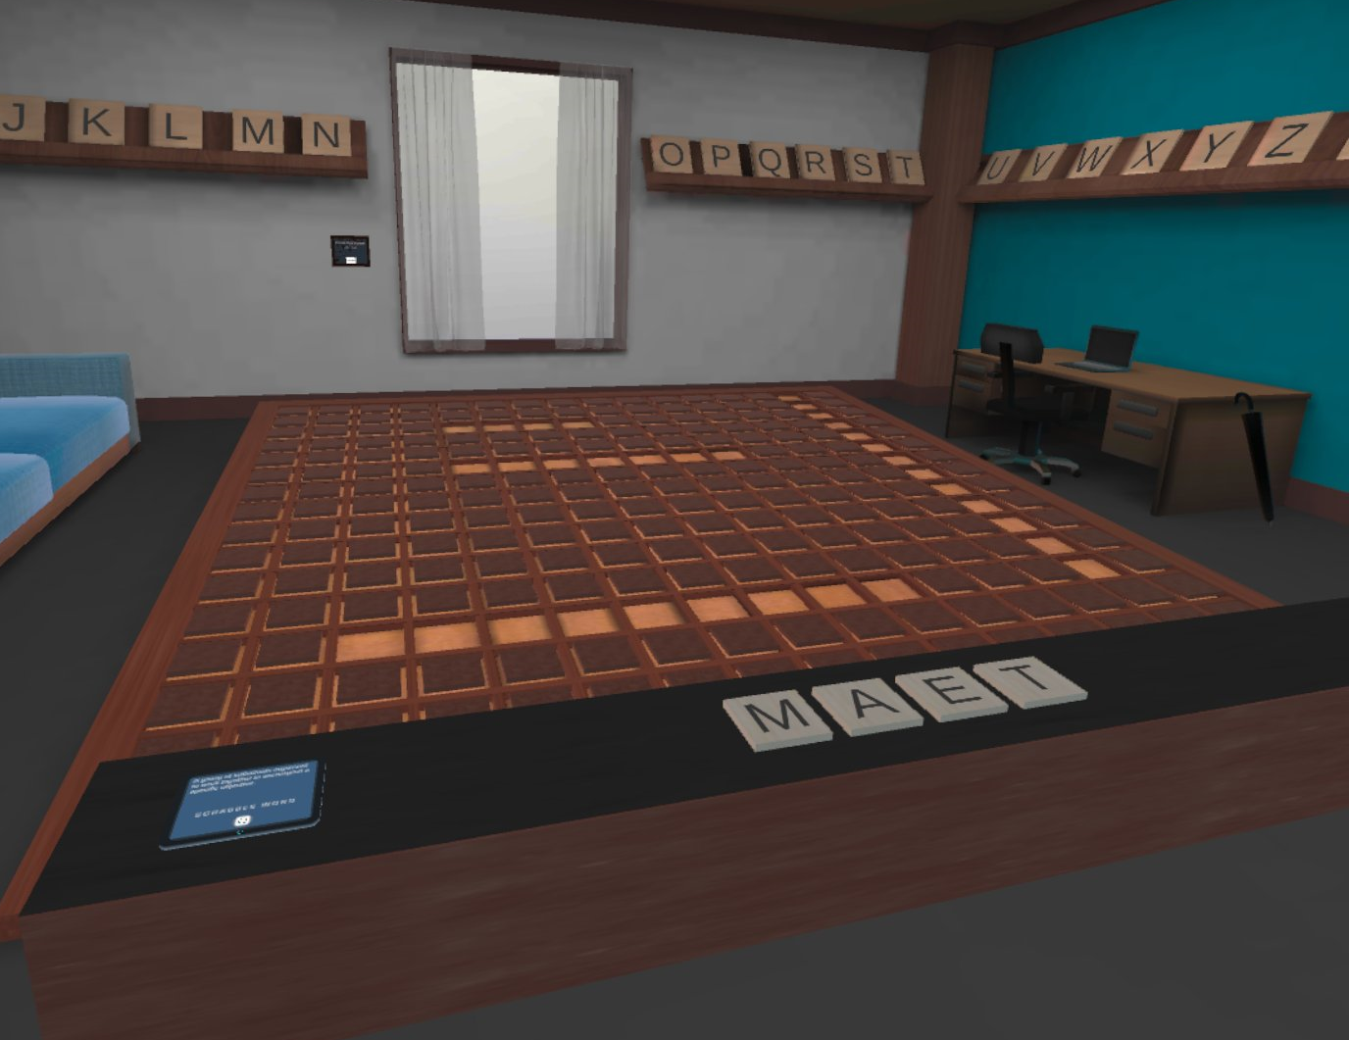
Puzzle 1.3 QI Vocabulary
Review QI vocabulary
Prompt and letters appear on the
Scrabble board

Slide 15
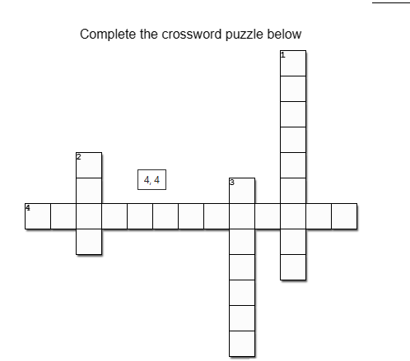
Puzzle 1.3 QI Vocabulary
1-A way for physicians to compare data, both internally or externally against data from other physicians, to identify care gaps and improvement opportunities- MCENAKRBH
2-A group of individuals that works together to accomplish a specific objective- AEMT
3- Mechanism used to assign a quantity to quality of care by comparison to a criterion. UEMSREA
4- Improve patient experience; Improve health outcomes, Reduce cost of health care; and, Improve provider’s experience. UAIMIQAPLAE_DUR

Slide 16
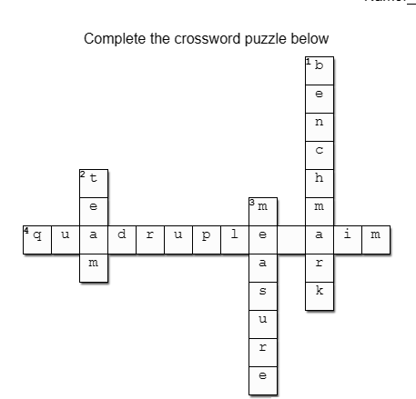
Puzzle 1.3-Solution
Reduce adverse events in ICU from 82% to 46% within the next year.
Within 9 months from now, be able to offer same day access with primary care provider
Transfer every patient from Emergency department to inpatient units with 3h of decision to admit
In the next 6 months, increase the amount of completed routine screening pap tests in female patients under 20 y/o to 80%.
By the end of next year, decrease rates of delirium in admitted patients over 65 y/o from 37% to 0%.
Notes:
By the end of next year, decrease rates of delirium in admitted patients over 65 y/o from 37% to 0%.

Slide 17
Puzzle 1.4-SMART AIM
Reduce adverse events in ICU from 82% to 46% within the next year.
Within 9 months from now, be able to offer same day access with primary care provider
Transfer every patient from Emergency department to inpatient units with 3h of decision to admit
In the next 6 months, increase the amount of completed routine screening pap tests in female patients under 20 y/o to 80%.
By the end of next year, decrease rates of delirium in admitted patients over 65 y/o from 37% to 0%.
Puzzle 1
Puzzle 1.2
Puzzle 1.4
Puzzle 2.1
Puzzle 2.3
Puzzle 1.3
Puzzle 2.2
Puzzle 3.3
Puzzle 3.2
Puzzle 3.1
Need information from puzzle 3.1 to solve puzzle 3.2

Slide 18
Puzzle 1.4-SMART AIM
Transfer every patient from Emergency department to inpatient units within 3h of decision to admit
Within 9 months from now, be able to offer same day access with primary care provider
In the next 6 months, increase the amount of completed routine screening pap tests in female patients under 20 y/o to 80%.
By the end of next year, decrease the rate of delirium in admitted patients over 65 y/o from 37% to 0%.
Reduce adverse events in ICU from 82% to 46% within the next year.

Slide 19
Puzzle 1.4-SMART AIM
Reduce adverse events in ICU from 82% to 46% within the next year.
Offer patients same day access with primary care provider within 9 months -
By the end of next year, decrease rates of delirium in admitted patients over 65 y/o from 37% to 0%.
Increase the amount of completed routine screening pap test in female patient under 20 y/o testing by 80% in the next 6 months.
Transfer every patient from Emergency department to inpatient units with 3h of decision to admit

Slide 20
Puzzle 1.4- Aim Statement
Reduce adverse events in ICU from 82% to 46% within the next year. This aim is not specific
Within 9 months from now, be able to offer same day access with primary care provider- this aim has no measure
Transfer every patient from Emergency department to inpatient units with 3h of decision to admit - this aim is not time bound
In the next 6 months, increase the amount of completed routine screening pap tests in female patients under 20 y/o to 80%. - This aim is not relevant
By the end of next year, decrease rates of delirium in admitted patients over 65 y/o from 37% to 0%. - This aim is not attainable.

Slide 21
Room 1 Completed

Slide 22
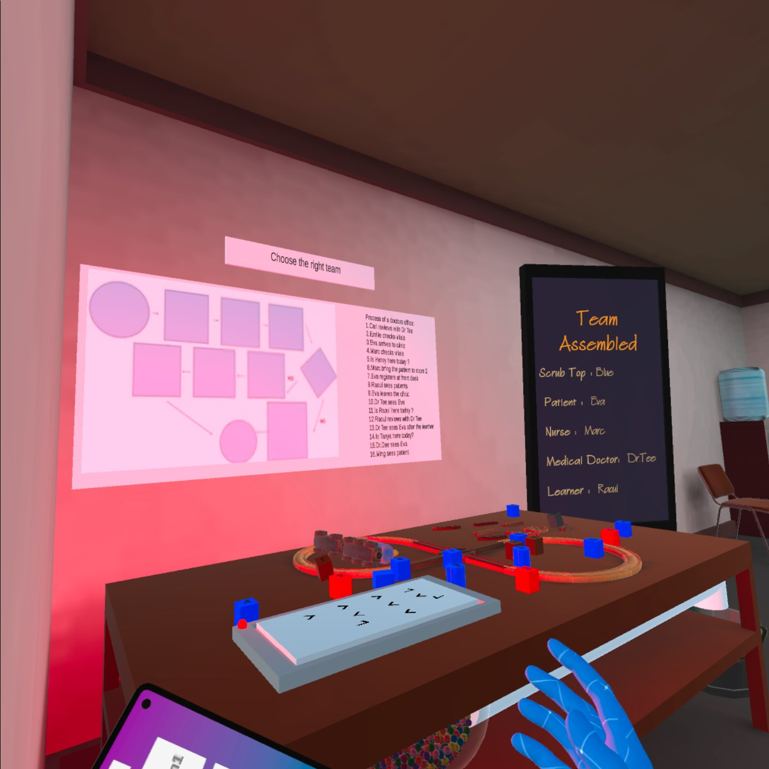
Puzzle 2.1-Process Map
Aim: Build the process map

Slide 23
Puzzle 2.1 Process Map
Carl reviews with Dr Tee
Emilie checks vitals
Eva arrives to clinic
Marc checks vitals
Is Henry here today ?
Marc bring the patient to room 2
Eva registers at the front desk
Raoul sees the patient
Eva leaves the clinic
Dr Tee sees Eva
Is Raoul here today?
Raoul reviews with Dr Tee
Dr Tee sees Eva after the learner
Is Tanya here today?
Dr Dee sees Eva
Wing Sees patient
2
4
5
6
7
8
1
3
11
13
14
15
16
9
10
12

Slide 24
Puzzle 2.1 Process Map
Carl reviews with Dr Tee
Emilie checks vitals
Eva arrives to clinic
Marck checks vitals
Is Henry here today ?
Marc bring the patient to room 2
Eva registers at the front desk
Raoul sees the patient
Eva leaves the clinic
Dr Tee sees Eva
Is Raoul here today?
Raoul reviews with Dr Tee
Dr Tee sees Eva after the learner
Is Tanya here today?
Dr Dee sees Eva
Wing Sees patient
3
7
6
4
11
13
12
8
10
9
1
2
5
14
15
16

Slide 25
Puzzle 2.2- Worst Possible Idea
Puzzle 1
Puzzle 1.2
Puzzle 1.4
Puzzle 2.1
Puzzle 2.3
Puzzle 1.3
Puzzle 2.2
Puzzle 3.3
Puzzle 3.2
Puzzle 3.1
Need information from puzzle 3.1 to solve puzzle 3.2

Slide 26
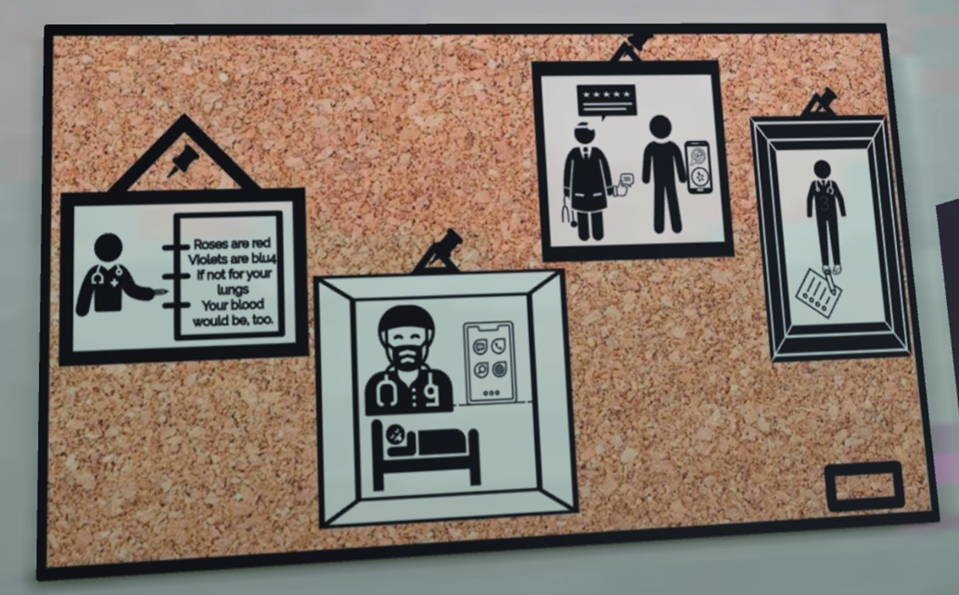
Puzzle 2.2- Worst Possible Idea
CODE: 4953

Slide 27
Puzzle 2.2- Worst Possible Idea

Slide 28
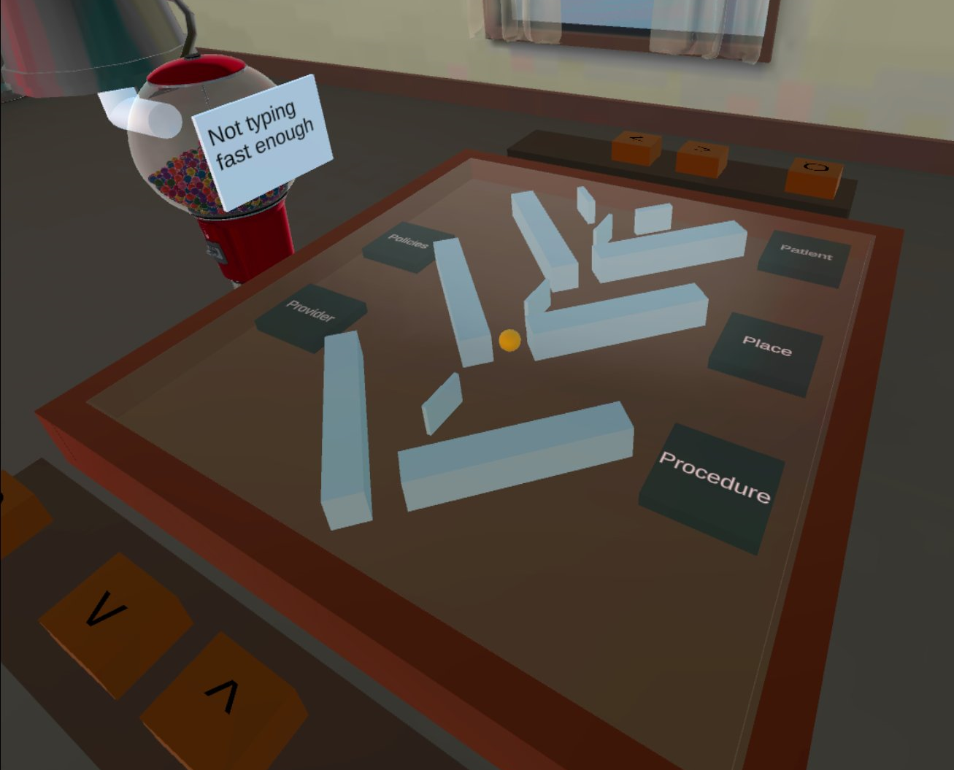
Puzzle 2.3-FISHBONE DIAGRAM
Not typing fast enough (provider)
Not booking meet and great (policies)
Not arriving on time for appointment (patient)
Not enough exam room (place)
To many results to review (procedure)
Started clinic late
(provider)
Not typing fast enough
Not booking meet and great
Not arriving on time for appointment
Not enough exam room
To many results to review
Started clinic late
Puzzle 1
Puzzle 1.2
Puzzle 1.4
Puzzle 2.1
Puzzle 2.3
Puzzle 1.3
Puzzle 2.2
Puzzle 3.3
Puzzle 3.2
Puzzle 3.1
Need information from puzzle 3.1 to solve puzzle 3.2

Slide 29
Room 2 completed

Slide 30
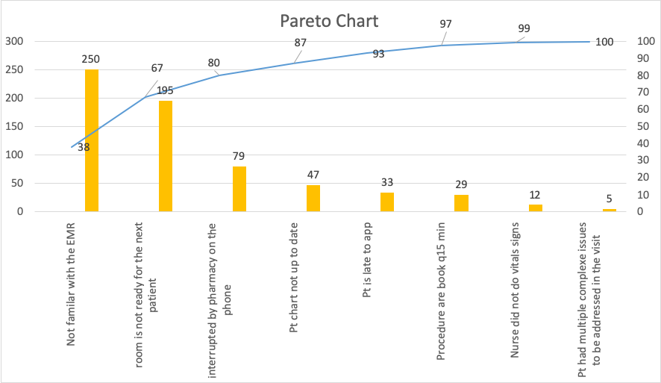
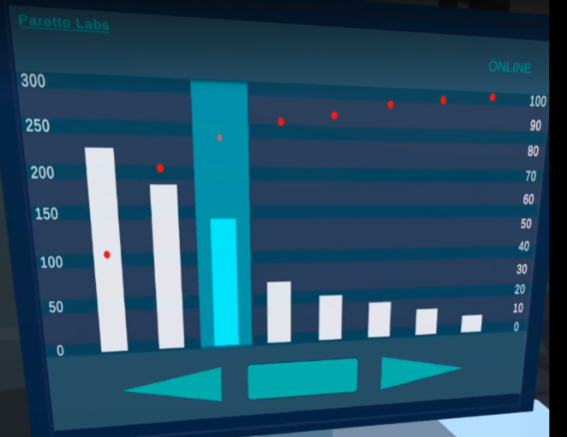
Puzzle 3.1-Pareto Chart
Players must reconstruct the
pareto chart
This unlocks the door to the
Second portion of the room

Slide 31
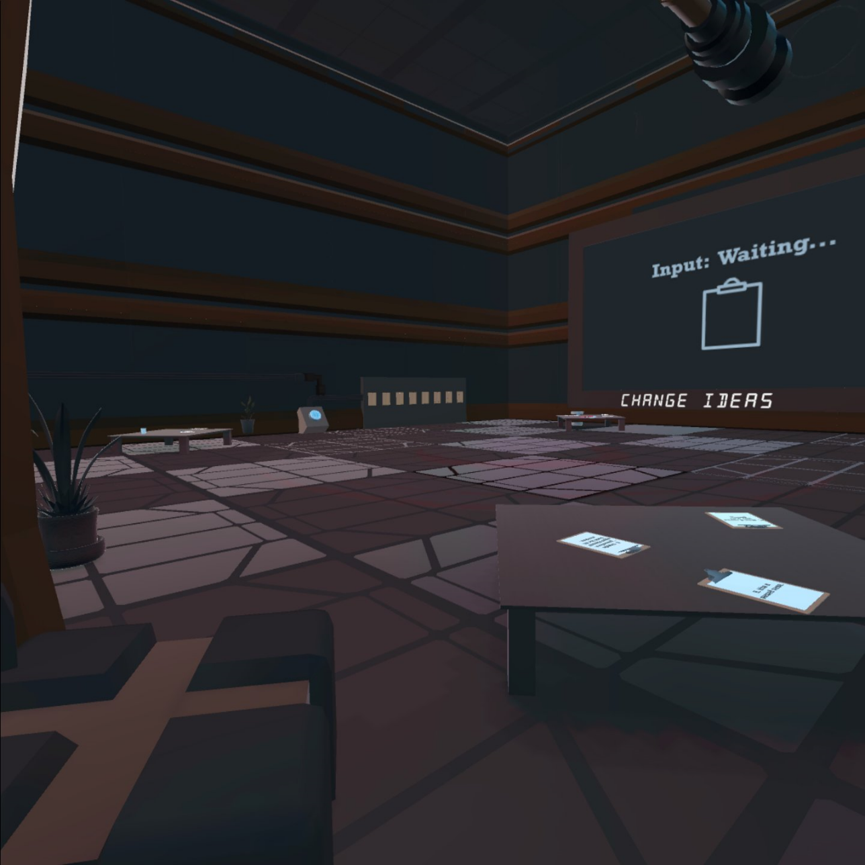
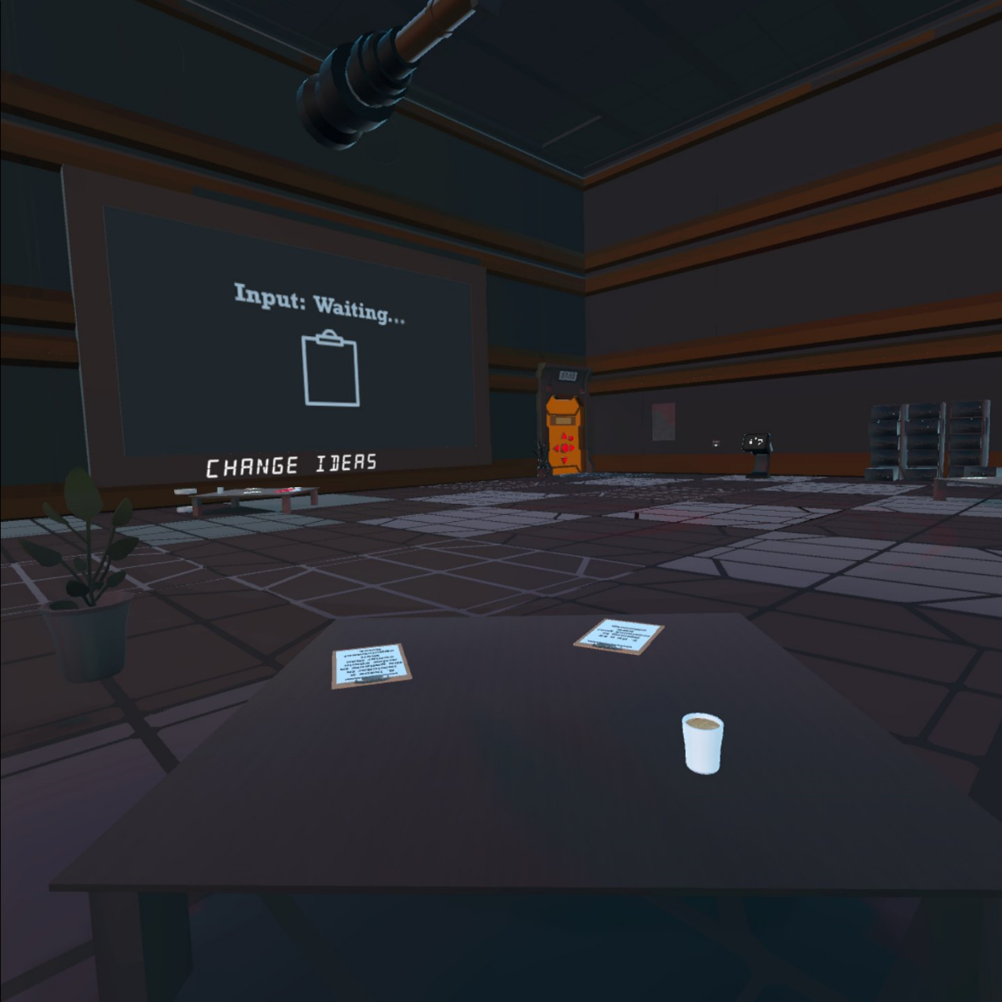
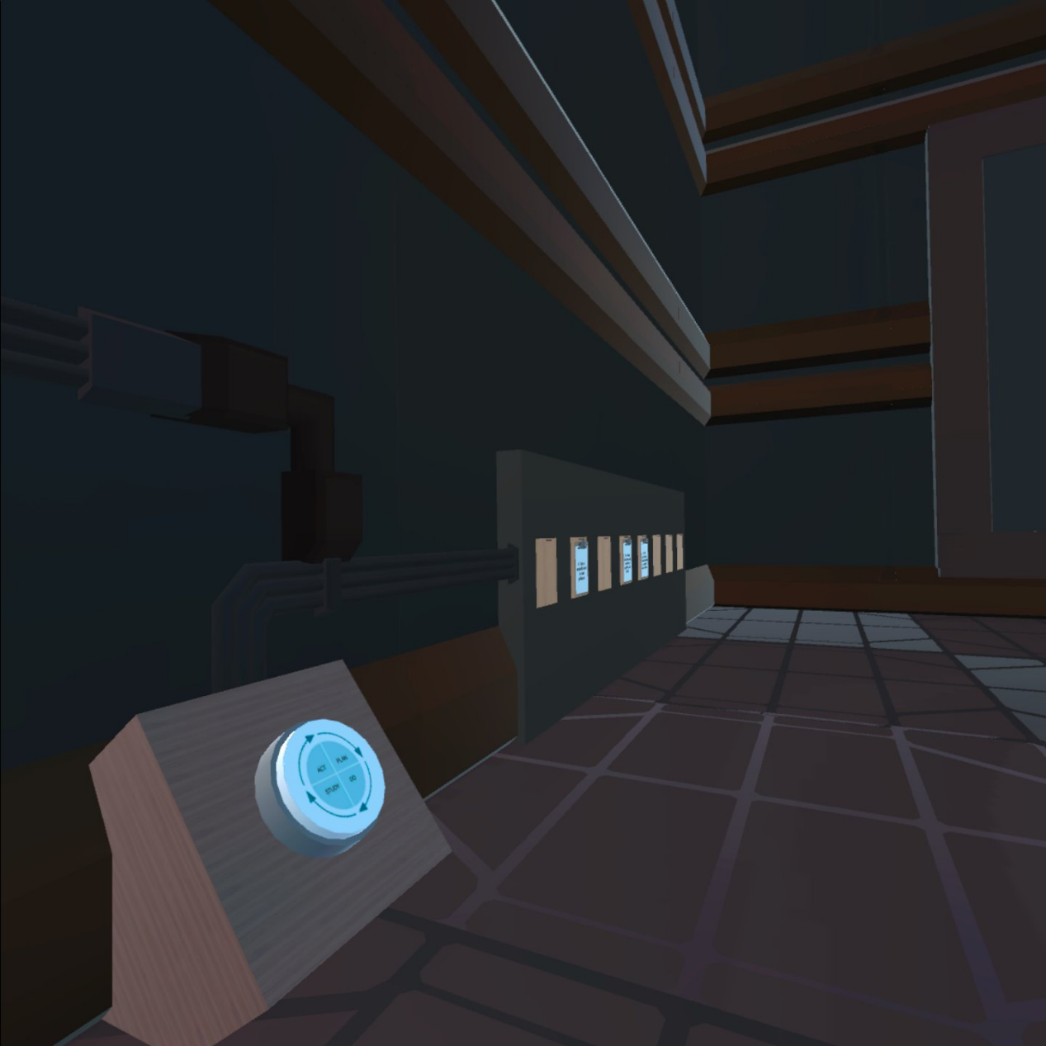
Puzzle 3.2 Change Ideas
Players see several clip board scattered across the room.
They have some change ideas listed on them.
Based on the bars from the Pareto chart, they must prioritize their change ideas.
Puzzle 1
Puzzle 1.2
Puzzle 1.4
Puzzle 2.1
Puzzle 2.3
Puzzle 1.3
Puzzle 2.2
Puzzle 3.3
Puzzle 3.2
Puzzle 3.1
Need information from puzzle 3.1 to solve puzzle 3.2

Slide 32
Puzzle 3.2-CHANGE IDEA
The Pareto chart and the clipboard are in different “location” therefore players must communicate with each other to arrange the change ideas in the correct order
Max 1 issue per visit policy
Hire a second nurse
Book Procedure for 30 min
Do a 1h training to maximize your EMR efficiency
Using second room to see patients
All pharmacy communication must be done by fax
Hire a Summer coop student to update your chart
Issue reminder to patient to arrive 20 min early to their appointment

Slide 33
Puzzle 3.2-CHANGE IDEA
Do a 1h training to maximize your EMR efficiency
Using second room to see patients
All pharmacy communication must be done by fax
Hire a Summer coop student to update your chart
Reminder to patient to arrive 20 min early to their appointment
Book Procedure for 30 min
Hire a second nurse
Max 1 issue per visit policy

Slide 34
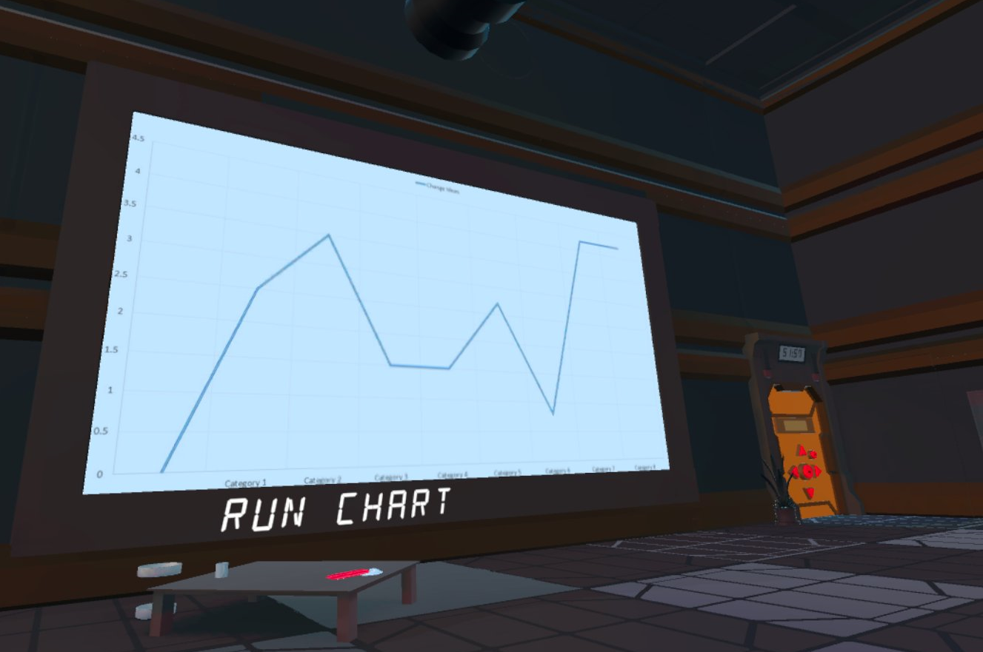
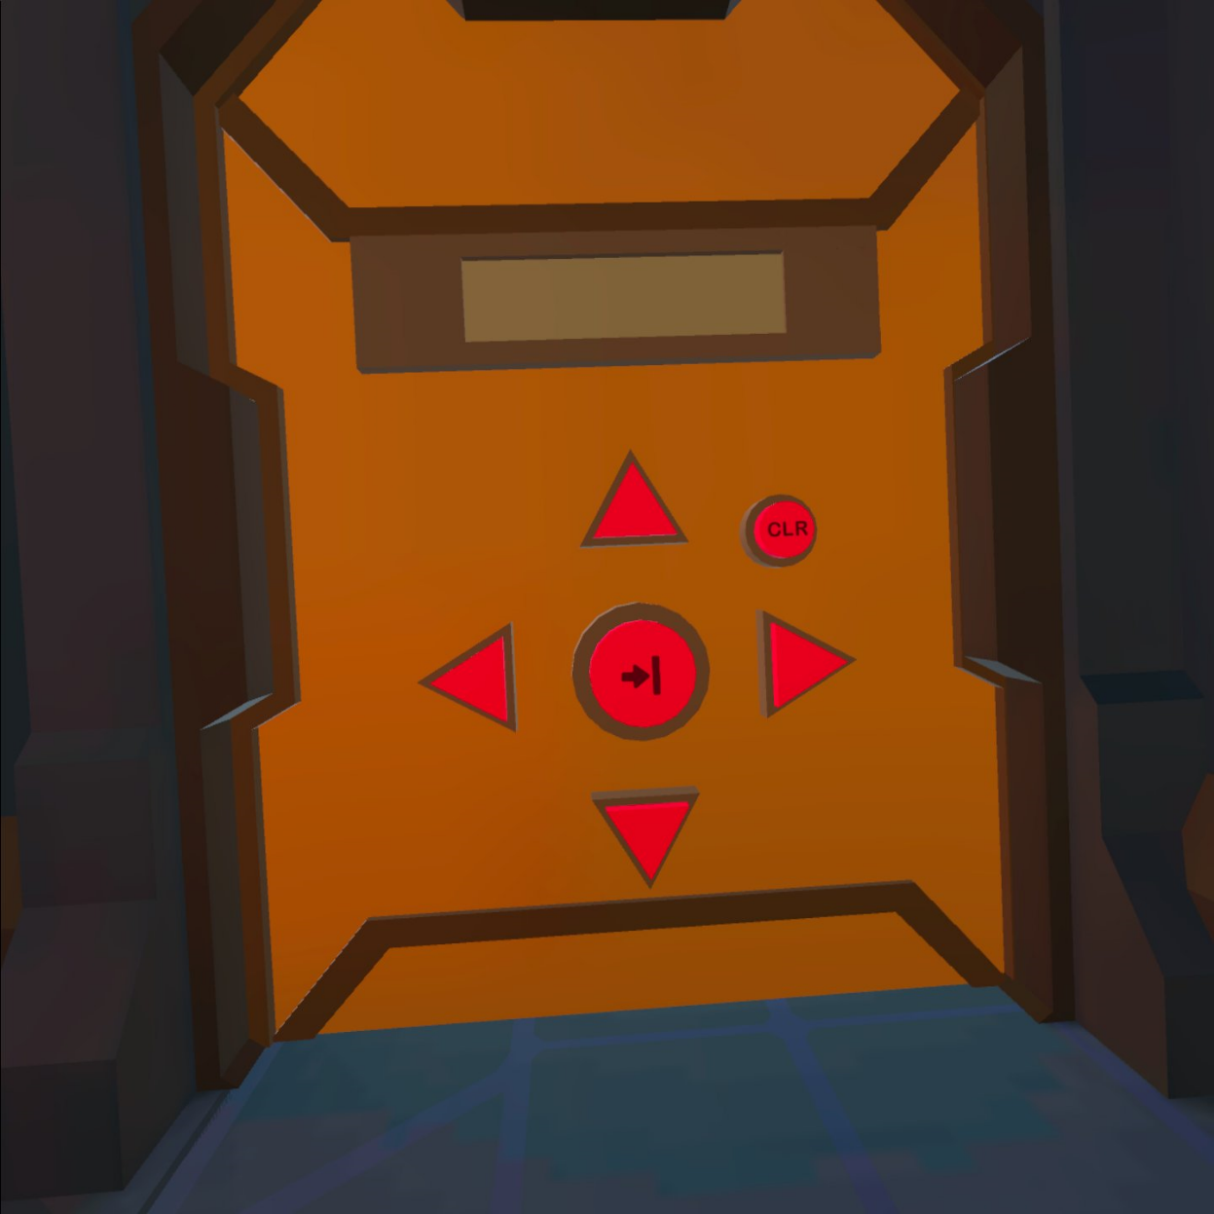
Puzzle 3.3
Pressing the “PDSA” button generate a run chart.
The “direction” of the change is the code for the directional lock

Slide 35
Congratulations!!!
YOU ESCAPED THE OFFICE

Slide 36
NEXT STEPS
Tried on 27 individuals (3 med students, 19 family medicine residents, 4 uOttawa DFM faculty members)
Being implemented for all the uOttawa DFM PGY1 as part of their QI curriculum –Nov 17, 2023
Collecting data on learners experience

Slide 37
Closing Slide
Thank you!
Please fill out your session evaluation now!
#myfmf
FamilyMedicineForum
FamilyMedForum
FamilyMedForum

