Slide 1
Session Title
Caring For Your Diabetic Patient In The Hospital
Presented by: Dr Benjamin Schiff
Let’s prepare for the future together!
Date: Nov 8th 2023

Slide 2
COI – Presenter Disclosure
Presenter: Dr Benjamin Schiff
Relationships with financial sponsors:
•Any direct financial relationships, including receipt of honoraria: None
•Membership on advisory boards or speakers’ bureaus: None
•Patents for drugs or devices: None
•Other: None
Presenter Disclosure
Notes:
Where a faculty/presenter has no relationships to disclose, indicate Not Applicable under Relationships with Financial Sponsors.
Complete this slide for the primary presenter and ALL co-presenters if applicable.
Reminder: Disclosures made on your COI forms should match disclosures made on the COI slide.

Slide 3
COI – Disclosure of Financial Support
This program has not received financial support
DISCLOSURE OF FINANCIAL SUPPORT
This program has not received any in-kind support
Potential for conflict(s) of interest:
•[None
Notes:
Where a program has received no external financial support (e.g., monies for food, logistics assistance such as registration, AV set-up, etc.), indicate No External Support.

Slide 5
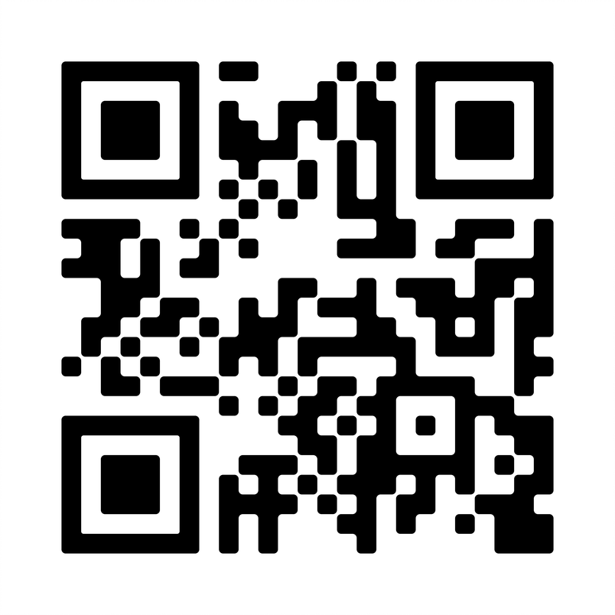
Learn more about MIGS at www.cfpc.ca/migs

Slide 6
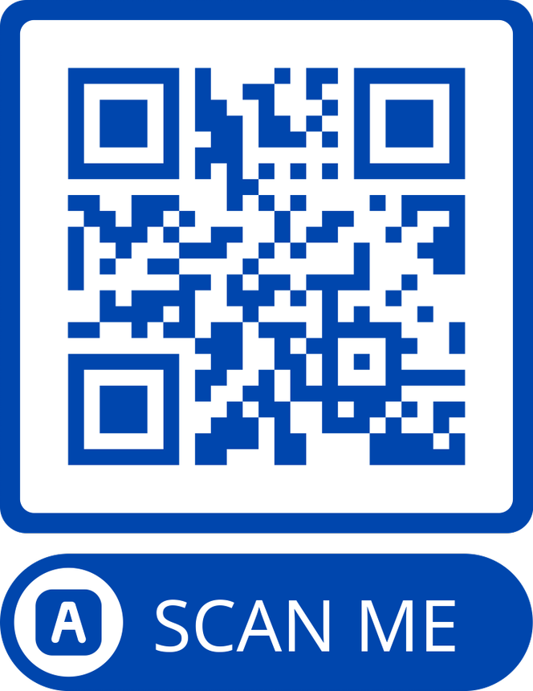
Join over 5,000 of your colleagues in one or more of the 21 virtual spaces. The app is available for both iOS and Android.
MiGroups

Slide 7
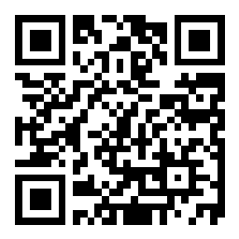
POLL QUESTION #1 What challenges do you face managing DM in the hospital? Slido.com #3476452

Slide 8
CASE # 1
60 y/o male
PMHx includes DM2, HTN, and CKD
Meds include Perendopril, Metformin 850 mg BiD, Semiglutide, and HCTZ
2 days of nausea, vomiting and diarrhea
HR 110, BP 110/60
Cr 180, urea 18, K+ 5.9

Slide 9
CASE #2
72 y/o female
PMHx includes DM2, HTN, and breast cancer
Meds include insulin glargine 28 units qHS, insulin lispro 4 units AC meals, and amlodipine
3 days of H/A and right sided weakness
CT shows solitary left-sided brain metastasis
Started on dexamethasone

Slide 10
CASE #3
75 y/o male
PMHx includes DM2, DLP, HTN and COPD
Meds include Metformin 500 mg TiD, Empagliflizin 10 mg Ramipril, Atorvastatin, and Tiotropium
3 days of cough, chills, yellow sputum and SOB
RR 28, oxygen saturation 88%
CXR shows RLL infiltrate
Cr 130, WBC 14, lactate 6.3

Slide 11
LEARNING OBJECTIVES
At the end of this session, you will be able to determine the appropriate goals of care with respect to diabetes in the in-patient setting
At the end of this session, you will be able to safely and effectively achieve glucose targets, with particular emphasis on the prescription of sliding scales
At the end of this session, you will be Identify the challenges and pitfalls of managing diabetes in the hospital setting

Slide 12
Outline
Background and Glycemic Targets
Factors Affecting Glucose
Review of medications
Co-morbid conditions
Approach to Management
Sliding Scale Insulin
Steroids
Tips and pitfalls
D/C planning
Take home messages

Slide 13
In-hospital Hyperglycemia is Common
Approximately 1/3 of in-patients have been found to have hyperglycemia
Many have pre-existing diabetes prior to admission
Hyperglycemia

Slide 14
Adverse Effects of Hyperglycemia
Hyperglycemia
Increases risks of postoperative infections and delirium
Prolonged hospital stay, resource utilization
Increased renal dysfunction and renal allograft rejection in transplant

Slide 15
Hyperglycemia and Acute Illness
Hyperglycemia
Acute Illness
Increased stress hormones, use of glucocorticoids, decreased level of activity
Decreased immune function, wound healing, increased oxidative stress
Inzucchi SE. NEJM 2006;355;1903
Notes:
Script: Acute illness results in a number of physiologic changes (e.g., increases in circulating concentrations of stress hormones) or therapeutic choices (e.g., glucocorticoid use) that can exacerbate hyperglycemia. Hyperglycemia, in turn, causes physiologic changes that can exacerbate acute illness, such as decreased immunefunction and increased oxidative stress. This leads to a vicious cycle of worsening illness and poor glucose control.

Slide 16
POLL QUESTION #2 What is the target for AC glucose in non-critically ill patient Slido.com #3476452

Slide 17
In-Hospital Management of Diabetes
Diabetes Canada Clinical Practice Guideline Committee
Malcom et al
Can J Diabetes 42 (2018) S115-S123

Slide 19
American Diabetes Association
Insulin therapy should be initiated for treatment of persistent hyperglycemia starting at a threshold 180 mg/dL (10.0 mmol/L) (checked on two occasions).
Once insulin therapy is started, a target glucose range of 140–180 mg/dL (7.8–10.0 mmol/L) is recommended for the majority of critically ill and noncritically ill patients.

Slide 20
FACTORS INFLUENCING GLYCEMIC CONTROL
Diet ( )
Mobility/Exercise
Timing of medication(s)
Acute illness
IV (D5W)
Artificial feeding (TPN)
Medications
Co-morbidities (renal failure, liver failure)

Slide 21
MEDICATIONS Canadian Diabetes Association

Slide 22
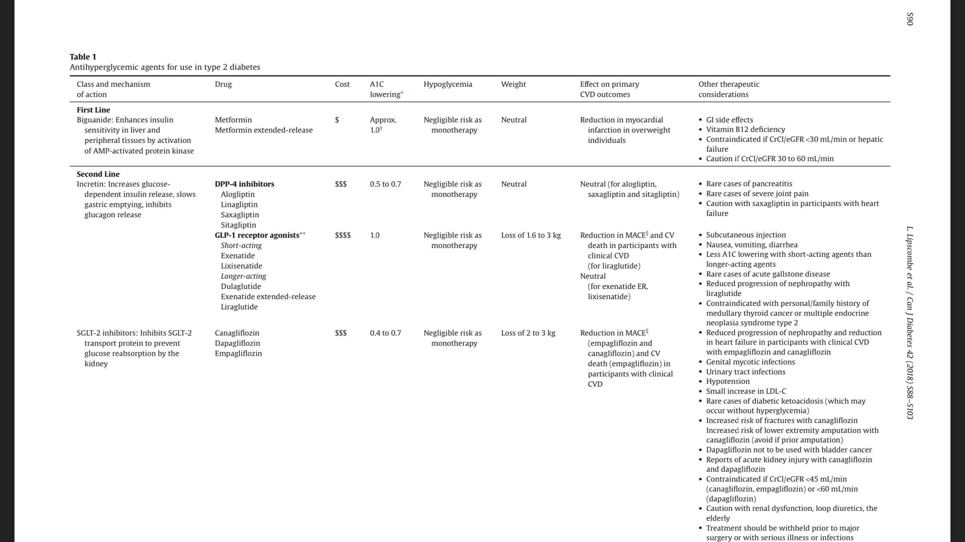

Slide 23
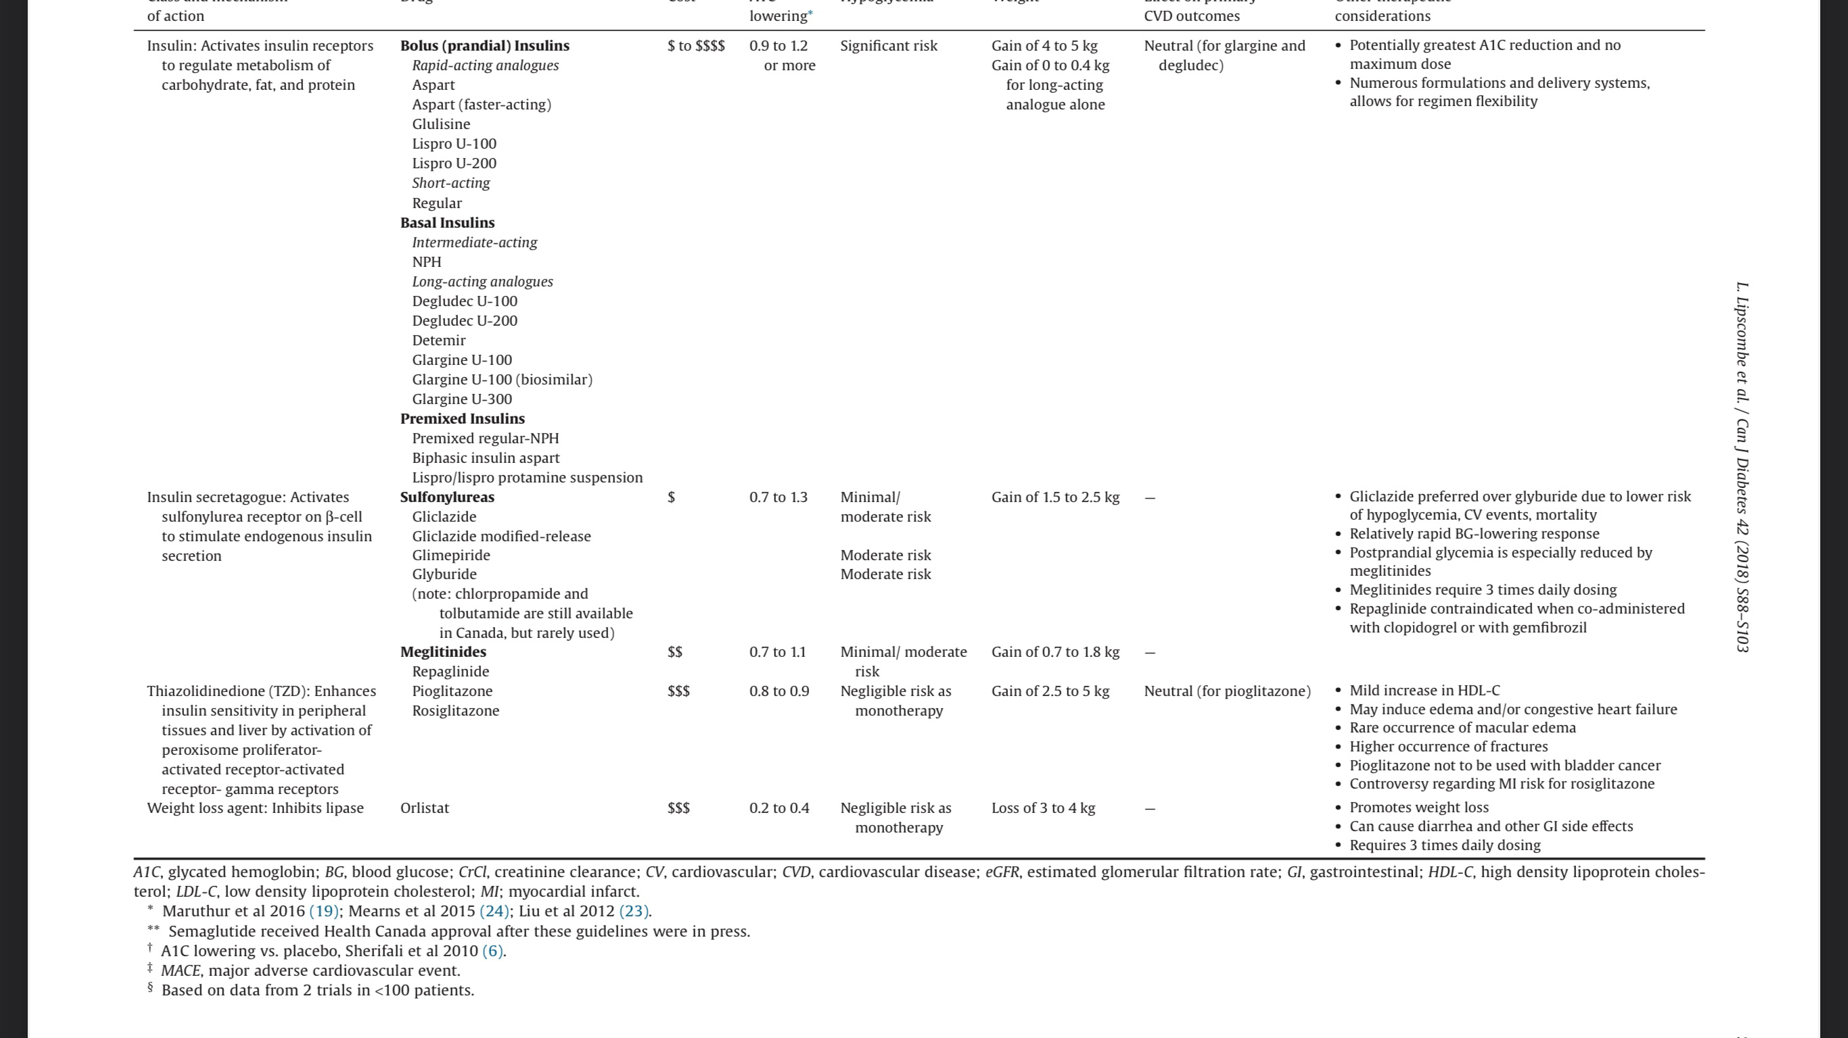

Slide 24
POLL QUESTION #3 Which Medication is Safest in the Hospital Setting? Slido.com #3476452

Slide 25
Metformin
First line in Type 2 Diabetes, but little evidence in hospital setting
Lactic Acidosis main concern
Liver disease; hold
Renal Failure (CrCL<30, or 30-60 and conditions associated with hypoperfusion/hypoxemia); hold or adjust dose
Acute and/or unstable CHF; hold
IV contrast: Hold before and 48hr post

Slide 26
(Sodium-glucose Cotransporter-2) SGLT2 Inhibitors
Have been associated with DKA (euDKA); acute illness, alcohol intake, reduced insulin dose
Definitely associated with hypotension
Risk of UTIs and genital infections
Consider holding while in Hospital, especially if acutely ill

Slide 27
(Dipeptidyl peptidase-4) DPP-4 Inhibitors
Seems to be the safest choice in hospital
May lower the need for insulin (“Oral antidiabetes agents for the management of inpatient hyperglycaemia: so far, yet so close,”, Koufakis et al Diabetic Medicine May 2020

Slide 28
Secretagogues
Sulfonylureas (e.g. Glyburide, Gliclazide) associated with high risk of (prolonged) hypoglycaemia, so should be avoided in most cases
Non –Sulfonylureas (Repaglinide) can be considered due to their short half-life

Slide 29
CO-MORBID CONDITIONS

Slide 30
Renal Failure
Diabetic patients at risk, even if not previously known RF
Common complication of acute medical illnesses
Increases risk of hypoglycaemia and acidosis
Closely monitor renal function, reassess management (diabetes meds, other nephrotoxic medications, etc)

Slide 31
Liver Disease
Metformin and lactic acidosis
Risk of hypoglycemia (hepatic gluconeogenesis)
Concomitant pancreatic dysfunction (exocrine and endocrine)

Slide 32
MANAGEMENT

Slide 33
Approach to Management
Complete Hx, including dietary history, home values (if available), medications, diabetic complications (RF)
Labs, including Urea, Cr, K+, and HgB A1C
Determine goals of glycemic control ("tight" vs relaxed, short term vs long term)
Evaluate and anticipate impact of acute illness(es) on glucose control and choice of medication
Avoid hypoglycemia (protocol)

Slide 34
Management (cont’d)
Diabetic diet
Accuchecks (frequency and duration individualized)
Determine which currently prescribed medications (if any) are appropriate to continue (including insulin)
Reassess management as clinical situation changes
Sliding Scale Insulin (SSI)
SADMANS

Slide 35
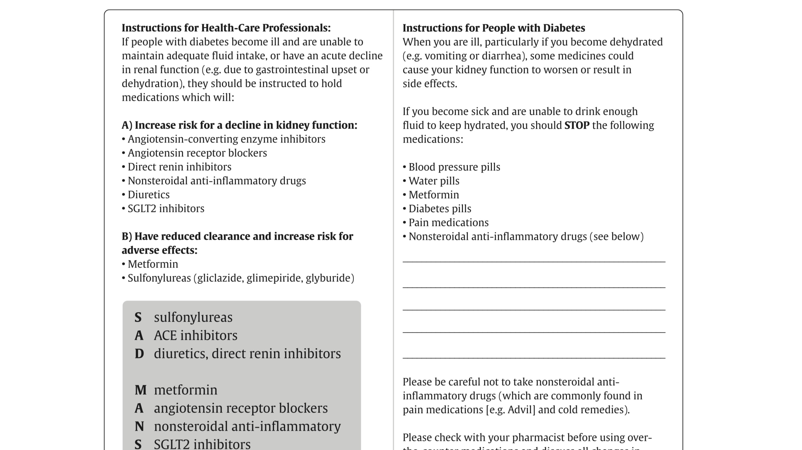

Slide 36
Sliding Scale Insulin (SSI)

Slide 37
POLL QUESTION #4 Is Sliding Scale Insulin Alone Recommended? Slido.com #3476452

Slide 38
Short-acting insulin (Lispro, AKA Humolog)
Often QiD, but increased risk of hypoglycemia overnight
Alternative is TiD AC meals, +/- ½ dose at HS
Both CDA and ADA recommend against using sliding scale alone..however, recent data may support its use
Reactive as opposed to pro-active
Preferred approach is basal-bolus or basal-correction, if control sub-optimal

Slide 39
American Diabetes Association
16.7 An insulin regimen with basal, prandial, and correction components is the preferred treatment for non–critically ill hospitalized patients with good nutritional intake. A
16.8 Use of only a sliding scale insulin regimen in the inpatient hospital setting is strongly discouraged. A

Slide 40
INDICATIONS
On home insulin
NPO
Variable PO intake
Acutely ill
Peri-operative
Co-morbities, especially liver disease, renal failure
Use of steroids

Slide 41
INDICATIONS
On multiple PO medications
Holding usual PO medications
Glucose above target

Slide 42
Sliding Scale Alone
BG (mmol/L) | Bolus insulin (U)
<4 | Call MD
4.1 – 10.0 | 0
10.1 – 13.0 | 2
13.1 – 16.0 | 4
16.1 – 19.0 | 6
>19.0 | Call MD
Queale WS. et al. Arch Int Med 1997;157

Slide 43
Sliding Scale Insulin Alone Results in Variable Glucose Control
BG (mmol/L)
What do you do?
16.5
What do you do?
+6 U
14.0
+4 U
Sliding Scale alone
BG (mmol/L) | Bolus insulin (U)
< 4 | Call MD
4.1 – 10.0 | 0
10.1 – 13.0 | 2
13.1 – 16.0 | 4
16.1 – 19.0 | 6
> 19.0 | Call MD
10.0
6.0
6.0
4.0
What do you do?
What do you do?
0 U
0 U
3.0
Breakfast
Lunch
Dinner
Bedtime
Bolus insulin QID
QID: four times daily; SSI: sliding-scale insulin; BG: blood glucose
Notes:
43

Slide 44
BASAL + BOLUS + CORRECTION Results in Smoother Glycemic Control
6+2 U
What do you do?
Correctional Insulin AC meals
12.0
BG (mmol/L) | Bolus insulin (U)
< 4 | Call MD
4.1 – 10.0 | 0
10.1 – 13.0 | 2
13.1 – 16.0 | 4
16.1 – 19.0 | 6
> 19.0 | Call MD
10.0
6+0 U
What do you do?
What do you do?
6.0
6.0
6.0
4.0
What do you do?
18 U
6+0 U
Breakfast
Lunch
Dinner
Bedtime
6U
6U
6U
Basal insulin
ROUTINE Bolus insulin
Routine Basal

Slide 45
Sliding Scales
I begin with basic sliding scale, and review the glycemic readings
I tend to use wider range at bottom end
Adjust the scale according to readings:
if glu 10.1-13 2 units
13.1-16 4 units
16.1-20 6 units
18.1-22 8 units
22.1-26 10 units
> 26 12 units
Next step(s) depend on anticipated duration of the need for the sliding scale
I don’t necessarily include “call MD”

Slide 46
APPROACH TO PRESCRIBING BASAL/BOLUS
1) Based on sliding insulin patient is receiving; divide half-half basal and bolus
2) Estimate based on weight

Slide 47
Sliding Scales
AC breakfast 12 4 units
AC Lunch 20 10 units
AC supper 18 10 units
HS 16 8 units
Total amount of insulin is 32 units
Can start with 20 basal (e.g. Degludec) and 8 bolus TiD

Slide 48
INSULIN DOSING
Glucose Management in Hospitalized Patient
CHARLES KODNER, MD; LAURIE ANDERSON, MD; and KATHERINE POHLGEERS, MD, University of Louisville School of Medicine, Louisville, Kentucky
Am Fam Physician. 2017 Nov 15;96(10):648-654.

Slide 50
POLL QUESTION #5 Which factor(s) determine who will likely require bolus or basal-bolus with SSI? Slido.com #3476452

Slide 51
Inpatient Glycemic Control With Sliding Scale Insulin in Noncritical Patients With Type 2 Diabetes: Who Can Slide?
J. Hosp. Med. 2021 August;16(8):462-468
Migdal et al

Slide 52
The Study
Retrospective review of charts: 25, 813, and 8,095 (31.4%) treated with Sliding Scale Insulin (SSI) alone (no basal)
Excluded patients receiving non-insulin treatments
Primary outcome was proportion of patients with glucose between 70-180 mg/dl (4-10) without hypo
Main determining factor was baseline glucose and HgB A1C

Slide 53
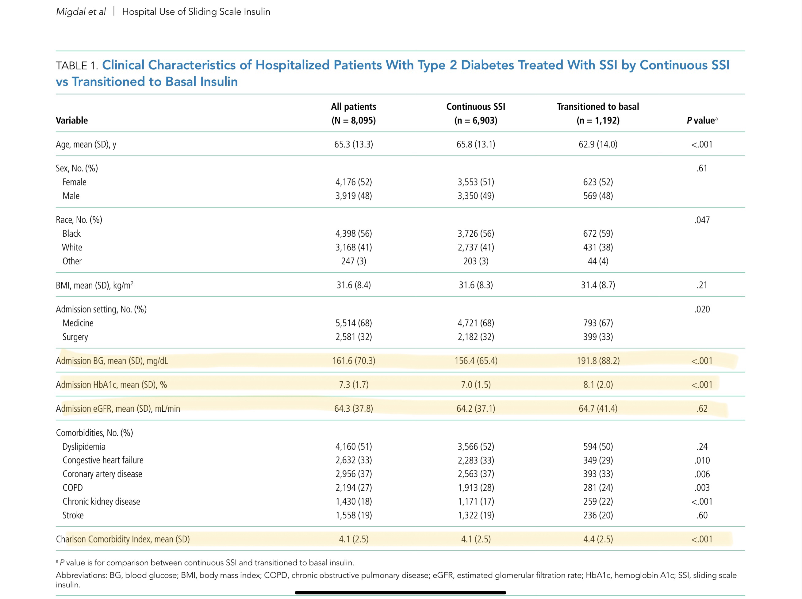

Slide 54
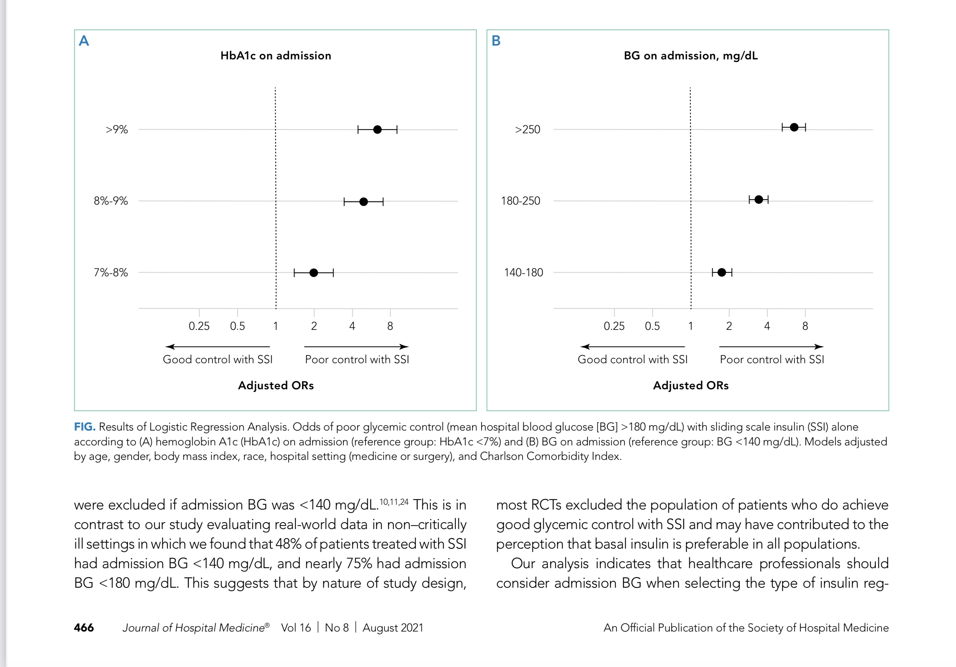

Slide 55
Inpatient Notes: How We Treat Hyperglycemia in the Hospital Francisco J. Pasquel, MD, MPH; and Guillermo E. Umpierrez, MD, CDE
Annals of Internal Medicine • Vol. 174 No. 8 • August 2021

Slide 57
Endocrine Society Clinical Practice Guideline The Journal of Clinical Endocrinology & Metabolism, 2022, 107, 2101–2128
Recommendation 7.1 and 7.2
In most adult patients with hyperglycemia (with or without known type 2 diabetes (T2D)) hospitalized for a noncritical illness, we suggest that scheduled insulin therapy be used instead of noninsulin therapies for glycemic management
In select adult patients with mild hyperglycemia and type 2 diabetes (T2D) hospitalized for a noncritical illness, we sug­gest using either dipeptidyl peptidase-4 inhibitor (DPP4i) with correction insulin or scheduled insulin therapy.

Slide 58
Endocrine Society Clinical Practice Guideline
Recommendation 10.2
In adults with diabetes treated with diet or noninsulin diabetes medications prior to admission, we suggest initial therapy with correctional insulin or scheduled insulin therapy to main­tain glucose targets in the range of 100 to 180 mg/dL (5.6 to 10.0 mmol/L).
For hospitalized adults started on correctional insulin alone and with persistent hyperglycemia [≥2 point­of-care blood glucose (POC-BG) measurements ≥ 180 mg/dL in a 24-hour period (≥10.0 mmol/L)], we suggest addition of scheduled insulin therapy.
We suggest initiation of scheduled insulin therapy for patients with confirmed admission blood glucose (BG) ≥ 180 mg/dL (≥10.0 mmol/L).

Slide 59
IN SUMMARY
Sliding Scale Insulin (SSI) alone may be enough in some select patients
Those individuals with high A1C and/or high admission glucose more likely to require a basal/bolus approach
Reasonable though to start with SSI alone in most patients, and transition to basal/bolus after 48 hours depending on clinical evolution
Patients on home insulin will need at least SSI with basal on admission; dose adjustment may be necessary

Slide 60
STEROIDS

Slide 61
Steroids
Variable effect on glycemic control
Can cause hyperglycemia in non-diabetics
Particular risk with Prednisone (peak effect at 8 hours)
Avoid HS insulin qD steroids
Caution when changing from IV to PO
Can use qD N or NPH in AM

Slide 62
TIPS AND PITFALLS

Slide 63
Helpful Tips
Ensure you know what the patient is actually taking, not just what they were prescribed
Review accuchecks early in the day BEFORE long acting insulins
Include in your orders fixed time(s) to reassess sliding scales, accuchecks etc as a “forced” reminder
Err on the side of higher glucose values, especially if you anticipate a short term admission (minimize risk of hypoglycemia, improve patient comfort)
Converting temporarily to short acting formulations (e.g. gliclazide)

Slide 64
Pitfalls
Not reviewing the actual glucose readings
Continuing accuchecks qid despite being in target range
Forgetting about IVs that continue unnecessarily
Not reassessing sliding scales if NPO, vomiting etc
Using metformin with IV contrast, especially cardiac caths
Not recognizing euDKA (SGLT2)
Complications associated with Acute Kidney Injury
Giving extra doses of short-acting insulin in between sliding scale

Slide 65
DISCHARGE PLANNING

Slide 66
In most situations, resume medications as prescribed at home
Dietary counselling/Pt education
Consider modifying treatment if clear evidence of sub-optimal baseline control (ideally in consultation with pt’s primary care provider)
May need to modify based on sequelae of hospitalization (e.g., new renal failure, new cardiac disease,new medications e.g. steroids)
Ensure safe and effective transition to patient’s primary health care provider(s)

Slide 67
CASE # 1
60 y/o male
PMHx includes DM2, HTN, and CKD
Meds include Perendopril, Metformin 850 mg BiD, Liraglutide and HCTZ
2 days of nausea, vomiting and diarrhea
HR 110, BP 110/60
Cr 180, urea 18, K+ 5.9

Slide 68
CASE #2
72 y/o female
PMHx includes DM2, HTN, and breast cancer
Meds include insulin glargine 28 units qHS, insulin lispro 4 units AC meals, and amlodipine
3 days of H/A and right sided weakness
CT shows solitary left-sided brain metastasis
Started on dexamethasone

Slide 69
CASE #3
75 y/o male
PMHx includes DM2, DLP, HTN and COPD
Meds include Metformin 500 mg TiD, Empagliflizin 10 mg,Ramipril, Atorvastatin, and Tiotropium
3 days of cough, chills, yellow sputum and SOB
RR 28, oxygen saturation 88%
CXR shows RLL infiltrate
Cr 130, WBC 14, lactatate 6.3

Slide 70
TAKE HOME MESSAGES

Slide 71
Endeavour to maintain patients within recommended glycemic range while avoiding hypoglycemia
Individualize use of SSI, adding basal +/- bolus as necessary (using baseline HgB A1C as a guide)
Reassess accuchecks, as well as other medications, on a regular basis, especially as the clinical situation evolves
Consider adding DPP-4 if not already taking

Slide 72
QUESTIONS?

Slide 73
Closing Slide
FamilyMedicineForum
Please fill out your session evaluation now!
@FamilyMedForum
Click this button in the agenda!
FamilyMedForum
#myfmf

Slide 74
