Slide 1
Title Slide
Integrated Primary Care Workforce Planning in Toronto
Ivy Lynn Bourgeault

Slide 2
COI – Presenter Disclosure (1)
Presenter Disclosure
Presenter: Ivy Lynn Bourgeault
Relationships with financial sponsors:
Any direct financial relationships, including receipt of honoraria: None
Membership on advisory boards or speakers’ bureaus: None
Patents for drugs or devices: None
Other: Employee of the University of Ottawa, President of Canadian Health Workforce Partners Inc.
Notes:
Where a faculty/presenter has no relationships to disclose, indicate Not Applicable under Relationships with Financial Sponsors.
Complete this slide for the primary presenter and ALL co-presenters if applicable.
Reminder: Disclosures made on your COI forms should match disclosures made on the COI slide.

Slide 3
COI – Presenter Disclosure (2)
Disclosure of Financial Support
This program has received financial support from Service Canada in the form of a Contribution Agreement through the Foundation for Advancing Family Medicine
This program has received in-kind support from Ontario Health, Toronto in the form of Technical and Analytic Support
Potential for conflict(s) of interest:
Ivy Lynn Bourgeault has received a secondment from FAFM to support this program of research
No supporting organization licenses/distributes/benefits from the integrated primary care workforce planning toolkit, a product that will be discussed in this program
Notes:
Where a program has received no external financial support (e.g., monies for food, logistics assistance such as registration, AV set-up, etc.), indicate No External Support.

Slide 4
Fit-for-Purpose Planning in Toronto
Phase 1 – Toolkit Development (2017-2018)
Development of a fit-for-purpose planning process and quantitative planning model
Phase 2 – Toolkit Operationalization (2019-2022)
Operationalization a first cycle of integrated, interprofessional, needs-based primary care workforce planning
Phase 3 – Next Steps in Planning (2022-2024)
Building capacity for planning in the Toronto Region and beyond
Local groups engaged in planning:
East Toronto Health Partners
Mid-West Toronto OHT
North Toronto OHT
North York Health Partners
West Toronto OHT
www.hhr-rhs.ca
4

Slide 5
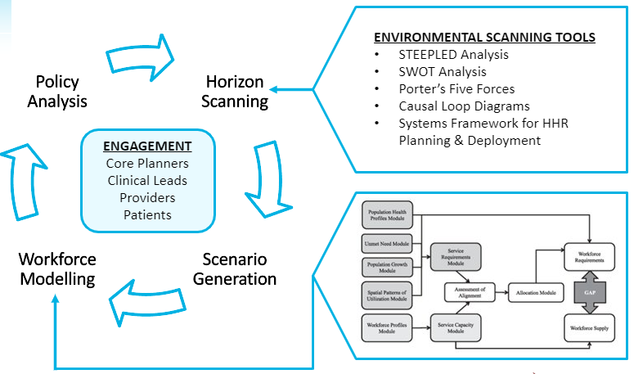
Overview of the Planning Process
The planning approach is interactive and iterative
It includes horizon scanning, scenario generation, and quantitative workforce modelling activities, which inform policy analysis and decision-making
Engagement with stakeholders is embedded in each step
www.hhr-rhs.ca
5

Slide 6
Planning Toolkit: Data Architecture
1
2
3
Source Data
Interactive Dashboard Planning Platform
Integrated Data Repository
Population
Workforce
Modeling
www.hhr-rhs.ca
6

Slide 7
Interactive Workforce Planning Toolkit
Highlights
Interactive Dashboard
Outlines steps for conducting workforce planning
Includes narrative interpretation of the data
Includes questions to consider at each step
Supports synthesis of various data to identify priorities
Trend analyses support evaluation of primary care initiatives
Informed by feedback from users
www.hhr-rhs.ca
7
Notes:
Overview of Interactive Toolkit
Our planning process guides users through: Understanding Community Characteristics, Understanding Service Requirements, Understanding Workforce Service Capacity, Assessing Alignment, Exploring the Factors at Play, Putting It All Together, and Summarizing.
Users can walk through each step sequentially for a given neighbourhood, or choose to focus on a single step across multiple neighbourhoods.
Step 5 offers the option to explore population growth and retirement scenarios, compare communities, and look at trends over time.
Trend analyses support evaluation of primary care initiatives. For example, we will be able to explore changes in indicators of health outcomes, utilization, and attachment in neighbourhoods such as Thorncliffe Park, where additional resources have been mobilized.

Slide 8
www.hhr-rhs.ca
8
Notes:
Step 1 – Understand Community Characteristics
In Step 1, we assemble data related to population size, age structure, health status, marginalization, health services utilization, attachment, and other relevant community characteristics.
We can compare neighbourhood indicators with city benchmarks.
The panel on the right offers a narrative summary.
We also include some additional questions for dashboard users to consider.

Slide 9
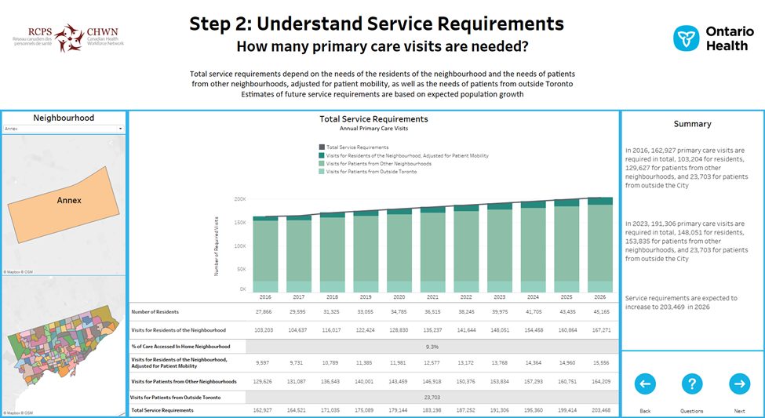
www.hhr-rhs.ca
9
Notes:
Step 2 – Understand Service Requirements
In Step 2, we estimate total service requirements, broken down into services required for residents of a given neighbourhood, residents of other neighbourhoods, and patients from outside the city.

Slide 10
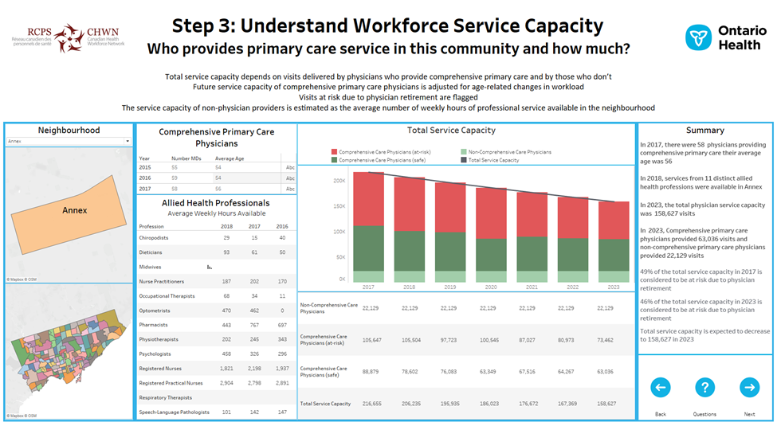
www.hhr-rhs.ca
10
Notes:
Step 3 – Understand Workforce Service Capacity
In Step 3, we look at the characteristics and capacity of the primary care workforce, including physicians and allied health professionals. We focus on physician service capacity in the form of primary care visits, and we flag service capacity that is at risk due to physician retirement.

Slide 11
www.hhr-rhs.ca
11
Notes:
Step 4 – Assess Alignment
In Step 4, we bring together service requirements and service capacity and assess the alignment between the two. The gap, and how it is expected to change over time, can inform decision-making and resource allocation.

Slide 12
www.hhr-rhs.ca
12
Notes:
Step 5 – Explore the Factors at Play

Slide 13
www.hhr-rhs.ca
13
Notes:
Step 6 – Put it all together

Slide 14
Impact Across System Stakeholders
The approach helps providers, planners, stakeholders to:
Understand more about the patients they are serving, where they come from, and their primary care needs
Estimate the primary care resources needed to care for patients
Identify current and future emerging needs, taking into account population growth, demographic shifts, changing population characteristics, and changing workforce supply
Inform strategies to improve and transform care by testing a range of relevant scenarios
Ultimate Goal: Find solutions for health system issues by moving from reactive decision-making to proactive planning
www.hhr-rhs.ca
14

Slide 15
For More Information & Connect
w/CHWN
Poor health workforce planning is costly, risky and inequitable Ivy Bourgeault, Sarah Simkin, Caroline Chamberland-Rowe https://www.cmaj.ca/content/191/42/E1147
Implementing leading practices in regional-level primary care workforce planning: Lessons learned in Toronto Sarah Simkin, Caroline Chamberland-Rowe, Cynthia Damba, Nathalie Sava, Ting Lim and Ivy Lynn Bourgeault https://journals.sagepub.com/doi/full/10.1177/08404704221117263
Co-developing an integrated primary care workforce planning approach at a regional level: overarching framework and guiding principles Ivy Lynn Bourgeault, Caroline Chamberland-Rowe & Sarah Simkin https://human-resources-health.biomedcentral.com/articles/10.1186/s12960-021-00578-z
An integrated primary care workforce planning toolkit at the regional level (part 1): qualitative tools compiled for decision-makers in Toronto, Canada Caroline Chamberland-Rowe, Sarah Simkin & Ivy Lynn Bourgeault https://human-resources-health.biomedcentral.com/articles/10.1186/s12960-021-00610-2
An integrated primary care workforce planning toolkit at the regional level (part 2): quantitative tools compiled for decision-makers in Toronto, Canada Sarah Simkin, Caroline Chamberland-Rowe & Ivy Lynn Bourgeault https://human-resources-health.biomedcentral.com/articles/10.1186/s12960-021-00595-y
www.hhr-rhs.ca
info@hhr-rhs.ca
@CHHRN
chhrn1
Canadian Health Workforce Network
www.hhr-rhs.ca
15

Slide 16
Closing Slide
Thank you!
Please fill out your session evaluation now!
#myfmf
FamilyMedicineForum
FamilyMedForum
FamilyMedForum

