Slide 1
Changes in Primary Care of Older Adults Since COVID-19
The association between patients’ frailty status, multimorbidity and demographic characteristics and changes in primary care for chronic conditions during the COVID-19 pandemic: A pre-post study
Shireen Fikree, MSc
Co-authors: Shuaib Hafid, Jennifer Lawson, Gina Agarwal, Lauren E Griffith, Liisa Jaakkimainen, Dee Mangin, Michelle Howard

Slide 2
Presenter Disclosure Shireen Fikree
Relationships w/ financial sponsors: None
Any direct financial relationships, including receipt of honoraria: N/A
Membership on advisory boards or speakers’ bureaus: N/A
Patents for drugs or devices: N/A
Other: N/A

Slide 3
Disclosure of Financial Support
This program has received financial support from : N/A
This program has received in-kind support from: N/A
Potential for conflict(s) of interest:
Other: Dr. Lauren Griffith is supported by the McLaughlin Foundation Professorship in Population and Public Health

Slide 4
Learning Objectives
By the end of the presentation, attendees should be able to:
Understand the impact of COVID-19 on chronic condition management.
Identify key factors influencing changes in primary care management.
Recognize the role of telemedicine in maintaining chronic condition care for older adults.

Slide 5
Background

Slide 6
Health Implications Associated with Ageing
Multimorbidity
Frailty
The coexistence of 2 or more chronic medical conditions
Global prevalence among older adults: 55-98%
Adverse health outcomes:
Responsible for most deaths
a multidimensional syndrome of reserve loss which gives rise to vulnerability and increases pt risk to adverse medical events
Global prevalence among older adults:12-24%
Notes:
Chronic diseases and multimorbidity, the coexistence of 2 or more chronic conditions, are highly prevalent among older adults (≥65 years) globally and are responsible for most deaths
For frailty Global prevalence challenging to define b/c no consensus definition
Frailty is not fully explained by the presence of specific health conditions as it often coexists with multimorbidity. Both frailty and multimorbidity share adverse health outcomes such as diminished quality of life, higher health care use, and caregiver burden. The combination of frailty and multimorbidity may exacerbate these issues

Slide 7
Responding through Primary Care Efforts
Primary Care in Canada: the provision of longitudinal and comprehensive personalized healthcare services
Family physician can screen, manage, and coordinate care for pts with multimorbidity and frailty
Notes:
-primary care is person-centred
-naturally positioned to screen for frailty and create care plans for diagnosed patients with the main goals being to improve quality of life and functional abilities, and prevent unnecessary admission to hospitals
--With the population continuing to age globally and high prevalence of multi-morbidity and frailty, it is necessary to direct primary prevention efforts towards identifying vulnerable patients and assessing their frailty status
-Early identification of pre-frail patients is key because once the syndrome progresses it can become very challenging to reverse & pts may not have choice of plausible trt options
----------------------------
Primary care plays a central role in the identification, management, and coordination of care for patients with multimorbidity and frailty

Slide 8
Join at slido.com #1888893
ⓘ Start presenting to display the joining instructions on this slide.

Slide 9
Do you believe the COVID-19 pandemic had a significant impact on older adults' access to healthcare services?
ⓘ Start presenting to display the poll results on this slide.

Slide 10
Primary Care During the COVID-19 Pandemic
March 2020 → clinicians temporarily switch to providing virtual care
Physician concerns over challenges providing virtual care: patients’ limited access + tech literacy
Digital divide impacts older patients, those living with disabilities, and low SES
Notes:
-this inequality impacts vulnerable individuals including those who are of older age, living with disabilities, and have low SES and education levels
-Given the overlap in sociodemographic factors associated with frailty and the digital divide, questions arise as to how such complex clinical syndromes & their comorbidities were managed during this period.
----------------------------------------------------------------------------------------------------------------------
Caring for frail patients requires an individualized approach, and the monitoring of underlying multi-morbidity’s often requires in-person consultations (i.e., labs)
-With virtual care becoming further integrated within the healthcare system, and ageing pop’n this research will inform future primary virtual care processes and provide evidence to prioritize addressing pandemic-related gaps in the care of patients experiencing frailty.

Slide 11
Objective
Notes:
Evidence to support the recovery from the COVID-19 pandemic is essential to avoid further negative outcomes due to pandemic interruptions to primary care

Slide 12
To understand whether the shift from in-person to virtual care during the COVID-19 pandemic impacted primary care management of older adults (65 years+) with common chronic conditions

Slide 13
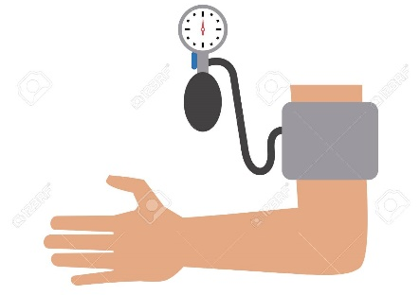
Cont.
Among those with hypertension, diabetes and/or chronic kidney disease to what extent has the frequency of routine monitoring activities (blood pressure, number of HTN/Metformin prescriptions, HbA1c & eGFR tests) changed comparing 14 months pre-pandemic to 14 months since the pandemic. Are these changes associated with patient age, sex, neighbourhood income, multimorbidity, and level of frailty?
Notes:
BP, hemoglobin A1c , estimated glomerular filtration rate – these are exemplar activities
---------------------------------------------------------------------------------------------------
Secondary prevention → still all under prevention umbrella → for ppl with the conditions: monitoring conditions but still part of preventing further bad things from happening. All these things are prevention still even tho I have said “monitoring”
dm, HT among most common chronic conditions -Diabetes is the leading cause of kidney disease. High BP can also damage the kidneys and cause disease, very common, High blood pressure is the second leading cause of kidney failure
BP measures, HbA1c and eGFR are common measures across several conditions for primary prevention screening and/or monitoring. These were ‘exemplar’ common activities

Slide 14
Methods

Slide 15
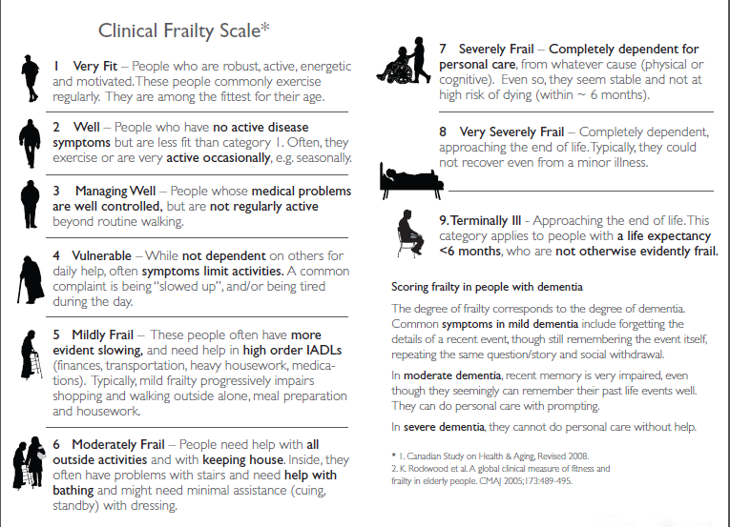
Study Design
Retrospective closed cohort using data from the MUSIC network
Up to date pt. level clinical data from primary care EMR systems in Hamilton, ON
Sub-set of pts 65 + years from 1 of 2 interprofessional academic family practices whose physician completed assessment for frailty in 2019
Notes:
-MUSIC data is comprised of regularly updated de-identified patient-level clinical data from primary care electronic medical record (EMR) systems held by 55 primary care providers within Hamilton, Ontario, Canada. There are over 38,000 active patients represented in the MUSIC network, and they live within diverse neighbourhoods and represent a broad range of SES. The data is updated every 6 months and contributes to the Canadian Primary Care Sentinel Surveillance Network (CPCSSN) data set
-The frequency and comprehensive quality of CPCSSN-MUSIC data is ideal for the study of changes in practice, through time, in response to significant environmental imperatives.
The CFS has nine levels, ranging from “very fit” to “terminally ill”. The CFS has low administration time (less than 1 minute per assessment), high utility across many clinical practice domains, good inter-rater agreement between physicians and multidisciplinary teams, and correlates well with other frailty scoring instrument
Jan-June 2020 data collection was done (77% of pts CFS scores reported)
---------------------------------------------------------------------------------------------------------------------------------------
CFS
was first developed by Rockwood et al. in 2005 as a judgement-based tool used by healthcare professionals to measure the degree of frailty
visual chart, grading frailty originally on 7 point but then 9 point updated
Typically, a cut point score of ≥5 has been used to indicate a frail state. The scale has been clinically validated for individuals ≥65 years
ease of application as it focuses on criteria which are readily observed i.e., balance, use of walking aid
requires practitioners to combine their clinical judgment with observable and objective measurements, it has become one of the most practical ways of screening for the presence of frailty and provides valuable data that helps to guide routine patient care

Slide 16
Cohort
2043 patients (65 yrs and older) identified with CFS score
After data quality exclusions and chronic condition specification: 658 patients identified (32.2%)
Observation Period (14 months pre/since pandemic):
Pre-COVID: Feb 19, 2019 → March 14, 2020
Since-COVID: March 15, 2020 → May 9, 2021
Notes:
As described previously in Mangin et al., 2022 submitted, appropriate data quality exclusions were applied and of the eligible patients, scores were completed for 77% of them -> sample size = 2043.
cohort creation -> removed deceased/inactive otherwise results biased by missing data
To analyze chronic condition management, we chose hypertension, diabetes, and chronic kidney disease as exemplar conditions that are common, often co-occurring, and are managed in primary care.
- with potential disruptions leading to adverse cardiovascular outcomes

Slide 17
Outcomes of Interest
Cohort Level | Chronic Disease Type | Outcomes of Interest
Chronic Disease Specific Cohort | Any pt with DM, HTN, or CKD | No. of BP measures, mean SBP/DBP
 | HTN only, no DM | No. HTN Rx
 | DM only, not HTN
 | Any pt. with DM | No. Metformin Rx
 | Any pt. with DM | Any HbA1c test done
 |  | Mean HbA1c score
 | Any pt. with DM, HTN, or CKD | Any eGFR test done
 |  | Mean eGFR measures
Notes:
Essentially we completed descriptive analyses, and identified associations b/w pt characteristics and changes in monitoring, rx and test results using regression models.
Labs focus for pt with DM, HT, CKD (HbA1c & eGFR)
Prescription meds focus on diabetes & hypertension mgmt
=======================================================================
T2D is a risk factor for CVD and PVD so treating BP in pts with diabetes has more benefits in those outcomes then treating the glycemia itself
Statistical significance of changes was evaluated using paired t-tests (continuous) or McNemar’s test for change in proportions (binary) as appropriate. To address the influence of potentially non-normally distributed outcome data on the t-tests, we conducted a non-parametric Wilcoxon Signed Ranks test as a sensitivity analysis.
Model significance was tested by the Likelihood Ratio test and Hosmer and Lemeshow test. Odds ratios, 95% CIs and p-values were reported. Complete cases were used.

Slide 18
Outcomes of Interest
Stratify outcomes by patient characteristics (age, sex, neighborhood-level income quintile, frailty level, and condition count category)
Binary Logistic Regression: Investigating associations between patient characteristics and reductions in frequencies of medication prescriptions, BP measures, and lab tests
Dichotomized outcomes: Were there reductions during the pandemic compared to the pre-pandemic period (yes) or the same or more (no).

Slide 19
Results

Slide 20
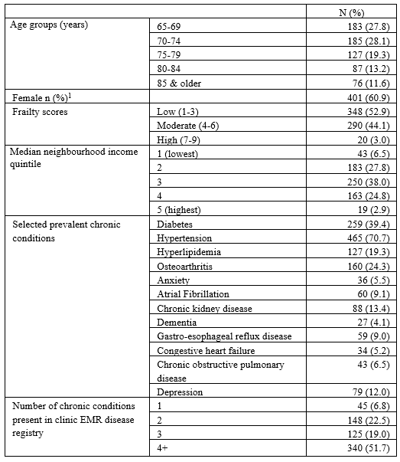
Descriptive Analysis
658 primary care patients with hypertension, diabetes, and/or chronic kidney disease
Mean age: 75 years
Approximately half (52.9%) had a frailty score of 1-3 (low)
Mean 4.4 chronic conditions, most common: hypertension (70.7%)
Notes:
-Deceased and inactive patients were on average older, had higher assessed frailty level, and had been diagnosed with a greater number of chronic conditions compared to the active.
-

Slide 21
Chronic disease management activities in patients
 | Pre-pandemic | During the pandemic | Mean or percent change | 95% Confidence Interval | P value
Processes
Blood pressure measures (mean) | 1.7 | 0.6 | -1.14 | -1.28, -1.00 | <0.001
Any HbA1c test in those with DM (%) | 88.0% | 65.3% | -22.8% | -0.29, -0.17 | <0.001
Any eGFR test (%) | 85.9% | 68.7% | -17.2% | -0.21, -0.13 | <0.001
Hypertension medication Rx’s
Hypertension without DM (mean) | 2.6 | 2.1 | -0.48 | -0.75, -0.20 | <0.001
DM without hypertension (mean) | 2.1 | 1.7 | -0.41 | -0.76, -0.06 | 0.023
Metformin Rx’s (mean) | 1.2 | 1.0 | -0.13 | -0.30, 0.04 | 0.137
Test results
Blood pressure mmHg (mean) Systolic Diastolic | 135.2 74.6 | 133.8 73.2 | -1.42 -1.37 | -3.20, 0.36 -2.54, -0.20 | 0.117 0.022
HbA1c % in DM only (mean) | 7.2 | 7.1 | -0.12 | -0.24, 0.01 | 0.071
eGFR (mL/min/1.73 m²) (mean) | 64.9 | 62.4 | -2.4 | -3.12, -1.72 | <0.001

Slide 22
Changes in Outcomes Stratified by Patient Characteristics
The same findings extended when stratifying changes in outcomes to all levels of patient characteristics
However, those who were older, had increasing levels of frailty, and increasing numbers of chronic conditions generally experienced lesser reductions in care
Notes:
Generally, older age, increasing level of frailty, and increasing numbers of chronic conditions were associated with lesser reductions in care.

Slide 23
Changes in Outcomes Stratified by Patient Characteristics
Notes:
For HbA1c and eGFR measures, the number of tests decreased for almost all patient groups. Patients living with higher frailty levels tended to have less reduction in tests compared to patients living with low levels, both for the number of HbA1c measures (% fewer: 25.0% vs. 64.5%) and the number of eGFR measures (% fewer: 36.8% vs. 56.1%)

Slide 24
Association b/w Individual Pt Characteristics and Changes in Outcomes
Odds of having fewer: | Model Significant? | Results:
BP measures | No | Not presented
HTN Rx’s
Metformin Rx’s
HbA1c tests
eGFR tests | Yes | Female pts were less likely to have had a reduction compared to male pts Patients with 2 chronic cond’s & those with 4 or more were 2x as likely to have had a reduction compared to those with only 1 cond
Notes:
The models testing associations between individual patient characteristics and odds of having fewer blood pressure measures, HbA1c tests, hypertension medication prescriptions and metformin prescriptions were not statistically significant
When controlling for all other variables, female patients were less likely to have had a reduction in eGFR tests compared to male patients
Patients with 2 chronic conditions and those with 4 or more conditions were twice as likely to have reduced numbers of measures compared to those with only 1 condition

Slide 25
Discussion

Slide 26
Before this presentation, did you have any preconceived notions about the effectiveness of telemedicine in managing chronic conditions?"
ⓘ Start presenting to display the poll results on this slide.
Notes:
Not sure if there is time for this one.

Slide 27
Interpretations
Those who are most at risk of contracting COVID-19 can take advantage of virtual-visits – digital divide may not be an issue
Slight mean dec in number rx – stable use of these meds are important for chronic conditions (DM and HTN)
Minimal changes to disease monitoring parameters – important to maintain longitudinal relationships with older patients with chronic conditions.
Notes:
-Those who are at high risk of contracting COVID-19 can take advantage of these virtual services
-Prior studies suggest older adults are actually not reluctant towards using new tech and are satisfied with telemedicine. Also reduces “cost of physical contact”
-For lab test measures, perhaps decrease due to lack of testing capacity due to pandemic lab infrastructure changes
-Stable use of HT and DM meds are important, this slight dec may be b/c docs prescribed extended durations

Slide 28
Summary

Slide 29
Overall Messages
Overall decrease in routine preventative & monitoring services, but no substantial change to disease monitoring parameters
Generally, older age, increasing level of frailty, and increasing numbers of chronic conditions were associated with lesser reductions in care.
Patients living in lower income neighbourhoods did not experience notable changes.
Notes:
Decrease no. of services that typically require in-person visits either to the office or lab

Slide 30
Questions?
Notes:
The things measured in this thesis are not indicators of quality of care or if guideline appropriate care…these things measured (BP, diabetes check etc.) that are often done routinely (could be overused a bit), call them widgets of care. Done routinely to keep check on chronic conditions. Hypothesis was more broadly was about how did these routine widgets of care change over time.
If any data and design a study → We may have been overdoing these widgets of care beforehand → other data to tell if ppl missed out on anything → hospitalizations, mortality due to inadequate care. Or follow up w/ indv patients and see if care was adequate for them. Even when tried to come up with quality of chronic condition management score but w/ full chart reviews Probability sampling -> stratified sampling for pts and or docs too

Slide 31
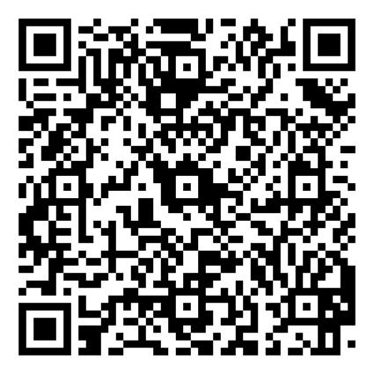
Thank you!
Please evaluate the session

