Slide 1
Title Slide
Feasibility of Nutrition Risk Screening in Older Adults
Marlis Atkins RD & Catherine B. Chan PhD
Alberta Health Services & University of Alberta
On behalf of the COMRISK team

Slide 2
COI – Presenter Disclosure (1)
Presenter Disclosure
Presenter: Catherine Chan
Relationships with financial sponsors:
Any direct financial relationships, including receipt of honoraria: Alberta Institute of Agrologists
Membership on advisory boards or speakers’ bureaus: None.
Patents for drugs or devices: None
Other: None
Notes:
Where a faculty/presenter has no relationships to disclose, indicate Not Applicable under Relationships with Financial Sponsors.
Complete this slide for the primary presenter and ALL co-presenters if applicable.
Reminder: Disclosures made on your COI forms should match disclosures made on the COI slide.

Slide 3
COI – Presenter Disclosure (2)
Disclosure of Financial Support
This program has received financial support from Alberta Health Services in the form of an unrestricted research grant.
Potential for conflict(s) of interest:
None.
Notes:
Where a program has received no external financial support (e.g., monies for food, logistics assistance such as registration, AV set-up, etc.), indicate No External Support.

Slide 4
Physical and psychosocial risk factors for malnutrition in older adults
Inadequate intake, impaired absorption, increased energy expenditure
Weight change
Poor appetite
Skipping meals
Swallowing difficulties
Malnutrition
Nutrition Risk
Functional change
Veg & Fruit intake
Fluid intake
Eating with others
Difficulties with meal preparation
Heather Keller olderadultnutritionscreening.com/screen-tools/
Adapted from McKinley JR. Coll Physicians Edinb 2008

Slide 5
Moderate-High Nutrition Risk Prevalence in Older Adults
Early identification of nutrition risk
can prevent frailty and increase independence.
Laur C., Keller H. Nutr. Today. 2017: https://doi.org/10.1097/NT.0000000000000218
Alberta
Canada
58%
(SCREEN-8)
Fedoruk et al. Can J Aging. In press, 2023.
87.7%
(SCREEN-II)
Borkent et al. Healthcare 8:151, 2020.

Slide 6
Reinders et al Clinical Nutrition 2019
Notes:
Malnutrition is treatable and PREVENTABLE but is largely undetected.
Screening in the community can identify people at moderate to high nutrition risk and target them for intervention

Slide 7
COMRISK: Feasibility of screening for nutrition risk
Community Dwelling Older Adults ♀ and ♂ ≥ 65 years
P2PCN
19
GCC
93
Fedoruk et al. Can J Aging. In press, 2023.
RDPCN
163
Central Alberta
Social Worker
1
Administrators/Managers
6
RNs
2
Screeners
Feasibility
Survey
+
Outreach Workers
2
LPNs
5
RDs
4
Geary et al. Can J Aging. Published online, October 9 2023.
Notes:
Screening occurred during routine clinic visits, outreach assessments or check-in phone calls during the Covid-19 pandemic.

Slide 8
Nutrition risk screening is feasible
Can be successfully carried out, overall score 6.2 out of 7
User friendly
Screeners: 6.3 (in person) and 6.1 (phone)
Administrators: 6.7
Implementable into workflow
Screeners: 6.4
Administrators: 6.7
Good tool to open the conversation
Support from physicians was key

Slide 9
Nutrition risk screening is acceptable
An…intervention to make nutritious foods more accessible…would address the needs of older adults with limited resources
Agreeable, palatable, or satisfactory, overall score 6.5 out of 7
Beneficial for older adults
Screeners: 6.7
Administrators: 6.7
RDs: 6.5
Supports the work of the respondent
Screeners: 6.4
Administrators: 7.0
RDs: 6.8

Slide 10
Nutrition risk screening is appropriate
Fits well with and is relevant to the setting and patient/client, overall score 6.1 out of 7
SCREEN-8 is a good tool for assessing nutrition risk
Screeners: 6.7 (in person), 5.5 (phone)
Administrators: 7.0 (in person), 5.0 (phone)
Able to recommend community supports
Screeners: 6.0
No gaps in appropriate community supports
Screeners: 5.1
Able to identify and provide referrals
Screeners: 6.3 – community resources; 5.9 – medical services; 6.5 – nutrition services (RD)
Opportunity to provide education about nutrition risk
Screeners: 6.7 (in person), 6.0 (phone)

Slide 11
Appropriateness quotes
In-person visitation would be ideal
I did not feel so confident about the referral to supports in the community
Were able to identify but client did not want to be referred

Slide 12
Screening by community-based organizations can increase capacity and accessibility
If we could educate organizations that have the opportunity to [screen]…it would provide better outcomes for aging in the community

Slide 13
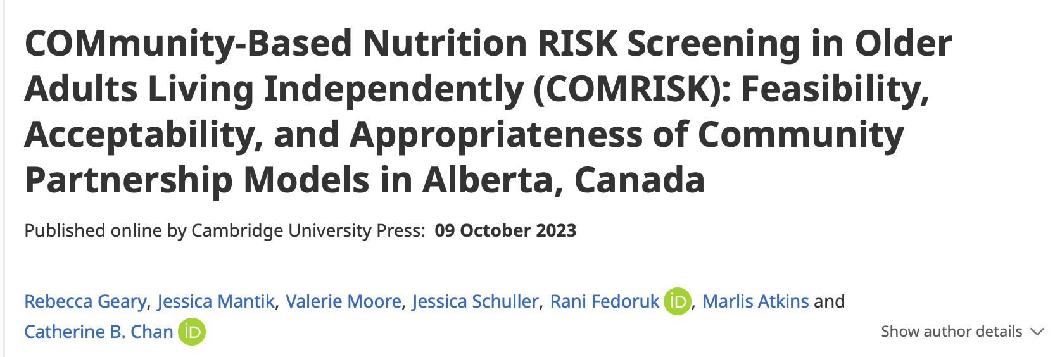
Summary and Conclusions
Screening for nutrition risk in primary care and other community settings is
Feasible
Acceptable
Appropriate
Community resources to alleviate financial strain and provide nutritious foods may be lacking
35% of those at moderate risk received a referral, the first step in preventing progression to high nutrition risk / malnutrition
Sustainability requires incorporation into the EMR

Slide 14
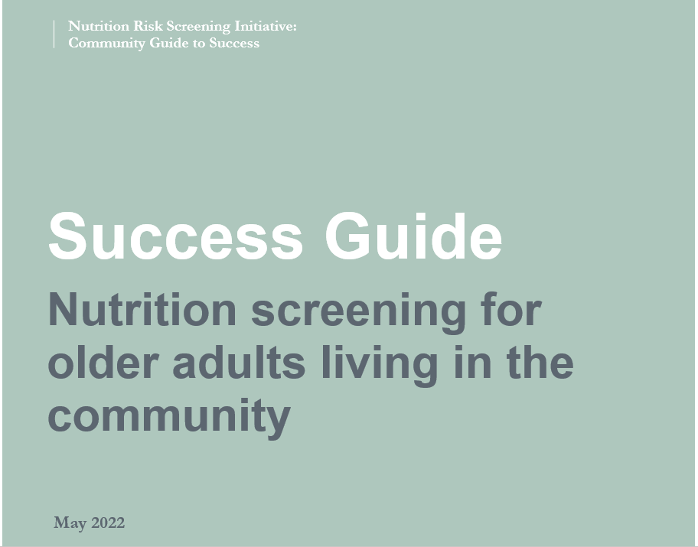
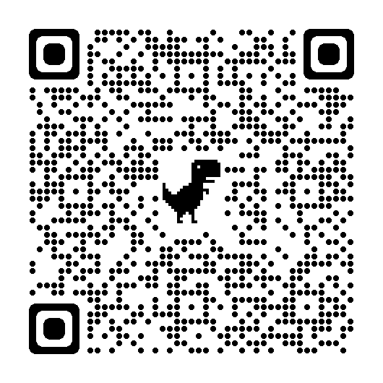
The Last Word: The Patient Perspective Get More Information
“It made me realize the importance of nutrition and if you need help or assistance of any type, that health services are there…It was good for me. It’s got me sort of on track with my eating habits again and I’m even starting to put a little bit of weight on! It has improved my quality of life.” (Patient)
Nutritioncareincanada.ca

Slide 15
THANKS
The COMRISK team
Catherine Chan PhD – U Alberta
Rani Fedoruk MSc RD – U Alberta
Marlis Atkins RD – AHS
Heidi Olstad RD – AHS
Naomi Popeski PhD - AHS
Lori Watts RN – RDPCN
Monica Morrison ED – GCC
Jill Ward RN – P2PPCN
Rebecca Geary RD – U Alberta
Jessica Schuller RD – U Alberta
Valerie Moore RD – U Alberta
Jessica Mantik RD – U Alberta
With thanks to
Heather Keller – U Waterloo
All the participants
Do you have any questions?
Please keep this slide for attribution

Slide 16
Closing Slide
Thank you!
Please fill out your session evaluation now!
#myfmf
FamilyMedicineForum
FamilyMedForum
FamilyMedForum

