Slide 1
Title Slide
Management of Rheumatoid Arthritis in Canadian Primary Care
Anh N.Q. Pham, PhD

Slide 2
COI – Presenter Disclosure (1)
Presenter Disclosure
Presenter: Anh N.Q. Pham
Relationships with financial sponsors:
Mitacs Accelerate Postdoctoral Fellowship, funded by Mitacs and Alberta Bone and Joint Health Institute (ABJHI).
Notes:
Where a faculty/presenter has no relationships to disclose, indicate Not Applicable under Relationships with Financial Sponsors.
Complete this slide for the primary presenter and ALL co-presenters if applicable.
Reminder: Disclosures made on your COI forms should match disclosures made on the COI slide.

Slide 3
COI – Presenter Disclosure (2)
Disclosure of Financial Support
This program has received financial support from The Arthritis Society in the form of Strategic Operating Grant.
Potential for conflict(s) of interest: Not applicable.
Notes:
Where a program has received no external financial support (e.g., monies for food, logistics assistance such as registration, AV set-up, etc.), indicate No External Support.

Slide 4
Research Team
C. Allyson Jones
PhD
Neil Drummond
PhD
University of Calgary
Claire E.H. Barber
MD, PhD
University of Calgary
Scott Garrison
Doug Klein
University of Alberta
MD, PhD
University of Alberta
MD, PhD
University of Alberta
Jessica Widdifield
PhD
University of Toronto
Cliff Lindeman
PhD
University of Alberta
Tyler Williamson
PhD
University of Calgary
Cheryl Barnabe
MD, PhD
University of Calgary
Anh N.Q. Pham
PhD
University of Alberta

Slide 5
background
Rheumatoid Arthritis is a chronic inflammatory joint disorder with a prevalence of 1.2% in Canadian population*;
Predominantly diagnosed and managed by rheumatologists;
The involvement of family physicians is key to management of RA since they are often the first point of contact for patients;
Prior research has raised concerns around the under-documentation of RA management in primary care.
*PHAC, 2020 (https://www.canada.ca/en/public-health/services/publications/diseases-conditions/rheumatoid-arthritis.html)
Notes:
Although rheumatoid arthritis (RA) is predominantly managed by rheumatologists, prior research has raised concerns around the under-documentation of RA management in primary care.

Slide 6
Objectives
Identify people with RA recorded in primary care EMR data
1
Estimate the prevalence of RA recognized in primary care
2
Describe the management of RA in primary care
3
Notes:
Our objective was to to, and.

Slide 7
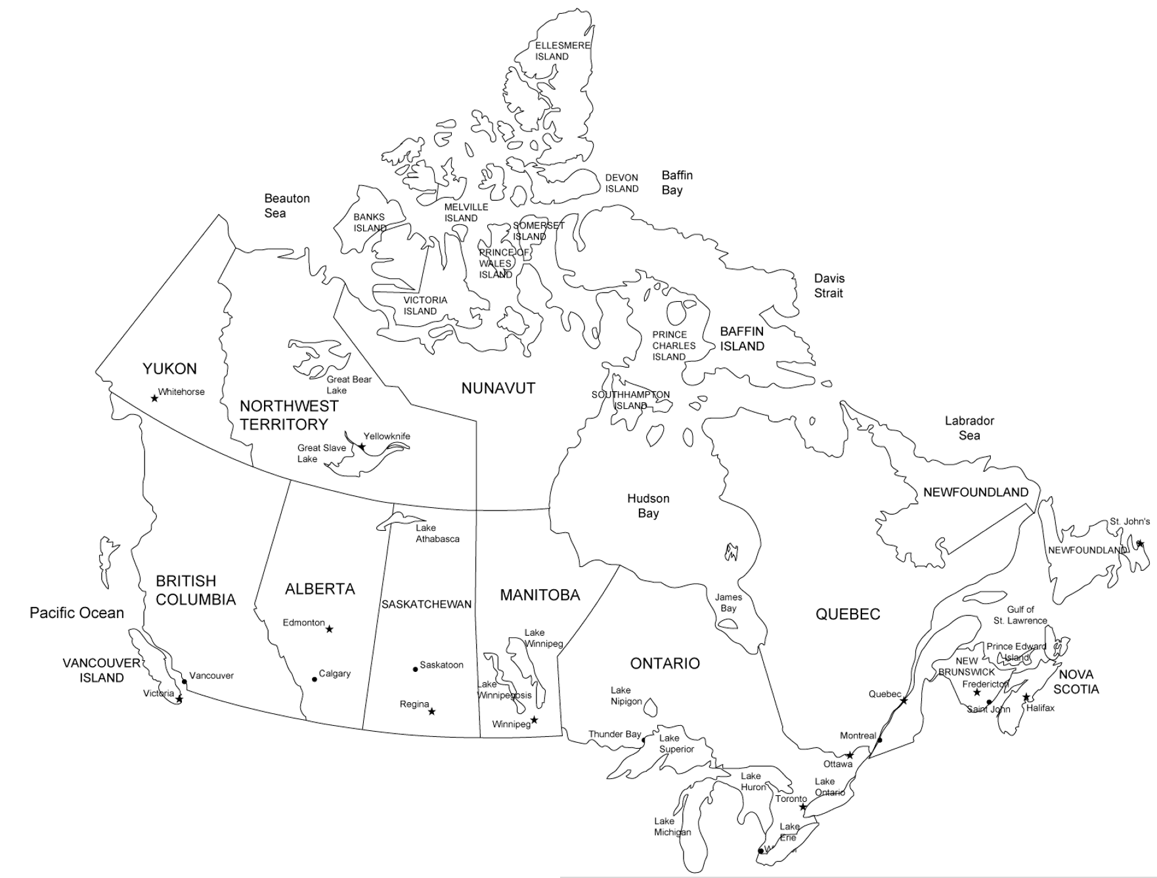
Data source
CPCSSN
RCSSSP
Canadian Primary Care Sentinel Surveillance Network
Réseau canadien de surveillance sentinelle en soins primaires
Figure 1. CPCSSN networks
Notes:
The Canadian Primary Care Sentinel Surveillance Network (CPCSSN) database contains EMR data from 245 primary care practices across Canada.

Slide 8
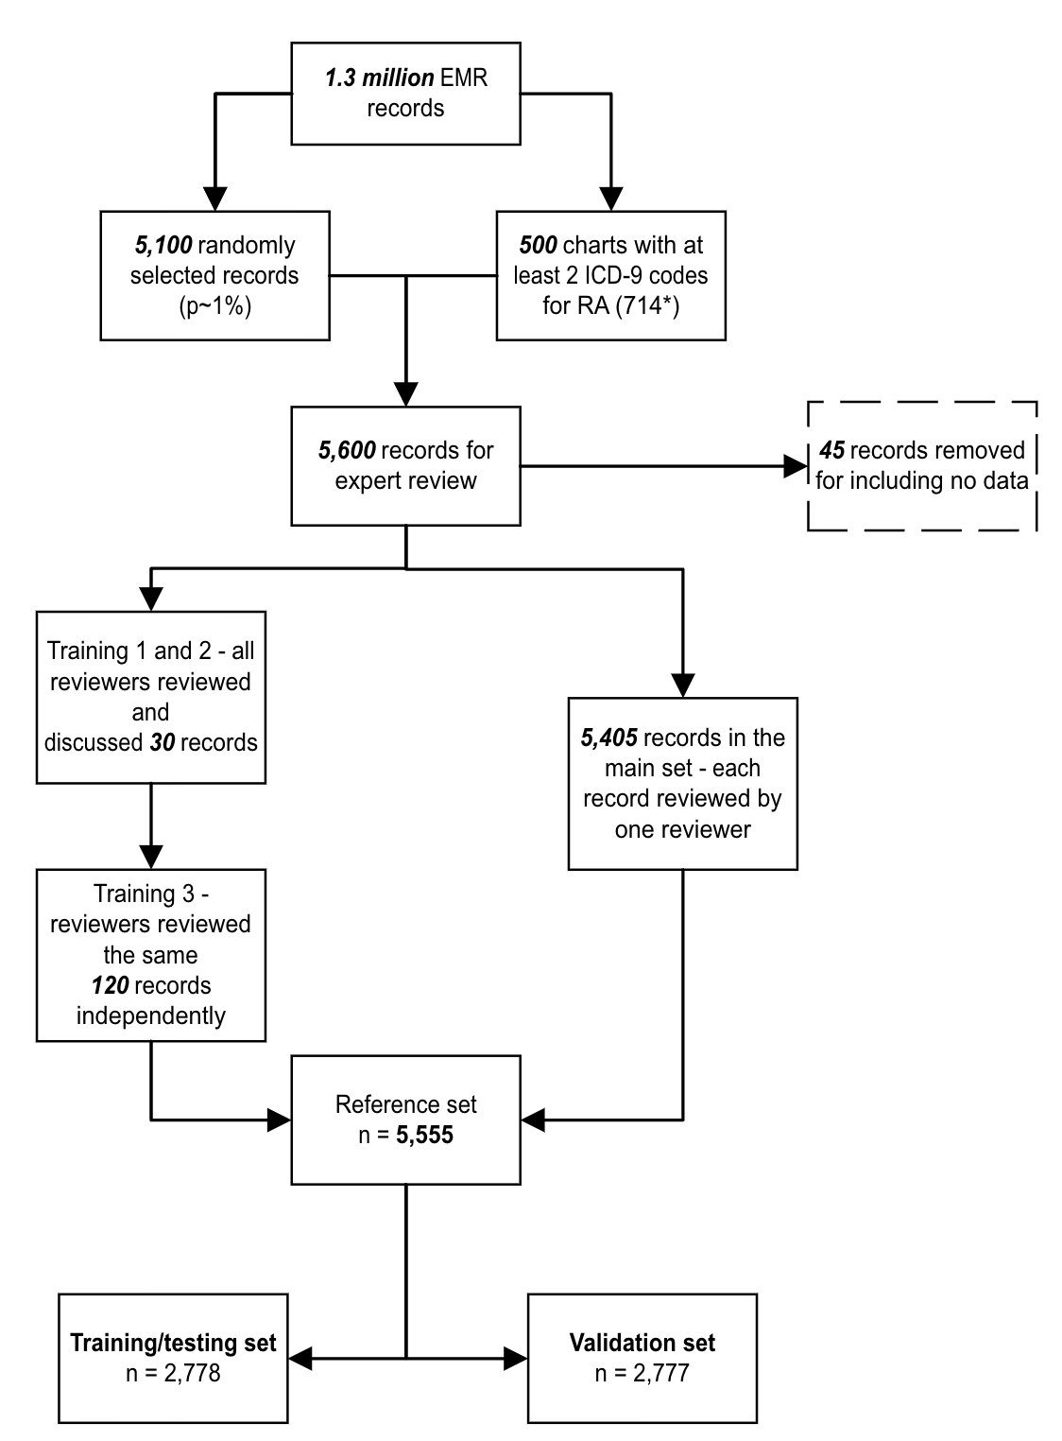
Participants
Adults age 19+
One clinical record in CPCSSN 2020
Figure 2. Flowchart for charts in the reference set
Notes:
As of 2020, CPCSSN had ~1.5 million deidentified records for people over the age of 19. All were eligible to be included in this analysis. A random sample of 5,500 EMR charts was selected for case definition development.

Slide 9
Case definition development
Reference set
Chart review
Inter-rater reliability calculation
ML algorithm
Training
Tuning
Working criteria for RA
Important variables
Extraction of important features from ML algorithms
Evaluation
Final case definition
Case definitions
Validation

Slide 10
Machine Learning
Figure 3. Steps to develop, evaluate, and validate a case definition

Slide 11
RA case definition
At least 2 occurrences of text “rheumatoid arthritis” within 24 months in billing, encounter diagnosis, or health condition table
OR
At least 1 occurrence of text “rheumatoid arthritis” in the health condition table
Sensitivity
Specificity
Positive Predicted Value
Negative Predicted Value
81.6 (75.6-86.4)
98.0 (97.4-98.5)
76.3 (70.1-81.5)
98.6 (98.0-98.6)
Notes:
Two occurrences of ‘rheumatoid’ anywhere in a CPCSSN record OR one occurrence of ‘rheumatoid arthritis’ in the problem list/health conditions table identifies patients with sensitivity of 78.6%, specificity 99.1%, PPV 83.1%, NPV 98.8%. Use of this case definition identified an age-adjusted prevalence of 0.7%. RA was more common among females, those aged 60-79y, rural residents, and overweight or obese people. People with RA are more likely to have multi-comorbidities. Only 35.8% and 33.3% of patients had documentation of a methotrexate and prednisone, respectively.

Slide 12
Prevalence of ra in cpcssn
Figure 4. Sex-specific prevalence of RA by age group, CPCSSN 2008-2020.
Notes:
Use of this case definition identified an age-adjusted prevalence of 0.7%.

Slide 13
Characteristics of Patients with RA
Characteristic | Prevalence of RA (n (%))
 | 12,083
Age
Mean (SD) | 65.0 (16.5)
Sex
Female | 8,709 (1.2)
Male | 3,386 (0.6)
Resident postal code
Rural | 2,346 (1.1)
Urban | 9,432 (0.9)
Deprivation category
Q1 - Most privileged | 2,426 (0.8)
Q2 and Q3 | 4,706 (0.9)
Q4 and Q5 | 4,248 (0.9)
Smoking status
Never-smoke | 8,215 (0.8)
Ever-smoke | 3,868 (1.5)

Slide 14
Characteristics of Providers who are seeing PATIENTS with RA
Characteristic | n (%)
 | 1153 / 1389 (83)
Provider sex
Female | 649 (80)
Male | 441 (86)
Provider age
Mean (SD) | 51.2 (10.8)
Academic clinic
No | 158 (97)
Yes | 70 (89)
Clinic postal code
Rural | 30 (97)
Urban | 199 (93)

Slide 15
Comorbid conditions
Conditions | n (%) | PR (95% CI)
n | 12,083
Hypertension | 5,968 (1.9) | 1.64 (1.57-1.71)
Diabetes | 2,459 (1.7) | 1.26 (1.20-1.32)
Depression | 4,091 (1.4) | 1.46 (1.41-1.52)
COPD | 1,591 (2.8) | 1.65 (1.56-1.74)
Asthma | 1,797 (1.4) | 1.59 (1.51-1.67)
Myocardial Infarction | 739 (2.1) | 1.34 (1.25-1.45)
Other cardiovascular | 2,857 (2.2) | 1.55 (1.48-1.63)
Stroke | 370 (2.4) | 1.21 (1.09-1.34)
Fracture Hip, Spine, or Leg | 505 (2.7)
Ulcer or stomach problem | 837 (2.3) | 1.76 (1.64-1.89)
Cancer | 419 (1.9) | 1.50 (1.37-1.66)
RDCI* |  | 1.24 (1.23-1.26)
*Rheumatic Disease Comorbidity Index (RDCI)
= 2 × lung disease
+ [2 × (heart attack, other CV, OR stroke) OR 1 × hypertension]
+ fracture + depression + diabetes + cancer + (ulcer or stomach problem) (England et al. 2014)

Slide 16
Records of ra laboratory tests
Figure 6. Documentation of RA laboratory tests in CPCSSN, 1990-2020.
Notes:
Only 35.8% and 33.3% of patients had documentation of a methotrexate and prednisone, respectively.

Slide 17
Records of ra medication
Figure 6. Documentation of DMARDs and steroids prescription in CPCSSN, 1990-2020.
Notes:
Only 35.8% and 33.3% of patients had documentation of a methotrexate and prednisone, respectively.

Slide 18
Take away messages
We successfully identified a case definition with acceptable validation metrics for identifying RA in Canadian primary care EMR data.
Although the epidemiology characteristics of RA was compatible with existing evidence (albeit lower prevalence), the under documentation of laboratory tests and RA medications raises concerns about the continuity of health information between rheumatologists and primary care.
Notes:
Our study identified a case definition with acceptable validation metrics for identifying RA in Canadian primary care EMR data. Although the epidemiology characteristics of RA was compatible with existing evidence (albeit lower prevalence), the under documentation of laboratory tests and RA medications raises concerns about the continuity of health information between rheumatologists and primary care.
Describe characteristics of patients managed and documented in primary care data.
Recognize salient features of the clinical management of RA by community-based family physicians are used.
For those interested: Explain a process of developing a case definition using a machine learning approach.

Slide 19
Next steps
Analysis: Data linkage
Interview: Patients with RA
Focus Group: Family physicians

Slide 20
To provide your perspective

Slide 21
Closing Slide
Thank you!
Please fill out your session evaluation now!
#myfmf
FamilyMedicineForum
FamilyMedForum
FamilyMedForum

