Slide 1
KidneyWise Update – Primary Care Essentials for Managing CKD
Allan Grill MD, CCFP (COE), MPH, FCFP, CCPE
Associate Professor (UofT – DFCM; QHS – DFM)
Chief, Department of Family Medicine, Oak Valley Health
Lead Physician, Markham Family Health Team
Family Medicine Forum, Nov. 8/23, 11:30-12:30

Slide 2
Faculty/Presenter Disclosure
Faculty: Dr. Allan Grill
Relationships with financial sponsors:
Any direct financial relationship including receipt of honoraria:
CADTH – Member, Canadian Drug Expert Committee
CFPC – Physician Advisor, Dept. of Programs & Practice Support
Markham Family Health Team – Lead Physician
Markham Stouffville Hospital – Chief, Dept. of Family Medicine
Alpha Labs – Consultant, ON Cystatin C project
MPI Research – Participant stipend (paediatric vaccines)
All of the above organizations are not-for-profit

Slide 3
Faculty/Presenter Disclosure (Cont’d)
Faculty: Dr. Allan Grill
Relationships with financial sponsors:
Any direct financial relationship including receipt of honoraria:
Speaker – OCFP Family Medicine Summit 2021
Speaker – This Changed My Practice Live 2021 (Div. of CPD, Faculty of Medicine, University of British Columbia)
Speaker – PriMed Canada 2021, 2023 (HRH)
Speaker – ACFP Family Medicine Summit 2022
Speaker – North Bay Physicians LEG annual conference 2023
Relationships with commercial interests: N/A.

Slide 4
Faculty/Presenter Disclosure (Cont’d)
Faculty: Dr. Allan Grill
Relationships with financial sponsors:
Memberships on advisory boards or speakers’ bureau:
Pfizer Canada – COVID-19 Prevention & Treatments 2023; COVID-19 treatment management in Long-term Care Settings in Ontario
Patents for drugs or devices: N/A
Other - financial relationships/investments: N/A

Slide 5
Disclosure of Financial Support
This program has received financial support: N/A
This program has received in-kind support from the OH-Ontario Renal Network (Provincial Lead, Primary Care; 2012-2018)
Potential for conflict(s) of interest:
Dr. Allan Grill’s FMF registration fee for Nov. 8/23 has been waived.

Slide 6
Mitigating Potential Bias
The content for this program has been reviewed by the FMF Scientific Planning Committee
This program has been presented numerous times at other accredited medical conferences and evaluation feedback has been reviewed for biases identified by participants
I assume responsibility for ensuring the scientific validity, objectivity, and completeness of the content of my presentation

Slide 7
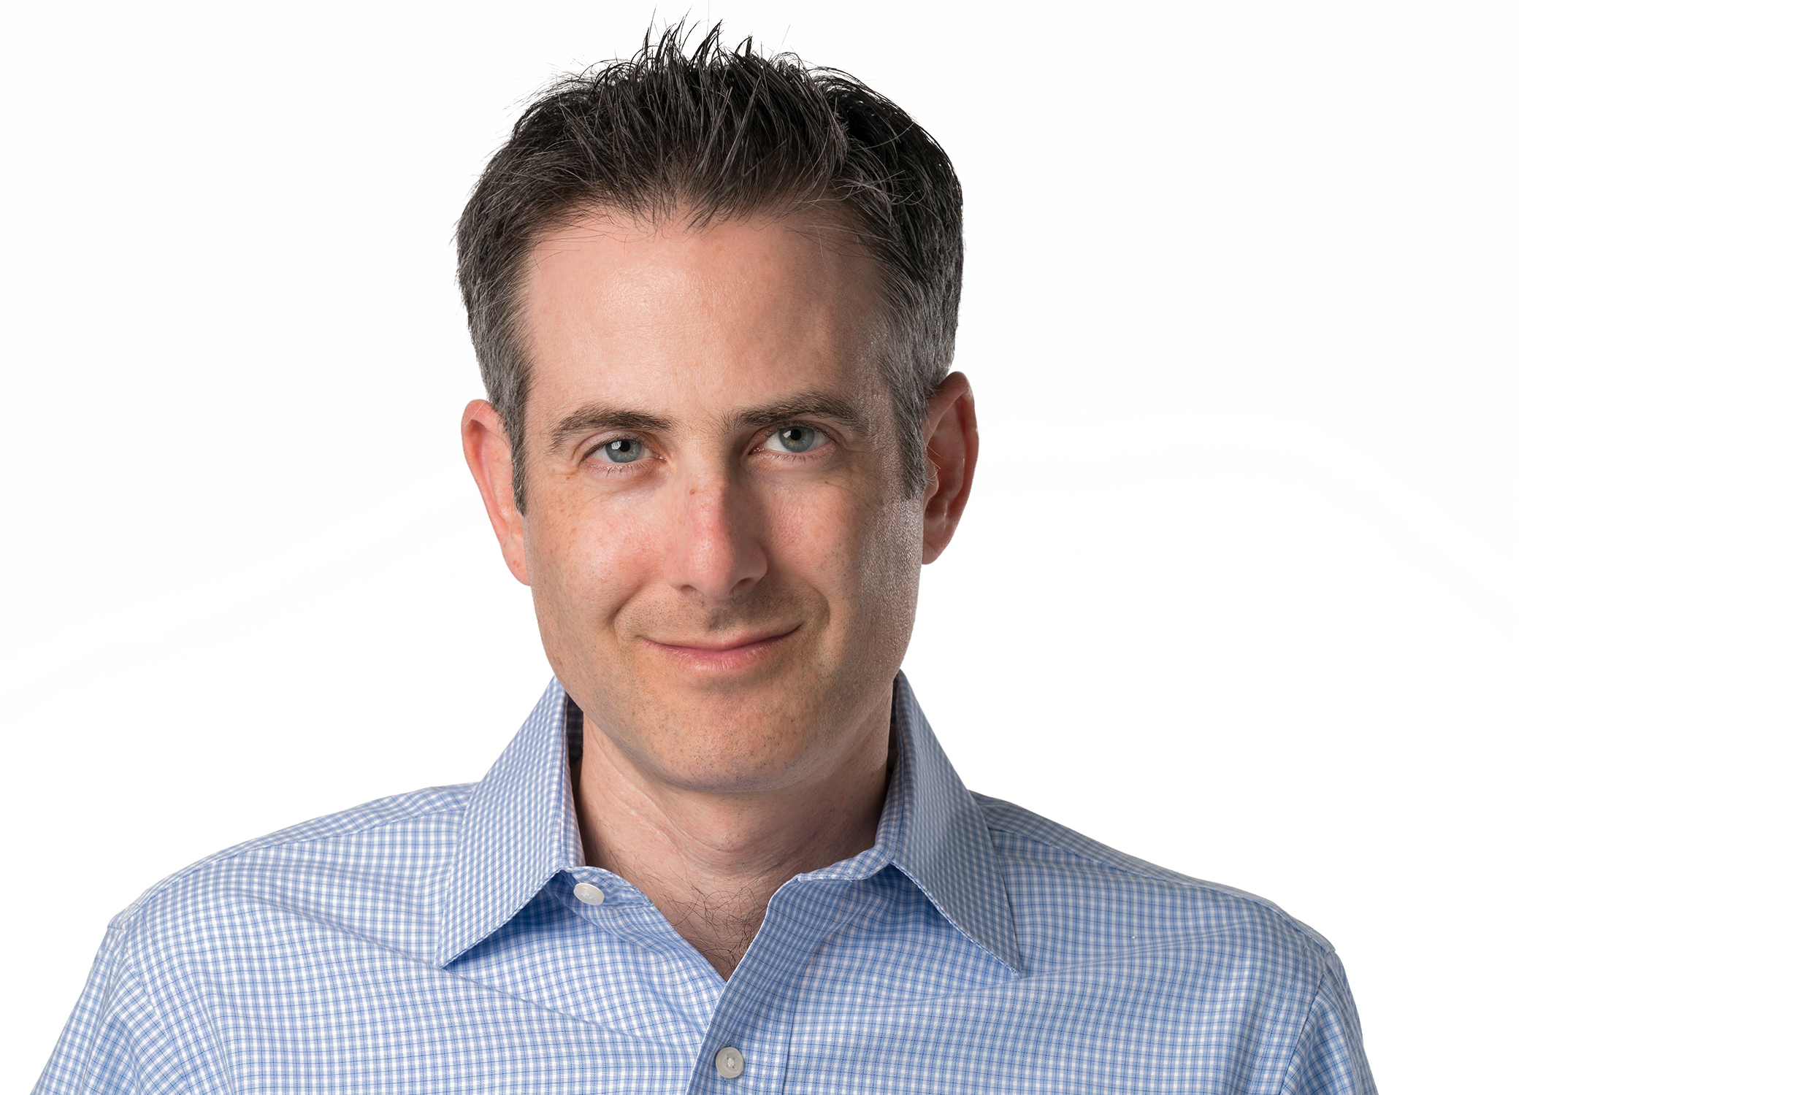
Tweet Tweet
@allan_k_grillMD
#FMF2023 or #myFMF
@CFPC_e or @CFPC_f

Slide 8
Learning Objectives
To identify a practical clinical algorithm that can be implemented in primary care practice to help manage patients with Chronic Kidney Disease (CKD)
To differentiate patients with increased risk of advanced CKD using the Kidney Failure Risk Equation (KFRE)
To interpret blood pressure treatment targets and use of SGLT2 inhibitors for patients with CKD
To introduce new pharmacotherapy treatments for CKD (Finerenone)

Slide 9
Terminology
Chronic Renal Failure is an outdated term
Replaced by Chronic Kidney Disease (CKD)
Acute Renal Failure is also an outdated term
Replaced by Acute Kidney Injury (AKI)
Isn’t it better to focus on “Renal Success”?

Slide 10
Prevalence of CKD
10% of North Americans have CKD
26 million people
25% of North Americans > age 65 have CKD
Only 3% of CKD patients progress to ESRD

Slide 11
Why Should CKD Be Important to Primary Care?
~ 90% of CKD cases are at low risk of progression and can be followed by a Primary Care Provider (e.g. family physician, nurse practitioner); 100% in LTC
Early identification and treatment can prevent/delay End Stage Renal Disease (ESRD)
Medication reviews can prevent AKI in LTC
Comorbid cardiovascular disease risk reduction/management (e.g. DM, CAD/CHF)
Referral of patients at increased risk of progression to advanced stages of CKD to nephrology

Slide 12
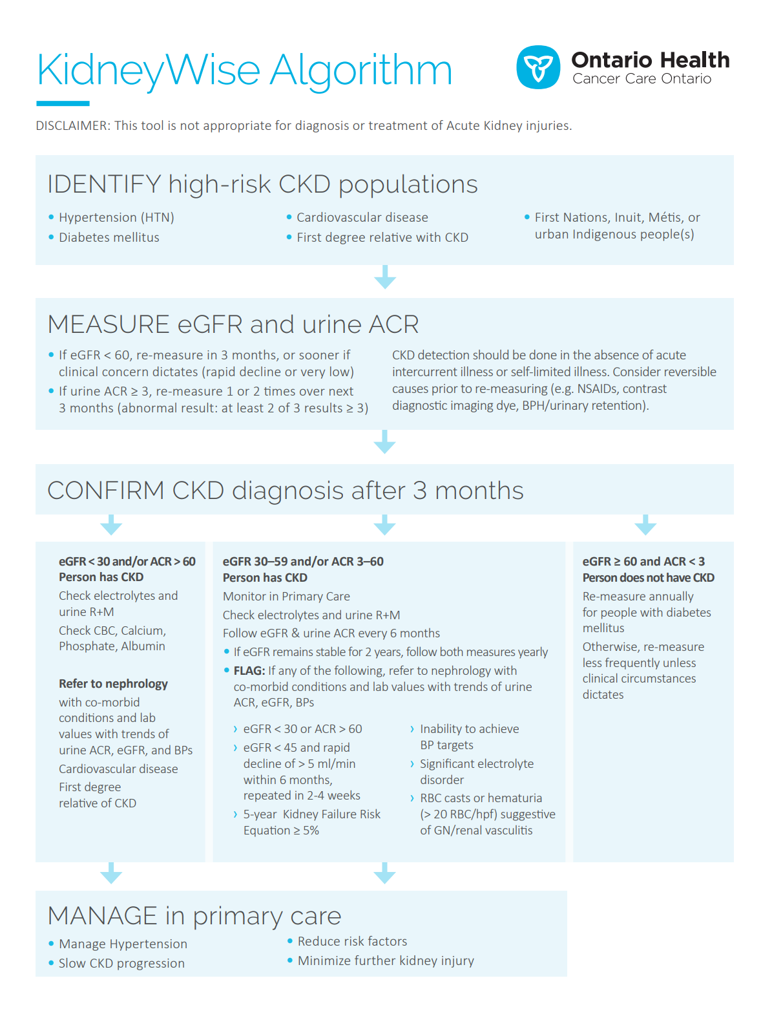
CKD AT-A-GLANCE: KIDNEYWISE
See tool at
www.kidneywise.ca

Slide 13
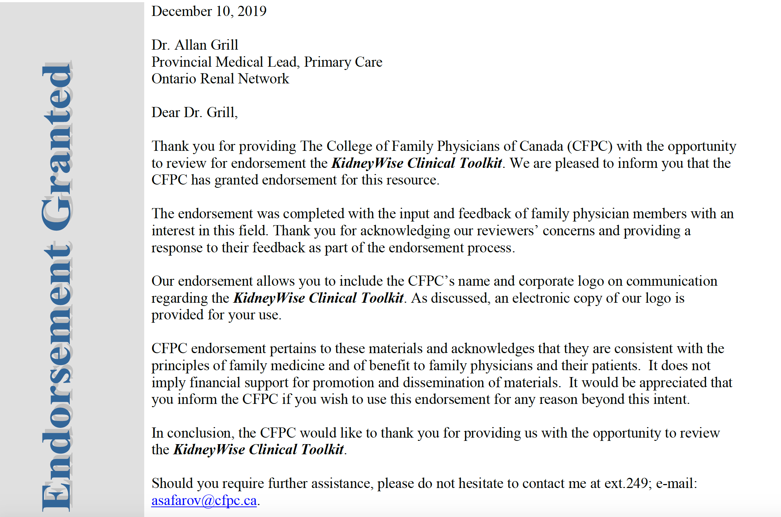
KidneyWise Clinical Toolkit
Notes:
The KidneyWise Clinical Toolkit consists of three separate documents:
1. An evidence-based Clinical Algorithm that is divided into the following sections:
Identify – Identifies patients at higher risk of having CKD that should be tested
Detect – Details the types of tests that should be used to detect CKD and based on the test results, guides providers on next steps (i.e. follow-up and referral)
Manage – Provides recommendations for management of CKD in primary care to reduce the risk of further disease progression
2. The Evidence Page offers PCPs further clinical detail regarding the algorithm content including references to clinical guidelines that were used in the development of the toolkit.
3. The Standardized Outpatient Nephrology Referral Form provides PCPs with referral guidance by outlining clinical scenarios that would require consultation with a nephrologist along with the appropriate investigations that should accompany the referral.

Slide 14
KidneyWise Clinical Toolkit
Clinical Algorithm that helps with identification, detection, and management of patients with CKD and guidance on which patients may benefit from referral to a nephrologist
Evidence Summary that offers further clinical detail regarding the algorithm content, including references to clinical guidelines that were used in the development of the toolkit
Outpatient Nephrology Referral Form that provides referral guidance by outlining clinical scenarios that would require consultation with a nephrologist along with the appropriate investigations that should accompany the referral
Notes:
The KidneyWise Clinical Toolkit consists of three separate documents:
1. An evidence-based Clinical Algorithm that is divided into the following sections:
Identify – Identifies patients at higher risk of having CKD that should be tested
Detect – Details the types of tests that should be used to detect CKD and based on the test results, guides providers on next steps (i.e. follow-up and referral)
Manage – Provides recommendations for management of CKD in primary care to reduce the risk of further disease progression
2. The Evidence Page offers PCPs further clinical detail regarding the algorithm content including references to clinical guidelines that were used in the development of the toolkit.
3. The Standardized Outpatient Nephrology Referral Form provides PCPs with referral guidance by outlining clinical scenarios that would require consultation with a nephrologist along with the appropriate investigations that should accompany the referral.

Slide 15
Guidelines Referenced
Kidney Disease Improving Global Outcomes CKD Guidelines
Hypertension Canada Guidelines
Canadian Cardiovascular Society Dyslipidemia Guidelines
Diabetes Canada Clinical Practice Guidelines
KidneyWise is referenced in CKD chapter
Notes:
HTN Canada updated their guidelines in 2016, and Diabetes Canada will update their guidelines in 2018.

Slide 16
Clinical Algorithm – Identify
Hypertension
Diabetes
Cardiovascular Disease
Added FNIM (First Nations, Inuit, Metis) > 18 years old – 2018 update
Added First degree relative with CKD – 2020 update
Do not screen if life expectancy is less than 10 years (e.g. frail elderly
population)
Notes:
There are other risk factors: family History of ESRD, Connective tissue diseases (e.g. SLE)
Note: The ORN does not recommend screening frail elderly patients for CKD, even if they have any of the above risk factors. First Nations Inuit Métis (FNIM) patients are at particularly high risk of CKD and progression to ESRD, mediated primarily through higher risk of the above 3 risk factors.

Slide 17
What Tests Should Be Ordered? - Detect
Creatinine/ eGFR
Measure of kidney function
Urine for ACR (albumin to creatinine ratio)
Measure of kidney damage/injury (protein excreted in urine)
Do not order a 24hr. urine collection
Important Note: CKD detection should be done in the absence of acute inter-current illness
Low eGFR in such scenarios may reflect AKI (acute kidney injury) and require more rapid evaluation
Notes:
Both eGFR and urine ACR are predictors of risk for progression (and CV risk). Therefore important to measure both. Urine ACR is the preferred way to detect urine protein/albumin. It is not necessary for PCPs to order a 24-hr urine for protein.

Slide 18
If The Results Are Abnormal, When Should One Repeat The CKD Screening Tests? - Detect
Assuming no inter-current illness:
If eGFR < 60, repeat in 3 months or sooner if clinical concern
If urine ACR ≥ 3, repeat 1-2 more times over the next 3 months
One test result is not enough to make the diagnosis of CKD
CKD is defined as a persistent abnormality for at least 3
months
Notes:
Assuming no inter-current illness:
If eGFR < 60, repeat in 3 months or sooner if clinical concern
Rapid decline from previous eGFR result
Unexpected result → very low eGFR
If urine ACR ≥ 3, repeat 1-2 more times over the next 3 months
At least 2 out of 3 urine ACRs must be elevated to be considered abnormal

Slide 19
What if Initial Test Results Create Clinical Concern?
Clinical Concern = rapid decline from previous eGFR or unexpected eGFR/urine ACR result
Repeat eGFR & urine ACR sooner (e.g. 2 weeks)
Always consider reversible causes prior to re-testing:
Recent treatments with NSAIDs
Herbal remedies
Use of contrast dye for diagnostic imaging
Obstruction (e.g. BPH/urinary retention)
Volume depletion (e.g. dehydration due to illness; diuretics)
Consider the above any time an eGFR/Cr is ordered and the result is unexpected (e.g. annual flu vaccine; medical w/u)
Renal ultrasound not recommended as part of routine CKD screening, but can be ordered to rule out a cause of AKI!
Notes:
-CKD is defined as abnormalities of kidney structure or function, present for >3 months, with implications for health (KDIGO).
-While waiting to repeat the abnormal CKD screening tests, consider the possibility of reversible causes
Infection (e.g. stop ACEI/ARB, diuretic – especially with diarrhea/vomiting/dehydration)
Volume depletion (e.g. dehydration)
Medications (e.g. NSAIDs, aminoglycosides, diuretics)
IV contrast dye used for diagnostic imaging (consider holding diuretics, increase hydration beforehand)
Obstruction (e.g. BPH/urinary retention)

Slide 20
Interpreting The Results Three Months Later - Detect
Patient does not have CKD
Follow-Up Recommendations:
Re-test annually for patients with diabetes, less frequently otherwise unless clinical circumstances dictate more frequent testing
Avoid labeling a patient with CKD unless confirmed
Notes:
Patient does not have CKD
Follow-Up Recommendations:
Re-test annually for patients with diabetes, less frequently unless clinical circumstances dictate more frequent testing
Note: Avoid labeling a patient with CKD unless confirmed

Slide 21
Interpreting The Results Three Months Later - Detect
Patient has CKD
Refer patient to a nephrologist
Work-Up Recommendations:
Consider ordering & sending the following with referral:
Urine R&M, electrolytes – update 2018
CBC, serum calcium, phosphate, albumin – update 2018
Don’t lose relationship with your patient!
Notes:
Patient has CKD
Refer patient to a nephrologist
Work-Up Recommendations:
Consider ordering & sending the following with referral:
Urine R&M, electrolytes (for albuminuria)
Urine R&M, electrolytes, CBC, serum calcium, phosphate, albumin, PTH (for low eGFR)
In patients with low eGFR (ie < 30), their risk for metabolic complications including anemia and bone mineral disorders increases – therefore these additional modest tests are recommended prior to referral.
Don’t lose relationship with your patient!

Slide 22
Interpreting The Results Three Months Later - Detect
Patient has CKD
Work-Up: Check urine R&M (inflammatory causes), electrolytes
Follow-Up Recommendations:
How often do you follow-up?
Notes:
Patient has CKD
Work-Up: Check urine R&M, electrolytes
Follow-Up Recommendations:
Serial following of eGFR and urine ACR to monitor for progression
Every 6 months once diagnosis made
Annually once eGFR is stable for 2 years
Refer to a nephrologist if:
eGFR < 60 and decline ≥ 5ml/min within 6 months (confirmed on repeat testing within 2-4 weeks), or
eGFR < 30 or ACR > 60, or
eGFR <45 and urine ACR between 30 and 60 on 2 occasions, at least 3 months apart
Inability to achieve blood pressure targets, or
Significant K+ disorder, RBC casts or hematuria (> 20 RBC/hpf)
There is no need for exhaustive investigations at this point.

Slide 23
KDIGO CKD Follow-up Advice

Slide 24
Interpreting The Results Three Months Later - Detect
Follow-Up Recommendations:
Serial following of eGFR and urine ACR to monitor for progression
Every 6 months once diagnosis made
Annually once eGFR is stable for 2 years
Notes:
Patient has CKD
Work-Up: Check urine R&M, electrolytes
Follow-Up Recommendations:
Serial following of eGFR and urine ACR to monitor for progression
Every 6 months once diagnosis made
Annually once eGFR is stable for 2 years
Refer to a nephrologist if:
eGFR < 60 and decline ≥ 5ml/min within 6 months (confirmed on repeat testing within 2-4 weeks), or
eGFR < 30 or ACR > 60, or
eGFR <45 and urine ACR between 30 and 60 on 2 occasions, at least 3 months apart
Inability to achieve blood pressure targets, or
Significant K+ disorder, RBC casts or hematuria (> 20 RBC/hpf)
There is no need for exhaustive investigations at this point.

Slide 25
KFRE – Kidney Failure Risk Equation
Uses demographic and lab information to calculate risk of kidney disease progression resulting in kidney failure and need for renal replacement therapy (e.g. dialysis or transplant) in patents with CKD stages 3-5.
Abbreviated KFRE consists of 4 variables - age, sex, eGFR and urine ACR
www.kidneyfailurerisk.com
https://qxmd.com/calculate/calculator_308/kidney-failure-risk-equation-4-variable

Slide 26
CKD Criteria for Referral to Nephrology
Criteria | Status
eGFR < 30 ml/min/1.73m² on 2 occasions, at least 3 months apart | No change
Proteinuria (urine ACR > 60 mg/mmol on at least 2 of 3 occasions), present for > 3 months | No change
eGFR < 45 ml/min/1.75m² and decline ≥ 5ml/min within 6 months (confirmed on repeat testing within 2-4 wks) | Revised
eGFR <45 and urine ACR between 30 and 60 on 2 occasions, at least 3 months apart | Removed
5-year KFRE is ≥ 5% | New

Slide 27
Clinical Algorithm – Manage
Notes:
NNT = 20 for CKD vs. 35-40 without CKD using Framingham criteria – Primary Prevention
KDIGO recommends using a moderate dose of a statin based on CV risk rather than treating to target

Slide 28
Clinical Algorithm – Manage
Sulfonylureas/ACEIs/Diuretics/Metformin/ARBs/NSAIDs/SGLT2s
Don’t forget to adjust dose of renally excreted medications!
Cockcroft-Gault formula is validated for the purpose of drug adjustment, but studies show CKD-EPI formula just as accurate as a measure of eGFR
Notes:
Minimize further kidney injury
Consider wellness visits or new patient encounters to review medications. Work with pharmacy if available.

Slide 29
Summary of Proposed BP Treatment Targets – HTN Canada
Notes:
Also works for any patient over age 75.

Slide 30
Summary of Proposed BP Treatment Targets – HTN Canada
Notes:
Also works for any patient over age 75.

Slide 31
Summary of Proposed BP Treatment Targets - KidneyWise
Patient Population | Systolic BP Target | Diastolic BP Target
People with CKD (without DM) | <120 mmHg | <90 mmHg
People with CKD and DM | <130 mmHg | <80 mmHg
People with CKD that have any one of the following characteristics: Frail Elderly Resides in Long-Term Care/ Nursing Home Polypharmacy (>5 medications)* History of Stroke Chronic illness likely to limit life expectancy to < 3 yrs. | <140 mmHg | <90 mmHg
Need to measure BP using an oscillatory automated cuff – otherwise not generalizable to the SPRINT study
Also applies to any ‘high risk’ patient
Notes:
Also works for any patient over age 75.

Slide 32
Go Slow or SPRINT? – you decide

Slide 33
Clinical Algorithm – CKD Management
Blood Pressure
Urine ACR
If > 130/80 – treat HTN based on HTN Canada Guidelines | If > 3 - Treat with ACEI or ARB (but watch for hypotension)
If > 135/85 – treat HTN based on HTN Canada Guidelines | If > 30 AND BP > 135/85 – Treat HTN with ACEI or ARB (1st choice pharmacotherapy)
CKD + DM
CKD (Non-DM)
Lytes/Cr 2 weeks after starting ACEI
or ARB
Expect up to 25% change in eGFR/Cr levels
Notes:
Treatment targets – currently examining these – SPRINT showed CV benefit in lower BP control (120 mmHg) in CKD w/out DM and high risk framingham patients, but also showed more side effects (orthostatic hypotension) and AKI. Accord did not show benefit in lower BP control in diabetes.

Slide 34
CKD + DM – Role of SGLT-2 Inhibitors
CMAJ 2019 October 15;191:E1128-35
Notes:
1st 3 trials showed reduction in CV risk with DM + CKD; Credence showed that AND reduction in renal composite outcome
Credence Trial: patients with DM & elevated urine ACR (100%); 60% eGFR < 60. Poor glycemic control. Canagliflozin vs. Placebo.
Composite outcome – doubling of Cr, ESRD, CV or renal related death. All patients on Max ACEI or ARB.

Slide 35
CKD + DM – Role of SGLT-2 Inhibitors
CMAJ 2019 October 15;191:E1128-35
Notes:
Credence trial showed benefit for renal outcomes as a primary endpoint; other trials not designed to measure renal outcomes as primary result.

Slide 36
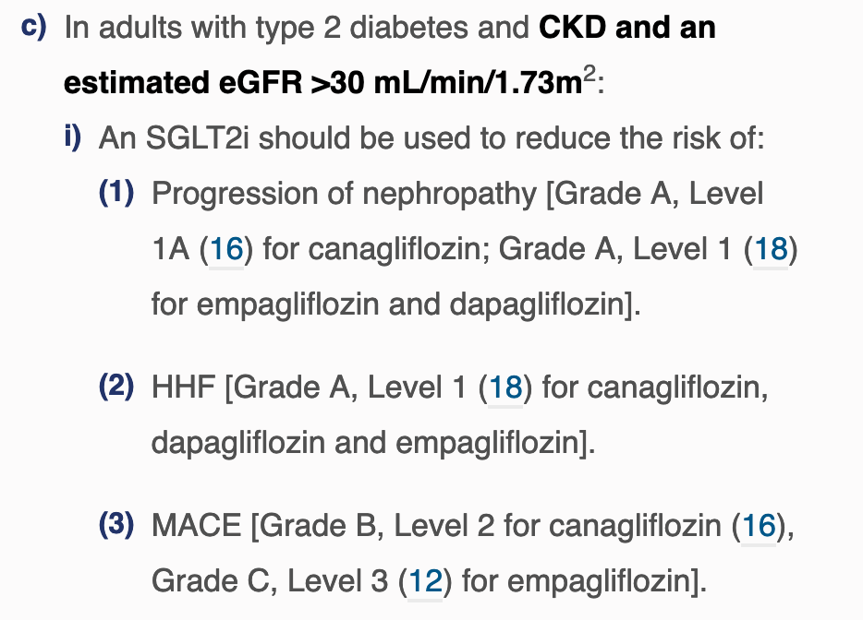
CKD + DM – Role of SGLT-2 Inhibitors
https://www.canadianjournalofdiabetes.com/article/S1499-2671(20)30228-8/fulltext
Diabetes Canada 2020 Update
Notes:
Credence Trial: patients with DM & elevated urine ACR (100%); 60% eGFR < 60. Poor glycemic control. Canagliflozin vs. Placebo.
Composite outcome – doubling of Cr, ESRD, CV or renal related death. All patients on Max ACEI or ARB.

Slide 37
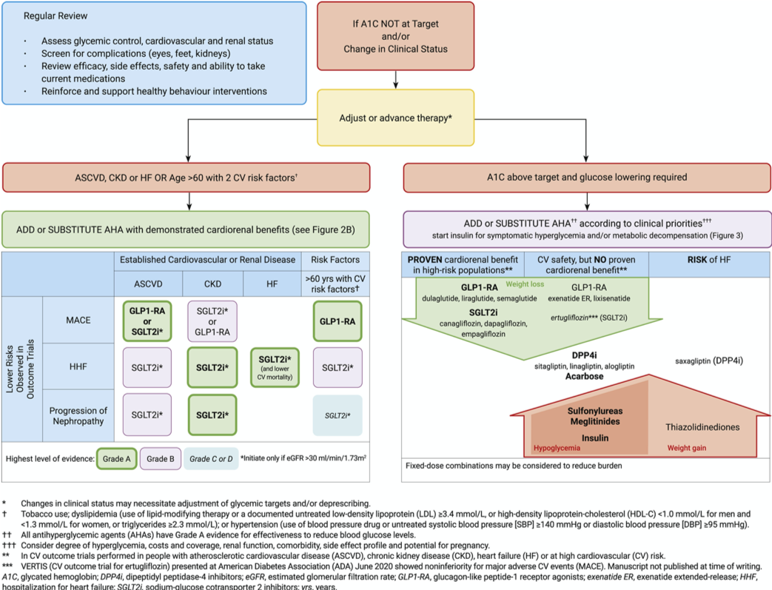
CKD + DM – Role of SGLT-2 Inhibitors
Diabetes Canada 2020 Update
Notes:
Credence Trial: patients with DM & elevated urine ACR (100%); 60% eGFR < 60. Poor glycemic control. Canagliflozin vs. Placebo.
Composite outcome – doubling of Cr, ESRD, CV or renal related death. All patients on Max ACEI or ARB.

Slide 38
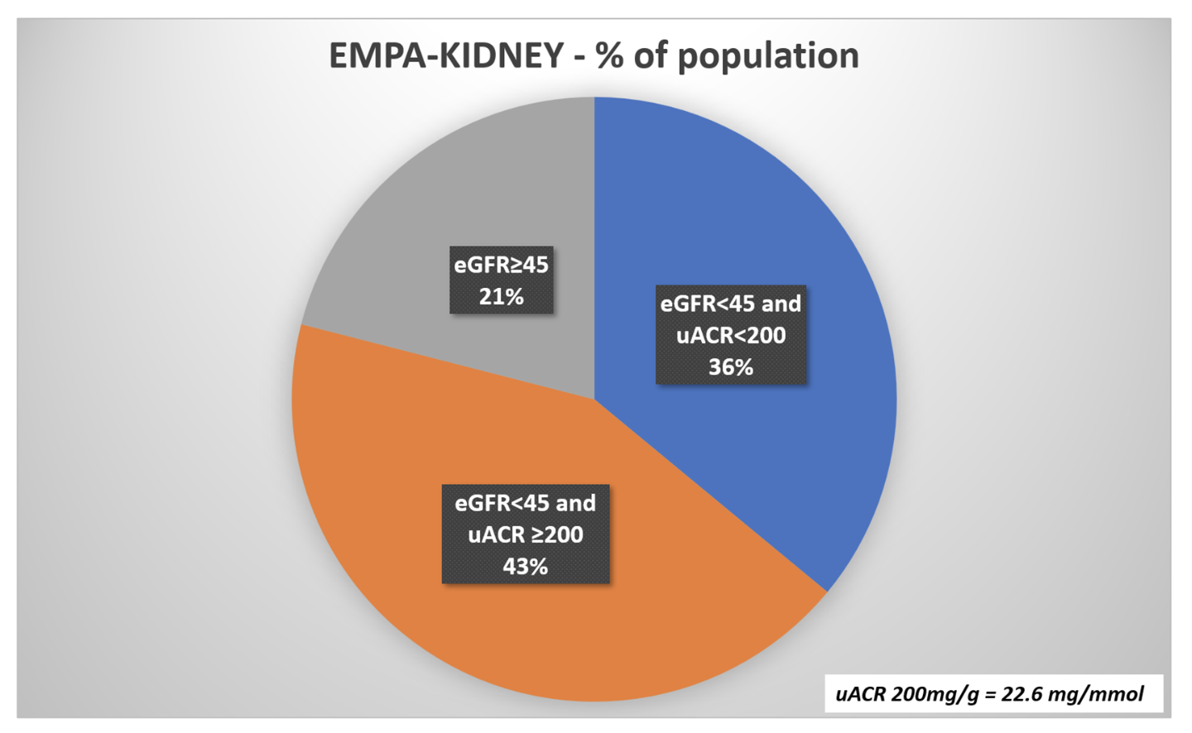
CKD - no DM – Role of SGLT-2 Inhibitors
DAPA-CKD:
Dapagliflozin vs. placebo
1/3 of patients had CKD without DM; lowest eGFR was 25 ml/min
Mean eGFR 43; Heavy proteinuria (Urine ACR 23-565 mg/mmol)
Primary renal composite endpoint statistically significantly reduced
EMPA-KIDNEY
Empagliflozin vs. placebo
54% did not have DM
Lowest eGFR was 20 ml/min
Mean urine ACR = 37 mg/mmol
Primary renal composite AND
CV related mortality
On ACEI or ARB
Notes:
Wide range of CKD patients in terms of eGFR and urine ACR
Composite outcome – doubling of Cr, ESRD, CV or renal related death. All patients on Max ACEI or ARB.
No CVD requirement

Slide 39
EMPA-KIDNEY Results I

Slide 40
EMPA-KIDNEY Results II

Slide 41
EMPA-KIDNEY - Results
Are the benefits clear enough to treat every CKD patient (without diabetes) in the absence of heavy proteinuria with an SGLT2i?
Jury is still out.

Slide 42
CKD & SGLT-2 Inhibitors – Other Stuff
Side effects:
Mycotic genital infections; UTIs
DKA (rare)
Hypotension
Caution if using in combination with loop diuretics → AKI secondary to volume depletion.
Lower limb amputation (more relevant for patients with DM)
Dapagliflozin contraindicated with bladder cancer
Overall benefits:
Weight loss; lowers BP; glycemic control; reduces proteinuria
Lowers risk of CV events, HHF, progression of CKD
Don’t forget:
Dose adjustment – e.g. Empagliflozin can be given until eGFR 20
SADMANS
CMAJ 2019 October 15;191:E1128-35
Notes:
Credence trial showed benefit for renal outcomes as a primary endpoint; other trials not designed to measure renal outcomes as primary result.

Slide 43
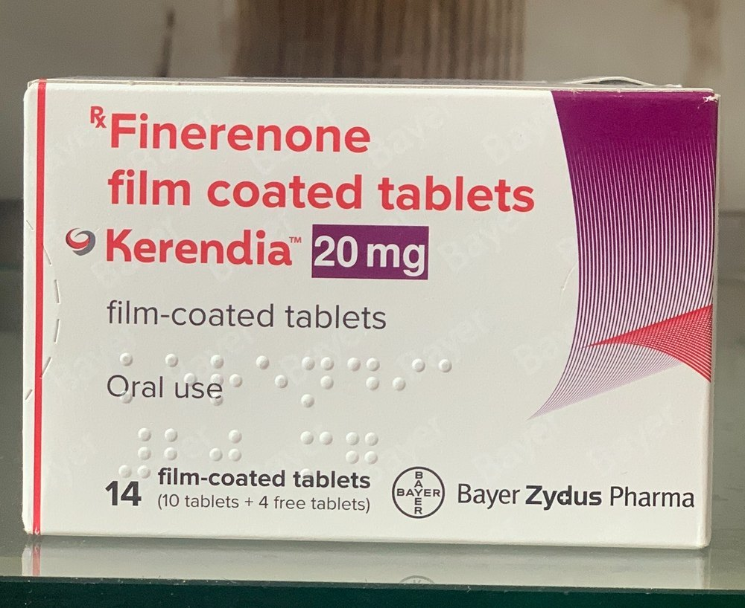
Finerenone – New Kid on the Block
Mineralcorticoid Receptor Antagonist (MRA)
Health Canada indication:
For patients with CKD + DM
Adjunct to Standard of care therapy (ACEI/ARB + SGLT2i)
Reduce risk of ESKD, sustained decrease in eGFR (Renal benefits)
Reduce risk of CV death, non-fatal MI, HHF (CV benefits)
FIDELIO & FIGARO trials – evidence supports these outcomes
BUT…

Slide 44
Finerenone – New Kid on the Block
BUT…
Only 6.7% of the patients in the trial were on ACEI/ARB AND and SGLT2i
So is Finerenone better than an SGLT2i? Is it an appropriate add-on therapy? (CONFIDENCE trial underway)
Renal outcome data was stronger in the FIDELIO trial
Mean baseline eGFR was 44 ml/min vs. 68 ml/min
Mean urine ACR was 92 mg/mmol vs. 35 mg/mmol
Again – magnitude of benefit is higher in those with more advanced CKD (with DM) and heavy proteinuria who are progressing on standard Tx
Conclusion: please consider consulting nephrology before you start this medication

Slide 45
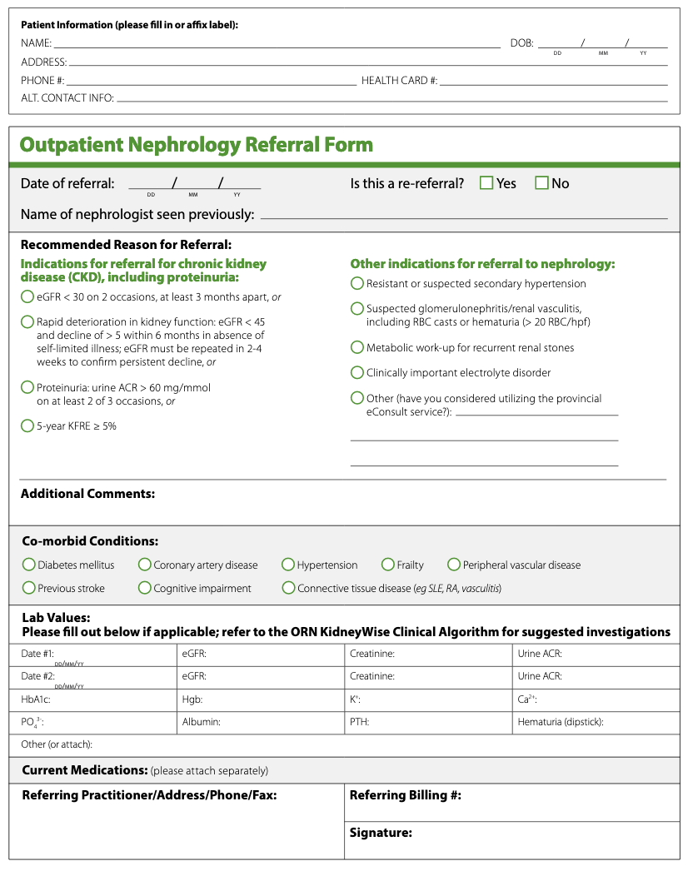
Outpatient Nephrology Referral Form
Notes:
Highlight the ease of filling out the form, especially when incorporated into an EMR. Should also encourage those in the audience from ON to start using it.
While the standardized outpatient nephrology referral form is not mandatory at this time, we hope PCPs and nephrologists support this initiative. Nephrologists should encourage PCP colleagues in their communities to use this form when referring patients for a nephrology consultation. Ultimately, it is our hope that PCPs and nephrologists throughout the province will adopt it for use in their clinical practice so that care can be provided in a more consistent and coordinated manner.

Slide 46
Recommended Reasons for Referral
Most patients with non-progressive/ low-risk CKD can be managed by primary care providers!
Notes:
Discuss outlined recommended reasons for referral (on slide).
The recommended reasons for referral align with the Clinical Algorithm.

Slide 47
Simplified CKD Patient Pathway
Dialysis
PRIMARY CARE
GENERAL NEPHROLOGY
MULTI-CARE KIDNEY CLINICS
Conservative
Patients at-risk of CKD
Patients with CKD managed by PCPs
Referral to nephrologist
Nephrology Consult
CKD patient managed in nephrology clinic
Patients with CKD referred to program for multidisciplinary care
Patients with CKD receiving multidisciplinary care
Transplant
Primary Care management of CKD doesn’t stop after
referral!
Notes:
Now that we’ve discussed the structure of ORN, the next few slides will look at the clinical areas that our organization covers. We’ve developed this informal simplified CKD patient pathway. In an ideal world a CKD patient would be identified in primary care, managed up to a certain point, then referred to nephrologist as their disease progresses. Once in general nephrology, CKD patients would be managed until they are progressing towards ESRD and require more intensive Multidisciplinary care and modality education which occurs in the CKD programs in a clinic that are called “pre-dialysis clinics”.
Once they reach ESRD, CKD patients are provided an option of selecting Dialysis, Transplant or Conservative Care.
The early detection & prevention of progression portfolio spans this front end of the journey (dotted red line). This priority panel will focus on the CKD patients in the primary care space. We have a sister panel that will be looking at the CKD patients from that point of referral into nephrology to hand-off prior to dialysis.
Pause for questions

Slide 48
CFP – Oct. 2018 – pg. 728-735
Notes:
#9 ranked downloaded article in 2018

Slide 49
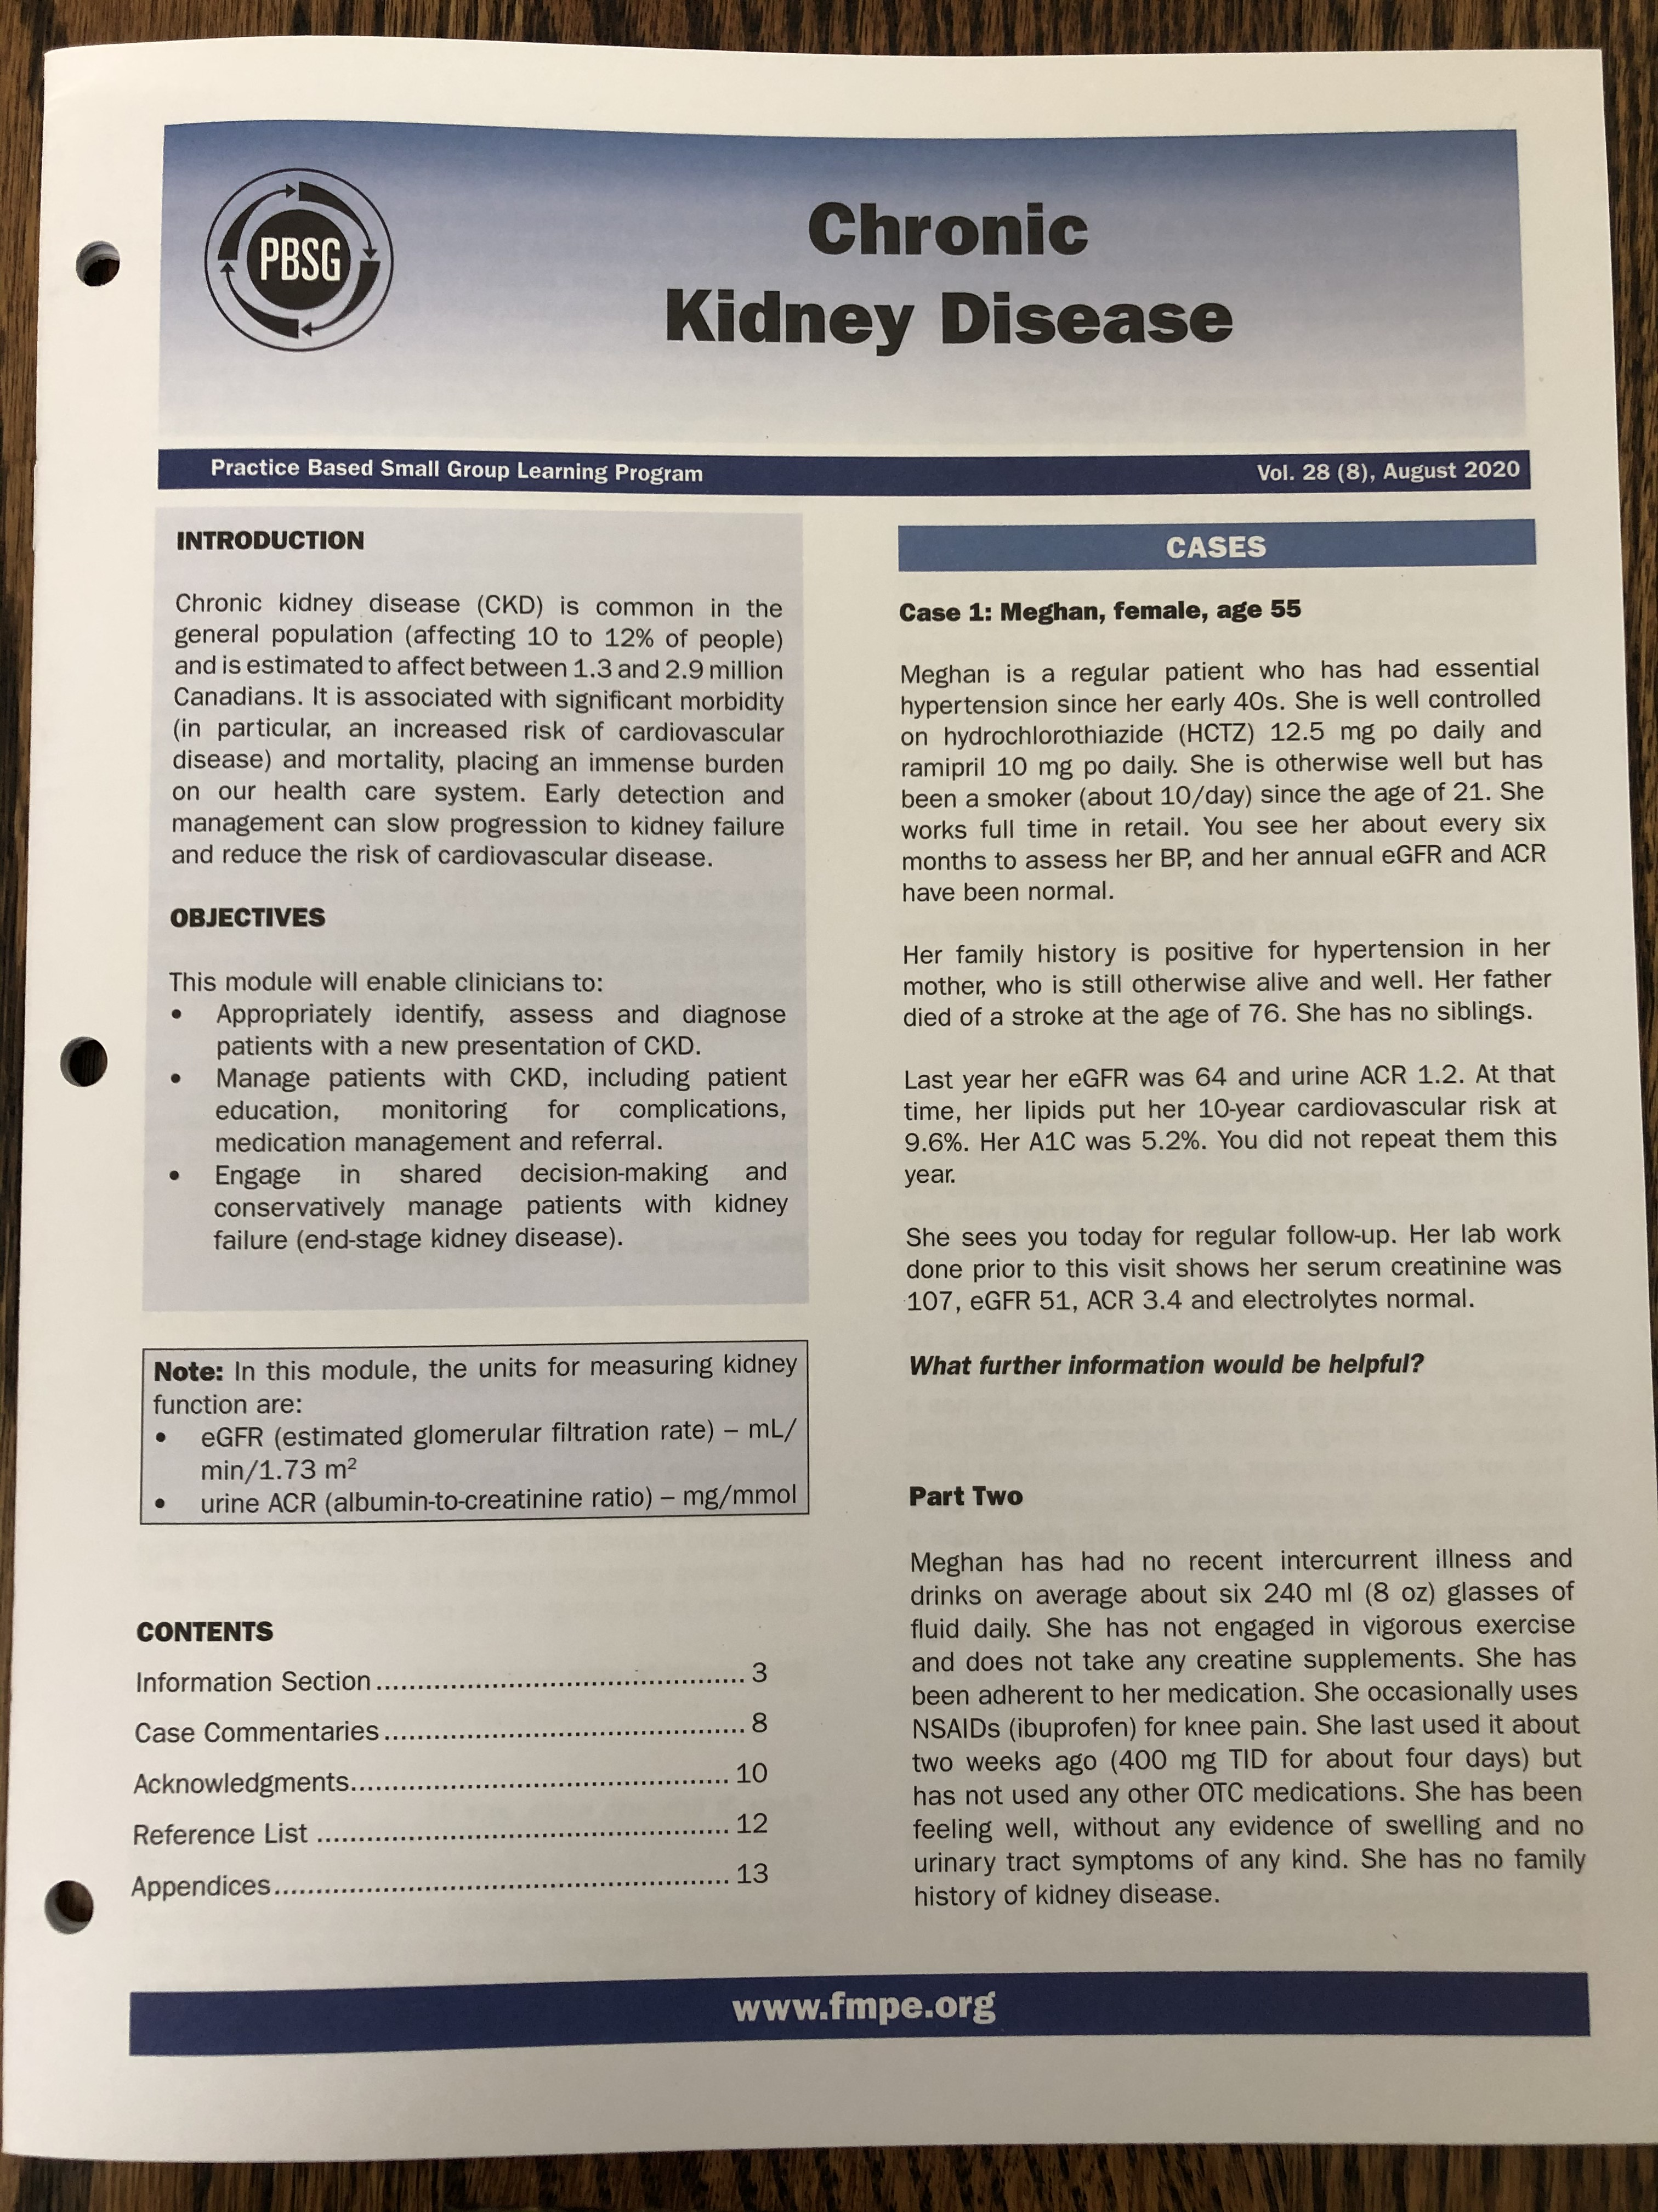
FMPE - PBSG
Notes:
#9 ranked downloaded article in 2018

Slide 50
Take Home Points
CKD testing should only be applied to patients at high risk of CKD and in the absence of acute intercurrent illness; avoid in elderly patients with limited life expectancy – Identification
eGFR and urine ACR are the tests of choice - Detection
eGFR should be done at least annually in some situations (e.g. med reviews; flu season - LTC)
Most cases of CKD in primary care are low-risk and can be managed by PCPs – Management
Refer to nephrology as appropriate
The KidneyWise Clinical Toolkit will make CKD care easier for PCPs and empower us to improve patient outcomes
Notes:
To conclude:
CKD testing should only be applied to patients at high risk of CKD and in the absence of acute intercurrent illness – Identification
eGFR and urine ACR are the tests of choice – Detection
Most cases of CKD in primary care are low-risk and can be managed by PCPs - Management
Serial follow-up to monitor for progression towards ESRD
Cardiovascular disease risk reduction is a key role PCPs can play with respect to patients with CKD
Refer to nephrology as appropriate
The KidneyWise Clinical Toolkit will make CKD care easier for PCPs and empower us to improve patient outcomes

Slide 51
Take Home Points
The 2 major updates to the KW Toolkit (2018) were BP treatment targets and addition of KFRE (5-year ≥ 5%) as a referral criteria to nephrology
Consider more aggressive treatment targets for patients with CKD & HTN (120 mmHg)
SGLT2i therapy should be considered in patients with CKD + DM:
If poor glycemic control
If known CVD or CHF to reduce further risk
If heavy proteinuria (urine ACR > 30 mg/mmol) present despite ACEI/ARB therapy
SGLT2i therapy should be considered in patients with CKD (and no DM)
If heavy proteinuria
Consult nephrology
Finerenone is a new MRA drug to treat patients with CKD + DM to reduce risk of progression of CKD & CV risk
Patient should already be on an ACEI/ARB + SGLT2i and still have CKD progression
Reserve for those with heavy proteinuria (elevated urine ACR > 30 mg/mmol)
Consult nephrology
Notes:
To conclude:
CKD testing should only be applied to patients at high risk of CKD and in the absence of acute intercurrent illness – Identification
eGFR and urine ACR are the tests of choice – Detection
Most cases of CKD in primary care are low-risk and can be managed by PCPs - Management
Serial follow-up to monitor for progression towards ESRD
Cardiovascular disease risk reduction is a key role PCPs can play with respect to patients with CKD
Refer to nephrology as appropriate
The KidneyWise Clinical Toolkit will make CKD care easier for PCPs and empower us to improve patient outcomes

Slide 52
Questions?
Please complete your FMF evaluation forms

