Slide 1
Session Title
Examining access to primary care for people with OUD: a randomized controlled audit study
Presented by: Sheryl Spithoff
Presentation Date:

Slide 2
COI – Presenter Disclosure
Presenter Disclosure
Presenter: Sheryl Spithoff
Relationships with financial sponsors:
•Any direct financial relationships, including receipt of honoraria:
Clinician Scientist award Department of Family and Community Medicine, University of Toronto
•Membership on advisory boards or speakers’ bureaus: None
•Patents for drugs or devices: None
•Other: None
Notes:
Where a faculty/presenter has no relationships to disclose, indicate Not Applicable under Relationships with Financial Sponsors.
Complete this slide for the primary presenter and ALL co-presenters if applicable.
Reminder: Disclosures made on your COI forms should match disclosures made on the COI slide.

Slide 3
COI – Disclosure of Financial Support
Disclosure of Financial Support
This program has received financial support from the Foundation for Advancing Family Medicine in the form of a research grant.
Potential for conflict(s) of interest:
None identified
Notes:
Where a program has received no external financial support (e.g., monies for food, logistics assistance such as registration, AV set-up, etc.), indicate No External Support.

Slide 4
Team
Sheryl Spithoff, MD, MSc
Lana Mogic, BSc
Susan Hum, MSc
Rahim Moineddin, PhD
Christopher Meaney, MSc
Tara Kiran, MD, MSc

Slide 5
Background
People with opioid use disorder (OUD) are growing population, complex health needs
Primary care has potential to improve health outcomes for people with complex health conditions
People with OUD enrolled with family doctor in Ontario more likely to have appropriate cancer screening, diabetes monitoring (Spithoff 2019)
Yet people who use substances/have addictions are less likely than others to have a primary care provider
Ontario study (same study): 43% enrolled vs 73% matched controls
Canadian study of PWUD, only 56% reported engagement with primary care (Kendall 2020)
Surveys, interview studies have identified barriers
Patient factors, system factors, health care providers
Research goal: determine if family doctors’ discretion in accepting new patients affects access for people with OUD
Notes:
Similar findings in American study
Tara Kiran, Tara Gomes, Mel Kahan and me
-people with OUD enrolled with FP more likely to have appropriate cancer screening, diabetes monitoring
Patient factors- complex lives, other mental health concerns
System factors- travel, cost, parking, few PCPs
Provider factors- surveys reluctant to take on patient with adictions

Slide 6
Our study objective: determine if family physicians are less likely to accept people with OUD as new patients than people with diabetes
Primary analysis: Compare the proportion of people with OUD offered a new patient appointment vs those with diabetes
Secondary stratified analysis
population size
(urban vs rural)
physician gender
(men vs women)
model of care
(team vs not team)
years in practice
(>20 vs < 20)
Notes:
We conducted a stratified analysis
-compared proportions in each subgroup
.

Slide 7
Randomized Controlled Audit Study
Unannounced phone calls to randomly-selected Ontario FPs asking for a new patient appointment
Randomly assigned a scenario
One: a patient with diabetes in treatment with a “diabetes” doctor
Two: a patient with OUD in treatment with a “methadone” doctor
Outcome: an offer of a new patient appointment*
Notes:
with the physician or another physician/NP in the same practice
-stated I am new to the area, and my diabetes doctor suggested I find a family doctor
-I am new to the area and my methadone doctor suggested I find a family doctor
4 different variables
2 sample chi square tests
Sample size
Olah
22% of people with Dm offered NP
We estimated 10% diff would be significant
Included close to 800
Many did not meet inclusion criteria- not primary care, not in practice, no voicemail, used health care connect
Negative, no callback 6 weeks, call up to 5x

Slide 8
Results
383 family physicians
Primary analysis: Family physicians were almost 3 times less likely (4.0% vs 11.4%) to offer a new patient appointment to a patient with OUD than one with diabetes
Notes:
Exclusions
-restricted pratices, independent practice
-one per address
-small population centre
we also excluded physicians whose practice address was in a community with a population less than 10 000, unless they were close (ie, within 50 km) to a community with a population greater than 20 000. We excluded physicians in these communities because we hypothesized that the study scenario may not be plausible given that these settings may be too small to have a methadone clinic or an endocrinologist.
At the time of making the phone calls, we excluded physicians
who did not provide primary care,
were no longer in practice
had a voicemail stating they were not accepting new patients
required an in person visit prior to accepting a new patient
required a health card number prior to accepting new patients, or only used Health Care Connect (a government service that requires a health card number) to accept new patients (Figure).
We also excluded physicians if we were unable to contact them, or leave a message, after 5 phone calls.

Slide 9
Results
Stratified analysis
Physicians with >20 years in practice were almost 13x less likely to offer appointment to patient with OUD vs diabetes
Women were almost 5x less likely
Urban location 3.5x less likely
Not team practice 2.5x less likely
Others not statistically significant:
Physician <20 years (1.4x)
Men (1.7x)
Rural location** (0/17 vs 2/23)
Team practice (3/22 vs 0/15)
But other than rural location, all showed similar trend

Slide 10
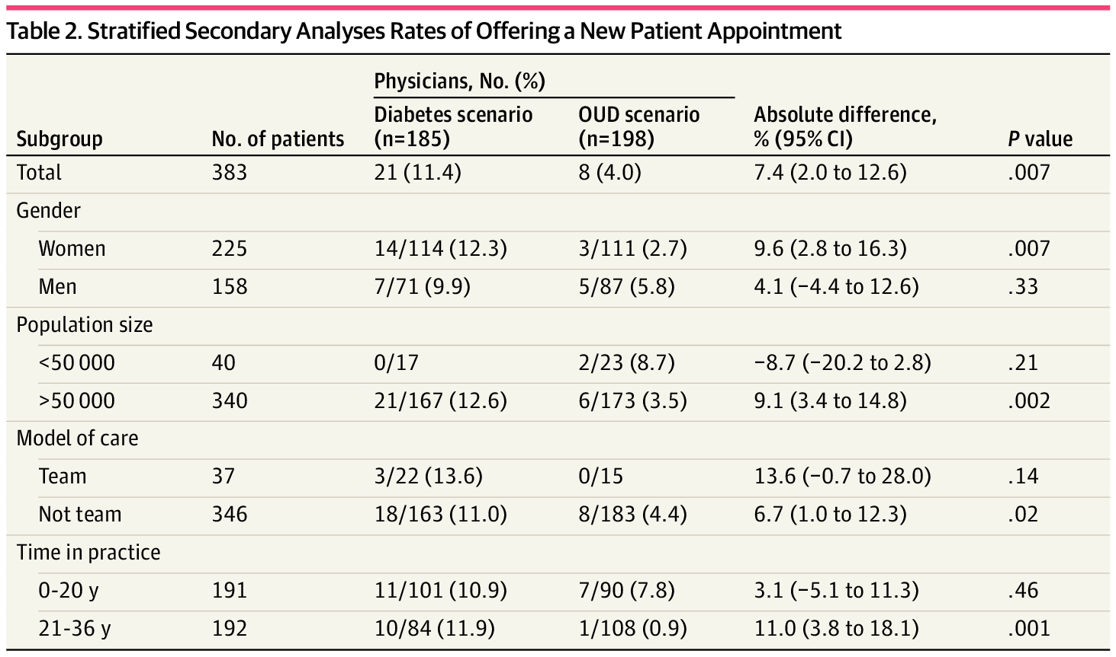

Slide 11
Discussion
Family physician discretion in accepting new patients contributes to poor access to primary care for people with OUD
Align with findings from survey studies
Physicians reluctant to accept patients requiring prescribed opioids or with addictions
Reasons from the literature
Surveys: lack of training, supports, stigma
Compensation models in Ontario
Notes:
Many work in capitation models- with inside and outside basket codes
Diabetes- outside of basket codes
OUD codes are as well, but only if MD is providing addiction care, rare in Ontario

Slide 12
Discussion
Subgroup analysis
Physician with more years in practice 13x less likely
Aligns with Canadian survey 2019, family physicians with more years in practice, less likely to accept patients who required prescribed opioids (Marshall 2019)
Indicates changing attitudes and behaviours among newer physicians
May reflect changing norms and/or better training/education
Women 5x less likely
Does not align with survey data in Canada (Marshall 2019) and UK (Blake 2015)
Explanation unclear

Slide 13
Recommendations
Policies that reduce physician discretion in accepting new patients
Enhanced training for addictions/anti-oppression training in medical schools and for practicing physicians
Primary health care systems that ensure everyone has family physician or primary care nurse practitioner
A primary care system with appropriate resources, funding and accountability (Price Baker report)
Notes:
Universal coverage needs to be combined with policies that provide everyone with access to high quality primary care
other countries have figure out
-automatic eligibility for primary care
how to have much higher rates of access to primary care
-Norway 100%, Netherlands 99% (2020 Commonwealth report, Norway has 2x physicians)
Anti-oppression training
-individuals become aware of their own biases, power, privilege as well as in organizations and society
-learn how to counter-act oppression and create more equitable processes/structures

Slide 14
Closing Slide
Please fill out your session evaluation now!
FamilyMedicineForum
Click this button in the agenda!
@FamilyMedForum
FamilyMedForum
#myfmf

Slide 16
Recommendations
Accountability to a governmental organization (e.g., to Ontario Health Teams)
Automatic eligibility for FP or NP
Timely access, including after hours care
Resources
Shift funds to primary care
Capacity
FPs and NPs
Team-based care
Paperwork
Compensation for complexity of work
Support for IT infrastructure and after-hours clinics

Slide 17
Exclusions
Exclusions
-restricted practices
-not in independent practice
-only one per address
-we also excluded physicians whose practice address was in a community with a population less than 10 000, unless they were close (ie, within 50 km) to a community with a population greater than 20 000. We excluded physicians in these communities because we hypothesized that the study scenario may not be plausible given that these settings may be too small to have a methadone clinic or an endocrinologist.
At the time of making the phone calls, we excluded physicians
-who did not provide primary care,
-were no longer in practice
-had a voicemail stating they were not accepting new patients
-required an in person visit prior to accepting a new patient
-required a health card number prior to accepting new patients, or only used Health Care Connect (a government service that requires a health card number) to accept new patients (Figure).
-We also excluded physicians if we were unable to contact them, or leave a message, after 5 phone calls.

Slide 18
Vision
99% have GP
Most able to get same day access
After hours urgent care
Triage
At hospital
GPs in call group

Slide 19
For our primary outcome, we used 2-sample χ 2 tests to compare unconditional offers of a new
patient appointment for a patient in treatment for diabetes with a patient in treatment for OUD. We
also used multivariable logistic regression to model the likelihood of being offered a new
appointment with a physician after controlling for our prespecified confounding factors: gender,
rurality, years in practice and model of care.
For our prespecified secondary analysis, we performed a stratified analysis comparing
proportions of patients offered an appointment for each scenario stratified by gender (men vs
women), municipality population size (rural, population below 50 000 vs urban, population above
50,000), model of care (team-based vs not), and years in practice (more than 20 years vs less than
20 years). The absolute proportion differences 95% CIs and P values are reported. For our analyses,
we considered a P < .05 to be statistically significant. Statistical analyses were conducted using SAS
version 9.4 (SAS Institute).

