Slide 1


Introducing the New SOGC Induction of Labor Guidelines 2023
Family Medicine Forum
November 8, 2023
Dr. Hannah Shenker MD CCFP
Dr. Helen Mavromichalis MD CCFP
McGill University

Slide 2
Presenter Disclosure
Neither Dr Hannah Shenker or Dr. Helen Mavromichalis have any conflicts of interest of financial support to disclose.

Slide 3


Slide 4

To Induce or not? How and when?
31 year old G1P0 @ 39 wks, low risk pregnancy, asking for elective IOL.
32 year old G4P3 GDM diet controlled with LGA infant (EFWT 4.2 kg) @ 38 wks
36 year old G2P1 TOLAC @ 41 wks. Cervix 1 cm, long.
39 year old G1P0 IVF pregnancy @ 39+2.
36 year old G2P1 @38+2. IUGR 6% with poor interval growth and oligohydramnios.
36 year old G1P0 GBS + PROM 8 hrs ago at 39+5 weeks. No CTX.

Slide 5
Key Recommendations: General Principles
IOL should be a shared decision between the pregnant individual and the care provider, with respect for the individual’s choice.
All pregnant individuals should be offered a dating ultrasound at 8-12 weeks gestation.
Routine elective induction of labor at 39 weeks gestation is not recommended. If requested, the provider should consider patient preferences, local health care resources, and local cesarean delivery rates associated with induction
Quality assurance audits for induction of labor practices are important within health care organizations.
  Important quality measures include the indication for induction, the induction approach, and outcomes

Slide 6

Indications for Induction of Labor
(not exhaustive)
High Priority
Other Indications
Chorioamnionitis
Term PROM with GBS +
Hypertensive Disorders of Pregnancy
  PET w/ severe features at any GA
  PET without severe features at ≥ 37 weeks
Post term pregnancy ≥42 weeks
Maternal disease not responding to treatment
Suspected fetal Compromise
Stable, significant antepartum hemorrhage
Fetal growth restriction
Diabetes requiring insulin/poor control
AMA ≥39 wks
Cholestasis of pregnancy
IUFD (or prior IUFD)
Late term pregnancy (41-41+6 weeks)
Oligohydramnios
Gestational HTN ≥38 weeks (uncomplicated)
Term PROM, GBS negative
Uncomplicated twin pregnancy – certain scenarios
Logistical issues

Slide 7
Risks associated with IOL
Failure to establish labor
Tachysystole
Chorioamnionitis
Cord prolapse with ARM
Uterine Rupture
Assisted vaginal birth or Cesarien Delivery
PPH
Adverse neonatal outcomes related to iatrogenic early-term birth (37-39 wks)
  Short-term NICU admission, LBWT, Obstructive airway Dx, CP, Epilepsy, Intellectual disability, Low APGAR, Perinatal Mortality.

Slide 8
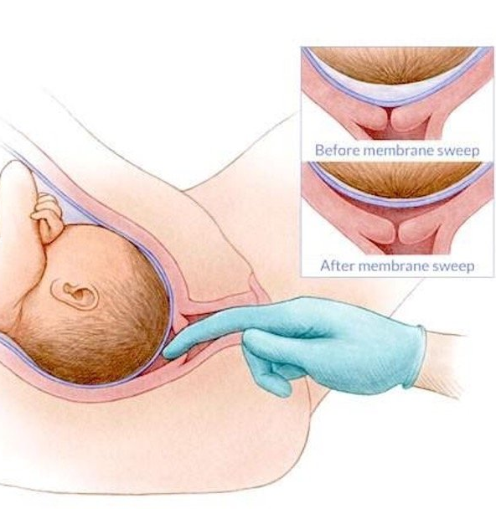
Non-Pharmacological methods
Regular sweeping of the membranes may be offered from 38 wks to reduce the incidence of late term pregnancy.
  GBS colonization is not a contraindication to a membrane sweep.
Castor oil, nipple stimulation, and breast compression can reduce the need for induction of labor and may be offered to low-risk individuals at term.

Slide 9
Key Recommendations: Specific scenarios
Late term induction of labor should be offered at or after 41 weeks gestation.
Suspected macrosomia or LGA alone is not an indication for induction before 39 weeks.
  Cesarean delivery may be considered for ultrasound estimated fetal weight >4500 g in the presence of diabetes and estimated fetal weight >5000 g in the absence of diabetes.
Induction of labor may be offered at 39 weeks gestation for advanced maternal age (≥40 yrs)
There is insufﬁcient evidence that IOL is associated with maternal or fetal beneﬁts for pregnancies conceived via assisted reproductive technologies
(LGA) refers to fetal weight >90th % for a given gestational age.
Macrosomia = EFWT ≥4000-4500 g, regardless of gestational age.

Slide 10
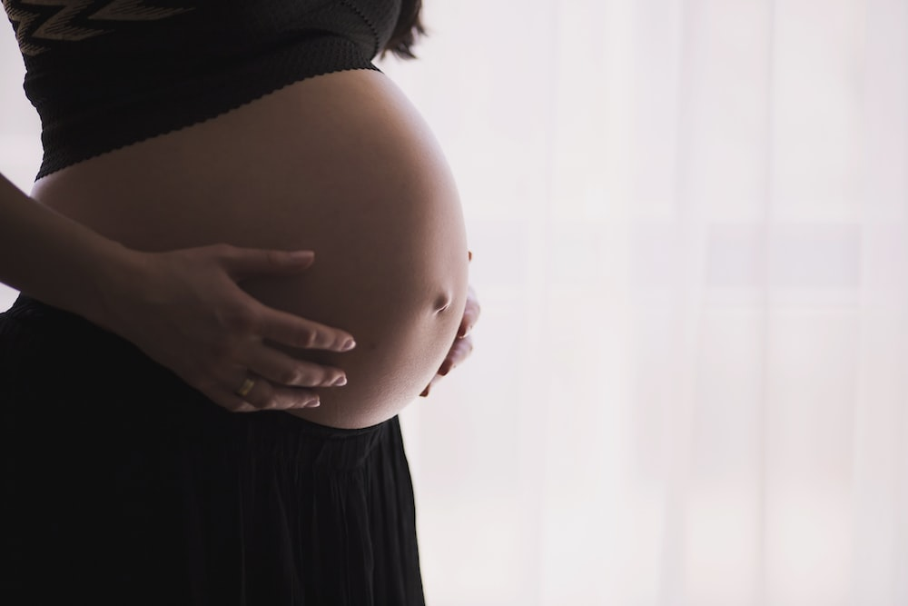
Case Study
36 year old G1P0 @ 39+5 weeks GA
Presents to L+D with SRM x 8 hrs
GBS + on vaginal-anal swab done @ 36 weeks
No Allergies
No CTX, normal fetal movements, clear fluid
Afebrile, normal vitals, FHR 135
Birth Plan states no IOL unless “absolutely necessary”

Slide 11
Term PROM (≥37 weeks)
For patients who are GBS + with term rupture of membranes, IOL should be offered as soon as resources allow, and antibiotic prophylaxis should be started while awaiting IOL.
For patients who are GBS - with term PROM, IOL may be offered as soon as resources allow. Expectant management for up to 24 hours is also acceptable. Digital pelvic exams should be avoided until active labor begins, and then done only when indicated.
Either oral misoprostol or oxytocin can be used for induction of labor in the setting of term PROM, regardless of Bishop score.

Slide 12
Case Study
31 year old G1P0 @ 39+0 weeks GA
Healthy
Normal Pregnancy
3rd trimester US showed EFWT 50%, normal fluid
Asking for IOL, she read online that if she is induced now, it will reduce her chances of needing C/S.
Cervix is closed, long, soft.

Slide 13

What about ARRIVE?
Randomly assigned 6106 low-risk nulliparous pregnant people with a singleton fetus to induction of labor at 39-39+4 weeks gestation versus expectant management.
No difference was found in the primary outcomes of perinatal death or severe neonatal complications.
The frequency of CD was lower in the IOL group (18.6% vs. 22.2%; RR 0.84; 95% CI 0.76-0.93).
Grobman WA, Rice MM, Reddy UM, et al. Labor induction versus expectant management in low-risk nulliparous women. N Engl J Med 2018;379:513-23.

Slide 14
How Can we interpret ARRIVE?
Study demographics make the data and outcomes challenging to extrapolate to the typical Canadian population and should therefore be interpreted with caution.
  average age was 24 years
  median BMI was 30.3
  44% had no private health insurance
  48% were unemployed
  Indigenous representation was too low to be speciﬁcally reported.
A 2022 publication found that while rates of induction at 39 weeks gestation increased substantially after publication of the ARRIVE trial, neither the overall CD rate nor the rate of pre-eclampsia decreased signiﬁcantly.
A 2021 meta-analysis of 16 randomized controlled trials (n = 8796) found no decrease in the CD rate with induction before 40 weeks.
They did show a possible reduction in hypertension, meconium-stained amniotic ﬂuid, and mean birth weight, as well as an increase in the length of maternal hospitalization.
“For individuals requesting IOL at 39 weeks gestation, consideration should be given to the available evidence, the population studied, and health care resources within each clinical setting.”

Slide 15
Case Study
32 year old G4P3 @ 38 weeks
GDM diet controlled
Previous SVD x 3, BWT 3.2 kg, 3.4 kg, 3.6 kg
Ultrasound shows EFWT 4.2 kg with normal fluid and placentation
Normal fetal surveillance
Cervix is 2 cm/50% mid position/ -2

Slide 16
Macrosomia
(LGA) refers to fetal weight >90th % for a given gestational age.
Macrosomia = EFWT ≥ 4000-4500 g, at any gestational age.
Suspected macrosomia or LGA alone is not an indication for induction before 39 weeks.
Discussions with patients should include the limitations of ultrasound to accurately predict fetal weight.
Meta-analysis of 56 studies using ultrasound to predict fetal weight >4000
sensitivity 56%
specificity 92%
the tendency is to overestimate fetal weight
2015 RCT (n = 822)
Pregnancies with an EFWT >95th%, including GDM with diet control
Compared IOL at 37-38+6 to expectant management to 41 weeks
Results:
  reduction in shoulder dystocia (RR 0.32; 95% CI 0.15-0.71)
  reduction in neonatal fractures (RR 0.20; 95% CI 0.04-0.92).
  The IOL group had a lower average birthweight (3831 g vs. 4118 g) and a higher likelihood of needing phototherapy
1. Boulvain M, Senat M-V, Perrotin F, et al. Induction of labor versus expectant management for large-for-date fetuses: a randomized controlled trial. Lancet 2015;385:2600-5.
2. Malin GL, Bugg GJ, Takwoingi Y, et al. Antenatal magnetic resonance imaging versus ultrasound for predicting neonatal macrosomia: a systematic review and meta-analysis. BJOG 2016;123:77e88.

Slide 17

Macrosomia
There is insufﬁcient data to recommend IOL at a speciﬁc gestational age for suspected fetal macrosomia.
A risk reduction strategy giving importance to individual patient preferences should be taken.
Discussion should include
  The potential maternal morbidity associated with C/S delivery
  Risk of urinary and anal incontinence
  Risk of instrumental delivery
  Risk of shoulder dystocia to the mother and infant
  Neonatal risks associated with early term birth before 39 weeks
Cesarean delivery may be considered for
  EFWT >4500 g with GDM
  EFWT >5000 g without GDM.

Slide 18
Case Study
44 year old G4P3 @ 39+0 weeks GA
Previous SVD x 3
GDM diet controlled
Normal Fetal Surveillance and BP
3rd trimester US showed EFWT 29%, normal fluid
Cervix 0.5 cm/25%/-3, posterior cervix.
Cephalic presentation.

Slide 20
Key Recommendations
Cervical ripening should occur whenever the Bishop score is less than 7.
For outpatient settings, the preferred method of cervical ripening is the use of a cervical balloon. Where insertion of a cervical balloon is not possible, use of prostaglandin E 2 is recommended.
For individuals requiring inpatient cervical ripening, the preferred options are balloon, oral misoprostol, or both concurrently.
Health care providers should be cautious when using any prostaglandin in a potentially compromised fetus

Slide 21
Key Recommendations
Health care providers should not offer amniotomy or oxytocin until the modiﬁed Bishop score is ≥7.
Should cervical ripening and/or IOL be unsuccessful, consider an alternative or combined method of cervical ripening and/or IOL before proceeding with cesarean delivery

Slide 22
“The modiﬁed Bishop score should be used and documented to determine if cervical ripening is required”
The 2 variables predictive of a successful IOL are the condition of the cervix prior to induction (with intact membranes) and prior vaginal delivery.
There is an increased rate of C/S when IOL is undertaken with a Bishop score <7 (outside the setting of PROM).

Slide 23
GBS +
All cervical ripening agents are appropriate for individuals who are colonized with GBS.
Antibiotics should be started when the patient is in active labor or with rupture of membranes.

Slide 25
Case Study
36 year old G2P1 @ 38+2 weeks GA
Ultrasound requested because fundal height measuring small for dates
Previous SVD 3 years ago at 40 wks, BWT 3.4 kg
Normotensive, GDM screen normal.
U/S shows IUGR 6% with oligohydramnios and poor interval growth. Uterine artery doppler studies normal.

Slide 26
Mechanical Options for Cervical Ripening: Balloon Catheters
equally effective as PGE2 (i.e Cervidil)
slightly less effective than prostaglandin PGE1 (Misoprostol)
greater safety proﬁle than prostaglandins
  lowest risk of uterine rupture in a previously scarred uterus
similar incidence of maternal and neonatal infection compared with pharmacologic agents
highly suitable for outpatient use
should be avoided with ruptured membranes
Caution where there is evidence of a lower tract genital infection

Slide 27
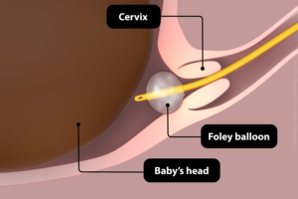
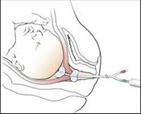
Single balloon catheters are more cost effective than double balloon catheters.
inﬂate with 30-60 mL of water after passing the balloon through the internal cervical os.
The catheter is left in place for up to 24 hours.
Adding tension does not confer beneﬁt.
Cook Balloon (double lumen)

Slide 28
Pharmacologic Options for Cervical Ripening
Misoprostol (PGE1 )
Vaginal Dinoprostone (PGE2)
highly effective as both a cervical ripening and induction agent
stable at room temperature, economical, and has multiple routes of administration
Fever can be seen with high doses (400mcg) but rarely with IOL dosing
can cause uterine tachysystole, with or without fetal heart rate changes.
increases successful vaginal birth within 24 hours without increasing the incidence of assisted vaginal birth or C/S rates
available as a controlled-release vaginal mesh (cervidil) or intravaginal gel
maternal side effects include fever, chills, vomiting, and diarrhea
can cause uterine tachysystole, with or without fetal heart rate changes.

Slide 29
The evidence for PGE1
2020 randomized controlled trial (n = 4400)
compared titrated oral misoprostol in doses of 20-50 mg with vaginal dinoprostone.
The oral misoprostol group showed:
  higher vaginal delivery rates (78.3% vs. 72.9%; P ¼ 0.005)
  less tachysystole with fetal heart rate changes (3.6% vs. 8.6%; P= 0.007)
  less abnormal fetal heart rate tracings (8.9% vs. 15.4%, P =0.006)
A 2016 systematic review of 20 interventions for IOL
serious adverse events with the use of misoprostol were similar to other prostaglandins and oxytocin, with similar or better efﬁcacy.
no difference in uterine tachysystole with abnormal fetal heart rate.
2010 Cochrane review of 121 trials comparing vaginal misoprostol with no treatment or other methods of IOL
vaginal doses of 25 mg of misoprostol resulted in a greater need for oxytocin augmentation, but less uterine tachysystole (with and without fetal heart rate changes)
doses of 50 mg signiﬁcantly increased the incidence of vaginal birth within 24 hours.
Wang X, Zhang C, Li X, et al. Safety and efﬁcacy of titrated oral misoprostol solution versus vaginal dinoprostone for induction of labor: a single-center randomized control trial. Int J Gynaecol Obstet 2021;154:436e43.
Alﬁrevic Z, Keeney E, Dowswell T, et al. Which method is best for the induction of labour? A systematic review, network meta-analysis and cost-effectiveness analysis. Health Technol Assess 2016;20:1e584.
Hofmeyr GJ, Gülmezoglu AM, Pileggi C. Vaginal misoprostol for cervical ripening and induction of labour. Cochrane Database Syst Rev 2010;10:CD000941.

Slide 30
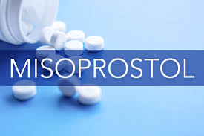
Pharmacokinetics of Misoprostol (PGE1)
Oral, sublingual, and vaginal routes all cause an increase in uterine tone after a single dose.
Within 1- 2 hours of an oral dose, serum levels fall and effects on uterine activity subside due to extensive ﬁrst-pass hepatic metabolism.
With both SL and vaginal dosing, the increased resting tone is replaced by rhythmic contractions after 1-2 hours, which last for 3-4 hours.
Due to the longer half-life of (ALL) prostaglandins, clinicians should proceed with caution where there is an increased likelihood of tachysystole, fetal compromise, or uterine rupture.

Slide 31

Outpatient Use of Cervical Ripening Agents
2020 meta-analysis of outpatient vs inpatient cervical ripening using PGE2 or balloon catheters found no difference in outcomes or safety.
  ** in low-risk and high-resource populations
Conditions for inpatient management include
  Risk factors for an adverse perinatal outcome
  Transportation challenges or environmental considerations
Dong S, Khan M, Hashimi F, et al. Inpatient versus outpatient induction of labour: a systematic review and meta-analysis. BMC Pregnancy Childbirth 2020;20:382.

Slide 32
Key Recommendation
Oral misoprostol in a titratable fashion or oxytocin with amniotomy is the preferred method of induction of labor when the Bishop score is 7 or greater.

Slide 33
2021 Cochrane systematic review and meta-analysis for induction of labor:
“The best available evidence suggests that low-dose oral misoprostol probably has many benefits over other methods for labor induction. This review supports the use of low-dose oral misoprostol for induction of labor and demonstrates the lower risks of hyperstimulation than when misoprostol is given vaginally. More trials are needed to establish the optimum oral misoprostol regimen, but these findings suggest that a starting dose of 25 mg may offer a good balance of efficacy and safety.”

Slide 34
Re: Off Label Use of Misoprostol for IOL
“Misoprostol has been studied in >100 000 pregnancies, has been used worldwide for >15 years, and is recommended in other international IOL guidelines. Therefore, misoprostol should be included as part of the informed decision-making process for induction of labor.”

Slide 35
Oral misoprostol for IOL (Bishops ≥7)
Advantageous 2-hour half-life and allows for titratable dosing
The dose should be started at 20-25 mg and titrated to contractions up to 50 mcg/dose.
Continuous EFM is recommended for at least 20 minutes post administration.
When signs of active labor present, establish EFM. Continue ambulation as per fetal health surveillance guidelines
Once active labor has commenced and/or the membranes are ruptured, the clinician is not required to switch from misoprostol to oxytocin, as continuing with misoprostol may be more effective

Slide 36
Absolute contraindications to PGE 1 use
Previous full thickness uterine surgery
Known fetal compromise

Slide 37
Case Study
36 year old G2P1 @ 41 weeks GA
Healthy
Previous C/S 26 months ago for breach presentation
EFWT @ 36 weeks 60%, normal fluid and placentation
Would like TOLAC, No CTX or SRM
Cervix is 3 cm/75%/-2 cephalic presentation

Slide 38
Oxytocin for IOL
Oxytocin is a hormone that binds to uterine receptors to produce contractions.
No direct effects on the cervix.
Administered as a controlled IV infusion for IOL
Half-life of 1-6 minutes and a time to steady plasma concentration of 40 minutes.
Dosing regimen of oxytocin should be individualized and titrated to uterine activity,
The uterus is increasingly responsive to oxytocin as pregnancy progresses and decreasingly responsive with prolonged labor due to the saturation of receptors.
Volume overload and hyponatremia may occur with high doses (>40 mU/minute) or prolonged infusion
Continuous EFM should be utilized with oxytocin infusions due to the risk of uterine tachysystole with fetal heart rate (FHR) changes.
Early amniotomy after starting oxytocin is associated with shorter IOL to delivery intervals.

Slide 39
Low-Rate versus Expedited-Rate
Oxytocin Protocol
The actual dose of oxytocin is the same in both regimens, only the time to reach that dose is altered.

Slide 40
IOL for Trial of Labor after Cesarean.
What about the risk of Uterine Rupture?
“Although oxytocin can increase the risk of uterine rupture somewhat, it is the safest method of IOL with prior uterine surgery”

Slide 41
Questions?

