Slide 1
Title Slide
Common Office Presentations:
adults with intellectual and developmental disabilities (IDD)
Drs. Alicia Thatcher, Amanda Tzenov,
Jill Achenbach, Ian Casson, Marilyn Crabtree

Slide 2
COI – Presenter Disclosure (1)
Presenter Disclosure
Presenters: Alicia Thatcher, Amanda Tzenov, Jill Achenbach and Ian Casson
Relationships with financial sponsors:
Any direct financial relationships, including receipt of honoraria: Not applicable to this presentation
Dr. Tzenov is a member of the CFPC Physician Wellness SPC and receives an honorarium for this, and is on the FMF Committee and receives travel and FMF registration reimbursement
Dr. Achenbach is a co-investigator on a research grant about IDD Health Checks from the N.S. Health Authority
Dr. Thatcher is paid for her clinical work for Creative Options Regina, a support service for people with disabilities
Membership on advisory boards or speakers’ bureaus: None
Patents for drugs or devices: None
Other: Faculty of: Memorial University (Dr. Tzenov); Dalhousie (Dr. Achenbach); Saskatchewan (Dr. Thatcher); Queen’s (Dr. Casson, adjunct)
Notes:
Where a faculty/presenter has no relationships to disclose, indicate Not Applicable under Relationships with Financial Sponsors.
Complete this slide for the primary presenter and ALL co-presenters if applicable.
Reminder: Disclosures made on your COI forms should match disclosures made on the COI slide.

Slide 3
COI – Presenter Disclosure (2)
Disclosure of Financial Support
This presentation has received no external support
Notes:
Where a program has received no external financial support (e.g., monies for food, logistics assistance such as registration, AV set-up, etc.), indicate No External Support.

Slide 4
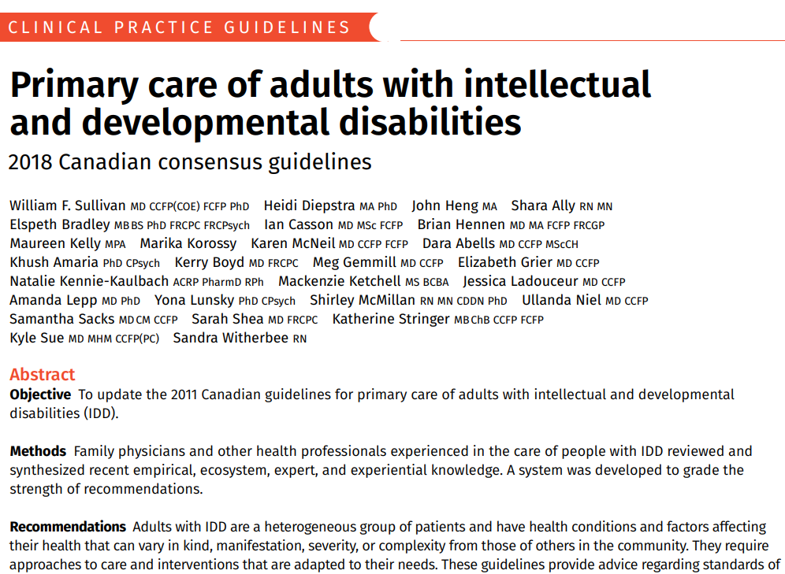
Learning objectives
Apply clinical pearls to assess common problems
Use tools to make care easier, e.g., the “HELP” framework
Recognize that family practice serves the needs of adults with IDD well
Notes:
- tools that have been developed by Canadian family physicians – based on research and guideline recommendations – freely available on the web, with EMR versions available in some cases
- we provide or aspire to provide continuity and comprehensiveness of care – and these are of great benefit for patients with complex health and social issues, and barriers to health care like communication issues; I mean this to say you don’t have to be an expert in DD; you just need to be a family physician

Slide 5
FMF IDD Case - Alicia
FMF 2023
Notes:
Introduce self, what kind of setting I work in, why interested in DD

Slide 6
Laura
40 year old female with moderate ID secondary to Kabuki syndrome
PMHx:
"autistic-like tendencies“
recurrent ear infections
chronic allergic rhinosinusitis
tinea pedis
Meds:
Loratadine
Ethinyl estradiol and desogestrel
Aripiprazole
Clonazepam
Vitamin B12
Vitamin D3
Olanzapine (PRN)
Lorazepam (PRN)

Slide 7
“We’ve noticed some behaviour changes lately. At baseline, Laura has 5-10 “escalations” per month, but this has increased to 20-30 per month. We also noticed some changes to her eating habits.”
Notes:
Presenting Concern
Accompanied by paid caregivers

Slide 8
HPI
Increase in “escalations” at home / in community.
Waking at night (12am-2am) eating non-nutritious items
New mild iron deficiency anemia NYD
Social Hx
English, limited language skills
Group home
Mother died, Father visits
Notes:
HPI
Increase in “escalations” at home and in the community.
Waking at night (12am-2am) eating non-nutritious items found in the kitchen such as soya sauce, BBQ sauce, ranch dressing, and cocoa powder.
New mild iron deficiency anemia NYD despite no dietary restrictions and taking a continuous OCP for menstrual suppression.
Soc Hx
Laura communicates verbally but has limited vocabulary and limited expressive and receptive language skills.
Lives in a group home.
Her mother died during the pandemic. Her father has been away off and on for business trips, visits regularly when in town.

Slide 9
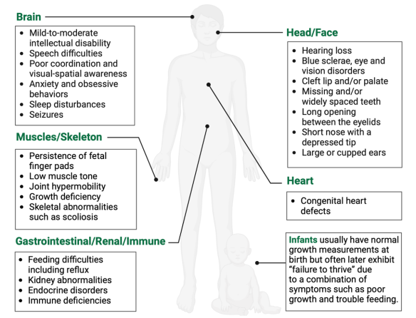
Kabuki Syndrome
Rare, multisystem disorder – distinctive facial features, growth delays, varying degrees of ID, skeletal abnormalities, short stature
1 / 32,000 births
M = F
Most from gene mutations (~70%) in KMT2D (more common) or KDM6A
Notes:
***Note to consider adding information in your patient’s profile about common problems that occur with their syndrome, where it’s easy to find for yourself and/or other providers.
Kabuki syndrome was first reported in the medical literature in 1981 by Japanese physicians. The disorder was originally called Kabuki-makeup syndrome because the facial features of many affected children resembled the makeup used by actors in kabuki, a form of Japanese theater. The term “makeup” has since been dropped and the preferred term for the disorder is Kabuki syndrome.
Graphic from: https://www.kabukisyndromefoundation.org/about-kabuki-syndrome/
Other resources:
https://rarediseases.org/rare-diseases/kabuki-syndrome/
https://www.ncbi.nlm.nih.gov/books/NBK62111/
https://www.orpha.net/consor/cgi-bin/OC_Exp.php?Lng=GB&Expert=2322

Slide 10
Remember… all behaviour is communication
Medical condition?
Pain?
Med side effect?
Problem with supports or expectations?
Depression
Anxiety
ADHD
Other?
Life events?
Trauma?
Notes:
E:
Sensory processing – hypo/hyper
Bland food??
new supports?
Father being away
Support with grief process
L:
Mother’s death
any other known trauma?
Changes to roommates – health, relationships, conflict, new people
P:
Anxiety? Depression?
All behaviour is communication
https://oadd.org/wp-content/uploads/2016/12/41023-JoDD-22-2-v10f-101-120-Bradley-and-Korossy.pdf

Slide 11
DDx
Fatigue, sleep disorder
Pain – source?
GERD / gastritis / esophagitis / PUD / DUD
Allergies / sinusitis
Ear infection
Dental pain/infection
Depression, grief
Many others
Notes:
Regarding the change in behaviour / increased "escalations", what's on your DDx?
Fatigue
Pain
GERD
Allergies / sinusitis
Ear infection
Dental pain/infection
Depression
Many others
What physical exam maneuvers/systems would you prioritize?
Abdominal exam
HEENT
Feet/derm
Weight
What investigations might you consider?
H. pylori stool antigen
FIT

Slide 12
Canadian Consensus Guidelines for Primary Care for Adults with Developmental Disabilities
Approach to Care
Physical Health
Mental Health
IDD Toolkit
http://ddprimarycare.surreyplace.ca
Notes:
Toolkit***
These guidelines include:
General, physical, behavioural & mental health recommendations for adults with DD
Especially for those conditions not screened for by routine health assessments of the general population
For example, paying special attention to constipation, cerumen impaction, GERD

Slide 13
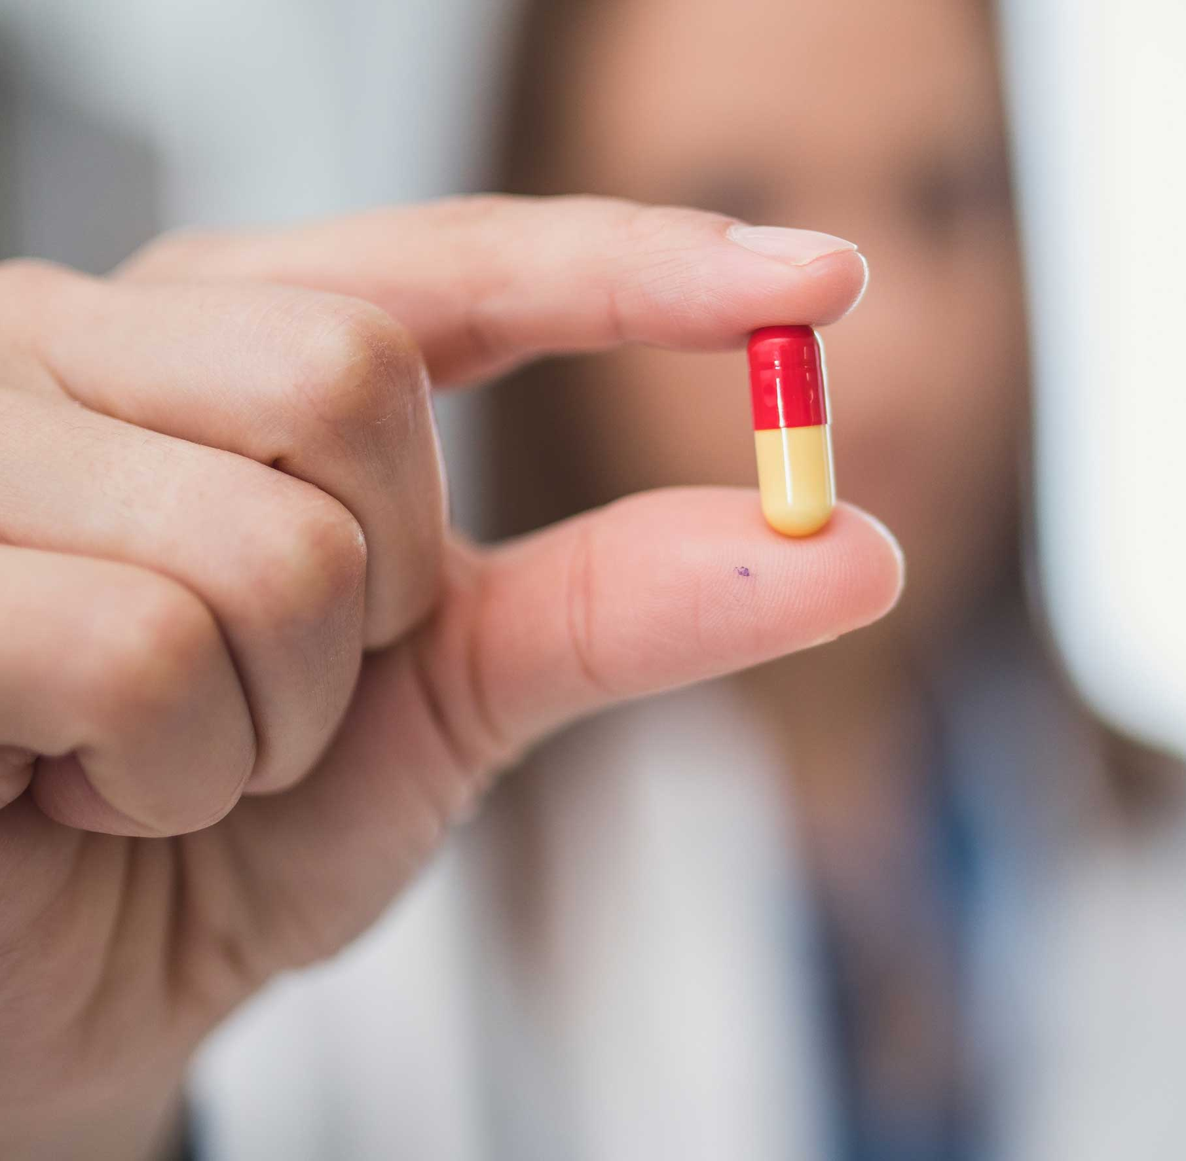
Case Resolution: Laura
Notes:
Given the high rates of GERD among people with IDD and associated with Kabuki syndrome, in addition to the nighttime consumption of foods and condiments, I started a trial of a PPI after ruling out H. pylori, in addition to starting ferrous fumarate. FIT test was negative.
The "escalations" drastically improved to 3-5 per month.
Nighttime eating reduced to 2-3x per week instead of daily. I changed the timing of her iron and PPI (switched iron from PM to AM, and switched PPI from AM to PM) and her nighttime eating fully resolved.
She was reviewed by GI for other concerns - a gastroscopy was done which revealed Barrett's esophagus, therefore the PPI will be continued indefinitely.

Slide 14
Upper GI Dysmotility & IDD
Dysphagia (60%)
Pulmonary aspiration (41%)
Malnutrition (33%)
GERD (32-50%)
Gastritis (32%)
Notes:
Unique challenges in diagnosis and care
Dysphagia (60%):
Uncoordinated swallowing
inadequate nutrition / caloric intake, decreased hydration, choking, aspiration pneumonia
impacting QOL , psychological and social impacts
Predisposing factors include craniofacial abnormalities, abnormal sensory or motor development, higher risk with more severe IDD
decreased hydration and nutrition status
Pulmonary aspiration (41%)
Typically 2º to GERD or dysphagia, leading cause of mortality in patients with dysphagia 2º to neurologic dysfunction
Neurologic deficits and mechanical abnormalities (e.g. cerebral palsy) at increased risk
Multifactorial: dysphagia, reflux, dependence for feeding and oral care
Poor dental hygiene also increases risk of aspiration pneumonia, which is thought to occur due to potentially more pathogenic oral bacteria and higher quantity of bacteria
Clinical suspicion of aspiration → videofluoroscopic swallow study
Repeated pulmonary aspirations (80% silent) → chronic lung disease
GERD (32%)
Neuromuscular dysfunction is primary etiology in IDD
Chronic GERD → erosive esophagitis, esophageal stricture, Barrett’s esophagus → carcinoma of the esophagus
Consider domination syndrome, more common in patients with IDD (regurgitate food then re-swallow or expel it) – assoc. w. wt loss, malnutrition, dental problems, halitosis, and electrolyte disturbance
H. Pylori is higher in children with developmental disabilities who live in group homes) → peptic ulcer disease → gastric adenocarcinoma
Dental caries
Often overlooked sequela of upper GI dysmotility
Poses a serious health concern as a consequence of both poor oral hygiene and GERD
Poor ability to cooperate and more severe disabilities → increased risk for impaired oral health
More severe the neurological damage in CP, more frequent presence of biting reflex and consequently, higher risk of oral diseases due to the difficulty to perform an adequate oral hygiene
Similarly, among patients with CP, those who had IDD had higher rates of caries when compared to those without ID
Oral care should take place regularly in patients with IDD and can usually be accomplished in a general dental practice.
Gastric Emptying Disorders
In the absence of a structural change to the stomach, disorders related to proper emptying of gastric contents into the duodenum occur secondary to neurogenic or myogenic disorders, psychological stress, and/or neuronal developmental disorders.
Most commonly, delayed gastric emptying is seen in those with reflux esophagitis, dyspepsia, autonomic neuropathies, psychiatric disorders, and conditions like systemic sclerosis [34].
While the exact prevalence of delayed gastric emptying in those with IDD has not been ascertained, a study of 58 children with cerebral palsy found that 67% of participants had delayed gastric emptying as demonstrated by gastric scintigraphy [35].
The prevalence of delayed gastric emptying or gastroparesis, in the general population is 0.16% [36]. Sequelae of delayed gastric emptying include malnutrition, reflux esophagitis, and constipation, which is a disorder of the lower gastrointestinal tract [35].
Eosinophilic Esophagitis
Esophagitis is typically caused by reflux of stomach contents, medication irritation, infections, or allergies. Studies have shown that patients with IDD are also at greater risk of eosinophilic esophagitis in addition to GERD.
Diagnostic criteria for eosinophilic esophagitis include “symptoms of esophageal dysfunction and at least 15 eosinophils per high-power field on esophageal biopsy and after a comprehensive assessment of non-EoE disorders that could cause or potentially contribute to esophageal eosinophilia” [34].
In a retrospective study of 229 children diagnosed with eosinophilic esophagitis, 29 (12.7%) children were found to have autism spectrum disorder and 70 (30.6%) had developmental disorders [35]. This is a significant difference from the national prevalence of autism spectrum disorder (0.5%-3%) and developmental disorders (17.8%) [35].
While this may be secondary to increased access to and contact time with medical professionals within this patient population, it has been hypothesized that there is a shared immunologic pathway between these conditions [35].
Multiple studies have found increased levels of Th2 cell activation and its related cytokines, which are associated with eosinophilic esophagitis in patients with autism spectrum disorder [36-37]. Because peripheral eosinophilia is not necessarily related to EoE, endoscopy with biopsy of the lower and mid esophagus is required to make the diagnosis.
Literature review:
https://www.cureus.com/articles/60724-upper-gastrointestinal-disorders-in-adult-patients-with-intellectual-and-developmental-disabilities#!/

Slide 15
Clinical Pearls
All behaviour is communication! → Use the HELP framework to develop DDx (often multifactorial!)
Upper GI Dysmotility extremely common among patients with IDD – manifesting most commonly as GERD and dysphagia
Undifferentiated behavioural concern or change from baseline? → Assess for unidentified health problem → Consider therapeutic trial based on leading hypothesis (e.g. PPI, acetaminophen, PEG 3350) → Reassess early (within a few days to weeks)
Notes:
Ask audience:
I’m curious if anyone here would manage the case differently in your own clinic, or if you had any other thoughts or questions I didn’t address
Ask audience/presenters:
Any other examples of interesting/unique ways in which GERD or other illnesses presented in patients with IDD?

Slide 16
Gynecological issues: Menstrual Regulation/Suppression and Cervical Cancer Screening
A. Tzenov, MSc, MD, CCFP
Notes:
Amanda Tzenov
Family doctor and assistant professor at Memorial University, St John’s, Newfoundland
I practice general family medicine in an academic family medicine clinic, but I also am part of a consult-service for adults with intellectual and developmental disabilities called the Forest Road Clinic.
This clinic was established in 2015 to address the health disparities of adults with IDD and in particular to help with the transition from the pediatric health care system here in Newfoundland to the adult system (which is far more fragmented). Our consult service has now expanded beyond just transitional patients, to any adults with IDD, via referral through social work or their family physician. We have on average between 15-20 referrals per year, and myself and Denise Cahill (who is a nurse practitioner with our clinic) run a half day clinic per week.
I was initially recruited to this clinic by Dr Kath Stringer, who is one of the authors of the Canadian Consensus Guidelines on the Care of Adults with Intellectual and Developmental Disabilities.
Poster (#603) on Thursday, November 9th -> available to view all day, but specifically I’m more likely to be there to answer questions between: 9:30 to 10:15, 12:30-2pm, and 3-3:30pm.

Slide 17
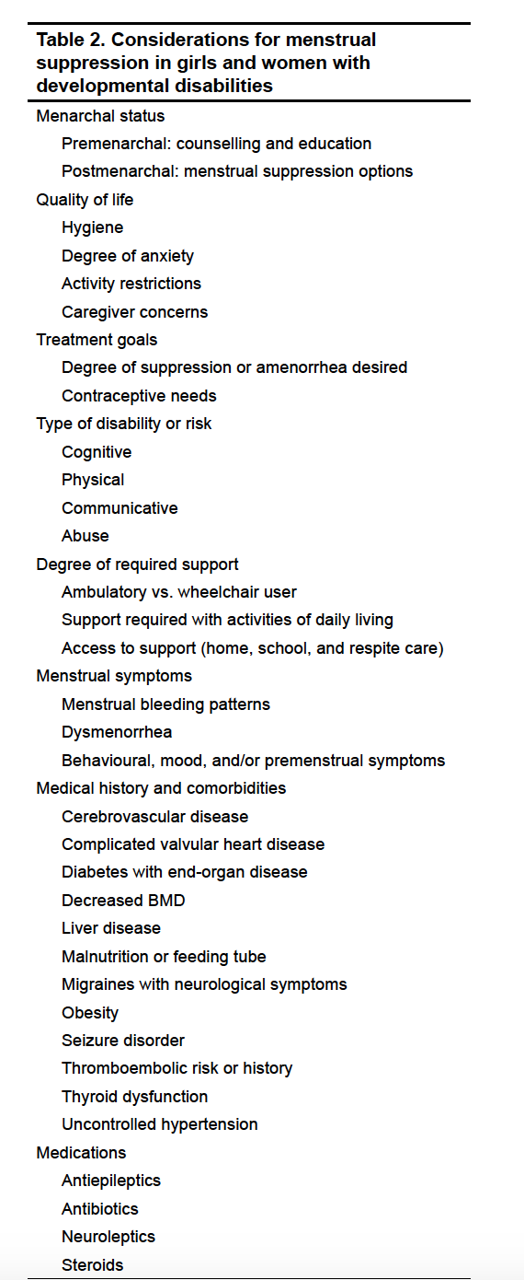
Case
25 yo with cerebral palsy, seizure disorder, recurrent aspiration pneumonia, sialorrhoea, global developmental delay (profound), PEG tube
Presented for medication review with mom and dad
Parents asked about menstrual suppression as well
Notes:
Hx of iron deficiency
Regular periods, not heavy
Has friend who’s daughter is on depo-provera for menstrual suppression, wanted to consider same
Non-weight bearing
Some irritability of late, but did not seem to occur around time of menses
Not sexually active and has not been
No previous trials of medication for menstrual suppression
Currently using pads, no caregiver concerns with hygiene – pt requires total care
Recent labs completed and normal hgb but ferritin 19
hx chronic constipation, previously prescribed iron but unable to use due to worsening constipation
Previously had a rib fracture picked up on a CXR completed for worsening cough and aspiration pneumonia
No other trauma at time, however dad does pick her up for transfer from wheelchair to bed
They also complete chest physiotherapy for her regularly
Other meds she was on:
- chloral hydrate 9ml of 100 mg/ml solution qhs
- Trileptal (oxcarbazepine) 8 mls of 60 mg/ml solution BID for seizures
- diazepam 5 mg in am and 10 mg qhs – seizures/agitation
- lansoprazole 30 mg po daily – suspected GER/ulcer
- Ventolin prn via nebulizer
- glycopyrryolate for PRN use (when gets closer to botox injection time) – for siallorhea
- baclofen pump for spasticity
- botox injections for siallorhea into parotid glands

Slide 18
The Canadian Guidelines for the Primary Care of Adults with IDD (Can Fam Physician 2018)
Issues associated with menstruation
No evidence to prefer one method of menstrual regulation or suppression over another
Notes:
The Canadian Guidelines for the Primary Care of Adults with IDD (Can Fam Physician 2018), section on Women’s Health:
Issues associated with menstruation are noted;
- iron deficiency anemia
- menstrual related pain
- excessive bleeding
- reduced seizure control
- negative effects on hygiene, function, behaviour
- social isolation
- increased caregiver burden
No evidence to prefer one method of menstrual regulation or suppression over another
_ the options include: ocp, patch, ring, progesterone only options, ius, nexplanon
Important to note: in Canada, law prohibits parents/SDM from consenting to surgical sterilization on behalf of person with IDD²

Slide 19
Key learning points
Menstrual suppression/therapeutic amenorrhea should be considered safe and viable options for women who need or want to have fewer or no menses¹
Menstrual suppression should not be initiated in young women with developmental disabilities until after the onset of menses¹
Combined hormonal or progesterone-only products can be used in an extended or continuous manner to obtain menstrual suppression¹
Document assessment of (in)capacity and identify SDM according to provincial/territorial regulations
Document request, reasons, options discussed with SDM
Consider use of the IDD Health Check (ddprimarycare.surreyplace.ca)
¹Kirkham, Y.A. Menstrual Suppression in Special Circumstances. JOGC. 2019: 41(2):E7-17
Notes:
Add in links to IDD health check or the CFPC MIG webpage
Point 2: education and support are sometimes all that is needed as patients progress through puberty and menarche… awaiting menarche also confirms normal hormonal function and the absence of an obstructive anomaly. Once a decision is made to pursue treatment, the least intrusive and with the lowest side effect profile is desirable.
Last point: when collecting background information to help make a decision here, it would be helpful to use the IDD Health Check available on the surrey place website, and also available via the IDD MIG website

Slide 20
Case Resolution
Discussion around options for menstrual suppression, and reviewed risks/benefits of each
Decided against menstrual suppression due to risks outweighing benefits, discussion with mom and dad
Started PEG 3350 (restoralax) daily
Discussed with dietician – changed formula to increase iron
Advised on ibuprofen prior to menses for cramping and to help reduce menstrual flow
Notes:
Risks out weighing benefits:
- Depo-provera: previous rib fracture, wheelchair bound, concerns re: osteoporosis and further fractures
- CHC: not interested as didn’t want to give anything to increase risk of VTE
-- IUD: pt had significant spasticity and would be ++ invasive approach (likely requiring gyne involvement, general anaesthesia) and parents were not interested in same

Slide 21
Cervical Cancer Screening in Patients with IDD
There is no evidence or apparent reason why women with IDD should not be screened according to same guidelines as the general population
But multiple studies show women with IDD have lower screening rates than women without IDD
Screening is best done systematically, as part of a program, which means more than just doing a Pap smear for an individual
Notes:
There is no evidence or apparent reason why women with IDD should not be screened according to same guidelines as the general population.
Many women with IDD are sexually active and at risk of cervical cancer. The proportion of those sexually active is not known at a population level; individual histories of sexual activity may not be reliable; sexual abuse and symptoms may not be reported.
But multiple studies show women with IDD have lower screening rates than women without IDD.
in Ontario, for example, twice as many women with IDD are not screened for cervical cancer compared to women without IDD (Cobigo, 2013). The difference is not explained by other factors such as age, socio-economic status, rurality and healthcare utilisation.
Screening is best done systematically, as part of a program, which means more than just doing a Pap smear for an individual.
A program of cervical cancer screening in Great Britain (Wood and Douglas, 2007) identified these desirable components, among others:
How do you identify people with IDD in your practice? Do they receive regular comprehensive health checks? How would you issue invitations for cervical cancer screening? Can you identify non-attenders and identify their special needs?
Can you use home caregivers, other health professionals or administrative staff to prepare for cancer screening?
Do you have appropriate communication methods and information resources available? How would you care for women who do not have capacity to give informed consent?

Slide 22
Approach to the Pelvic Exam in patients with IDD
Get to know your patient
Educate patient and caregivers about the exam, tailor language to appropriate level as necessary
Don’t assume the pelvic exam will be more difficult or uncomfortable for someone with a disability over anyone else
Women with disabilities can and do have sex
Consider use of anatomy models with visual demonstration before the visit
Allow extra time
Encourage patient to bring a support person
If needed, locate cervix manually first
Anatomy likely normal, but have various speculum sizes available
Consider not using stirrups for patient comfort
Soothing voice, deep breathing techniques, visualization and praise
Consider pelvic US if bimanual is not possible
Consider short acting benzodiazepines for pre-sedation if high anxiety, spasticity, or agitation*
Notes:
re: benzos: a Test dose at home prior to the visit is recommended, to document patients reaction and the peak action of the medication*
If any of this is not possible – consider other options

Slide 23
Other options?
HPV DNA testing on cervical or vaginal swabs
Procedural sedation or general anasethetic to enable speculum exams
Notes:
Re: HPV testing:
A recent review by the Canadian Agency for Drugs and Technologies in Health considered available evidence; its report concluded that HPV PCR testing of cervical samples is better at detecting precancer or cancer than Pap testing and would decrease the overall cost of screening.
⁽Delpero, E., Selk, A. Shifting from cytology to HPV testing for cervical cancer screening in Canada. CMAJ May 2022, 194 (17) E613-E615; DOI: 10.1503/cmaj.211568)
Health care professional (speculum) HPV DNA testing has been implemented in PEI as of May 2023 and is to be implemented in New Brunswick. New Brunswick will also introduce self-sampling "to encourage screening participation in under- and never-screened populations”, according to a NB Department of Health spokesperson (CBC news report, August 2023).
Ontario is “working towards” replacing cytology (Ontario Cervical Screening Program, Cancer Care Ontario, 2022); no mention of a self-sampling component of the program.
Self-sampling has fair agreement with physician sampled HPV testing (Karwalajtys, T [from McMaster Dept. of Family Medicine!] et al. Sexually Transmitted Infections, 2006).
Another study from 2017 (Asciutto) out of Sweden: The vaginal self-sampling and the clinician-taken HPV tests had the same sensitivity of 92.8% (95% confidence interval=86.3- 96.8%) and specificity for detection of high-grade squamous intraepithelial lesion (HSIL) and adenocarcinoma in situ (AIS).
pros and cons of this?
1 in 150 lifetime risk of developing cervical cancer, 1 in 500 risk of dying of it (American Cancer Society website); 90% lower risk of death – i.e., 1 in 25,000, if my math is right - in women who are vaccinated before age 16 (Lei J et al, N Engl J Med 2020)
In Canada, the chance of a healthy person dying because of anesthesia is probably between 1 in 200,000 and 1 in 400,000. This is certainly comparable with the risks of commercial airline travel and much safer than travelling by car. (Canadian Anesthesiologists Society website)
The caveat to this is that you quoted the chance of a "healthy person" dying because of anesthesia - I would say my patients with IDD would very rarely be included in a healthy patient sample... often very high aspiration risk for multiple reasons. One of our colleagues notes that if there is a necessary procedure being scheduled that requires general anesthesia, they will try to advocate to get any other invasive maneuvers done simultaneously, where appropriate, which may include labs, pap smear, IUD insertion/removal, ear flushing, dental work, nail clipping or toenail removal in some cases..
consideration of the risks and benefits of GA and whether the speculum exam is needed is important*

Slide 24
Summary
Menstrual suppression:
Fulsome discussion with patient or SDM/caregivers regarding options. Understand reason for request.
Continuous hormonal contraception, depo-provera, IUS, implantable devices all options to consider
Cervical cancer screening:
Low rates of screening (multiple reasons for same)
Recognize barriers in getting full history of sexual activity and underscreening
Consider measures to improve comfort for patients during procedure
Consider HPV testing
Notes:
Summarize and hand over to next presenter

Slide 25
A NEWCOMER WITH POSSIBLE IDD
Seeking DISABILITY support when diagnosis is UNDEFINED
Jillian Achenbach, MD, Msc, CCFP
FMF, Nov. 8, 2023

Slide 26
Consult TO ADULT IDD CLINIC
Middle aged man with a possible IDD who immigrated to Canada 8 years ago
Has difficulty understanding complex instructions
Does not read or write
Had opportunity to take EAL classes, but did not learn English
Family physician suspects IDD and is hoping for support with application to Disability Support Program
Notes:
-Consultation clinic with Dalhousie University Family Medicine in Halifax that sees adult patients with IDD
-2 family physicians with special interest in IDD.
-We area teaching clinic have residents with us most of the time
-We work with a community partner, Inclusion N.S. on a regular basis.
-We have occasional collaboration with a social worker, FPN, OT students and BI student.
- Although our referral criteria include a diagnoses of IDD, we have been seeing quite a few people with unconfirmed IDD - often newcomers.
-This is one such case

Slide 27
SOCIAL HISTORY
Estranged from his parents and siblings
Not employed. Receives social assistance
Recent rent increase and food insecurity
Lives with wife, who has a physical disability and perhaps mild IDD
Daughter lives with the wife’s relatives and is doing well
No substance use
FUNCTIONAL HISTORY:
Independent for most ADLs, but requires help picking out appropriate clothing
Requires assistance with most IADLS
DOES HE HAVE AN IDD? WOULD HE QUALIFY FOR DISABILITY SUPPORT?

Slide 28
Criteria for disability support program in N.S.
1. Intellectual or Developmental Disability
a) IQ <70
b) Impairments in functioning within 2+ ADLs or IADLs
c) Onset before the age of 18 years
2. Long term mental illness affecting 2+ ADLs or IADLs
3. Physical disability affecting 2+ ADLs or IADLs
4. Brain injury may be considered based on functional assessment
Notes:
-Are there guidelines for the work-up of intellectual disability in adults?
-Review published in the American Academy of Neurology in 2021 by Frueh et al that looked for current recommendations in the literature
-They found 9 studies
-As of yet there are no standardized guidelines, but they put together some recommendations based on what they could find

Slide 29
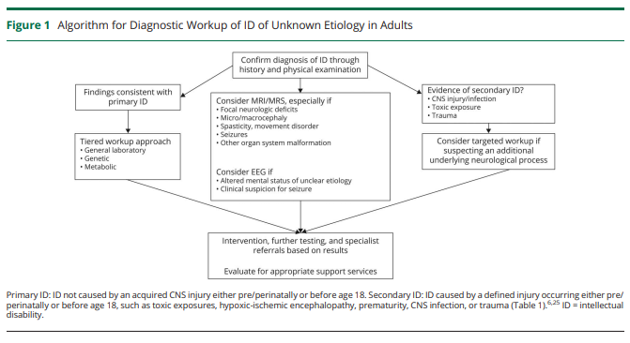
Frueh et al (2021) Neurology: Clinical Practice 11: 534-540
Notes:
-A diagnosis of IDD should rely on standardized psychological testing and assessment of functional impairment, and it should be confirmed that the symptoms should have developed before age 18
-In real life, many people do not have access to this type of assessment, and they may therefore be limited in the type of support they receive
-The first step to determining an etiology is a thorough history, including birth, pregnancy, and family histories and physical exam (e.g. extreme prematurity, hypoxic-schemic injury, deficits in hearing or vision, onset of symptoms, FHx IDD, seizures, strokes, progressive cognitive decline, consanguinity )

Slide 30
DEVELOPMENTAL HISTORY:
Pregnancy and birth history unknown
No known CNS injury, exposure, or trauma before or after birth
Attended school until Grade 1 and then went to a school for children with disabilities
Learned basic counting, but did not learn to read or write
MEDICAL HISTORY:
Asymmetric hearing loss since childhood
No seizures, head injuries or focal neurological
deficits

Slide 31
MEDICATIONS
None
FAMILY HISTORY:
No known consanguinity
Older brother and younger sister died in childhood.
Has healthy daughter with no IDD

Slide 32
PHYSICAL EXAM:
BP 110/84, O2 99%, HR 85 and reg
Height 153 cm (short stature), BMI 24 , WC 92.6 cm, HC not measured
Appears sleepy
Some apparent difficulty hearing (not wearing his hearing aids)
Translator had some difficulty understanding his speech
No dysmorphic features
No spasticity or movement disorder
Normal findings except for a 5x3 cm soft, mobile nodule on back

Slide 33
Frueh et al (2021) Neurology: Clinical Practice 11: 534-540

Slide 34
BLOODWORK:
WBC 5.94, Hgb 148, PLT 202, Ferritin 89.5
eGFR > 90, Na 141, K 3.9
Random glucose 8.6 (high)
Chol 3.89, TG 1.05, LDL 2.35, Non-HDL 2.82, HDL 1.07
ALT 75 (high)
Ca 2.32, Alb 43
TSH 1.58
lead level cancelled by lab
CT HEAD:
No intracranial abnormality

Slide 35
MICROARRAY:
Normal Male CMA Notable AOH > 10 Mb < 2%, arr (X,Y) x1, (1-22)x2
No clinically relevant genome deletions or duplications.
Absence of heterozygosity (AOH) on chromosome 11 raises the suspicion for a recessive disorder or uniparental disomy.
FRAGILE X TESTING:
FMR1 RP PCR detected 29 trinucleotide repeats.
Not in keeping with Fragile X
Referred to Genetics

Slide 36
GENETICS ASSESSMENT:
There was absence of heterozygosity on both sides of the centromere of chromosome 11 (22 megabases)
Proceeded with methylation assessment for Russell-Silver syndrome as he had short stature . This was non-diagnostic
Additional attempts at assessing this stretch of AOH for concurrent autosomal recessive etiologies were not successful
Does not meet criteria for exome sequencing
Notes:
-Exome sequencing out-performed CMA in patients with IDD, GDD, and ASD with a diagnostic yield up to 40 % as compared with 20%, but costs are high
-Sequencing an individual's exome instead of their entire genome has been proposed to be a more cost-effective and efficient way to diagnose rare genetic disorders due to the fact that phenotypes of genetic disorders are a result of mutated exons. Since the exome only comprises 1.5% of the total genome, this process is more cost efficient and fast
-Even is he was eligible, the preferred exome test would be a trio. which would not be possible as specimens from biological parents are not available.
-https://ddprimarycare.surreyplace.ca/wp-content/uploads/2019/05/2.1-Genetic-Assessment_may-27.pdf

Slide 37
Frueh et al (2021) Neurology: Clinical Practice 11: 534-540

Slide 38
Frueh et al (2021) Neurology: Clinical Practice 11: 534-540

Slide 39
Frueh et al (2021) Neurology: Clinical Practice 11: 534-540

Slide 40
OCCUPATIONAL THERAPY ASSESSMENT
Functional IADL Assessment
Observed at home
Able to do tasks such as housekeeping, cooking and laundry with some cueing from his wife, who has a physical disability
Was able to assist wife with her personal care
His wife noted to perform of the cognitive tasks
Reliance on wife’s family for help with financial tasks and navigating the community

Slide 41
OCCUPATIONAL THERAPY ASSESSMENT
Multiple Errands Test
Performed at shopping centre with translator present
Did not use strategies to navigate the shopping centre
Well focused on tasks, but had some difficulty with perseveration
Fairly good with money, but had difficulty with planning
He stopped the test early because he thought he did not have enough money
Results somewhat difficult to interpret due to language barrier, inability to read, and not being familiar with the location

Slide 42
Next STEPS
SW connected with Department of Community Services to determine the state of their housing and funding arrangements
Application submitted for Disability Support
OT arranged an introductory tour at vocational training centre
Bloodwork and abdominal u/s ordered to work-up elevated AST
Fasting blood sugar and A1c ordered
FP had arranged for excision of mobile nodule on his back

Slide 43
CASE RESOLUTION
Qualified for Independent Living Support
Vocational program was only accessible by public transportation, so he did not feel it would be feasible to attend.
Application initiated for Access-a-bus
Hepatic steatosis identified on ultrasound
FIB-4 score 0.66. Does not qualify for Fibroscan in N.S.
Referred to dietician
Sleep study recommended
Positive screen for Hep C, but negative viral load. No other findings on bloodwork and liver enzymes stable.
Fasting blood sugar and A1c within normal range
Will have ongoing monitoring of liver enzymes and diabetes screening with FP

Slide 44
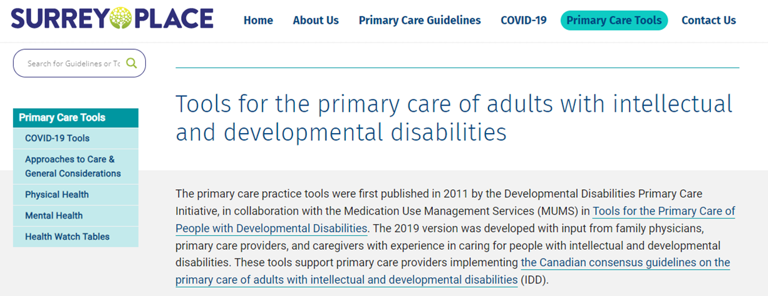
Resources
Guidelines:
https://ddprimarycare.surreyplace.ca/guidelines/
Tools:
https://ddprimarycare.surreyplace.ca/tools-2/

Slide 45
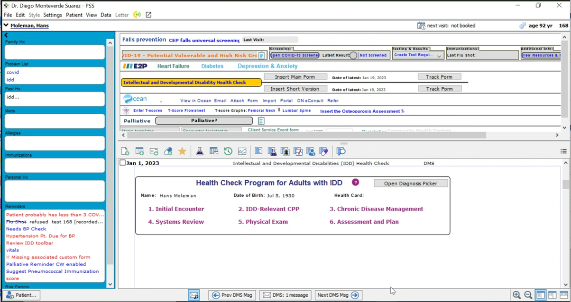
Telus PS Suite version of IDD Health Check
Instructions to add to patient charts at
https://ddprimarycare.surreyplace.ca/tools-2/general-health/preventive-care-checklist/

Slide 46
Join us in the CFPC DD Member Interest Group
Developmental Disabilities Member Interest Group
email migs@cfpc.ca to sign up for the “DD MIG”
also request to be part of the discussion platform, DD “MiGroups”
Join in our every-other month webinar series by Zoom
Next webinar is on Wednesday, November 30 at 20:00 – 21:00h Eastern Time. The topic is “IDD and epilepsy”.
Zoom link will be posted on the MiGroups platform (and, if you are signed up for the platform, notification of the posting will also be sent to you by email)

Slide 47
Closing Slide
Thank you!
Please fill out your session evaluation now!
#myfmf
FamilyMedicineForum
FamilyMedForum
FamilyMedForum

