Slide 1
Title Slide
Managing Anxiety Conditions in Primary Care Using the Ottawa Anxiety Algorithm
Douglas Green MD

Slide 2
COI – Presenter Disclosure
Presenter Disclosure
Presenter: Douglas Green
Relationships with financial sponsors:
•Any direct financial relationships, including receipt of honoraria: Not applicable
•Membership on advisory boards or speakers’ bureaus: Not applicable
•Patents for drugs or devices: Not applicable
•Other: Not applicable
Notes:
Where a faculty/presenter has no relationships to disclose, indicate Not Applicable under Relationships with Financial Sponsors.
Complete this slide for the primary presenter and ALL co-presenters if applicable.
Reminder: Disclosures made on your COI forms should match disclosures made on the COI slide.

Slide 3
COI – Disclosure of Financial Support
This program has received financial support from [organization name] in the form of
Not applicable
This program has received in-kind support from [organization name] in the form of
Not applicable
Potential for conflict(s) of interest:
Not applicable
Disclosure of Financial Support
Notes:
Where a program has received no external financial support (e.g., monies for food, logistics assistance such as registration, AV set-up, etc.), indicate No External Support.

Slide 4
Learning Objectives
Discuss prevalence and presentation of anxiety in primary care
Define and differentiate the most common types of anxiety disorders
Describe the common concurrent disorders found in patients with anxiety disorders
Describe the mainstay of pharmaceutical management for the anxiety
Review non-medication treatment for anxiety
Demonstrate how to use the Ottawa Anxiety Algorithm to diagnose and manage anxiety in primary care using a case

Slide 5
Who I am
Psychiatrist working with The Ottawa Hospital Shared Mental Health team for the last 12 years
Multidisciplinary team that provides to 2 academic family health teams (serving over 30,000 patients):
Diagnostic and treatment suggestions
Group and individual CBT and DBT
Teaching of family health team staff and residents
Main diagnoses we treat are anxiety and depression

Slide 6
Introduction
Anxiety disorders are the most common psychiatric disorders (greater than depression!)
Estimated annual prevalence of 18 %
Higher prevalence amongst women
Under recognized in primary care
About 40% of patients go untreated

Slide 7
Burden of Anxiety Disorders
Associated with:
Substantial functional impairment
Greater use of health care services and costs
Decreased work productivity
Increased risk of suicide
Burden increases with severity of anxiety and number of comorbid anxiety and other disorders

Slide 8
Impact of anxiety disorders
Anxiety disorders impose an economic burden comparable with the costs of depression, with 54% of the cost expended for non-psychiatric medical care of physical complaints
Incur two-fold the primary care costs and overall health care costs compared with those without anxiety

Slide 9
Impact of anxiety disorders
Significantly associated with:
thyroid disease
respiratory disease
GI disease
arthritis
migraine headaches and
allergic conditions
Comorbidity with physical conditions is associated with poor quality of life and disability

Slide 10
Comorbidity
Although directionality of comorbidity varies, a primary anxiety disorder often contributes to secondary depression or substance abuse
Much comorbidity exists with depression, substance abuse, and somatization
At least 30% and possibly up to 2/3rds of patients with one anxiety disorders may have another anxiety disorder

Slide 13
Recognition of anxiety disorders in primary care
Only about one third of patients with an anxiety disorder treated in primary care receive appropriate treatment
One of the reasons is under recognition of anxiety disorders

Slide 14
Why is anxiety under diagnosed in primary care?

Slide 15
Possible reasons for under diagnosis
Patient unwillingness or inability to discuss their anxiety problems
Limited knowledge of some primary care provider about anxiety disorders
Time pressures of health care providers with perception that not enough time to inquire about emotional problems
May present with somatic symptoms or sleep disturbance

Slide 16
Barriers to treatment
An even greater barrier may be the nonunitary nature of anxiety disorders
Instead of having one disorder (e.g. major depression) to diagnose and treat PCP are faced with multiple anxiety conditions (GAD, PD, SAD, PTSD and OCD) with 5 different diagnostic and treatment approaches

Slide 17
Assessment
Patients present can present with various somatic complaints or sleep disturbance
Need to rule out various causes including:
Effects of a substance (e.g., drug abuse or medication)
Medical cause
Other psychiatric disorder

Slide 19
DSM-5
Schizophrenia Spectrum and Other Psychotic Disorders
Bipolar and Related Disorders
Depressive Disorders
Anxiety Disorders
Obsessive-Compulsive and Related Disorders
Trauma- and Stressor-Related Disorders

Slide 20
5 common Conditions with anxiety
Generalized anxiety disorder
Panic disorder
Social anxiety disorder
Obsessive-compulsive disorder
Post-traumatic stress disorder

Slide 21
Case #1
35-year-old woman who recently started a new job
Always been anxious and describes herself as a “worrier”
Has multiple worries about her relationship with her boyfriend, the health of her parents, and getting things done at home
Has difficulty controlling her worry and it affects her sleep and leaves her feeling “on edge” and irritable with frequent headaches and muscle tension

Slide 22
Generalized Anxiety Disorder

Slide 23
Generalized anxiety disorder (GAD)
Excessive, difficult to control worry about multiple things
Accompanied by at least three of:
Restlessness or feeling keyed up or on edge
Easily fatigued
Difficulty concentration
Irritability
Muscle tension
Sleep disturbance

Slide 24
GAD (contd.)
Symptoms need to last at least 6 months
Accounts for 50% of anxiety disorders seen in primary care
Prevalence in primary care of 6%
Only depression more common
Tends to be chronic with fluctuating severity
Onset typically in 30s
Disability comparable with depression

Slide 25
Case # 2
42-year-old man with a longstanding fear of social situations
Tends to get anxious when meeting new people as he fears they will judge him as being socially awkward
Tends to avoid most social situations unless the group is small, and he knows the people well

Slide 26
Social Anxiety Disorder

Slide 27
Social anxiety disorder (SAD)
Marked excessive or unrealistic fear or anxiety about social situations
Fear is related to possible exposure to scrutiny of others
Active avoidance of feared situation(s)

Slide 28
SAD (contd.)
Prevalence in primary care is 5.7%
Tends to be a chronic condition
Onset in teens common
Rate of recovery of only 38%
Associated with:
Marked impairment in work productivity
Decreased income

Slide 29
Case # 3
25-year-old man under some stress following a breakup
One week after breakup he experienced sudden onset of rapid pounding heart, difficulty breathing, feelings of unreality, dizziness and tingling in his fingers
Fearing he was having a heart attack he called an ambulance and went to the ER where investigations were negative
Since then, he has had other similar episodes and worries constantly about having another

Slide 30
Panic Disorder

Slide 31
Panic Disorder
Recurrent unexpected panic attacks
Common symptoms include:
Elevated heart rate
Shortness of breath
Trembling
Abdominal distress
Dizziness
Fear of death or losing control

Slide 32
Panic disorder (contd.)
Persistent concern about additional panic attacks or change in behaviour related to attacks
Prevalence in primary care estimated to be 4-6%
Tends to be chronic and relapsing
Onset in 20s or 30s common

Slide 33
Case # 4
38-year-old firefighter who responds to a call where he witnesses the death of a baby from a respiratory condition
Following that he experiences intense anxiety at any reminder of this experience
He wakes up often with nightmares related to this
He stays off work due to his anxiety
He is noted to be more irritable and will not let his children go outside as he fears for their safety

Slide 34
Posttraumatic Stress Disorder

Slide 35
Posttraumatic stress disorder (PTSD)
Exposure to actual or threatened death, serious injury, or sexual violation
Intrusion symptoms (distressing memories, nightmares or flashbacks)
Avoidance of stimuli associated with the event
Negative alterations in cognition and mood
Alterations in arousal and reactivity

Slide 36
PTSD (contd.)
Point prevalence in primary care of 11.8%
More likely to reach out to family doctors than to a mental health specialist
Tends to be chronic
Onset in 20s common
Only one-third recovered at 1 year
One-third still experience symptoms 10 years after trauma exposure

Slide 37
Case # 5
53-year-old woman presents to her family doctor for treatment of hypertension
He notes her hands are quite red and raw
She admits to a longstanding fear of being contaminated by germs
Spend several hours per day washing her hands

Slide 38
Obsessive-compulsive Disorder

Slide 39
Obsessive-compulsive disorder (OCD)
Obsessions
Recurrent and persistent thoughts, urges or images that are experienced as intrusive and unwanted and cause anxiety or distress
and/or
Compulsions
Repetitive behaviours (e.g. hand washing) or mental acts (e.g. counting) that the individual feels driven to perform to reduce the anxiety caused by the obsessions

Slide 40
OCD (contd.)
Estimated lifetime prevalence of 1.6%
Shame may prevent patients from revealing their symptoms
Average time to diagnosis is 11 years
Onset in 20s usual
70% experience a chronic course
Only 23% experience a waxing and waning course

Slide 41
Comorbidity
Mood disorders
Substance abuse
Psychosis
Another anxiety disorder (> 50%)
Estimated that up to 90% of patients with GAD have another disorder
Lower remission rates and higher rate of suicide

Slide 42
Comorbidity (contd.)
Patients with anxiety disorders have higher prevalence of:
Hypertension
Other cardiovascular diseases
Arthritis
Thyroid disease
Respiratory disease
Migraine headaches

Slide 43
Treatment

Slide 44
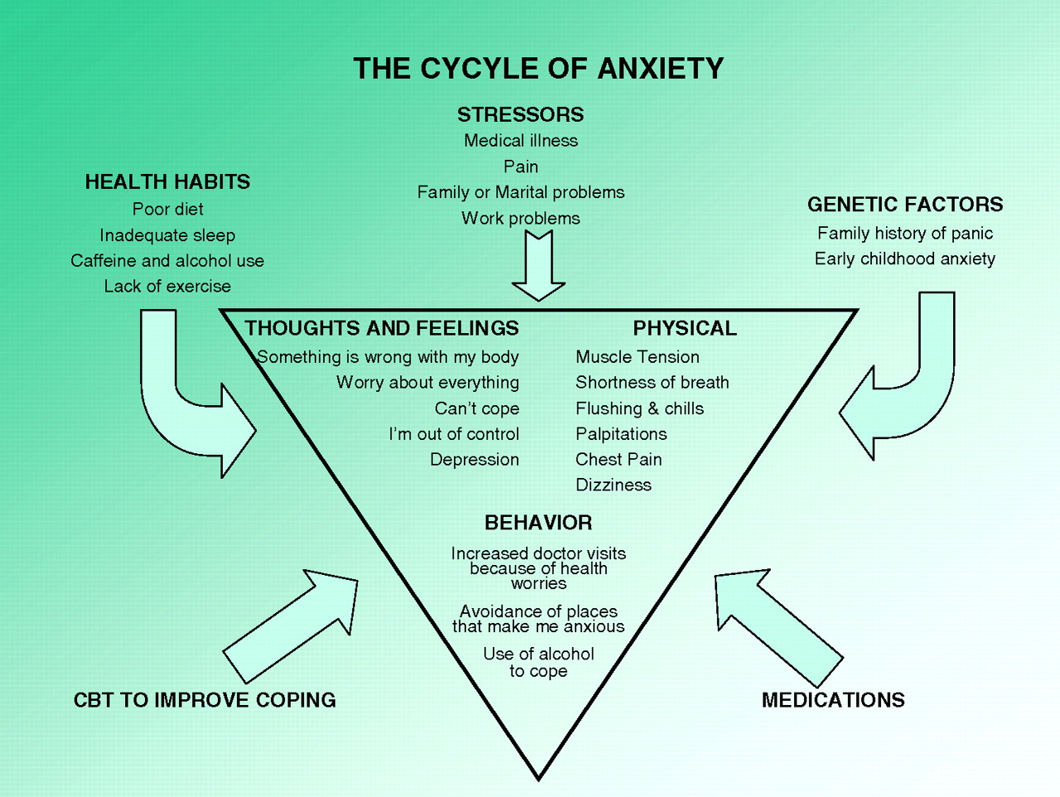

Slide 45
Treatment
Medication
Psychotherapy

Slide 46
Medications
Antidepressants
Benzodiazepines
Anticonvulsants
Antipsychotics
Azapirones

Slide 47
Medications
Antidepressants
Benzodiazepines
Anticonvulsants
Antipsychotics
Azapirones

Slide 48
Antidepressants
SSRIs and SNRIs are considered first line treatments
Better tolerated than TCAs and MAOIs
Not all have indication for all anxiety disorders

Slide 49
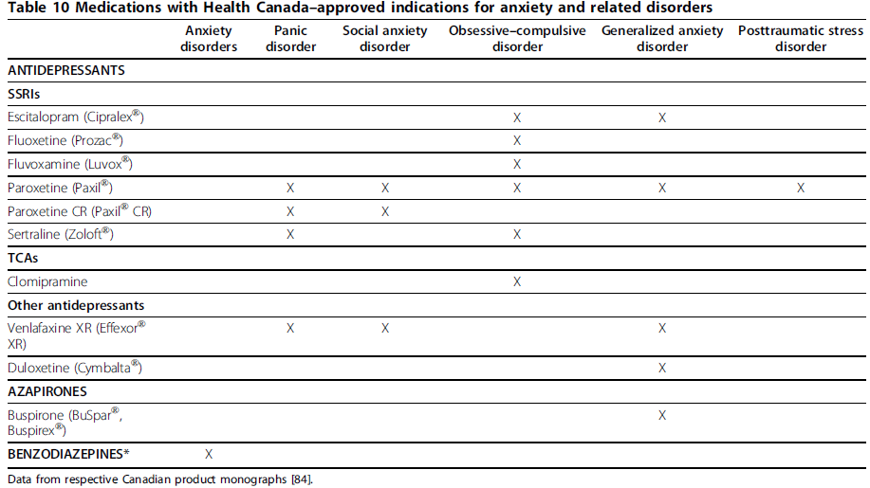

Slide 50
Antidepressants
Should be initiated at low doses to avoid SE
Titrated to recommended dose range in 1–2 week intervals
Onset of significant improvement often takes 2-8 weeks
Higher doses may be required

Slide 51
Antidepressants (contd.)
Full response (greater than 50% improvement) may take up to 12 weeks or more
Goal is full remission although not all achieve this
Remission defined as loss of diagnostic status and no functional impairment
To avoid relapse treatment should continue for at least 12-24 months for most patients

Slide 52
Medications
Antidepressants
Benzodiazepines
Anticonvulsants
Antipsychotics
Azapirones

Slide 53
Benzodiazepines
May be used as an adjunct early in therapy
Should be restricted to short term use arising from concerns about:
Dependency (Note: avoid in those with substance use disorders)
Sedation
Cognitive impairment
Falls and fractures in the elderly

Slide 54
Benzodiazepines (contd.
Generally dosing should be regular rather than as-needed
Clonazepam used often due to longer half-life

Slide 55
Medication
Antidepressants
Benzodiazepines
Anticonvulsants
Antipsychotics
Azapirones

Slide 56
Anticonvulsants
Limited RCTs demonstrating efficacy
Evidence for pregabalin and gabapentin in SAD
Pregabalin in GAD both as first line agent or as adjunctive therapy
Lamotrigine, carbamazepine, divalproex and topiramate third line for some anxiety disorder

Slide 57
Medication
Antidepressants
Benzodiazepines
Anticonvulsants
Antipsychotics
Azapirones

Slide 58
Antipsychotics
Quetapine as second line or adjunctive therapy in GAD
Risperidone and olanzapine adjunctive therapy in PTSD and OCD
Side effects include:
Weight gain
Diabetes
Hyperlipidemia
Sedation
Need to monitor weight, glucose and lipids periodically

Slide 59
Medication
Antidepressants
Benzodiazepines
Anticonvulsants
Antipsychotics
Azapirones

Slide 60
Azapirones
Main drug in this category is buspirone
Second line medication for GAD
Side effects include dizziness, drowsiness and nausea
Not used much

Slide 61
Treatment
Medication
Psychotherapy

Slide 62
Psychotherapy
Most evidence for cognitive behavioural therapy (CBT)
Addresses factors that cause and maintain the patient’s anxiety symptoms

Slide 63
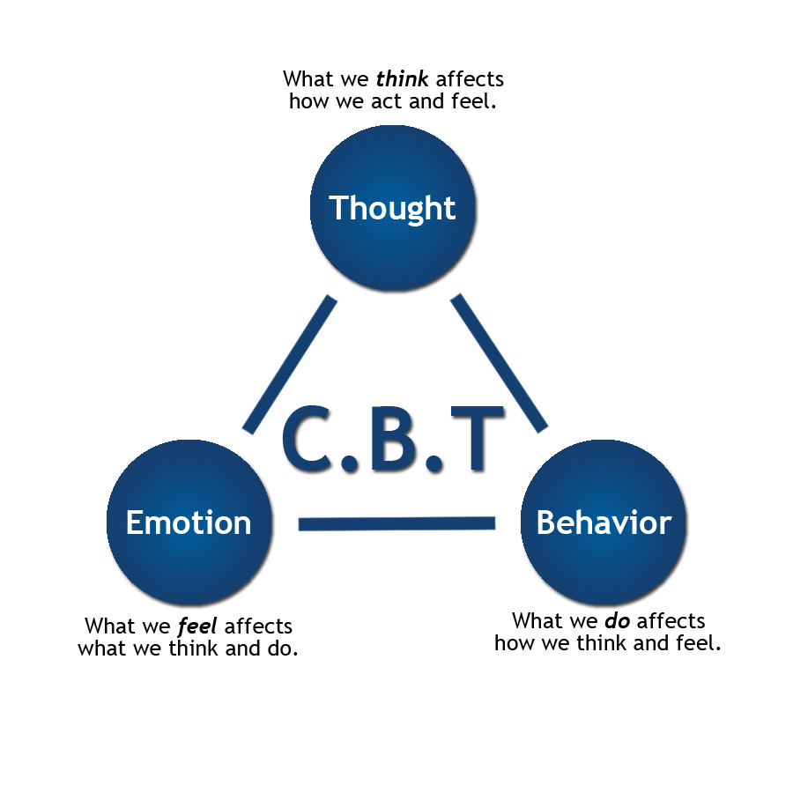

Slide 64
CBT
Can be effectively delivered as individual or group therapy ($ can be limiting factor)
Can also be self-directed using:
Books (e.g. The Anxiety and Phobia Workbook)
Internet (https://www.anxietycanada.com/)
Apps (e.g. Mindshift)

Slide 65
Choice of CBT vs. Medication
Generally, both demonstrate equal efficacy
Evidence does not support routine combination for most disorder therapy although this is often done, especially when the condition is more severe
Limited response to one type of treatment should lead to addition of the other

Slide 66
Factors in treatment selection
Patient preference
Ability of patient to engage in treatment
Severity of illness
Clinicians’ skills and experience
Availability of psychological treatments
Patient’s prior response to treatment
Cost
Presence of comorbid medical or psychiatric disorders

Slide 67
The Ottawa Anxiety Algorithm
Companion to the Ottawa Depression Algorithm (www.ottawadepressionalgorithm.ca)
Developed to assist with the management of anxiety
Principles in developing:
User friendly
Practical
Evidence based
Free
Based on Chronic Care Model and the Stepped Care Model

Slide 68
Chronic Care Model
System Design
e.g. case management, regular f/u
Self-management support
Decision support
e.g. embedding evidence-based guidelines into clinical practice
Information systems
e.g. tracking individuals, monitoring team performance and outcomes
Organizational change
e.g. create a culture and mechanism that promote safe, high quality care
Links with community resources

Slide 69
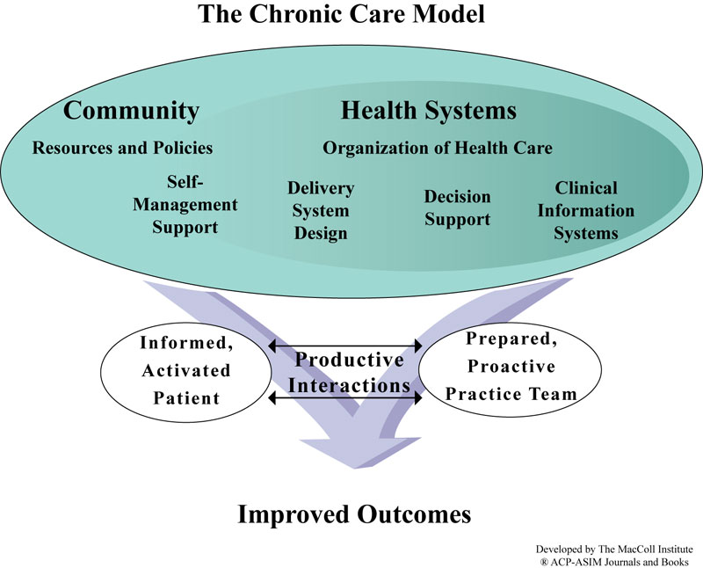

Slide 70
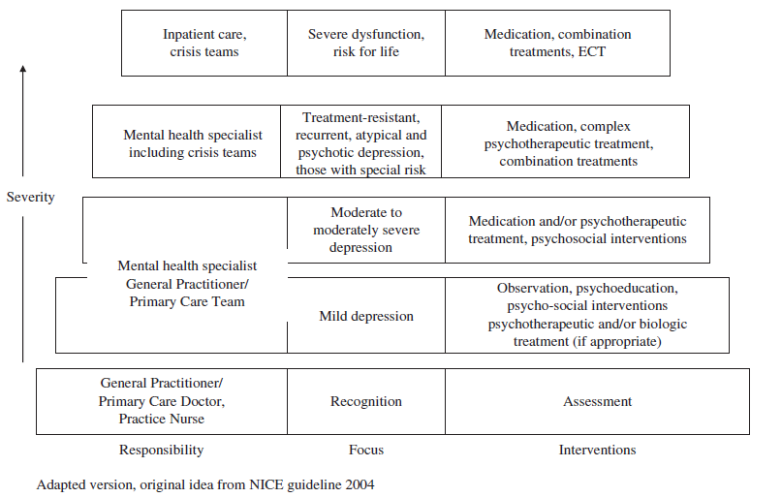
Stepped Care Model

Slide 71
www.ottawaanxietyalgorithm.ca

Slide 72
In summary
Anxiety disorders are the most common psychiatric disorders
Associated with significant functional impairment, cost and morbidity
SSRIs and SNRIs are first line treatments
Anticonvulsants, benzodiazepines and antipsychotics may be used in some cases
CBT is an effective alternative treatment
The Ottawa Anxiety Algorithm (www.ottawaanxietyalgorithm.ca) can assist with management

Slide 73
References
Katzman et al. Canadian clinical practice guidelines for the management of anxiety, posttraumatic stress and obsessive-compulsive disorders. BMC Psychiatry 2014, 14 (Suppl 1): S1
Combs H, Markman J. Anxiety Disorders in Primary Care. Med Clin N Am 2014;98:1007-1023
Kelly K. et al. Toward achieving optimal response: understanding and managing antidepressant side effects. Dialogues in Clinical Neuroscience 2008;10(4):409-418

Slide 74
Thank you!
If you have questions, please contact me at dogreen@toh.ca

Slide 75
Closing Slide
Thank you!
Please fill out your session evaluation now!
#myfmf
FamilyMedicineForum
FamilyMedForum
FamilyMedForum

