Slide 1
The Professional Learning Plan: Optimize your CPD!
PRESENTED BY:
Dr. Lennie Lalla
Melissa Lujan
November 9, 2023
Notes:
Lennie

Slide 2
Presenter: Dr. Lennie Lalla,
Director, Continuing Professional Development and
Interim Co-Executive Director, Professional Development and Practice Support
Relationships with financial sponsors: NA
Other financial relationships/investments: Paid employee of the College of Family Physicians of Canada
Faculty/ Presenter Disclosure
Notes:
Lennie

Slide 3
Presenter: Melissa Lujan,
Manager, Mainpro+
Relationships with financial sponsors: NA
Other financial relationships/investments: Paid employee of the College of Family Physicians of Canada
Faculty/ Presenter Disclosure
Notes:
Melissa

Slide 4
Disclosure of Financial Support
This program has not received financial support from any external organizations.
Notes:
Melissa

Slide 5
Mitigating Potential Bias
Conflicts of Interest were discussed and addressed for all members of the planning committee.
All potential conflicts of interest for speakers are discussed by the scientific planning committee and appropriately mitigated.
All incidents of bias (both intentional and unintentional) will be brought to the planning committee with the potential of the speaker being removed from future sessions should it be deemed necessary.
Notes:
Melissa

Slide 6
Learning Objectives
At the end of the presentation, you will be able to:
Describe the benefits of using a PLP for practice improvement
Describe how self-directed reflection can help identify practice gaps
List the 5 reflective steps in a PLP
Effectively write a SMART goal
Apply PLP steps to your next CPD plan
Notes:
Lennie

Slide 7
PLP Walk-through Two ways to participate:
1. Start your own PLP by logging into your Mainpro+ account at https://portal.cfpc.ca/
Scroll to the PLP icon at the bottom of the page and hit ‘Enter’
2. Join along as we review our sample PLP!
Notes:
Melissa
Our sample PLP will be using a persona of Dr. Hannah Smith, a fictional member of the CFPC

Slide 8
Easy access from your Mainpro+ dashboard!
The PLP has been developed into an engaging and fully bilingual CPD activity with easy access right from the Mainpro+ dashboard
The PLP has been approved for: 12 credits for self-guided pathway or 20 credits for peer-supported pathway (certified Assessment credits)
Reviewing data with a trusted peer/colleague is encouraged
Notes:
Melissa

Slide 9
Question:
Have you ever used a PLP tool or a similar resource?
Notes:
Lennie

Slide 10
5 Steps in the PLP
Notes:
Lennie

Slide 11
Notes:
Melissa

Slide 12
Notes:
Melissa
Once you click on Enter, you will see a rolling slide of some information that you can find about the PLP. This one in particular speaks to […]

Slide 13
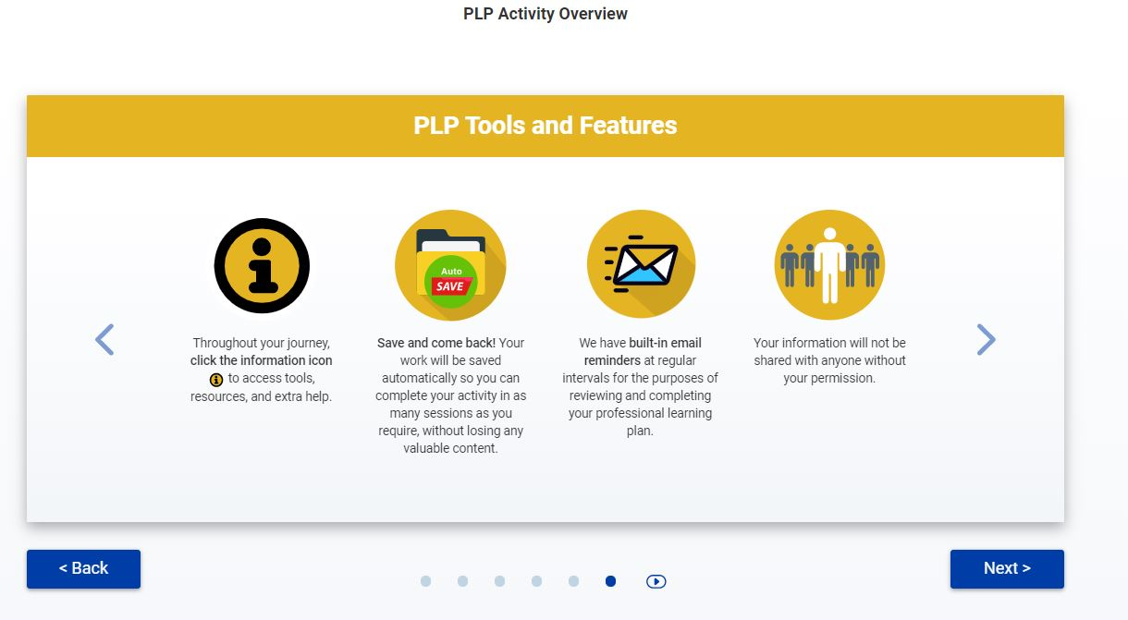
Notes:
Melissa
This is the last rolling slide that will go over the following:

Slide 14
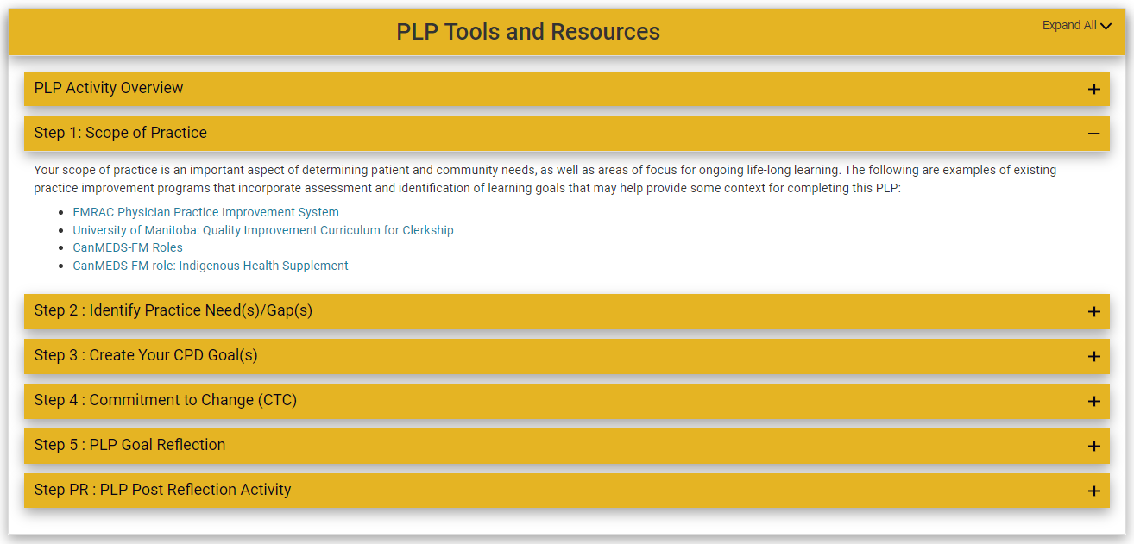
Notes:
Melissa
“I” icon, for each step, accompanying tips and guides on a separate page

Slide 15
Notes:
Melissa
Dr. Hannah Smith will be completing the Self-Guided pathway today

Slide 16
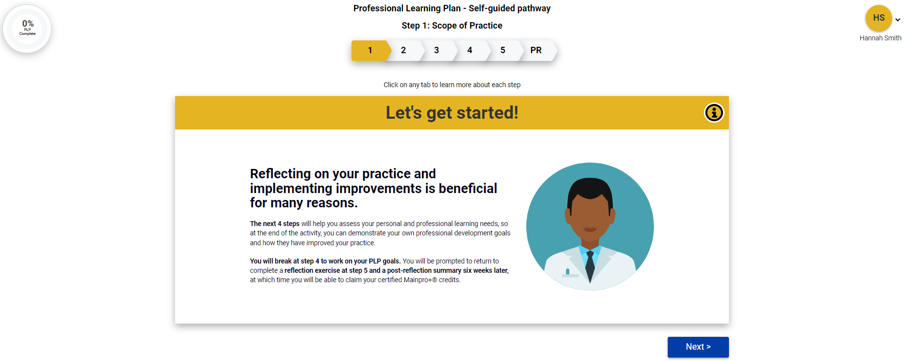
Notes:
Melissa
Features; circle progress wheel would give info about where you are in tool, progress bar shows you where you are in the steps, it’s clickable. You need to finish one step before advancing to the next step because inputs are dependent on the information that you enter.
If I were to click on the name to the right (next slide)

Slide 17
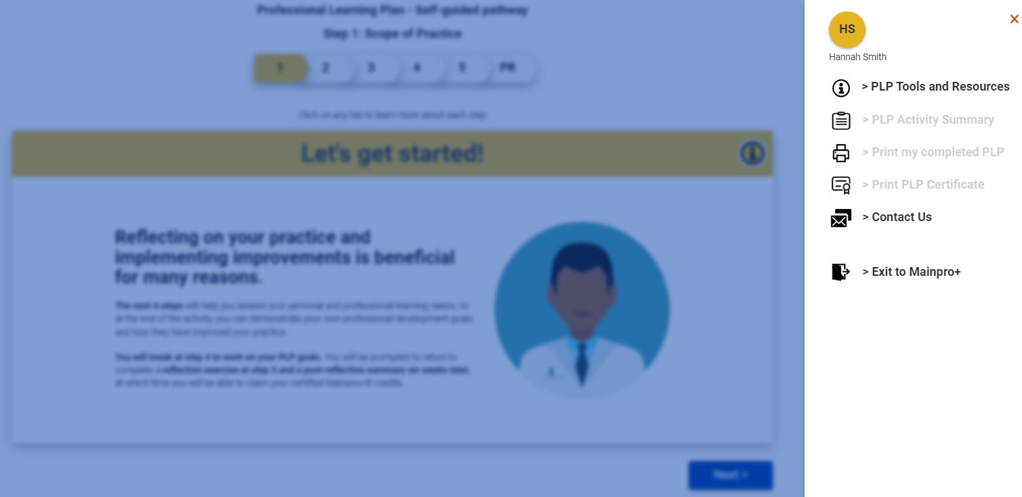
Notes:
Melissa
PLP dashboard, includes the following. Some are greyed out because you haven’t made it to that step yet. Once you complete it, you can access it here.
Now Dr. Lalla will go through the steps with you

Slide 18
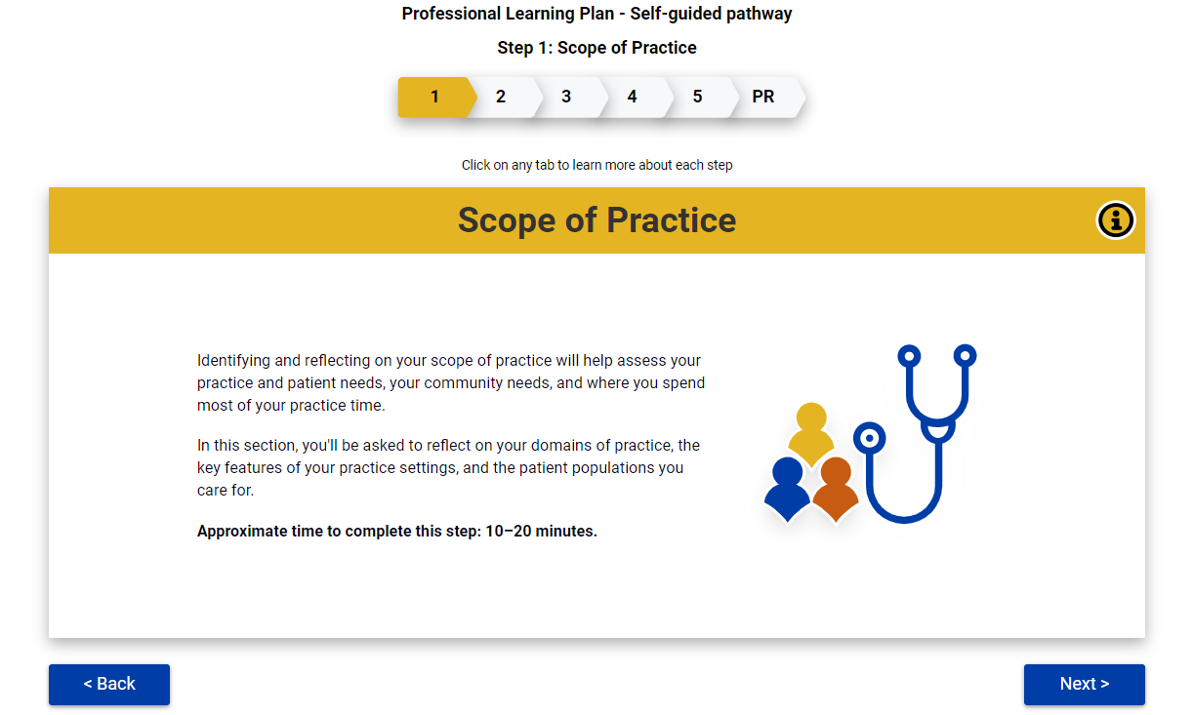
Notes:
Lennie

Slide 19
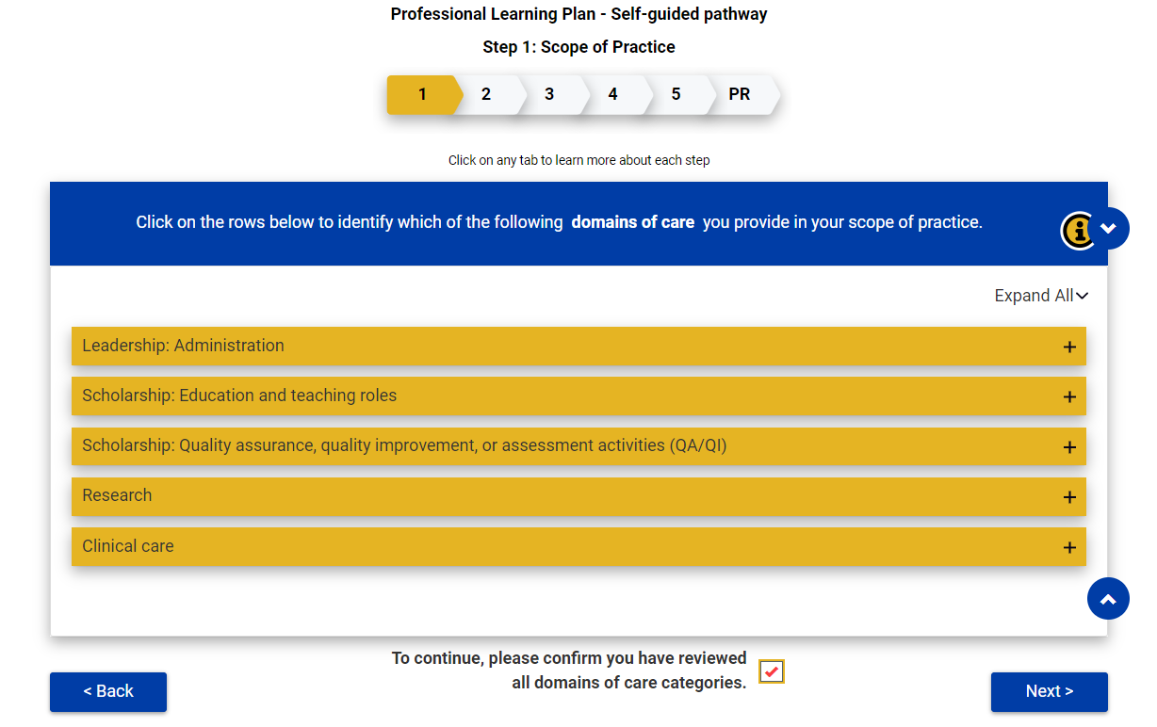
Notes:
Lennie

Slide 20
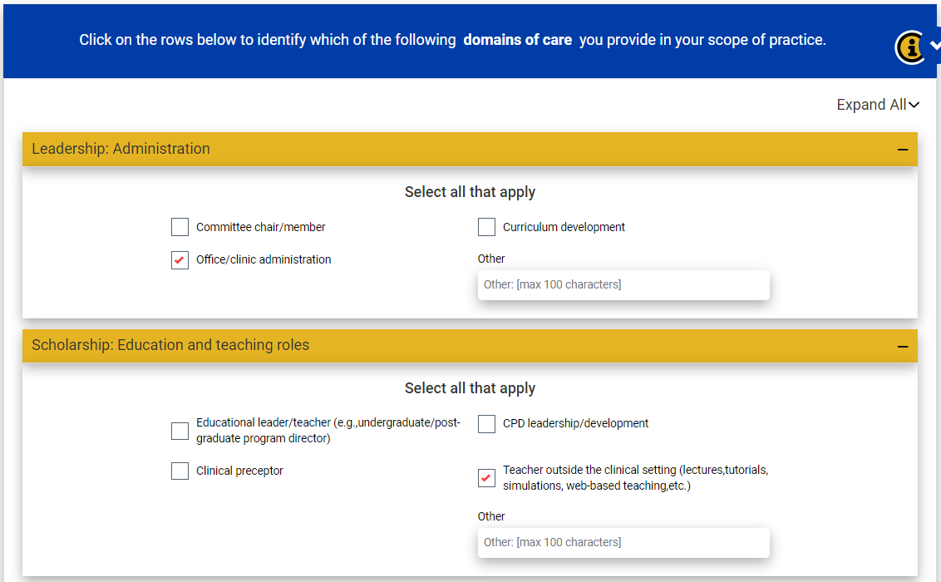
Notes:
Lennie

Slide 21
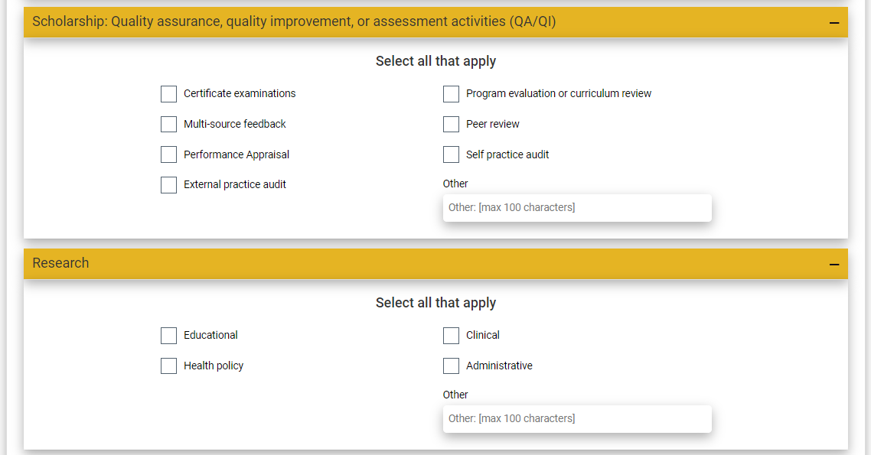
Notes:
Lennie

Slide 22
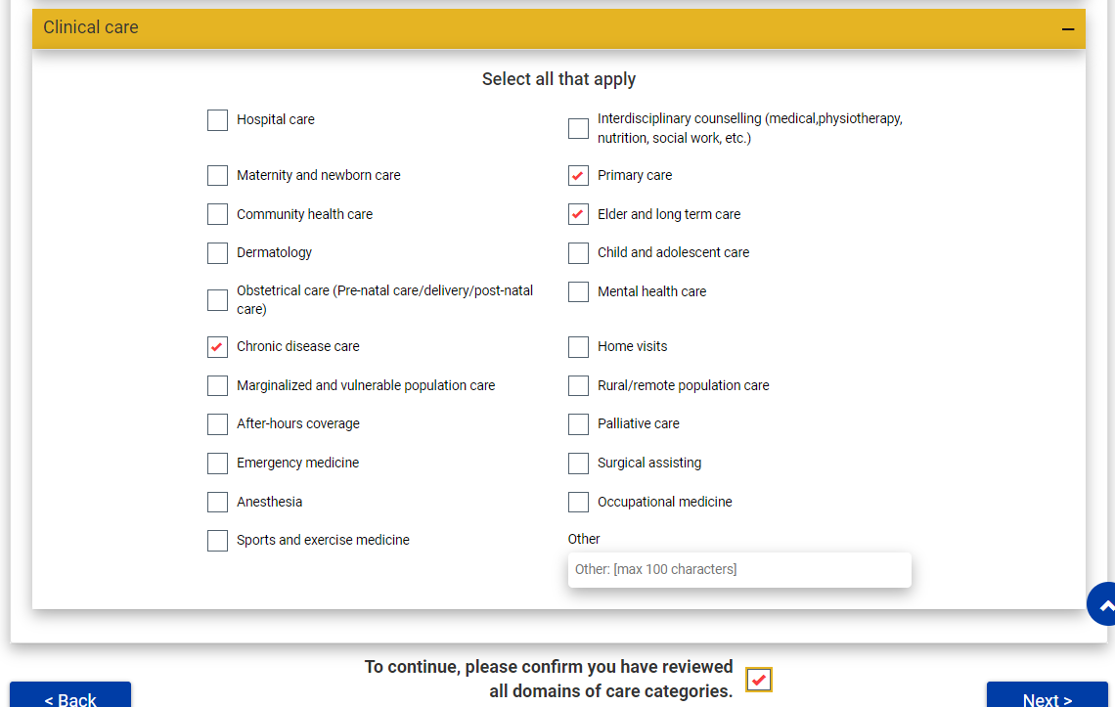
Notes:
Lennie

Slide 23
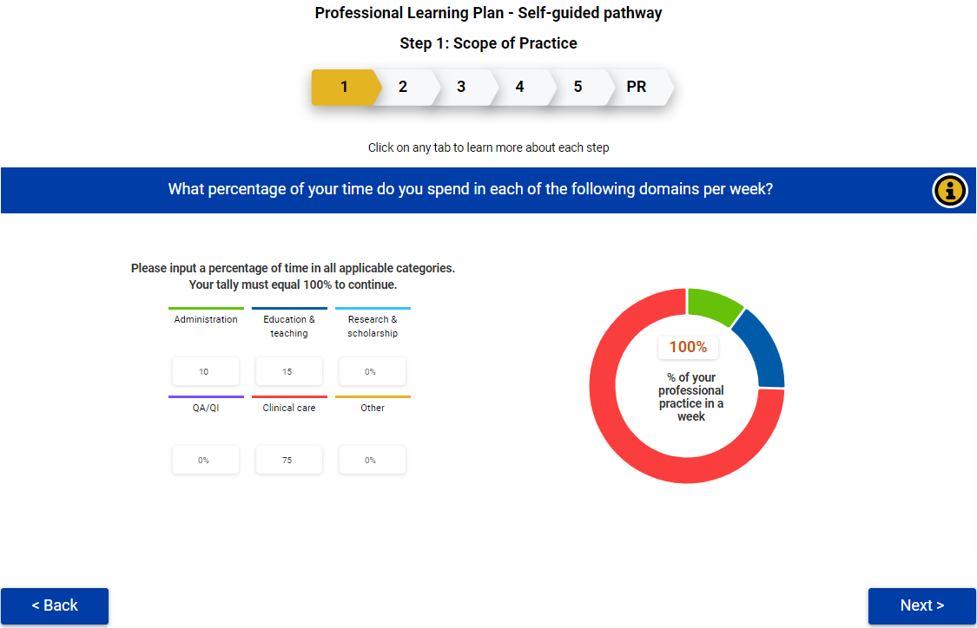
Notes:
Lennie

Slide 24
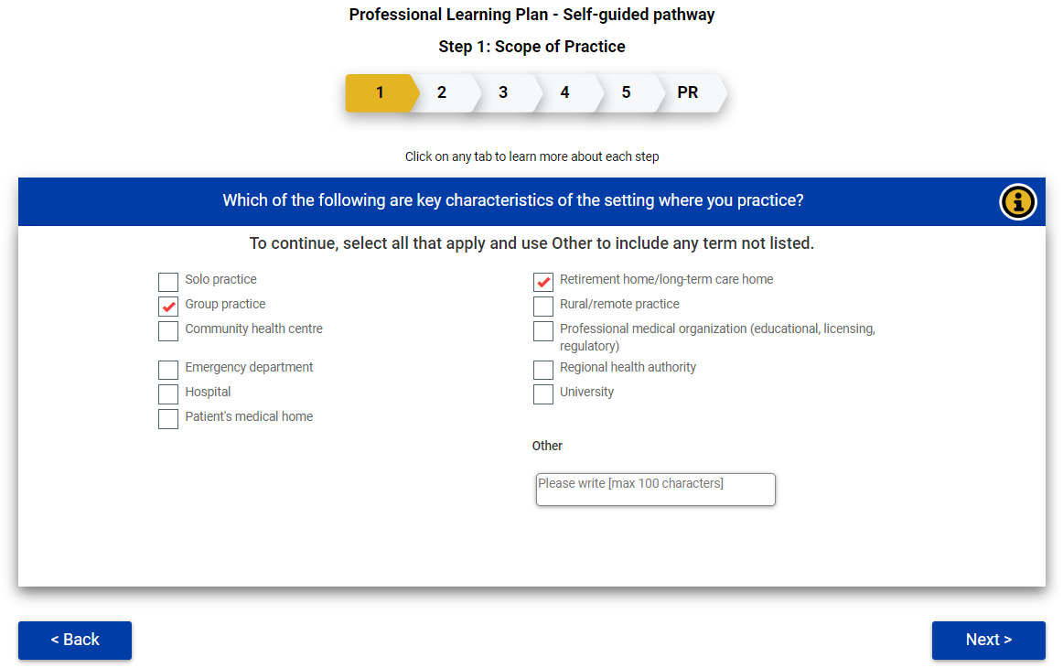
Notes:
Lennie

Slide 25
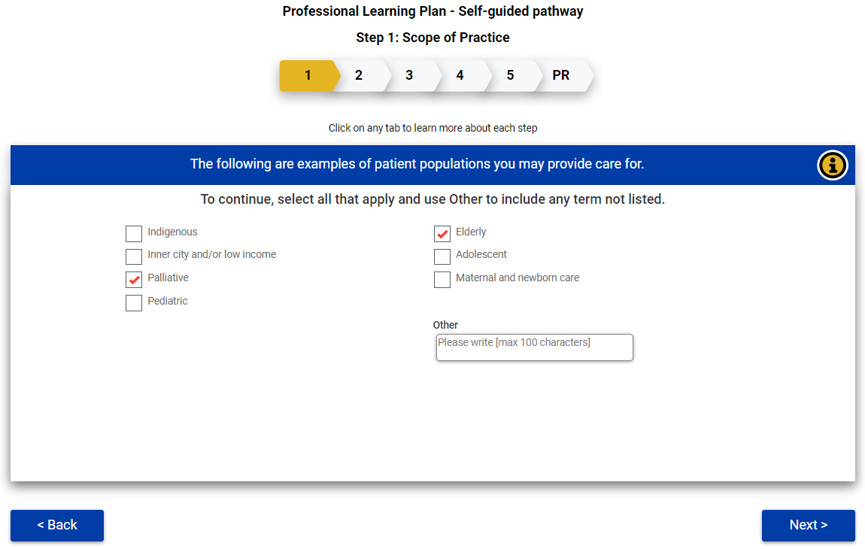
Notes:
Lennie; include comment that if they do not have a clinical practice, they can describe this in the "other" box (medical students, residents, etc)

Slide 26
Next Step
Notes:
Lennie

Slide 27
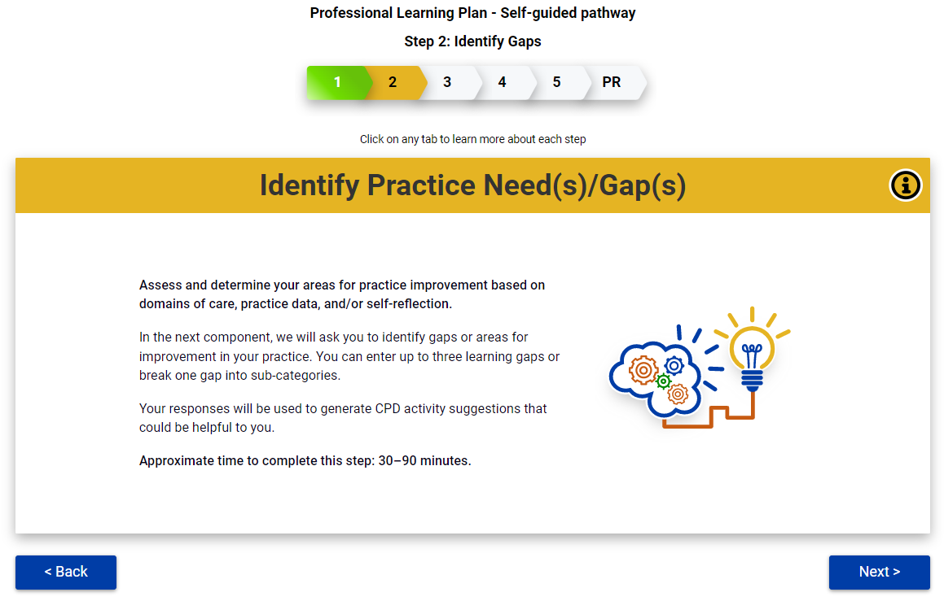
Notes:
Lennie

Slide 28
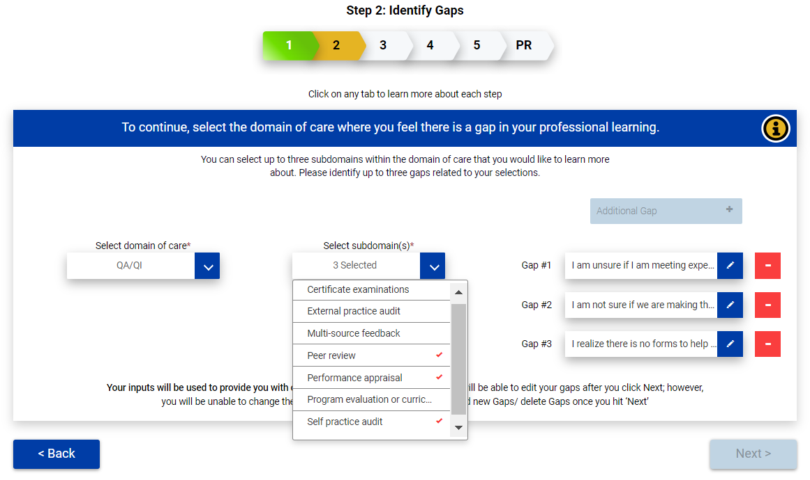
Notes:
Lennie

Slide 29
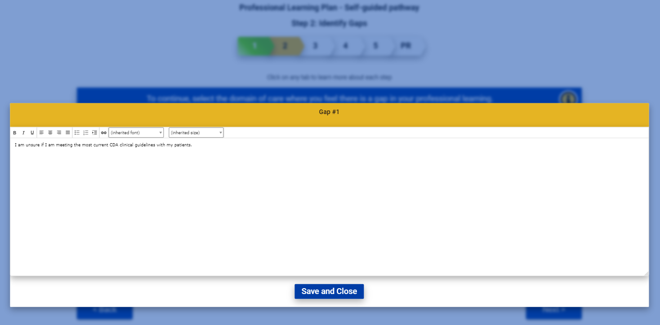
Notes:
Lennie

Slide 30
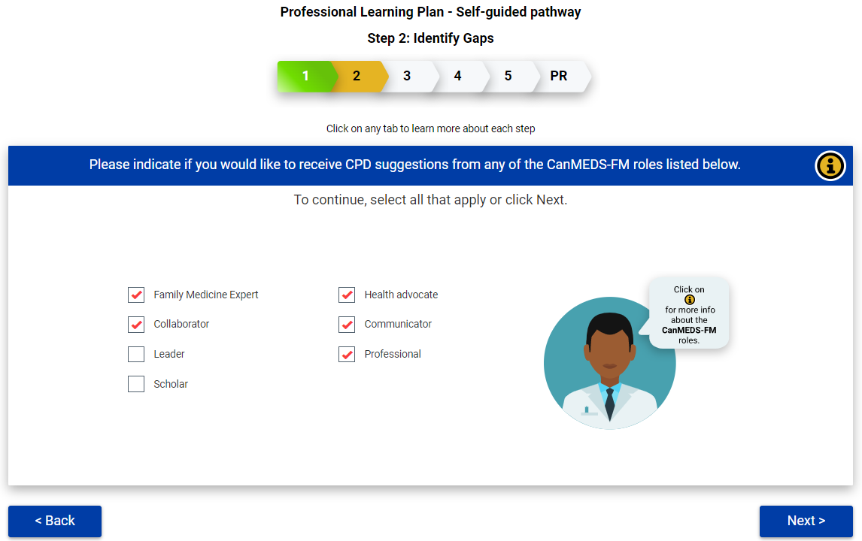
Notes:
Lennie
(produces list based on domains of care, subdomains of care, canMEDS-FM)

Slide 31
Notes:
Lennie

Slide 32
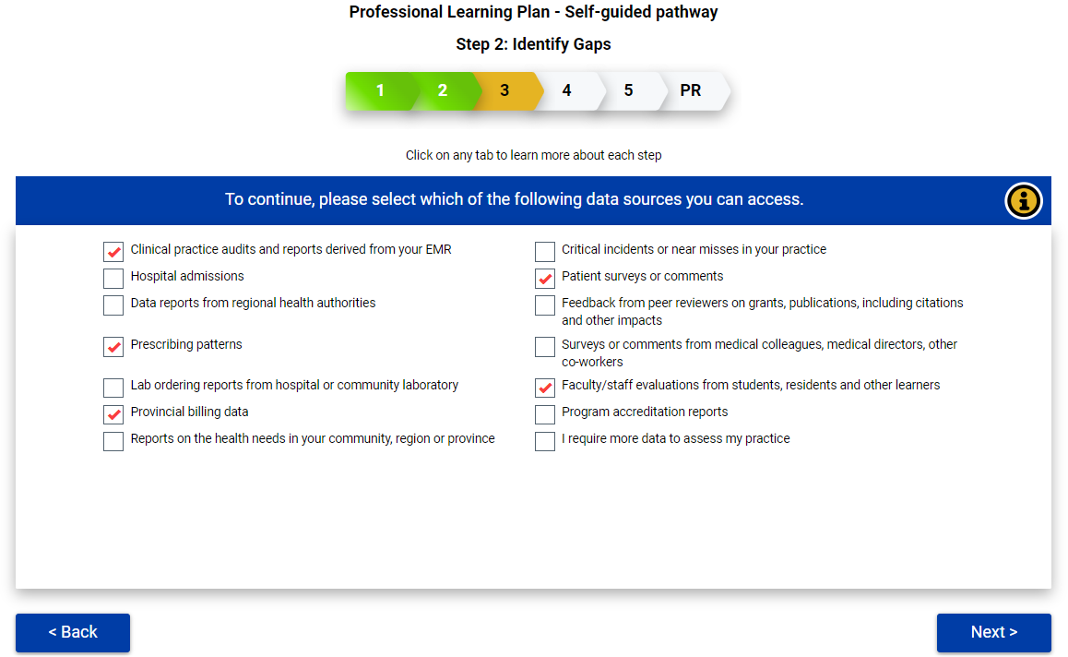
Notes:
Lennie

Slide 33
Next Step
Notes:
Lennie

Slide 34
Notes:
Lennie

Slide 35
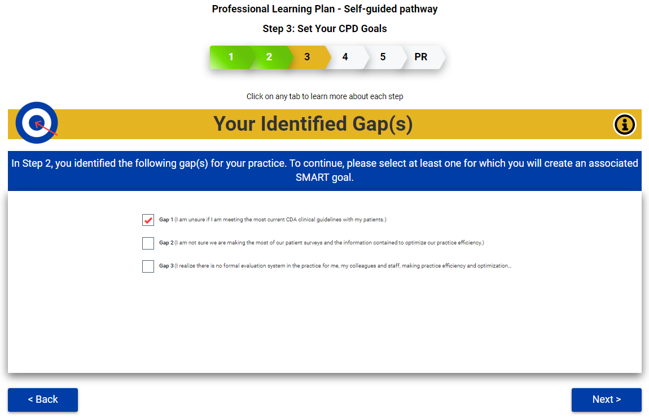
Notes:
Lennie (at this stage should encourage participate to select one gap to approach)

Slide 36
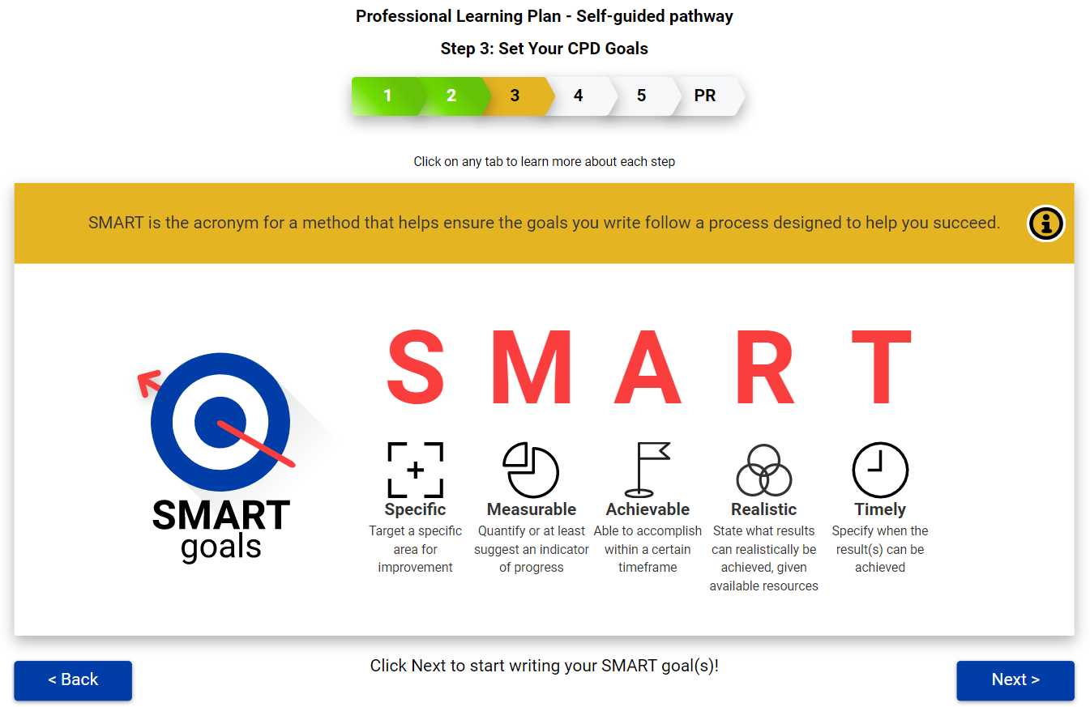
Notes:
Lennie
(remember "I" icon which can help)

Slide 37
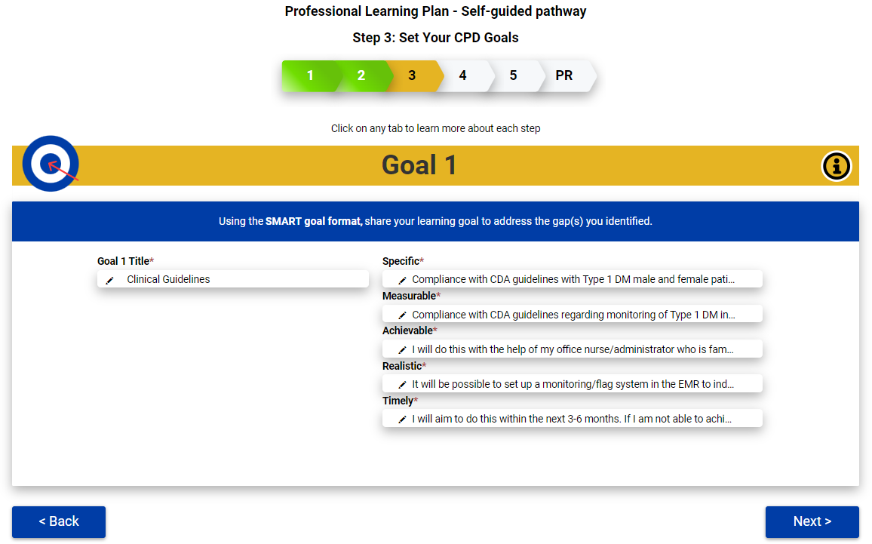
Notes:
Lennie

Slide 38
Notes:
Lennie

Slide 39
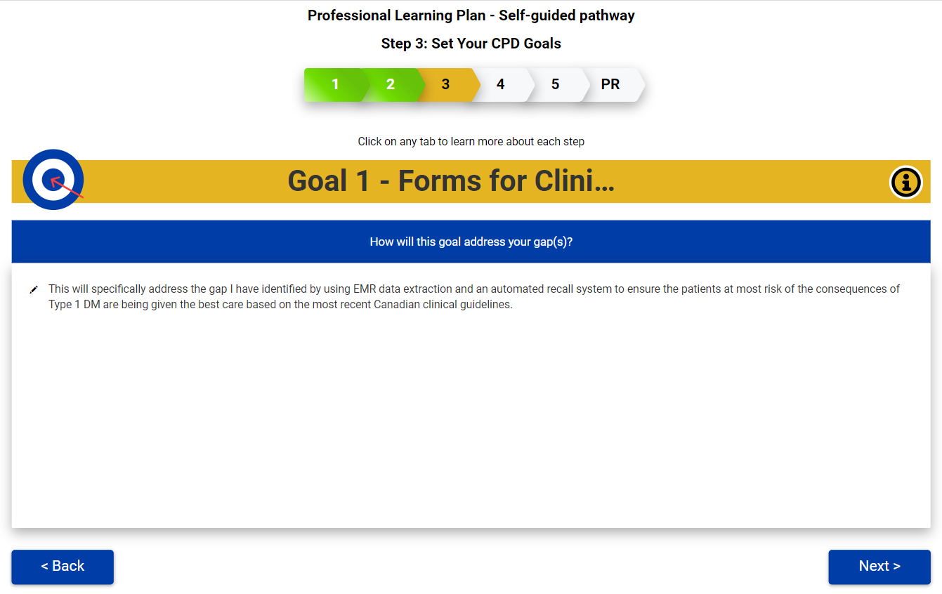
Notes:
Lennie

Slide 40
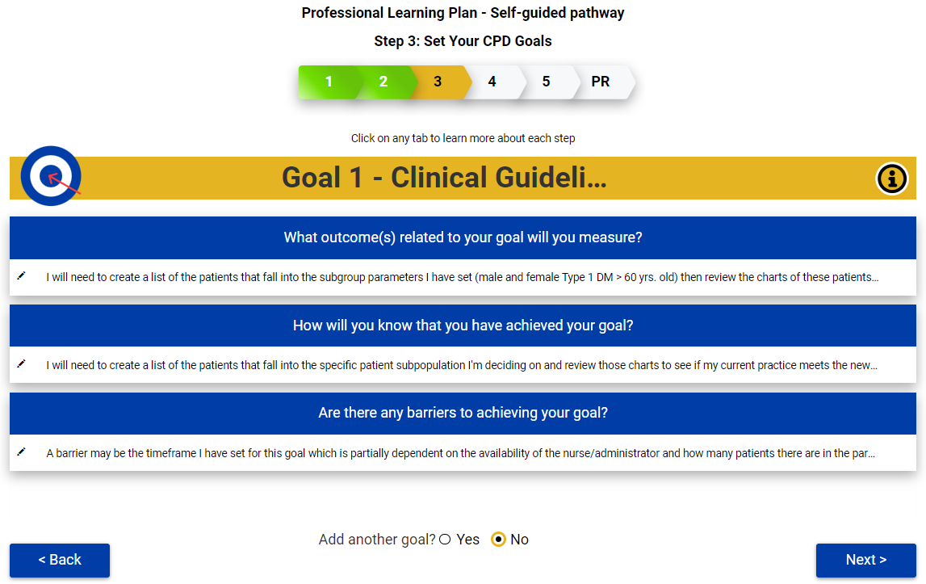
Notes:
Lennie

Slide 41
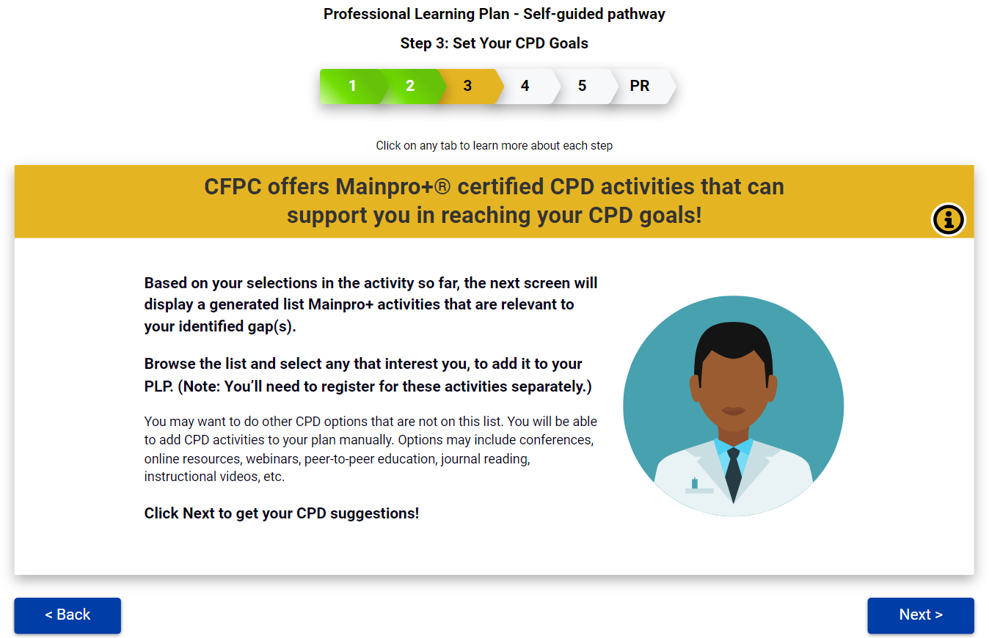
Notes:
Lennie

Slide 42
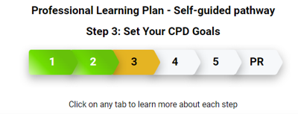
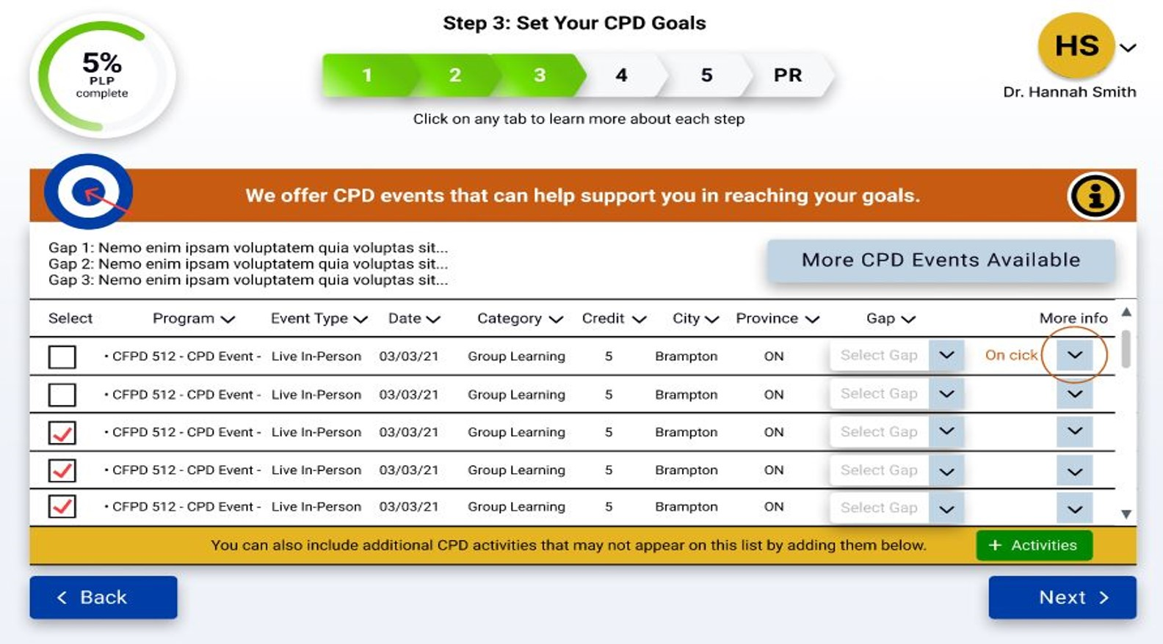
Notes:
Lennie

Slide 43
Notes:
Lennie

Slide 44
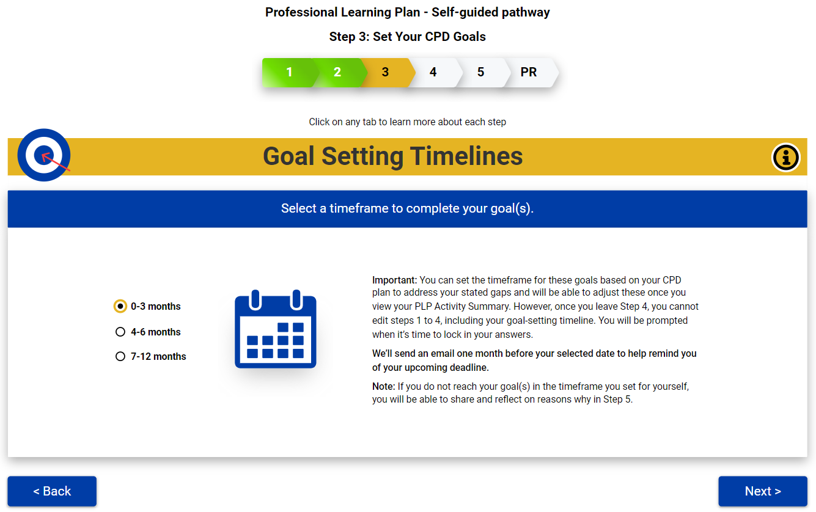
Notes:
Lennie

Slide 45
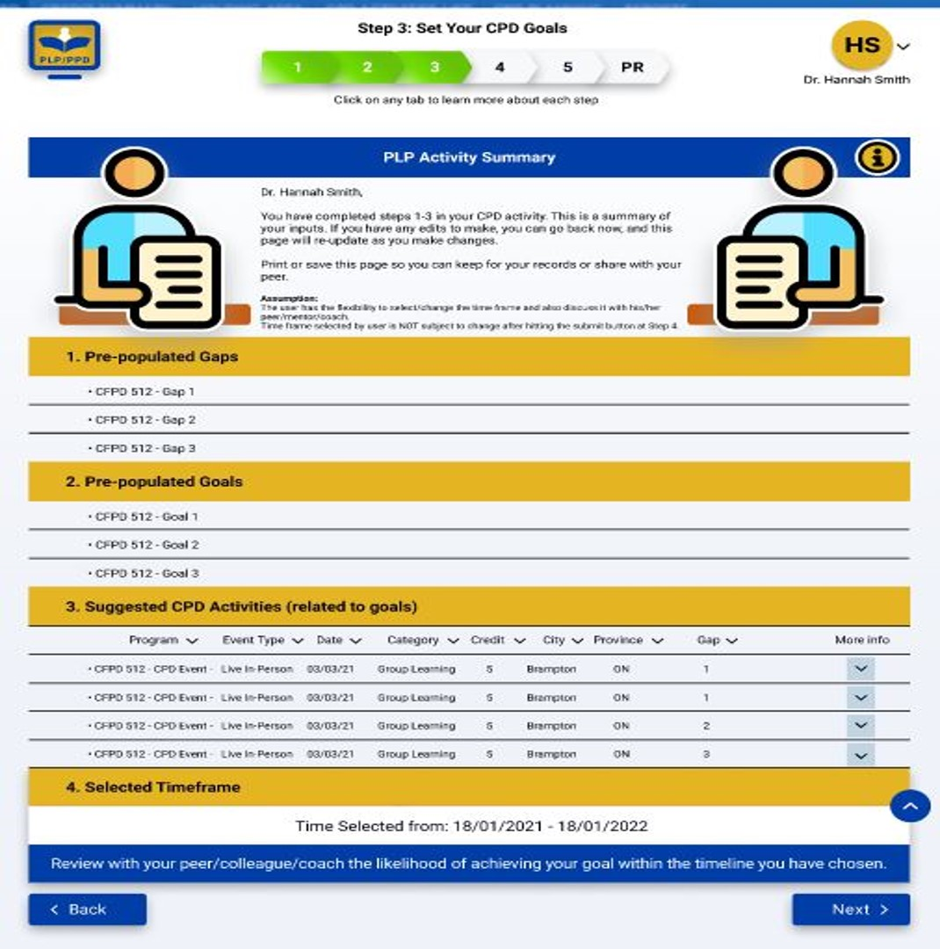
Notes:
Lennie

Slide 46
Next Step
Notes:
Lennie

Slide 47
Notes:
Lennie

Slide 48
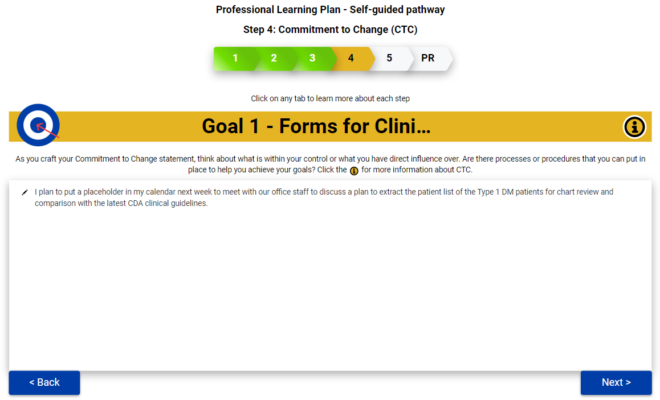
Notes:
Lennie

Slide 49
Pause
Notes:
Lennie

Slide 50
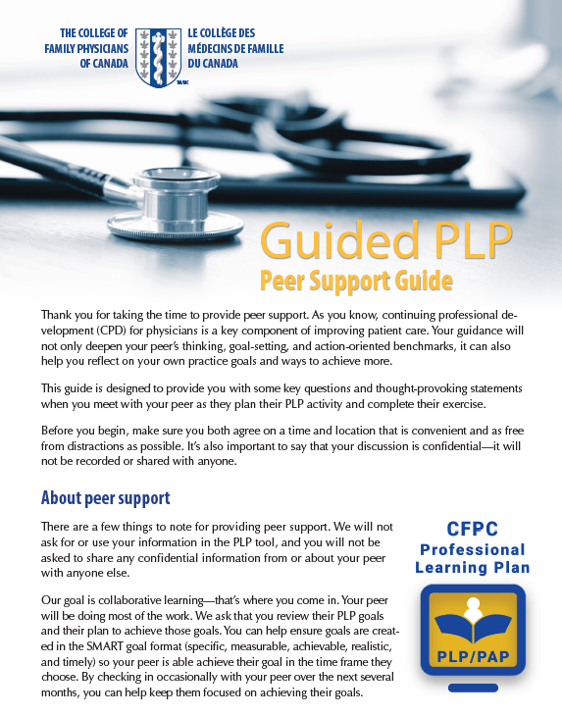
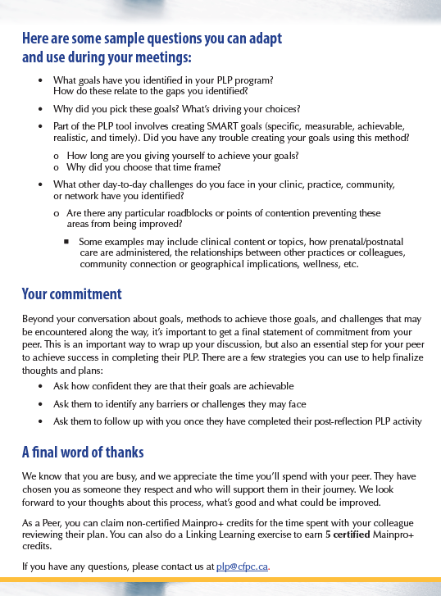
Notes:
Lennie

Slide 51
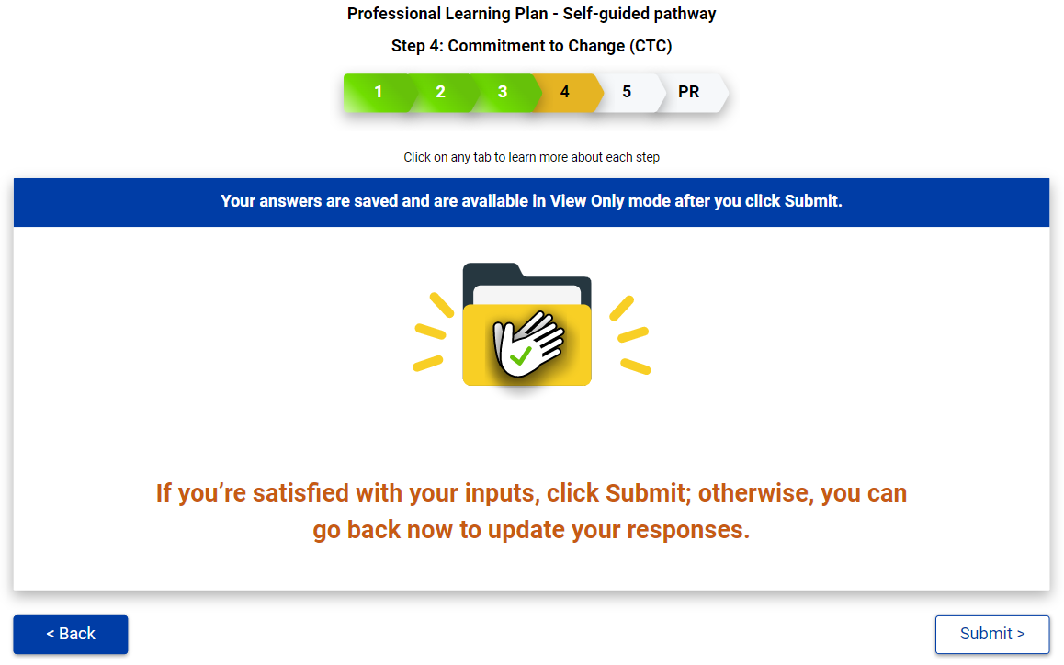
Notes:
Lennie
Answers locked at this point

Slide 52
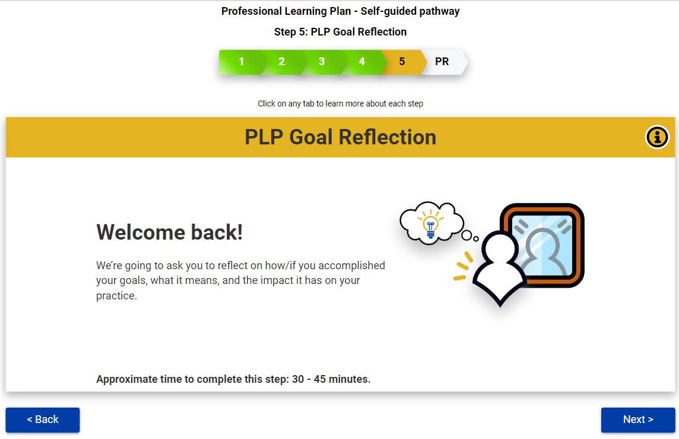
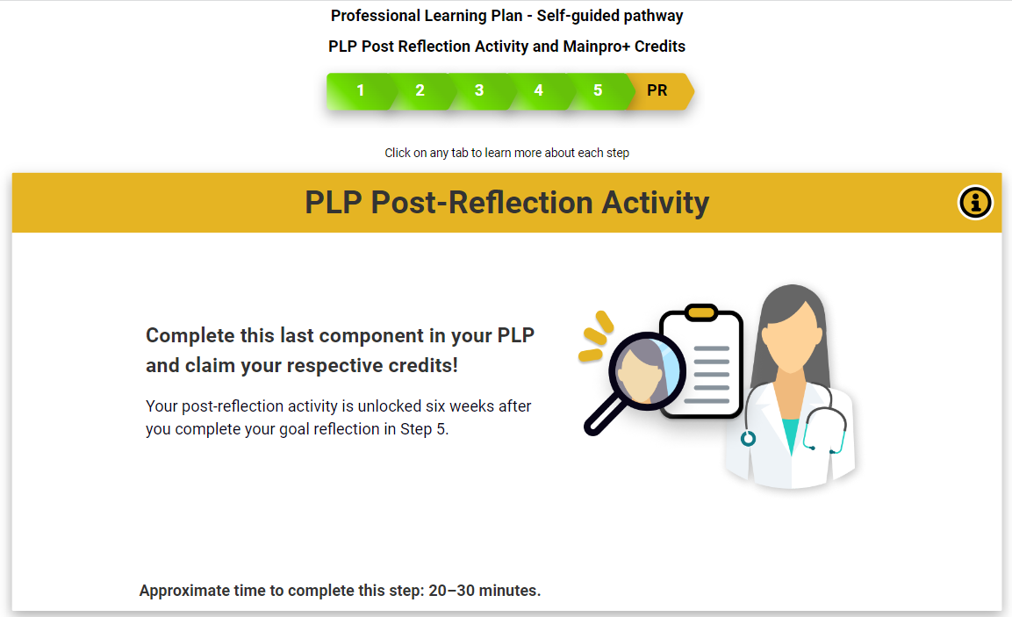
Step 5: PLP Goal Reflection
(after goals/timeframe completed)
PLP Post Reflection
(6 weeks later)
Notes:
Lennie
(selected time frame directs email prompts. At any time, the participant can go back into the system to complete the goal reflection. Discusses challenges around meeting the goal. Not necessary for the goal to be met. Once the goal reflection is done, post reflection is done after 6 weeks).

Slide 53
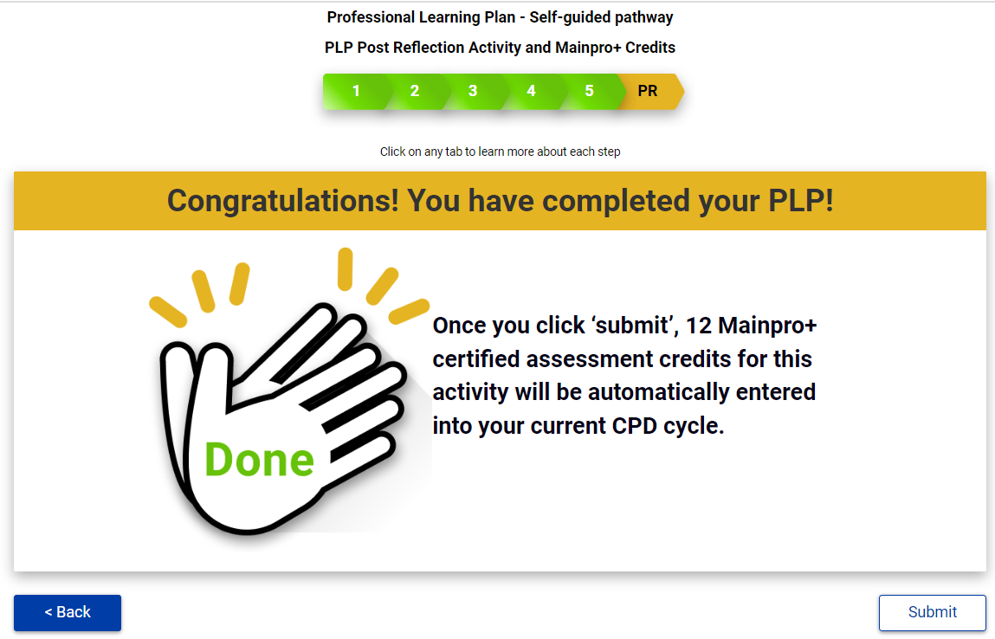
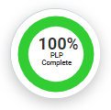
Direct Credit Entry
Notes:
Melissa

Slide 54
Discussion:
Now that you have had a chance to learn about the PLP, how might you use this tool in your practice?
E.g., research, clinical improvement, CPD credits
Notes:
Lennie

Slide 55
Please complete your session evaluation
Notes:
Melissa

Slide 56
Notes:
Melissa

