Slide 1
Title Slide
Supporting Implementation of Serious Illness Conversations in Primary Care
Janet Reynolds, MD, CCFP, FCFP
Amy Ma, Patient Partner - Choosing Wisely Canada

Slide 2
COI – Presenter Disclosure (1)
Presenter Disclosure
Presenter: Janet Reynolds, MD, CCFP, FCFP
Relationships with financial sponsors:
Any direct financial relationships, including receipt of honoraria: Choosing Wisely Canada Primary Care Co-Lead; Practising Wisely Facilitator
Membership on advisory boards or speakers’ bureaus: N/A
Patents for drugs or devices: N/A
Other: Family Physician and Medical Director, Crowfoot Village Family Practice, Medical Director Calgary Foothills Primary Care Network
Notes:
Where a faculty/presenter has no relationships to disclose, indicate Not Applicable under Relationships with Financial Sponsors.
Complete this slide for the primary presenter and ALL co-presenters if applicable.
Reminder: Disclosures made on your COI forms should match disclosures made on the COI slide.

Slide 3
COI – Presenter Disclosure (1)
Presenter Disclosure
Presenter: Amy Ma
Relationships with financial sponsors:
Any direct financial relationships, including receipt of honoraria: Choosing Wisely Patient Advisor
Membership on advisory boards or speakers’ bureaus: Choosing Wisely Patient Advisory Group, CMA Patient Voices member, CASCADES Advisory Committee
Patents for drugs or devices: N/A
Other: N/A
Notes:
Where a faculty/presenter has no relationships to disclose, indicate Not Applicable under Relationships with Financial Sponsors.
Complete this slide for the primary presenter and ALL co-presenters if applicable.
Reminder: Disclosures made on your COI forms should match disclosures made on the COI slide.

Slide 4
COI – Presenter Disclosure (2)
Disclosure of Financial Support
This program has received no financial support
This program has not received in-kind
Potential for conflict(s) of interest:
Janet Reynolds receives a stipend from Choosing Wisely Canada.
Amy Ma receives a stipend from Choosing Wisely Canada.
Notes:
Where a program has received no external financial support (e.g., monies for food, logistics assistance such as registration, AV set-up, etc.), indicate No External Support.

Slide 5
LEARNING OBJECTIVES
Describe a Serious Illness Conversation (SIC)
Review the SIC Guide and resources
A patient’s/caregiver’s perspective on what matters during SIC

Slide 6
ADVANCE CARE PLANNING
Seriously ill
Chronically ill
Healthy adults
Time to Talk – Serious Illness Conversation
What matters most to you now?
What do I need to know about you to best care for you?
Does your decision-maker know?
Do you have a decision maker?
What have you discussed?
Do you have a Personal Directive?
advancecareplanning.ca
Notes:
JR – review advance care planning

Slide 7
ACP RESOURCES
Conversations Matter: An advance care planning guidebook
It’s available in the following languages:
Arabic
Chinese (Simplified Chinese)
Chinese (Traditional Chinese)
English
French
Punjabi
Spanish
Vietnamese
Notes:
Conversations matter guidebook is available in different languages

Slide 8
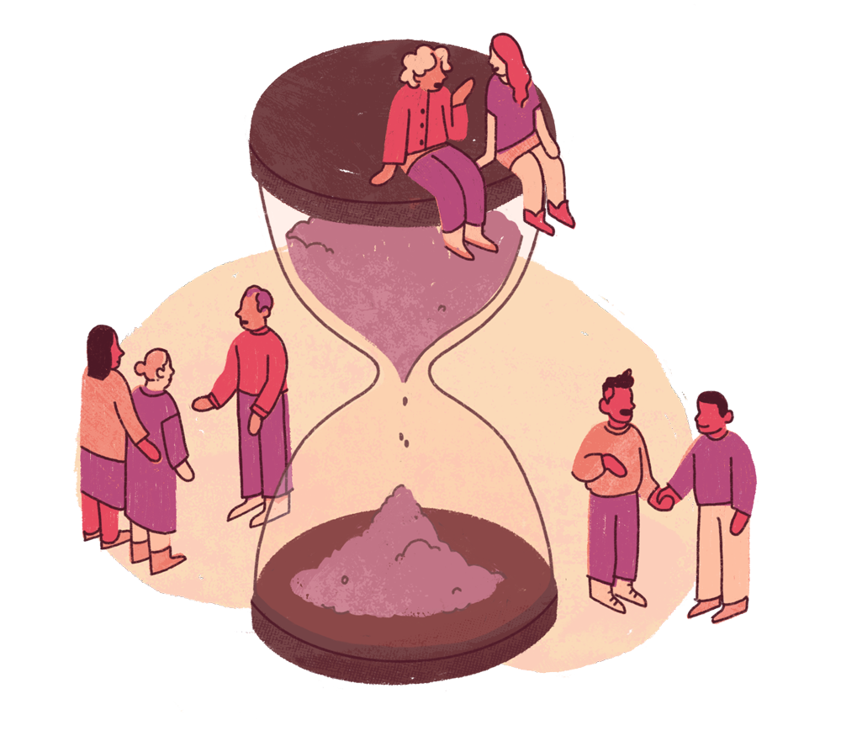
Navigating serious or progressive chronic illness is stressful for patients and their loved ones.
For clinicians and patients, this is a crucial time to talk.
Notes:
While many with serious illnesses want to avoid tests and treatments that may cause harm, particularly at the end of life, many end up receiving them because their wishes are not known.
Earlier and better conversations about values, goals, and wishes ensure individuals receive the care they want, feel less distress, and avoid treatments that are potentially harmful.
Patients are talking about it, just not to their HCP
FP are in unique position to have a relationship with pt over time, trust….

Slide 9
RECOMMENDATION
Don’t offer tests or treatments without establishing your patient’s prognosis, preferences, and goals of care. Potentially harmful or overly aggressive tests or treatments can be avoided by having discussions about goals and wishes, and documenting this information.

Slide 10
RATIONALE
Early conversations about disease understanding, wishes and goals with patients who have serious or progressive chronic illness can avoid potentially harmful tests or treatments. Ensuring patients discuss and document wishes and goals, as well as identify a substitute decision maker can support evidence-informed and patient-centred care.

Slide 11
PARTICIPATING SOCIETIES
Canadian Academy of Child and Adolescent Psychiatry | Canadian Academy of Geriatric Psychiatry | Canadian Association for the Study of Liver | Canadian Association of Emergency Physicians | Canadian Association of Gastroenterology | Canadian Cardiovascular Society
Canadian College of Medical Geneticists | Canadian Critical Care Society | Canadian Society of Endocrinology and Metabolism | Canadian Geriatrics Society | Canadian Headache Society | Canadian Neurological Sciences Federation
Canadian Neurological Society | Canadian Orthopaedic Association | Canadian Paediatrics Society | Canadian Psychiatric Association | Canadian Society for Vascular Surgery | Canadian Society of Allergy and Clinical Immunology
Canadian Society of Internal Medicine | Canadian Society of Palliative Care Physicians | Canadian Society of Surgical Oncology | Canadian Special Interest Group of the American Burn Association | Canadian Spine Society | Canadian Thoracic Society | Canadian Urological Association
Cell Therapy Transplant Canada | College of Family Physicians of Canada | Nurse Practitioner Association of Canada | Public Health Physicians of Canada | Canadian Society of Nephrology | Society of Obstetricians and Gynaecologists of Canada | Society of Rural Physicians of Canada
Notes:
30 societies support this recommendation

Slide 12
WHAT MAKES A TEST/TREATMENT/PROCUDURE UNNECESSARY?
Up to 30% of tests, treatments, and procedures in Canada are potentially unnecessary
Unnecessary tests, treatments, and procedures:
do not add value for patients
potentially expose patients to harm
lead to more testing to investigate false positives
contribute to unwarranted stress for patients and their families
consume precious time and resources

Slide 13
POSSIBLE DRIVERS
Provider Drivers | Patient Drivers
Practice habits | Lack of understanding of risks
Outdated decision-support systems | Bias re: benefits of modern medicine
Defensive medicine | Influence of TV/media
Payment systems reward doing more | Social Determinants of Health
Lack of time for shared decision-making
Notes:
Possible Drivers of Unnecessary Tests, Treatments, and Procedures
Provider Drivers:
Practice habits are traditionally difficult to change, even in the face of new evidence
Outdated decision-support systems encourage over-ordering
Defensive medicine and fear of malpractice lawsuits drive over-investigations
Payment systems reward doing more
Others – lack of skills/competency
Patient Drivers (Amy)
Patients might request tests and treatments without having all the information about risks and benefits
Over emphasis/bias towards benefits of modern medicine
Influence of TV/media
Social Determinants of Health – people of different backgrounds may avoid healthcare system, and when it’s too late they may be requesting unnecessary/aggressive care
Common to both:
Lack of time for shared decision-making between clinicians and patients

Slide 14
RESOURCE STEWARDSHIP
Source: The Globe and Mail
Notes:
To team – yes a news article, will look for literature
Advance care plans can include important information about preferences for place of death. “We know that 75% of Canadians want to die at home,” says Dr. Amit Arya, a palliative care physician working in the Greater Toronto Area. “However, data shows that Canada has high utilization of acute care at the end of life, which means we may not be providing care that aligns with the values or wishes of Canadians.”
Article: https://www.theglobeandmail.com/opinion/article-dying-in-canada-is-costing-a-fortune-and-worse-its-not-how-we-want-it/
(https://www.fams.ca/resources/Documents/Board%20Documents/FAMS%20Minutes/Dying%20in%20Canada%20is%20costing%20a%20fortune%20-%20and%20worse,%20it's%20not%20how%20we%20want%20it%20to%20go%20%20%20Globe%20and%20Mail%202021%201025.pdf)

Slide 15
MISMATCH: WISHES AND OBSERVED REALITY
Most patients wish to die at home
Most patients die in hospitals
70 % of hospitalized seniors wish to have comfort measures instead of interventions that prolong life: over 2/3 are admitted to ICU
Rate of error 37 % in the documentation of level of care in medical records
Notes:
Amy’s slide
Sources :
Présentation de Dr Buchman à l’assemblée annuelle de Choisir avec soin
Palliative Care. CMA’S National Call to Action (2014-2015)
2014 Annuel Report of the Office of the Auditor General of Ontario
Heyland et al.1 interviewed 1439 patients and family members across 16 Canadian hospitals and compared the patient/substitute decision maker (SDM)’s self- described resuscitation preferences to the documented code status in the chart. They found a 37% error rate – 35% of patients didn’t want CPR but had a full code order, and 2% wanted CPR and had a no-CPR order. This is an unacceptable level of avoidable medical error.

Slide 16
Why do you think there is a mismatch?
Notes:
Amy’s slide

Slide 17
What information sources shape patients’ understanding of CPR’s success?
Social media
Television
Discussions with family doctors
Experiences of friends and family
Notes:
Amy’s slide

Slide 18
How many patients believe that the rate of CPR success is greater than 75%?
10%
30%
50%
70%
Notes:
Amy’s slide

Slide 19
WHAT DO PATIENTS KNOW ABOUT CPR?
> 50% of patients estimate that CPR has success rate over 75%
Most people underestimate the risks associated with CPR
Television is the most frequent source of information on CPR (65% in a Californian study)
> 90% want to receive CPR
Notes:
Amy’s slide
Most people overestimate the success of CPR and underestimate its morbidity. Patients in previous studies have cited television as a large source of their belief, and that rates of survival after CPR vary between 19% and 75%.
Two bioethicists observed in 2017 that "CPR has acquired a reputation and aura of almost mythic proportions," such that withholding it might appear "equivalent to refusing to extend a rope to someone drowning.“
This myth can lead to unrealistic expectations about the outcomes of CPR.
This translates into the importance of Serious Illness Conversations.
Sources :
Jones GK, Brewer KL, Garrison HG. Public expectations of survival following cardiopulmonary resuscitation. Acad Emerg Med 2000;7:48–53.doi:10.1111/j.1553-2712.2000.tb01891.xpmid:http://www.ncbi.nlm.nih.gov/pubmed/10894242
Bandolin NS, Huang W, Beckett L, et al. Perspectives of emergency department attendees on outcomes of resuscitation efforts: origins and impact on cardiopulmonary resuscitation preference. Emergency Medicine Journal Published Online First: 13 July 2020. doi: 10.1136/emermed-2018-208084
https://www.bmj.com/company/newsroom/patients-overestimate-the-success-of-cpr/
https://pubmed.ncbi.nlm.nih.gov/28112611/

Slide 20
CPR REALITY
Canadian Study:
In-hospital CPR for cardiopulmonary arrest was associated with 30.4% success at the end of CPR
Only 12% were alive at discharge.
Duration of CPR >10 minutes was predictive of significantly decreased survival to discharge
Notes:
Janet
Canadian study: In-hospital CPR for cardiopulmonary arrest was associated with 30.4% success at our center at the end of CPR but only 12% were alive at discharge. Duration of CPR >10 minutes was predictive of significantly decreased survival to discharge.
Survival statistics, especially those related to specific interventions like CPR, provide valuable information that patients and their families can use to make informed decisions. For example, if a patient understands the low survival rate or the potential for disability associated with CPR, they may choose to decline or limit such interventions if they align with their values and preferences.
Out-of hospital cardiac arrest : ~ 20-25% de ROSC, 6-10% sortent de l’hôpital vivants
In-hospital cardiac arrest: 15-20% survie à 30 jours
Sasson, C., Rogers, M. A., Dahl, J., & Kellermann, A. L. (2010). Predictors of survival from out-of-hospital cardiac arrest a systematic review and meta-analysis. Circulation: Cardiovascular Quality and Outcomes, 3(1), 63-81.
Dr’s also over estimate success rates
References:
https://www.ncbi.nlm.nih.gov/pmc/articles/PMC2945517/#CIT5

Slide 21
HARMS AND BENEFITS OF OTHER INVASIVE TESTS OR TREATMENTS
Blood transfusions
Paracentesis
Dialysis
Others?
Notes:
Serious Illness related

Slide 22
When is a good time to have these conversations?
Admission to hospital New Dx Progression of chronic illness Loss of autonomy Transition of care | Before a new treatment Before a new investigation Age milestones Periodically
Notes:
Janet

Slide 23
BENEFITS OF SERIOUS ILLNESS CONVERSATIONS
Better quality of life for a patient
Reduction of invasive treatments at EOL
Earlier referral to palliative care (or initiations of Palliative Care)
Increased chance that the wishes of the patient will be respected
Better preparation for family towards the grieving process
Survival
Curative Treatments
Rehabilitation
Disease Management
Pain and Symptom Management
Palliative Care
Palliative Treatments
Palliative Care Unit
Grief
End-of-Life Care
Bernacki RE, Block SD; American College of Physicians High Value Care Task Force. Communication about serious illness care goals: a review and synthesis of best practices. JAMA Intern Med. 2014 Dec;174(12):1994-2003. doi: 10.1001/jamainternmed.2014.5271. PMID: 25330167.
Notes:
Care for illness is a spectrum
Amy and Janet

Slide 24
An Evidence-Based Approach
Early communication can improve care
Better quality of life and care, consistent with patient’s wishes
Improved bereavement
Avoidance of harmful care
What can clinicians do?
Have early conversations
Educate patients and families
Use a checklist, conversation guide
Notes:
Janet
Early Communication Can Improve Care
Serious illness conversations are associated with better quality of life and care more consistent with patient preferences
Associated with improved bereavement outcomes for families
Avoid potentially harmful care at end of life such as feeding tubes, nonbeneficial medications
What Can Clinicians Do?
Have early conversations either in an outpatient setting or before a crisis in a hospital setting with patients who have serious or progressive chronic illness
Educate patients and families
Use a checklist or conversation guide

Slide 25
Time to Talk.
Choosing Wisely Canada encourages conversations between clinicians and patients with serious or progressive illnesses.
Taking the time to talk can help to avoid potentially harmful or overly aggressive tests and treatments that may not align with an individual’s goals and wishes.
Notes:
Developed early in the COVID pandemic
Based on Harvard medical school serious illness conversation guide

Slide 26
START THE DISCUSSION
How do you bring up SIC with your patients?
What challenges have you encountered in having SIC with patients and caregivers?
How might a patient want to have this conversation?
Notes:
Janet will start
Amy will continue with the last question
Sometimes SIC happens under stress or duress, like when a patient is acutely unwell, and this could result in a patient receiving care that is inconsistent with their values.
really important to review
Think about what might motivate you to have the discussion – a patient experience after a hospital stay, “I think I did that in the hospital” “I don’t even really remember talking about this” I don’t know the doctors name”, a family member or loved one’s experience
There are many natural opportunities that present if you are thinking about ACP
planned surgery
post discharge or ED visit
Our patients are talking about it, often not with us, (family, friends, lawyers)
Encouraging the discussion also helps the substitute decision makers feel comfortable they are representing their loved ones’ wishes
AMY – How might a patient want to have this conversation
Challenges:
Time
Expertise
Comfort level
Need Amy’s perspective

Slide 27
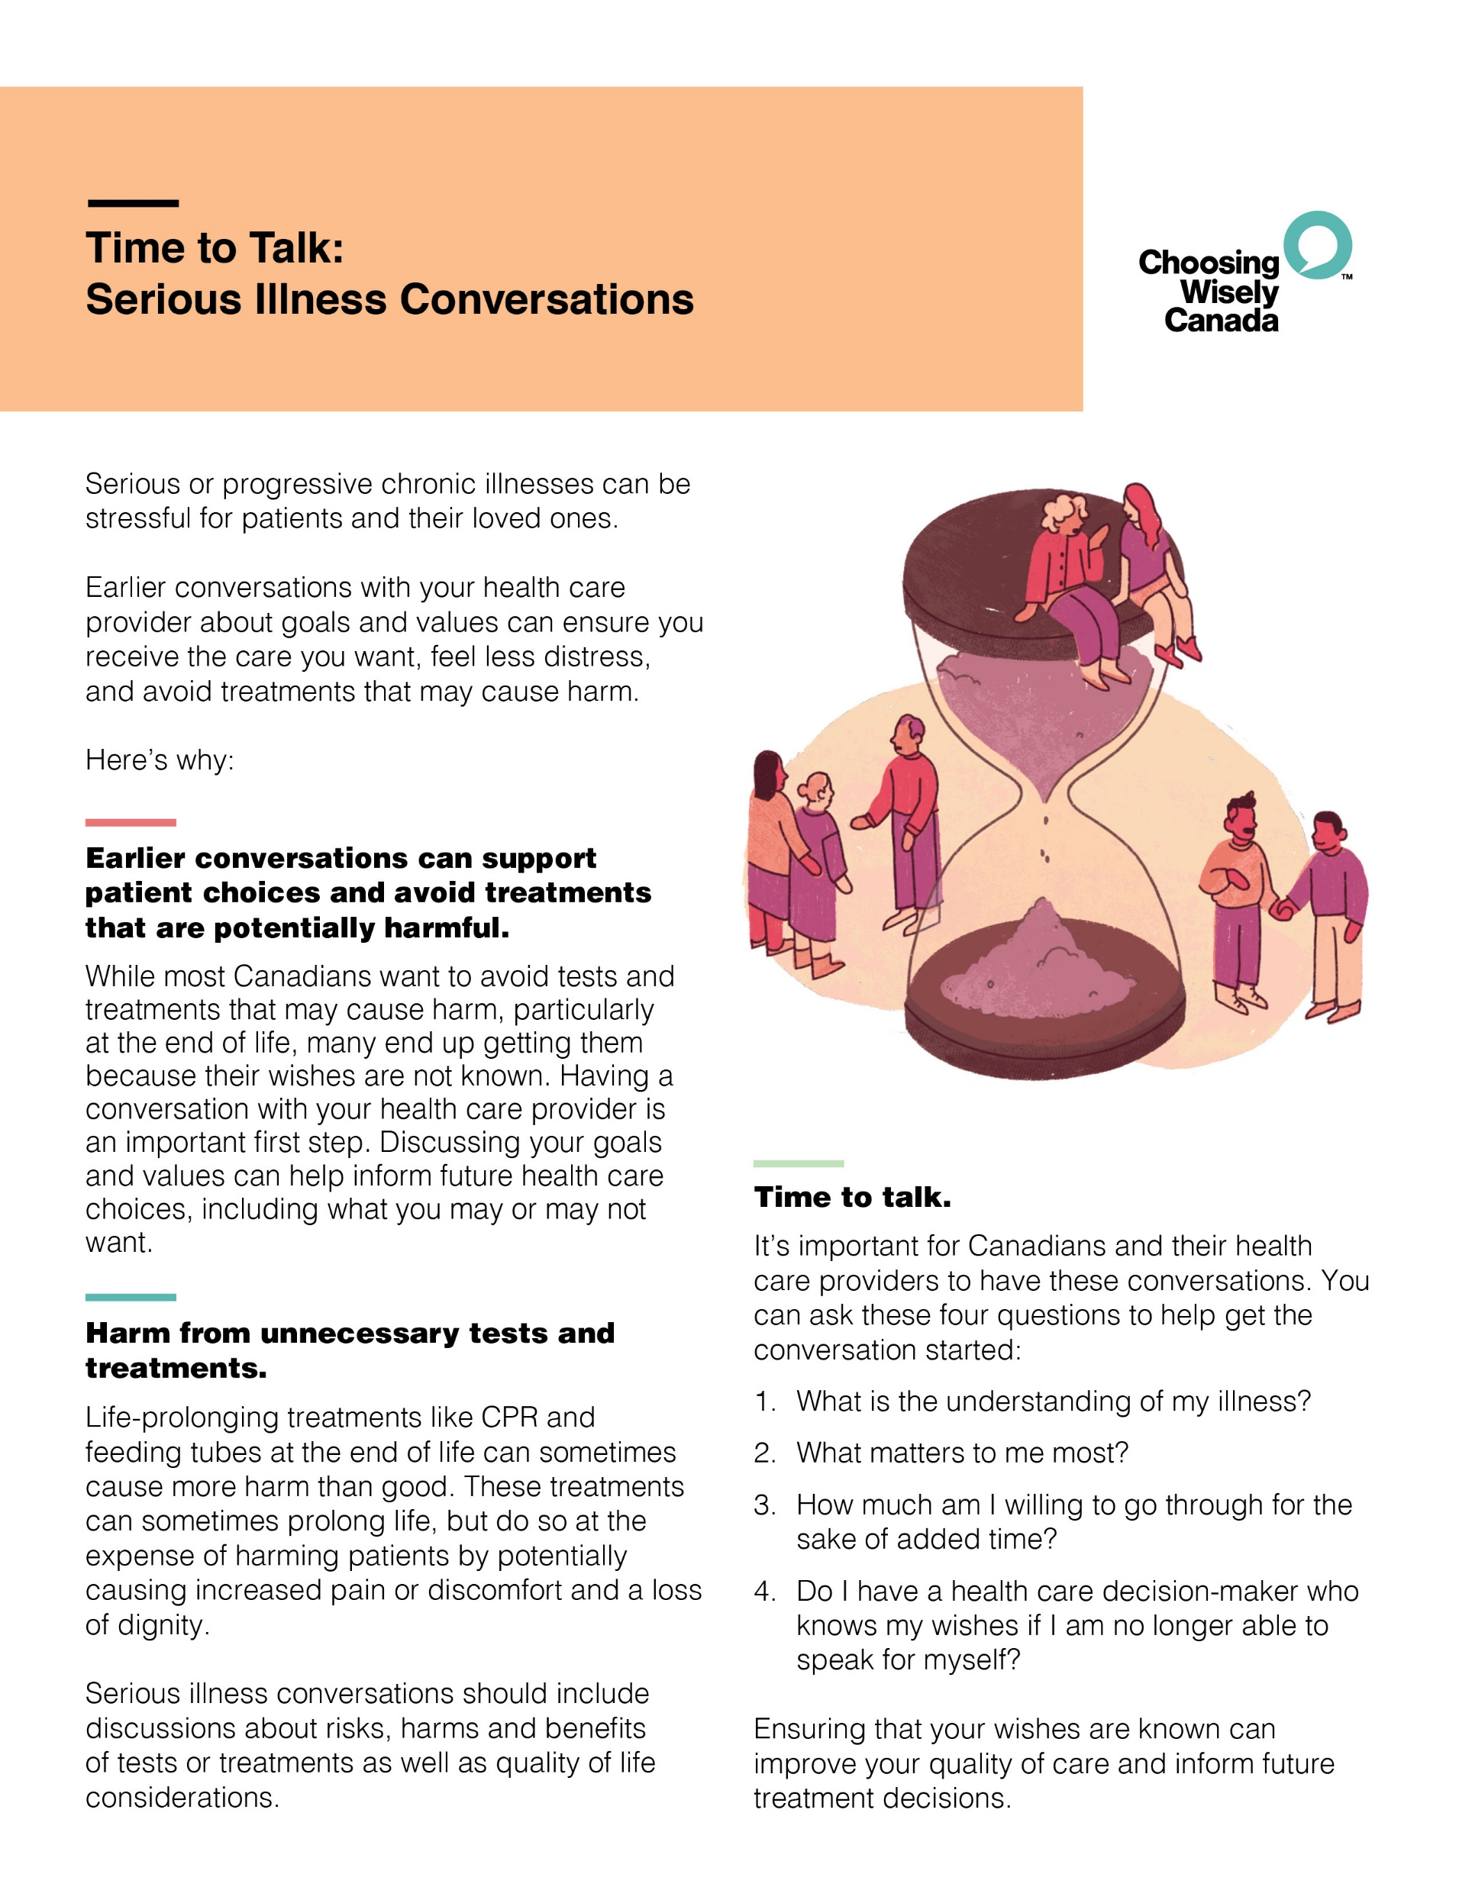
PATIENT PAMPHLET
Designed for clinicians and patients to discuss serious illness conversations.
Notes:
Amy

Slide 28
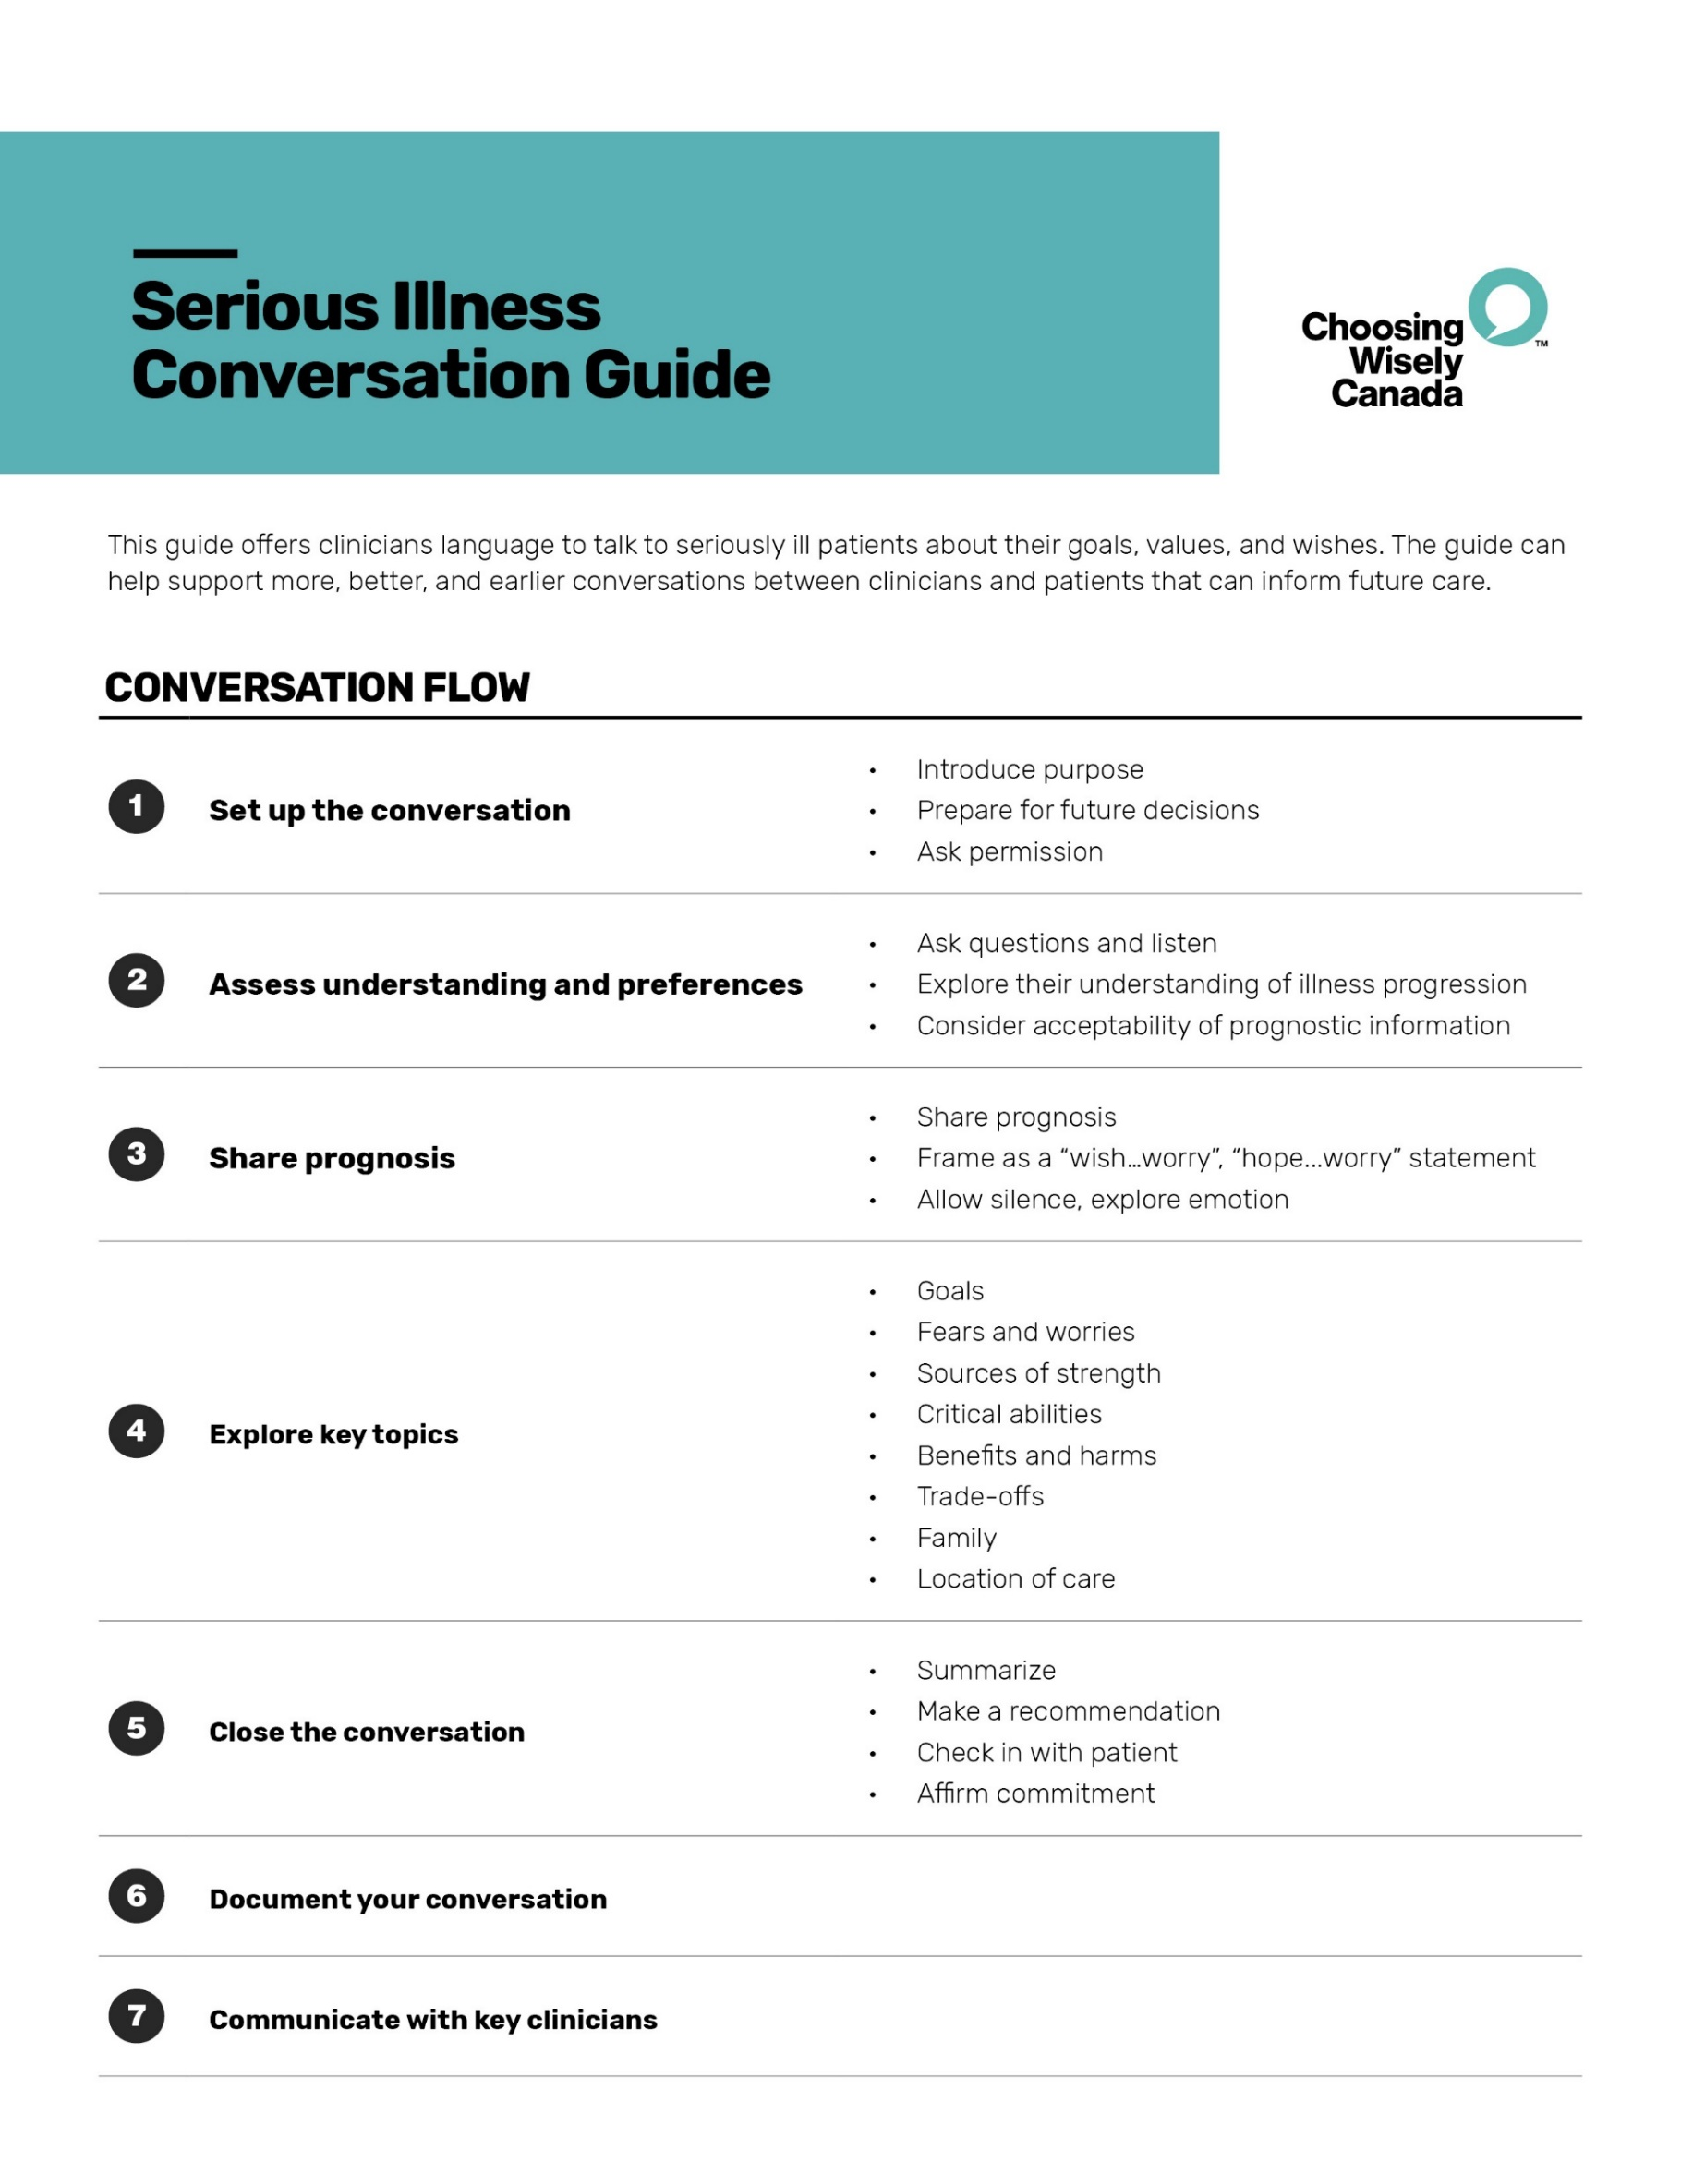
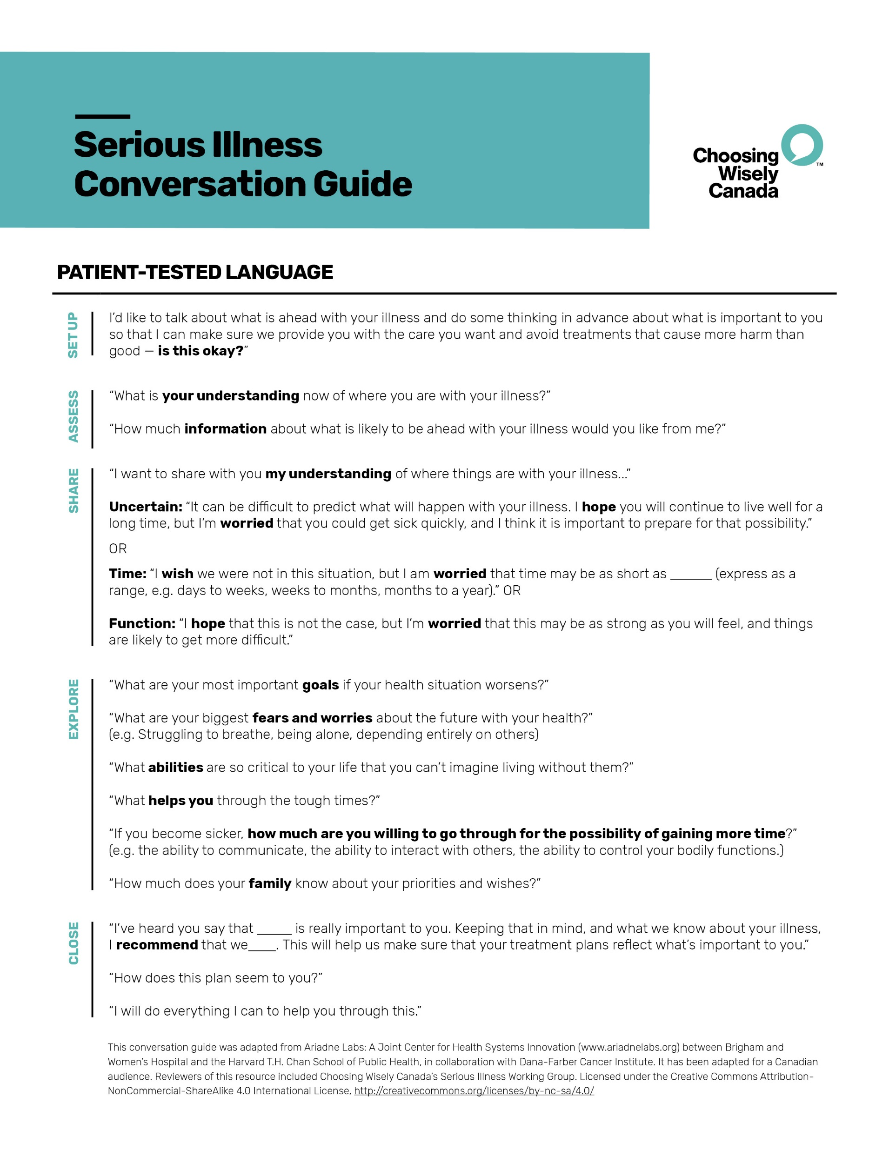
CONVERSATION GUIDE
Designed to help support better and earlier conversations between clinicians and patients about goals and wishes that can inform future care.
Notes:
Janet
This is an important conversation, so I find using the guide very helpful, it’s like an agenda
The order doesn’t matter, the conversation might not all happen in one visit or at one time
The language is patient tested as well so these are phrases that were not considered offensive or abrasive to patients.

Slide 29
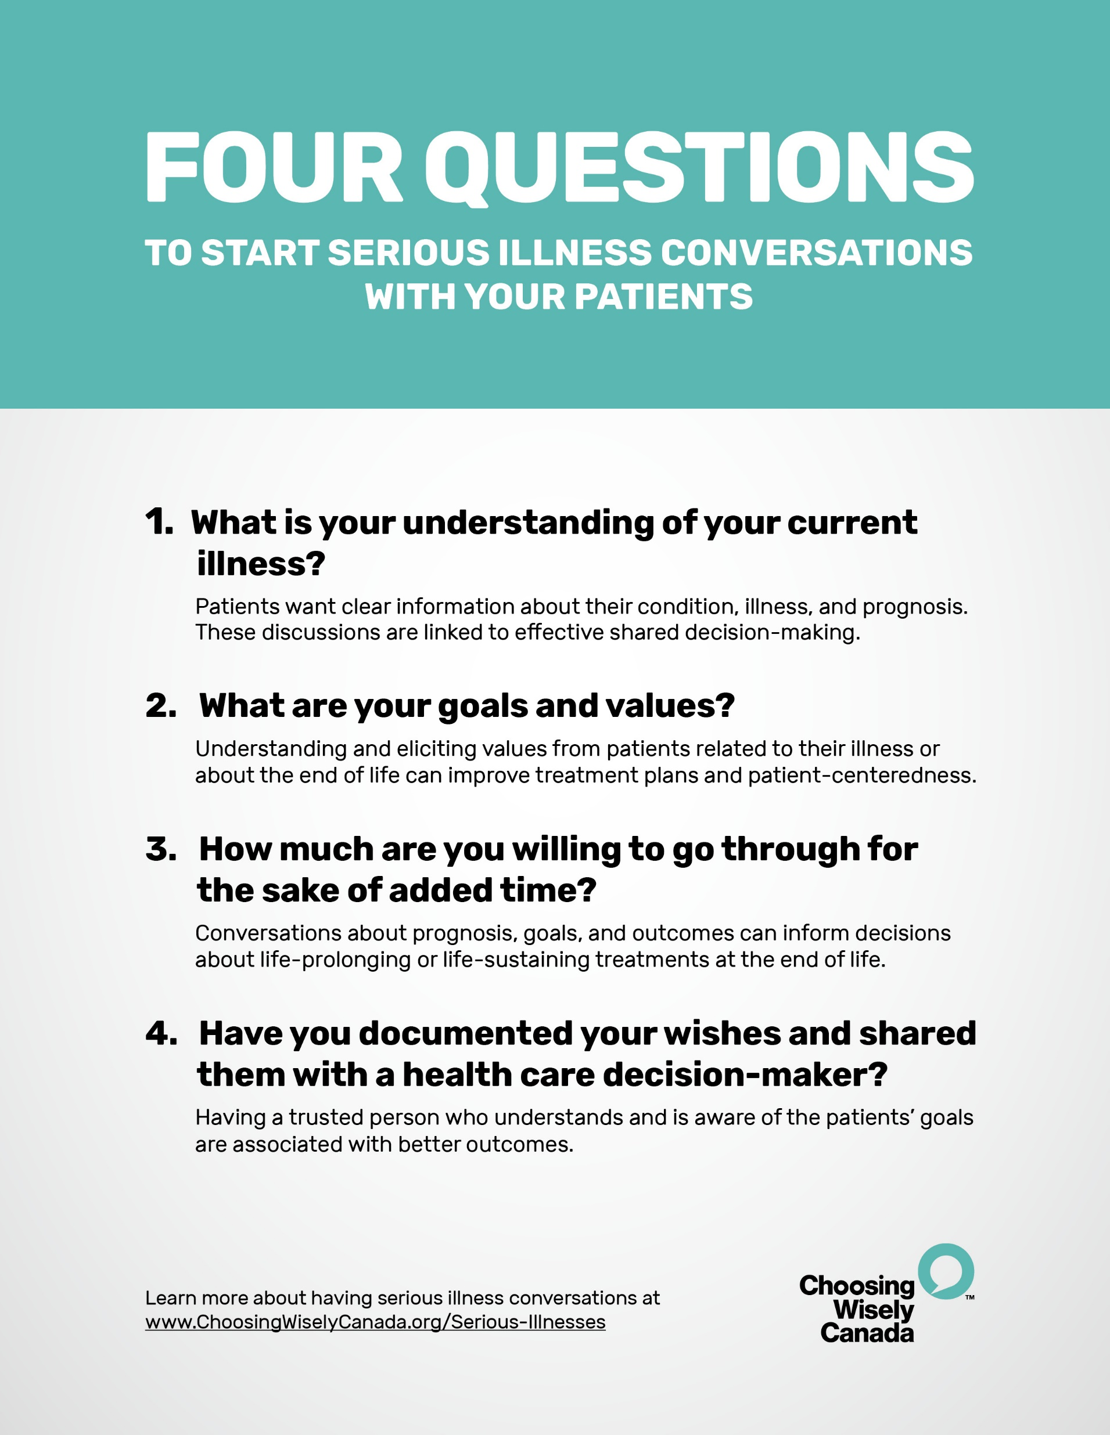
FOUR QUESTIONS
Designed for clinicians to ask patients to start conversations about goals, wishes, and values.
Notes:
Janet

Slide 30
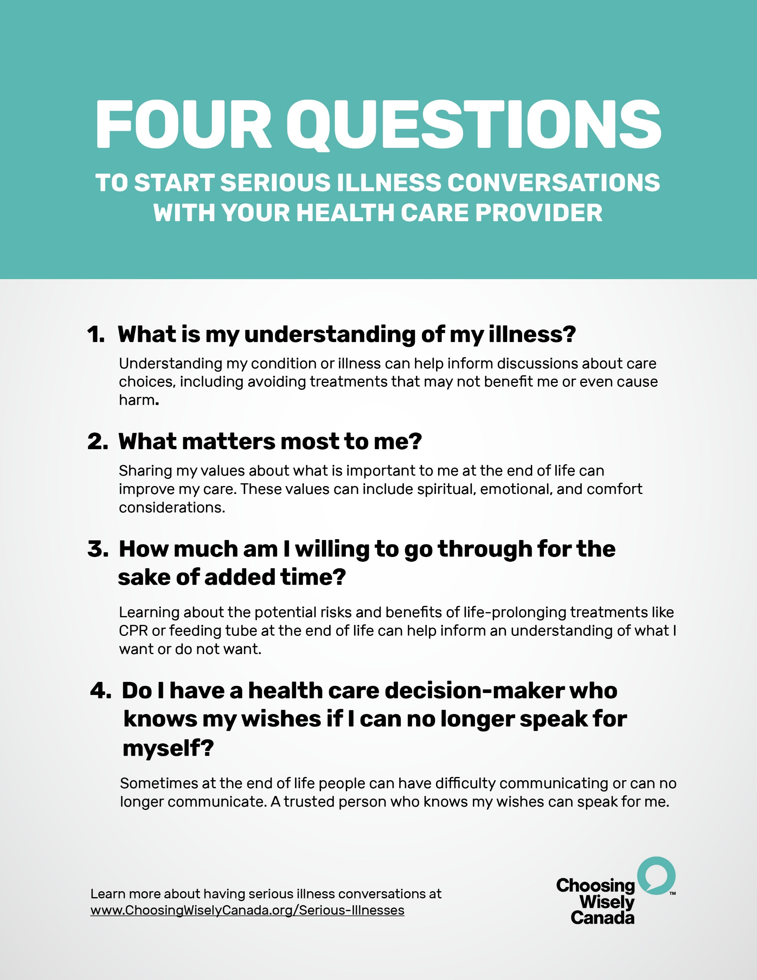
FOUR QUESTIONS
Designed for patients to ask their health care provider to start conversations about goals, wishes, and values.
Notes:
Amy

Slide 31
PATIENT CONTEXT
Understand your patient’s context
Health status
Personal beliefs
Cultural and spiritual beliefs
Education on Advance Care Planning
Patient’s health literacy
Notes:
We do this all the time
Encourage discussion with the patient’s support person
Often patients think their estate planning/will and POA are ACP’s

Slide 32
IT’S NOT “ONE AND DONE”
Serious Illness Conversations can happen over time

Slide 33
QUESTIONS?
jreynolds@cvfp.com
Notes:
Any questions for both Amy or Janet to this email!

Slide 34
ACP Resources
www.advancecareplanning.ca
Includes resources with Indigenous perspectives
https://choosingwiselycanada.org/time-to-talk/
English and French
ABOUT US - Ariadne Labs
First Nations Health Authority - https://www.fnha.ca/Documents/FNHA-BC-Centre-for-Palliative-Care-Preparing-for-a-Serious-Illness-Conversation-Guide.pdf
Notes:
Videos for SIC
What about
First Nations Health Authority: https://www.youtube.com/watch?v=BT6RWhXOJHY

Slide 35
To know more…
Schedule of « Choosing Wisely » talks at FMF
List of resources
Choosing Wisely Websites
(Qc and Canada)

Slide 36
Closing Slide
Thank you!
Please fill out your session evaluation now!
#myfmf
FamilyMedicineForum
FamilyMedForum
FamilyMedForum

