Slide 1


New, True & Poo
“We don’t care what the evidence shows,
we are going to show you the evidence”
Mike Allan
Tina Korownyk
Danielle Perry
peerevidence.ca

Slide 2


Faculty/Presenter Disclosure - Mike
Speakers Bureau/Honoraria: OCFP, NLCFP, ACFP, NBCFP, Peterborough Hospital Rounds, PEIP & MEME conference, Sharp, UBC (varying rounds/ conferences), WCB AB, Worksafe BC, Edmonton Diabetes Assoc.
Consulting Fees: N/A
Grants/Research Support: Funding for clinical trials (BedMed) - Canadian Institute of Health Research (CIHR), Partnership for Research and Innovation (PRIHS)
Patents: N/A
Other: Salary - CFPC, Honorarium from BS Medicine Podcast

Slide 3
Faculty/Presenter Disclosure - Tina
Speakers Bureau/Honoraria: PEIP & MEME conference, ACFP and other provincial conferences, Sharp
Consulting Fees: N/A
Grants/Research Support: Funding for clinical trials (BedMed) - Canadian Institute of Health Research (CIHR), Partnership for Research and Innovation (PRIHS)
Patents: N/A
Other: Salary - UofA

Slide 4
Faculty/Presenter Disclosure - Danielle
Speakers Bureau/Honoraria: PEIP conference, ACFP, Dalhousie CPD, Center for Effective Practice
Consulting Fees: N/A
Grants/Research Support: N/A
Patents: N/A
Other: Salary – College of Family Physicians of Canada, Correctional Services of Canada.

Slide 5
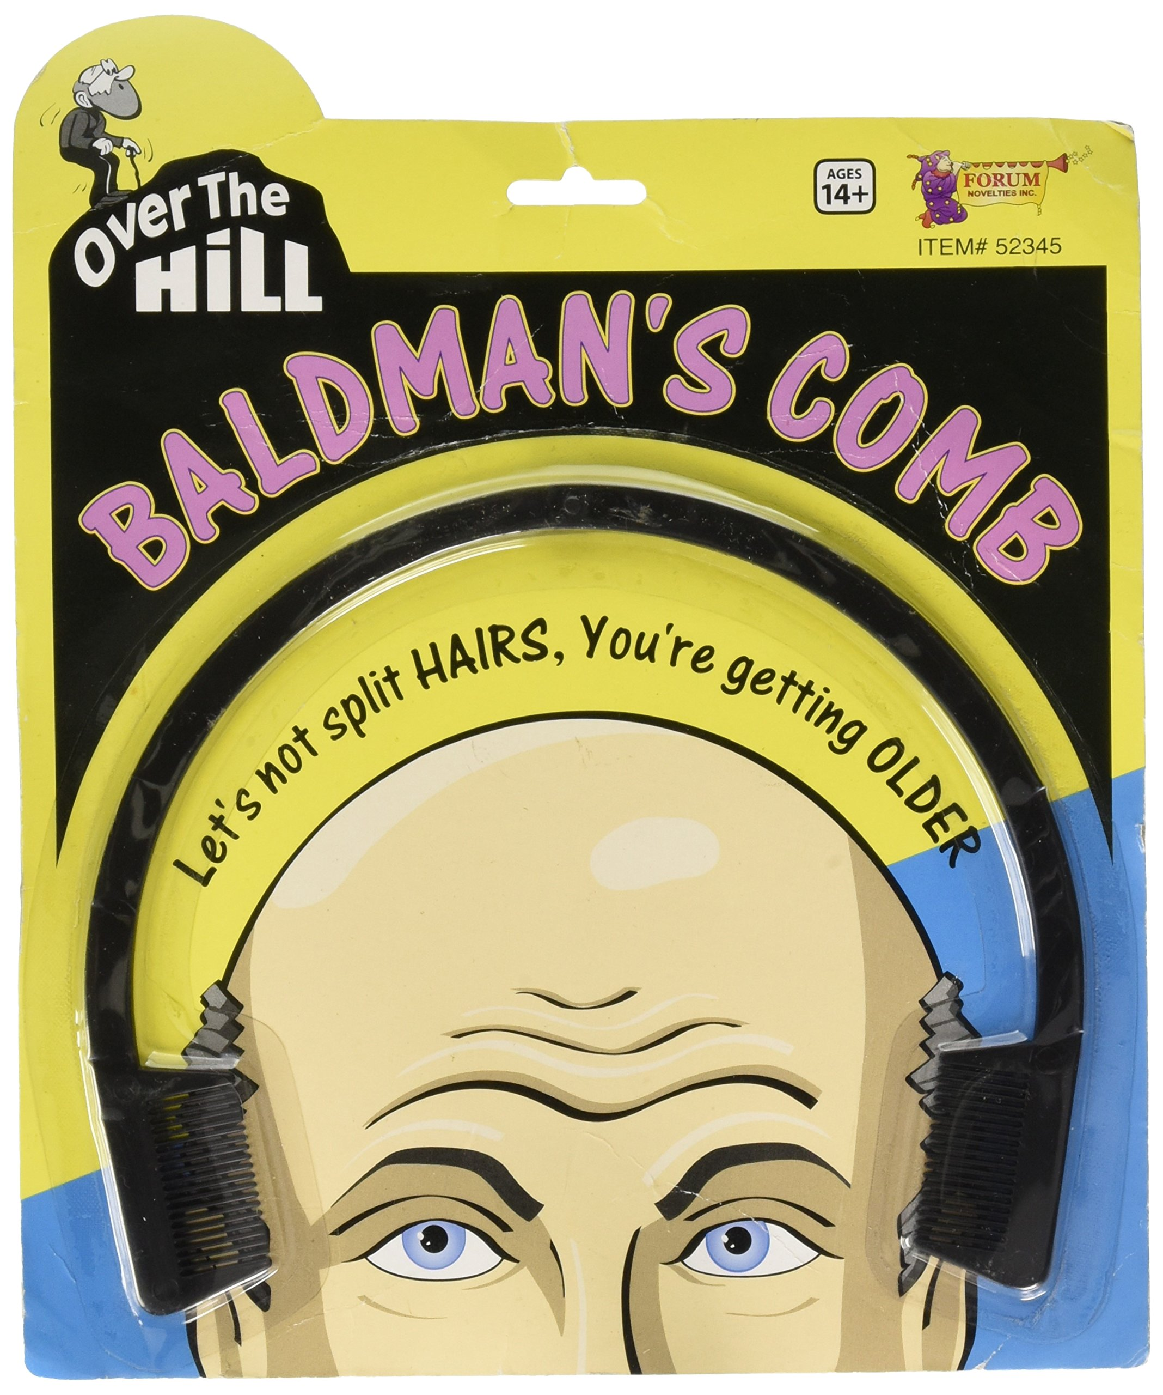
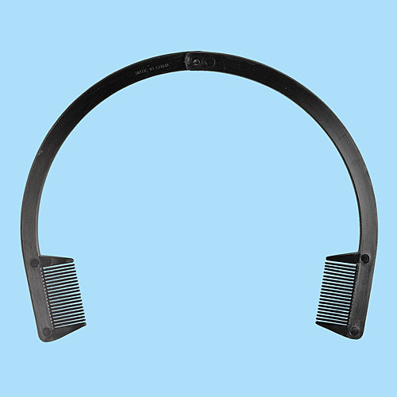
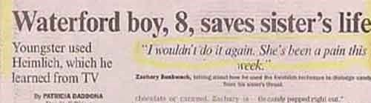

Objectives
Describe novel 2021 interventions or diagnostic information relevant to family medicine.
Describe newly confirmed/proven 2021 interventions or diagnostic information relevant to family medicine.
Describe newly determined findings from 2021 that should help reconsider practice interventions or diagnostic information relevant to family medicine.
What’s New
What’s True
What’s Poo

Slide 6



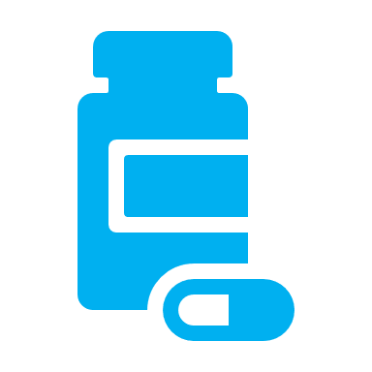
RCT: Early treatment for Gestational Diabetes
802 women, 4 wks - <20 wks preg:
- 46% family Hx diabetes, BMI ~32
Pregnancy
Pregnancy-related HTN - eclampsia, preeclampsia, gestational HTN: NSS
At 24-28 weeks’: women on meds: 67% vs 46% (deferred/no)
Perineal Injury: 0.8% vs 3.6%, NNT 37
0.8 fewer NICU days.
Immediate GD treatment or deferred/no Tx (based on OGTT at 24-28 wks)
Bottom-Line: Dx & Tx of gest diabetes before 20 wks’ gestation may reduce adverse neonatal outcomes, namely resp distress for 1 in 14. Quality of life, NICU days, & perineal injury, may be improved.
Composite Adverse Neonatal Outcomes: 25% v 31%; RR 0.82 (0.68, 0.98); NNT 18
- Of individual components, only neonatal resp distress (10% v 17%, NNT 14) SS
Simmons D et al. N Engl J Med. 2023 Jun 8;388(23):2132-44.
Notes:
Inclusion Criteria:
Women 4 weeks-19 weeks + 6 days gestation
Risk factor for hyperglycemia (previous gestational diabetes, BMI >30, age >40, first degree relative with diabetes, previous macrosomia, PCOS, non-European ancestry. 22% primigravid
Had to meet WHO diagnostic criteria for gestational diabetes prior to 20 weeks’ gestation (A 2-hour 75-g OGTT was performed before 20 weeks’ gestation. Women fulfilling World Health Organization (WHO) diagnostic criteria for gestational diabetes11 (a fasting glucose level of ≥92 mg per deciliter [≥5.1 mmol per liter], a 1-hour glucose level of ≥180 mg per deciliter [≥10.0 mmol per liter], or a 2-hour glucose level of ≥153 mg per deciliter [≥8.5 mmol per liter]) before 20 weeks’ gestation were eligible for randomization.)
Exclusion Criteria:
Preexisting diabetes
Fasting glucose level >6.1 mmol/L, 2-hour glucose level >11.1 mmol/L, active medical disorders that local investigators considered to be contraindications to participation.
Interventions:
Immediate treatment for gestational diabetes
(Management included education, dietary advice and instructions on how to monitor capillary blood glucose levels; thresholds for the initiation and intensification of pharmacotherapy were consistent with those used in previous RCTs)
Deferred or no treatment (depending on the results of a repeat oral glucose-tolerance test OGTT) at 24-28 weeks’ gestation
The clinic and trial staff and participants were unaware of the OGTT results.
Results:
N=802 (f/u available for 793)
Mean age: 32
Primigravid: 173/793 22%
Family hx DM: 363/793 46%
GDM in prev preg: 226/793 28%
PCOS: 152/793 19%
Baseline BMI ~32
Initial OGTT tested at ~16 weeks
OGTT <14 weeks gestation: 184/793 23%
Dx of GDM at weeks 24-28: 238/355 67%
Outcomes
Originally three primary outcomes, however when the results of the second were NSS, the third outcome was moved into secondary.
Composite of Adverse Neonatal Outcomes (birth <37 weeks’ gestation, birth trauma, birth weight >4500 g, respiratory distress, phototherapy, stillbirth or neonatal death, shoulder dystocia)
Pregnancy-related HTN (preeclampsia, eclampsia, or gestational HTN)
Neonatal lean body mass (moved into secondary because pregnancy-related HTN was not statistically significant)
Canadian Guidelines (2018):
Diabetes Canada: Clinical Practice Guidelines (https://guidelines.diabetes.ca/cpg/chapter36): “In women at high risk of undiagnosed type 2 diabetes, early screening (<20 weeks) with an A1C should be done to identify women with potentially overt diabetes to guide fetal surveillance and early maternal treatment, including self-monitoring of blood glucose, interventions that promote healthy behaviours and healthy weight gain.”
Similar to what is being studied in this trial.
To conceal the trial-group assignment from the women in the control group and the treating healthcare team, some women without early gestational DM (“decoys”) were randomly assigned to the same treatment assignments.
Other Outcomes
Caesarean delivery, induction of labour- NSS
Median EQ-5D Score at 24-28 weeks (Scores 0-1, higher=better):
0.83 v. 0.81 (deferred)
RR 1.03 (95 % Cl 1.01, 1.04)
Clinically Meaningful = 0.04 – 0.1 (likely MCID)
Perineal Injury:
3/375 (0.8%) v. 13/365 (3.6%)
RR 0.23 (95% Cl 0.10, 0.51)
No difference in all neonatal secondary outcomes (including the neonatal lean body mass) except for median number of bed days in special care nursery or NICO
RR 0.60 (0.41, 0.89)
Difference in 0.80 (-1.3, -0.3) fewer days (in favour of immediate treatment.
Limitations:
Maybe not generalizable without risk factors for hyperglycemia
Nonstandardized approach to treatment for GF and the use of treatment targets that had been established for the third trimester of pregnancy and had not been tested in early pregnancy

Slide 7
Triple-Hormone-Receptor agonist (Retatrutide) for Weight Loss
RCT 338 adults with obesity without DM. Age ~48, weight 108kg, BMI 37
Retatrutide (6 arms): 1mg, 4 mg (start 2 or 4mg), 8mg (start 2 or 4mg), 12 mg (start 2mg) s.c. weekly vs placebo x 48 wks
Most common AE’s: nausea (14-60% vs 11% placebo), vomiting (3-26% vs 1% placebo), hypersensitivity (3% vs 3-20%)
Surrogates (lipids, BP, A1C) generally improve: E.g. 41% of hypertension pts stopped ≥1 BP med on 8mg/weekly
Limitations: Industry funded, small numbers per group (phase 2 trial), included overweight with risk = 4%
Outcome (48 weeks) | 1mg | 4mg | 8mg | 12 mg | Placebo
Mean % change in weight | 9 | 17 | 23 | 24 | 2
≥10% weight loss (NNT) | 27% (6) | 75% (2) | 91% (2) | 93% (2) | 9%
Withdrawals due to adverse events | 7% | 8% | 10% | 16% | 0
Bottom Line
Retatrutide s.c weekly results in an average 9-24% weight loss after 48 weeks vs 2% with placebo. At 4mg and up, ≥75% experience ≥10% weight loss & 7-16% will discontinue due to adverse events.
DP
N Engl J Med. 2023;10.1056/NEJMoa2301972
Notes:
Semaglutide data: mean change ~15%, with ~70-75% losing at least 10% vs 15% placebo. Here, up to 90% losing at least 10% body weight. Note comes at cost of more stopping for AE>. 6% for sema, but here ~10-16%.
At first glance, indirectly appears better than sema or tirzepatide.
USA; dose escalation every 4 weeks for up to 12 weeks; all participants received lifestyle intervention incl regular counseling sessions by dietician or HCP; no energy deficit specifically required.
Only 4% of participants were overweight with a comorbidity (BMI <30),
48% female
Primary outcome at 26 weeks similar to secondary outcome at 48 weeks (end of trial) – we present 48 weeks – more interested in long term (26 weeks is when wgt loss peaks normally).
AE’s typically occurred during dose escalation – mild to moderate in severity and more frequent in higher doses
No difference in SAE’s compared to placebo (4% both groups). Unique AE hypersensitivity (3% placebo vs 3-20% drug) and hyperesthesia (1% placebo vs 1-14% drug). Increases HR 1-9/minute at 6 months, starts to get less (2-7)
Between 33-43% had DM, hypertension, or dyslipidemia – Also improved

Slide 8


1. Whartson S, et al. N Engl J Med. 2023 Jun 23; 2. Garvey WT et al. Lancet 2023 June 26;S0140-6736(23)01200-X; 3. Knop FK et al. Lancet 2023. June 23;S0140-6736(23):01185-6. 4. Weghuber D et al. N Engl J Med. 2022 Dec 15;387(24):45-57.
Snappers
Daily Oral GLP-1 Orforglipron
272 adults (109 kg, BMI 38) given orforglipron 12 mg, 24 mg, 36 mg, 45 mg or placebo x 36 weeks
>10% weight loss: 70% versus 9% (placebo)
Bottom-Line
Industry funded with results similar to other GLP-1 agonists. NA in Canada (Oct 2023).
Tirzepatide for obesity in patients with TIIDM
938 adults (101 kg, HgbA1c 8%) randomized to tirzepatide 10 mg, 15 mg or placebo x 72 weeks. All received lifestyle intervention.
>10% weight loss: 65% versus 9% (placebo)
Bottom-Line
Industry funded with results like previous studies.
Oral Semaglutide for overweight & obesity
667 adults (105 kg, BMI 38) given semaglutide 50 mg or placebo x 68 weeks. All received lifestyle intervention.
>10% weight loss: 70% versus 12% (placebo)
Bottom-Line
Industry funded with results similar to weekly semaglutide and other GLP-1.
Semaglutide for obesity in adolescents
201 adolescents (108 kg, BMI 37) randomized to semaglutide 2.4 mg/weekly or placebo x 68 weeks. All received lifestyle intervention.
>10% weight loss: 62% versus 8% (placebo)
Bottom-Line
Industry funded with results similar to studies in adult patients.
*GI Adverse Events (nausea/vomiting) common in all trials. Mainly mild to moderate and occurring during dose escalation and not leading to permanent discontinuation.
DP
Notes:
Orforglipron: new GLP-1 triple mechanism, PO. Small RCT. Mean weight loss at 36 weeks: ~14% vs 2% placebo, and loss greater than 10% was 70% vs 9%. All very similar to other GLP1. Difference: AE drop-outs: ~15-20% vs 2% placebo. Other GLPs usually around 5% drop outs.
Oral sema: FINALLY. Previously, only had data with 14mg dose in DM and studies designed to look at glycemic control/CVD. This was specific to weight loss. Used 50g dose. Used special formulation. Removed a pretty standard filler and binder because of concners of absorption. If not aware, need to take oral sema first thing in AM on empty stomach, with no more than 120 ml water, wth no other food, drink or meds for at least 30 minutes. Mean weight lossin original DM studies: ~5%. Here, it was 15% vs 2% placebo. Stopping for AE typical at ~5% vs 4% placebo. Very similar to SC semaglutide weight loss studies.
Tirzepatide: smaller study that first tirzep weight loss study (>2000 patients). Older study found weight loss ~20%, with 80% losing more than 10% body weight. This stidy found mean weight loss ~15%, with 65% losing at lest 10%
Semaglutide in adolescents: works similar to adults. Still don’t know long-term safety. Still seeing weight regain when stop. In adults, mean weight loss ~15% and 70% lose at least 10% body weight. Here , mean weight loss 15% (same)
1. Daily oral GLP-1 receptor agonist orforglipron for adults with obesity.
Phase 2 double-blind RCT
Conducted in Canada, US, Hungary
36 weeks
Funding: Eli Lilly Garvey WT, e al. Lancet 2023 June 26;S0140-6736(23)01200-X
Inclusion:
Age 18-75
BMI >27 with at least one weight-related coexisting condition (HTN, dyslipidemia, CVD, obstructive sleep apnea) or BMI >30 (obesity)
Stable body weight (<5 kg gain or loss) for three months prior to randomization
Exclusion
Diabetes (HgbA1c >6.5%)
Prior/planned surgical treatment for obesity;
Endoscopic/device-based therapy for obesity (had or planned)
Elevated resting pulse (>100bpm)
Interventions:
2-week lead in and screening period (nothing given)
Orforglipron 12 mg , 24 mg , 36 mg , 45 mg Starting dose: 2 or 3 mg (escalated over 16 weeks; different schedules based on starting dose)
Placebo
Once daily x 36 weeks;
Throughout the trial, education regarding healthy eating and exercise was provided by trial personnel to all participants.
2-week follow up period
Outcomes:
Primary Outcome: % change from baseline in body weight at week 26.
12 mg: -8.6%
24 mg: -11.2%
36 mg: -12.3%
45 mg: -12.6%
Placebo: -2.0%
Secondary Outcome: % Change in Body Weight from Baseline to Week 36.
12 mg, 24 mg, 36 mg, 45 mg, placebo, resp.
-9.4%, -12.5%, -13.5%, -14.7%, -2.3%
Responder Analyses
(12 mg, 24 mg, 36 mg, 45 mg, placebo, respectively)
No p-values or measures of statistical differences provided.
>5% weight reduction:
26 weeks: 74%, 89%, 90%, 87%, 23%
36 weeks: 72%, 90%, 92%, 90%, 24%
>10% weight reduction:
26 weeks: 39%, 57%, 71%, 70%, 2%
36 weeks: 46%, 62%, 75%, 69%, 9%
>15% weight reduction (exploratory):
26 weeks: 21%, 26%, 34%, 34%, 0%
36 weeks: 22%, 33%, 43%, 48%, 1%
Withdrawals due to AEs:
14% (12 mg),
19% (24 mg),
10% (36 mg- Subcohort 1),
21% (36 mg- Subcohort 2),
16% (45 mg Subcohort 1),
13% (45 mg Subcohort 2),
2% (placebo)
*Subcohorts were those with different starting doses (2 mg or 3 mg) and therefore different dose escalation schemes.
Nausea was most common adverse event (37-58% orforglipron versus 10% with placebo).
Vomiting: 14-32% versus 6% with placebo
GI events were the most common adverse events that led to trial discontinuation (30/35 participants who discontinued intervention).
Most episodes were mild-moderate in severity, occurred during dose escalation and resolved without discontinuation of intervention.
2. Tirzepatide once weekly for the treatment of obesity in people with type 2 diabetes (SURMOUNT-2): a double-blind, randomized, multicentre, placebo-controlled, phase 3 trial.
Phase 3, double-blind
72 weeks
7 countries, 77 sites (Argentina, Brazil, India, Japan, Russia, Taiwan, USA)
Funding: Eli Lilly
Inclusion:
Adults >18 years
BMI >27
Type 2 Diabetes (HgbA1c 7-10%) on stable therapy (either diet/exercise alone or oral antihyperglycemic medications) for at least 3 months prior to screening
Exclusion:
Change in body weight >5 kg within 3 months prior to screening.
Previous/planned surgical treatment for obesity.
Treatment with anti-obesity medications.
DPP-4, oral GLP-1, or any injectable treatment for TIIDM within three months of screening.
Interventions:
Tirzepatide 10 mg SC
Tirzepatide 15 mg SC
Dose Escalation: Starting 2.5 mg weekly increasing by 2.5/q4 weeks.
Placebo SC
All participants received a lifestyle intervention, which included regular lifestyle counselling sessions delivered by a dietician or qualified healthcare professional focused on healthy balance meals with a recommended calorie deficit of 500 cal/day (relative to estimated total daily energy expenditure) and at least 150 minutes/week of physical activity.
Those on sulfonylureas at baseline had their dose halved or stopped if already on lowest dose.
Metformin was recommended as first-line rescue therapy for patients not prescribed antihyperglycemic medications at baseline. Basal insulin was permitted for participants already receiving combination therapy (at investigator’s discretion).
Population Included:
N=938 (92% completed)
Mean Age 54
51% female,
76% white
60% Hispanic/Latino
~18 years living with obesity
Mean Weight: 100.7 kg
BMI >40: 23%
HgbA1c: 8%
54% on one oral antihyperglycemic drug at baseline
66% HTN, 61% dyslipidemia
63% >3 weight-related complications
Outcomes:
Coprimary endpoints= Percent change in bodyweight from baseline and bodyweight reduction of 5% or higher.
Week 72:
10 mg, 15 mg, placebo, respectively.
Percent Change in Weight:
-12.8%, -14.7%, -3.2%
Estimated Treatment Difference (ETD)
10 mg versus placebo: -9.6% (-11.1, -8.1)
P<0.0001
ETD: 15 mg versus placebo: -11.6% (-13.0, -10.1) p<0.0001
Weight Reduction >5%
247/312 (79%)
257/311 (83%)
102/315 (32%)
OR (10 mg versus placebo): 8.3 (5.6, 12.3)
OR (15 mg versus placebo): 10.5 (6.8, 16.1)
Weight Reduction >10%
189/312 (61%)
202/311 (65%)
30/315 (9%)
OR (10 mg versus placebo): 16.1 (9.9, 26.1)
OR (15 mg versus placebo): 19.4 (11.9, 31.7)
Weight Reduction >15%
124/312 (40%)
149/311 (48%)
8/315 (3%)
OR (10 mg versus placebo): 25.2 (12.2, 52.1)
OR (15 mg versus placebo): 36.1 (17.5, 74.5)
Weight Reduction >20%
67/312 (22%)
96/311 (31%)
3/315 (1%)
OR (10 mg versus placebo): 25.6 (8.7, 75.4)
OR (15 mg versus placebo): 42.2 (14.1, 123.5)
Patients with HgbA1c <6.5%:
249/312 (80%)
247/311 (79%)
63/315 (20%)
OR (10 mg versus placebo): 17.8 (11.1, 28.6)
OR (15 mg versus placebo): 18.5 (11.2, 30.7)
Post-hoc analysis: Proportion of patients taking >2 antihyperglycemic medications decreased from 38% and 38% to 33% and 32% with 10 mg and 15 mg, and increased with placebo from 42% to 53%.
No significant between group differences in overall incidence of AEs.
Treatment-emergent AEs: 78% (10 mg), 71% (15 mg), 76% (placebo)
Most common AEs with tirzepatide= GI disorders (diarrhea/NV)
Mild to moderate in severity, occurring mainly during dose escalation and decreased over time.
Three cases of confirmed pancreatitis (2= 15 mg, 1 = placebo)
No difference in cholelithiasis.
3. Oral semaglutide 50 mg taken once per day in adults with overweight or obesity (OASIS 1): a randomized, double-blind, placebo-controlled, phase 3 trial.
Double-blind, phase 3 superiority trial
9 countries, 50 outpatient clinics (Asia, Europe, North America)
68 weeks + 7-week follow up
Funding: Novo Nordisk
Inclusion:
Adults > 18 years (>20 years in Japan)
BMI >30 or BMI >27 with >1 body weight-related complication or comorbidity (HTN, dyslipidemia, obstructive sleep apnea, CVD) and with at least one self-reported dietary bodyweight loss effort
Exclusion:
>5 kg change in body weight in the 90 days prior to screening
Previous/planned weight loss surgery
HgbA1c >6.5% or history of diabetes
Interventions:
Semaglutide 50 mg
Initiated at 3 mg and increased every 4 weeks (up to 50 mg by week 16)
Placebo
Oral, once daily
Both received lifestyle intervention: counselling on diet (500 calorie deficit relative to estimated total energy expenditure) and 150 minutes/week of physical activity. Counselling sessions every 4 weeks from registered dietician or other qualified healthcare professional.
Population Included:
N=667
Mean age: 50
73% female
74% White
Mean body weight: 105.4 kg
Mean BMI: 37.5
46% HTN
40% dyslipidemia
76% >1 comorbidity at screening
Results:
Coprimary endpoints= percentage change in body weight and whether participants reached a bodyweight reduction of at least 5% at 68 weeks.
Change in body weight (%): -15.1% versus -2.4% (placebo)
ETD: -12.7% (-14.2, -11.3) p<0.0001
Weight Reduction >5%
269/317 (85%)
76/295 (26%)
OR 12.6 (8.5, 18.7), p<0.0001
Weight Reduction >10%
220/317 (69%)
35/295 (12%)
OR 14.7 (9.6, 22.6), p<0.0001
Weight Reduction >15%
170/317 (54%)
17/295 (6%)
OR 17.9 (10.4, 30.7), p<0.0001
Weight Reduction >20%
107/317 (34%)
8/295 (3%)
OR 18.5 (8.8, 38.9), p<0.0001
Impact of weight loss on QOL Physical Function Score
Participants with a 14.6-point change (clinically meaningful change)
149/98 (50%)
87/278 (31%)
OR 2.8 (1.9, 4.1)
Participants whose BMI changed from >30 to <30.
129/294 (44%)
19/268 (7%)
OR 14.1 (8.0, 25.9)
Safety
AEs leading to D/C: 19/334 (6%) 12/333 (4%)
GI disorders leading to D/C: 4% vs 2%
GI Disorders: 268/334 (80%) versus 154/333 (46%)
Cholelithiasis 11/334 (3%) vs. 4/333 (1%)
GI-related (nausea, constipation, diarrhea, vomiting) was typically transient and mild-moderate in severity and resolved without permanent trial product discontinuation. Peaked during dose escalation period.
Benign/Malignant Neoplasm Events:
30/334 (9%) versus 17/333 (5%)
Malignant Neoplasms:
5/334 (2%) versus 4/333 (1%)
Imbalance likely due to benign neoplasms.
4. Once weekly semaglutide in adolescents with obesity.
Double-blind, placebo-controlled
12-week, run-in (lifestyle intervention)
68-week intervention period
7-week follow-up
37 sites (multinational)
Funding: Novo Nordisk
Run-in period: used to ensure lifestyle intervention (which is first line treatment in adolescents)
Used to ensure documentation of at least one failed lifestyle intervention attempt.
Lifestyle intervention = diet and physical activity counselling for weight loss
Inclusion:
Adolescents 12 to <18 years old
BMI in > 95th percentile or BMI > 85th percentile with at least one weight-related coexisting condition
At least one unsuccessful dietary weight-loss effort
Those with T2DM- treated with diet/exercise alone or metformin alone, with HgbA1c <10%
Exclusion:
Weight change >5 kg or use of medication for obesity within 90 days before screening
Previous bariatric surgery
Uncontrolled thyroid disease
Major depressive disorder within 2 years before screening
Diagnosis of severe psychiatric disorders or bulimia nervosa
History of suicide attempt
Intervention:
Semaglutide 2.4 mg SC/weekly
Placebo
All participants and parents/guardians received behavioural lifestyle therapy (counseling about healthy nutrition and physical activity for weight loss throughout the trial)
Population Included:
N=201
38% male
Mean age 15.4
64% age 15 to < 18
Mean body weight: 107.5 kg
Mean BMI: 37
Impact of weight on QOL (IWQOL) = 84 (0-100, higher=better)
99% of adolescents randomized to semaglutide completed the trial (87% completed at max dose); 96% completed on placebo
Results:
Primary Endpoint= % Change in BMI
-16.1% versus 0.6% (placebo)
Diff: -16.7% (-20.3, -13.2); p<0.001
Secondary Confirmatory Endpoint= >5% reduction in body weight
95/131 (73%) vs 11/62 (18%)
OR 14.0 (6.3, 31); P<0.001
Change in body weight:
-15.3 kg versus 2.4 kg
Diff: -17.7 (-21.8, -13.7)
>10% reduction in body weight:
81/131 (62%); 5/62 (8%)
OR 23.0 (8.3-63.7)
>15% reduction in body weight:
70/131 (53%); 3/62 (5%)
OR 25.8 (7.6, 88)
>20% reduction in body weight:
49/131 (37%); 2/62 (3%)
OR 20.0 (4.6, 86.3)
Change in IWQOL Total Score:
5.3 versus 1.0
Diff: 4.3 (0.2, 8.3)
Harms:
GI disorders: 61.7% versus 41.8%
Primarily nausea, vomiting and diarrhea; mild to moderate in severity and of short duration (median 2-3 days)
Peaked during or shortly after the 16-week dose escalation period.
No difference in discontinuation due to AEs between groups (5% v. 4%)
Serious Adverse Events (11% v. 9%

Slide 9
RCT: Testosterone Replacement and CV Safety
5246 men (age 63), CVD (44%) or high risk
- hypogonadism Sx & ↓testosterone (<300ng/dL or 10.4 nmol/L)
mean 22 months
Adverse effects: discontinuation ~60% both groups
PE: 0.9% vs 0.5% placebo, NNH=217
PSA level: ~0.2 mcg/L over placebo
Nonfatal arrhythmias (NNH=56), AF (NNH=93), acute kidney injury (NNH=130)
Testosterone 1.62% gel vs placebo,
Target: 350-750ng/dL or 12.1-26.0 nmol/L, dose 65mg (~3.2 pumps)
Bottom-Line: In men with hypogonadism and high CV risk, the use of testosterone gel did not increase risk of CVD more than placebo.
CVD: 7% vs 7.3% placebo, non-inferior
Lincoff AM, et al. NEJM 2023; DOI:10.1056/NEJMoa2215025.
Notes:
Background: FDA required trials to review CV safety of testosterone products
One small RCT in 2010: stopped prematurely due to increased incidence CV events among those receiving testosterone
Results conflicting from cohort trials and meta-analyses
This current trial has 273 adjudicated primary endpoint events “greater in number than those in all previous randomized trials of testosterone combined”
Dose adjustments made to testosterone to maintain levels between 12-26nmol/L or to manage high Hct levels (sham adjustments also done to maintain blinding)
From lexicom: 1.62% gel: “40.5mg applied QAM” and can be increased to 81mg/day if needed. Mean daily dose in trial was 65mg.
Pulmonary embolism: 0.9% vs 0.5% placebo, NNH=217 (SS using chi-sq)
Hypogonadism = decreased sexual desire or libido, decreased spontaneous erections, fatigue or decreased energy, low or depressed mood, loss of axillary or pubic body hair or decreased frequency of shaving, or hot flashes;

Slide 10

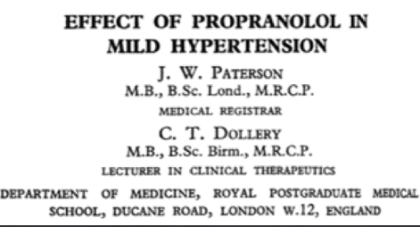
Hypertension: A brief History
9 patients
avg lying BP 199/109 mmHg

Slide 11
RCT Chlorthalidone vs Hydrochlorothiazide for CVD Events?
13,523 Veterans with HTN taking HCTZ
- age ~72, 97% men, 11% past CVD, BP med 2.6
x2.4 years
Switch: HCTZ (25-50mg) to chlorthalidone (12.5-25 mg)
- 95% (25mg & 12.5mg)
Bottom-Line: Past analyses suggested chlorthalidone better than HCTZ. This new RCT shows HCTZ & chlorthalidone are similar at preventing CVD.
No Difference in any CVD or death
Low Potassium <3.1: 5% vs 3.6% (HCTZ)
New allergic/ADR: 1.6% vs 0.3% (HCTZ)
Limitations: design favors the old drug
NEJM 2022; 387, 2401–2410.
Notes:
Did not report % people on 25 mg HCTZ after randomization
All subsequent activities were considered to be usual care, including filling the first and subsequent trial-drug prescriptions, hypertension management, changes in medication, and adverse event monitoring. The trial did not mandate clinic visits or data reporting.

Slide 12
RCT of Spironolactone for Facial Acne in Women
410 women, facial acne >6 months
- English/Welsh, age 29, ~80% moderate+
- 24 weeks
Spironolactone (50 mg/d to week 6, then 100 mg/d) or placebo
Improved (Self-assessed): 12 wks, no diff
- At 24 wks 82% v 63% (placebo), NNT 6
- Improved (Investigator) 12 wks: 19% v 6%, NNT 8
-Quality of life improved at 12 & 24 wks
Overall AE: 64% vs 51%; NNH 8. Mostly dizziness (19% v 12%) & headache (20% v 12%)
Bottom-Line: Spironolactone may lead to self-assessed improvement in acne for 1 in 6 women at 24 eks. Dizziness and headache are common.
Santer M et al. BMJ 2023. May 16;381:e074349.
Notes:
Pragmatic in this case allowed for patient-reported outcomes and concomitant use of topical treatments.
IGA= Investigator’s Global Assessment (0-4 Higher= More Severe); IGA of 3 = moderate severity
Included Population:
84%: current or previous use of topical txs
42% using hormonal tx
Acne >5 years: 52%
Exclusion Criteria:
Score of Investigator’s Global Assessment (IGA) of 0-1 (clear or almost clear)
Had ever taken spironolactone
Accutane use in the past 6 mos
Oral abx use >1 week in past mo
Planning on getting pregnant/changes in contraception.
Renal impairment e-GFR < 60 ml/min
Raised serum creatinine
Serum potassium concentrations above upper limit of laboratory reference range
Sprionolactone contraindicated (e.g., taking potassium sparing diuretic, angiotensin converting enzyme inhibitors, angiotensin II receptor blocker or hereditary problems of galactose intolerance.
Other Outcomes:
Participants Self-Assessed “Improved” (12 weeks)
68% versus 72%
*Acne-specific QOL (0-30, higher=better) (12 weeks):
17.8 versus 19.2 (MD 1.27; 0.07-2.46)
*Acne-specific QOL (0-30, higher=better) (24 weeks):
17.4 versus 21.2 (MD 3.45; 2.16-4.75)
*Adjusted for baseline variables
2 withdrawals due to adverse events in each arm.
Adverse Events in Men-
Gynecomastia, decreased libido and relative impotence (Santer 2023)
Limitations:
IGA not measured at 24 weeks (no face to face assessment)
Conducted during the covid-19 pandemic.
Remote follow-up visits
Limited collection of investigator-assessed acne severity
Reduced availability of data for treatment adherence
FASCE- Ongoing trial
Spironolactone 150 mg/d versus Doxycycline 100 mg/d (x 3 months, then spironolactone versus placebo x 3 months)
Possibility for prescribing higher doses?

Slide 13
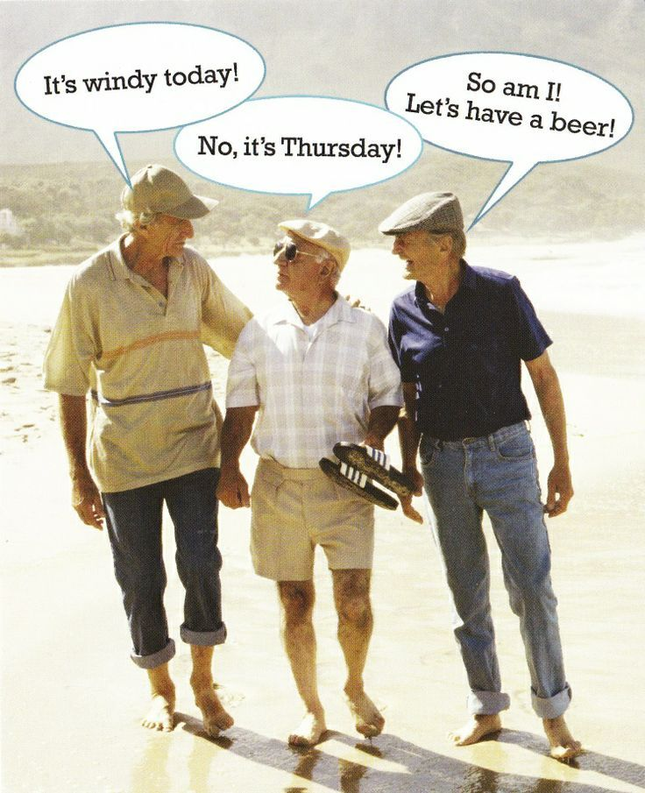
Listen Up
Time to talk about getting older.

Slide 14
RCT Lecanemab for Alzheimer’s Disease
(mild cognitive impairment or mild AD)
1795 patients
- age 71, MSE ~26, 53% on meds
x18 months
Lecanemab infusion 10mg/kg vs placebo q2wk
D/C AE: 7% vs 3% placebo, NNH=25
Most common Adverse Events:
  Infusion rxns (NNH=6), most mild/moderate
  ARIA-H (NNH=12), ARIA-E (NNH=10)
  With Sx (NNH=200 & 36),
  Headache (NNH=33),
  Falls (NNH=125)
OUTCOMES: Reduced Amyloid
(higher scores worse)
CDR-SB (0-18 scale; baseline 3.2):
  Change: +1.2 vs +1.7 (placebo),
  Diff= -0.5 (MCID: 1 - 1.5)²
ADAS Cog14 (0-90 scale; baseline 24):
  Change: +4.1 vs +5.6 (placebo),
  Diff -1.4 (MCID ~2-5 points)³
1. NEJM 2023; 388; 1: 9-21.2. Lancet Psychiatry 2021; 8: 1013-16. 3. Nature reviews 2023; 19: 132-133.
Notes:
MCI = mild cognitive impairment, AD = Alzheimer’s disease ARIA = amyloid related imaginag abnormalities (E=effusions, H = hemoorhage)
EiSai makes lecanenmab – they designed trial and analyzed data, aided in drafting; partially funded by Biogen
No MOCA, no MMSE at baseline or studied at all
Sensitivity analyses performed using imputating o fmissing data with mean values from placebo group (https://doi.org/10.1038/s41582-022-00768-w) – results attenuated (-0.39 versus -0.45)
MCI (62%) or mild AD (38%),
CDRSB (Clinical dementia rating – sum of boxes)– assess six domains (memory, orientation, judgement, problem solving, community affairs, home/hobbies, personal care)
Each domain score ranges from 0 to 3 with total score from 0 to 18
Higher = more impairment, 0.5 to 6 indicates early AD
ADAS cog = 14 items, range 0-90, higher = worse impairment
Drop out rate 17%
Infusion reactions, 96% mild-moderate, 75% with first dose, ~45% needed meds
ARIA (Amyloid related Imaging Abnormalities) & if E it is edema or effusion and if H it is hemorrhage.
Details about ARIA-E: 80% were asymptomatic with 70% happening first 3 months; 80% resolved within 4 mo of detection. About 3% had symptomatic ARIA-E (HA, visual disturbance and convusion)
Details about ARIA-H: (ie. those without ARIA-E): NNH90 (~9% vs 8%); symptomatic s was 0.7% vs 0.2% placebo causing dizziness. Macrohemorrahge occurred in 0.5% more than placebo group .
More ARIA if ApoE carrier status positive (epsilon 4)
MCID for CDR-SB is -1 (MCI) and -1.5 for mild AD = decrease in score suggests less impairment. But this RCT showed both scores increasing (ie. both groups ‘worsening’) - - reference #2 on slide
Other references suggest MCID 1-2.5 points over 1 year; ADAS cog 11 2-5 points over 1 year
CONTEXT: donepezil² reduces CDR-SB by 0.5 and generally well tolerated (and ADAS-Cog 2.7)

Slide 15
Chasing amyloid levels: two more RCTs
Donanemab¹ for early Alzheimer’s
1736 pts (age 73, MSE ~22), Donanemab vs placebo, x76 wks
iADRS (0-144, lower=worse, MCID 5-9): start 104, -10 vs -13, diff 3
Solanezumab² in “Pre-clinical Alzheimer’s”
1170 pts (age 72, MMSE 29), Solanezumab, x4.5 years
No difference
Bottom-Line: Biologics make big changes in Amyloid/Tau. Clinical effects are similar to placebo or below meaningful thresholds. Harms are high.
No evidence they are better than cholinesterase inhibitors.
1. JAMA 2023; doi: 10.1001/jama.2023.13239. 2. NEJM 2023; DOI: 10.1056/NEJMoa2305032
Notes:
Solanezumab – mid trial dose increase to 1600mg based on released trial data
Preclinical Alzheimer Cognitive Composite score (PACC): validated; devised for the measurement of amyloid related cognitive decline in unimpaired populations in clinical trials
Four components: 1) Free and Cued Select Reminding test (FCSRT), delayed paragraph recall, Digit symbol substitution test, MMSE total score
PACC is sum of four resulting z scores: negative score = worsening cognitive performance
Seems to be a lot of missing patients… 572 and 591 got drug/placebo but analysis of primary outcome includes only 401 and 423 patients
Donanemab, modified ITT (participants with a baseline and at least 1 postbaseline efficacy measure)
iADRS: assessment of cognition and daily function from ADAS-cog13 and ADCS-iADL (range 0=144, lower = greater impairment)
-”meaningful within patient change”: 5 points for those with MCI, 9 points for those with mild dementia AD
- This “MWPC” is a “threshold for outcome scores above which a patient or physician would consider change meaningful”
ADAS-Cog change with Cholinesterase inhibitors = 2.7

Slide 16
What Next?
Antidepressant Augment or Switch in Treatment-Resistant Geriatric Depression
Two-step, pragmatic RCT
  Adults >60 yrs (age ~69) with treatment-resistant depression (>2 adequate trials)
  10-week augmentation or switch protocols
Step 1 (N=619)
Augment: Aripiprazole (Start 2.5 mg/d; Max 15 mg/d)
OR
Augment: Bupropion ER (Start 150mg/d; Max 450mg)
OR
Switch: Bupropion ER (Start 150 mg/d; Max 450 mg)
Step 2 (N=248; 50% direct)
Augment: Lithium (Start 150-300 mg/d; Max 1200 mg/d -Target drug level 0.6 mmol/L)
OR
Switch: Nortriptyline (Start 25 mg/d; Increase to 1 mg/kg - Targeting drug level 80-120 ng/mL)
Lenze EJ, et al. N Engl J Med. 2023 Mar 23;388(12):1067-79.
Notes:
Study conducted in at 5 sites in the US and Canada, pt had ~2.5 past antidepressants
Inclusion Criteria
PHQ-9 (0-27, higher=greater symptom severity): Initial >6; Amended: >10 (at 2 years) Baseline was ~16
Failure to respond adequately to two or more antidepressant treatment trials of recommended dose and length (approximately 12 weeks)
Exclusion Criteria (Step 1) – during the first 18 months, these patients could be directly admitted to Step 2; the protocol was then changed to remove this criteria and these became exclusion criteria to the entire trial.
Seizure Disorder, Parkinson’s Disorder
Exclusion Criteria (Step 2) : QTc prolongation or Wide QRS or EKG, Ischemic Heart Disease (e.g., prior MI, stent or bypass), Acute or chronic renal insufficiency
2-step process, however patients who were not eligible for step 1, could skip directly to step 2 (typically because they had already trialed medications in step 1)
Moving from Step 1 to Step 2:
Those moving from Step 1 to Step 2 were discontinued or tapered (slowly or rapidly) depending on current medications.
Treatment options were created through survey recommendations of clinicians who treat older adults with treatment-resistant depression.
Dosing- Step 1:
Augment: Aripiprazole (Start 2.5 mg/d; Max 15 mg/d)
OR
Augment: Bupropion ER (Start 150 mg/d; Max 450 mg/d)
OR
Switch: Bupropion ER (Start 150 mg/d; Max 450 mg/d)
Dosing- Step 2:
Augment: Lithium (Start 150-300 mg/d; Max 1200 mg/d)
*Target drug level 0.6 mmol/L; Starting dose depending on coexisting medical conditions or concurrent medications
OR
Switch: Nortriptyline(Start 25 mg/d; Increase to 1 mg/kg)
*Targeting drug level 80-120 ng/mL

Slide 17
What Next?
Antidepressant Augment or Switch in Treatment-Resistant Geriatric Depression
Step 1 (N=619) | Augment Aripiprazole | Augment Bupropion | Switch Bupropion
Remission | 29% | 28% | 19%
Falls (rate per person) | 0.33 | 0.55 | 0.38
Remission: Augmenting better than switch.
Falls worse with Augmenting Bupropion
Bottom Line
In older adults with treatment-resistant depression, augmentation may be preferred over switching. Augmenting with aripiprazole caused less falls than augmentation with bupropion.
Lenze EJ, et al. N Engl J Med. 2023 Mar 23;388(12):1067-79.
Notes:
Step 1 (N=619)
29% (AA) v. 28% (AB) v. 19% (SB)
AA Versus SB: Relative Risk (RR) 1.50 (1.06, 2.13) NNT 10
AB Versus SB: RR 1.49 (1.04, 2.12) NNT 12
Step 2 (N=248; 50% directly randomized)
19% (AL) versus 22% (SN)
RR 0.84 (0.53, 1.36) Not statistically significant
2-step process, however patients who were not eligible for step 1, could skip directly to step 2 (typically because they had already trialed medications in step 1)
Moving from Step 1 to Step 2:
Those moving from Step 1 to Step 2 were discontinued or tapered (slowly or rapidly) depending on current medications.
Used MADRS (0-60), Remission ≤10
Limitations:
Unclear who got better in step 2 (those who directly entered or those who failed step 1)
Open-Label (are they getting better because you are adding a med, versus switching)
Even with a taper- do you get less response? side effects?
No placebo
Enrolled ½ target sample, changed cut-off to get in (was PHQ-9 score ≥6 but then became ≥10, and no longer direct entry to step 2 (even if tried buproprion).
10-week durations (longer f/u= different results?)
Most common adverse events (no difference between groups):
Dizziness/impaired balance
GI distress
Reduced salivation
Tension/anxiety
Reduced/disturbed sleep

Slide 18
RCT - Acute Back/Neck Pain: Are Opioids an option?
347 - Age ~44, 51% male,
6 weeks, followed to 1 yr
5mg Oxycodone/2.5mg naloxone (MR) BID, titrate to 10mg
vs Placebo
Baseline pain 5.8 (0-10)- At 6 weeks, Opioid 2.8 vs 2.3 Placebo (p=0.051)
- Diff at year: 2.4 vs 1.8
- Function Worse
- Risk of Misuse (1 yr ): 20% vs 10%
Bottom-Line: All outcomes, opioids are similar or often worse (pain scores, function, etc) than placebo. Opioids should generally not be part of managing acute back pain.
Lancet. 2023 Jul 22;402(10398):304-312.
Notes:
Recruitment through GP and ER offices but also an advertising campaign thru social media (then refer to trial doctor). Australian study
Included patients with radiating pain, pain in the ≤12 weeks but had 1 month pain free before this, at least moderate pain severity. Excluded people with contraindications to opioid (using risk tool, allergies, clinical assessment, already taking ≥15mg morphine for this pain episode, <18 years old, surgery <6 months)
Lots to assure AC and blinding.
Start at 5mg Oxycodone /2.5mg naloxone (modified release) BID – titrated up to 10mg BID as needed. Titrate off once pain score 0-1 on 3 consecutive days or after 6 weeks.
All encouraged to stay active, etc.
Data collected at 2,4,6, 12, 26, 52 weeks. Primary endpoint was 6 weeks (the duration of trial therapy) : 0–10 scale by the Brief Pain Inventory Pain Severity Subscale)
347 enrolled and 310 analyzed (26 did not do baseline and at least one follow-up, and then one had metasese so was pulled from the study)
~80% was low back pain alone and regardless, ~60% had radiation
RMDQ=Roland Morris Disability Questionnaire (0-24, higher worse).
Function RMDQ (0-24) 15.7 baseline- 8.9 vs 6.6 (p=0.01) at 6 weeks
Mental health QoL (but not the score overall) also worse with Opioids
Risk of Misuse was score of 9 or more on Current Opioid Misuse Measure Scale

Slide 19

In it for the long haul:10-year outcomes of gastric banding.
Bottom Line
At 10 years, 1 in 5 patients who received gastric banding and were not obese may achieve diabetes remission, with more weight loss and lower pill burden.
RCT 2009-2011; 51 randomized, 41 with data at 10 years.
  Adults with BMI 25-30 and diabetes <5 years (81 kg, BMI 29.5, diabetes 2.2 years) randomized to gastric banding or medical therapy
Diabetes Remission (primary): 24% versus 0% (medical therapy) NNT 5
Weight Lost: 8.5 kg versus 4.7 kg (medical therapy)
Number of diabetes medications: 1 versus 3 (medical therapy)
No difference in surrogate markers, including blood pressure and cholesterol. Adverse events not reported.
DP
Qi QYD et al. Diabetes Obes Metab. Jun;25(6):1464-72
Notes:
2009-2011- 51 patients randomized
25= gastric band (22 had surgery)
26= medical therapy
N=41 (completed 10-year follow up); from what I can tell in the trial, no one in the diabetes care arm crossed over and had surgery during the 10-year time period
At 2 years, weight loss: -11.5 kg versus -1.6 kg (diabetes care)
Inclusion:
Adults 18-65
BMI 25-30
Diabetes < 5 years
Interventions:
Gastric Banding + MDC
MDC = Multidisciplinary Diabetes Care (5 years)
Review by a diabetes specialist every 3-6 months and by a dietician and diabetes educator two times in first year, then as required
Population Included:
N=41
Mean Age 54
76% female
Mean Weight: 81 kg
Mean BMI: 29.5
Duration of diabetes: 2.2 years
76% taking metformin
Baseline HgbA1c: 7.0%
Outcomes:
Gastric Banding Versus Medical Therapy
Primary Outcome = Diabetes remission (HgbA1c <6.5% without glucose-lowering medication)
5/21 vs 0/20; p=0.048
Taking Metformin: 14/21 vs. 20/20 p=0.009
Taking Sulfonyurea: 3/21 vs. 10/20 p=0.020
Taking SGLT2: 3/21 vs. 14/20, p<0.001
No difference in tx with DPP-4, GLP-1 or insulin
Weight Loss: 8.5 kg vs 4.7 kg, p=0.006
% weight loss: 9.8% vs 5.6% p=0.008
No difference in other surrogate markers including BP, cholesterol, 10-year coronary artery disease risk, micro/macrovascular complications
Number of diabetes meds: 1 versus 3 p<0.001
Adverse events not reported, however each participant in the surgery arm had their band adjusted a median of 20 times (80% of adjustments occurring during the first 5 years)

Slide 20
RCT: Reversing Frailty in Older Adults
168 community adults >65 yrs, clinical frailty score <5 (≤mildly frail). Age ~77.
- 3 months
Home exercise regime and dietary protein guidance (pamphlets and training for 5 min by FP) vs usual care
Only mildly frail (generalizability ?)
Change in frailty at 3 months
Intervention: 18% -> 6%
Control: 17% -> 18%
Grip strength, activity level & slowness better
69% felt better (usual not asked)
Bottom-Line: Recommending home exercise + walking & protein can reduce frailty progression (6% vs 18% usual) at 3 months. “Time needed” ~5 min for patient training.
Santer M et al. BMJ 2023. May 16;381:e074349.
Notes:
6 primary care practices in Ireland
Home based exercise: at least 3 to 5 hours/wk of exercising (10 physical exercises repeated 10x at least 4x/week) and walking
Dietary protein – 1.2g/kg/d
Share FI – exhaustion, loss of appetite, handgrip strength, functional difficulties (walking 10m or climbing 1 flight of stairs without rest) and low physical activity
69% felt better due to intervention however, usual care group was not asked or was not reported so could not make comparison.

Slide 21
It’s that time of year: RSV Vaccine for Older Adults
24966 community adults >60 years, considered “medically stable”. Age ~70.
International, ongoing. From 1st RSV season
- 7 months
Single dose RSVPreF3 IM vs placebo
No diff in serious AEs; no RSV-related deaths.
Common AEs: pain with injection (61% vs 9%, NNH 2) & fatigue (34% vs 16%, NNH 6)
RSV (PCR-confirmed) LRTI (no X-ray):
Efficacy 83%
0.056% vs 0.32%, NNT 379
Other Subgroups
- Any RSV: 0.22% vs 0.76%, NNT 186
- Severe: 0.008% vs 0.14%, NNT 758
Bottom-Line: RSVPreF3 (Arexvy) provided 83% efficacy RSV-LRTD, or NNT ~379. Not publicly covered in Canada, $300/shot.
Papi A, et al. NEJM 2023. Feb 16;388(7):595-608.
Notes:
Persons with chronic medical conditions were eligible if the investigator considered the participant’s condition to be medically stable.
39% had coexisting conditions that are known to be associated with an increased risk of severe RSV disease.
Primary Outcome: RSV Lower-respiratory tract disease defined by >2 lower respiratory symptoms or signs, including >1 sign OR >3 lower respiratory symptoms (symptoms= sputum, cough, dyspnea; signs= wheezing, crackles/rhonchi, tachypnea, hypoxemia, O2 supplementation)

Slide 22
RSV: What are the risks?
Authors report:
Vaccine: 1 / 1,000 participant-years
Placebo: 5.8 / 1,000 participant-years
Where do these numbers come from?
Baseline Event Rate = 0.32% or 3.2 in 1000
Time is 6.7 months (RSV season)
To make a year, multiple by 1.8
Assumption: RSV season is now all year!
 | 7 Million | Without Vaccine | With Vaccine | Helped/Harmed
Any RSV | Any RSV | 53,200 | 15,400 | 37,800 (0.5%)
 | LRTI | - 22,400 | - 3,920 | - 18,480 (0.26%)
 | Severe LRTI | - 9800 | - 560 | - 9240 (0.13%)
Fatigue | Fatigue | 1,120,000 | 2,380,000 | 1,260,000 (18%)
7 million Canadians ≥65 Vaccinate all: $2.1 Billion
36:1 Fatigue vs any RSV
2 RSV hospitalizations total (groups not given) & no deaths
Papi A, et al. NEJM 2023. Feb 16;388(7):595-608.
Notes:
Baseline Risk = 0.3% (NNT 400) Ratio of benefit 150:1
7 months of data (do you need another shot?)
Fatigue NNH 6
Pfizer – similar vaccine
International piece- where are they from?
Barely exists-
Next study: Malaria in the NWT
Persons with chronic medical conditions were eligible if the investigator considered the participant’s condition to be medically stable.
39% had coexisting conditions that are known to be associated with an increased risk of severe RSV disease.
Deaths similar (0.4-0.5%)
Primary Outcome: RSV Lower-respiratory tract disease defined by >2 lower respiratory symptoms or signs, including >1 sign OR >3 lower respiratory symptoms (symptoms= sputum, cough, dyspnea; signs= wheezing, crackles/rhonchi, tachypnea, hypoxemia, O2 supplementation)

Slide 23

peerevidence.ca

Slide 24
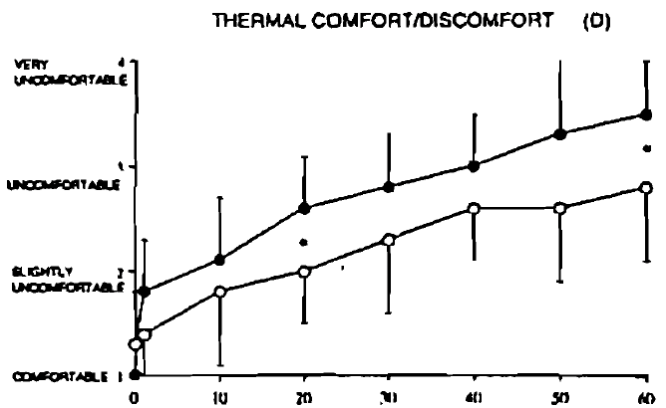
Hypothesis: Is dry or wet underwear better?
8 healthy male college students volunteered
10 C, in net chair, for 1 hr. Skin temp (average 14 sites), rectal temp and wgt loss measured q1 min during hr.
5 types of long underwear, wet with 175 ml
  Cotton, wool, polypropylene, wool/polypropylene blend, polypropylene ‘fishnet’
“Significance of wet underwear” (results subtitle)
At 1 hr, skin & rectal temp down 2 & 0.4 degrees.
  Cooling of skin temp similar in dry BUT start 1 C warmer.
Wet underwear comfort: Scale 1-4 (higher worse). Start 1 and at 60 min 2.8 dry & 3.5 wet.
Bottom-Line: Babies are right, wet underwear is uncomfortable!
BAKKEVIG. Ergonomics, 1994; 37(8): 1375-89,
Notes:
an estimate of core temperature wasmade using a rectal thermistor (150 mm, YSI 701, Yellow Spring Instruments) inserted 80nim beyond the anal sphincter. Not 1 mm more or less.
It’s always healthy college students.
Rectal temp every minute – I said pardon.
(100 shirt, 75 trousers)

Slide 25
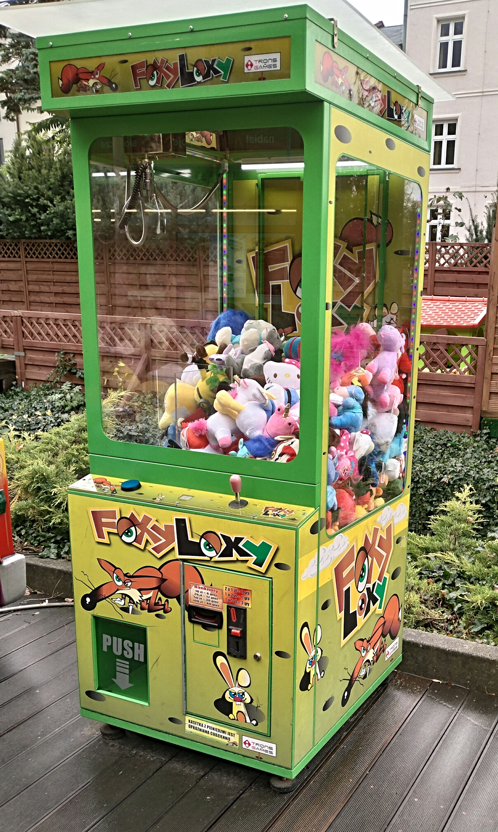
Necrobotics: using dead things as robots
Wanted to make a claw tool from dead spider
Froze a spider, inserted needle, seal with crazy glue, pumped air inside.
Used it to turn off a lightbulb and pick up an even larger dead spider
Adv Sci. 2022; 9:2201174.
Notes:
Historically: humans use dead things throughout history example hides for clothing or bones for tools.
Spiders use hydraulics to move limbs. They do no have antagonists muscle pairs (only flexors). Legs curl when they die beuase pressure no longer opposed the flexor muscles
“can camoflouge with its surroundings”
After 2 days, fell apart due to dehydration. Follow-up study idea: apply thin layer of vapor impermeable coating to mitigate water loss.

Slide 26
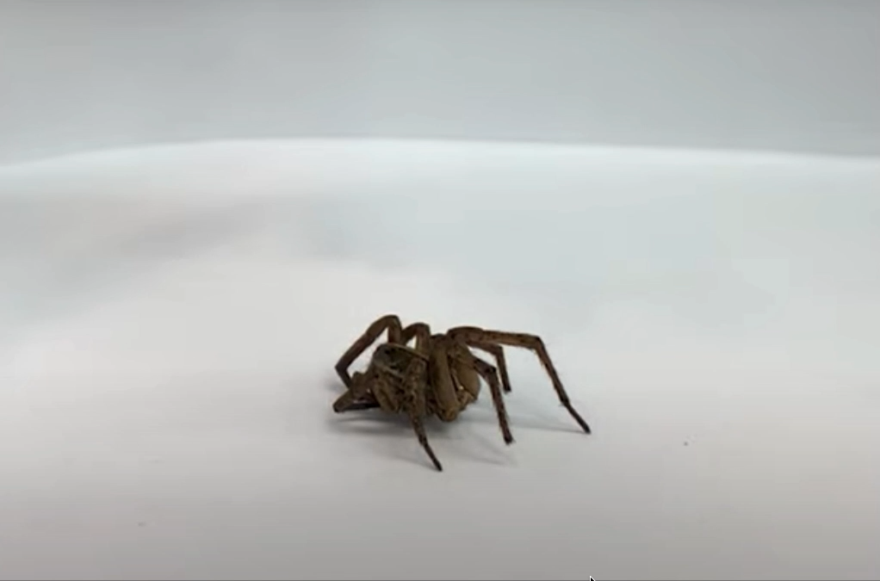
https://www.youtube.com/watch?v=pm910ZgN4nU
Notes:
Species?

Slide 27
Necrobotics: using dead things as robots
Wanted to make a claw tool from dead spider
Froze a spider, inserted needle, seal with crazy glue, pumped air inside.
Used it to turn off a lightbulb and pick up an even larger dead spider
Functional duration: 2 days
“no clear guidelines…regarding ethical sourcing and humane euthanasia of spiders”
  …next PEER guideline??
Bottom Line: “…Capturing small [dead] creatures discreetly in nature by camouflaging in the environment”. OR: Science has found a way to reanimate dead spiders;
...bringing my nightmares to life
Adv Sci. 2022; 9:2201174.
Notes:
Historically: humans use dead things throughout history example hides for clothing or bones for tools.
Spiders use hydraulics to move limbs. They do no have antagonists muscle pairs (only flexors). Legs curl when they die beuase pressure no longer opposed the flexor muscles
“can camoflouge with its surroundings”
After 2 days, fell apart due to dehydration. Follow-up study idea: apply thin layer of vapor impermeable coating to mitigate water loss.
Children’s claw games at the carnival will never be the same

Slide 28
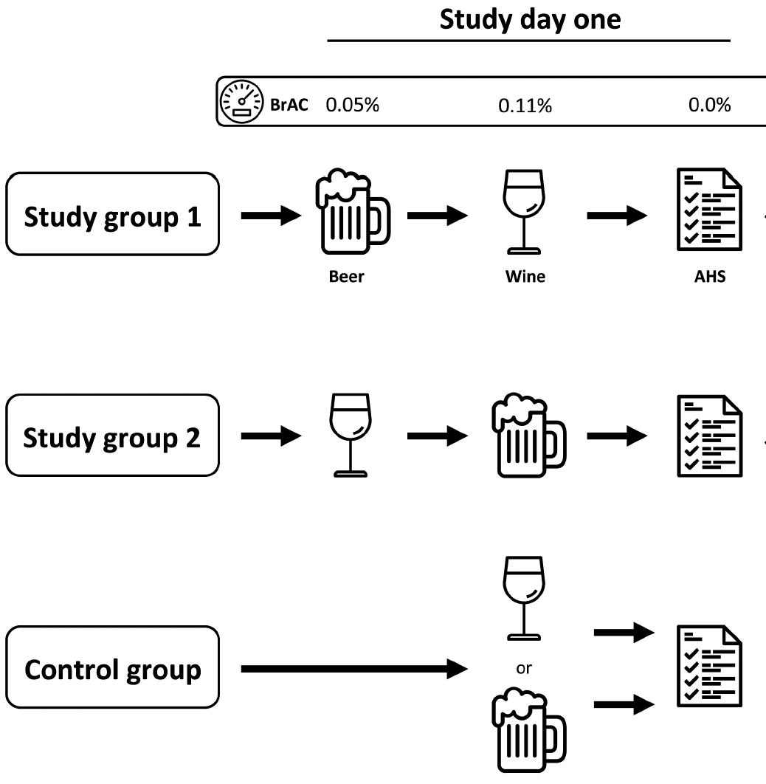
Hang-overs: It must be what I drank, not the amount!
90 Europeans, age ~24,
~50% male
Premium Pilsner Lager (Carlsberg)
Edelgräfler quality white wine
Could stop for safety concerns: impaired LOC or balance, nystagmus, feeling unwell, etc,…. + illusionary misjudgment.
Rate perceived drunkenness (0-10) & Acute Hangover Scale next day (0-56)
Drank ~1.3 Lt beer + 0.7 of wine over 4 hrs.
If only beer or wine, 2.6 or 1.4Lt respectively (~4 hours)
Am J Clin Nutr 2019;109:345–352.
Notes:
List of reasons you could stop: impaired level of consciousness, loss of orientation, impaired balance or gait, nystagmus, dysarthria, feeling unwell, nausea, tachycardia, neurologic symptoms, impairing psychomotor symptoms, prolonged reaction time, impaired protection reflexes, respiratory or cardiovascular abnormalities, illusionary misjudgment, etc.
Acute Hang-over scale was 0-7 on 8 items, total scale is 0-56, with 56 being worst.
Exclusion criteria: Exclusion criteria were aversion to beer or wine (or both), a history of drug or alcohol abuse, complete alcohol abstinence or intolerance, Eastern Asian origin [due to
common variants of genes coding for alcohol dehydrogenase (e.g., ADH1B, ADH1C) and acetaldehyde dehydrogenase (e.g., mitochondrial ALDH2 allele)], evidence of liver dysfunction
(i.e., abnormal serum liver function tests), or history of any of thefollowing: alcoholic liver disease, viral hepatitis, hepatocellular carcinoma, chronic pain, epilepsy, Wernicke encephalopathy,
thiamine deficiency, Korsakov syndrome, gastritis, bariatric surgery, immunosuppression, or recent history of infection (i.e., respiratory, gastrointestinal, genitourinary, etc.). Further
exclusion criteria were current pregnancy or breastfeeding, frequent use of pain medications, the use of medications known to interact with serum alcohol (i.e., via cytochrome 2E1, alcohol dehydrogenase, aldehyde dehydrogenase), e.g., antibiotics, opioids, nitrates, or antidepressant use.

Slide 29
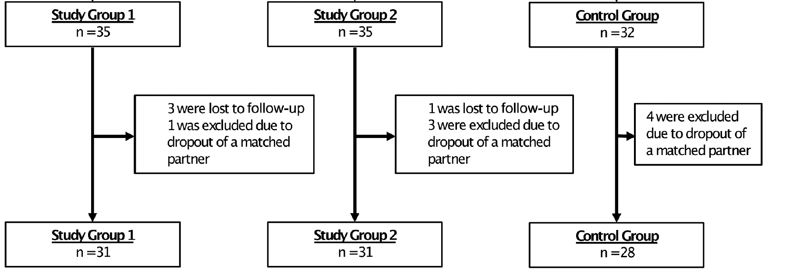
Hang-overs: It must be what I drank, not the amount!
MA
Actually started with 105,… but
Hangover was not predicted by type of alcohol or by the order in which they were consumed
Predictor of Hangover: Perceived drunkenness and vomiting (like most reliable)
Bottom-Line: How drunk you are is the best predictor of hangover (especially when you control for individuals’ alcohol level)
Am J Clin Nutr 2019;109:345–352.
Notes:
List of reasons you could stop: impaired level of consciousness, loss of orientation, impaired balance or gait, nystagmus, dysarthria, feeling unwell, nausea, tachycardia, neurologic symptoms, impairing psychomotor symptoms, prolonged reaction time, impaired protection reflexes, respiratory or cardiovascular abnormalities, illusionary misjudgment, etc.
Acute Hang-over scale was 0-7 on 8 items, total scale is 0-56, with 56 being worst.

Slide 30


