Slide 1
Title Slide
Somatizing: What Every Family Physician Need to Know!
Dr. Jon Davine

Slide 2
COI – Presenter Disclosure (1)
Presenter Disclosure
Presenter: Dr. Jon Davine
Relationships with financial sponsors:
Any direct financial relationships, including receipt of honoraria: Ontario College of Family Physicians, Touchstone Institute, McMaster University Continuing Education, CMEAway by Sea Courses, Pri-Med Canada/Humber River Hospital, University of Ottawa Dermatology, Peterborough FHT, Kitchener Waterloo Family Medicine
Membership on advisory boards or speakers’ bureaus: NO
Patents for drugs or devices: NO
Other: CAMH---Co-Editor of book, “Psychiatry in Primary Care”, Ontario Psychiatric Association---Treasurer
Notes:
Where a faculty/presenter has no relationships to disclose, indicate Not Applicable under Relationships with Financial Sponsors.
Complete this slide for the primary presenter and ALL co-presenters if applicable.
Reminder: Disclosures made on your COI forms should match disclosures made on the COI slide.

Slide 3
COI – Presenter Disclosure (2)
Disclosure of Financial Support
This program has NOT received financial support
This program has NOT received in-kind support
Potential for conflict(s) of interest:
Dr. Jon Davine has NOT received funding for this program
Notes:
Where a program has received no external financial support (e.g., monies for food, logistics assistance such as registration, AV set-up, etc.), indicate No External Support.

Slide 4
“For each ailment that doctors cure with medications (as I am told they do occasionally succeed in doing), they produce ten others in healthy individuals by inoculating them with that pathogenic agent a thousand times more virulent than all the microbes - the idea that they are ill.”
- Marcel Proust
(le cote de guermantes)

Slide 5
Objectives
Appreciate the range of diagnoses that make up “Somatic Symptom and Related Disorders (DSM-V)
Understand the range of conscious and unconscious mechanisms involved in these disorders.
Describe treatment modalities for these disorders both psychopharmacolgic and psychotherapeutic.

Slide 6
Straw Poll
Who thinks they have “somatized” in their life?

Slide 7
Introduction
Somatizing is a very common human experience
80% of us have somatic sensations in any week
If this becomes primary mode of behaving, this becomes a somatoform disorder
Estimated that somatoform disorders may cost 10- 20% of medical budgets in USA
10-30% of patients with somatic complaints that present to primary care practitioners, have no adequate physical cause to explain the complaint

Slide 8
Somatization
Lipowski (1988) “The tendency to experience and communicate somatic distress and symptoms; unaccounted for by pathological findings, to attribute them to physical illness, and to seek medical help for them…, this tendency becomes manifest in response to psychosocial stress…

Slide 9
“Shared Care” Important
Primary care practitioners well placed to treat somatizing
About 50% of patients refuse referral to mental health services
But 81% of MUS patients were willing to have psychosocial treatment from their primary care practitioner
The buck stops here!

Slide 10
Mind-Body Link
Examples of mind-body link
Tension headache
Butterflies in the stomach
“Tension chest-ache”
“Tension leg-ache”
“Tension __“
Important to acknowledge patient’s symptoms
“your pain is real, it is not imagined, and it’s not in your head”
“We simply know that stress can play a role in producing these symptoms”

Slide 11
Mind-Body Link
Hardware vs. Software
Stressed brain, therefore software not working properly, hardware remains intact
Symptoms are based on complex brain processes, not brain or tissue pathology

Slide 12
Three Forms of Somatizing
Medically unexplained symptoms (MUS)
Hypochondriacal somatization
Bodily preoccupation and worry about having a serious illness
Somatic presentations of psychiatric disorders e.g. Depression, Panic
Kirmayer and Robbins’91

Slide 13
Somatization “Unconscious”-DSM-V
Somatic Symptom Disorder
Functional Neurologic Symptom Disorder (Conversion Disorder)
Illness Anxiety Disorder (Hypochondriasis)
Body Dysmorphic Disorder (OCD Disorder)
Delusional Disorder, somatic type

Slide 14
Somatic Symptom Disorder
One or more somatic symptoms which distress and disrupt life
Excessive thoughts, feelings or behaviours related to these somatic symptoms
Symptoms persist for more than six months
Specifiers:
With predominant pain (previously pain disorder)
Persistent (severe symptoms, >6 months)
Mild
Moderate
Severe

Slide 15
Somatic Symptom Disorder
Along with pain, typically, this will also include GI disturbance and fatigue.

Slide 16
Functional Neurologic Symptom Disorder (Conversion Disorder)
Affects voluntary motor or sensory function.
Linked to psychological stressors.
Specify:
With weakness or paralysis
With abnormal movement
With swallowing symptoms
With speech symptoms
With attacks or seizures
With anesthesia or sensory loss
With special sesnory symptoms
With mixed symptoms

Slide 17
Conversion Disorder - Characterization
Usually acute onset
Symptom duration is often relatively brief, usually within two weeks if stressor is removed or addressed
Otherwise, may go on for….
Few studies on course of illness

Slide 18
Conversion Disorder – Medication
Meds not necessary
For patients able to identify psychological stressors, appropriate psychotherapy can be very helpful

Slide 19
Somatic Symptom Disorder with predominant pain
Associated with psychological factors.
Associated with both psychological factors and a general medical condition.
Pain disorder associated with a general medical condition (not a psychiatric diagnosis).

Slide 20
Somatic Symptom Disorder with predominant pain
Perhaps 40% of pain patients may be psychologically amplified
Usually in fourth or fifth decades
Females > Males – 2:1

Slide 21
Somatic Symptom Disorder with predominant pain – Treatment Options
Muscle relaxation techniques
Psychotherapy/Behavioural Activation
Medication

Slide 22
Somatic Symptom Disorder with predominant pain – Psychotherapy
CBT
Challenge cognitions
“This pain is not damaging my body”
“I can continue activities, even in some mild pain. I don’t have to stop.”
Behaviorally activate: e.g. gardening 15 minutes twice/week, then increase

Slide 23
Somatic Symptom Disorder with predominant pain - Medication
Try antidepressants, e.g. Nortriptyline or Amitriptyline at doses of 10-50 mg po qhs
These can help pain and possible sleep
Try Trazodone 25-50 mg po qhs for sleep

Slide 24
Somatic Symptom Disorder with predominant pain, if neuropathic or herpetic neuralgia
Duloxetine, Pregabalin, Gabapentin
Venlafaxine was equal to Duloxetine
Recommended against tricyclics
(Falk J, et al, Can. Fam. Physician 2021)

Slide 25
Pincus,T. et al. Cochrane Database, May 10, 2023
Meta-analysis, 176 RCT’s, about 30,000 patients
Looked at fibromyalgia, nerve pain, MSK pain
All antidepressants, except Duloxetine, lack sufficient evidence for efficacy and safety
Duloxetine 60 mg. once daily had small to moderate effect.
No evidence that higher dose added benefits

Slide 26
Somatic Symptom Disorder Persistent
At least six (6) months
One (1) or more physical complaint
Specify if:
persistent
mild, moderate or severe

Slide 27
Somatic Symptom Disorder, persistent
Chronic fatigue syndrome, Fibromyalgia, Irritable Bowel Syndrome
Has never been shown thus far to have a biological cause
In studies, there is felt to be a major psychiatric co-morbidity
Try not to dichotomize:
“Perhaps a % of both, thus may work on psychological side to see how far this takes us.”

Slide 28
Somatic Symptom Disorder, persistent
?LONG COVID
?LYME DISEASE

Slide 29
Illness Anxiety Disorder (Hypochondriasis)
Preoccupation with having a serious illness
Somatic symptoms are not present or only mild

Slide 30
Illness Anxiety Disorder (Hypochondriasis) – Treatment
Literature discusses link to OCD spectrum
E.g., intrusive thoughts, repetitive checking behaviours
Would then use CBT and OCD medication
May evolve into overvalued ideas, and ultimately delusions
Delusional disorder, somatic type
Would then use neuroleptics

Slide 31
Illness Anxiety Disorder (Hypochondriasis) – Treatment Efficacy
Recent RCT compared CBT and paroxetine to placebo
In the intent to treat analysis, only CBT differed significantly from placebo
In the completed analysis, both paroxetine and CBT differed significantly from placebo
(Greeven et al, Am J of Psych ’07)

Slide 32
Case – Betty
32 year old woman
Mother had breast cancer
Her own fears

Slide 33
Body Dysmorphic Disorder (BDD) - Definition
Preoccupation with an imagined defect in appearance
If a slight anomaly is present, concern is markedly excessive

Slide 34
BDD - Epidemiology
Prevalence:
Dermatology Clinic: 12% of patients had BDD
(Phillips ‘00)
Cosmetic Surgery Clinic: 6-8% (Sarven et al, ‘98)
General Population: 0.7% (Faravelli ‘97)
1.1% (Bienvenu et al, ‘00)
2.2% (Mayville ‘99)
13% (Bibby ‘98)
Male:female 1:1
Usually starts in Adolescence (Phillips et al ‘97)

Slide 35
BDD – Characteristics
Can resemble OCD, link with obsessive spectrum disorders.
Think about flaws 3-8 hours per day (Phillips ‘96)
Compulsive behaviours - checking appearance, grooming, seeking reassurance repetitively, may repetitively seek surgery.
Can go on to overvalued ideas and frank delusions.

Slide 36
Case
40’s year old woman
Concerns about “face that is horrible, looks like a monster”

Slide 37
BDD- Tx
100 people treated x 14 weeks with escitalopram (open label)
81% of completers responded
67% of treated subjects responded (including dropouts)
Thus, significant response to meds
(Phillips et al, Am. J of Psych, Sept. 2016)

Slide 38
BDD--Tx
58 responders then randomized to continued treatment with escitalopram vs. placebo for 6 months (RCT)
18% relapsed with escitalopram, 40% with placebo
Time to relapse was longer with escitalopram
36% of citalopram subjects showed continued improvement over the 6 months
Thus effective, and may want to continue treatment for at least 6 months
(Phillips, et al, Am. J of Psych, Sept. 2016)

Slide 39
BDD - Screening
Suggest to plastics, dermatology clinics (and to primary care practitioners)
“How do you feel this is affecting your life?”
“How do you feel the procedure will help you?”

Slide 40
Somatizing – “Conscious”
Factitious Disorder (Munchausen’s Syndrome)
Malingering

Slide 41
Malingering
Consciously done
Easily identifiable goals – drugs, money, legal issues
Link to Anti-Social Personality Disorder

Slide 42
Factitious Disorder Imposed on Self
Intentional production or feigning of physical or psychological signs or symptoms
The motivation for the disorder is to assume “the sick role”
External incentives for the behaviour (such as economic gain, avoiding legal responsibility, or improving physical well-being as in malingering are absent

Slide 43
Factitious Disorders Imposed on Self – Common Presentations
Infection (can be fatal septicemia)
Impaired wound healing
Bleeding
Hypoglycemia
Seizures
Rashes
Fever (flu)
Connective tissue disease
Vomiting, diarrhea
(Feldman et al ‘94)

Slide 44
Fictitious Disorder Imposed on Self – Conscious Part
Either:
Lying or exaggerating signs and symptoms
Knowingly tampering with samples or tests
Manipulation of ones body to produce positive tests results

Slide 45
The Spectrum
Conversion Disorder Factitious Disorder Malingering
Pain due to
Psychological factors
Somatization Disorder
Unconscious Conscious
(Adapted from Nadelson et al., 1979)

Slide 46
Factitious Disorder Imposed on Self
Gently confront
Overall prognosis is poor
Few admitted
Very few pursue any psychotherapy

Slide 47
Factitious Disorder Imposed on Another
Factitious Disorder (Munchausen) by proxy
90% of perpetrators are mothers
Usually involves infants, toddlers
Psychologically needs to assume the sick role, this time vicariously.

Slide 48
Somatization 2⁰ to Psychiatric Illness
Depression
Panic Disorder (aka “the great imitator”)
Generalized Anxiety Disorder
OCD
Delusional Disorder, Somatic type

Slide 49
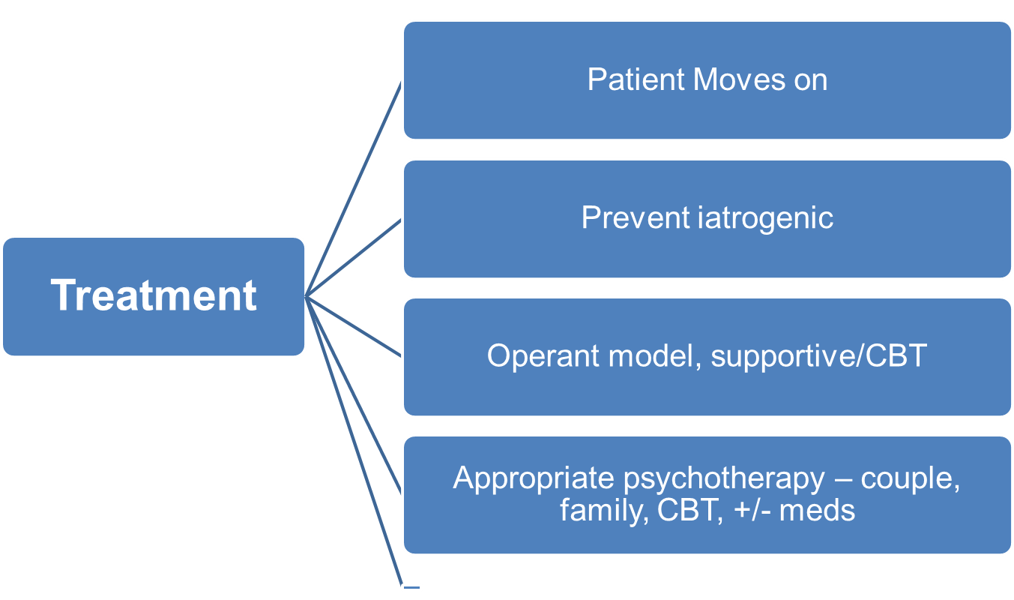
Treatment Outcomes

Slide 50
Assessment
Appropriate medical work-up (“Boy who cried wolf”)
Make a respectful mind-body link up early on

Slide 51
Treatment
See patient at regular intervals
Avoid E.R., other dispersal of care
If consultant to be used, contact beforehand
Judge progress by improvement in level of function
“Cure” is unlikely
Allow for relapses

Slide 52
Closing Slide
Thank you!
Please fill out your session evaluation now!
#myfmf
FamilyMedicineForum
FamilyMedForum
FamilyMedForum

