Slide 1
Land Acknowledgement
Traditional territory of the Kanien’kehà:ka, a place which has long served as a site of meeting and exchange amongst many First Nations including the Kanien’kehá:ka of the Haudenosaunee Confederacy, Huron/Wendat, Abenaki, and Anishinaabeg.
The Kanien’kehà:ka are the traditional custodians of the lands and waters on which we meet during the conference. Our gratitude.

Slide 2
Approach to Mould
and Housing-Related
Health Problems
Family Medicine Forum
Montreal, November 9, 2023
Donald Cole, MD, DOHS, MSc, FRCP(C)
Emeritus Professor, Dala Lana School of Public Health
Primary Care Locum (Grey-Bruce)
Marg Sanborn, MD, FCFP
Adjunct Professor, McMaster University
Primary care locum
Erica Phipps, MPH, PhD
Executive Director, Canadian Partnership for Children’s Health and Environment (CPCHE)
Director, RentSafe
Geri Blinick, MA
Project Manager, RentSafe
CPCHE

Slide 3
Disclosure of Financial Sponsors/Support
Presenter: Erica Phipps
RentSafe/CPCHE:
Catherine Donnelly Foundation
Raffi Foundation for Child Honouring
Postdoctoral Fellowship, University of Ottawa
CIHR grant - Prenatal Environmental Health Education (PEHE) Collaboration
Health Canada contract - Maternal-Infant Research on Environmental Chemicals (MIREC)
Member, Canadian Committee on Indoor Air Quality
No patents or other financial relationships
Work referenced in this presentation received financial support, in the form of grants for projects and outreach, from the Dragonfly Foundation, Catherine Donnelly Foundation and Raffi Foundation for Child Honouring.
The RentSafe initiative also benefits from in-kind support from RentSafe and CPCHE partners
Potential for conflict(s) of interest: None

Slide 4
Presenter Disclosure - Financial Sponsors
Presenter : Donald C Cole
Public e-consult and clinical consult provider in Ontario
Senior Advisor to Global Action For Fungal Infections (GAFFI) https://gaffi.org/who/senior-advisors/#biog4
Contracted MD with Occupational Health Clinic for Ontario Workers
Receipt of honoraria from Workplace Safety and Insurance Board (WSIB) of Ontario as member of the Scientific Advisory Table on Occupational Disease
Co-investigator on publicly funded grants, including on fungal infections.
No patents or other financial relationships

Slide 5
Case 1
Child in rental housing with allergic sx
multiple moulds in various locations throughout the house:
Mushroom-like growth under kitchen sink
child’s bedroom closet adjacent to unvented bathroom - black mould, front hall closet - children’s backpacks mouldy
youngest child developed runny nose and generally ill
sx resolved once family moved

Slide 6
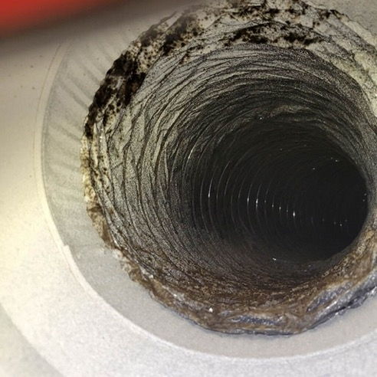
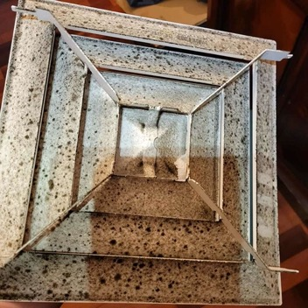
Case 2
Senior living in co-op apartment in seniors’ complex
chronic condensation around A/C ducts; mould eventually became visible on ceiling
initial inquiry led to superficial clean-up
follow-up revealed extensive mould in A/C system and surrounding areas
multiple units affected
Sx included chronic cough and congestion, fatigue & brain fog

Slide 7
Your experience
Do these cases resonate with ones you have seen in your practice?
Who among you have:
Had patients come in with symptoms linkable to mould?
Did you or the patient make the link to mould?
Been frustrated on how to resolve the patient’s health concern?
Been successful in spurring mould clean up and resolution of symptoms?
Made referrals to other service providers in the community?

Slide 8
Learning Objectives
We hope that by the end of this session, you will be able to:
Recognize potential housing-related mould exposure and associated symptom clusters affecting patients
Assess patients with suspected or self-reported mould exposure using a focused exposure history.
Identify community resources for patients with mould-related health problems in rental housing.

Slide 9
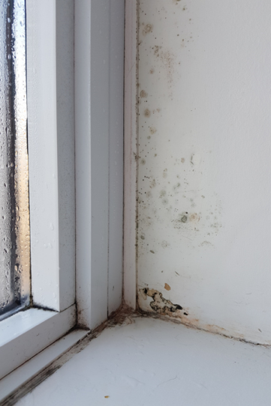
Descriptive Epidemiology of Mould Exposure (i)
Variability:
About 10% of population and 25-40% of atopic persons are allergic to mould
precautionary approach: Health Canada considers indoor mould growth to be a significant health hazard
mould is not consistent with healthy housing, not everyone in household will present with clinical sx
Health Canada (2014). Addressing moisture and mould in your home.
https://www.canada.ca/en/health-canada/services/publications/healthy-living/addressing-moisture-mould-your-home.html

Slide 10
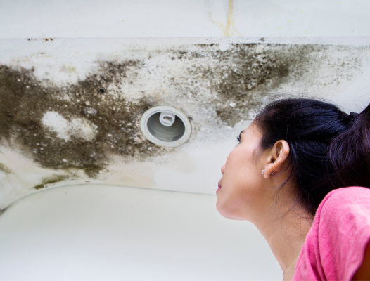
Descriptive Epidemiology of Mould Exposure (ii)
Vulnerable include:
children, cystic fibrosis, asthmatics, respiratory conditions
immune suppressed including haematological malignancies, cancer patients chemoTx & radiation , HIV positive, transplant patients
Summerbell & Hart (2021). Health Impacts of Indoor Dampness and Mould and Effective Remediation and Prevention Strategies: Expert Review and Summary of Evidence.
https://rentsafecanada.files.wordpress.com/2022/02/mould-expert-report_health-impactsremediation.pdf

Slide 11
Strength of Evidence -
Indoor Dampness and Mould (D/M) (i)
Category for Strength of Evidence | Health Impacts of Indoor D/M
Sufficient evidence of a causal relationship with indoor D/M | Exacerbation of existing asthma in children
Sufficient evidence of an association with indoor D/M | Asthma: development ever-diagnosed current exacerbation Bronchitis Eczema | Respiratory infections Dyspnea (chest tightening, difficulty breathing), Wheeze, Cough Allergic rhinitis Upper respiratory tract symptoms
Hung LL, et al. (2020). Recognition, Evaluation, and Control of Indoor Mold. American Industrial Hygiene Association

Slide 12
Strength of Evidence -
Indoor Dampness and Mould (D/M) (ii)
Category for Strength of Evidence | Health Impacts of Indoor D/M
Limited or suggestive evidence of an association with indoor D/M | Common cold like symptoms Allergy/atopy Depression, mediated by perception of control*
Inadequate or insufficient evidence to determine whether an association exists with indoor D/M | Altered lung function | Any other health effect not listed above
Limited or suggestive evidence of no association with D/M | No health effect identified
Hung LL, et al. (2020). Recognition, Evaluation, and Control of Indoor Mold. American Industrial Hygiene Association.
*Shenassa et al. Am J Public Health. 2007;97:1893–1899. doi:10.2105/AJPH.2006.093773

Slide 13
Climate change increasing mould exposure
Extreme rainfall events cause overland flooding from rivers, reservoirs, lakes
Gales and hurricanes cause surges and coastal flooding
Severe weather degrades housing ‘envelope’, increasing indoor water damage/mould

Slide 14
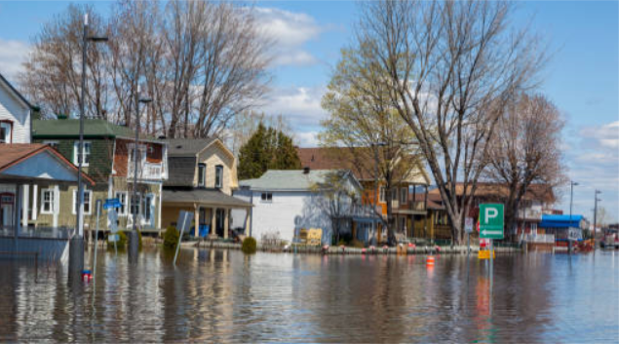
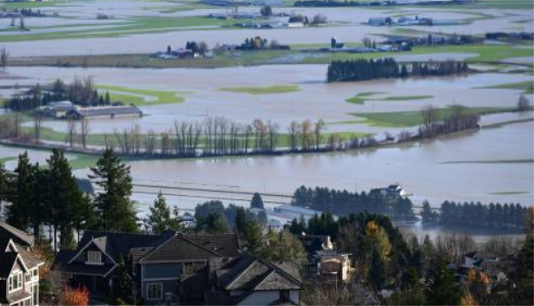
Flooding from rivers and lakes
Main cause of flooding in Canada
Upper: Gatineau, 2019, 2023
Lower: Abbotsford/Sumas 2021
Communities affected by flooding have higher mould exposure, and higher prevalence of mental health concerns

Slide 15
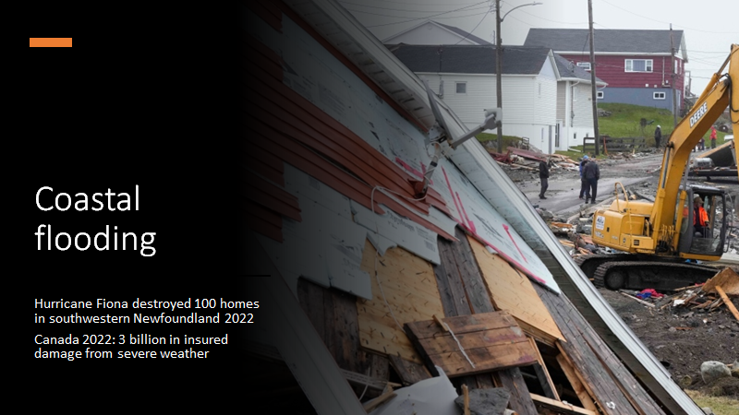

Slide 16
Health studies post Hurricane Harvey flooding
Time series analysis of medically insured - first year after hurricane:
1.7X increase in mold exposure-related diagnoses compared with year before hurricane
No increase in invasive fungal infections
Benedict, K., et al. (2023). Disaster Med Public Health Prep. 17(e504), 1–3. https://doi.org/10.1017/dmp.2023.28
Survey of 103 immunosuppressed residents affected by flooding:
49% engaged in cleanup of mold and water-damaged areas
Only 43% of those doing heavy cleanup wore a respirator
Chow, N.A., et al. (2019). Morbidity and Mortality Weekly Report. 68(21), 469-473. http://dx.doi.org/10.15585/mmwr.mm6821a1

Slide 17
Higher Prevalence Health Effects -Japan
Flooded Home respondents
Within 1 week:
Stress 42%
Anxiety 30%
Nasal sx 15%
Headaches/ dizziness 12%
Respiratory sx 11%
6 months post-flooding:
Stress 23%
Anxiety 16%
PTSD 8%
Nasal sx: OR 7 if “very much”
visible mold in home
Azuma, K., et al. (2014). International Journal of Environmental Health Research. 24(2): 158-175. https://doi.org/10.1080/09603123.2013.800964

Slide 18
Medical conditions among flood recovery personnel (paid & volunteer)- review (i)
Organ system/pathway | Clinical presentation | Exposure/agents
Upper airways: nose, sinuses, throat | Rhinitis, sinusitis, laryngitis | Fungi, allergens, MVOCs, irritants, particles
Lower airways: lung with bronchial system and alveoli | Bronchitis, asthma, bronchiolitis, allergic bronchopulmonary aspergillosis (ABPA), toxic alveolitis, pneumonitis | Fungi, allergens, fungal byproducts, fine particles
Combined upper and lower airway | Aspergillosis; fungal rhino-sinusitis & allergic extrinsic alveolitis (aka hypersensitivity pneumonitis) | Fungi, fine particles, fungal irritants, allergens
Johanning, E., Auger, P., et al. (2014). Environ Health Prev Med. 19:93–99
https://doi.org/10.1007/s12199-013-0368-0

Slide 19
Medical conditions among flood recovery personnel - review (ii)
Organ system/pathway | Clinical presentation | Exposure/agents
Skin and mucous membranes | Urticaria, sunburn-like rash, dermatitis (allergic or irritant type), conjunctivitis (burning & tearing) | Fungal irritants, allergens
Other organs: liver, kidney, & systems: central nervous, immune & endocrine | hepatitis, nephritis, headaches-cognitive & psychiatric disorders, severe fatigue thyroid, menstrual disorders | Fungi, organic dusts, microbial by-products, mycotoxins
Johanning, E., Auger, P., et al. (2014). Environ Health Prev Med. 19:93–99
https://doi.org/10.1007/s12199-013-0368-0

Slide 20
Clinical Approach
Assessment
Documentation of source/exposure
Documentation of symptoms
Clinical testing (as appropriate)
Management
Source/exposure reduction
Condition treatment
Social support

Slide 21
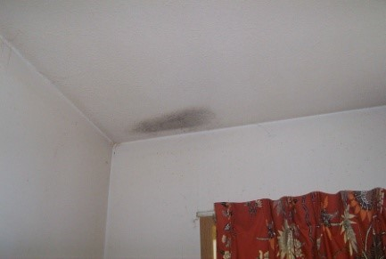
Documentation of Exposure (i)
General environmental exposure history (Community, Home, Hobby, Occupation, Personal, Diet & Drugs)*
Photos of sources by patient - caregiver. Bring into the office
* https://aseq-ehaq.ca/wp-content/uploads/2020/07/Taking-an-Exposure-History-CH2OPD2.pdf

Slide 22
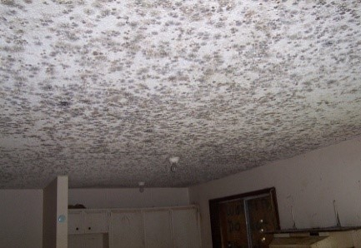
Documentation of Exposure (ii)
Assess size of mould affected area
Air testing for mould generally not helpful for either quantity or type of mould
Photo source: https://www.canada.ca/en/health-canada/services/publications/healthy-living/addressing-moisture-mould-your-home.html

Slide 23
Patient - Caregiver
Documentation of Symptoms
Diary of symptoms (own or child - dependent’s) in response to exposures
when worse e.g. when stuck indoors,
what may relieve symptoms e.g. walking outside, using medication
Fluctuating health status monitoring e.g.
serial peak flows by asthmatics with readings in mouldy area and away from mouldy environment
photos on cell phone of rash exacerbations
pain intensity (VAS scale) for headaches

Slide 24
Clinical Testing
Condition appropriate e.g.
WBC, CXR, pulmonary function testing for respiratory conditions
cognitive testing & depression scale for mycotoxic neurological effects
skin-prick allergen testing for recurrent rashes - limited suite panel (Alternaria, Cladosporium,Penicillium, Aspergillus, Candida)
Larenas-Linnemann et al. (2016). J Allegy Clin Immunol Pract. 4(3): P405-414 http://dx.doi.org/10.1016/j.jaip.2015.10.015
Specific fungal disease e.g. allergic bronchopulmonary aspergillosis (ABPA)
consider provincial public laboratory available fungal serology testing
Cole, D., et al. (2017). Lancet ID. 17(12): e412-e419 https://www.thelancet.com/journals/laninf/article/PIIS1473-3099(17)30308-0/fulltext

Slide 25
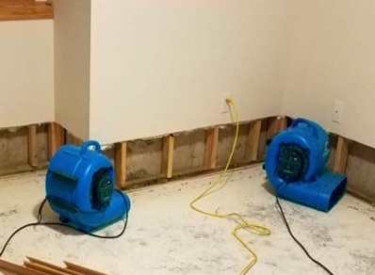
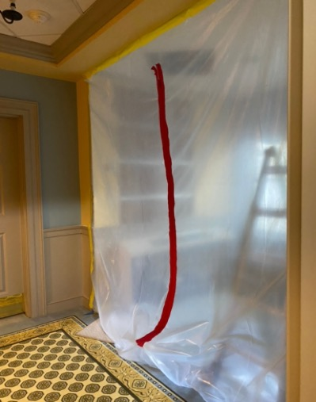
Exposure Reduction
Practical mould remediation guidance in: Part 2 Rentsafe Mould Expert Report https://rentsafecanada.files.wordpress.com/2022/02/mould-expert-report_health-impactsremediation.pdf
Building owner reducing humidity sources e.g. fix leaky plumbing, install extractor fans in bathroom, dehumidifiers in basement
Cleanup of mould - bleach not recommended; usually requires PPE protection; materials removal e.g. mould impregnated wall board
Professional cleanup if extensive

Slide 26
Symptom Reduction & Social Support
Treatment of condition e.g. asthma therapy
Social support
Supports for negotiations with building owner, financial challenges, move to other accommodation - importance of mould team.
Physician role to included referrals, letters (with patient consent)
https://rentsafe.ca/2019/06/26/new-resources-on-mould-and-health-for-physicians-and-their-patients/

Slide 27
Any urgent
s-mould-ering
questions?
?

Slide 28
The Housing Crisis as context for Mould Exposure

Slide 29
Housing Crisis & Mould Exposure
Dampness and mould occur most typically in:
older housing stock
housing with substandard renovations
housing with inadequate maintenance
unsuccessful attempts to adapt housing to unusually cold climates or unconventional foundations (e.g., homes built directly on irregular rock)
inadequate housing in Indigenous communities
Summerbell & Hart (2021). Health Impacts of Indoor Dampness and Mould and Effective Remediation and Prevention Strategies: Expert Review and Summary of Evidence. https://rentsafecanada.files.wordpress.com/2022/02/mould-expert-report_health-impactsremediation.pdf

Slide 30
Housing need in Canada
Definition of core housing need:
Adequacy: major repairs are required
Suitability: there are not enough bedrooms
Affordability: housing costs are more than 30% of household income
Approximately 1 in 10 Canadian households in core housing need, 2021
Renters 4x as likely to be in core housing need (renters = 20%; owners = 5.3%)
Nearly 20% of Indigenous population living in a dwelling in need of major repairs (2016 data)
https://www150.statcan.gc.ca/n1/pub/11-627-m/11-627-m2022056-eng.htm
https://www.cmhc-schl.gc.ca/blog/2019-housing-observer/indigenous-households-core-housing-need

Slide 31
Tenants experience multiple challenges
Rental housing stock is aging (78% built before 2000)
Onus is on tenants to raise concerns:
possible risks for tenants (eviction, stigma, discrimination)
tenants may not know their rights
face multiple hurdles in accessing justice and supports
Housing maintenance is subject to landlord engagement and compliance
Limited housing affordability and availability
many have to settle for what is available and affordable
Energy poverty:
continuous heating throughout housing unit can be challenge when faced with difficult choices in allocating scarce resources for daily living
https://www03.cmhc-schl.gc.ca/hmip-pimh/en#Profile/1/1/Canada

Slide 32
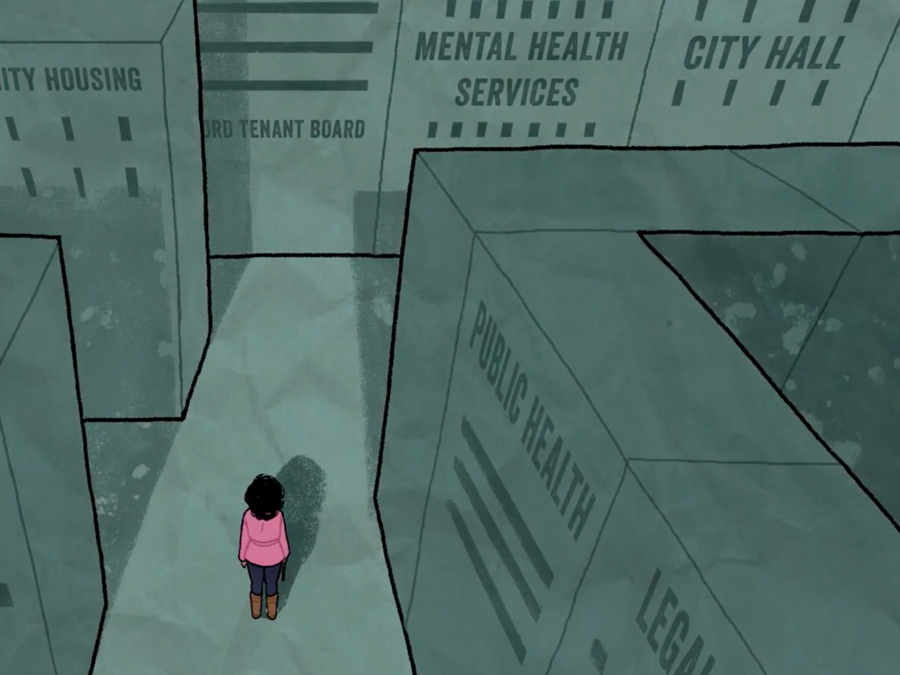
RentSafe
Ontario-based initiative led by CPCHE to address unhealthy conditions in low-income rental housing
Aims to improve the intersectoral “system” for response and prevention
Tenants’ grounded (lived) expertise informs the conceptualization of problems and solutions
Multiple sectors actively involved
Advancing the right to healthy homes for all
RentSafe.ca
LogementSain.ca
Image source: Frontline Connections: Supporting Tenants’ Rights to Healthy Housing (RentSafe video)

Slide 33
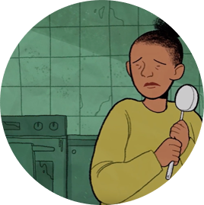
RentSafe baseline research
Focus groups with tenants living on low income and urban and rural settings (n=80)
Sectoral surveys with public health, legal aid, small-scale landlords, frontline professionals, municipal property standards/by-law)
Findings suggest insufficient:
resources for response and coordination across sectors
capacity for follow-up
regulatory framework in support of the right to healthy housing
RentSafe (2018). Towards Healthy Homes for All: RentSafe Summary and Recommendations.
https://rentsafecanada.files.wordpress.com/2018/10/rentsafe-summary-report_final.pdf

Slide 35
Who is the ‘mould action team’ in your community?
Addressing housing habitability concerns often requires intersectoral collaboration and coordination:
Physician:
diagnosing and reporting health effect
providing letter to support patient self-advocacy
Public Health
Legal aid (or equivalent)
Municipal by-law/property standards
Frontline social services
Housing providers
Tenants/residents

Slide 36
Building intersectoral capacity
Suite of resources to support action on mould in housing:
Training podcast for physicians https://rentsafe.ca/2018/03/08/blog-podcasts/
Guide for patients/tenants living with mould →
Guidance and sample letter for physicians to support patient/tenant self-advocacy
Expert report on mould health effects, prevention & remediation
Model by-law language
https://rentsafe.ca/2019/06/26/new-resources-on-mould-and-health-for-physicians-and-their-patients/

Slide 37
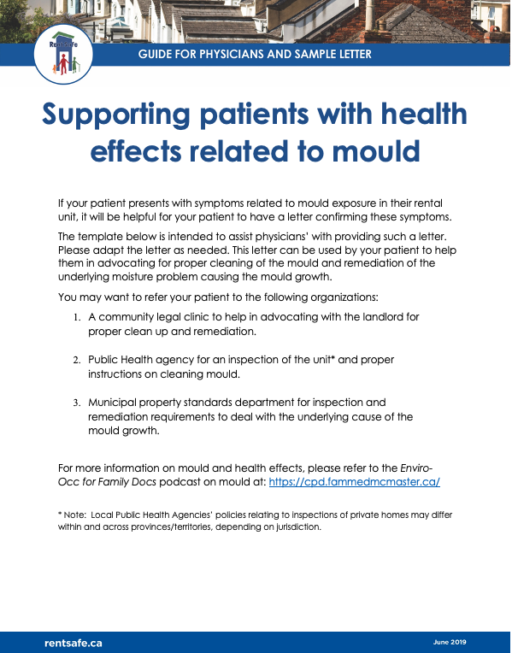
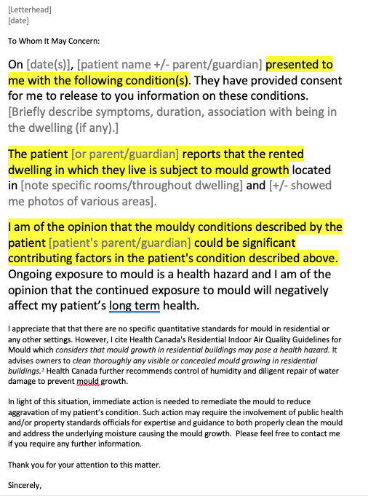
https://rentsafe.ca/2019/06/26/new-resources-on-mould-and-health-for-physicians-and-their-patients/

Slide 38
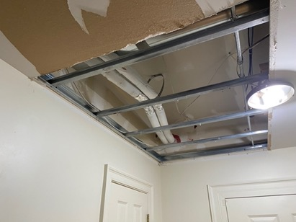
Case Revisit
Mom with children in rental unit
Senior in co-op building:
Primary care MD recognized mould exposure as contributor to physical, cognitive impacts
Repeated advocacy by residents led to fulsome investigation and response
Adult children provided portable, responsive HEPA filter air cleaner (not ionizing)
Remediation underway: significant replacement needed of ceiling, walls; multiple units

Slide 39
Discussion
Thinking of cases in your practice:
Do you think the RentSafe materials might help you in resolving patient’s concerns about mould exposure?
Are there things you have done in your practice which were particularly helpful?
Any further resources that might help you?

Slide 40
Thank you!
Merci ! RentSafe.ca LogementSain.ca Contacts: erica@healthyenvironmentforkids.ca geri@healthenvironmentforkids.ca
Key take-aways:
Consider mould exposure when patients present with non-specific symptoms
Ask about home and housing
Air testing for mould is not recommended in most cases
Physicians, as trusted/respected providers, can play a key role in advocating for healthy housing and connecting patients with community supports (e.g., legal aid, public health)

Slide 41
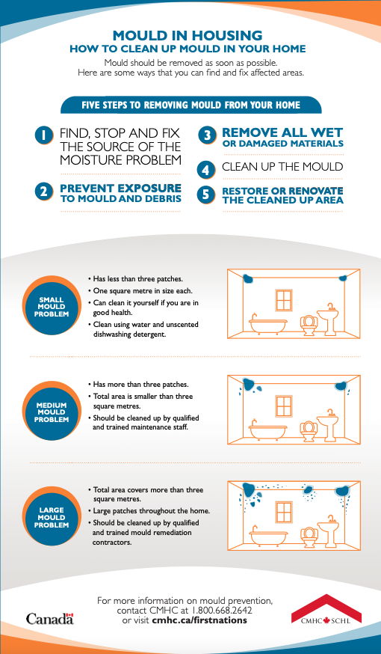
Resources:
RentSafe mould resources collection: https://rentsafe.ca/2019/06/26/new-resources-on-mould-and-health-for-physicians-and-their-patients/
Health Canada: https://www.canada.ca/en/health-canada/services/publications/healthy-living/addressing-moisture-mould-your-home.html
CMHC: https://www.cmhc-schl.gc.ca/professionals/industry-innovation-and-leadership/industry-expertise/indigenous-housing/develop-manage-indigenous-housing/maintenance-solutions/mould-in-housing
Public Health: See your local health unit/authority’s website

