Slide 1
Title Slide
“I SPY WITH MY LITTLE DERMATOSCOPE…”
Dr. Lynn Fong MD CCFP DipPDerm(UK)
Dr. Saadia H. Jan MBBS MClSc(FM) CCFP FCFP DipPDerm(UK)

Slide 2
Presenters:
Dr. Lynn Fong MD CCFP DipPDerm(UK)
Academic Family Physician
Health for All Family Health Team
Markham Family Medicine Teaching Unit
Dr. Saadia Hameed Jan MD, MBBS, MClSc(FM), CCFP FCFP, DipPDerm(UK)
Associate Professor
Department of Family Medicine
Schulich School of Medicine and Dentistry
Western University
Notes:
This slide must be visually presented to the audience AND verbalized by the speaker. Where a faculty/speaker has no relationships to disclose, indicate Not Applicable under relationships with Financial Sponsors.

Slide 3
Land Acknowledgement
We recognize and respect the Kanien’kehà:ka as the traditional custodians of the lands and waters on which we meet today.
This land has long served as a site of meeting and exchange amongst many First Nations including the Kanien’kehá:ka of the Haudenosaunee Confederacy, Huron/Wendat, Abenaki, and Anishinaabeg.
I acknowledge that we are all settlers, new and generational, who due to our various types of privilege, benefit from this land.

Slide 4
COI – Presenter Disclosure (1)
Presenter Disclosure
Presenters: Drs. Fong and Jan
Relationships with financial sponsors:
Any direct financial relationships, including receipt of honoraria: None
Membership on advisory boards or speakers’ bureaus: None
Patents for drugs or devices: None
Other: None
Notes:
Where a faculty/presenter has no relationships to disclose, indicate Not Applicable under Relationships with Financial Sponsors.
Complete this slide for the primary presenter and ALL co-presenters if applicable.
Reminder: Disclosures made on your COI forms should match disclosures made on the COI slide.

Slide 5
COI – Presenter Disclosure (2)
Disclosure of Financial Support
This program has NOT received financial support in any from, NOR in kind support.
Potential for conflict(s) of interest:
Drs. Fong and Jan will be talking about various dermatoscopes with company names, and courses on dermoscopy from a practice and user perspective. We are not benefitting financially or in kind, from these companies or courses.
DermLite and Heine are the 2 largest manufacturers of the dermatoscopes which are widely used in practice. Their dermatoscopes will be discussed in this program
Notes:
Where a program has received no external financial support (e.g., monies for food, logistics assistance such as registration, AV set-up, etc.), indicate No External Support.

Slide 6
Objectives
At the end of this session, participants will be able to
Discover what the dermatoscope is, how it works and its types
Learn an approach to dermoscopy of pigmented and non-pigmented lesions. (Focus on Pigmented Lesions)
Explore how to incorporate dermoscopy in primary practice

Slide 7
Why Should I Use Dermoscopy? $$$, no remuneration, ^ time to learn

Slide 8
What is a Dermatoscope?
Dermatoscopes are handheld devices used for the evaluations of skin lesions.
The practice is called dermoscopy
Dermatoscopes have a transilluminating light source and magnifying optics (10×).
Allow the visualization of subsurface skin structures located within the epidermis, DE junction, and papillary dermis, which are otherwise not visible to the eye.
Cost can be anywhere between $350 to over $1000.
Cameras and other storage devices can be attached to dermatoscopes.

Slide 9
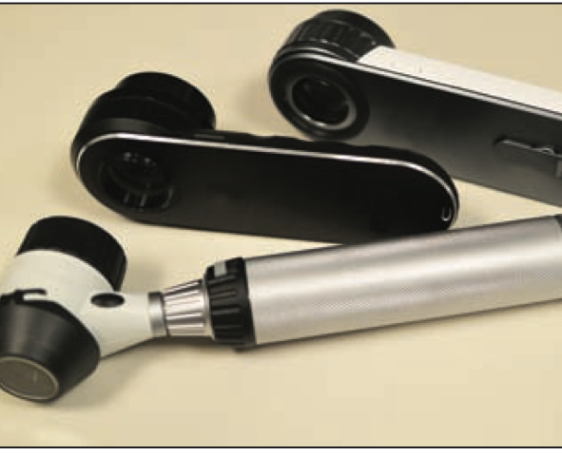
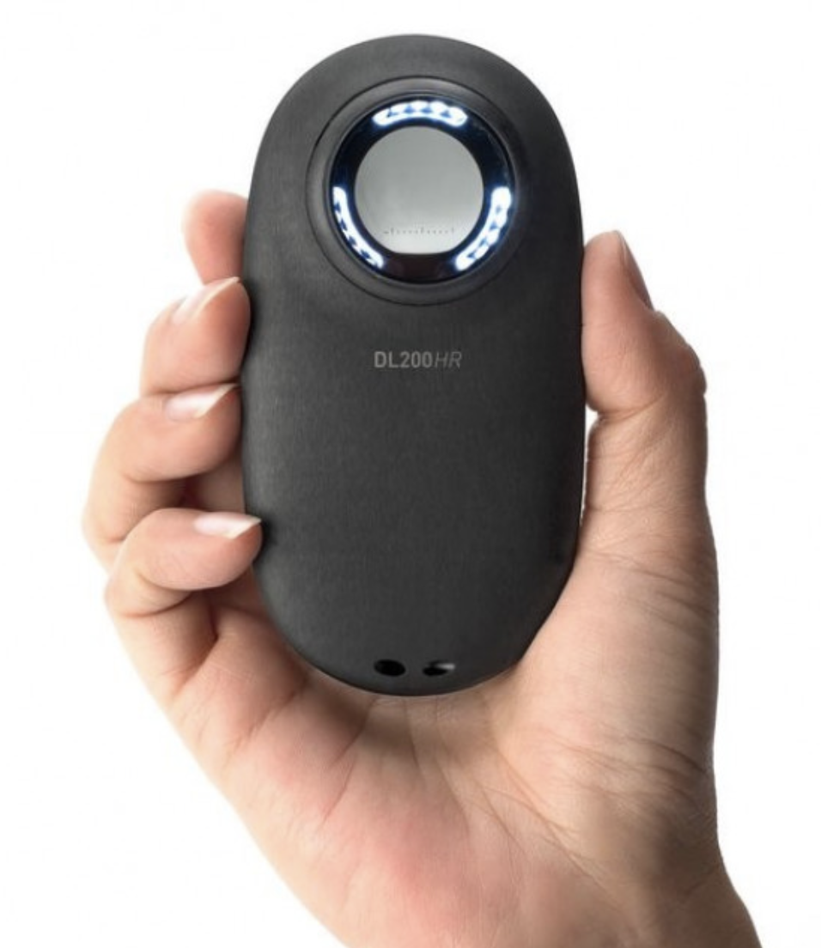
Dermatoscopes

Slide 10
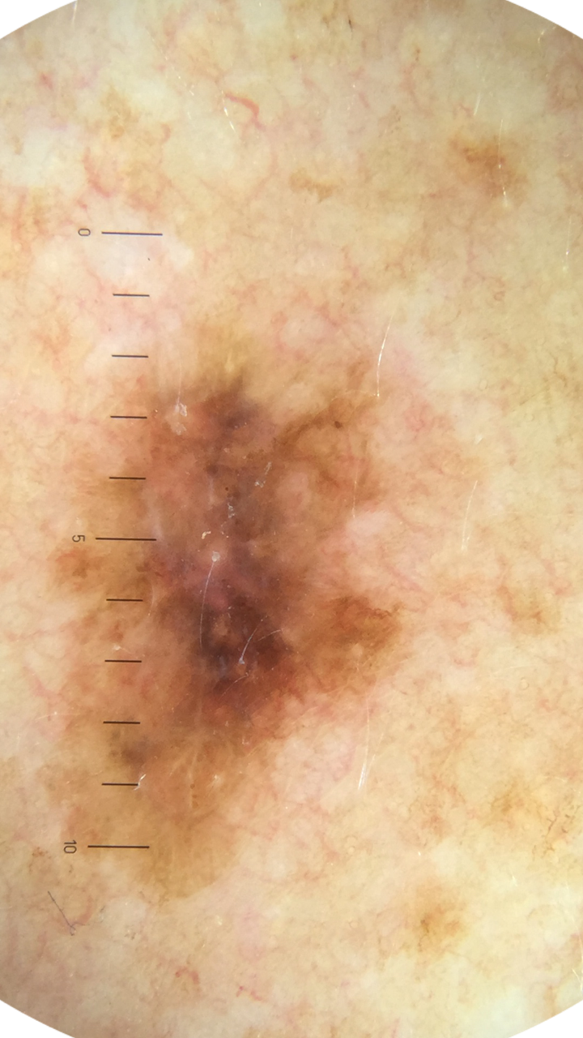

Slide 11
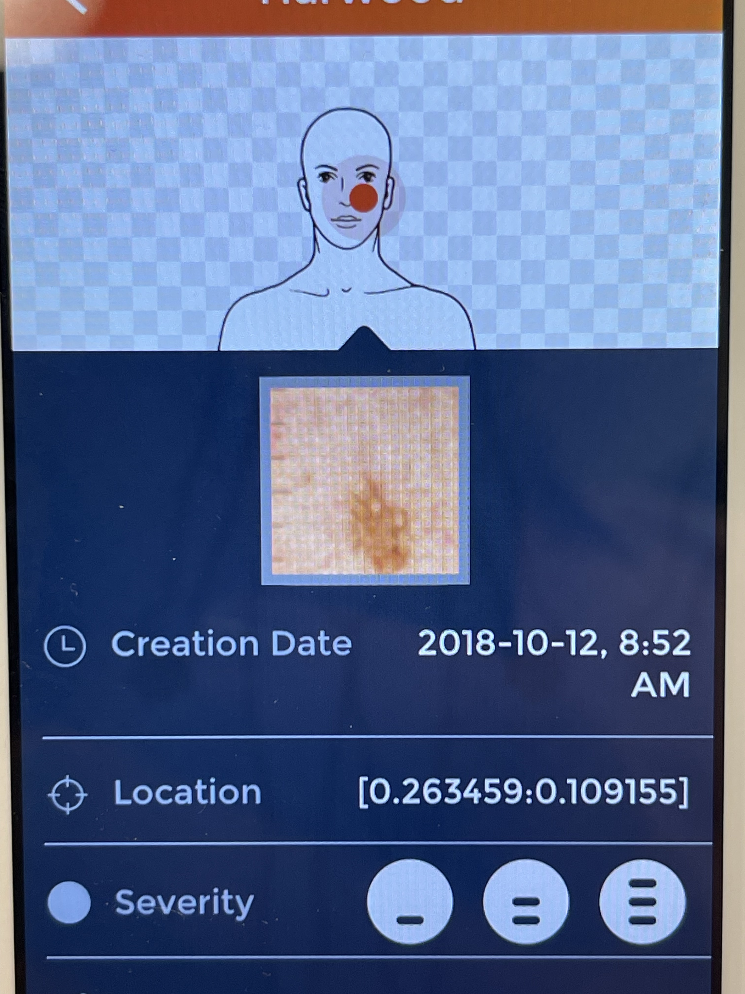

Slide 12
How do you choose a dermatoscope?
Level of competency
Budget
Needs (app for mole mapping, or EMR compatibility)
Design

Slide 13
TIP
Primary Care Dermatology Society of Canada (PCDSC) has an annual conference in Toronto/Vancouver in the fall.
Multiple Dermatoscope Vendors
Discounted Rates
Sessions on Dermoscopy

Slide 14
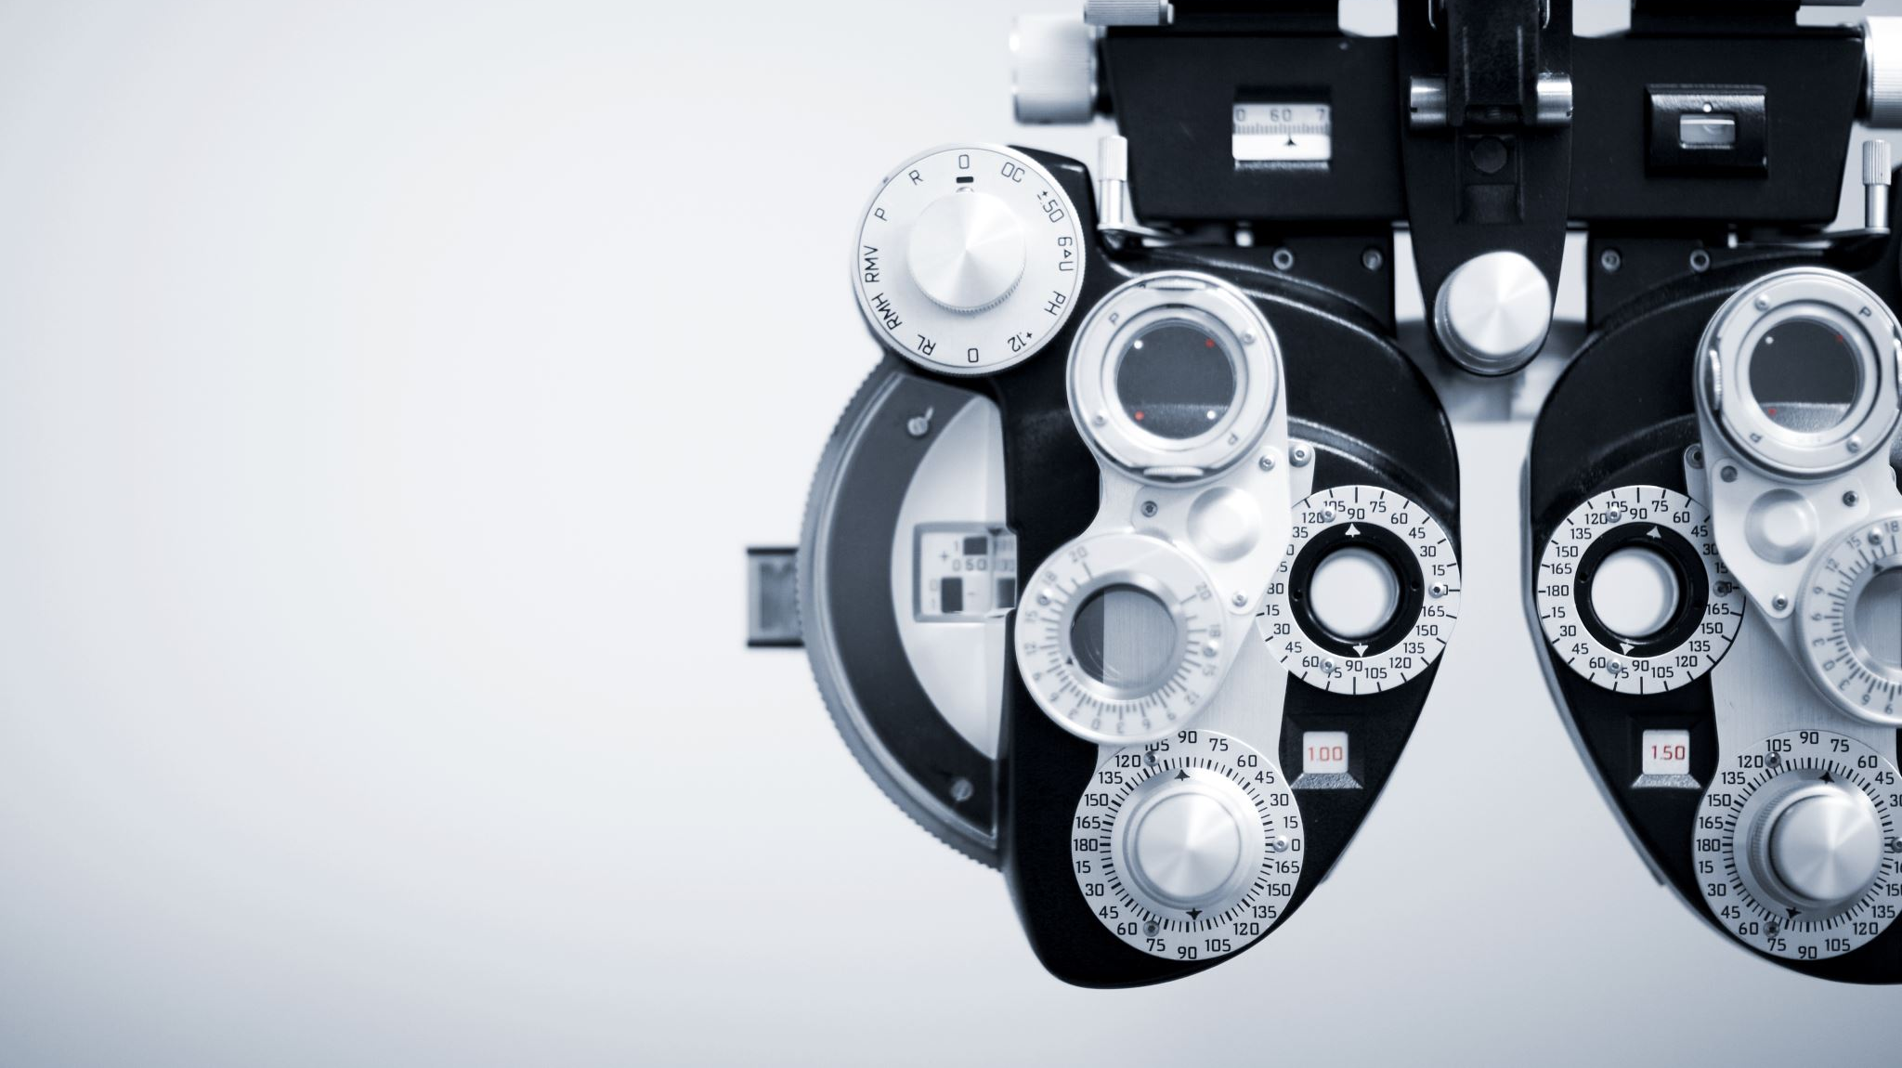
How does a dermatoscope work?
During naked eye exam, light is reflected off the skin surface hence we cannot see the structures located below this layer.
Dermatoscopes illuminate the skin via light-emitting diode bulbs.
Nonpolarized or Polarized.
Nonpolarized light requires a liquid interface (gel or alcohol) between the scope and skin to see the skin structures well.
Polarized light does not require an interface medium.
Most dermatoscopes are hybrid and allow toggling between polarized and non-polarized light.

Slide 15
Polarized and Non-Polarized Light

Slide 16
Non-polarized Polarized
Notes:
Surface of a lake seen without a polarizing filter (left) and with a polarizing filter (right). The polarizing filter cuts off a significant portion of the glare.

Slide 18
How effective is dermoscopy?
Notes:
3000 studies chosen 1987 to 2008 – assessment done in clinical settings, not just via photographs and later confirmed by histopathology. Has sensitivity and specificities.

Slide 19
Carli P, De Giorgi V, Chiarugi A, et al. Addition of dermoscopy to conventional naked-eye examination in melanoma screening: a randomized study. J Am Acad Dermatol 2004;50:683–9.
Prospective RCT - Adding dermoscopy resulted in a 42% reduction in number of pigmented skin lesions excised for diagnosis (p = 0.01).
Carli P, de Giorgi V, Crocetti E, MannoneF, Massi D, Chiarugi A, et al. Improvement of malignant/benign ratio in excised melanocytic lesions in the ‘dermoscopy era’: a retrospective study 1997–2001. Br J Dermatol 2004;150(4):687-92
In a retrospective study over 5 years among 2 dermatologists: the ratio of benign/ malignant pigmented lesions that were excised significantly decreased from 18:1 to 4:1(p = 0.037) with the addition of dermoscopy. Fewer benign lesions removed.
Kittler H, Guitera P, Riedl E, et al. . Identification of clinically featureless incipient melanoma using sequential dermoscopy imaging. Arch Dermatol2006;142:1113–9
Equivocal lesions - melanomas that lack discernible clinical and dermoscopic features, hence challenging to diagnose with one dermatoscopic exam. Ongoing dermoscopy surveillance of these lesions may help identify so-called featureless melanomas.
Notes:
Further dissescting these data: CM

Slide 20
1-Dermoscopy is a valuable tool to support visual inspection of suspicious lesions especially in the hands of experienced users
2-Data to support its use in primary care are limited, however it may assist in triaging suspicious lesions for urgent referral when employed by suitably trained clinicians.
3-Formal algorithms may be of most use for dermoscopy training purposes and for less expert observers however reliable data is lacking.

Slide 21
Michael A. Marchetti and Ashfaq A. Marghoob. Dermoscopy, CMAJ October 21, 2014, 186 (15) 1167
Although dermoscopy is primarily used by dermatologists, any health care professional can learn dermoscopy.
Piccolo D, Ferrari A, Peris K, Diadone R, Ruggeri B, Chimenti S. Dermoscopic diagnosis by a trained clinician vs a clinician with minimal dermoscopy training vs computer-aided diagnosis of 341 pigmented skin lesions: a comparative study. Br J Dermatol2002;147(3):481-6.
Analysis by a trained clinician or an AI neural network‐trained computer can improve the diagnostic accuracy of melanoma compared with that of an inexperienced clinician.
Computer diagnosis might represent a useful tool for the screening of melanoma, particularly at centres not experienced in dermoscopy.
(Dermoscopic image is a requisite!!!)

Slide 22
ncol2006;24:1877–82

Slide 23
C.J.L. Koelink, et al. Diagnostic accuracy and cost-effectiveness of dermoscopy in primary care: a cluster randomized clinical trial. Journal of the Europ Acad of Derm and Venerology, Volume 28, Issue 11, p. 1442-1449
A study of Dutch general practices that found that the probability of a correct diagnosis was 1.25 times higher when dermoscopy was used to evaluate suspicious skin lesions and incremental cost-effectiveness ratio was €89 (95% CI −€60 to €598). They concluded that the use of dermoscopy appeared to be cost effective (from a healthcare spending perspective).

Slide 24
In Summary, if
Dermoscopy increases diagnostic accuracy of melanomas,
It likely increases diagnostic accuracy of melanomas in primary care,
Any clinician can learn dermoscopy,
It is cost effective from a health spending perspective,
And AI based diagnostic applications for pigmented lesions, will require dermoscopic pictures as data,
then
Are Family Physicians practicing dermoscopy?

Slide 25
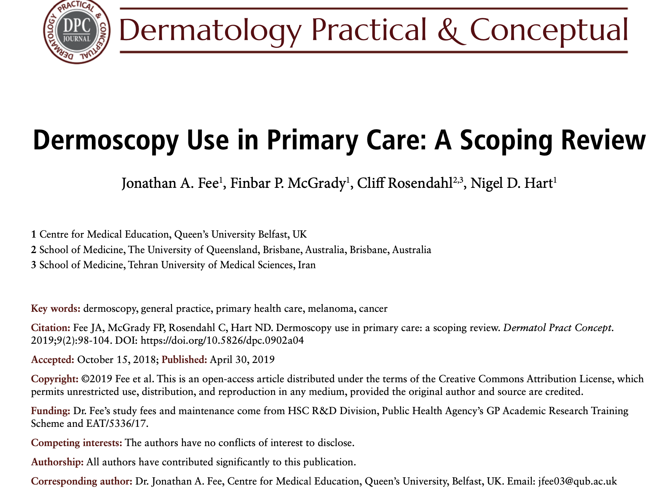

Slide 27
Use of dermoscopy varies by jurisdiction
Paucity of data around use and outcomes of dermoscopy in primary care.
Few FPs use dermoscopy (special focus/interest)
Those who use it do not use it consistently
Most FPs use it only for pigmented lesions
FPs who use it feel more confident in analyzing pigmented skin lesions
Barriers: cost of instrument and time cost for training
Perceived advantages: earlier diagnoses of melanoma, reducing dermatology referrals and reducing patient anxiety
Potentially HELP with BURNOUT! (patient & physician satisfaction survey?)

Slide 28
Foundation
1-Diagnostic Algorithms
Pattern analysis
2-Triage Algorithms
3-point checklist
ABCD rule of dermoscopy
Menzies method
7-point algorithm
TADA method

Slide 29
Diagnostic Algorithm: Pattern Analysis
Argenziano G, Soyer HP, Chimenti S, et al. Dermoscopy of pigmented skin lesions: results of a consensus meeting via the Internet. J Am Acad Dermatol2003;48(5):679-93
Consensus among dermatologists that pattern analysis had the highest sensitivity, specificity, and diagnostic accuracy for detecting malignant melanoma
This algorithm requires extensive knowledge and training to recognize the morphology of both normal and abnormal structures of the skin. It is applicable to both pigmented lesions, non pigmented lesions, parasites, hair, nails and other skin related structures.

Slide 30
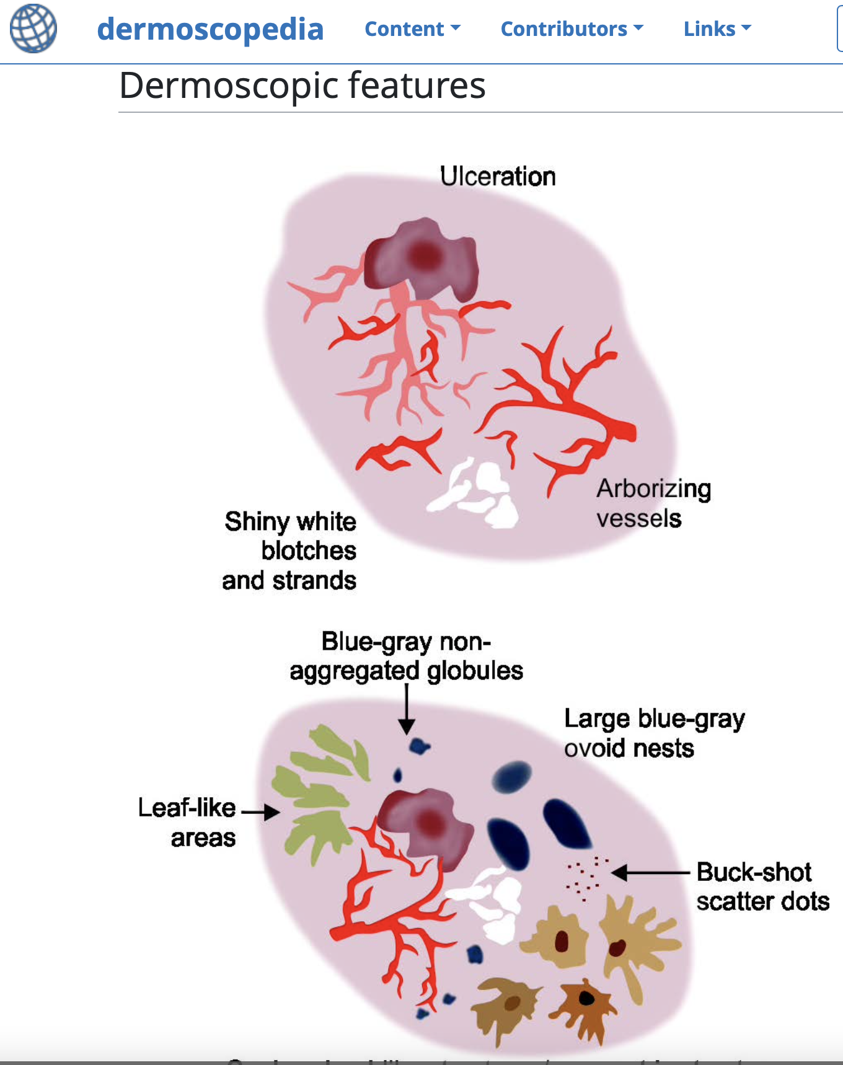
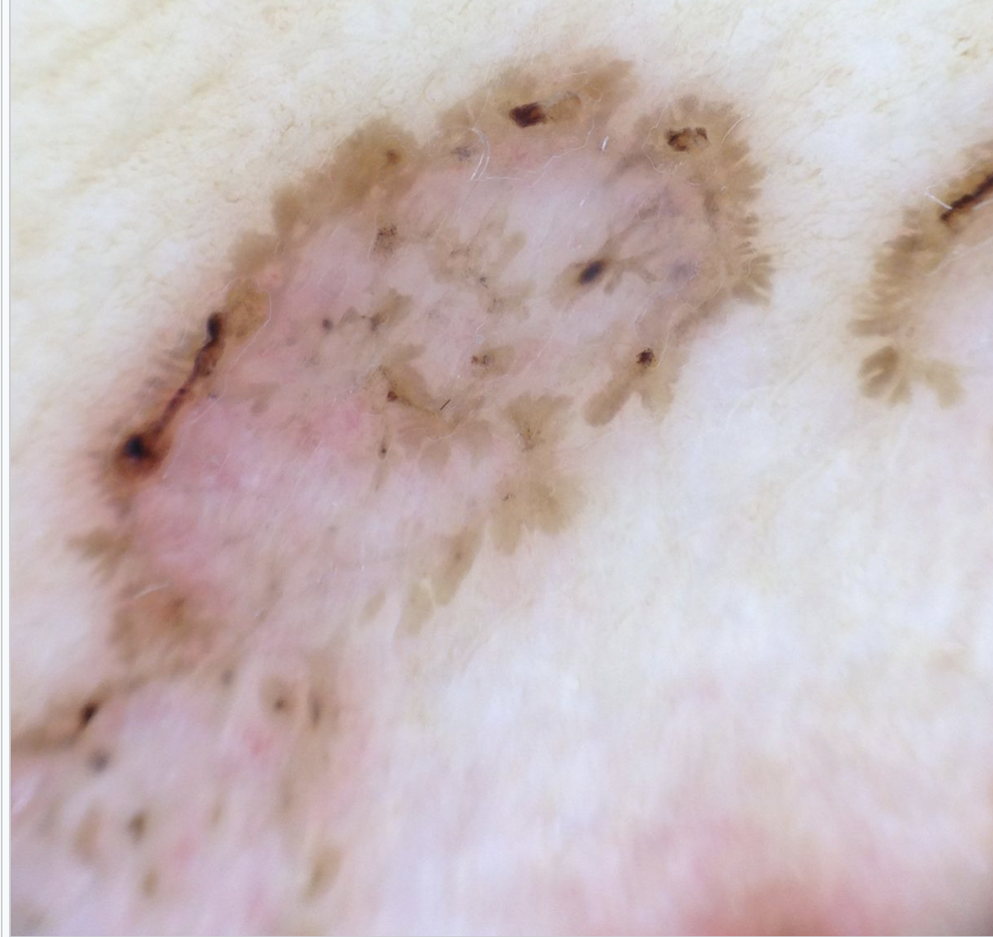
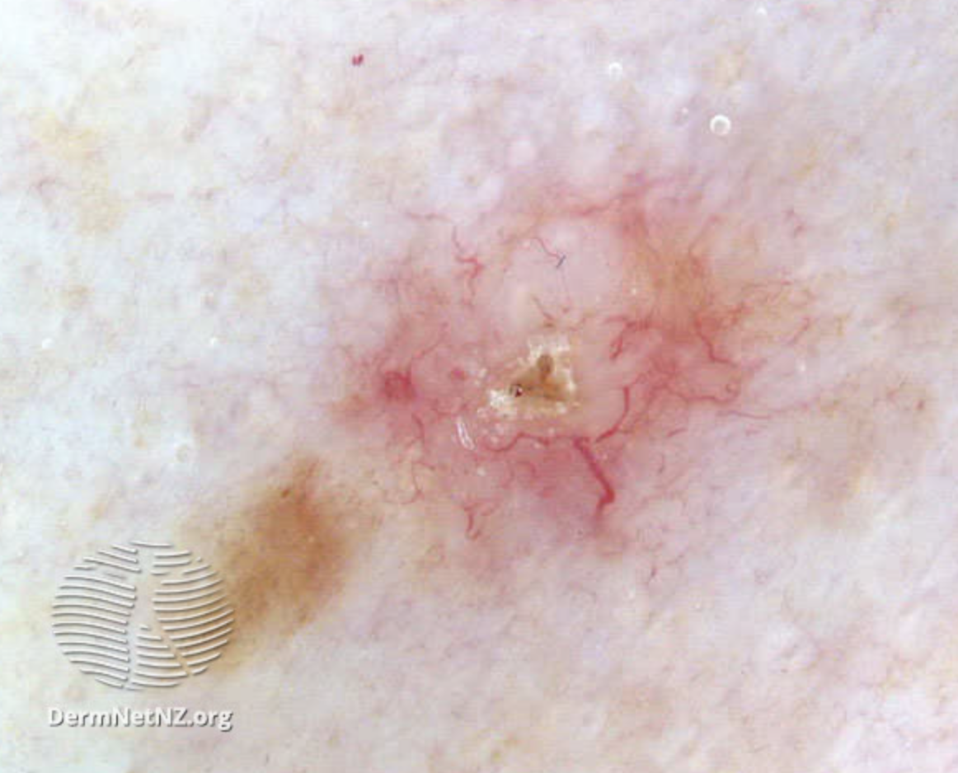
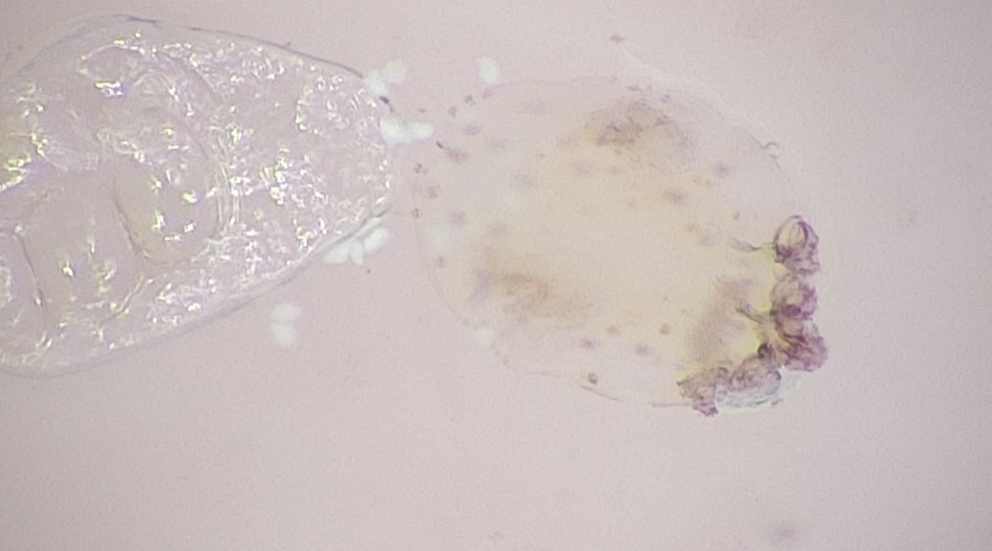

Slide 31
TIP

Slide 33
Triage Algorithms
3-Point checklist developed by Argenziano and colleagues in 2004
ABCD rule of dermoscopy more technical dermoscopic evaluation algorithm developed in 1994 by Stolz and colleagues
Menzies method The Menzies method was developed by Menzies and colleagues in 1996
CASH method Henning and colleagues developed the CASH algorithm in 2006 for the early dermoscopist
7-point algorithm (involves some pattern analysis) Argenziano and col- leagues developed the 7-point checklist in 1998
TADA method (involves sequential pattern analysis) Rogers and colleagues in 2016

Slide 34
Argenziano G, et al. Dermoscopy improves accuracy of primary care physicians to triage lesions suggestive of skin cancer. J Clin Oncol 2006;24(12):1877-82
The 3-point checklist is a valid and reproducible dermoscopic algorithm with high sensitivity (96.3% ) for the diagnosis of melanoma in the hands of non-experts. Thus, it may be applied as a screening procedure for the early detection of melanoma

Slide 35
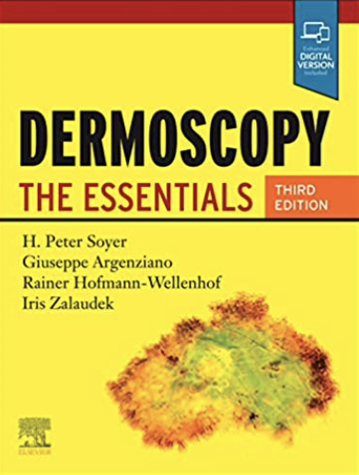
3-Point Checklist (2004)
Encourage Clinicians to start using Dermoscopy
Goal is to identify lesions that need a biopsy or referral to a specialist (Triage or screening)
No patient should ever leave an office with an undiagnosed Melanoma
The presence of 2/3 of the 3 criteria are highly suggestive of a Melanoma/suspicious lesion
The sensitivity and specificity are comparable to other algorithms
Even after a 1 hour training, novice dermoscopists were able to identify melanomas accurately, 96.3% of the time

Slide 36
3-Point checklist (2/3 = excise )
3 points | Definitions
1-Asymmetry | Asymmetry of colour and structure in one or two perpendicular axes
2-Atypical Network | Pigment network with irregular holes and thick lines
3-Blue – White Structures | Any type of Blue and/or White colour

Slide 37
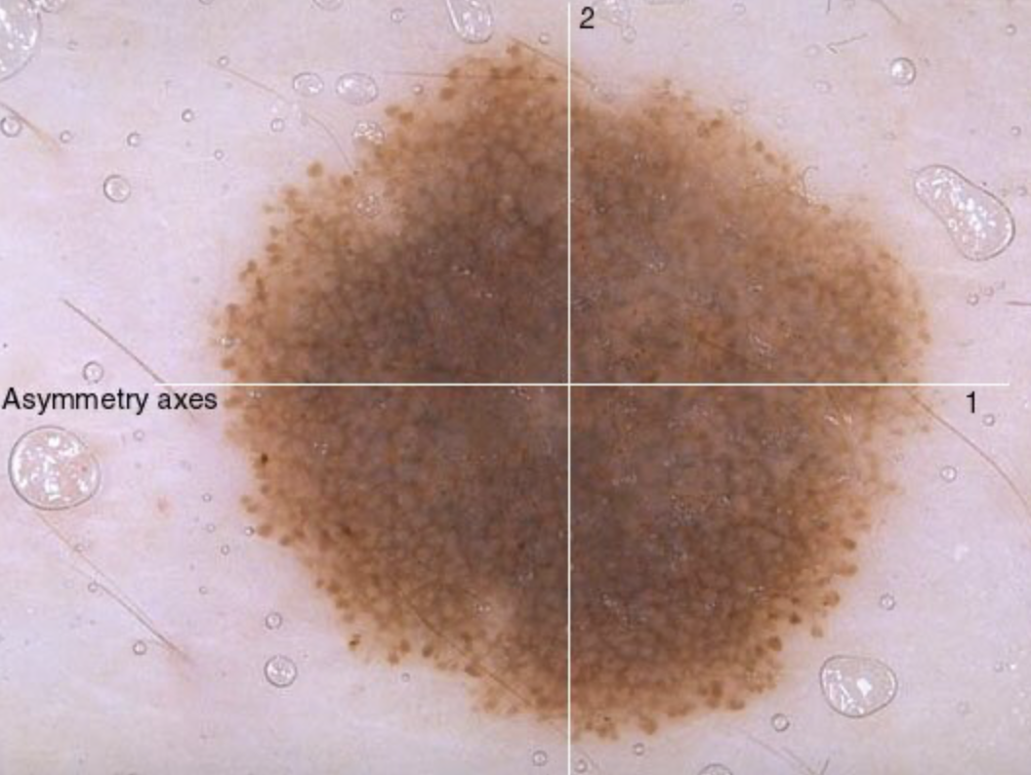
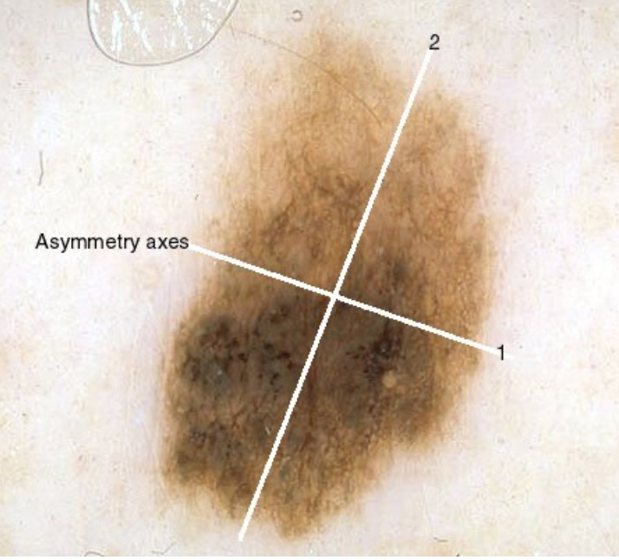
1 - Asymmetry

Slide 38
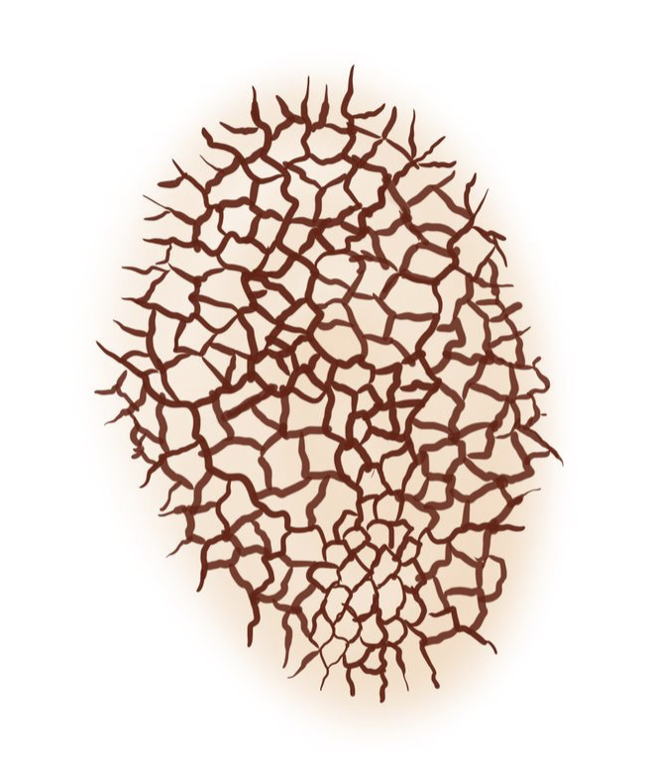
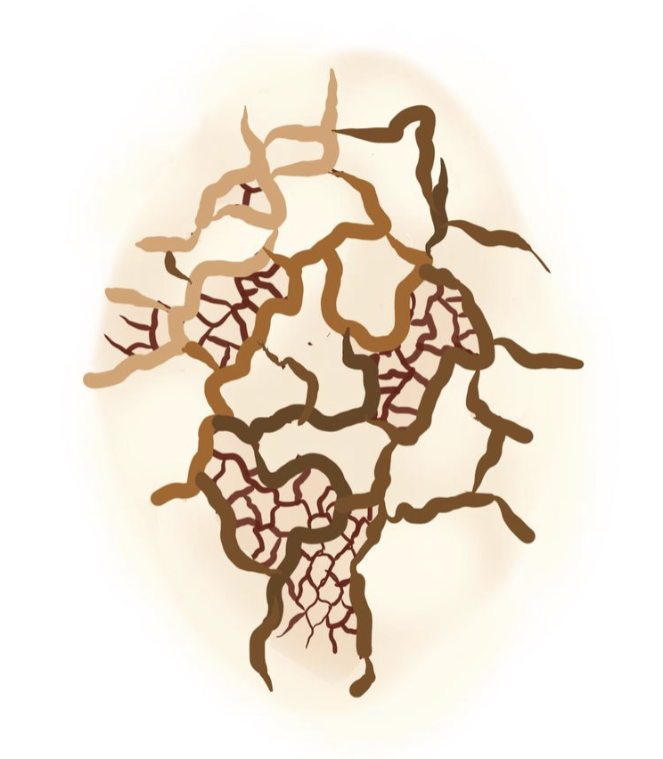
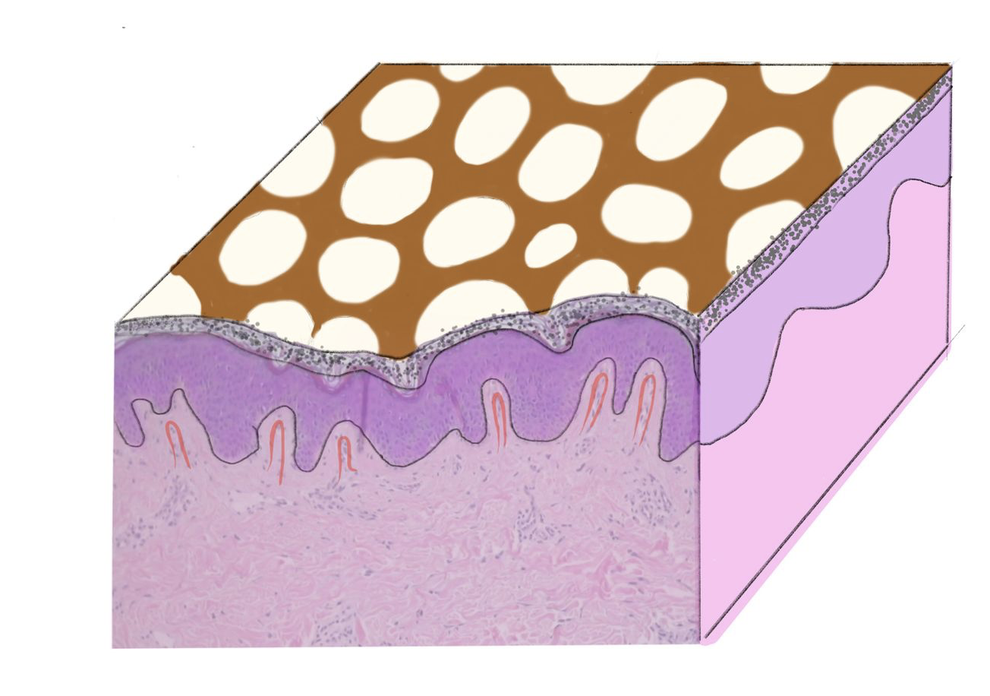
2 – Atypical Network
Normal pigment network is a grid-like reticular pattern.
Histologically, the lines correspond to increased melanocytes along elongated rete ridges.
The "holes" of the network correspond to the suprapapillary plates.
Atypical pigment network is irregularly meshed with lines varying in size, color, thickness, or distribution and is often seen in dysplastic nevi and superficial spreading melanoma

Slide 39
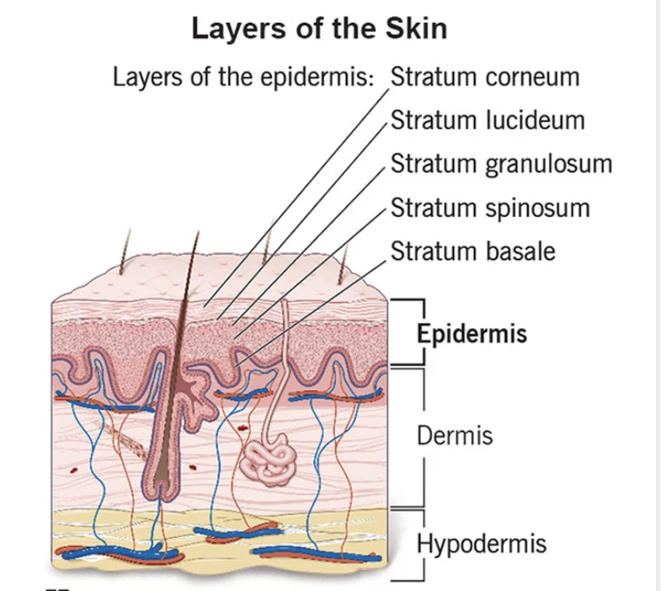
Histology

Slide 40
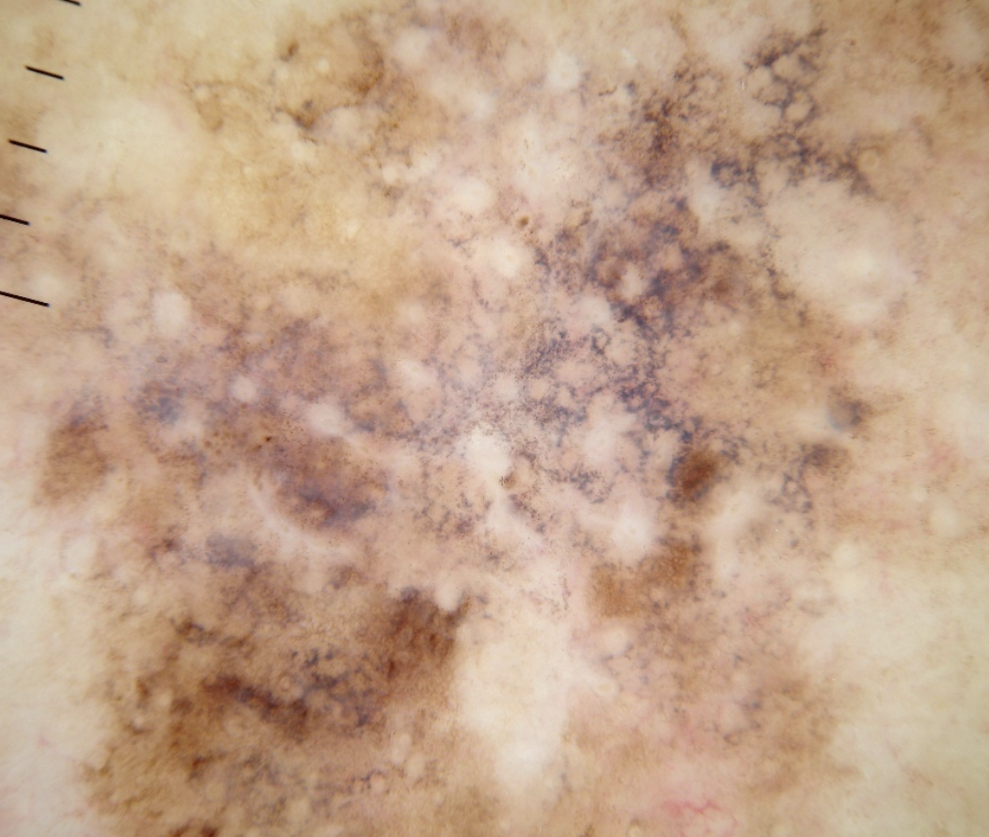
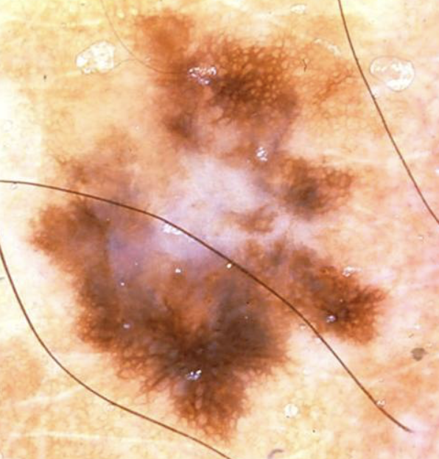
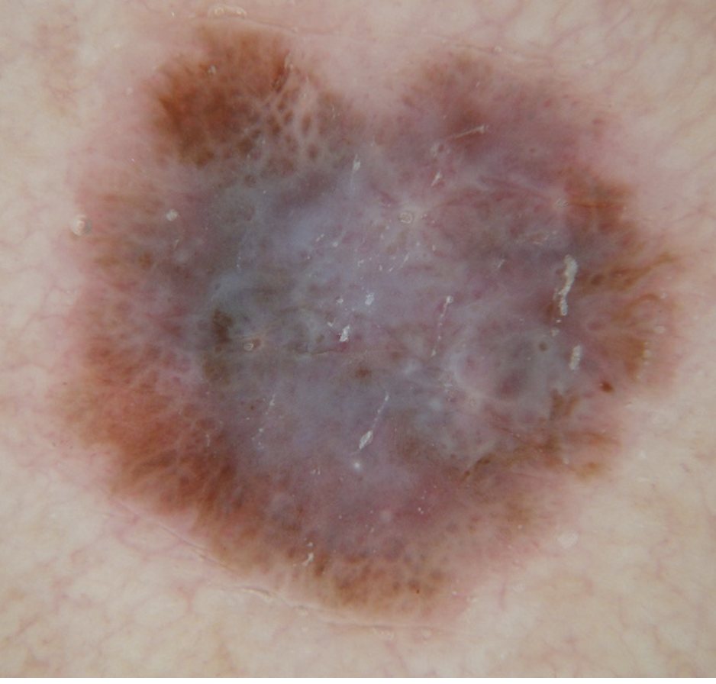
3– Blue and/or White structures
Blue-white veil is confluent blue pigmentation under a white “ground-glass” haze. Histopathologically: mlenaocytes/melanin in the dermis in combination with compact orthokeratosis
White veil. Histopathology fully evolved regression. The rete ridges are flattened. Regression structures consisting of both scar like depigmentation and peppering (granularity) are seen in melanoma.
Granularity (also known as “peppering”) is accumulation of multiple very small (<0.1 mm), blue-grey dots. Histopathologically, granularity correlates with melanin in the superficial dermis, either as fine melanin particles in melanophages or extracellular “dust-like” particles.

Slide 41
3-Point checklist (2/3 = excise )
3 points | Definitions
1-Asymmetry | Asymmetry of colour and structure in one or two perpendicular axes
2-Atypical Network | Pigment network with irregular holes and thick lines
3-Blue – White Structures | Any type of Blue and/or White colour

Slide 42
Dermoscopy alone is never enough. CONTEXT is very important!
In 2022 Melanoma was the 4% most common cancer in Canada
9,000 Canadians diagnosed
1,200 Canadians died
Incidence is rising but mortality rates are decreasing
In 2004, estimated economic burden of skin cancer in Canada was be $532 million, the majority being attributable to melanoma (83.4%), and the balance distributed between BCC (9.1%) and SCC (7.5%).
In 2030, projected to be $922 million annually

Slide 43
History and physical exam establish your index of suspicion for Melanoma!
Family history
Duration of onset
Risk factors (sun exposure, where you live and work)
Palpation of lesions and comparison with other lesions on the body
(patterns and lesions that stand out)

Slide 44
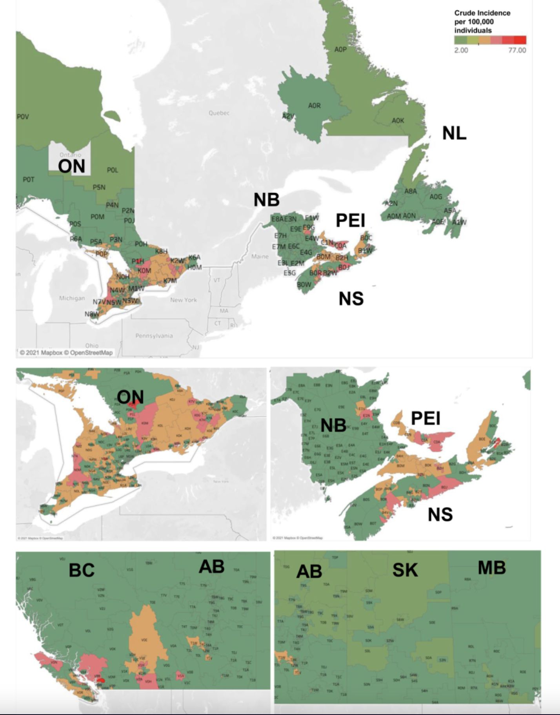

Slide 45
3-Point checklist (2/3 = excise )
3 points | Definitions
1-Asymmetry | Asymmetry of colour and structure in one or two perpendicular axes
2-Atypical Network | Pigment network with irregular holes and thick lines
3-Blue – White Structures | Any type of Blue and/or White colour

Slide 46
Simple nevus
Asymmetry
Atypical Network
Blue/White Veil
0/3 – no need to excise/refer

Slide 47
Pigmented Basal Cell Carcinoma
Asymmetry
Atypical Network
Blue/White Veil
2/3 – excise/refer

Slide 48
Malignant Melanoma
Asymmetry
Atypical Network
Blue/White Veil
3/3 – excise/refer

Slide 49
Cherry Angioma
Asymmetry
Atypical Network
Blue/White Veil
1/3 – no need to excise/refer

Slide 50
Benign Nevus
Asymmetry
Atypical Network
Blue/White Veil
1/3 – no need to excise/refer

Slide 51
Dysplastic/Atypical/Clark nevus
Asymmetry
Atypical Network
Blue/White Veil
2/3 – excise/refer

Slide 52
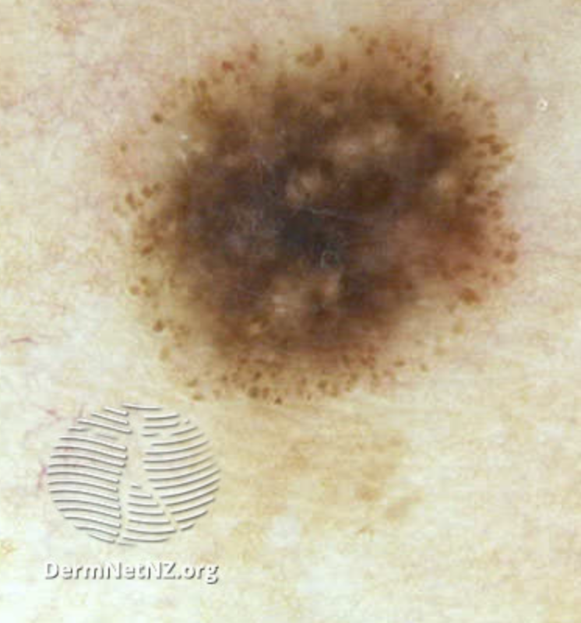
Spitz/Reed Nevus
Asymmetry
Atypical Network
Blue/White Veil
1/3 – excise/refer *

Slide 53
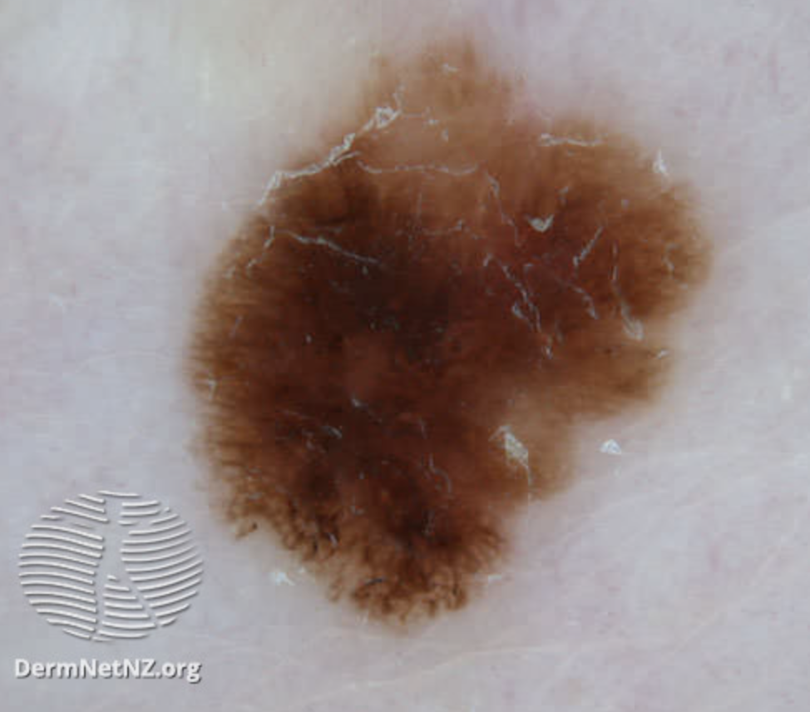
Malignant Melanoma (in-situ)
Asymmetry
Atypical Network
Blue/White Veil
2/3 – excise/refer

Slide 54
Malignant Melanoma (in-situ)
Asymmetry
Atypical Network
Blue/White Veil
2/3 – excise/refer

Slide 55
Dermatofibroma
Asymmetry
Atypical Network
Blue/White Veil
(clinical assx imp)
1/3 – no need to excise/refer

Slide 56
EDID
Both Drs. Fong and Jan were unable to find dermoscopy pictures of pigmented lesions in dark skinned individuals on the web.
This has implications for practice
As well for AI neural networks where dark skin lesions will be under-represented.

Slide 58
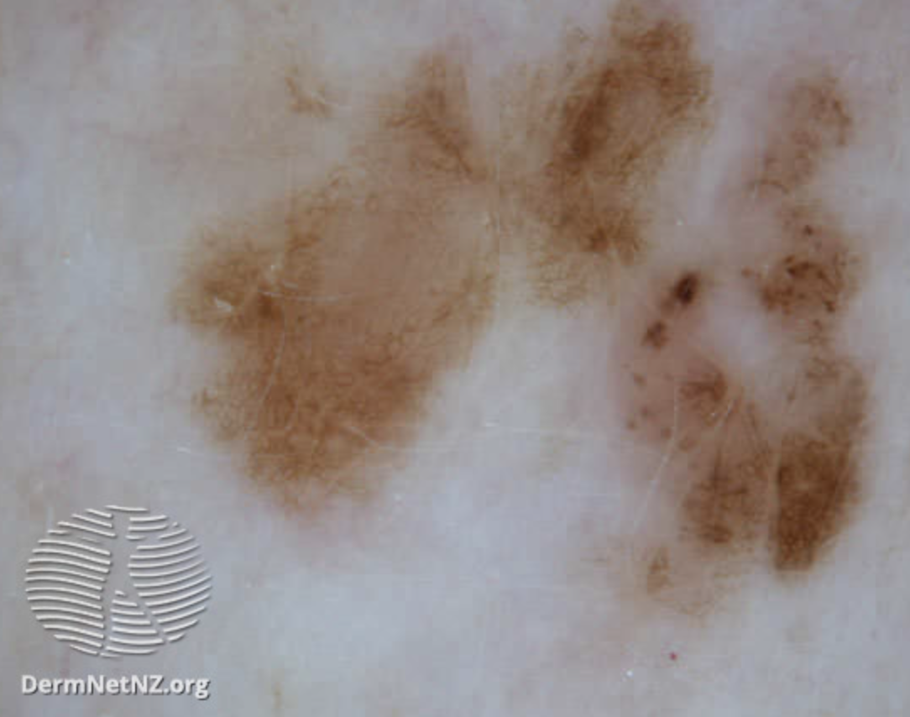
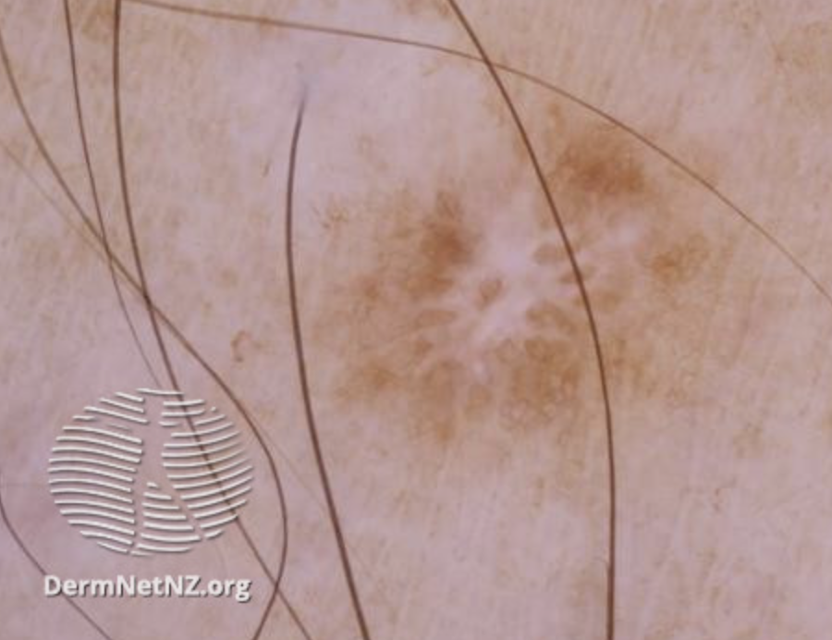
Beauty and the Beast or Ugly Duckling sign

Slide 59
Differential Diagnoses Seborrheic Keratoses

Slide 62
Quizz
https://pollev.com/sjan387

Slide 63
Notes:
Do not modify the notes in this section to avoid tampering with the Poll Everywhere activity. More info at polleverywhere.com/support Dermoscopy Quiz: 3-Point Checklist
https://www.polleverywhere.com/surveys/RCL2lOf4qnpMfgLYWoJH5?display_state=chart&activity_state=opened&state=opened&flow=Engagement&onscreen=persist

Slide 64
Notes:
Do not modify the notes in this section to avoid tampering with the Poll Everywhere activity. More info at polleverywhere.com/support Assign this lesion points out of 3 based on the 3-Point Checklist. Should this lesion be excised?
https://www.polleverywhere.com/multiple_choice_polls/tJjNF4inJOLorEak5x0uV?display_state=chart&activity_state=opened&state=opened&flow=Engagement&onscreen=persist&hide=instructions

Slide 65
Notes:
Do not modify the notes in this section to avoid tampering with the Poll Everywhere activity. More info at polleverywhere.com/support Assign this lesion points out of 3 based on the 3-Point Checklist. Should this lesion be excised?
https://www.polleverywhere.com/multiple_choice_polls/Wy10kO1iQMFjdQfrOwJdc?display_state=chart&activity_state=opened&state=opened&flow=Engagement&onscreen=persist&hide=instructions

Slide 66
Notes:
Do not modify the notes in this section to avoid tampering with the Poll Everywhere activity. More info at polleverywhere.com/support Assign this lesion points out of 3 based on the 3-Point Checklist. Should this lesion be excised?
https://www.polleverywhere.com/multiple_choice_polls/pvsLDi1sWz30Vko1waDG4?display_state=chart&activity_state=opened&state=opened&flow=Engagement&onscreen=persist&hide=instructions

Slide 67
Notes:
Do not modify the notes in this section to avoid tampering with the Poll Everywhere activity. More info at polleverywhere.com/support Assign this lesion points out of 3 based on the 3-Point Checklist. Should this lesion be excised?
https://www.polleverywhere.com/multiple_choice_polls/16wza2HRCueu78jkfRwtR?display_state=chart&activity_state=opened&state=opened&flow=Engagement&onscreen=persist&hide=instructions

Slide 68
Notes:
Do not modify the notes in this section to avoid tampering with the Poll Everywhere activity. More info at polleverywhere.com/support Assign this lesion points out of 3 based on the 3-Point Checklist. Should this lesion be excised?
https://www.polleverywhere.com/multiple_choice_polls/EtkfaMAQGAPeqF5PYQEdQ?display_state=chart&activity_state=opened&state=opened&flow=Engagement&onscreen=persist&hide=instructions

Slide 69
Notes:
Do not modify the notes in this section to avoid tampering with the Poll Everywhere activity. More info at polleverywhere.com/support Assign this lesion points out of 3 based on the 3-Point Checklist. Should this lesion be excised?
https://www.polleverywhere.com/multiple_choice_polls/lpCJMp7TGZdi58dF9skQn?display_state=chart&activity_state=opened&state=opened&flow=Engagement&onscreen=persist&hide=instructions

Slide 70
Notes:
Do not modify the notes in this section to avoid tampering with the Poll Everywhere activity. More info at polleverywhere.com/support Assign this lesion points out of 3 based on the 3-Point Checklist. Should this lesion be excised?
https://www.polleverywhere.com/multiple_choice_polls/03mmPtHeZdeo71ixgqLXB?display_state=chart&activity_state=opened&state=opened&flow=Engagement&onscreen=persist&hide=instructions

Slide 71
Notes:
Do not modify the notes in this section to avoid tampering with the Poll Everywhere activity. More info at polleverywhere.com/support Assign this lesion points out of 3 based on the 3-Point Checklist. Should this lesion be excised?
https://www.polleverywhere.com/multiple_choice_polls/4tycGfyCS5kxiRT35xJ5q?display_state=chart&activity_state=opened&state=opened&flow=Engagement&onscreen=persist&hide=instructions

Slide 72
Notes:
Do not modify the notes in this section to avoid tampering with the Poll Everywhere activity. More info at polleverywhere.com/support Assign this lesion points out of 3 based on the 3-Point Checklist. Should this lesion be excised?
https://www.polleverywhere.com/multiple_choice_polls/CjYDDpT0rvohp7C0KGqvg?display_state=chart&activity_state=opened&state=opened&flow=Engagement&onscreen=persist&hide=instructions

Slide 73
Notes:
Do not modify the notes in this section to avoid tampering with the Poll Everywhere activity. More info at polleverywhere.com/support Assign this lesion points out of 3 based on the 3-Point Checklist. Should this lesion be excised?
https://www.polleverywhere.com/multiple_choice_polls/pquf85SqWFwpuJTpsdz45?display_state=chart&activity_state=opened&state=opened&flow=Engagement&onscreen=persist&hide=instructions

Slide 74
Notes:
Do not modify the notes in this section to avoid tampering with the Poll Everywhere activity. More info at polleverywhere.com/support Assign this lesion points out of 3 based on the 3-Point Checklist. Should this lesion be excised?
https://www.polleverywhere.com/multiple_choice_polls/afNTXUQOrgKMR6GnxtuhK?display_state=chart&activity_state=opened&state=opened&flow=Engagement&onscreen=persist&hide=instructions

Slide 75
Notes:
Do not modify the notes in this section to avoid tampering with the Poll Everywhere activity. More info at polleverywhere.com/support Assign this lesion points out of 3 based on the 3-Point Checklist. Should this lesion be excised?
https://www.polleverywhere.com/multiple_choice_polls/PgHD5ui2ksqnPotJApzrV?display_state=chart&activity_state=opened&state=opened&flow=Engagement&onscreen=persist&hide=instructions

Slide 76
Notes:
Do not modify the notes in this section to avoid tampering with the Poll Everywhere activity. More info at polleverywhere.com/support Assign this lesion points out of 3 based on the 3-Point Checklist. Should this lesion be excised?
https://www.polleverywhere.com/multiple_choice_polls/f3tpPfC5a2Y7SClXu2fik?display_state=chart&activity_state=opened&state=opened&flow=Engagement&onscreen=persist&hide=instructions

Slide 77
Notes:
Do not modify the notes in this section to avoid tampering with the Poll Everywhere activity. More info at polleverywhere.com/support Assign this lesion points out of 3 based on the 3-Point Checklist. Should this lesion be excised?
https://www.polleverywhere.com/multiple_choice_polls/0KGYUGSkumwuxNaRlDogs?display_state=chart&activity_state=opened&state=opened&flow=Engagement&onscreen=persist&hide=instructions

Slide 78
Notes:
Do not modify the notes in this section to avoid tampering with the Poll Everywhere activity. More info at polleverywhere.com/support Assign this lesion points out of 3 based on the 3-Point Checklist. Should this lesion be excised?
https://www.polleverywhere.com/multiple_choice_polls/u0kSdFBuN0dZccd9SfWjg?display_state=chart&activity_state=opened&state=opened&flow=Engagement&onscreen=persist&hide=instructions

Slide 79
TIP

Slide 80
notes
QR codes for the bibliography and make the literature slides very succinct.
Have a legend on each slide where we have the pictures of the lesions
Have the 3 points as yes no for each case
15 cases
Resource summary at the end and also connected to website/Instagram – linktree
Skin of colour conference and segue into why we do not have dark skin cases in our slides

Slide 81
Closing Slide
Thank you! Chi Miigwech!
Please fill out your session evaluation now!
#myfmf
FamilyMedicineForum
FamilyMedForum
FamilyMedForum

