Slide 1



Title Slide
Top 10 EM Articles
Dalhousie ESEM
C.Boyd M. Clarke J. Muray
M. Clory R. Haworth

Slide 2
COI – Presenter Disclosure (1)
Presenter Disclosure
Presenter: All
Relationships with financial sponsors:
  Any direct financial relationships, including receipt of honoraria: No
  Membership on advisory boards or speakers’ bureaus: No
  Patents for drugs or devices: No
  Other: No
Notes:
Where a faculty/presenter has no relationships to disclose, indicate Not Applicable under Relationships with Financial Sponsors.
Complete this slide for the primary presenter and ALL co-presenters if applicable.
Reminder: Disclosures made on your COI forms should match disclosures made on the COI slide.

Slide 3
COI – Presenter Disclosure (2)
Disclosure of Financial Support
This program has received no financial support.
This program has received no in-kind support
Potential for conflict(s) of interest: None
[
Notes:
Where a program has received no external financial support (e.g., monies for food, logistics assistance such as registration, AV set-up, etc.), indicate No External Support.

Slide 4
Top 10 EM Articles to Change Your Practice

Slide 5
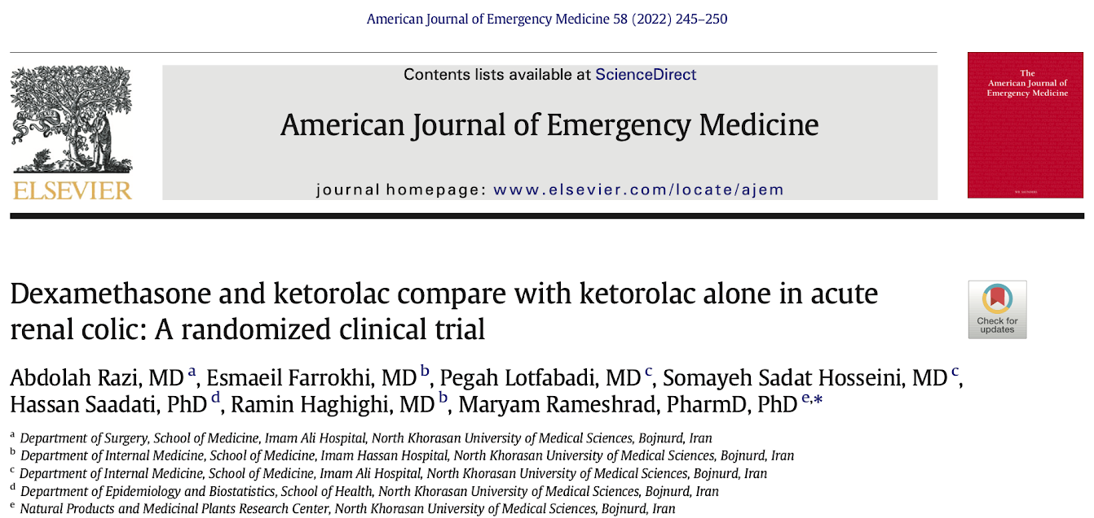

Slide 6
Background
Renal colic classically presents with sudden, severe flank pain radiating to the low abdomen and groin
Stretching of the renal pelvis leads to release of prostaglandins that cause smooth muscle spasms of the urinary tract wall
NSAIDs (ex. ketorolac) are considered first line treatment for analgesia, which are known to decrease formation of prostaglandin precursors

Slide 7
Background
Opioids are generally reserved for those with contraindications to NSAIDs or who require additional analgesia
  Opioids carry risk of respiratory depression, sedation, dependency, etc
Glucocorticoids act at the intracellular level to increase synthesis of anti-inflammatory mediators and reduce production of pro-inflammatory mediators
Analgesic effect of dexamethasone is not clear but may be related to inhibition of prostaglandin formation

Slide 8
Hypothesis
Co-administration of dexamethasone with ketorolac may alleviate renal colic and pain-induced vomiting and decrease narcotic requirement compared to ketorolac alone

Slide 9
Methods
Double blind randomized controlled trial
Randomized 120 patients with renal colic from an Emergency Department in Iran
60 patients assigned to ketorolac group
  Ketorolac 30 mg IV
  Sterile water placebo IV
60 patients assigned to ketorolac + dexamethasone group
  Ketorolac 30 mg IV
  Dexamethasone 10 mg IV

Slide 10
Methods
Primary outcome was pain scores on Visual Analog Scale at 30 and 60 minutes after drug administration
Secondary outcome was need for narcotics or anti-emetic drugs as well as grade of vomiting

Slide 11
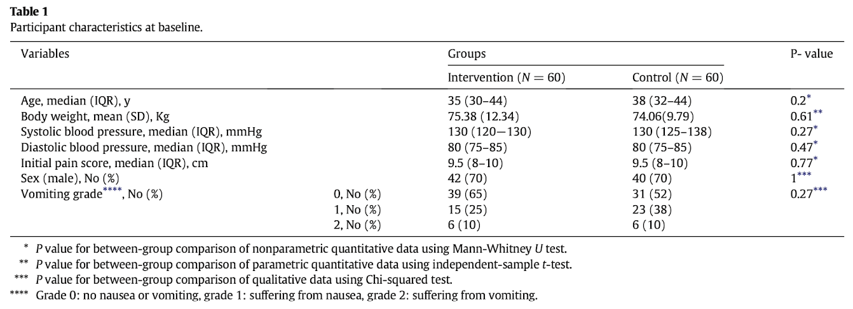
Results

Slide 12
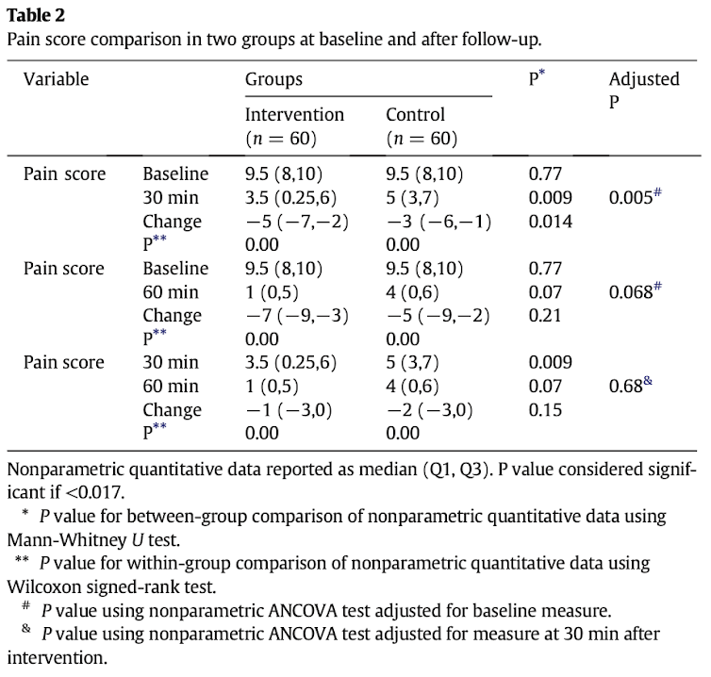
Results

Slide 13
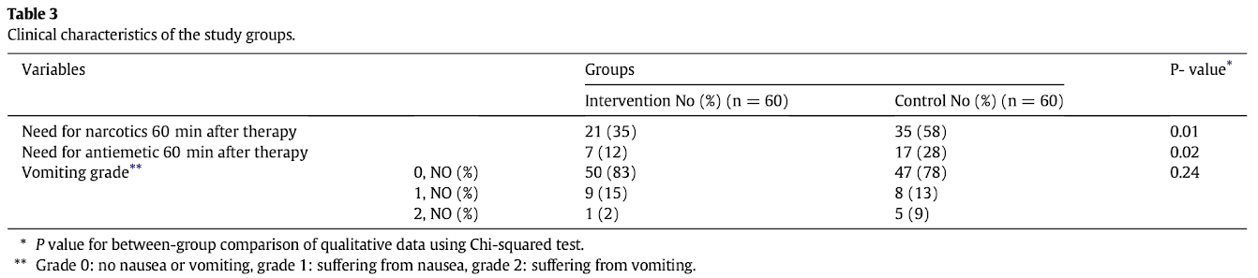
Results

Slide 14
Conclusion
Treating renal colic with ketorolac plus dexamethasone may lead to better pain control earlier and reduce the amount of narcotics and anti-emetics required

Slide 15
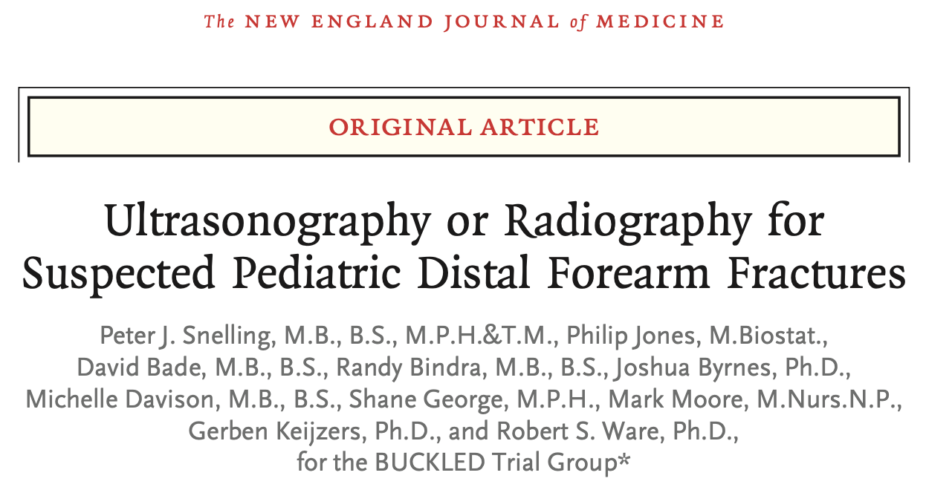

Slide 16
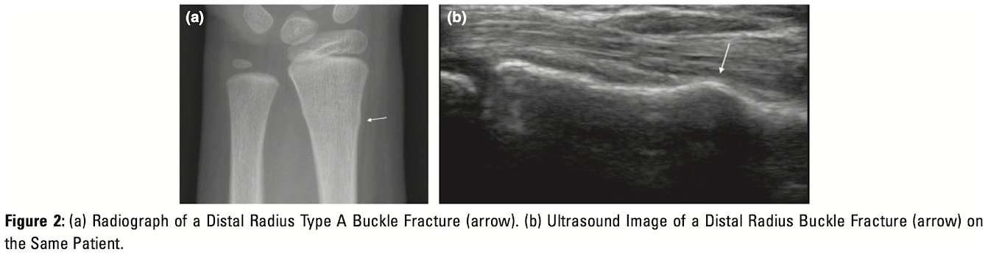
Introduction
Buckle fractures of the distal radius are among the most common fractures in children
Radiography is routinely performed as initial imaging of suspected fractures, but ultrasonography is becoming increasingly popular
Image from Snelling AJUM 2018

Slide 17
Introduction
Ultrasonography for diagnosis of distal forearm fractures is accurate, timely, and may be preferred by parents and children to radiography
Ultrasound does not expose the patient to any ionizing radiation
Purpose of this study was to compare the effect of ultrasonography to radiography as the initial diagnostic imaging modality on patient centred outcomes

Slide 18
Methods
Multi-centre, open-label, non inferiority, randomized controlled trial conducted at four centres in Australia
Randomized 270 children presenting to the ED with isolated, acute, clinically non-deformed distal forearm injuries for which imaging was indicated
  135 children assigned to initial ultrasonography
  135 children assigned to initial radiography

Slide 19
Methods
Patients in the ultrasonography group underwent point-of-care ultrasound using a six-view forearm ultrasonography protocol
Patients in the radiography group received biplanar imaging at a minimum
Initial treatment was standardized
  Patients with no fracture were managed conservatively
  Patients with buckle fractures were managed with a wrist splint
  Patients with other fractures received intervention as needed and cast immobilization

Slide 20
Methods
Primary outcome was physical function of the arm at 4 weeks as measured by the Pediatric Upper Extremity Short Patient-Reported Outcomes Measurement Information System (PROMIS) tool
  8 item questionnaire, scores range from 8-40
  Non-inferiority margin of 5 points on the PROMIS tool was pre-specified by the researchers
Secondary outcomes included physical function of the arm at 1 week and 8 weeks post-injury, patient and parent satisfaction, pain, frequency of complications, frequency of radiography, length of stay, and treatment time in the ED

Slide 21
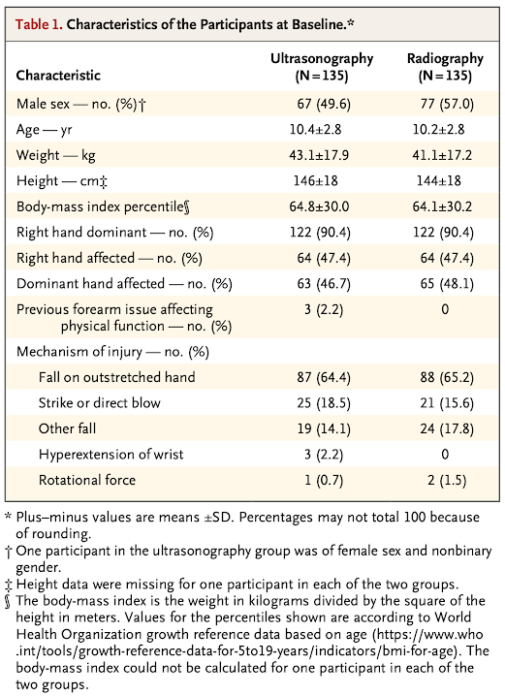
Results

Slide 22
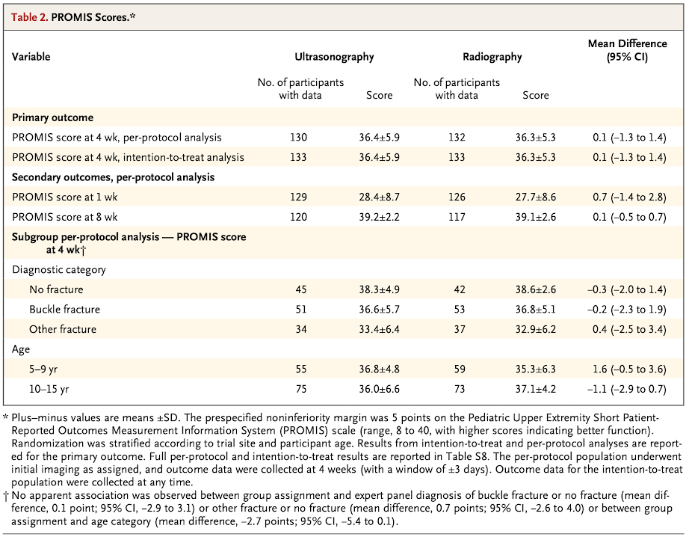
Results

Slide 23
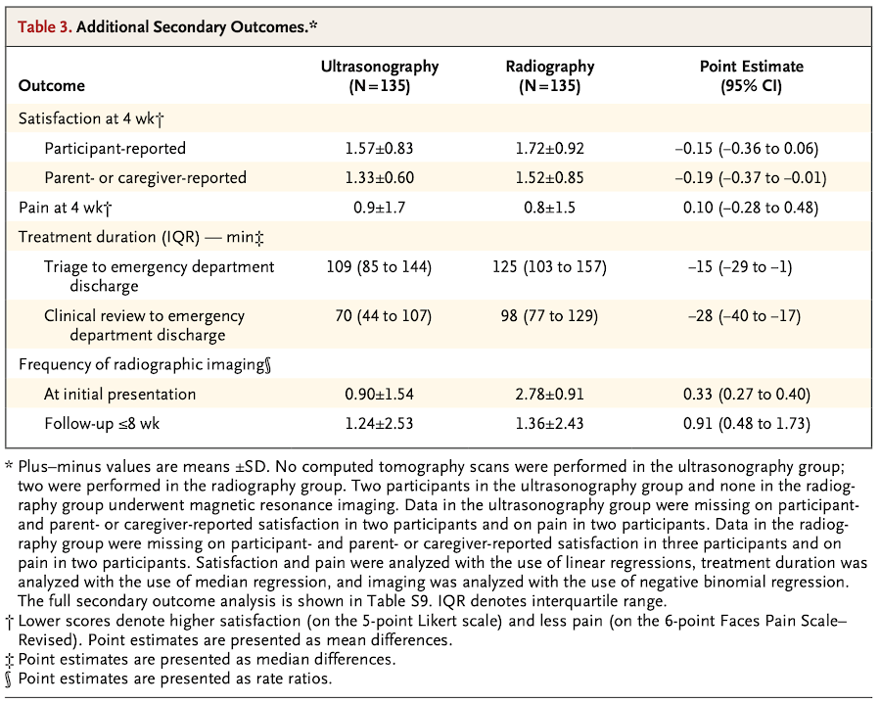
Results

Slide 24
Conclusions
Ultrasonography was non-inferior to radiography in terms of physical function of the arm at 4 weeks, with no differences in adverse events
Ultrasonography may be useful as the initial diagnostic test for distal forearm injuries in pediatric patients and can reduce the number of radiographs done on initial ED visits
Use of ultrasonography led to a shorter treatment time and shorter length of stay in the ED

Slide 25
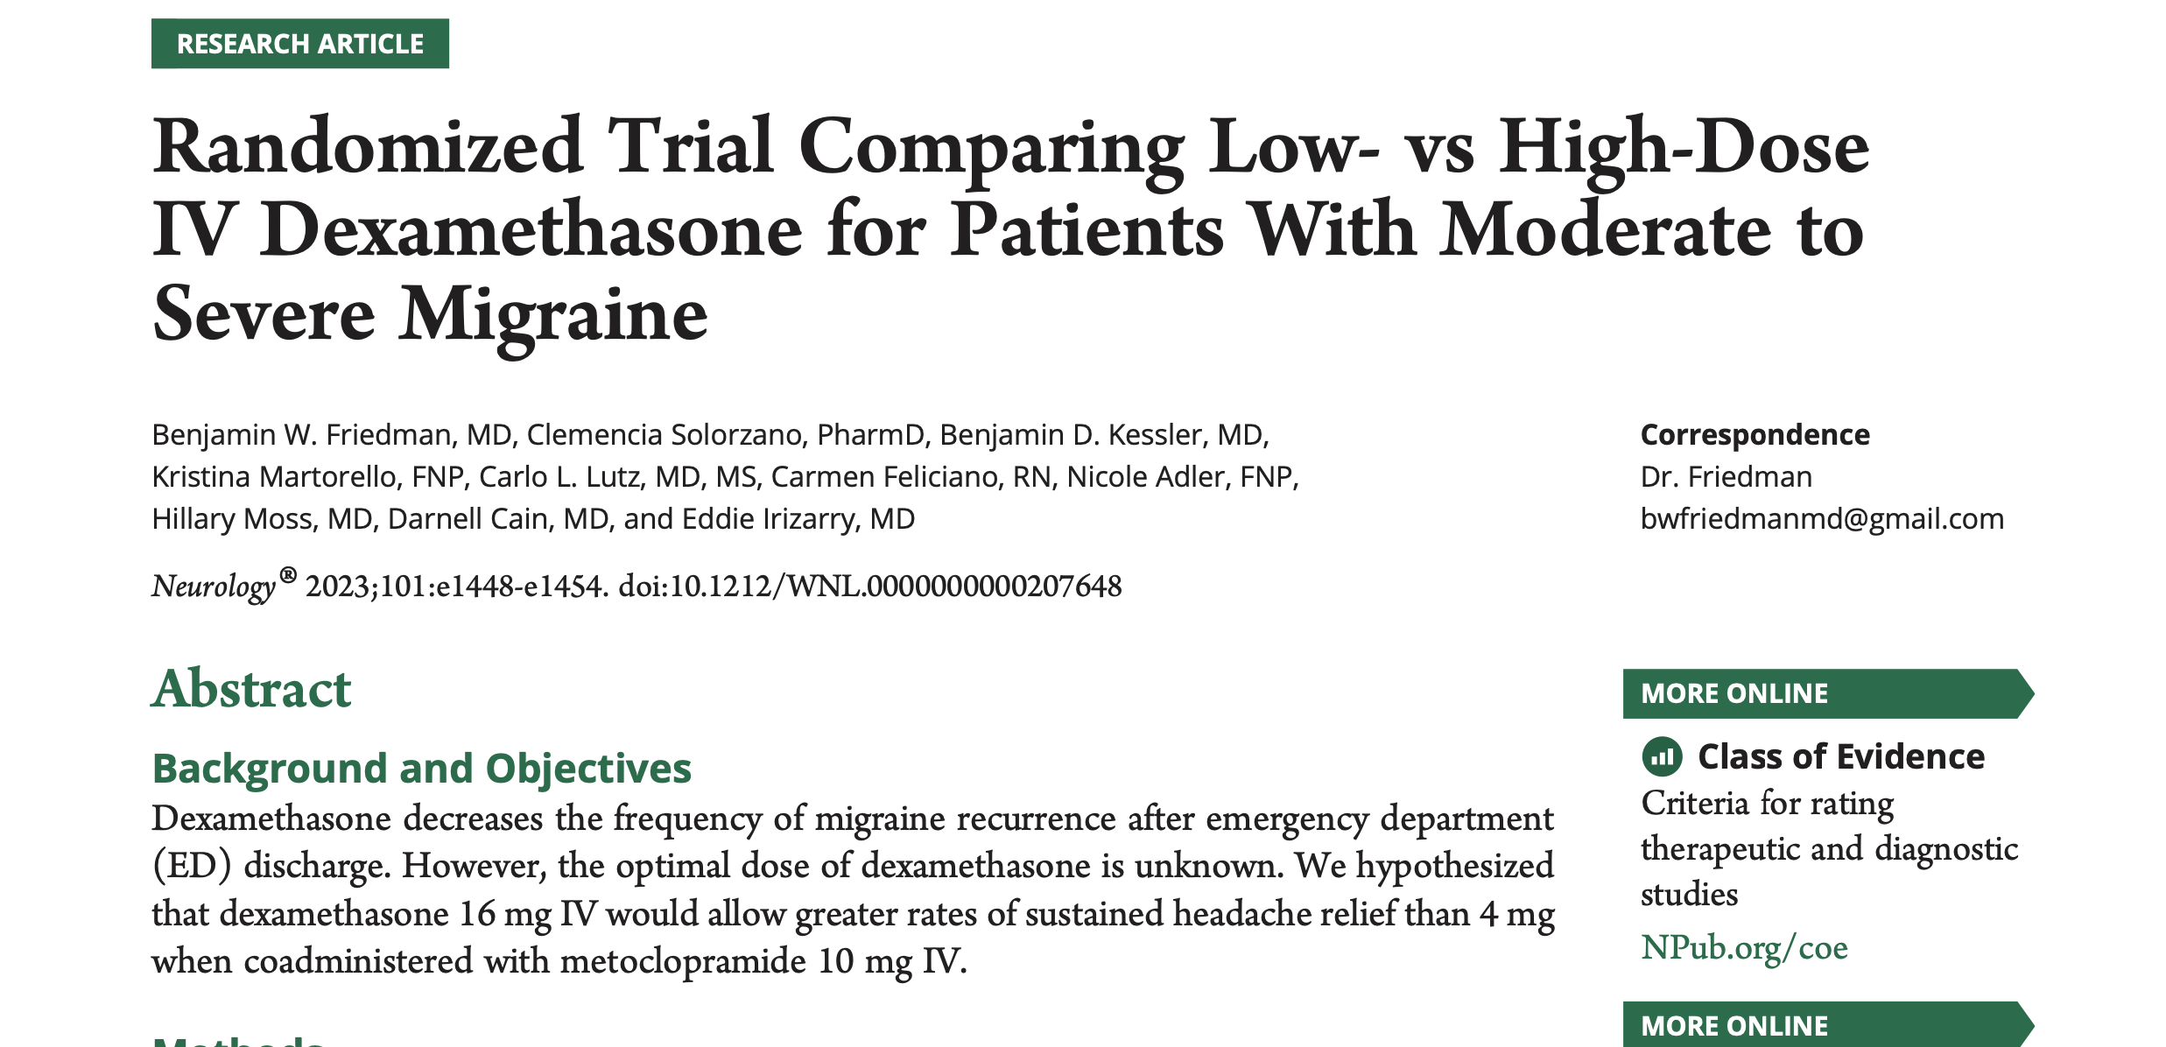
Not another headache!

Slide 26
Background
Migraine is a common cause of ED presentation for headache
Many patients treated successfully in ED with metoclopramide will have recurrence of headache within 24-48 hours
Dexamethasone has been shown to decrease incidence of “rebound headache” (NNT: 9)

Slide 27
COI
No COI declared by authors

Slide 28
Primary Outcome
Sustained headache relief for 48 hours
Defined as none or mild headache for entire 48 hour follow-up
Secondary outcome of obtaining headache relief within 2 hours

Slide 29
Study design
Randomized, double-blind trial
2 EDs in New York City
All patients received 10mg IV metoclopramide
Randomized to 4mg vs 16mg IV dexamethasone

Slide 30
Results
209 patients randomized
Trial stopped early for futility
Similar rates of headache relief and maintenance between groups (34% vs 41%)

Slide 31
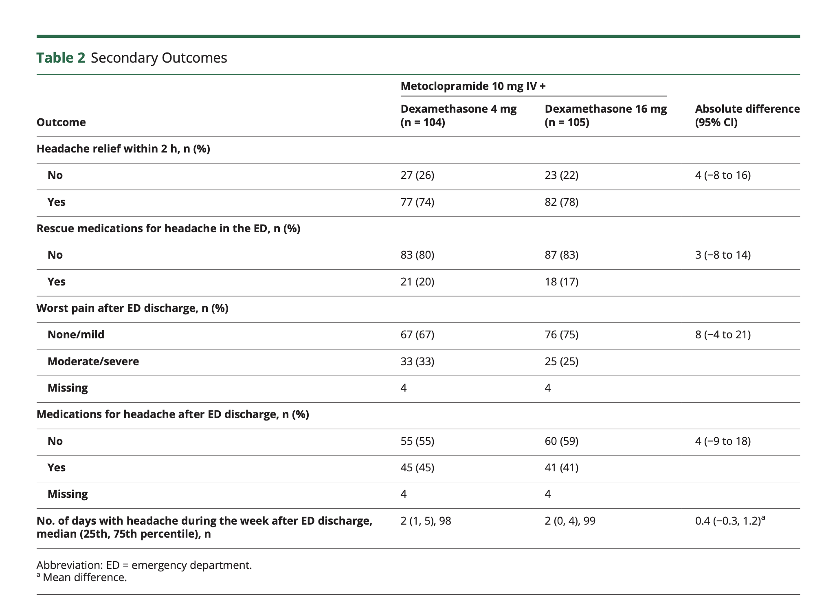

Slide 32
Limitations
Relatively small number of enrolled patients compared to those presenting with headache 209/1823 headache visits
Only about 1/3 of patients achieved sustained headache relief
Only 2 centre study

Slide 33
Conclusions
4mg of dexamethasone is likely as good as higher doses

Slide 34
Pro tips
Consider dexamethasone at a lower dose
For patients with repeat visits, ask about whether they have issues with rebound headaches when deciding on dexamethasone for headache cocktail

Slide 35
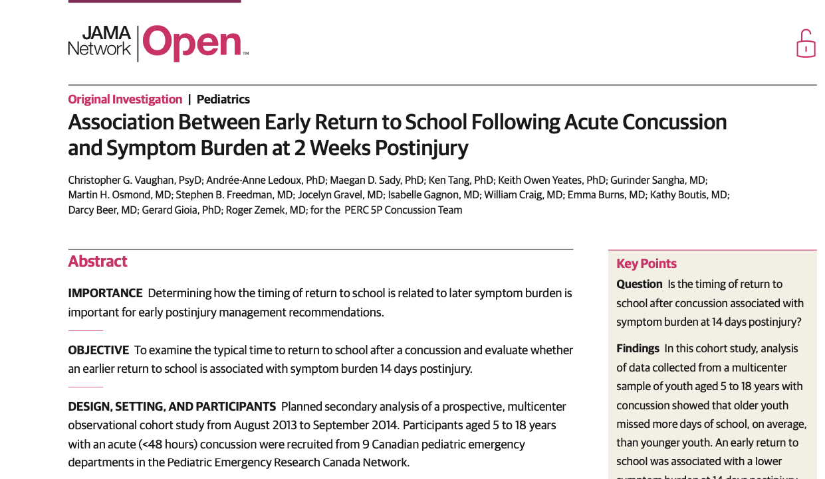
School’s out…or in?

Slide 36
Background
Guidelines have supported earlier return to school and non contact physical activity
Limited evidence to guide return to school advice
Absence from school has significant potential implications for patients

Slide 37
COI
Multiple authors involved in concussion guidelines
Multiple authors had received non-industry research funding
One author is founder of concussion care clinic.

Slide 38
Primary Outcome
Symptom burden at 14 days
Measured with post-concussion symptom inventory

Slide 39
Study Design
Prospective observational cohort study
Planned secondary analysis
9 Canadian pediatric emergency departments

Slide 40
Results
2000 of 3063 eligible for sub-study
1130 had complete data
Significantly decreased PCSI score in 8-12 and 13-18 age group (-1.668, 3.145)
Stronger effect in those with more severe symptoms at time of injury

Slide 41
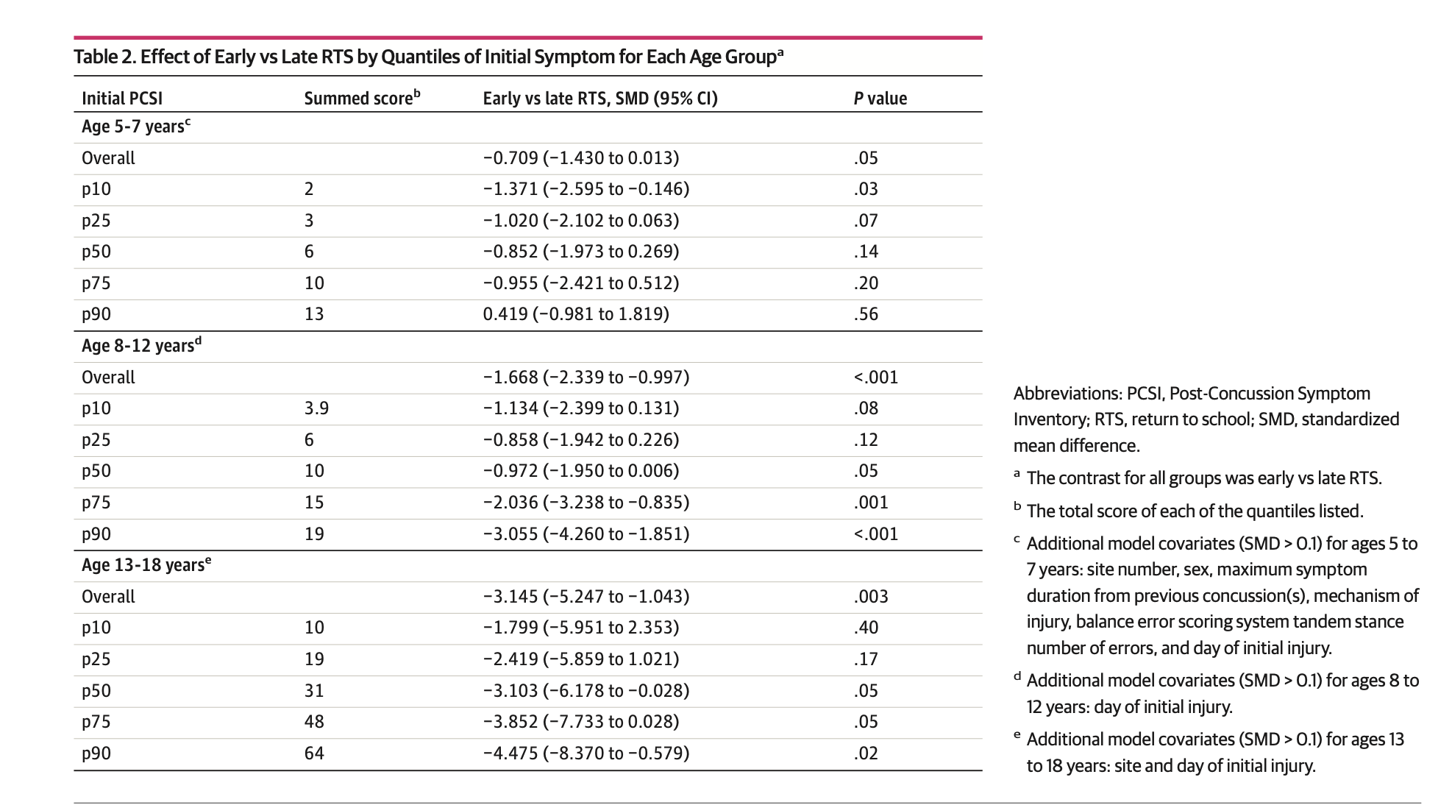
Results

Slide 42
Limitations
Observational study, not prospective or randomized
School absence is multifactorial so confounders possible
Unclear what additional accommodations were made

Slide 43
Conclusions
Earlier return to school after 24-48 hours may improve time to recovery from concussion

Slide 44
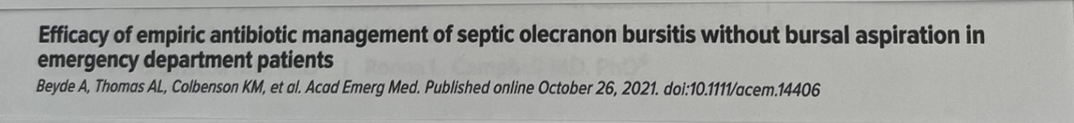

Slide 45
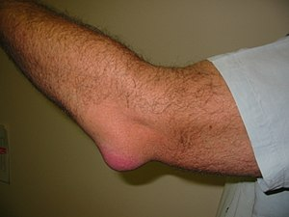
Background
Olecranon bursitis is a common ED complaint
For suspected septic olecranon bursitis many guidelines recommend aspiration of bursa prior to initiation of antimicrobial therapy.

Slide 46
Funding and COI
none

Slide 47
Primary Outcomes
Complicated versus uncomplicated bursitis resolution.
Uncomplicated resolution was defined as;
“bursitis resolution without subsequent bursal aspiration, surgery or hospitalization”
Notes:
Resolution defined as---

Slide 48

Study Design
single centre observational study
retrospective cohort study
Notes:
Examined ED management of suspect olecranon bursitis. Descriptive. High-quality chart review, very good methods, including careful variable definition, iterative assessments and triplicate review of 20% of charts

Slide 49
Results
266 ED presentations with olecranon bursitis over an 8-year period identified through EMR review.
Mean age 57 years, 85% male and 14% had diabetes
Only 4(1.5%) underwent aspiration in ED

Slide 50
Results
15% were admitted from ED
29% discharged without antibiotics
56%(147) discharged with antibiotics.
investigations | percentage
X-ray | 61
WBC | 46
ESR | 34
CRP | 36
Ortho Consult | 26

Slide 51
Results
The147 were suspected septic bursitis
9% lost to follow up
88% uncomplicated course--no surgery or admission
8 patients(6%) had delayed bursal aspiration at some point following ED visit
9 patients subsequently admitted for IV antibiotics—all had resolution without joint aspiration or surgery
Initially admitted patients only 10% had bursa aspiration.
Results even better for patients discharged from ED without antibiotics.
Notes:
6% went onto to require hospitalization. Arthrocentesis in 3 patients –no septic arthritis

Slide 52
Limitations
Abstractors not blinded to study objectives
Data quality dependent on accuracy of medical records
Single quaternary care ED
ED has robust follow-up system for primary care
Lack of diversity of patients
24 patients lost to follow-up(9%)

Slide 53
Discussion and conclusions
Empiric antibiotics without bursal aspiration is a reasonable initial approach to ED management of patients with suspected septic olecranon bursitis
About 90% safely resolve with this approach regardless of outpatient or inpatient management.
Notes:
.Potential of unnecessary antibiotics—I allergic reaction

Slide 54

Practice change and pro-tips
Notes:
>60% cephalosporin, 22% penicillin; 16 % each septra; 11% clindamycin;

Slide 55
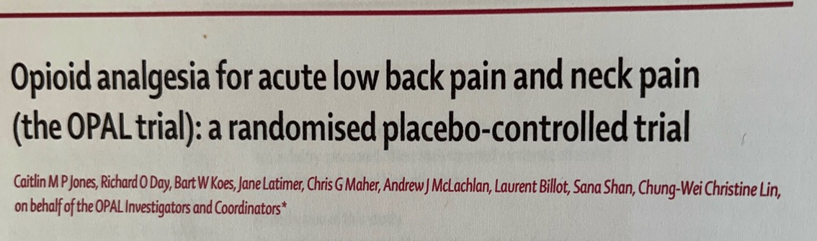

Slide 56
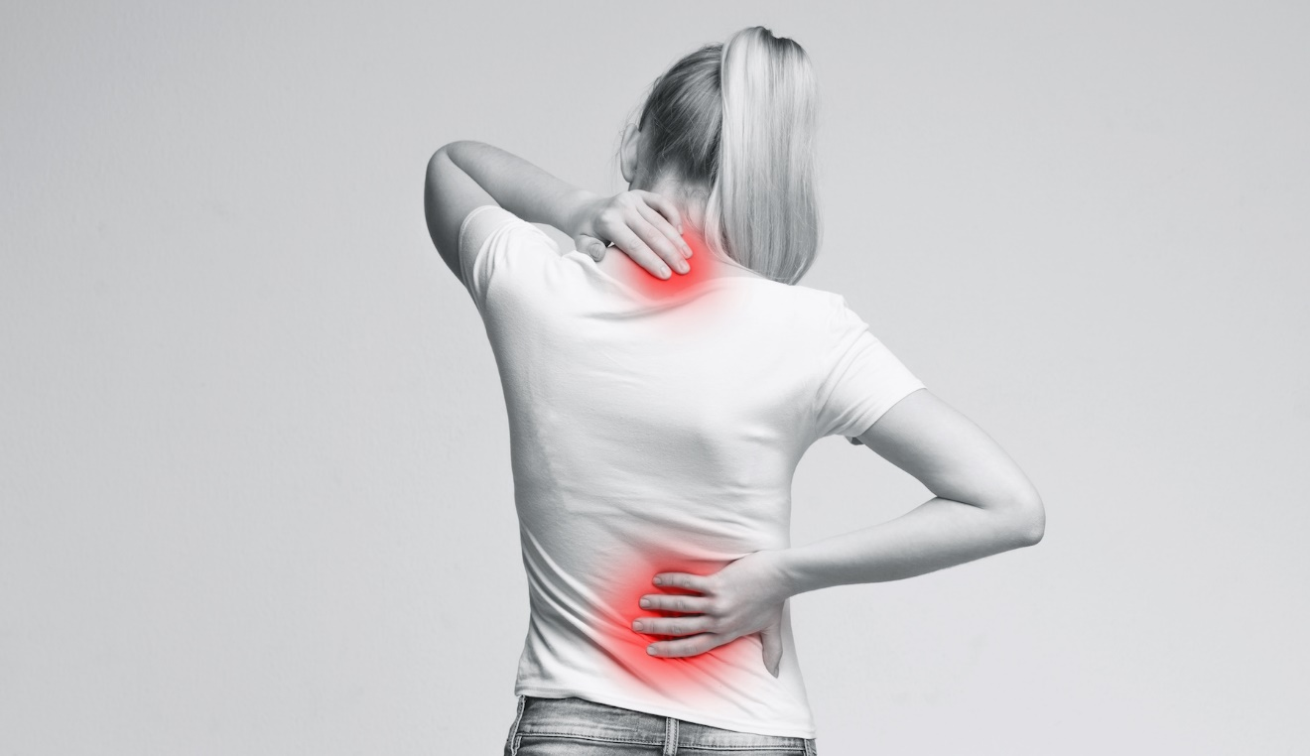
Background
Opioid analgesics are commonly used for acute low back and neck pain.
Supporting efficacy data are scarce.
Concerns surrounding opioid misuse and addition have prompted questions regarding appropriateness of opioids as a treatment option

Slide 57
Funding and COI
none

Slide 58
Outcomes
Primary
Pain severity at 6 weeks
Secondary
Pain severity at weeks 4,12, 26 and 52
Physical functioning
Patient reported satisfaction
Quality of life, physical
Quality of life, mental
Adverse events
Notes:
Pain severity subscale of Brief Pain Inventory(10-point scale)

Slide 59


Study Design
Randomized, double blind, placebo-control trial
157 primary care or emergency department sites
Notes:
Triple-blinded. 97% of patients recruited from primary care.

Slide 60
347 participants recruited over 6-year period
Participants experiencing acute low back pain or neck pain were randomly assigned to receive either opioid analgesia or a placebo.
151 participants in opioid group and 159 participants in placebo group included in primary analysis
Lost to follow-up/ withdrawal rates were 19% for opioid and 15% for placebo groups respectively
Notes:
Intervention: Opiod group

Slide 61
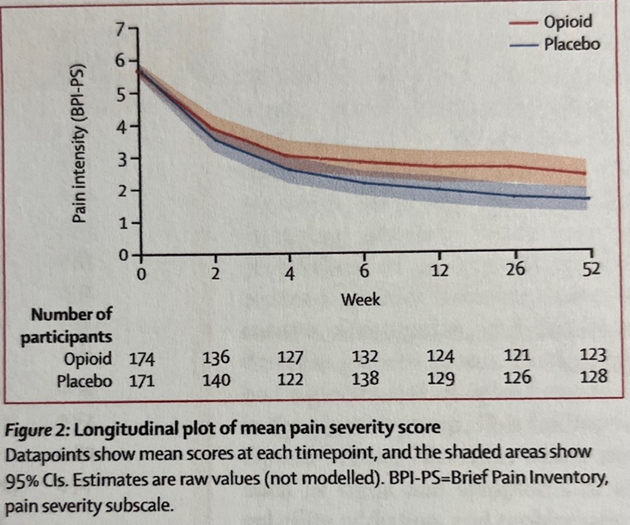
Results

Slide 62
Results
Opioid analgesia did not show significant superiority over placebo in decreasing pain intensity or improving functional outcomes for acute low back and neck pain.
No difference in adverse effects.
Opioid group had greater risk of opioid misuse at week 52
Notes:
Use Current Opioid Misuse Measure

Slide 63
Limitations
25% of data were missing at the primary timepoint—reduced power and could introduce bias if not random
Compliance of medication regime. Only 58% of participants reported compliance—only half were compliant.
No data collection on what guideline of care offered to participants in both groups
No collection of racial, ethnic or cultural data
Notes:
Rate of missing data is common in trials of opioids vs placebo. Systemic review and chronic back pain and mskl had 20% of trials missing more than 20% of data.(>220 trials). Compliance -->=80%

Slide 64
Practice change and pro-tips

Slide 65
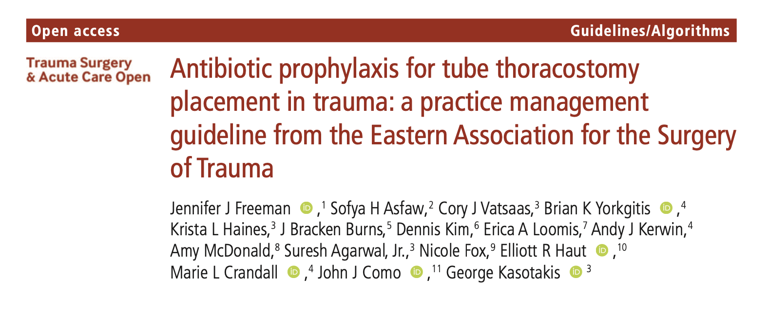

Slide 66


Background
In 2012 the Eastern Association for the Surgery of Trauma updated their guideline to "not recommend for or against antibiotic prophylaxis for tube thoracostomy insertion for traumatic hemothorax or pneumothorax"

Slide 67
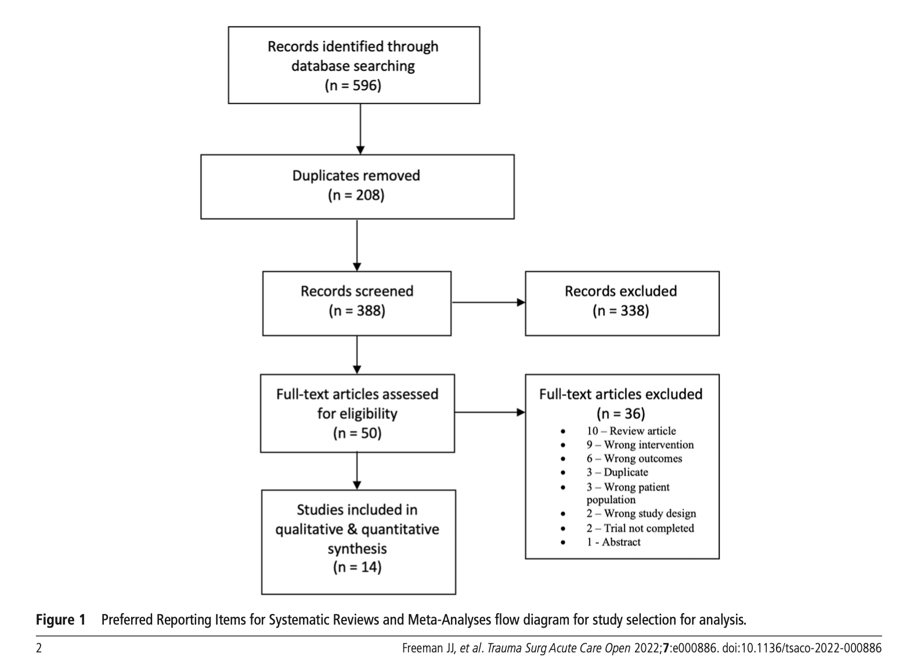
Methods

Slide 68
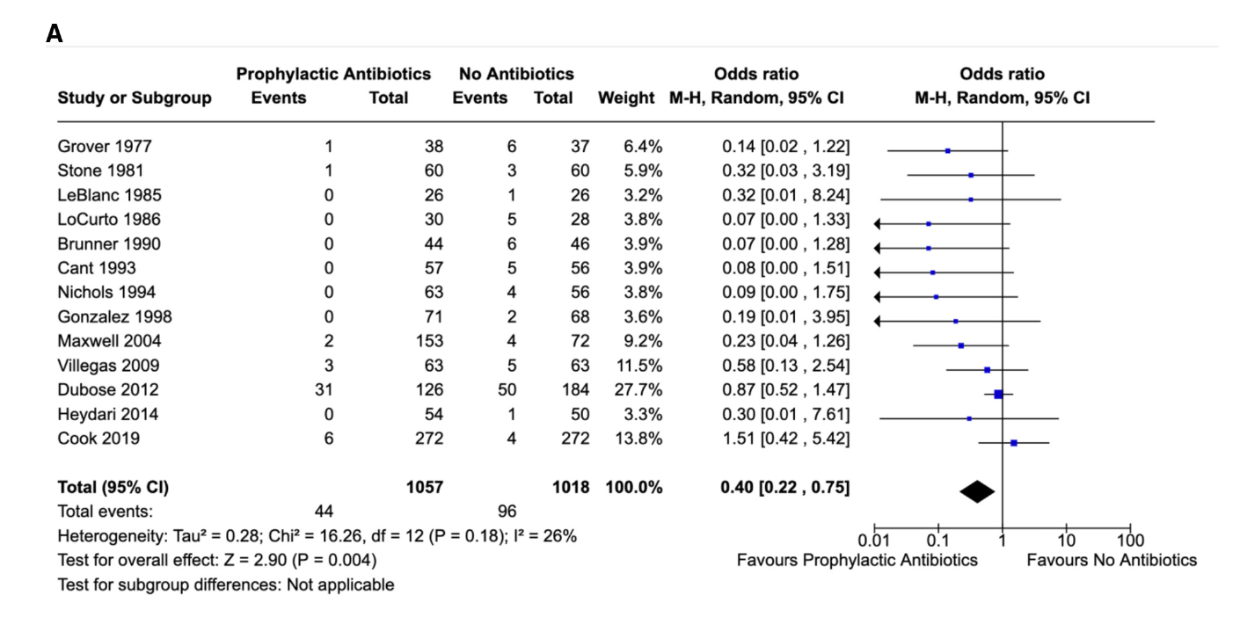
Results

Slide 69
Conclusion
"We conditionally recommend that antibiotic prophylaxis be given at the time of insertion to reduce empyema in adult patients who require tube thoracostomy for traumatic hemothorax or pneumothorax"

Slide 70

Practice Changing?

Slide 71



Slide 72
Background
Sutures, tissue adhesives and adhesive strips are all used for repair of lacerations in the ED.
Some felt that adhesive strips alone were easier for children to remove so the authors hypothesized that
  "repairing simple facial lacerations with skin adhesive and underlying adhesive strips would be superior to repairing wounds with skin adhesive alone in regard to cosmetic outcome"

Slide 73
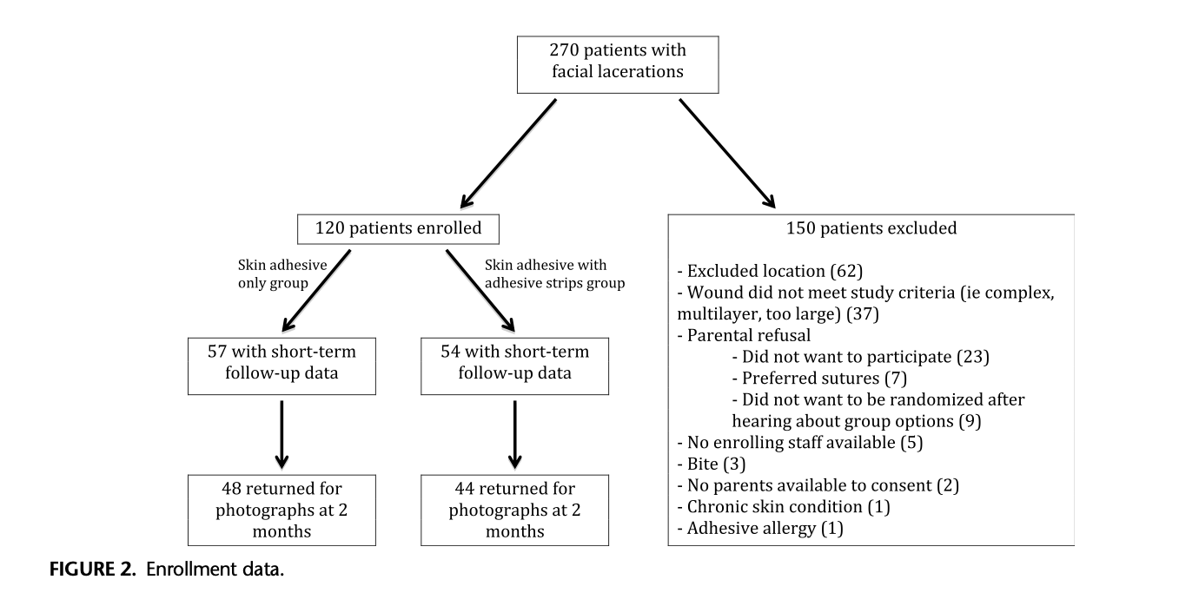
Methods

Slide 74
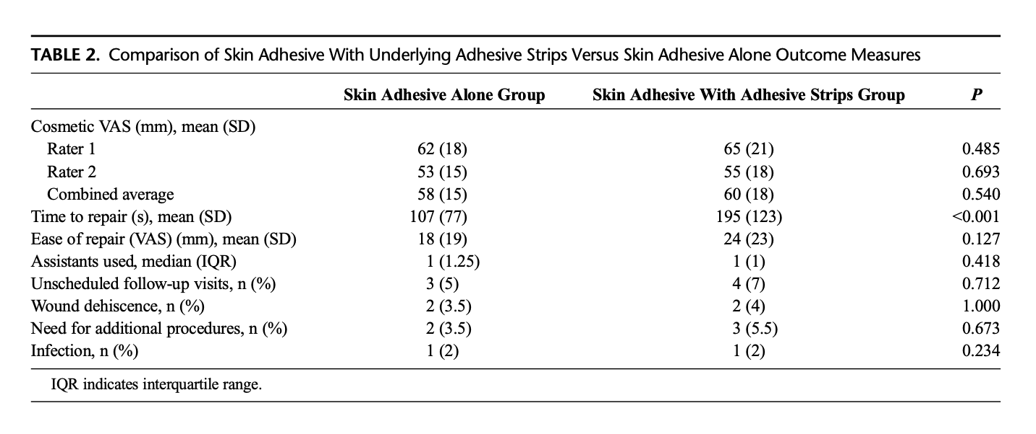
Results

Slide 75
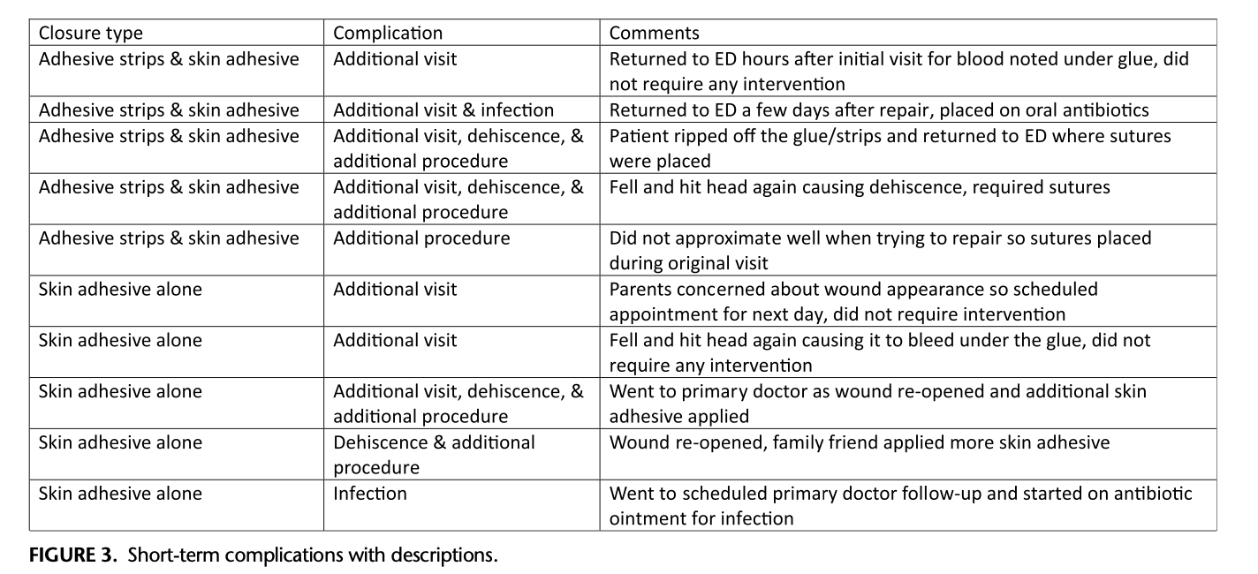
Results

Slide 76

Practice Changing?

Slide 77
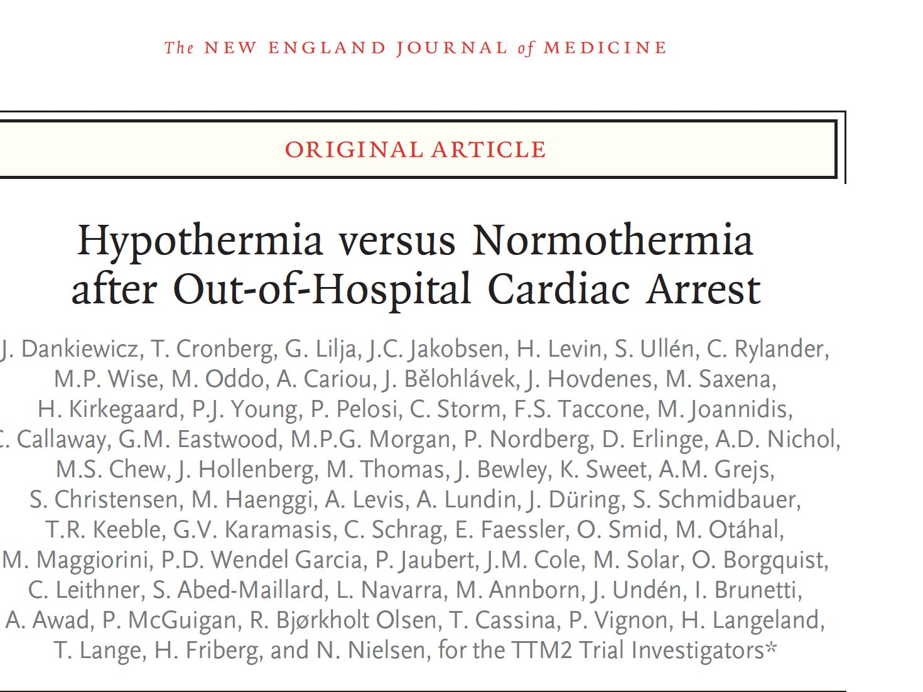

Slide 78
Background
Hypothermia has been recommended with Return of Circulation after Cardiac Arrest by the AHA since 2003.
The Temperature range Recommended is 32-36 C.
This trial tests this recommendation.

Slide 79
Funding and Conflict of Interest
Funding Government
Many of the Authors had conflicts related to Pharmaceutical and Device Manufacturers

Slide 80
Methods
Randomized, open label, prospective trail with blinded assessment of outcome
International multi-centre
Intention to treat
1850 Adults

Slide 81
Intervention
Intervention Group
  Temperature lowering to a target temperature of 33 C for 24 hours then gradually rewarmed about 1 C an hour.
Control Group
  Temperature control not initiated unless the temperature 37.5 C

Slide 82
Methods
Outcomes
  Death at 60 days
  Function at 60 days
    Modified Ranking Score

Slide 83
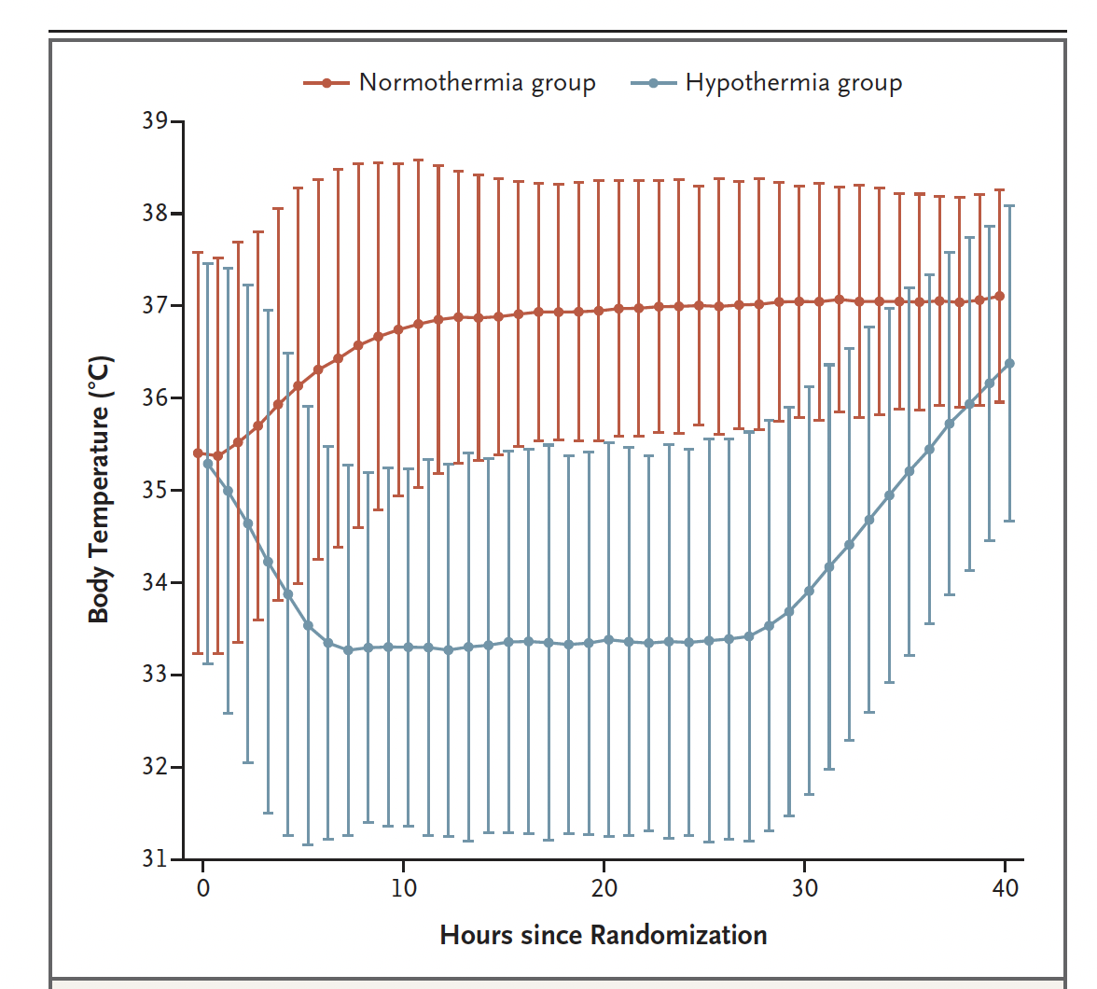
Methods

Slide 84
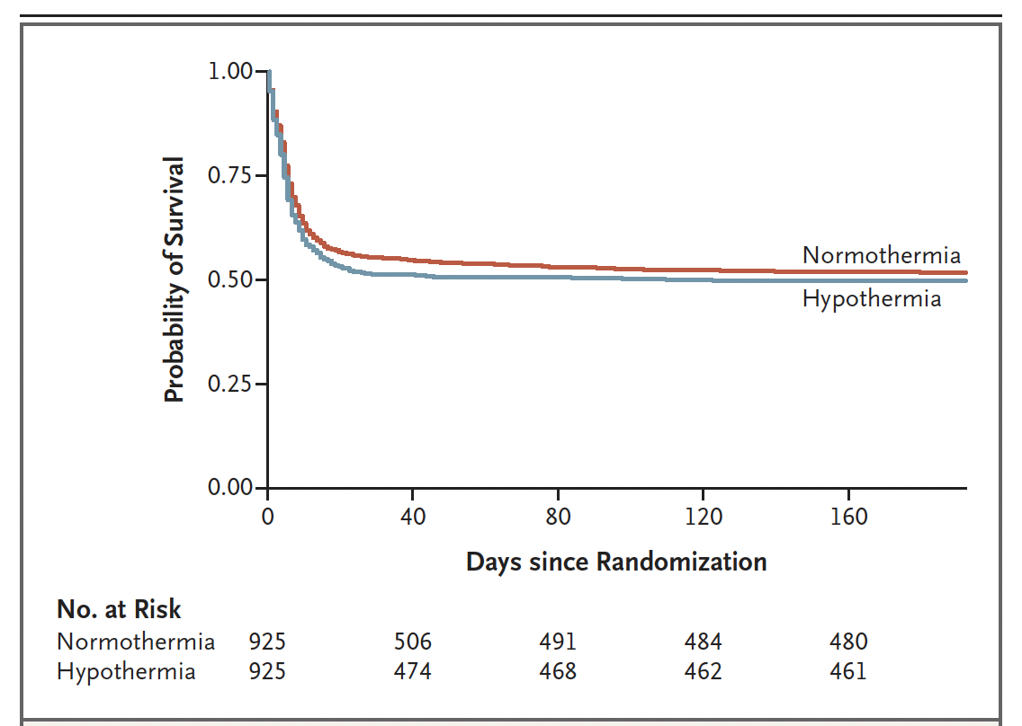
Results

Slide 85
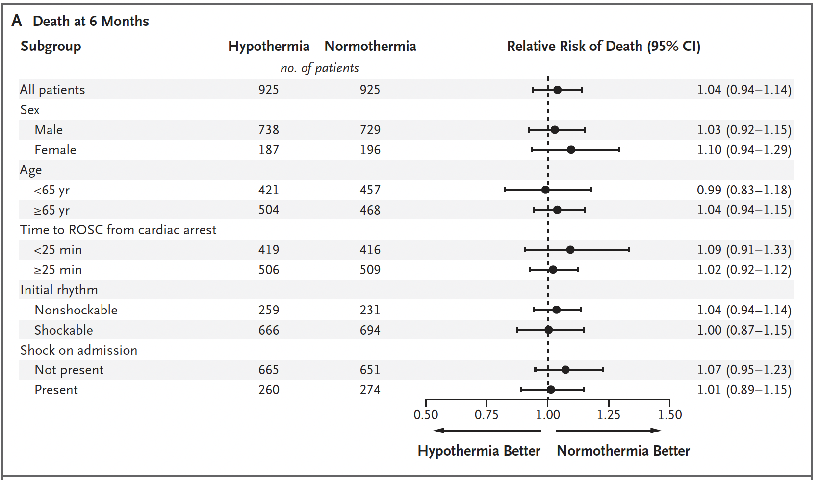
Results

Slide 86
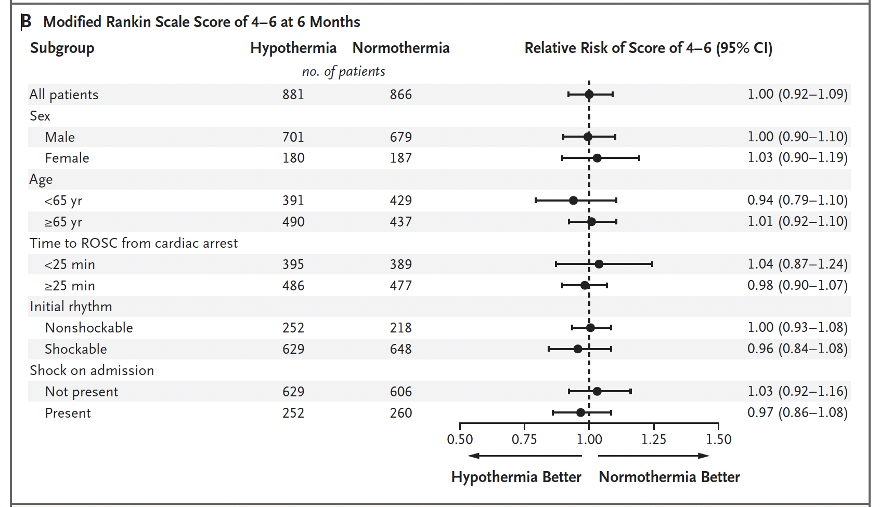
Results

Slide 87
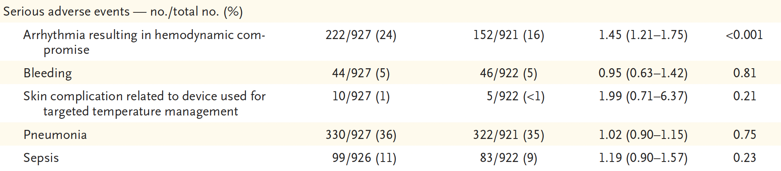
Results

Slide 88
Limitations
Excluded
  People under 18 years old
  Pregnant Women
There was no control group with no Temperature intervention.

Slide 89
Conclusions
Targeted Temperature Management has no advantage over preventing fever.

Slide 90
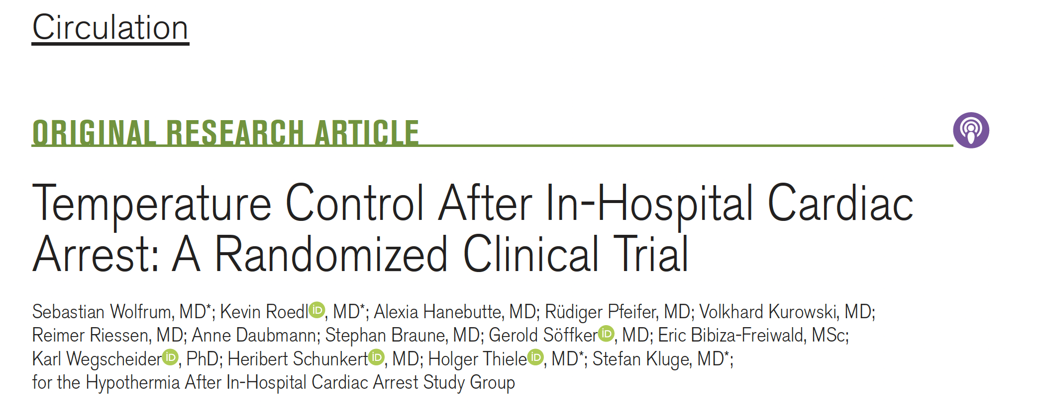

Slide 91
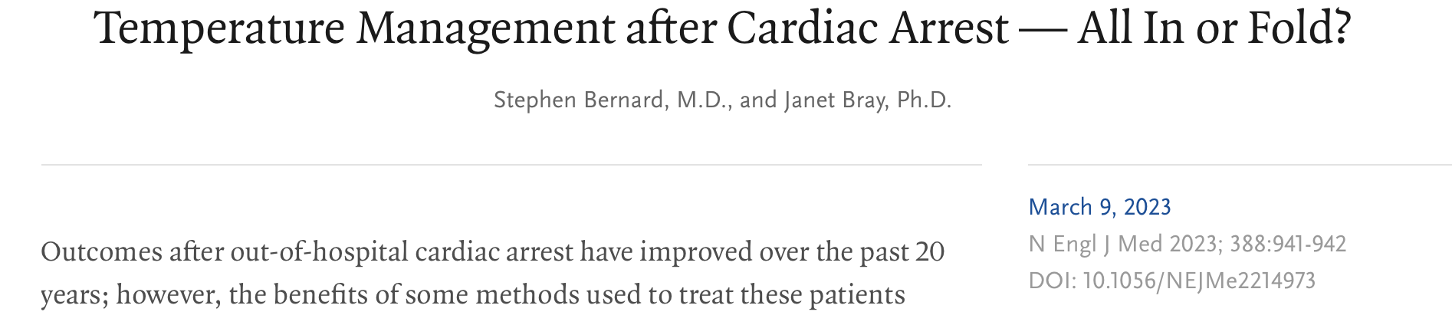

Slide 92
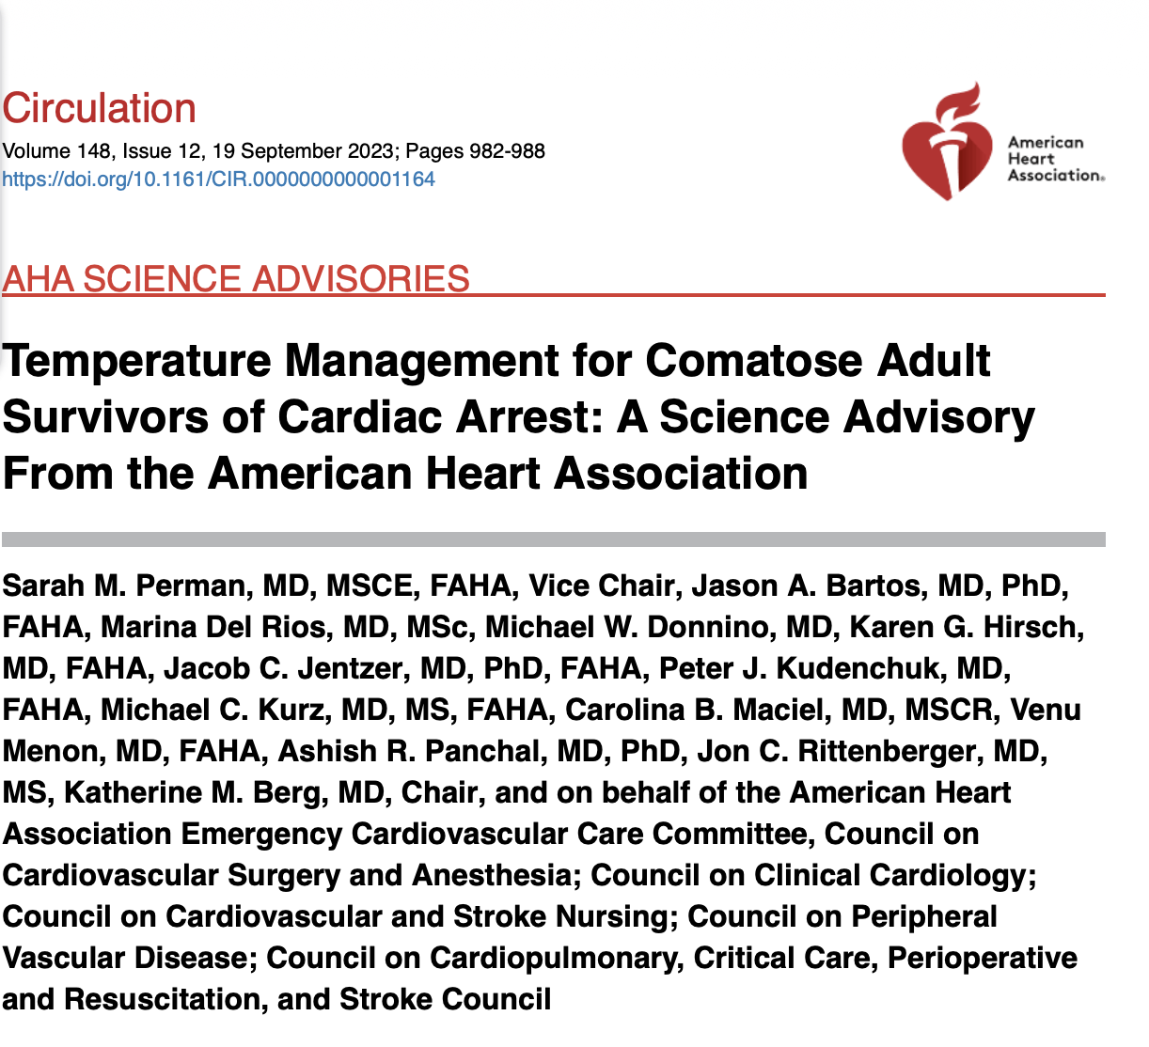

Slide 93
Pro Tip
It is time to abandon Targeted Temperature Management

Slide 94


Slide 95
Funding and COI
Government

Slide 96
Methods
Six Urban Emergency Departments in British Columbia
2020-2022
Retrospective Randomized Cohort Study
9223 Patients presenting with Syncope
54366 Controls (four controls for each patient)

Slide 97
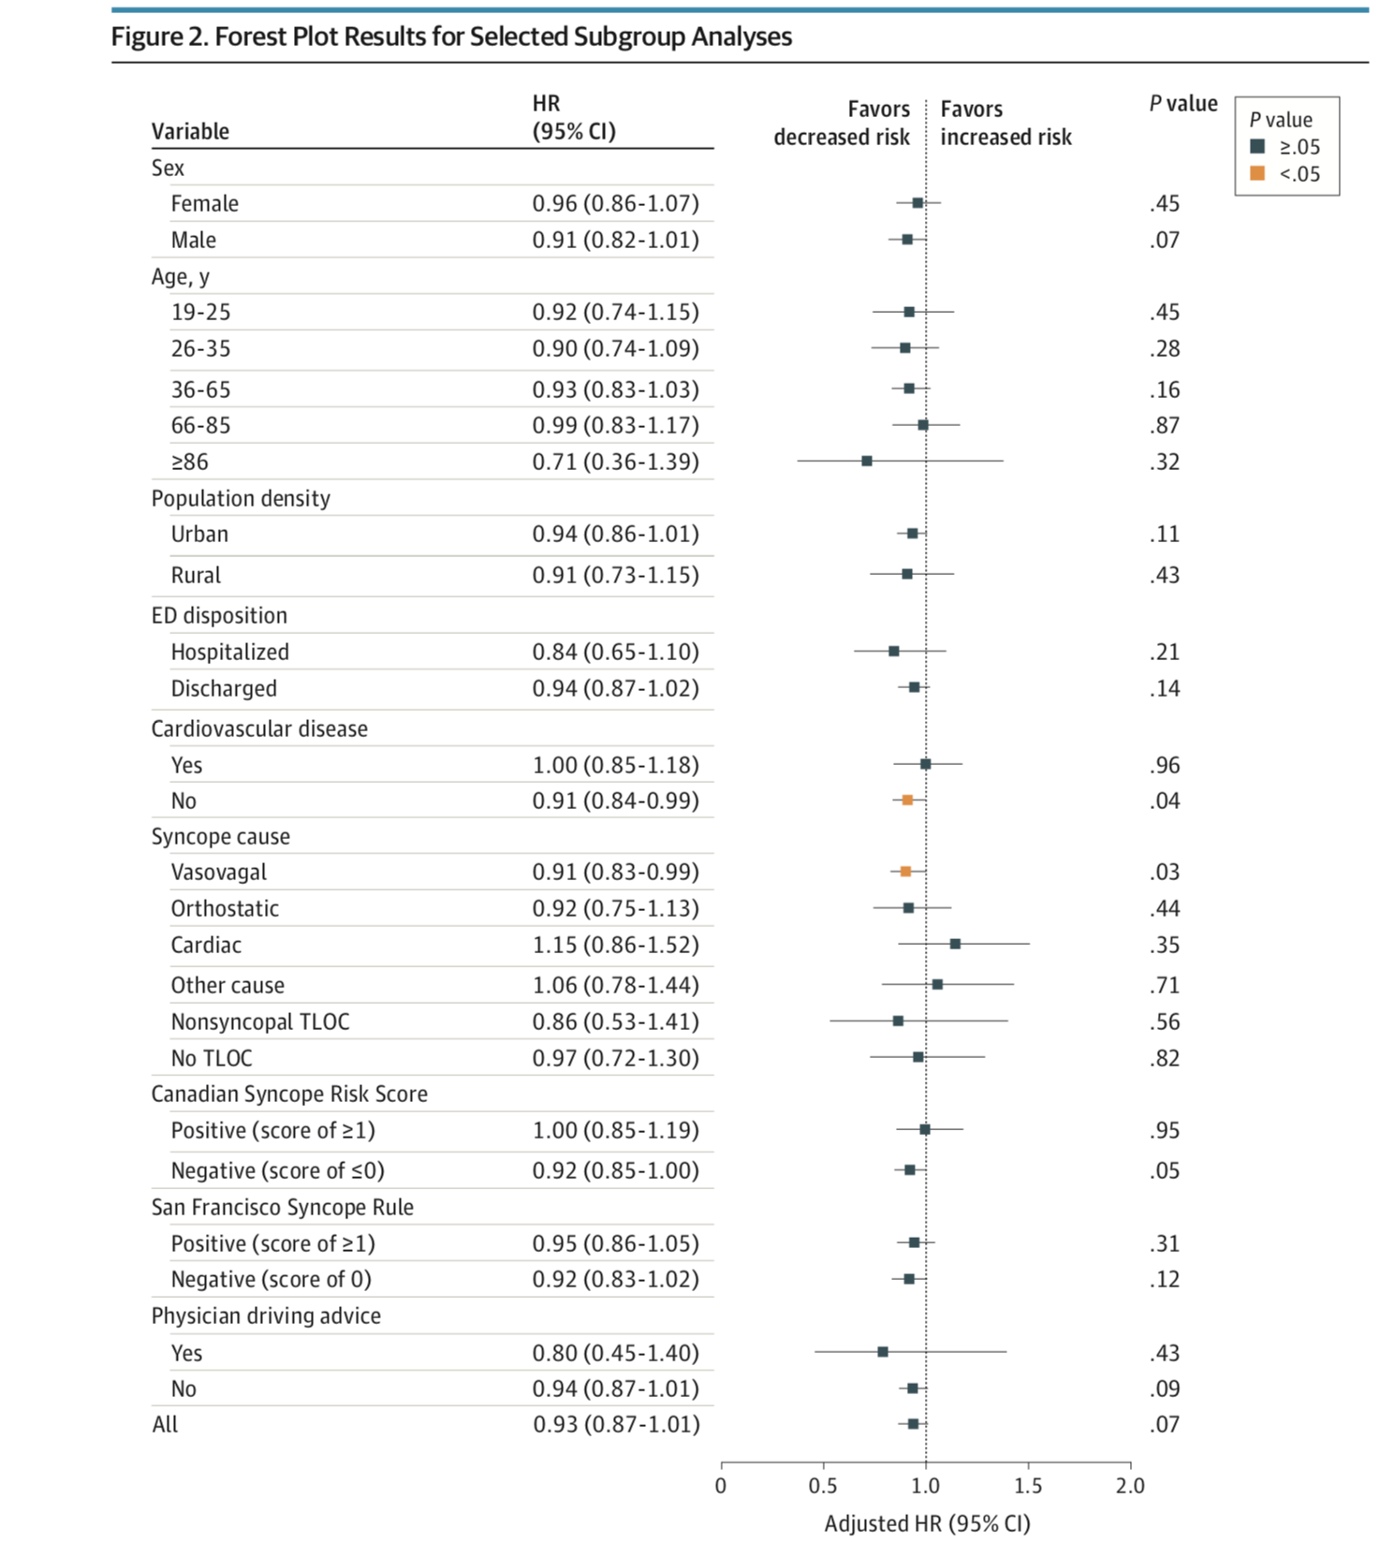
Results

Slide 98
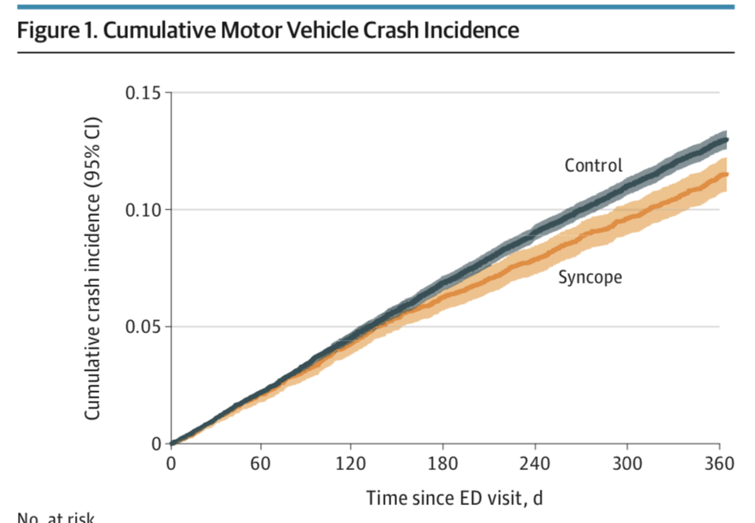
Results

Slide 99
Limitations
Retrospective
Did not consider the cause of Syncope

Slide 100
Conclusions
Discharge Instructions for patients with a diagnosis of Syncope do not need to be excluded from driving.

Slide 101
Pro Tip
No Driving Exclusion after Syncope

Slide 102




Closing Slide
Thank you!
Please fill out your session evaluation now!
#myfmf
FamilyMedicineForum
FamilyMedForum
FamilyMedForum

