Slide 1
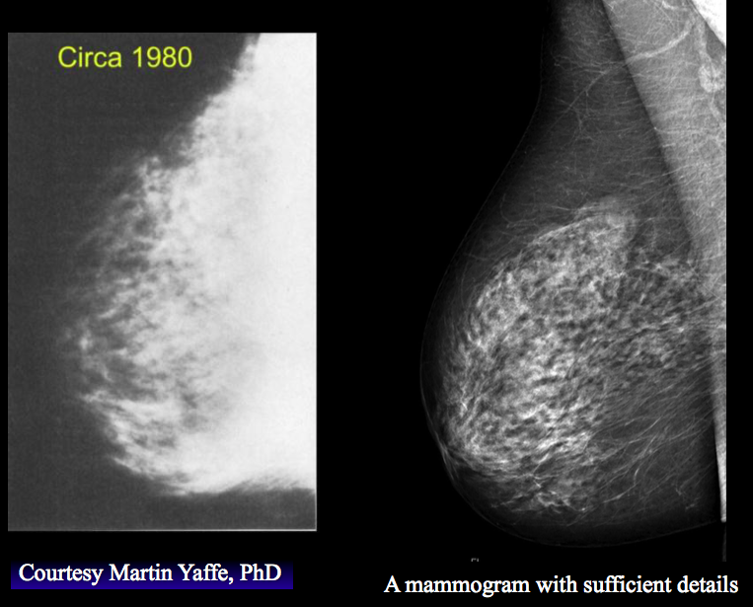
Beyond the Basics of Breast Screening:
What to do for the young, old, dense and high-risk
Anna N. Wilkinson, MSc., MD, CCFP, FCFP
Associate Professor, University of Ottawa
Family Physician, The Ottawa Academic Family Health Team
GP Oncologist, The Ottawa Hospital Cancer Centre
Program Director, PGY-3 FP-Oncology
Regional Cancer Primary Care Lead
Jean M Seely, MD, FRCPC, FCAR, FSBI
Regional Lead OBSP, Champlain Regional Cancer Program
Professor Radiology, University of Ottawa
Head Breast Imaging Section, The Ottawa Hospital
Clinician Investigator, Ottawa Hospital Research Institute
President of the Canadian Society of Breast Imaging

Slide 2
Disclosures
Faculty: Anna Wilkinson
Relationships with financial sponsors:
  CFPC Grant for Breast Cancer Survivorship Tool/Oncology Briefs
  Regional Cancer Primary Care Lead- Stipend
  Consultant for Thrive Health
  Canadian Breast Cancer Network- Honoraria
Faculty: Jean Seely
  Medical Advisory Board for Densebreasts-org (voluntary)
  Principal Investigator for TMIST (Tomosynthesis Mammography Interventional Screening Trial) in Ottawa – (voluntary)
  President of the Canadian Society of Breast Imaging (voluntary)
  Canadian Breast Cancer Network- Honoraria (advisor)
  BD Inc.- Honoraria (advisor)

Slide 3
Objectives
Ensure you have the information you need to discuss risks/benefits of breast screening with your patients
  Current recommendations
  Evidence base
  Specific populations:
    Dense Breasts
    High-Risk
    Women 40-49
    Women >74

Slide 4
Which of the following statements is true?
A. Screening mammography for a woman in her 40s should only be done if she has a positive family history of breast cancer
B. Breast tissue density is a risk factor for breast cancer that is equivalent to having a first degree relative with breast cancer
C. Most patients who develop breast cancer have a family history of breast cancer
D. Stopping screening mammography is recommended if life expectancy is < 15 years

Slide 5
Do you currently inform patients about their breast tissue density?
A. Yes
B. No

Slide 6
Do you recommend screening mammography for women in their 40s?
  A. Yes
  B. No
  C. Only if they have a positive family history of breast cancer

Slide 7
How many cancers are detected by mammography in extremely dense breast tissue (ACR D)?
A. 25%
B. 50%
C. 75%
D. 85%

Slide 8
How many women who get breast cancer have a family history of breast cancer?
A. 5%
B. 10%
C. 20%
D. 50%
E. 75%

Slide 9
Screening for a high-risk woman should start at age:
A. 25
B. 30
C. 40
D. 50

Slide 10
Breast cancer-specific mortality rate is highest in women aged:
A. 40-49
B. 50-59
C. 60-74
D. >74

Slide 11
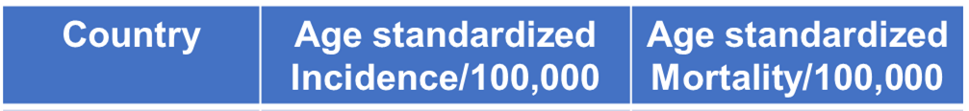
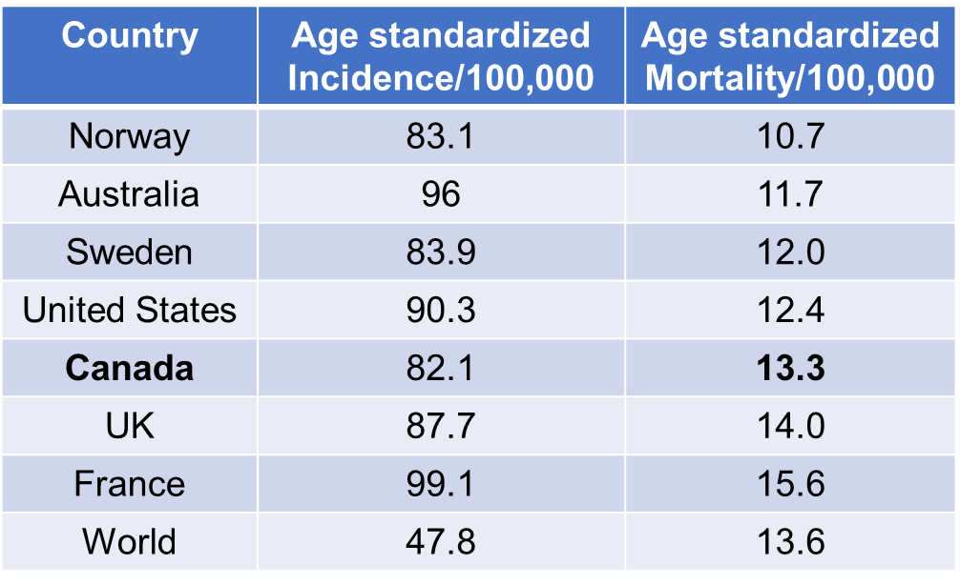
Breast Cancer
12.5% of Canadian women will be diagnosed with breast cancer in their lifetime
28,600 cases of breast cancer in 2022 in Canada
5,500 Canadian women will die from breast cancer
14% of all cancer deaths in women in 2022
Cancer Today (iarc.fr)
https://cancer.ca/en/cancer-information/cancer-types/breast/statistics

Slide 12

Why Screen?
Benefits
  Diagnosis at earlier stage
  Improved survival
  Decreased morbidity of treatments
  Treatment costs less
Harms
  Anxiety
  False positives
  Overdiagnosis

Slide 13
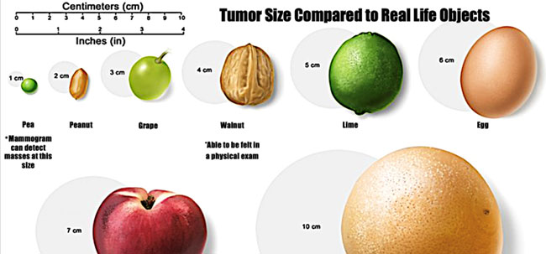
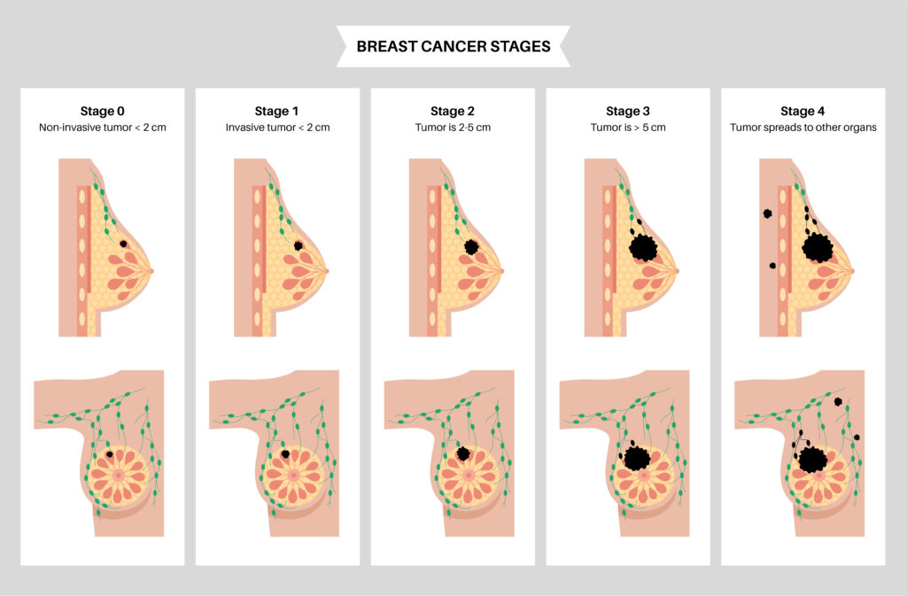
Earlier
Stage
Screen detected
Interval ca or symptomatically detected

Slide 14
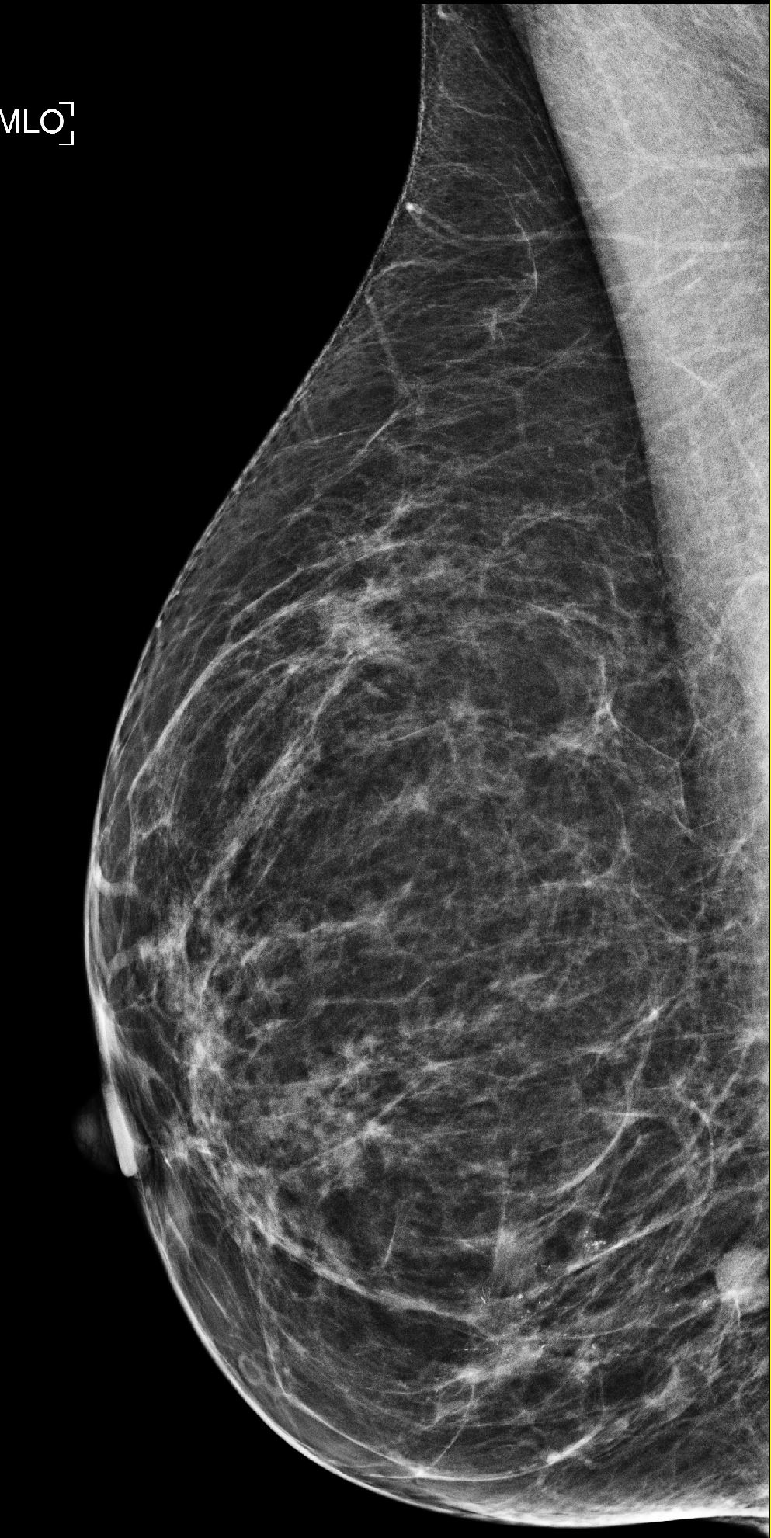
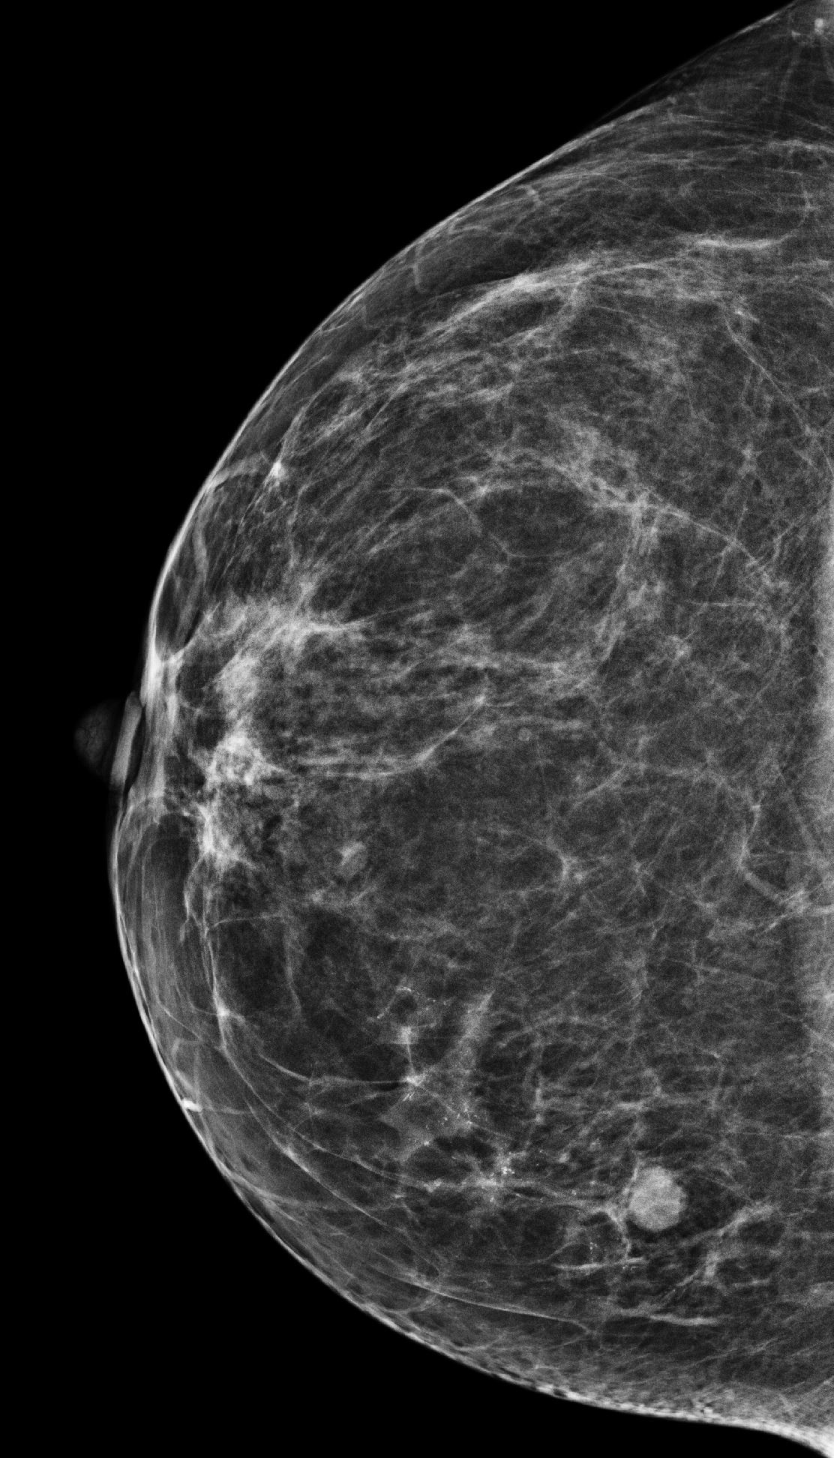
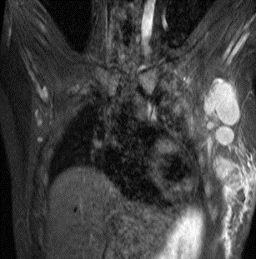
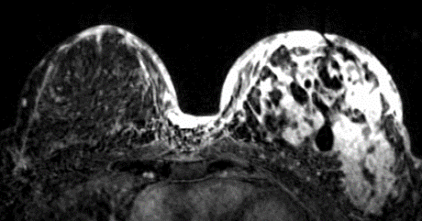
Two different 49 year old patients:
Screen detected vs symptomatic cancers

Slide 15
Improved Survival with Earlier Stage
Stage 1
Stage 2
Stage 3
Stage 4
100%
93%
72%
22%

Slide 16

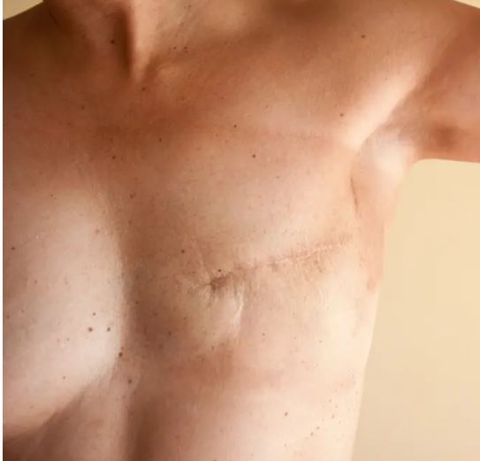
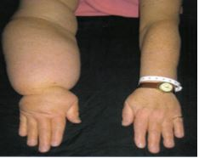
Increased Morbidity with Later
Stage Breast Cancer

Slide 17
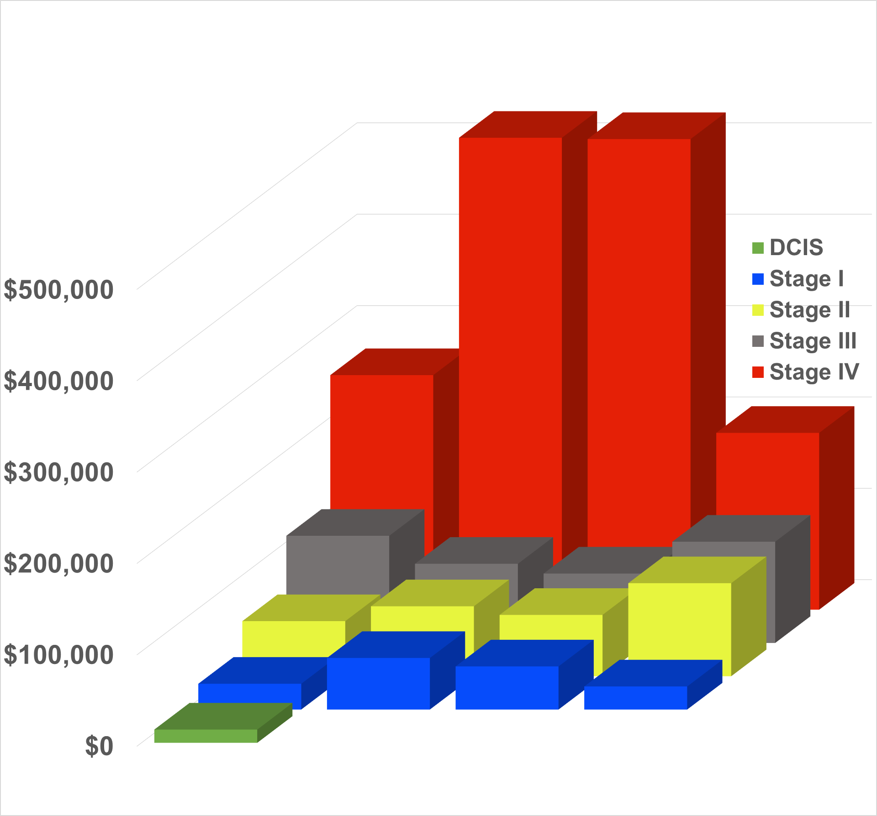
Increased Cost with Treatment of Later Stage Breast Cancer
Stage IV treatment 36x cost of DCIS
Cost to screen 1 women for 40’s ~$2600
Costs increase exponentially by stage
Stage IV 11x more costly than stage I
Cost for one case of stage IV >500K
HR+ HR+/HER2+ HER2+ TN
Breast Cancer Subtype

Slide 18
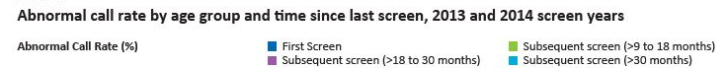
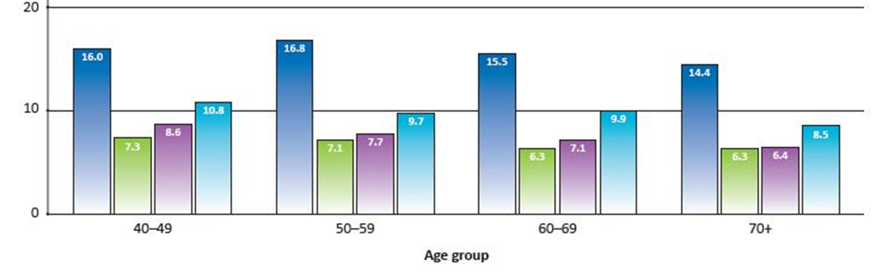
False Positives
Important to distinguish between recalls for further imaging vs benign biopsy
Imaging recall is not a false positive- it is a request for more information
Recall
~15% of women are recalled for further imaging on first screen
~7% of women recalled for further imaging on subsequent screens
Biopsy
1.4% biopsy rate
0.36% are cancers
Compare with: colon screening: 5% recall rate, 4.7% biopsy, 0.25% are cancers
cervical screening: 4% recall (colpo) rate 4%, 0.004% are cancer
Canadian Partnership Against Cancer. Breast Cancer Screening in Canada: Monitoring and Evaluation of Quality Indicators - Results Report, 2017. https://s22457.pcdn.co/wp-content/uploads/2019/01/Breast-Cancer-Screen-Quality-Indicators-Report-2012-EN.pdf

Slide 19
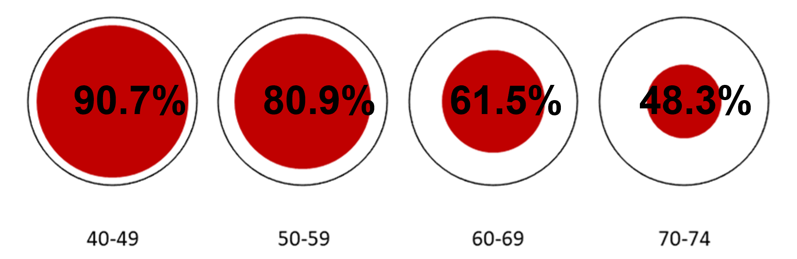
Overdiagnosis
“Overdiagnosis is the unnecessary treatment of cancer that would not have caused harm in a woman’s lifetime”
Relevant for older women with co-morbidities, less applicable for younger women
Mortality due to breast cancer in women diagnosed with breast cancer:
Wilkinson AN, Ellison LF, Billette JM, Seely JM. Journal of Clinical Oncology, August 4, 2023

Slide 20
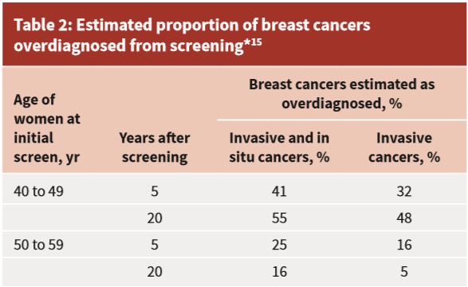
Canadian Task Force on Preventive Health Care:
Overdiagnosis
?
”Women less than 50 years of age are at greater risk of these harms than older women.”
Literature: Overdiagnosis ranges from 0.1-48%, lower for younger women
Klarenbach et al., 2018

Slide 21
Anxiety
There can be elevated levels of anxiety associated with abnormal mammograms
Many women would prefer to experience transient anxiety with the knowledge that cancer may be ruled out
“Benevolent sexism”? There is not the same emphasis on anxiety with other cancer screening.
Anxiety is highly personal and must be a discussion with your patient

Slide 22
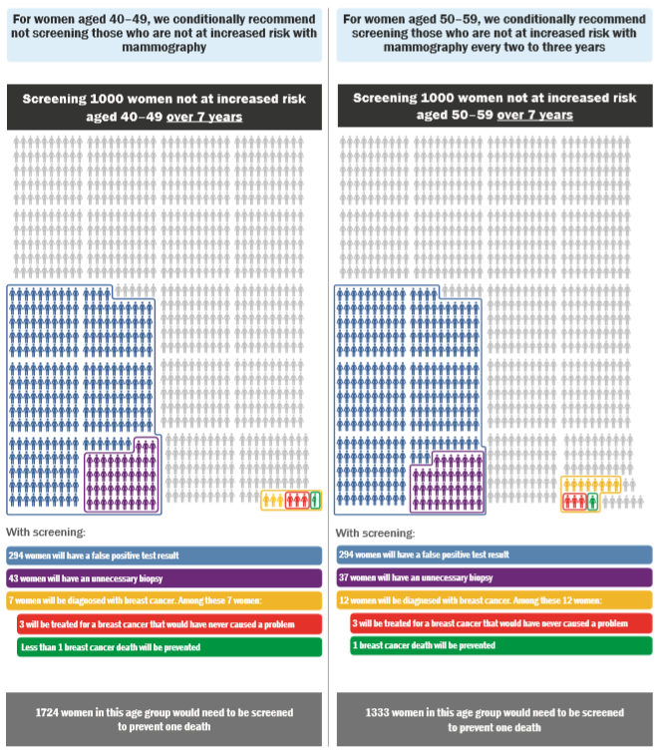
2018 Canadian Task Force Guideline Recommendations
All decisions to undergo screening is conditional on the relative value a woman places on possible benefits and harms from screening.
40 to 49 years, we recommend not screening with mammography (Conditional recommendation; low-certainty evidence)
  NNS (Number needed to screen) 1724
50 to 69 years, we recommend screening with mammography every 2 to 3 years; (Conditional recommendation; very low certainty evidence)
  NNS 50-59: 1333 ; NNS 60-69: 1087
70 to 74 years, we recommend screening with mammography every 2 to 3 years; (Conditional recommendation; very low-certainty evidence)
    NNS 645
Under Review
Notes:
Jean

Slide 23
The Evidence for Screening
11 randomized control trials:
  New York, USA 1963
  Malmö I, Sweden 1976
  Malmö II, Sweden 1978
  Kopparberg, Sweden 1976
  Östergötland, Sweden 1978
  Edinburgh, Scotland 1978
  Canada CNBSS I 1980
  Canada CNBSS II 1980
  Stockholm, Sweden 1981
  Göteborg, Sweden 1982
  Finland 1987
Timeline of Innovations in Breast Cancer Treatment
1984: Tamoxifen
2003: Digital mammography
2004: Aromatase inhibitors
2005: Trastuzumab (Herceptin)
2013: The 4 subtypes of breast cancer are defined
2014: Sentinel lymph node biopsy
2018: Genomic testing (Oncotype dx): 70% women with early-stage ER+ BC avoid chemotherapy
2021: CDK4/6 inhibitors for metastatic ER+ BC
2022: CDK4/6 inhibitors for adjuvant treatment
2022: Antibody-drug conjugate (Enhertu) metastatic HER2+
2022: Hypofractionated radiation (5 fractions)
2023: Immunotherapy for triple negative BC
Trials 30-60 years old
Do not reflect technological/treatment advances

Slide 24
CNBSS
Flawed design
  Palpable masses preferentially placed in screening arm
  58% and 49% had clinically palpable cancers vs 15% in average population
  16.4% advanced cancers in mammo vs 8.5% in usual care (p>0.003)
  Breast cancer mortality rate was 1.36x higher in screening arm vs. usual care
Poor quality
mammograms
CA Cancer J Clin 2002;52:68-71

Slide 25
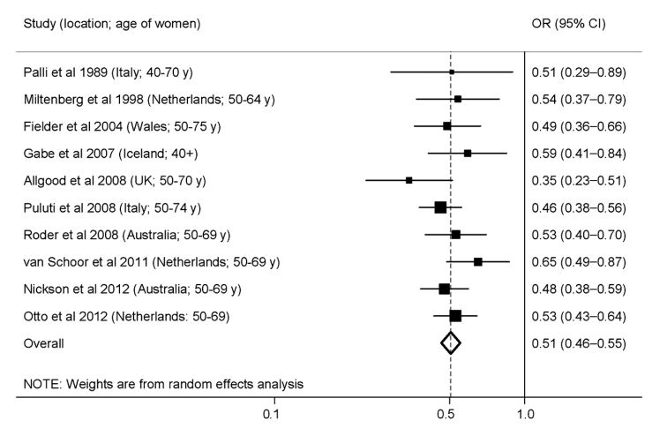
RCTs vs Modern Observational Trials
Observational
RCT
Screening=
benefit
Screening= harm
Screening= benefit
Screening= harm
Coldman et al, 2014

Slide 26
Observational Trials:
Pan-Canadian Study of Mammography Screening 2014
2,796,472 women screened over 20 years
The average breast cancer mortality among participants was 40% lower than expected (27% - 59%)
40-49 y: 44% lower mortality
Participation in mammography screening programs in Canada was associated with substantially reduced breast cancer mortality
Andrew Coldman, Norm Phillips, Christine Wilson et al, JNCI J Natl Cancer Inst 2014, 106(11)

Slide 27
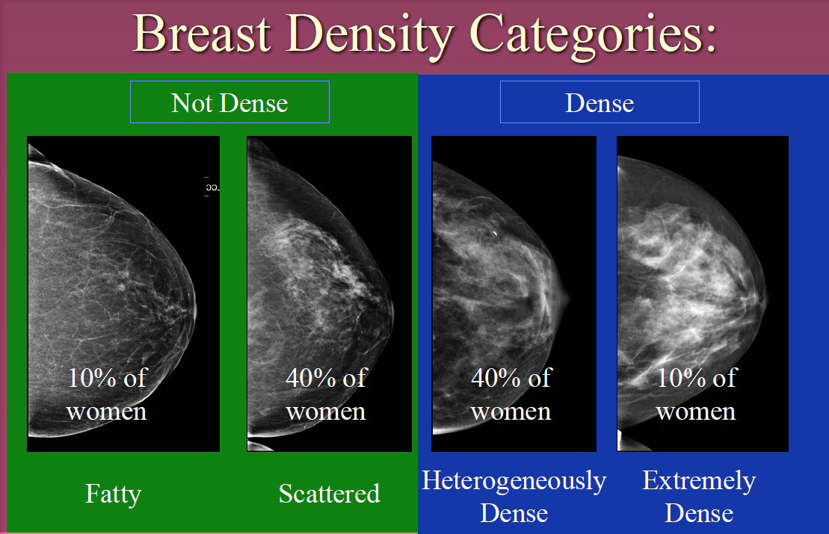
Breast Density
Dense breasts are those with less fatty tissue and more glandular/fibrous tissue
BI-RADS A –
Low (fatty-replaced)
BI-RADS B -Scattered fibroglandular densities
BI-RADS C -Heterogeneously dense
BI-RADS D -Extremely dense

Slide 28


How can you tell breast density?
Cannot Tell By:
Appearance
Size
Physical exam
Can Tell By:
Radiographically
  Mammogram
  Ultrasound
  MRI

Slide 29
Breast Density- Risk Factors
Non-modifiable
Genetic
Reproductive
Hormone exposure
Modifiable
Smoking
Alcohol
Sedentary Lifestyle
Obesity

Slide 30
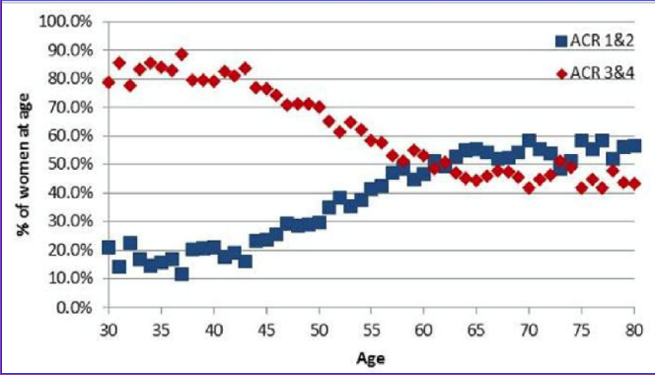
Age and Breast Density
Mammographic breast density can diminish over time
  75% in 30s have increased density
  25% in 70s have increased density
Women whose breast density does not diminish over time more likely to be diagnosed with breast cancer
Overall, 40% of women have dense breast tissue
Int J Cancer. 2104 Oct 1;135(7):1740-4

Slide 31
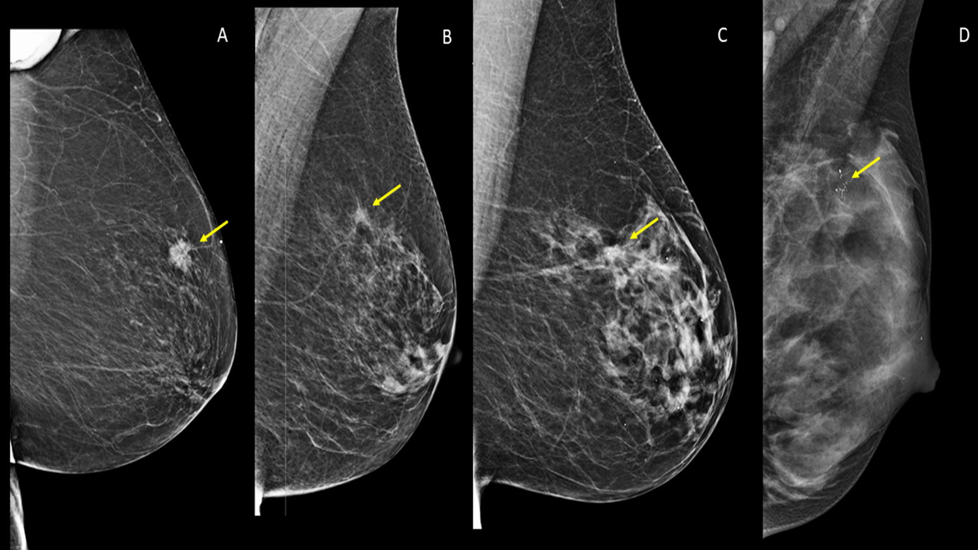
Implications of Dense Breasts
Limits cancer detection with mammography
Increases risk of developing interval cancers
Increases risk of developing breast cancer

Slide 32
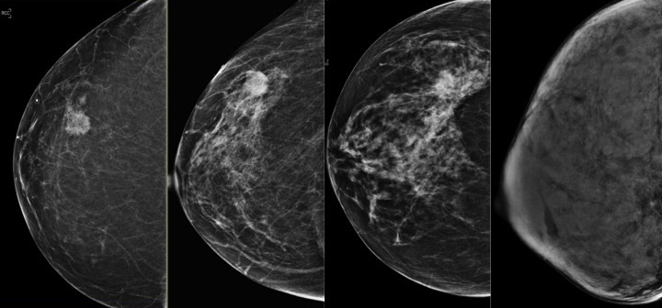

Limits cancer detection
Sensitivity of mammogram decreases to 50% in patients with extremely
dense breast tissue

Slide 33
Interval cancers 5 - 18X more common
Diagnosed in screen-negative breasts outside of the screening program within the interval between two screening rounds
Larger at diagnosis & more often node-positive
Higher nuclear grades, more aggressive subtypes
Have a poorer prognosis compared to screen-detected
Boyd NF et al. Breast Cancer Res 2011; 13:223, Pisano ED et al. NEJM 2005; 353:1773–1783, Boyd NF et al. NEJM2007; 356:227–236 Yaghjyan L et al. JNCI 2011; 103:1179–1189

Slide 34
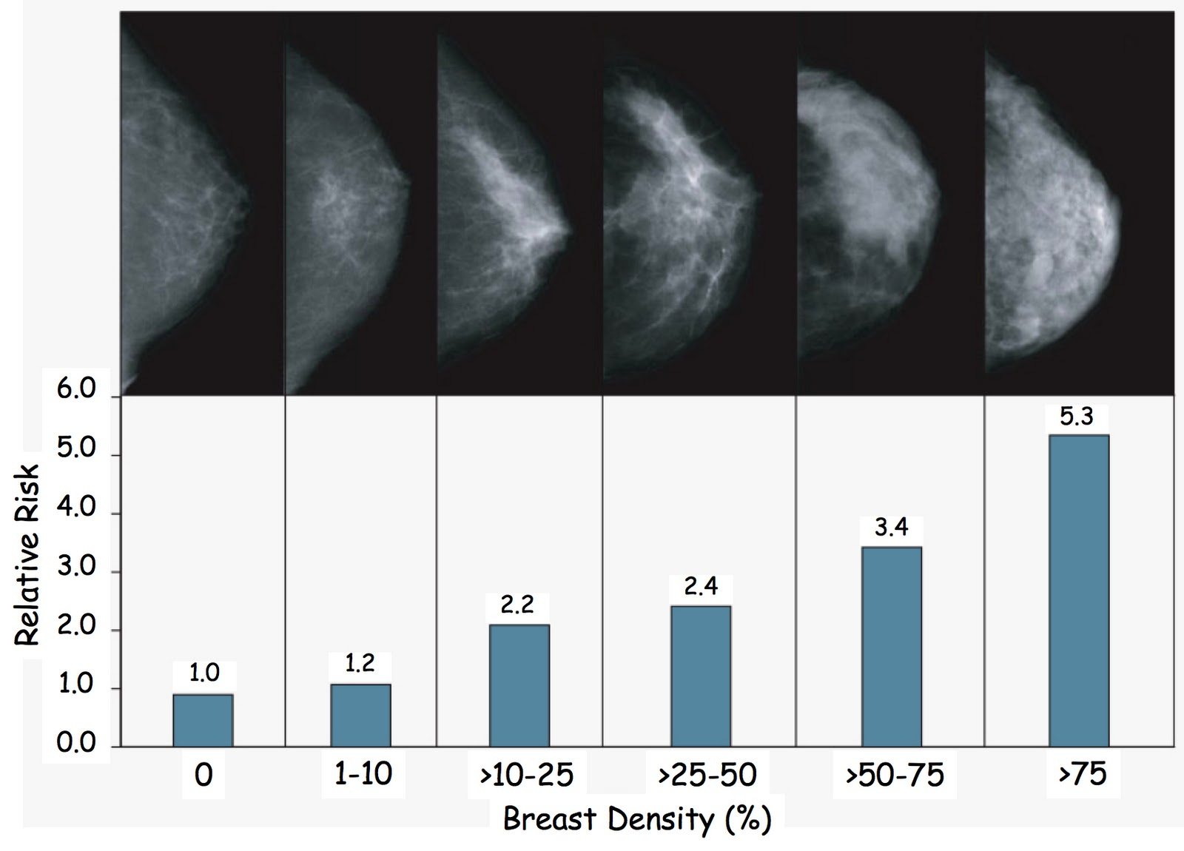
Increased Risk of Breast Cancer
Risk of breast cancer with ACR D is greater than risk of having a first degree relative with breast cancer
2X
Boyd N et al. NEJM 356:227-236

Slide 35
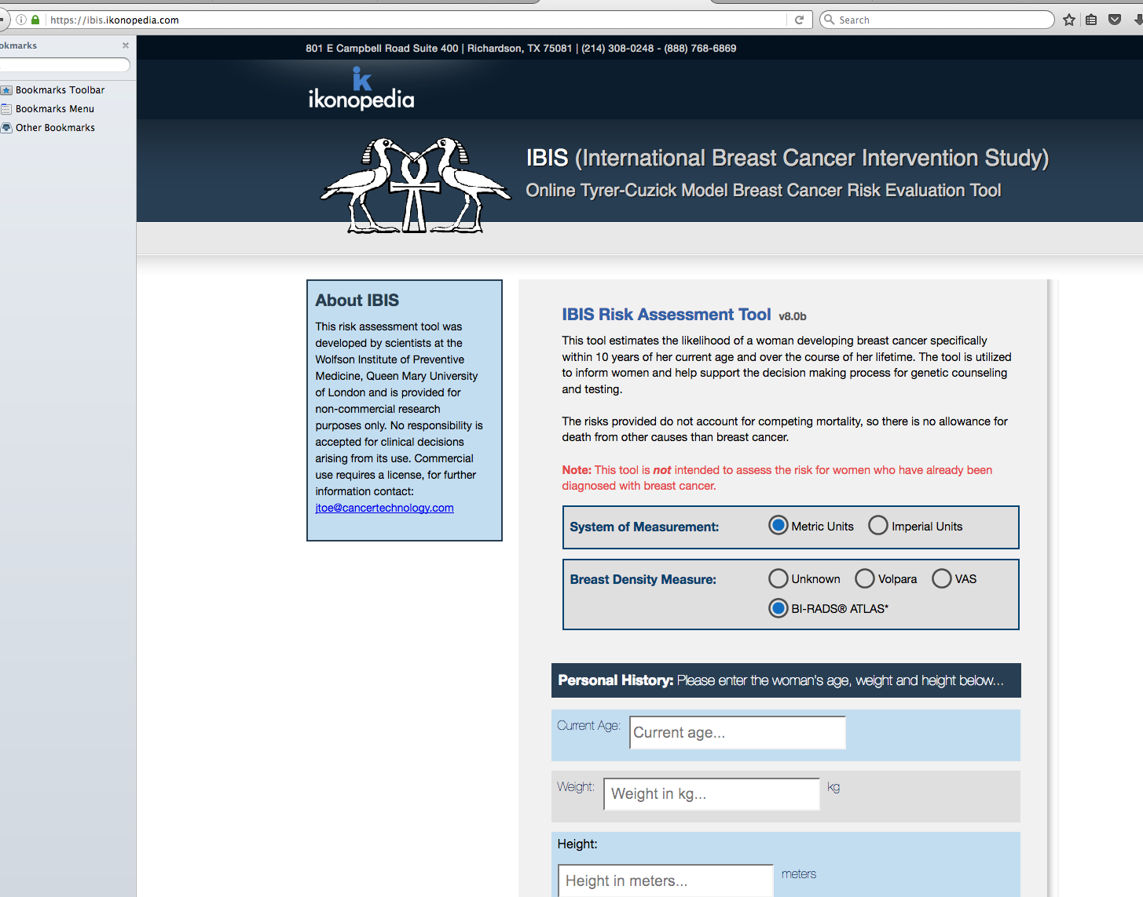

Determining Risk of Breast Cancer
IBIS Model
Online, free
Incorporates family history, breast density
Gives a 10 year and lifetime risk of developing breast cancer
Average risk: 1 in 8 or 12.5%
Intermediate risk >15%
High risk >20-25%

Slide 36
Supplemental Screening
Diagnoses an additional 4-7 cancers/1000
Ultrasound, MRI, Contrast enhanced mammography
Availability varies across Canada
Use IBIS Model
  Intermediate risk >15%- consider supplemental screening
  High risk >20-25%- refer to high risk program if available

Slide 37
Screening Recommendations for
Dense Breasts
Don’t be reassured by a recently normal mammogram
Annual Mammogram for ACR D
Supplemental screening (i.e. ultrasound, MRI) is recommended in some jurisdictions across Canada and should be a shared decision-making process based on patient preferences
Calculate your patient’s risk using IBIS
Consider supplemental screening if:
  Intermediate Risk (>15%) or
  Referral for high-risk program if risk >20-25%

Slide 38
Screening for High-Risk Women
Think of breast cancer risk starting at age 30
80% of breast cancers occur in women with no family history
Know your patient’s risk: IBIS, density, ethnicity, risk factors
Most breast cancers in high-risk women develop before age 69
Risk | Lifetime Risk | Associated Risk Factors
Average | <15%
Moderate | 15-25% | ACR C or D LCIS, ADH, ALH Intermediate family history Prior breast cancer
High | >25% | Genetic mutations (i.e. BRCA) Chest radiation age <30 Combination of risk factors
Risks for Breast Cancer
Female
Age
EtOH
Smoking
Overweight
Dense breasts
Hormone exposure
Genetic mutations
Radiation at age <30

Slide 39
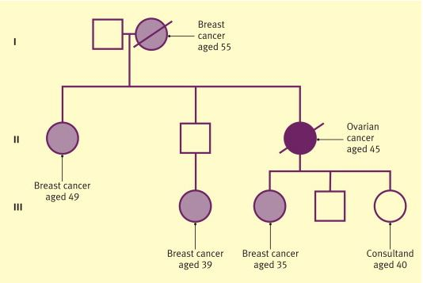
What is a “High-Risk” Family History?
Personal and/or close relative with one of the following:
1 case breast or ovarian cancer and 1 other case breast/ovarian/prostate/pancreatic cancer on same side of family
More than 1 primary breast cancer in same person
Both breast and ovarian cancer in same person
Family history of breast cancer <35 yrs.
Breast +/- ovarian cancer in Ashkenazi Jewish descent
Invasive ovarian cancer
Breast cancer in male

Slide 40
BRCA Gene Carriers
Prevalence 1 in 400 general population
1 in 40 Jewish ethnicity – European (Ashkenazi)
Clusters in the Netherlands, Iceland, Orkney Islands and Poland
Also have high risk of other cancers e.g., ovarian, colon, pancreatic, and thyroid
Risk of developing breast cancer in women
    46 – 87% (mean 65%) for BRCA 1
    37 – 84% (mean 45%) for BRCA 2
Lifetime risk with BRCA= >60%
50% develop breast cancer by the age of 50 years

Slide 41

How Should I Screen High-risk women?
If IBIS >20-25%
In Ontario, refer to High Risk Screening Program
Start EARLIER and screen more OFTEN
  10 years earlier than age of breast cancer diagnosis in first degree relative
  BRCA gene mutation carriers, start at 25-30 years of age
  Annual screening
JAMA Oncol. November 14, 2019.

Slide 42
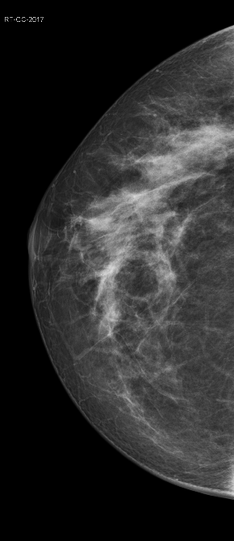
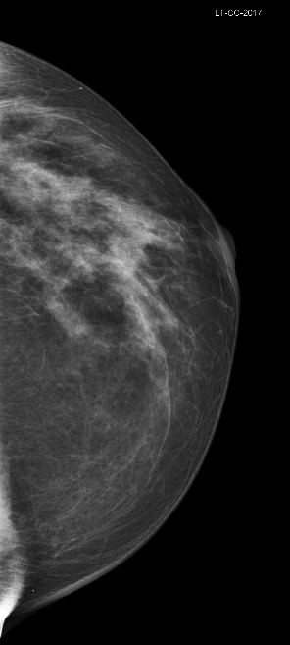
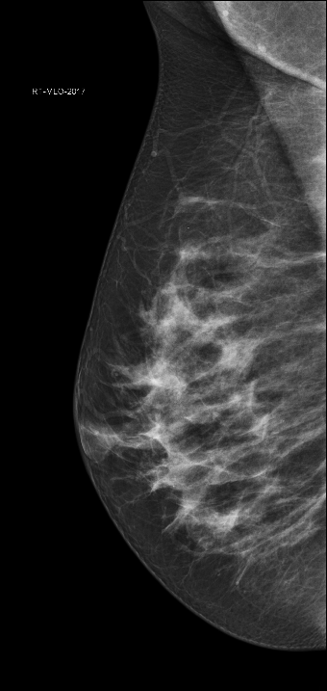
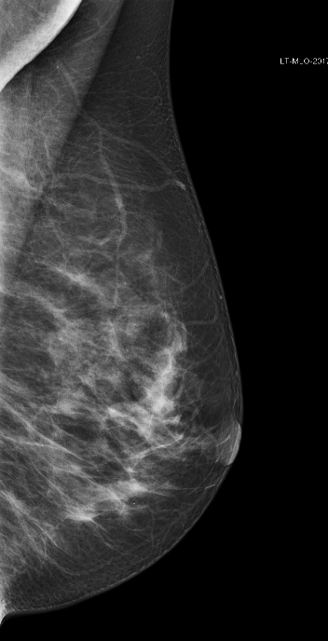
32 yo with Lifetime Risk >25%
Annual screening mammogram
Cancer seen only on MRI

Slide 43
Cancer Yield of Different Imaging Methods, Alone or in Combination
16.0
16.0
14.9
14.9
7.7
6.0
Kuhl C et al, EVA Trial J Clin Oncol 2010

Slide 44
Screening Recommendations for High Risk Women
If IBIS >20-25%
Annual screening mammography, starting at age 30 years, no stop age
AND
Supplemental screening MRI, age 25 - 69 years (stop at age 69)
OR
Supplemental screening ultrasound if unable to tolerate/access breast MRI, age 25-69 years (stop at age 69)

Slide 45
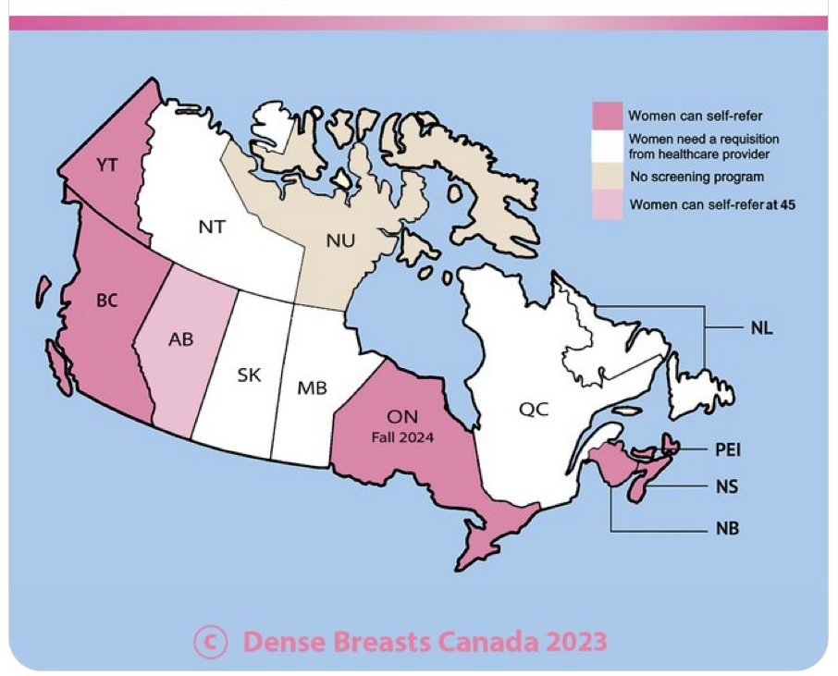
Breast Cancer in the 40s
Significant variation in provincial/territorial screening practices for 40-49
Roughly 1 in 5 breast cancer cases diagnosed in 40s compared to screened population
Breast cancer is the 2nd leading cause of death in women in 40s (behind all accidental)
27% of the life-years lost to breast cancer are in 40s
Median age at diagnosis of fatal cancers is 49 years
Notes:
Anna

Slide 46
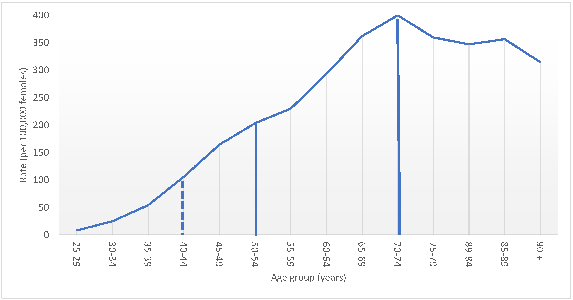
Incidence of Breast Cancer in Canada
18.5% of screened population
Curr. Oncol. 2022, 29, 29, 5627-5643 Wilkinson A, …Seely JM

Slide 47
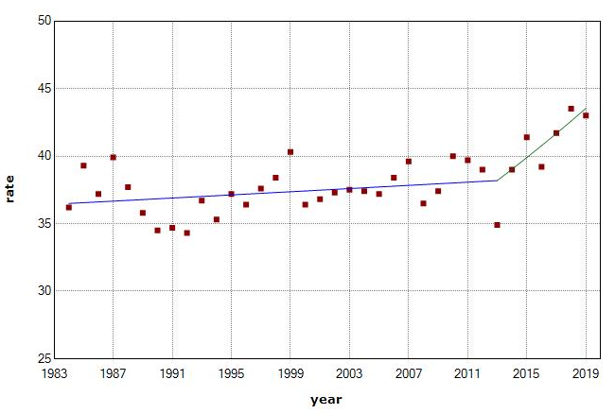
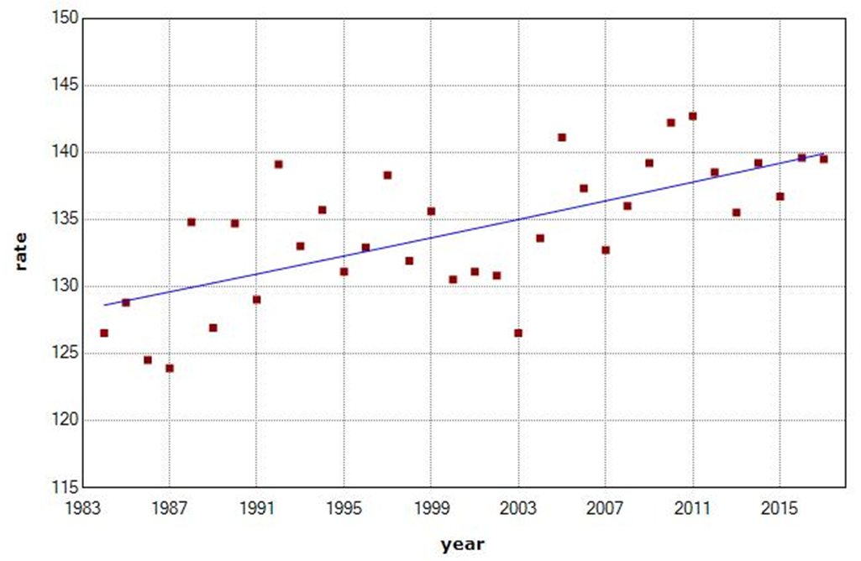

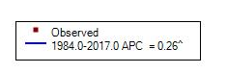
Breast Cancer Incidence in Younger Women is increasing
30’s
40’s

Slide 48
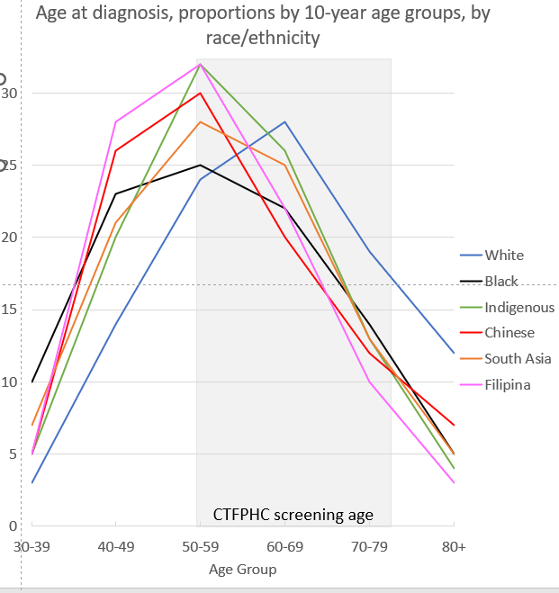
Non-White Women are Diagnosed with Breast Cancer at Younger Ages than White Women
Non-white women have a peak age of diagnosis of breast cancer earlier than 50
Mean age at diagnosis for white: 62, non-white: ~55
Mean age at death for non-white women 10 years earlier than white women

Slide 49
Impact of Change in CTF guidelines in 2011
2011 CTF recommended against screening women in 40s:
  Increase later stage disease at diagnosis in 40s and 50s
  10.3% increase in metastatic disease in 50s
Wilkinson, A. N. et al. Curr Oncol 29, 5627-5643

Slide 50
What happens when there are no organised screening programs for women 40-49?
1) More advanced stage breast cancer
p<0.001
p<0.001
p<0.001
p=0.003
p<0.001
p<0.001
p=0.001
p>0.05
40-49
50-59
Curr. Oncol. 2022, 29, Wilkinson A, …Seely JM

Slide 51
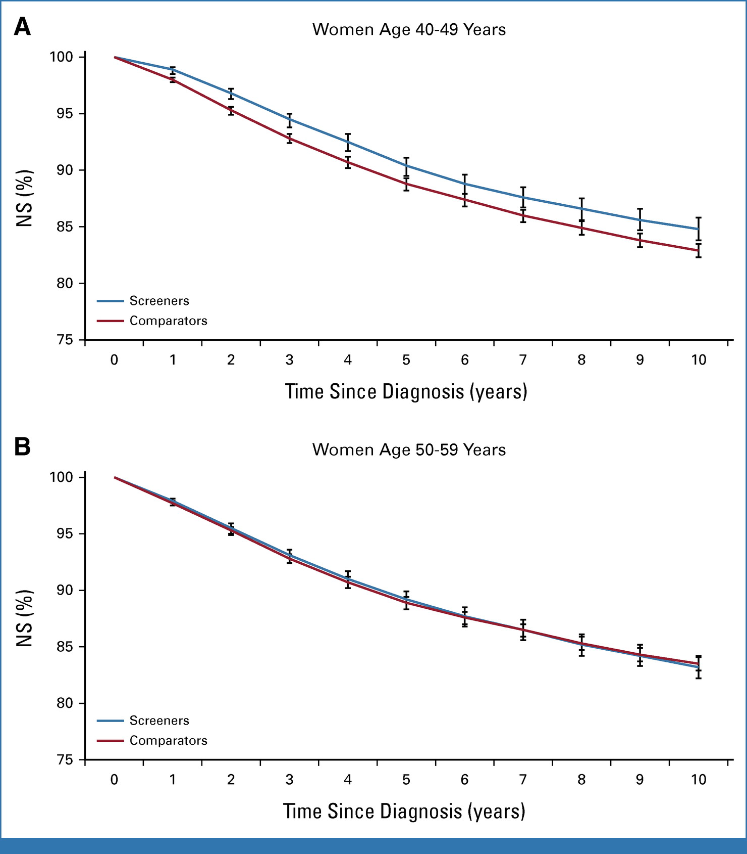
2) Significantly increased 10 year net survival

Slide 52
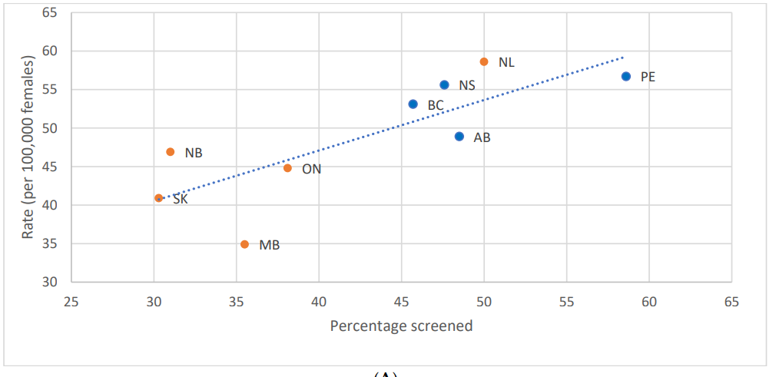
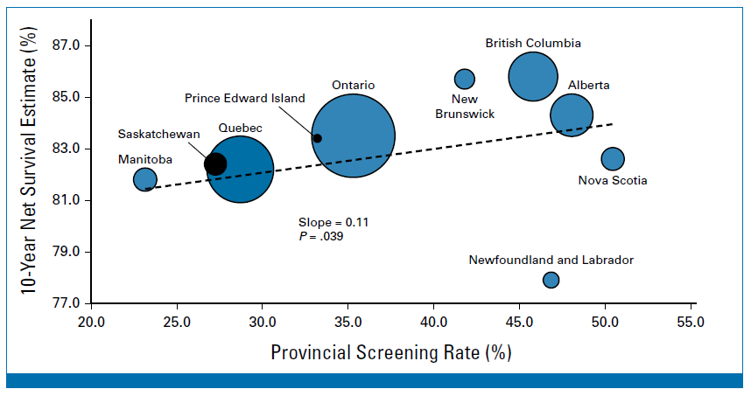
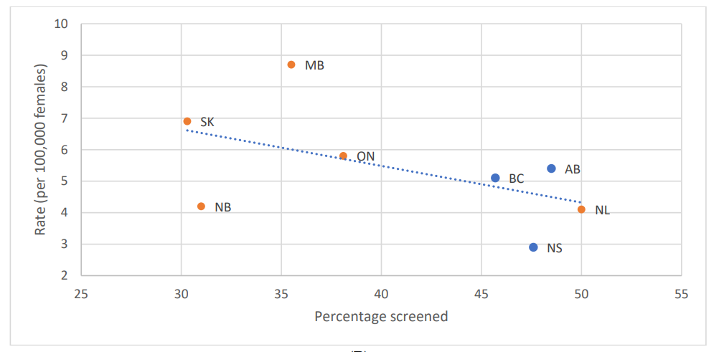
3) Screening participation rate correlated with stage at diagnosis and net survival
Stage 1
85.8%
Rate/100,000
Stage 4
81.8%
40-49 % Screened
Wilkinson AN, Ellison LF, Billette JM, Seely JM. Journal of Clinical Oncology, 2023

Slide 53
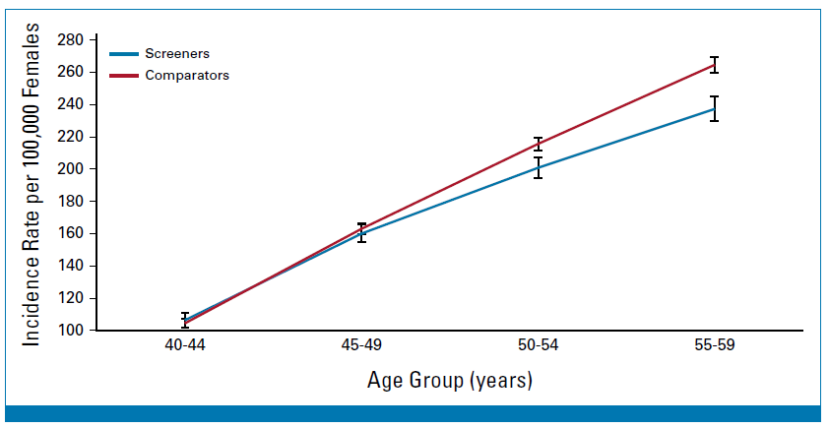
4) Increased breast cancer incidence in women in 50s

Slide 54
Screening Recommendations for Women 40-49
Discuss risks/benefits and patient preferences. Be aware that:
  Survival is significantly increased in women 40-49 who are screened
  Non-white women are at increased risk for diagnosis at an earlier age
  Overdiagnosis is minimal in women in 40s
  Dense breasts increase risk of breast cancer
  Use IBIS to quantify a patient’s risk
Women in their 40s should be screened annually with mammography
  +/- supplemental screening if dense breasts and IBIS >15%
Ray et al, AJR 2018; 210:264–270

Slide 55
Women >74
Most women in Canada at age 75 have a 10 year life expectancy
Breast screening most jurisdictions until age 74, Quebec until age 69
Women older than 70 represent 31% of breast cancer cases
Breast cancer specific mortality is highest in women over 70
Older women have worse outcomes than younger women with similar diagnoses
Overdiagnosis is an important factor in older women who may potentially have multiple co-morbidities.
Notes:
Jean

Slide 56
Screening Recommendations for Women >74
Screening in women >74 should be a discussion weighing risks/benefits with the patient
Screening should only be considered when life expectancy is >10 years
Screen with mammogram q2 years

Slide 57
Which of the following statements is true?
A. Screening mammography for a woman in her 40s should only be done if she has a positive family history of breast cancer
B. Breast tissue density is a risk factor for breast cancer that is equivalent to having a first degree relative with breast cancer
C. Most patients who develop breast cancer have a family history of breast cancer
D. Stopping screening mammography is recommended if life expectancy is < 15 years

Slide 58
Will you inform your patient about their breast tissue density?
A. Yes
B. No

Slide 59
Will you recommend screening mammography for women in their 40s?
  A. Yes
  B. No
  C. Only if they have a positive family history of breast cancer

Slide 60
How many cancers are detected by mammography in extremely dense breast tissue (ACR D)?
A. 25%
B. 50%
C. 75%
D. 85%

Slide 61
How many women who get breast cancer have a family history of breast cancer?
A. 5%
B. 10%
C. 20%
D. 50%
E. 75%

Slide 62
The breast cancer-specific mortality rate is highest in women aged:
A. 40-49
B. 50-59
C. 60-74
D. >74

Slide 63
Questions?

