Slide 1
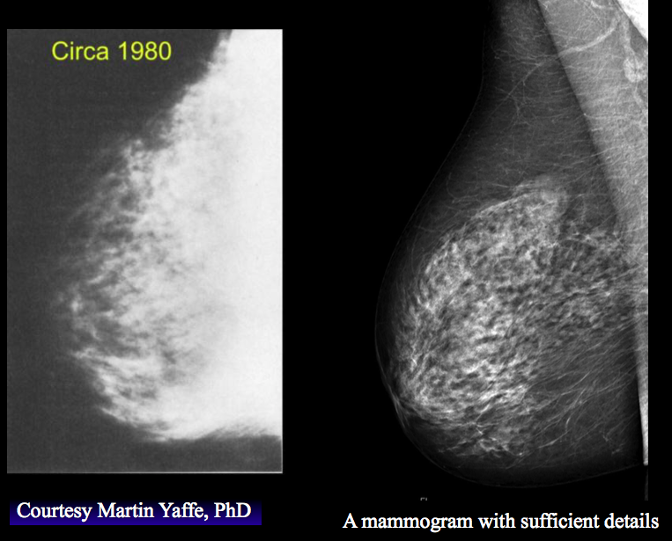
Beyond the Basics of Breast Screening:
What to do for the young, old, dense and high-risk
Anna N. Wilkinson, MSc., MD, CCFP, FCFP
Associate Professor, University of Ottawa
Family Physician, The Ottawa Academic Family Health Team
GP Oncologist, The Ottawa Hospital Cancer Centre
Program Director, PGY-3 FP-Oncology
Regional Cancer Primary Care Lead
Jean M Seely, MD, FRCPC, FCAR, FSBI
Regional Lead OBSP, Champlain Regional Cancer Program
Professor Radiology, University of Ottawa
Head Breast Imaging Section, The Ottawa Hospital
Clinician Investigator, Ottawa Hospital Research Institute
President of the Canadian Society of Breast Imaging
Notes:
-audience questions- 5min
-intro: Breast screening- current recommendations and evidence- 15 min
-density- 10min
-high-risk- 7 min
-women 40-49 - 10min
-women74 - 2 min
-audience questions- answers- 5 min
What if we split like this:
-audience questions- (Jean)
-intro: Breast screening- current recommendations and evidence (anna)
-density (jean)
-high-risk (jean)
-women 40-49 (anna)
-women74 (anna or jean)
-audience questions (jean)

Slide 2
Disclosures
Faculty: Anna Wilkinson
Relationships with financial sponsors:
  CFPC Grant for Breast Cancer Survivorship Tool/Oncology Briefs
  Regional Cancer Primary Care Lead- Stipend
  Consultant for Thrive Health
  Canadian Breast Cancer Network- Honoraria
Faculty: Jean Seely
  Medical Advisory Board for Densebreasts-org (voluntary)
  Principal Investigator for TMIST (Tomosynthesis Mammography Interventional Screening Trial) in Ottawa – (voluntary)
  President of the Canadian Society of Breast Imaging (voluntary)
  Canadian Breast Cancer Network- Honoraria (advisor)
  BD Inc.- Honoraria (advisor)

Slide 3
Objectives
Breast screening- current recommendations and evidence
What to do for:
  Dense Breasts
  High-Risk
  Women 40-49
  Women >74

Slide 4
Which of the following statements is true?
A. Screening mammography for a woman in her 40s should only be done if she has a positive family history of breast cancer
B. Breast tissue density is a risk factor for breast cancer that is equivalent to having a first degree relative with breast cancer
C. Most patients who develop breast cancer have a family history of breast cancer
D. Stopping screening mammography is recommended if life expectancy is < 15 years

Slide 5
Do you currently inform patients about their breast tissue density?
A. Yes
B. No

Slide 6
Do you recommend screening mammography for women in their 40s?
  A. Yes
  B. No
  C. Only if they have a positive family history of breast cancer

Slide 7
How many cancers are detected by mammography in extremely dense breast tissue (ACR D)?
A. 25%
B. 50%
C. 75%
D. 85%

Slide 8
How many women who get breast cancer have a family history of breast cancer?
A. 5%
B. 10%
C. 20%
D. 50%
E. 75%

Slide 9
Screening for a high-risk woman should start at age:
A. 25
B. 30
C. 40
D. 50

Slide 10
Breast cancer-specific mortality rate is highest in women aged:
A. 40-49
B. 50-59
C. 60-74
D. >74

Slide 11

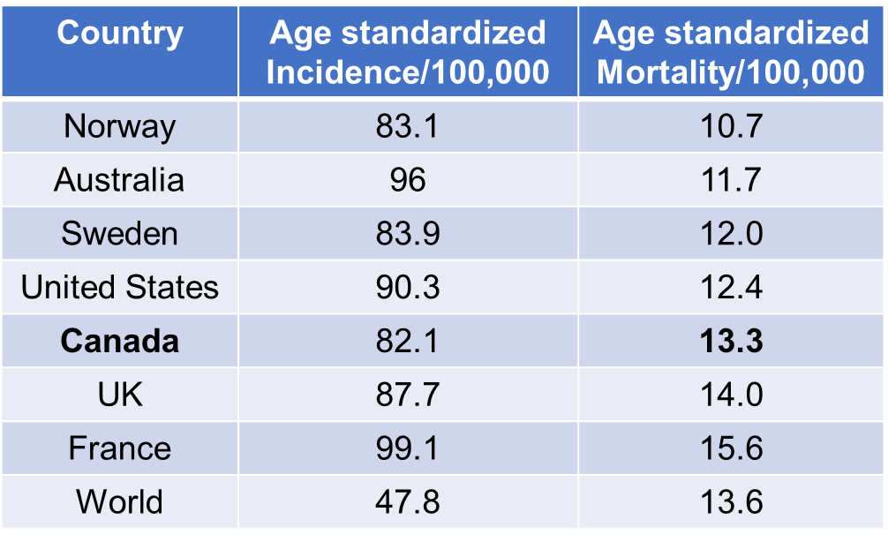
Breast Cancer
12.5% of Canadian women will be diagnosed with breast cancer in their lifetime
28,600 cases of breast cancer in 2022 in Canada
5,500 Canadian women will die from breast cancer
14% of all cancer deaths in women in 2022
Cancer Today (iarc.fr)
https://cancer.ca/en/cancer-information/cancer-types/breast/statistics

Slide 12
Why Screen?
Benefits
  Diagnosis at earlier stage
  Improved survival
  Decreased morbidity of treatments
  Treatment costs less
Harms
  Anxiety
  False positives
  Overdiagnosis

Slide 13
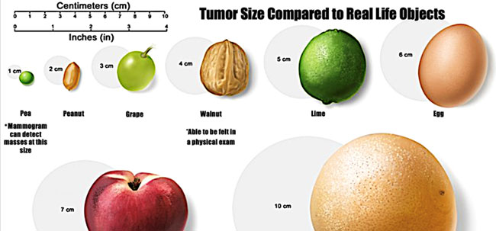
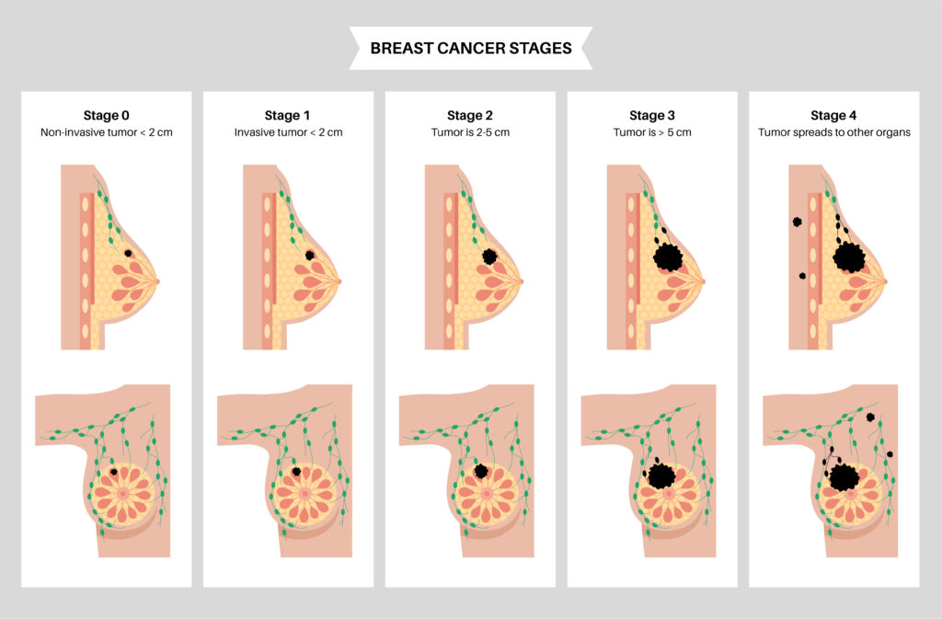
Earlier
Stage
Screen detected
Interval ca or symptomatically detected

Slide 14
Wilkinson, A. N. et al. Curr Oncol 29, 5627-5643
Notes:
40s dx at later satge
This graph shows the stage specific distribution of women with breast cacner at diagnosis according to age group. The ages between the dotted lines are the screening age groups. The light blue line is the early stage 1 BC. Stage II is the purple line. It shows that they corss over at

Slide 15
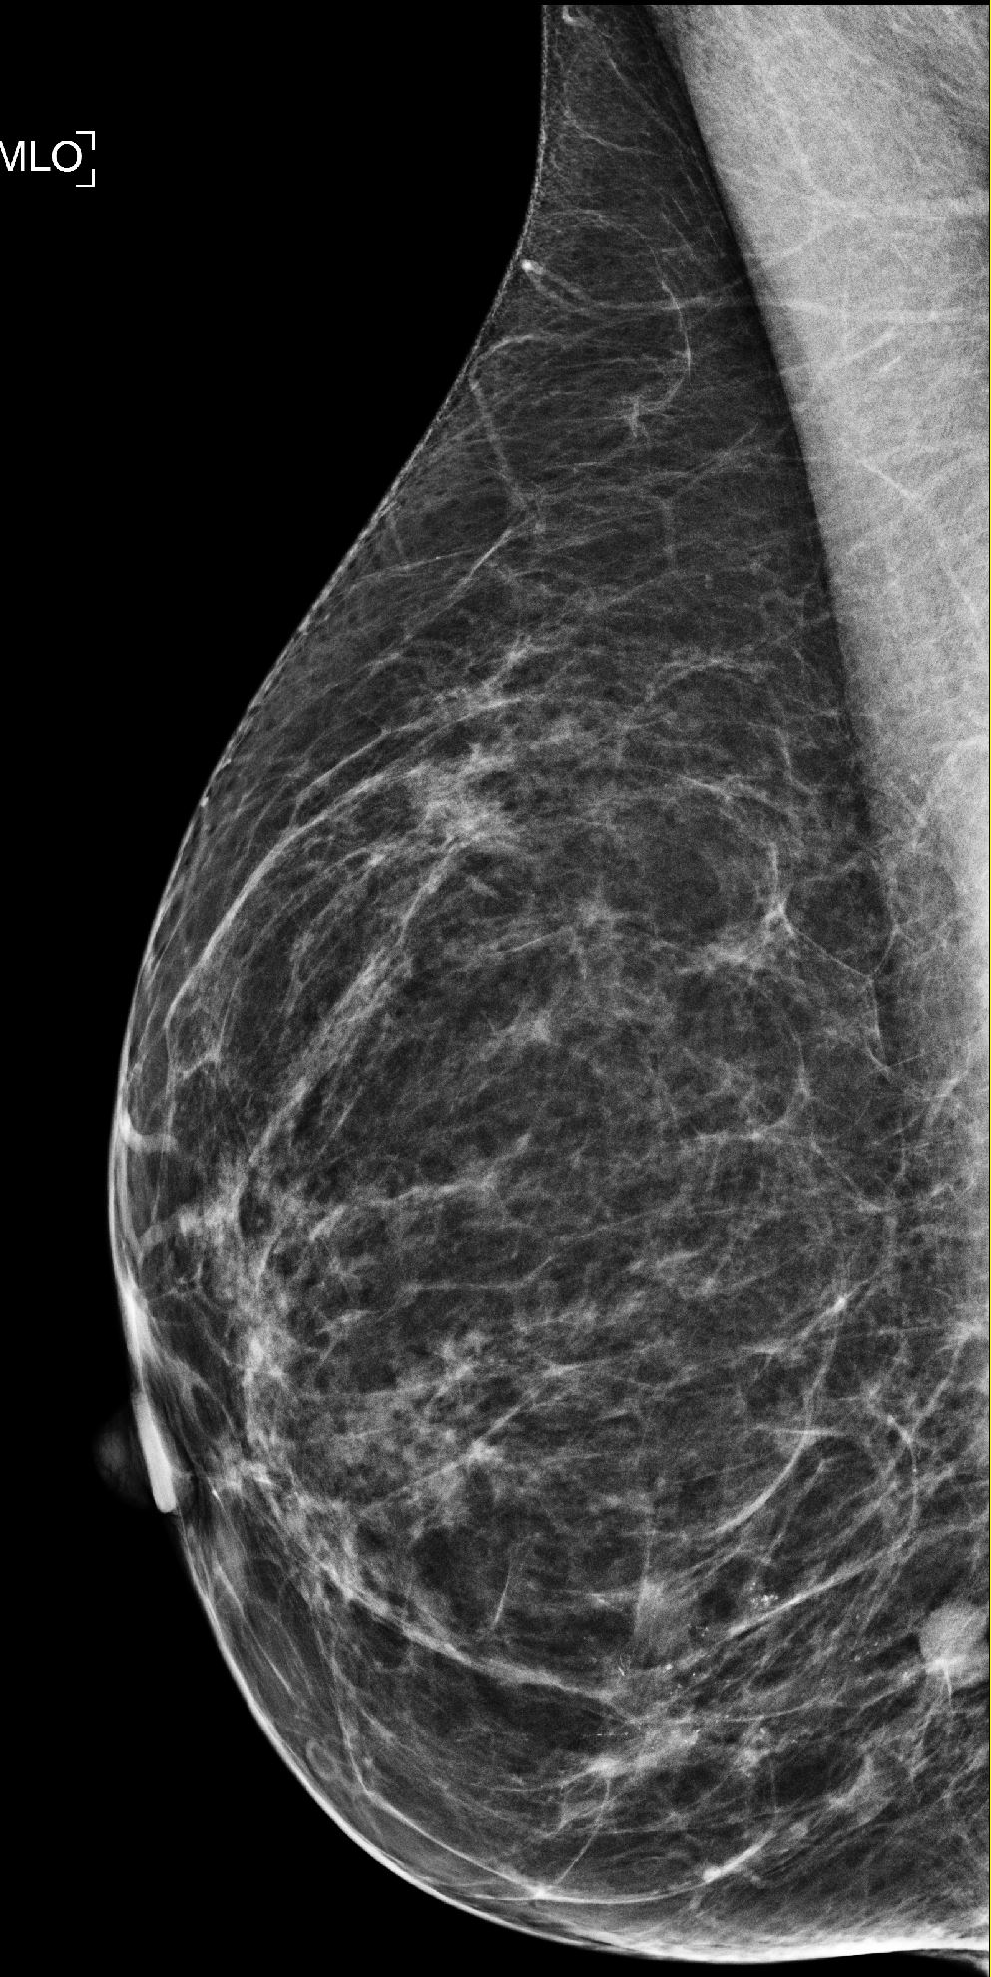
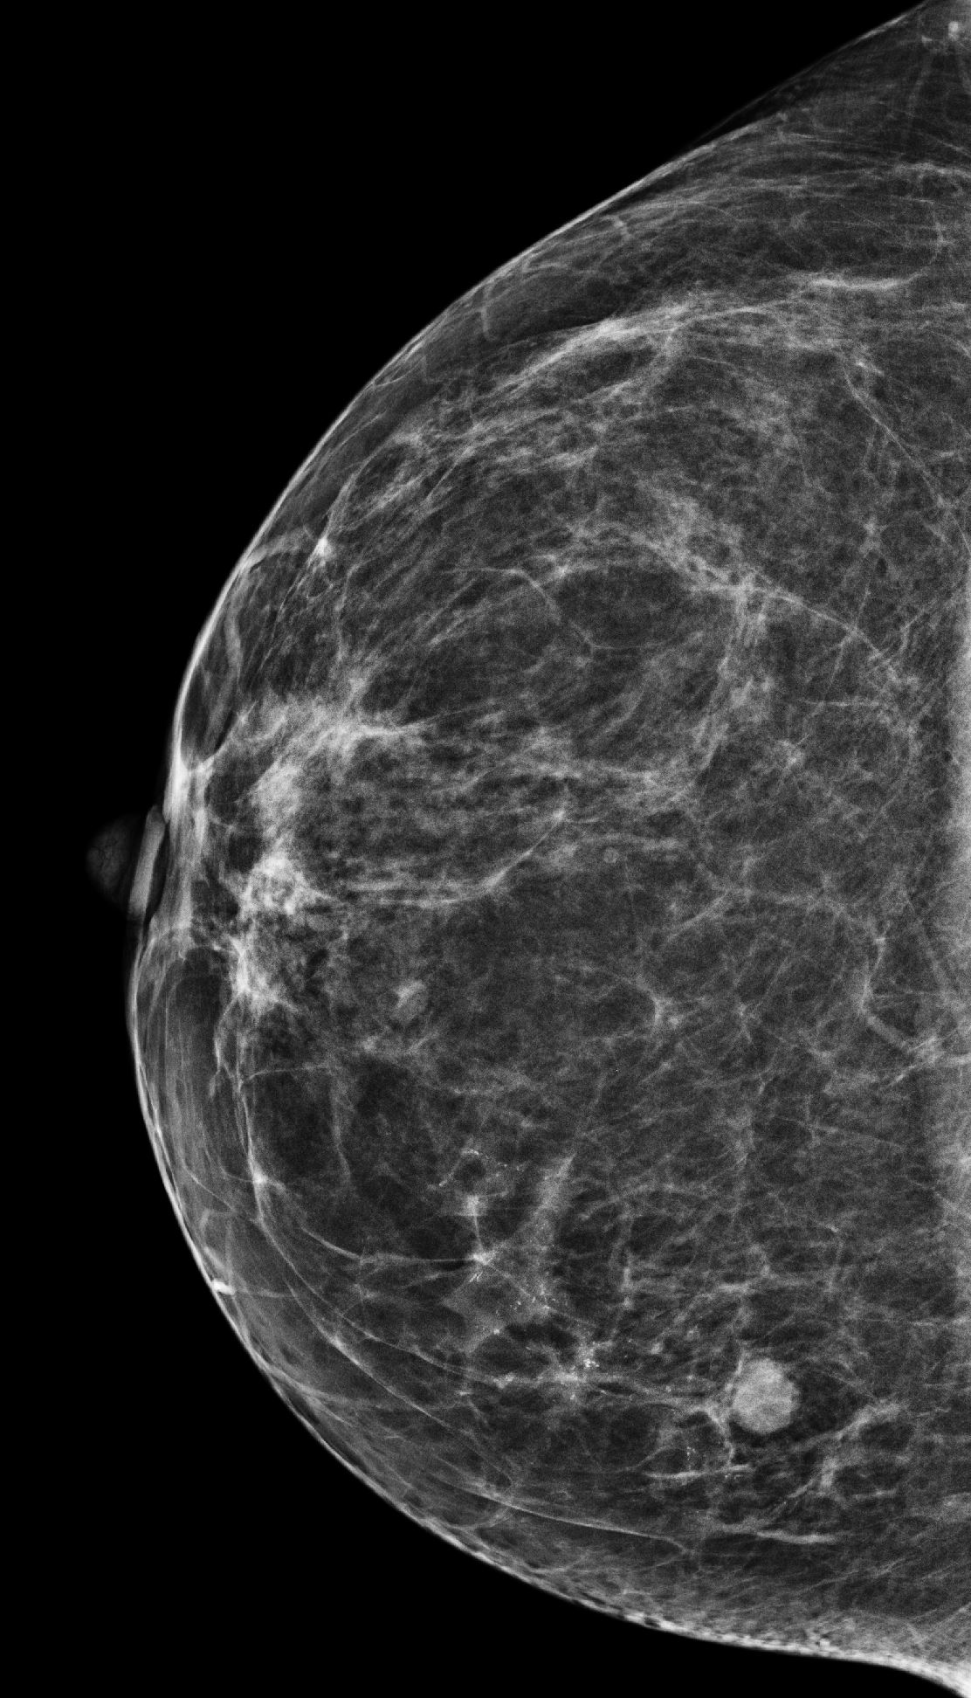
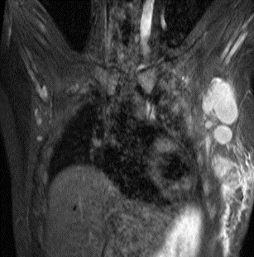
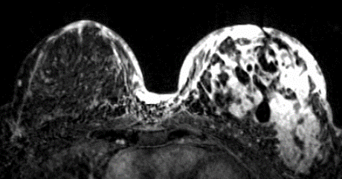
Two different 49 year old patients:
Screen detected vs symptomatic cancers

Slide 16
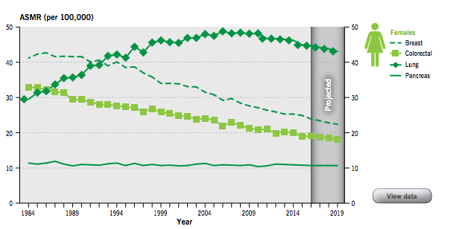
Mortality from Breast Cancer
Screening mammography began in 1989
Breast cancer mortality has decreased by 49% since 1989
Probability of dying from breast cancer decreased by 1.1% annually 1997 to 2020
https://www150.statcan.gc.ca/n1/pub/82-003-x/2023009/article/00002-eng.pdf
Notes:
Breast cancer mortality remained stable for 30 years from 1969. But in 1989, screening mammography programs were established across Canada. Since then BC mortality has dropped by 49%. It is estimated that over 32,000 breast cancer deaths have been avoided since 1986, assuming the same death rate from breast cancer in 1986.

Slide 17
Improved Survival with Earlier Stage
Stage 1
Stage 2
Stage 3
Stage 4
100%
93%
72%
22%
Notes:
The stage at which a BC is dx correlates directly with their survival, at stage 1, all women survive by 5 years, and stage 2, 93% survive. When dx at stage 3, 28% of women will not survive and an appalling 78% dx at stage 4 will die by 5 years.

Slide 18

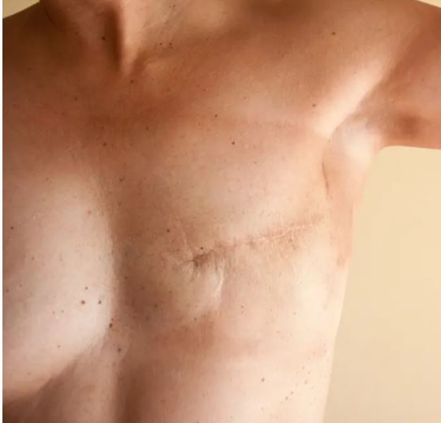
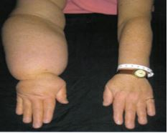
Increased Morbidity with Later
Stage Breast Cancer
Notes:
These are the many downsides of treatment for advanced breast cancer that are avoided in the majority of early stage breast cancers. We prevent these treatment effects with an early stage diagnosis.
%. Treatment is less intensive, with more breast conservation surgery, sentinel lymph node surgery and radiation with few patients needing chemotherapy. Duration of treatment is shorter, and more patients return to work sooner, after less costly treatment.
treatment is much more intensive, costlier and of longer duration.

Slide 19
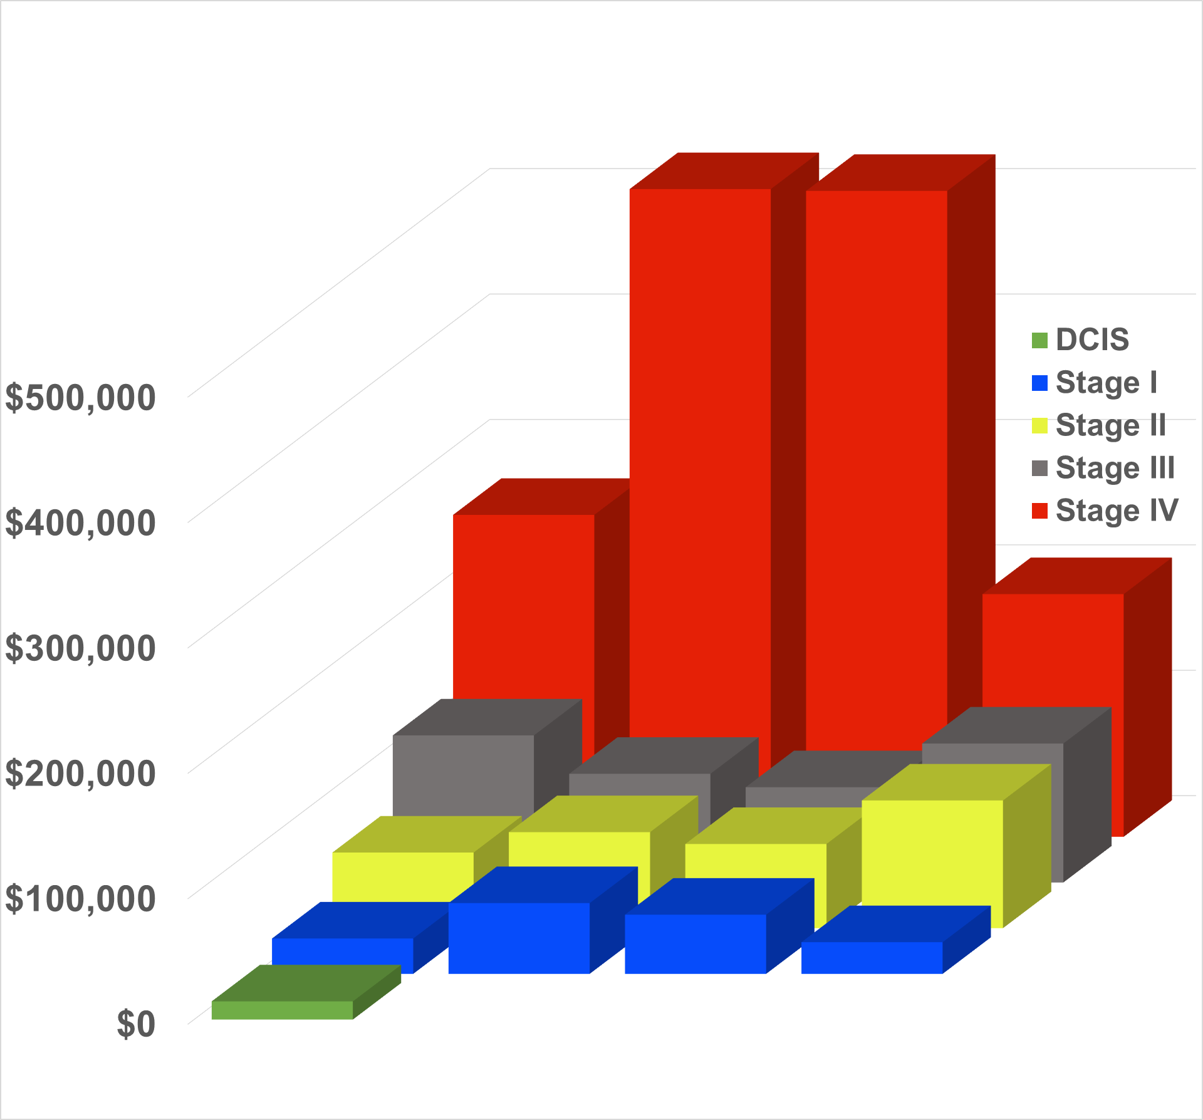
Increased Cost with Treatment of Later Stage Breast Cancer
Stage IV treatment 36x cost of DCIS
Cost to screen 1 women for 40’s ~$2600
Costs increase exponentially by stage
Stage IV 11x more costly than stage I
Cost for one case of stage IV >500K
HR+ HR+/HER2+ HER2+ TN
Breast Cancer Subtype

Slide 20
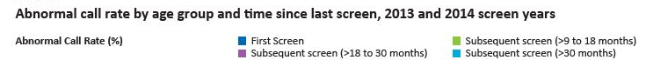
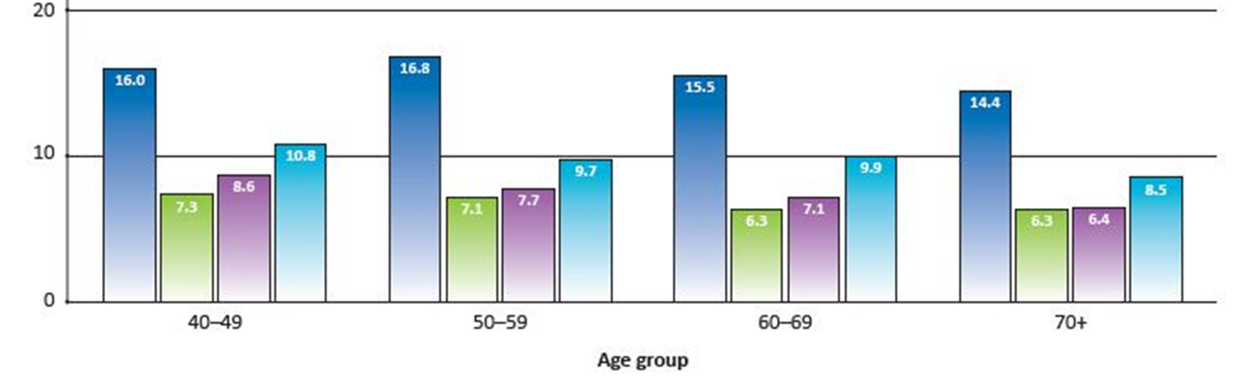
False Positives
Important to distinguish between recalls for further imaging vs benign biopsy
Imaging recall is not a false positive- it is a request for more information
Recall
~15% of women are recalled for further imaging on first screen
~7% of women recalled for further imaging on subsequent screens
Biopsy
1.4% biopsy rate
0.36% are cancers
Compare with: colon screening: 5% recall rate, 4.7% biopsy, 0.25% are cancers
cervical screening: 4% recall (colpo) rate 4%, 0.004% are cancer
Canadian Partnership Against Cancer. Breast Cancer Screening in Canada: Monitoring and Evaluation of Quality Indicators - Results Report, 2017. https://s22457.pcdn.co/wp-content/uploads/2019/01/Breast-Cancer-Screen-Quality-Indicators-Report-2012-EN.pdf

Slide 21
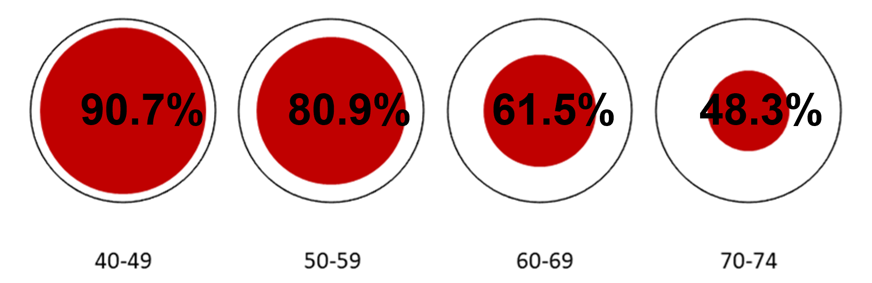
Overdiagnosis
“Overdiagnosis is the unnecessary treatment of cancer that would not have caused harm in a woman’s lifetime, as well as physical and psychological consequences from false positives.”
Relevant for older women with co-morbidities, but less applicable for younger women
Mortality due to breast cancer in women diagnosed with breast cancer:
Wilkinson AN, Ellison LF, Billette JM, Seely JM. Journal of Clinical Oncology, August 4, 2023

Slide 22
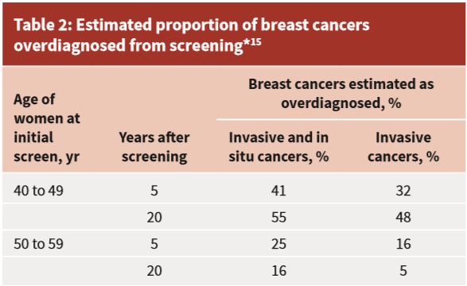
CanadianTask Force on Preventive Health Care:
Overdiagnosis
?
”Women less than 50 years of age are at greater risk of these harms than older women.”
Literature: Overdiagnosis ranges from 0.1-33%, lower for younger women
Klarenbach et al., 2018

Slide 23
Harms- Anxiety
There can be elevated levels of anxiety associated with abnormal mammograms
Many women would prefer to experience transient anxiety with the knowledge that cancer may be ruled out
“Benevolent sexism”? There is not the same emphasis on anxiety with other cancer screening.
Anxiety is highly personal and must be a discussion with your patient

Slide 24
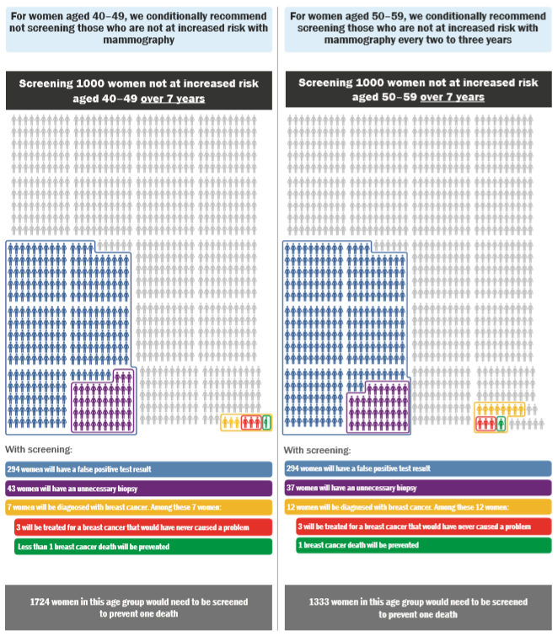
2018 Canadian Task Force Guideline Recommendations
All decisions to undergo screening is conditional on the relative value a woman places on possible benefits and harms from screening.
40 to 49 years, we recommend not screening with mammography (Conditional recommendation; low-certainty evidence)
  NNS (Number needed to screen) 1724
50 to 69 years, we recommend screening with mammography every 2 to 3 years; (Conditional recommendation; very low certainty evidence)
  NNS 50-59: 1333 ; NNS 60-69: 1087
70 to 74 years, we recommend screening with mammography every 2 to 3 years; (Conditional recommendation; very low-certainty evidence)
    NNS 645
Under Review

Slide 25
The evidence for screening
11 randomized control trials:
  New York, USA 1963
  Malmö I, Sweden 1976
  Malmö II, Sweden 1978
  Kopparberg, Sweden 1976
  Östergötland, Sweden 1978
  Edinburgh, Scotland 1978
  Canada CNBSS I 1980
  Canada CNBSS II 1980
  Stockholm, Sweden 1981
  Göteborg, Sweden 1982
  Finland 1987
Innovations in breast cancer treatment
1984: Tamoxifen
2004: Aromatase inhibitors
2005: Trastuzumab (Hereceptin)
2013: The 4 subtypes of breast cancer are defined
2014: Sentinel lymph node biopsy
2018: Genomic testing (Oncotype dx): allows 70% women with early-stage ER+ BC to avoid chemotherapy
2021: CDK4/6 inhibitors for metastatic ER+ BC, survival increases to ~5years
2022: CDK4/6 inhibitors approved for adjuvant treatment of high risk ER+ BC
2022: Antibody-drug conjugate (Enhertu) approved in metastatic HER2+ BC
2022: Hypofractionated radiation (5 fractions)
2023: Immunotherapy used for high risk and metastatic triple negative BC
Trials 30-60 years old
Do not reflect technological/treatment advances
Notes:
28-56 years old!

Slide 26
CNBSS
Flawed design
  Palpable masses preferentially placed in screening arm
  58% and 49% had clinically palpable cancers vs 15% in average population
  16.4% advanced cancers in mammo vs 8.5% in usual care (p>0.003)
  Breast cancer mortality rate was 1.36x higher in screening arm vs. usual care
Poor quality
mammograms
CA Cancer J Clin 2002;52:68-71

Slide 27
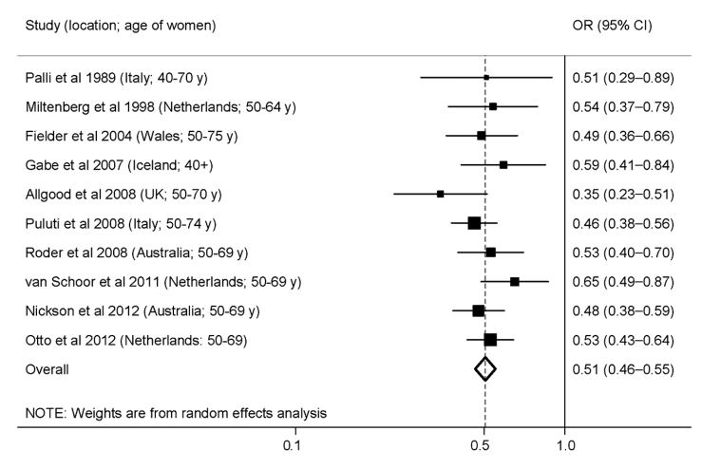
Modern Observational Trials of Screened Populations
Coldman et al, 2014
Notes:
Subject to healthy volunteer bias and selection bias

Slide 28
Observational Trials:
Pan-Canadian Study of Mammography Screening 2014
2,796,472 women screened over 20 years
The average breast cancer mortality among participants was 40% lower than expected (27% - 59%)
No difference in 40-49 y: 44% lower mortality
Participation in mammography screening programs in Canada was associated with substantially reduced breast cancer mortality
Andrew Coldman, Norm Phillips, Christine Wilson et al, JNCI J Natl Cancer Inst 2014, 106(11)
Notes:
Data were obtained from the screening programs and corresponding cancer
registries on screening mammograms and breast cancer diagnoses and deaths for the period between 1990 and
2009.
This observational trial is of course limited by self selection bias which increases the magnitude of effect of benefit of screening.

Slide 29
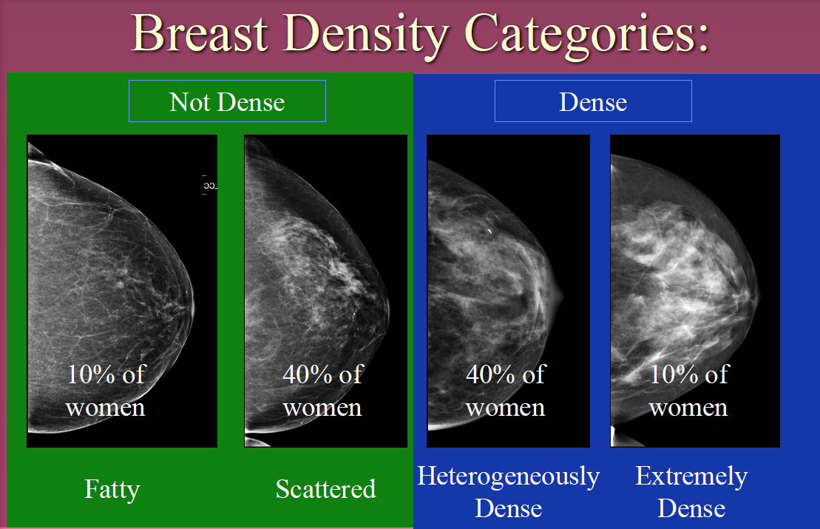
Breast Density
Dense breasts are those with less fatty tissue and more glandular/fibrous tissue
BI-RADS A –
Low (fatty-replaced)
BI-RADS B -Scattered fibroglandular densities
BI-RADS C -Heterogeneously dense
BI-RADS D -Extremely dense

Slide 30


How can you tell breast density?
Cannot Tell By:
Appearance
Size
Physical exam
Can Tell By:
Radiographically
  Mammogram
  Ultrasound
  MRI

Slide 31
Breast Density- Risk Factors
Non-modifiable
Genetic
Reproductive
Hormone exposure
Modifiable
Smoking
Alcohol
Sedentary Lifestyle
Obesity
Notes:
There are many causes of increased density too numerous to list in this talk. The most important causes are genetic, hormonal and dietary. Identical twins are found to share the same breast tissue density, and hormones, exogenous or endogenous increase density. Wieght gain, particulary postmenopausally, contribute significantly to increased breast density. Asian women are also more likley to have dense breasts.

Slide 32
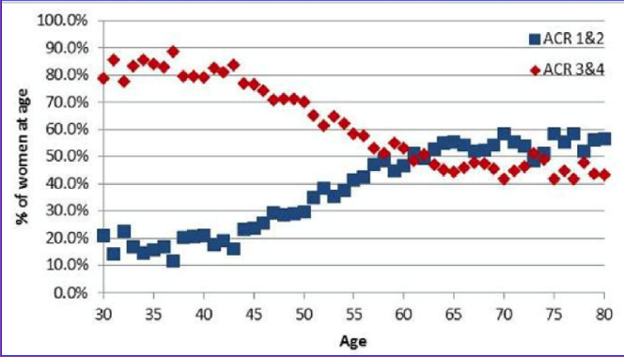
Age and Breast Density
Mammographic breast density can diminish over time
  75% in 30s have increased density
  25% in 70s have increased density
Women whose breast density does not diminish over time more likely to be diagnosed with breast cancer
Overall, 40% of women have dense breast tissue
Int J Cancer. 2104 Oct 1;135(7):1740-4
Notes:
Overall, although a decrease in density is noted with increasing age, 40% of all women have dense breast tissue. Women whose density does not decrease over time are more likely to be diagnosed with breast cancer

Slide 33
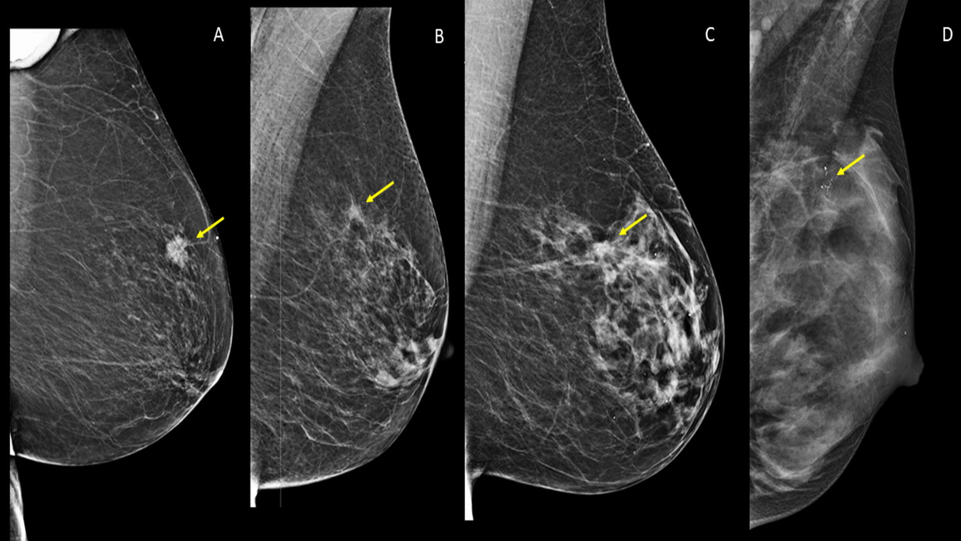
Implications of Dense Breasts
Limits cancer detection with mammography
Increases risk of developing interval cancers
Increases risk of developing breast cancer

Slide 34
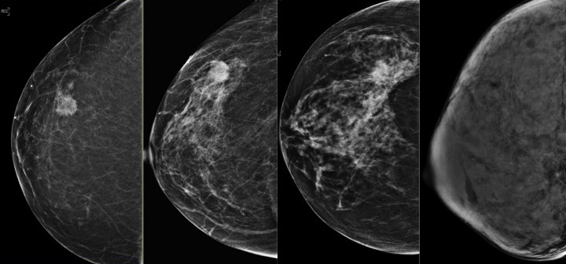

Limits cancer detection
Sensitivity of mammogram decreases to 50% in patients with extremely
dense breast tissue
Notes:
Now imagine that the cancer has no calcifications or architectural distortion. This series of 4 different patients each with a different density category and a cancer in the lateral breast. You completely miss the cancer in the lateral breast in the Densest breast. This is the masking effect of density.

Slide 35
Interval cancers 5 - 18X more common
Diagnosed in screen-negative breasts outside of the screening program within the interval between two screening rounds
Larger at diagnosis & more often node-positive
Higher nuclear grades, more aggressive subtypes
Have a poorer prognosis compared to screen-detected
Boyd NF et al. Breast Cancer Res 2011; 13:223, Pisano ED et al. NEJM 2005; 353:1773–1783, Boyd NF et al. NEJM2007; 356:227–236 Yaghjyan L et al. JNCI 2011; 103:1179–1189
Notes:
The masking effect has a marked impact, with elevated rates of interval breast cancer in women with dense breasts. Interval cancers are the cancers diagnosed in the interval after a normal screening mammogram before their next screen. And that’s important: Interval cancers are Larger at diagnosis & more often node-positive than screen-detected cancers
They tend to be Higher nuclear grade, more aggressive subtypes. They have a poorer prognosis compared to screen-detected cancers.

Slide 36
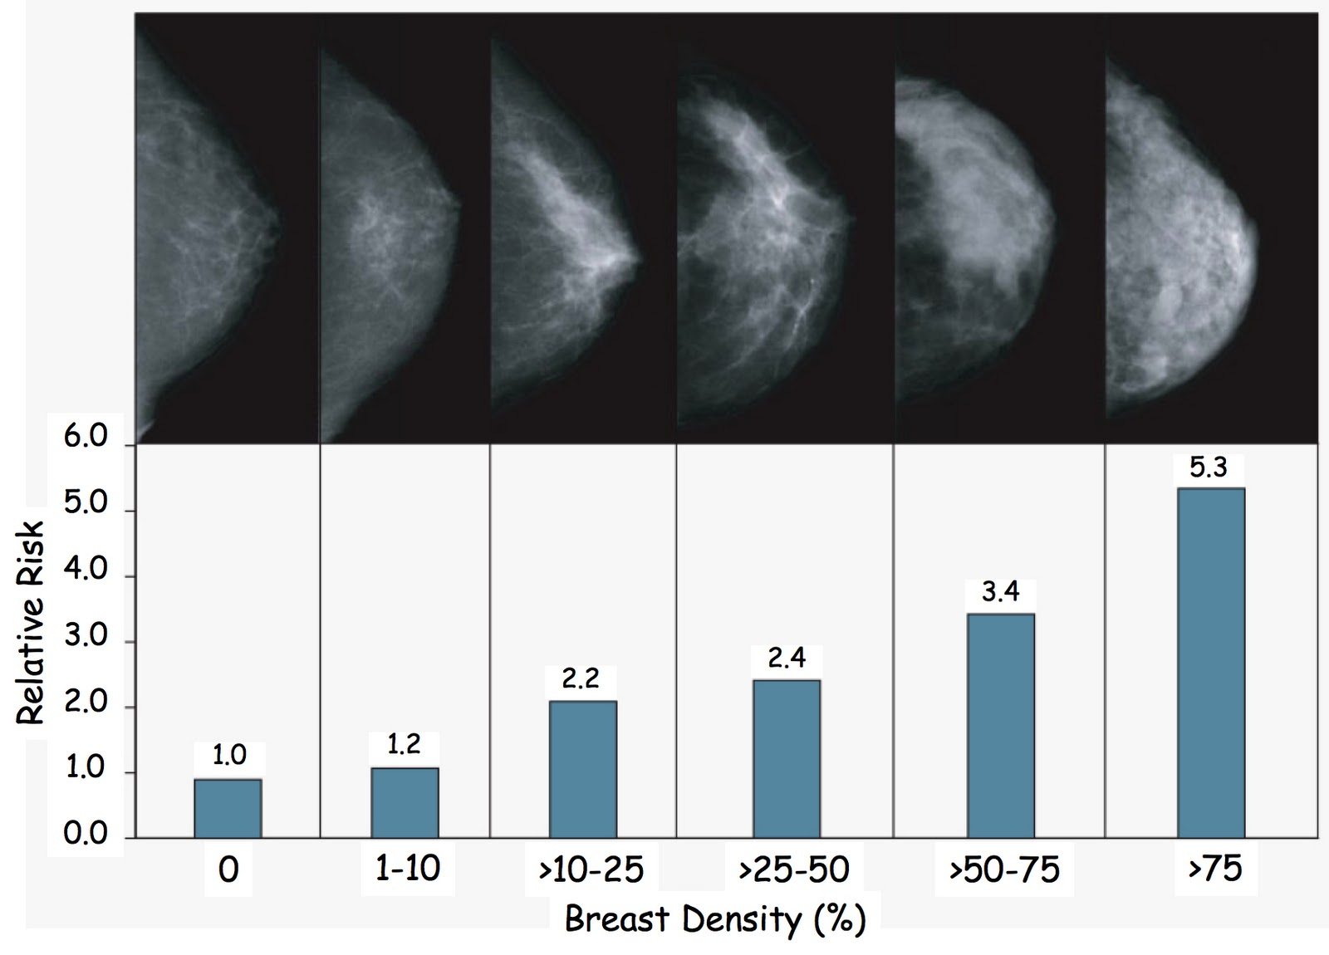
Increased Risk of Breast Cancer
Risk of breast cancer with ACR D is greater than risk of having a first degree relative with breast cancer
2X
Boyd N et al. NEJM 356:227-236
Notes:
Overall there was a doubling of the risk in the most dense women of >75% compared with those 25-50%. Risk was 5 times greater than the women with fatty replaced breasts.

Slide 37
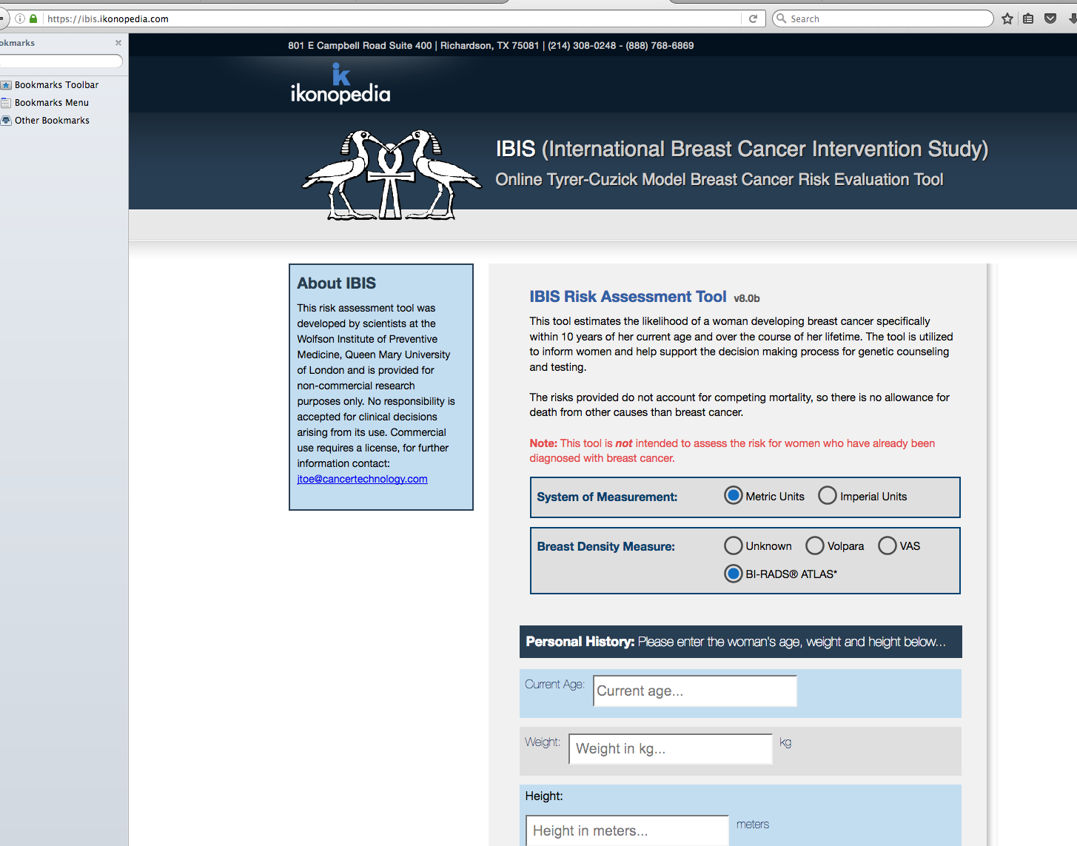

Determining Risk of Breast Cancer
IBIS Model
Online, free
Incorporates family history, breast density
Gives a 10 year and lifetime risk of developing breast cancer
Average risk: 1 in 8 or 12.5%
Intermediate risk >15%
High risk >20-25%

Slide 38
Supplemental screening
Diagnoses an additional 4-7 cancers/1000
Ultrasound, MRI, Contrast enhanced mammography
Availability varies across Canada
Use IBIS Model
  Intermediate risk >15%- consider supplemental screening
  High risk >20-25%- refer to high risk program if available

Slide 39
Screening Recommendations for
Dense Breasts
Don’t be reassured by a recently normal mammogram
Annual Mammogram for ACR D
Supplemental screening (i.e. ultrasound, MRI) is recommended in some jurisdictions across Canada and should be a shared decision-making process based on patient preferences
Calculate your patient’s risk using IBIS
Consider supplemental screening if:
  Intermediate Risk (>15%) or
  Referral for high-risk program if risk >20-25%

Slide 40
Screening for High-Risk Women
Think of breast cancer risk starting at age 30
80% of breast cancers occur in women with no family history
Know your patient’s risk: IBIS, density, ethnicity, risk factors
Most breast cancers in high-risk women develop before age 69
Risk | Lifetime Risk | Associated Risk Factors
Average | <15%
Moderate | 15-25% | ACR C or D LCIS, ADH, ALH Intermediate family history Prior breast cancer
High | >25% | Genetic mutations (i.e BRCA) Chest radiation age <30 Combination of risk factors
Risks for Breast Cancer
Female
Age
EtOH
Smoking
Overweight
Dense breasts
Hormone exposure
Genetic mutations
Radiation at age <30

Slide 41
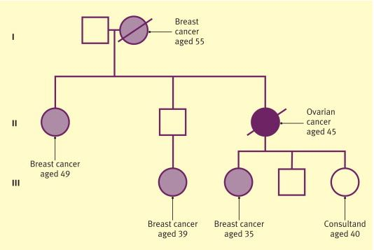
What is a “High-Risk” Family History?
Personal and/or close relative with one of the following:
1 case breast or ovarian cancer and 1 other case breast/ovarian/prostate/pancreatic cancer on same side of family
More than 1 primary breast cancer in same person
Both breast and ovarian cancer in same person
Family history of breast cancer <35 yrs
Breast +/- ovarian cancer in Ashkanzi Jewish descent
Invasive ovarian cancer
Breast cancer in male

Slide 42
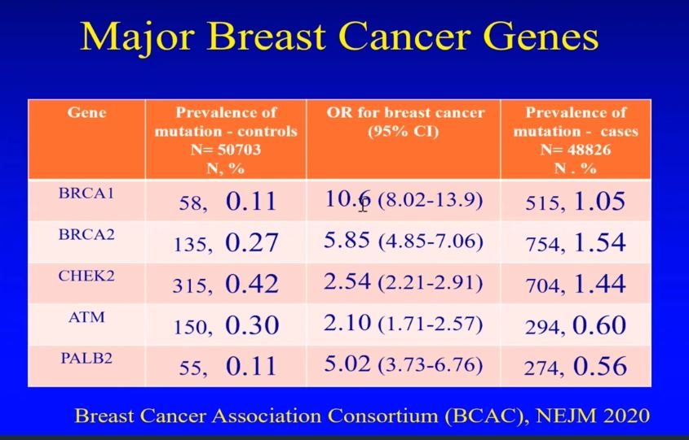

Slide 43
BRCA Gene Carriers
Prevalence 1 in 400 general population
1 in 40 Jewish ethnicity – European (Ashkenazi)
Clusters in the Netherlands, Iceland, Orkney Islands and Poland
Also have high risk of other cancers e.g., ovarian, colon, pancreatic, and thyroid
Risk of developing breast cancer in women
    46 – 87% (mean 65%) for BRCA 1
    37 – 84% (mean 45%) for BRCA 2
Lifetime risk with BRCA= >60%
50% develop breast cancer by the age of 50 years

Slide 44

How Should I Screen High-risk women?
If IBIS >20-25%
In Ontario, refer to High Risk Screening Program
Start EARLIER and screen more OFTEN
  10 years earlier than age of breast cancer diagnosis in first degree relative
  BRCA gene mutation carriers, start at 25-30 years of age
  Annual screening
JAMA Oncol. November 14, 2019.

Slide 45
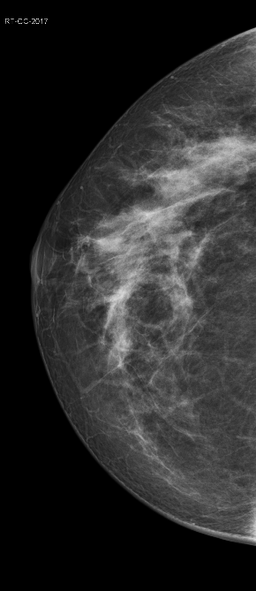
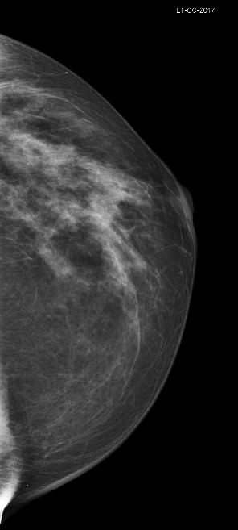
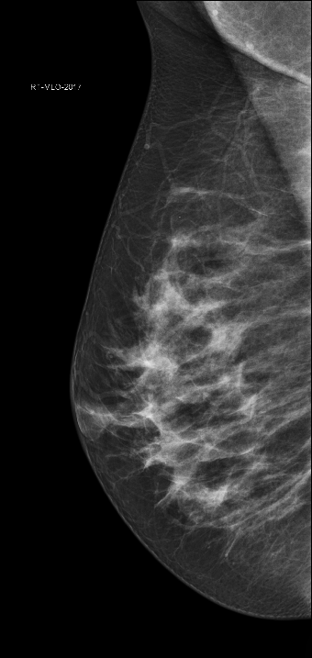
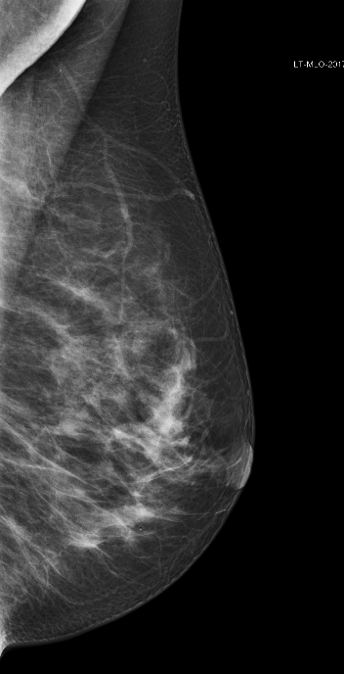
32 yo with Lifetime Risk >25%
Annual screening mammogram
Cancer seen only on MRI

Slide 46
Cancer Yield of Different Imaging Methods, Alone or in Combination
16.0
16.0
14.9
14.9
7.7
6.0
Kuhl C et al, EVA Trial J Clin Oncol 2010
Notes:
Prospective multicenter observational cohort study. 687 asymptomatic women
at elevated familial risk (>=20% lifetime) underwent 1,679 annual screening rounds consisting of CBE,
mammography, ultrasound, and MRI, read independently and in different combinations. In a subgroup
of 371 women, additional half-yearly ultrasound and CBE was performed more than 869 screening
rounds. Mean and median follow-up was 29.18 and 29.09 months. 27 women with cancers were found.
Positive predictive value was 39% for mammography, 36% for ultrasound, and 48% for MRI.

Slide 47
Screening Recommendations for High Risk Women
If IBIS >20-25%
Annual screening mammography, starting at age 30 years, no stop age
AND
Supplemental screening MRI, age 25 - 69 years (stop at age 69)
OR
Supplemental screening ultrasound if unable to tolerate/access breast MRI, age 25-69 years (stop at age 69)

Slide 48
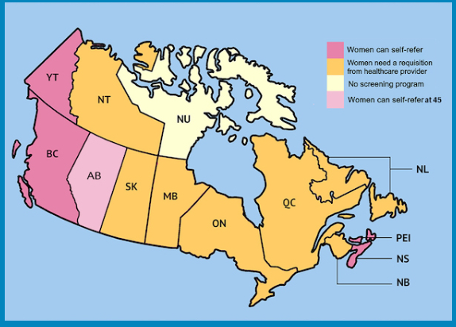
Breast cancer in the 40s
Significant variation in provincial/territorial screening practices for 40-49
Roughly 1 in 5 breast cancer cases diagnosed in 40s compared to screened population
Breast cancer is the 2nd leading cause of death in women in 40s (behind all accidental)
27% of the life-years lost to breast cancer are in 40s
Median age at diagnosis of fatal cancers is 49 years

Slide 49
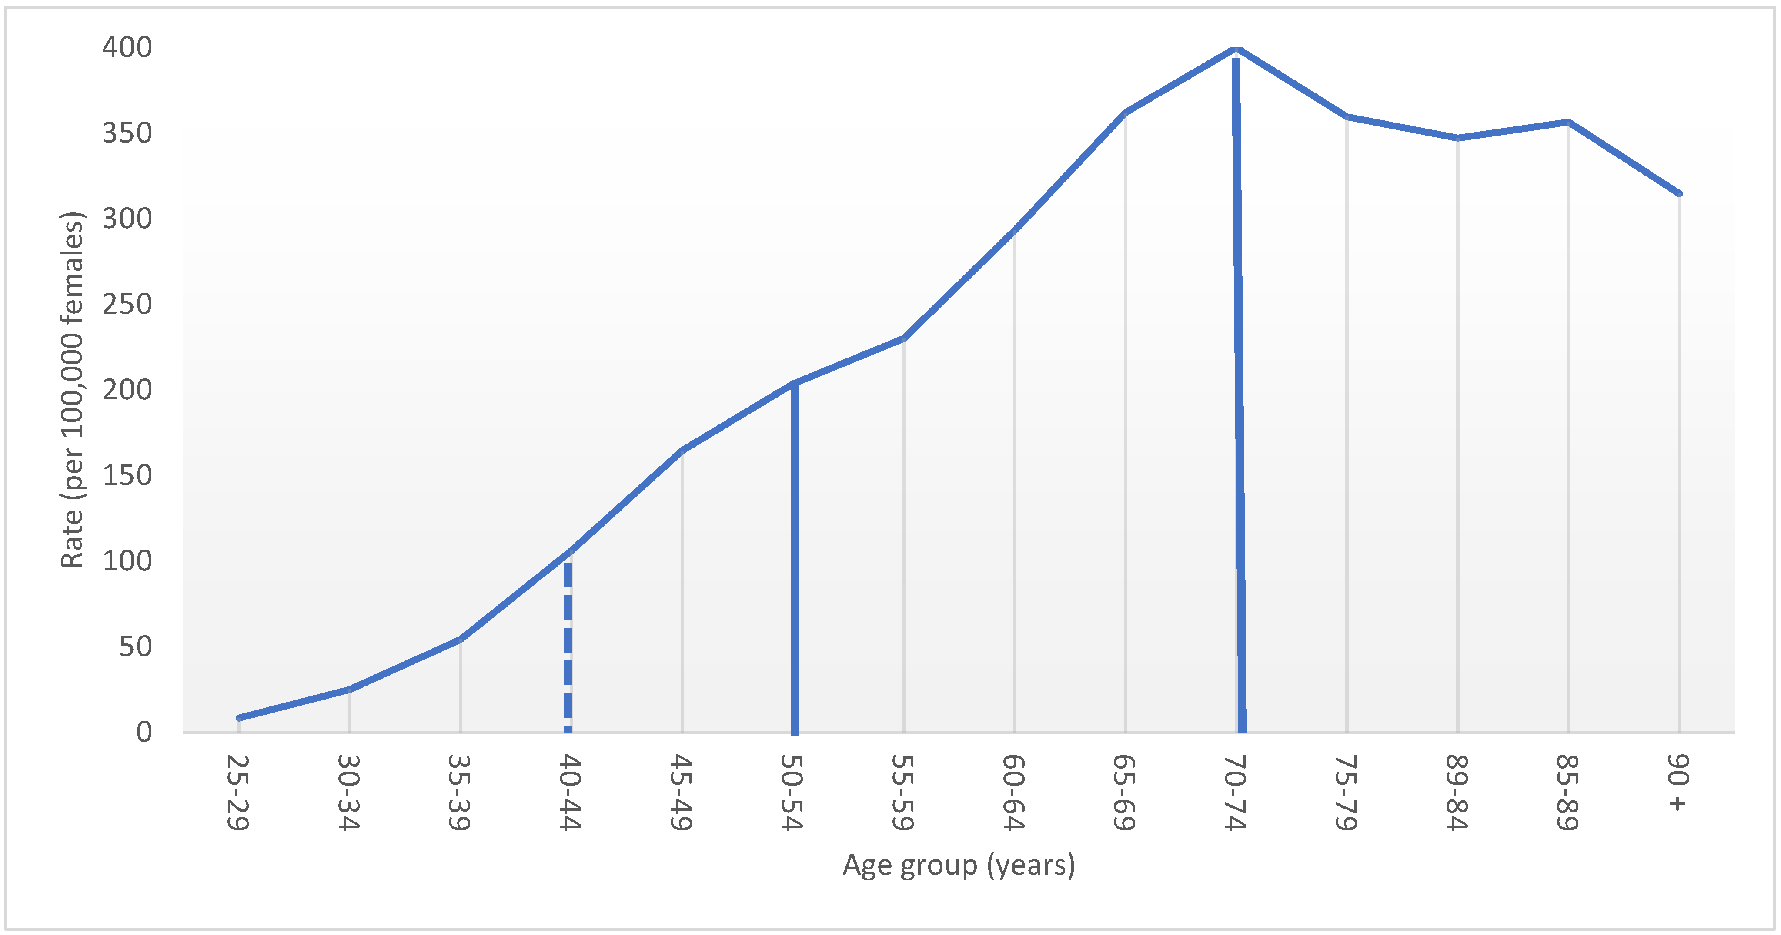
Incidence of Breast Cancer in Canada
18.5% of screened population
Curr. Oncol. 2022, 29, 29, 5627-5643 Wilkinson A, …Seely JM
Notes:
Doesn’t just start in 40s- unconcoius bias
The incidence of breast cancer between 2010-2017 steadily rose from age 30 as shown here.

Slide 50
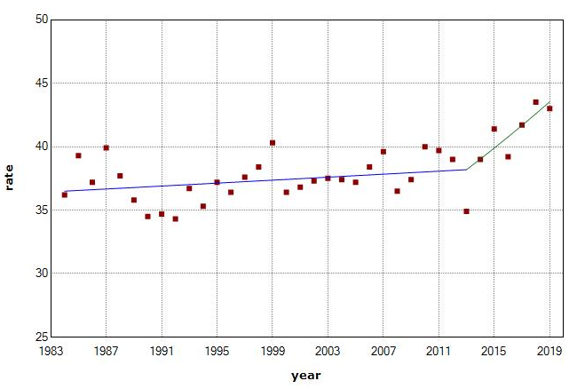
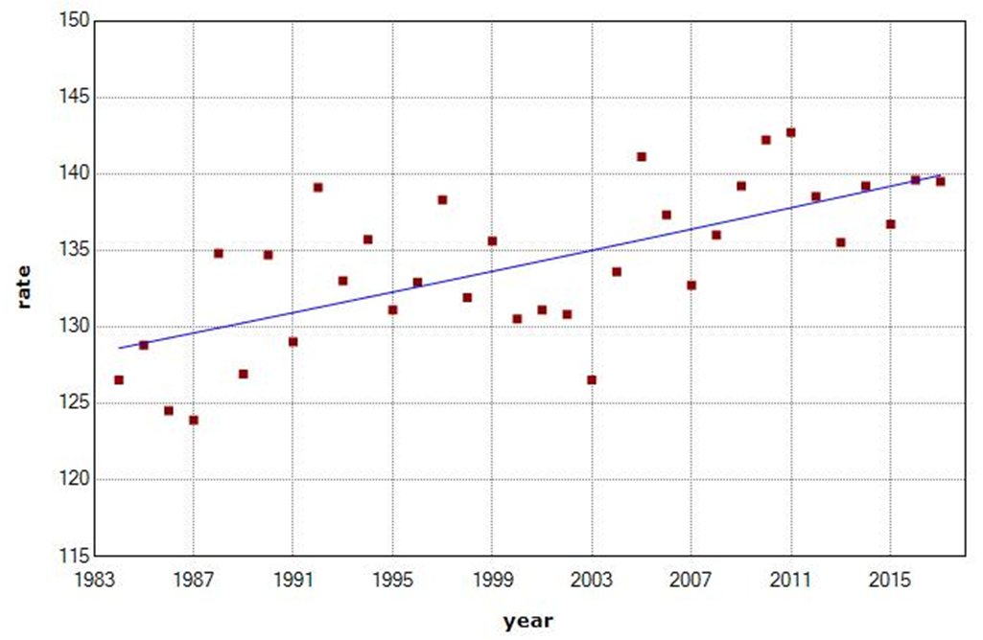

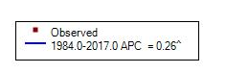
Breast Cancer Incidence in Younger Women is increasing
30’s
40’s

Slide 51
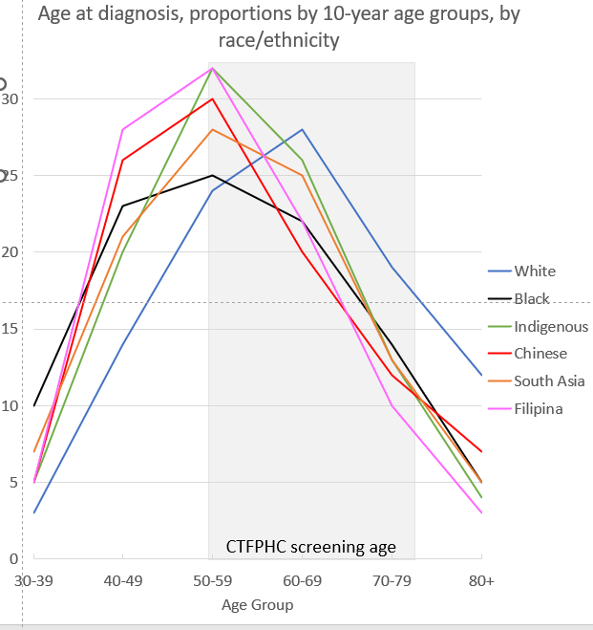
Non-White Women are Diagnosed with Breast Cancer at Younger Ages than White Women
Non-white women have a peak age of diagnosis of breast cancer earlier than 50
Mean age at diagnosis for white women: 62, mean age for non-white: ~55
Mean age at death for non-White women 10 years earlier than white women

Slide 52
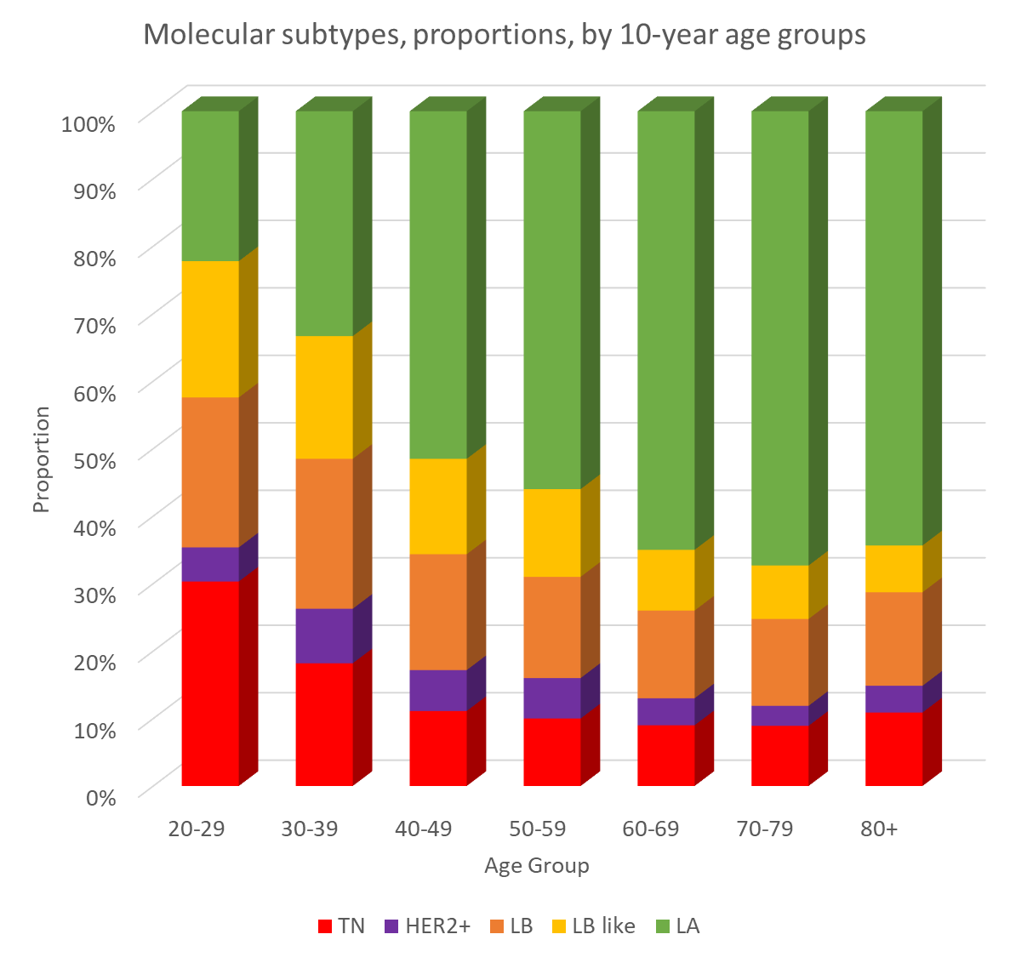
Young
Women Have More Aggressive Subtypes of Breast Cancer
More aggressive subtypes (Triple Negative, Her2+ and Luminal B/B-like) more common in younger women
Luminal A (least aggressive) more common in women older women
Excluded cases with unknown subtype
Source: Canadian Cancer Registry (CCR) 2012-2015, age at diagnosis 20+

Slide 53
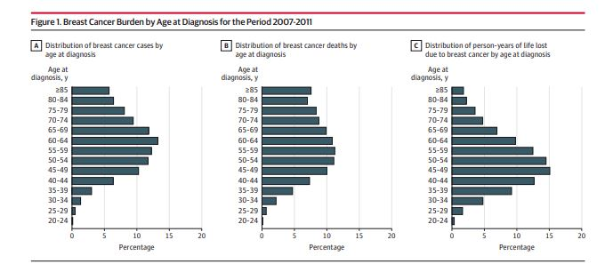
Oeffinger et al. JAMA 2015 https://jamanetwork.com/journals/jama/fullarticle/2463262
Notes:
Bigger impact in term of mortlaity
The incidence of breast cancer beings to rise markedly in the 40s.
The distribution of breast cancer deaths in fact rises most sharply in the ages 45-49. and the peak % of BC deaths is for women 50-54, and 55-59 years.
The distribution of person-years of life lost due to BC by age is highest for women 45-49 years.

Slide 54
Impact of Change in CTF guidelines in 2011
2011 CTF recommended against screening women in 40s:
  Increase later stage disease at diagnosis in 40s and 50s
  10.3% increase in metastatic disease in 50s
Wilkinson, A. N. et al. Curr Oncol 29, 5627-5643
Notes:
In 2011, we have shown a steady increase in the incidence of stage 2 BC in women in their 40s at the same time as a marked decrease in the incidence of stage 1 BC. Whereas the incidence of stage 1 and 2 was almost equal at 50 per 100,000 the gap has increased markedly to 60 per 100,000 stage 2 and 42 per 100,000 stage 1.

Slide 55
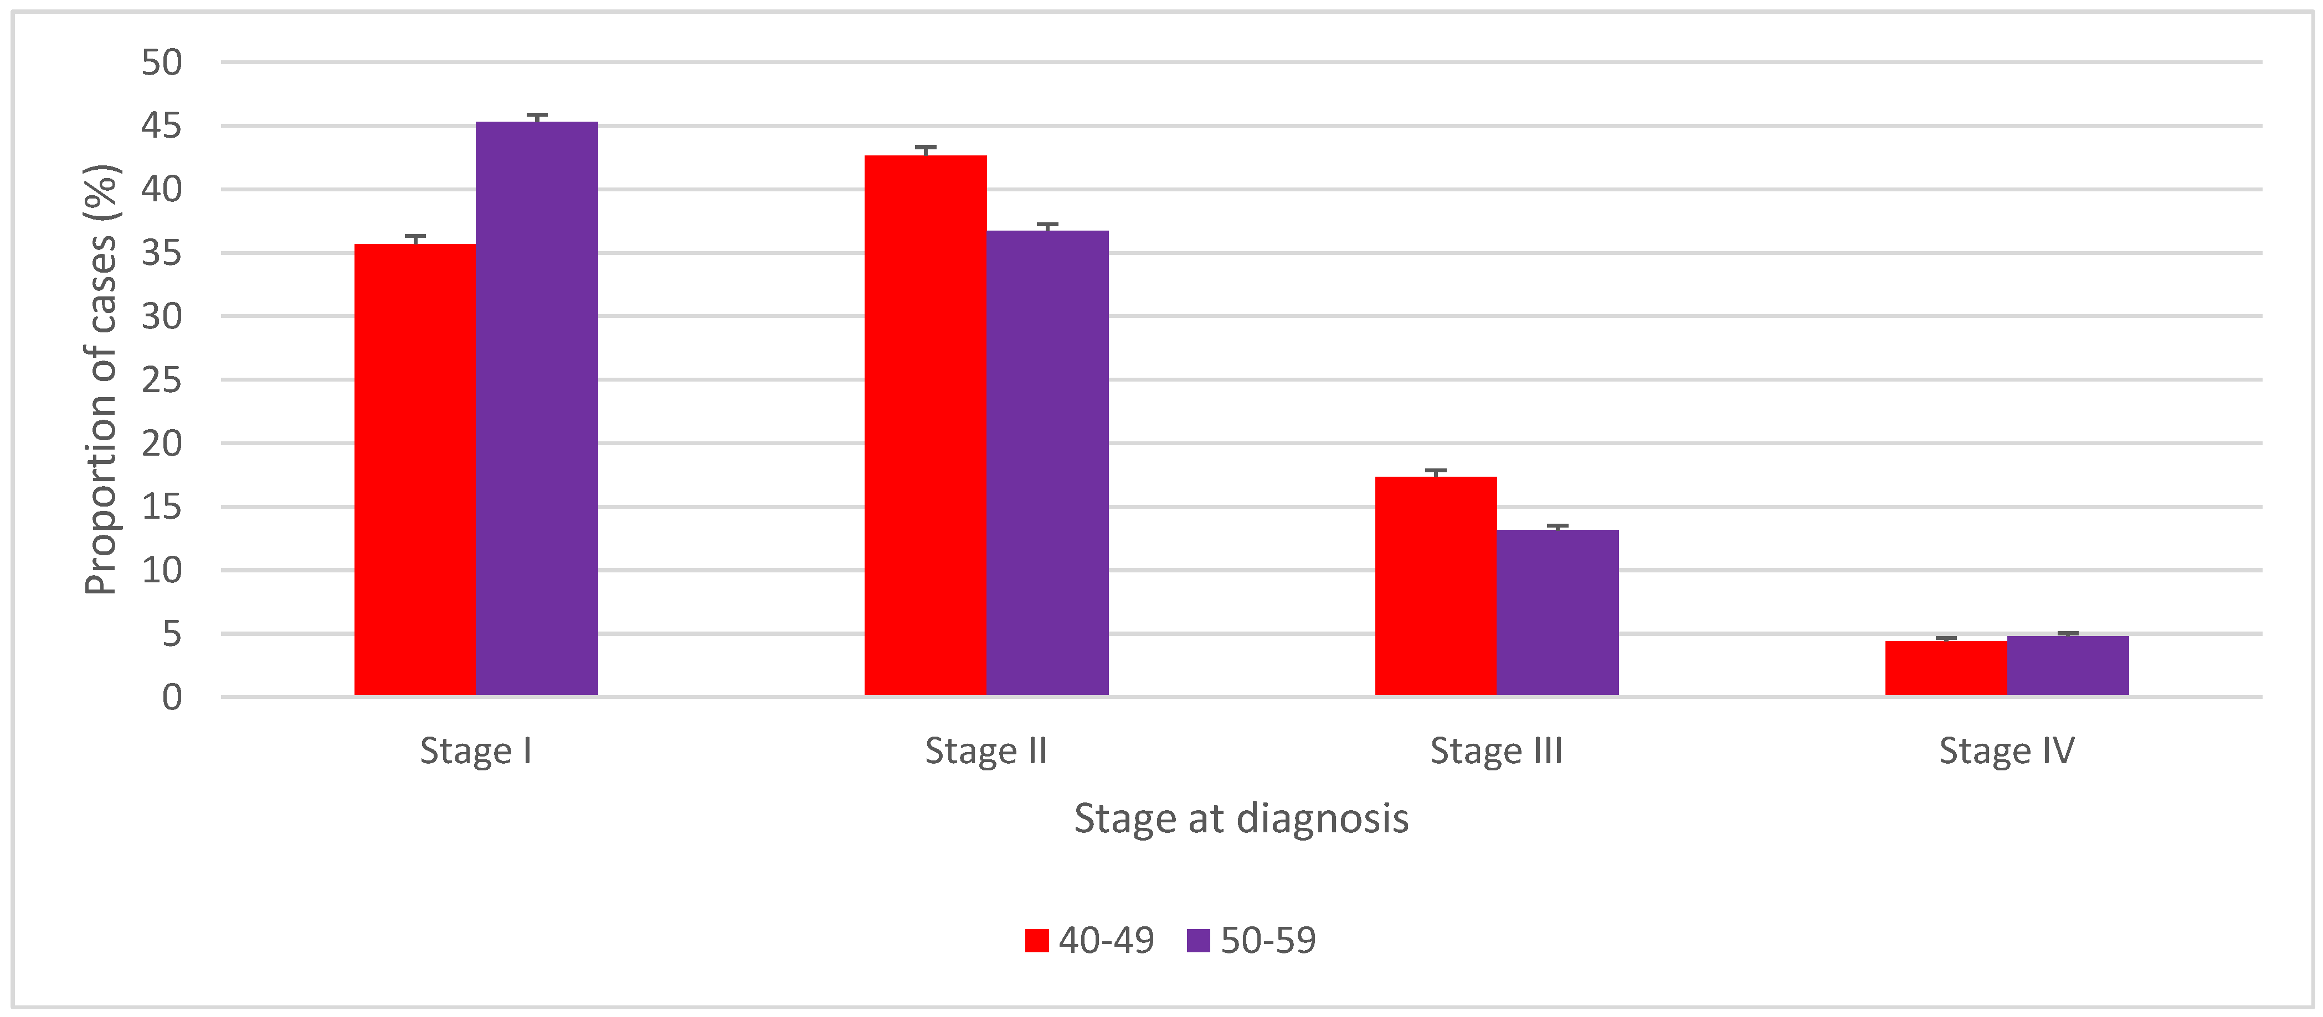
Women in 40s are Diagnosed with Later Stage Breast Cancer than Women in 50s

Slide 56
What happens when there are, or are not, organised screening programs for women 40-49:
1) Women 40-49 and 50-59 are diagnosed with later stage breast cancer if no screening program for 40s
p<0.001
p<0.001
p<0.001
p=0.003
p<0.001
p<0.001
p=0.001
p>0.05
40-49
50-59
Curr. Oncol. 2022, 29, Wilkinson A, …Seely JM

Slide 57
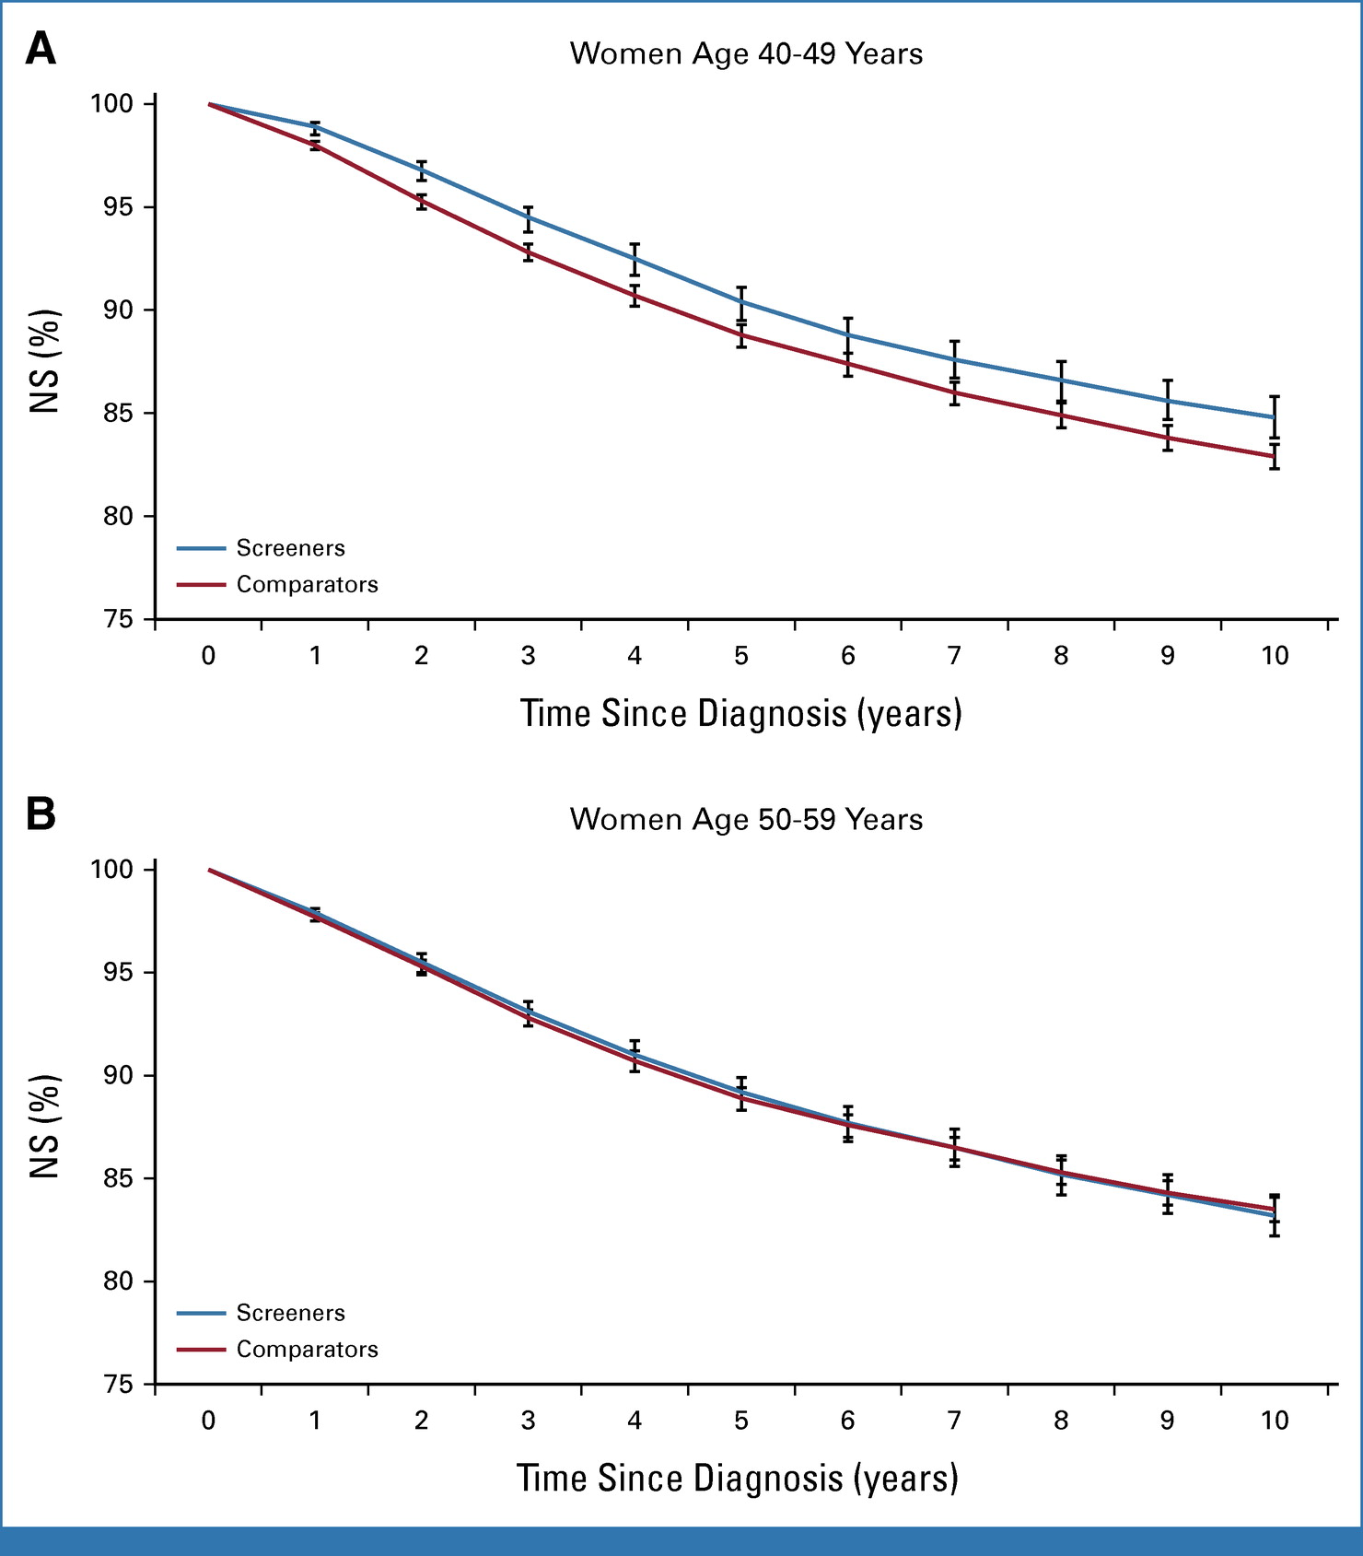
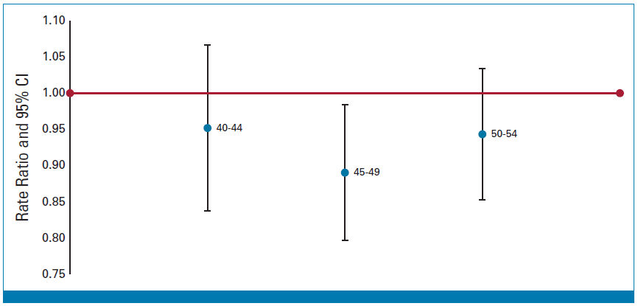
2) Net Survival significantly greater and mortality significantly less for women diagnosed with breast cancer if there is a screening program for 40s

Slide 58
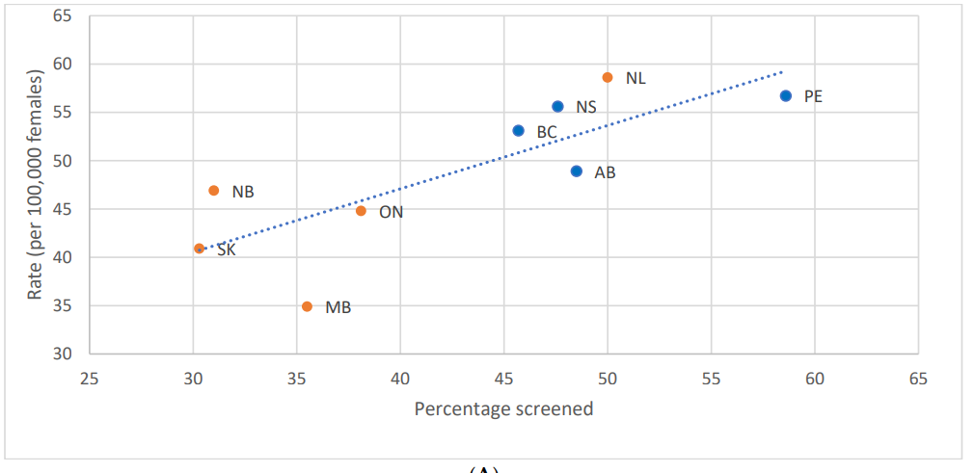
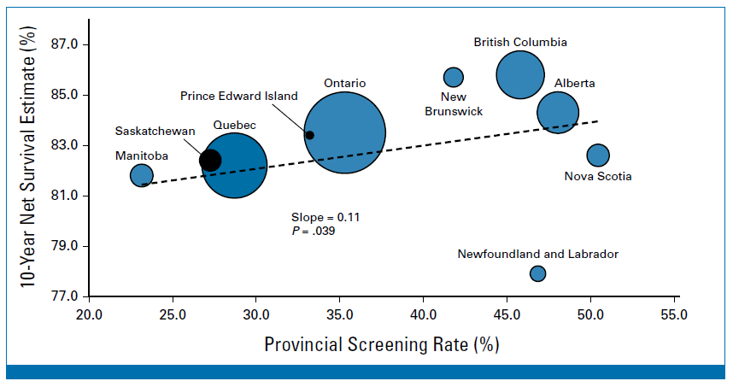
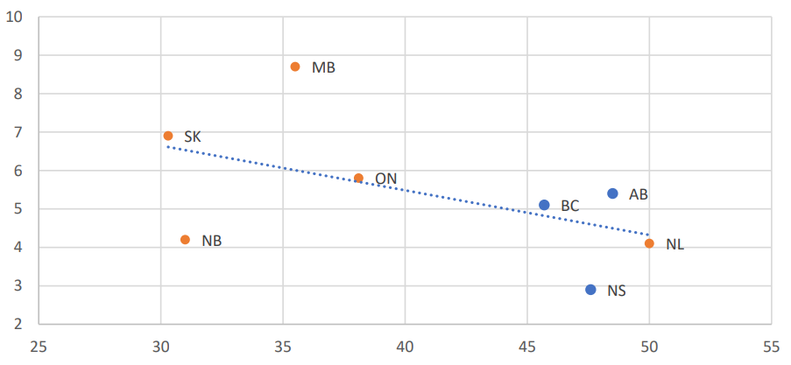
3) Significant correlation between provincial/territorial screening participation rate, stage at diagnosis and net survival
Stage 1
Rate/100,000
Stage 4
40-49 % Screened
Wilkinson AN, Ellison LF, Billette JM, Seely JM. Journal of Clinical Oncology, 2023

Slide 59
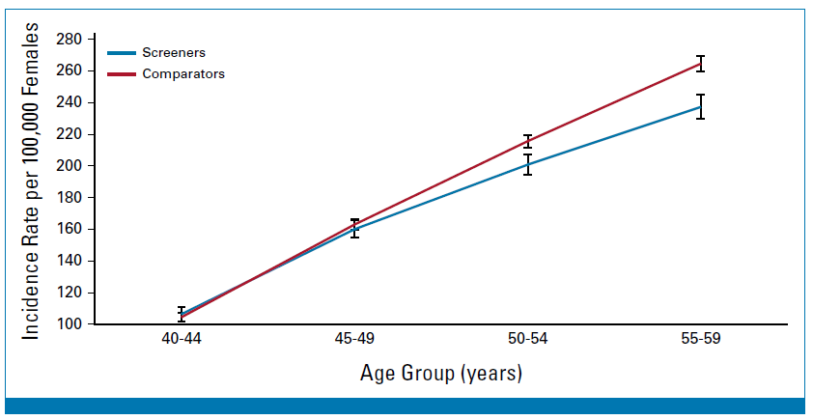
4) Increased breast cancer incidence in women in 50s if they live in a jurisdiction which does not screen in 40s

Slide 60
Screening Recommendations for women 40-49
Discuss risks/benefits and patient preferences. Be aware that:
  Survival is significantly increased in women 40-49 who are screened
  Non-white women are at increased risk for diagnosis at an earlier age
  Overdiagnosis is minimal in women in 40s
  Dense breasts increase risk of breast cancer
  Use IBIS to quantify a patient’s risk
Women in their 40s should be screened annually with mammography
  +/- supplemental screening if dense breasts and IBIS >15%
Ray et al, AJR 2018; 210:264–270

Slide 61
Women >74
Breast screening most jurisdictions until age 74, Quebec until age 69
Women older than 70 represent 31% of breast cancer cases
Breast cancer specific mortality is highest in women over 70
Older women have worse outcomes than younger women with similar diagnoses
Overdiganosis is an important factor in older women who may potentially have multiple co-morbidities.

Slide 62
Screening Recommendations for Women >74
Screening in women >74 should be a discussions weighing risks/benefits with the patient
Screening should only be considered when life expectancy is >10 years
Screen with mammogram q2 years

Slide 63
Which of the following statements is true?
A. Screening mammography for a woman in her 40s should only be done if she has a positive family history of breast cancer
B. Breast tissue density is a risk factor for breast cancer that is equivalent to having a first degree relative with breast cancer
C. Most patients who develop breast cancer have a family history of breast cancer
D. Stopping screening mammography is recommended if life expectancy is < 15 years

Slide 64
Will you inform your patient about their breast tissue density?
A. Yes
B. No

Slide 65
Will you recommend screening mammography for women in their 40s?
  A. Yes
  B. No
  C. Only if they have a positive family history of breast cancer

Slide 66
How many cancers are detected by mammography in extremely dense breast tissue (ACR D)?
A. 25%
B. 50%
C. 75%
D. 85%

Slide 67
How many women who get breast cancer have a family history of breast cancer?
A. 5%
B. 10%
C. 20%
D. 50%
E. 75%

Slide 68
The breast cancer-specific mortality rate is highest in women aged:
A. 40-49
B. 50-59
C. 60-74
D. >74

Slide 69
Questions?

