Slide 1
Title Slide
Pandemic Lessons for the Family Doctor
Dr. Magbule Doko, MD, CCFP
November 11, 2023

Slide 2
COI – Presenter Disclosure (1)
Presenter Disclosure
Presenter: Dr. Magbule Doko
Relationships with financial sponsors:
Any direct financial relationships, including receipt of honoraria: OCFP, CJDX
Membership on advisory boards or speakers’ bureaus: None
Patents for drugs or devices: None
Other: None
Notes:
Where a faculty/presenter has no relationships to disclose, indicate Not Applicable under Relationships with Financial Sponsors.
Complete this slide for the primary presenter and ALL co-presenters if applicable.
Reminder: Disclosures made on your COI forms should match disclosures made on the COI slide.

Slide 3
COI – Presenter Disclosure (2)
Disclosure of Financial Support
This program has not received financial support from any organization.
This program has not received in-kind support from any organization.
Potential for conflict(s) of interest:
Dr. Magbule Doko has received complimentary FMF registration for the day of the presentation from CFPC.
No products will be discussed in this program. I have no affiliation with any medical products.
Notes:
Where a program has received no external financial support (e.g., monies for food, logistics assistance such as registration, AV set-up, etc.), indicate No External Support.

Slide 4
Mitigating Potential Bias
The FMF Committee has mitigated the bias for this presentation as follows:
Presenter agrees to adhere to all Mainpro+ and National Standards
Presenter has received the COI Quick Tips document
Presenter agrees to present only evidence-based content or declare otherwise
Presenter agrees to refrain from using brand names wherever possible
Presenter agrees to include COI slides and verbal mention in each presentation
Notes:
ATTENTION: This slide must be visually presented to the audience AND verbalized by the speaker before the presentation starts.

Slide 5
Learning Objectives
Upon completion, participants will be able to…
Examine how the pandemic changed family medicine
List ways to continue integrating virtual care in your family practice
Prepare your family practice for future pandemics

Slide 6
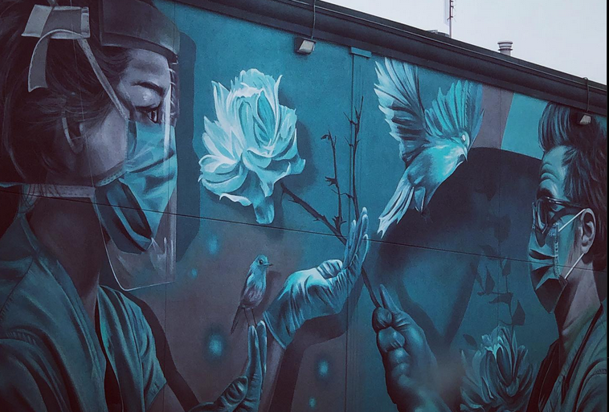
Make a List
Make a list of how you think Family Medicine has changed since the COVID Pandemic
You can compare your list to points in this talk
Feel free to share your points at the end of the talk

Slide 7
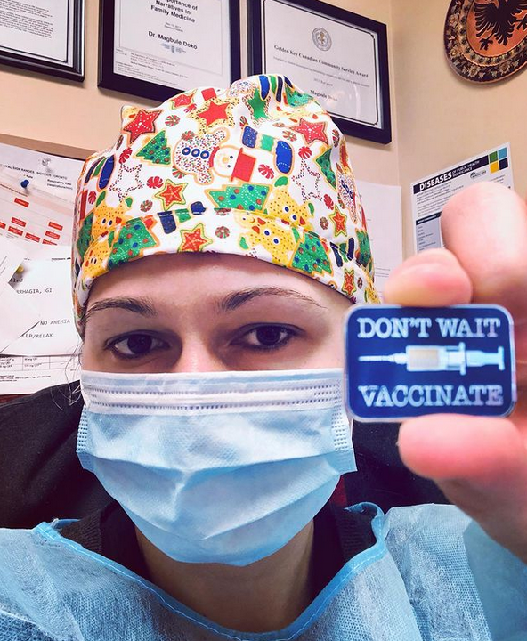
My Story as a Family Doctor during the Pandemic
March 2020
Fear
How to change over to virtual care in quick way
What should be seen in-person
How to protect myself, staff, and patients

Slide 8
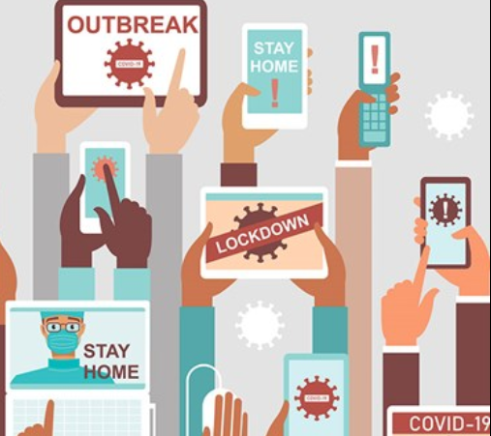
Uncertainty in early Pandemic days
Fear
… of the unknown
… of contracting the virus
… how long will this go on
… will there be a vaccine
… when will there be a vaccine
…will I bring it home to my family

Slide 9
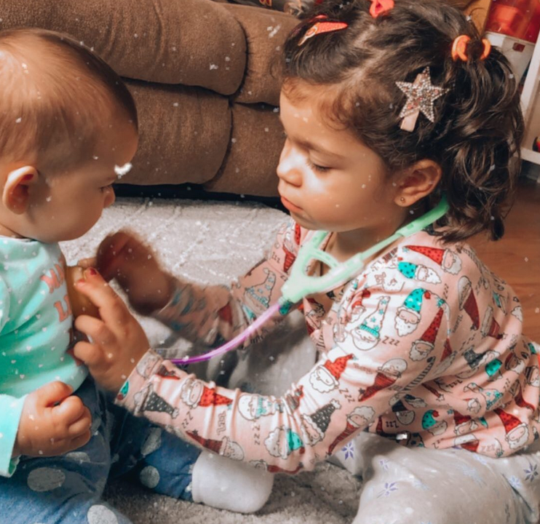
Integrating Virtual Care
Virtual care
Telephone
Video
had to start quickly – Logistics
Email
Cell line
Texts
Remote Access
Fax line
Uncertainty
Diagnosing and treating virtually

Slide 10
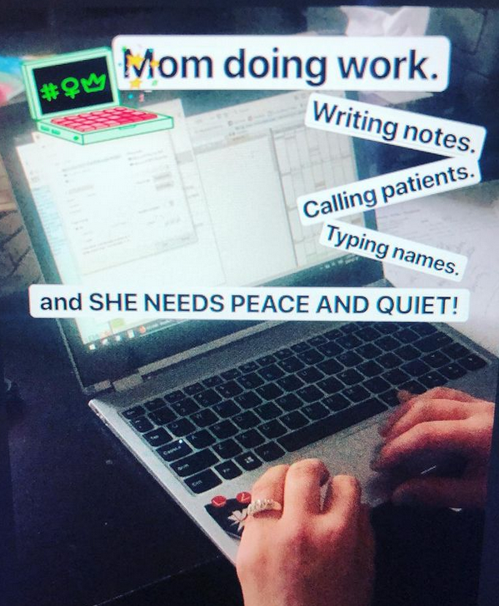
Calling patients from Home

Slide 11
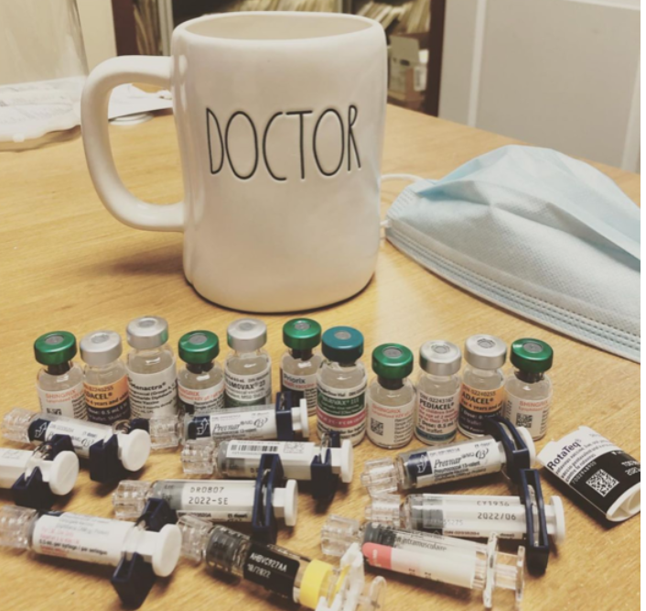
Essential In-Person Visits
In-person visits
Had to decide what was essential?
Well-Baby?
Paps?
Acute symptoms of concern?
Vaccines?

Slide 12
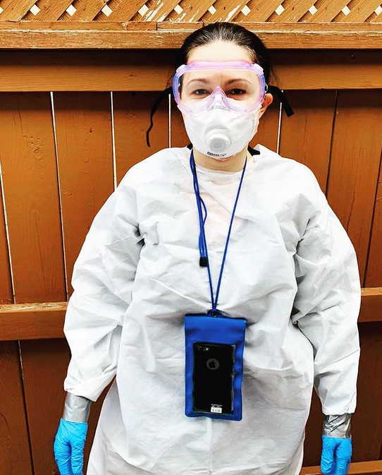
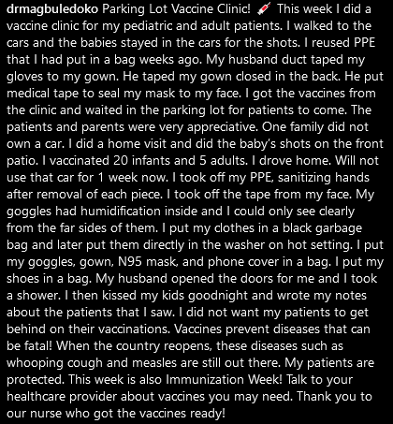
Essential In-Person Visits

Slide 13
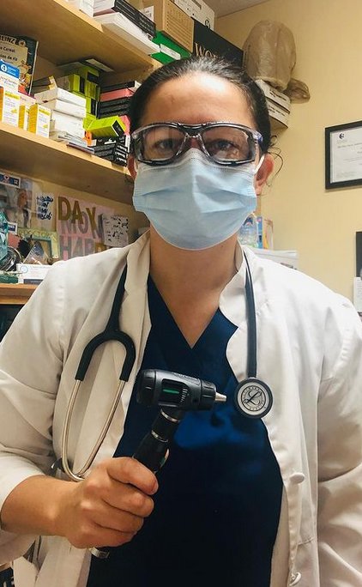
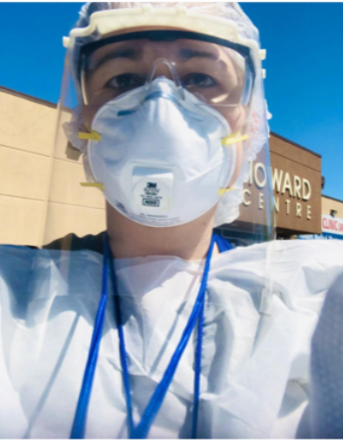
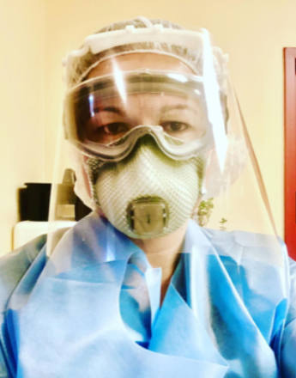
Essential In-Person Visits

Slide 14
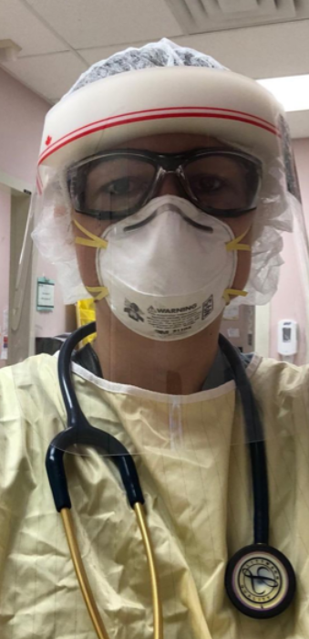
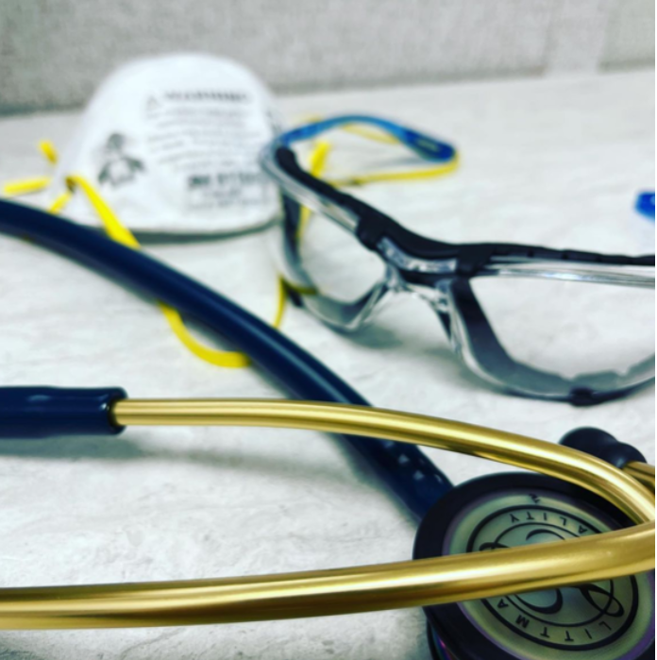
Personal Protective Equipment
PPE
Hard to find
Had to use expired
Had to reuse
Supply
Had to order online

Slide 15
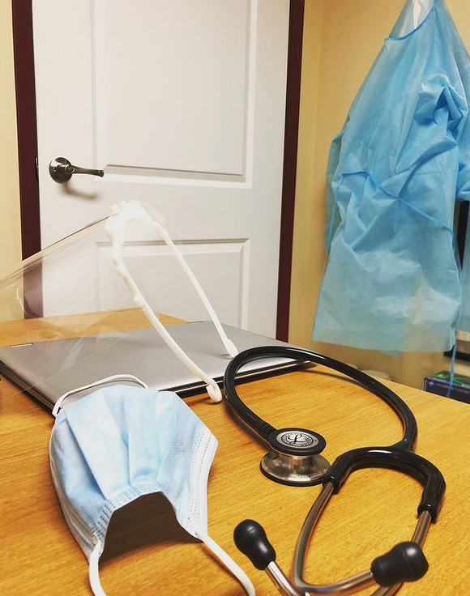
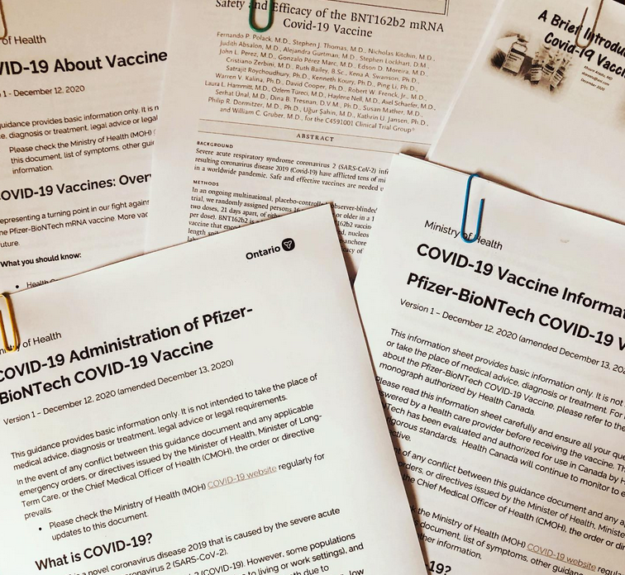
During the Pandemic
How did I continue to serve my patients?

Slide 16
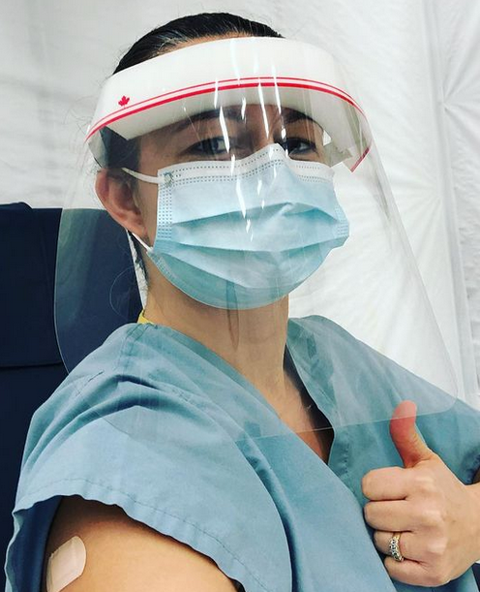
Work during the Pandemic
Parking Lot Vaccine Clinics
Childhood vaccines – kept all my patients up to date
Adult vaccines
Telephone Visits
Patients could Email or Text their concerns
Preventative screening
Calling lists

Slide 17
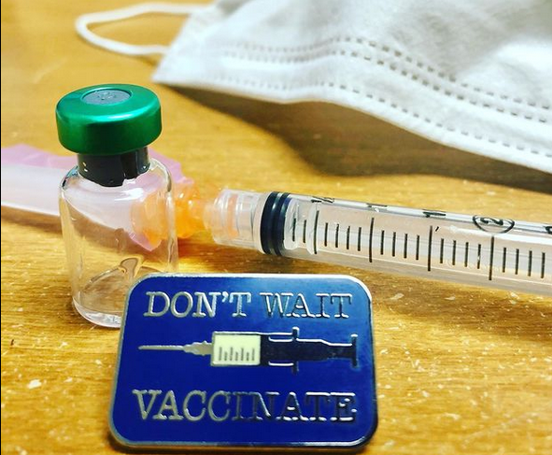
Keeping patients up to date
Vaccinations
COVID Vaccination – once available called to inform
Pap screening
Mammogram screening
FIT testing
Colonoscopy screening

Slide 18
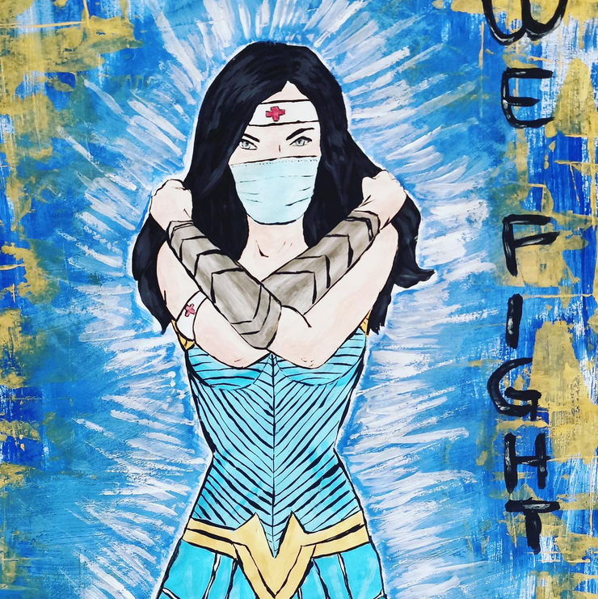
How could I extend my role in my Community
Had urge to help and keep moving forward
I took on new roles to help my community through the Pandemic

Slide 19
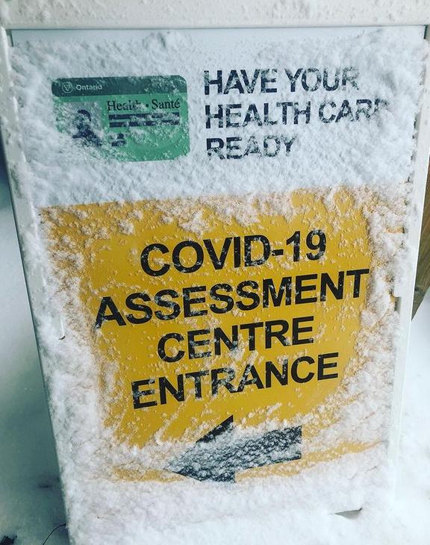
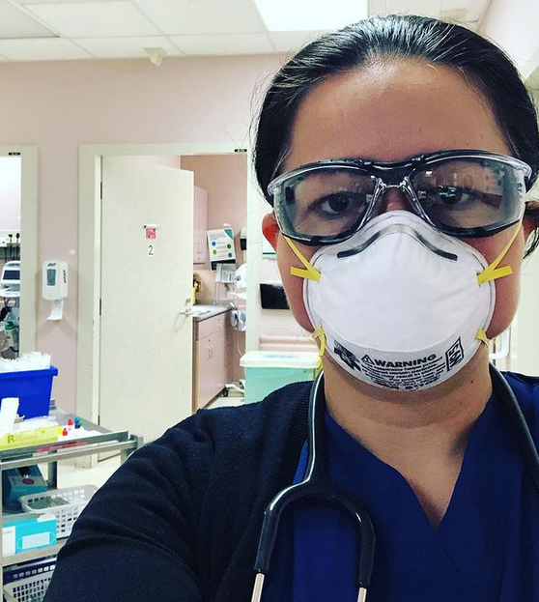
Working in COVID Assessment Centres
Adult & Pediatric Covid Assessment Centres
Required Hospital Privileges

Slide 20
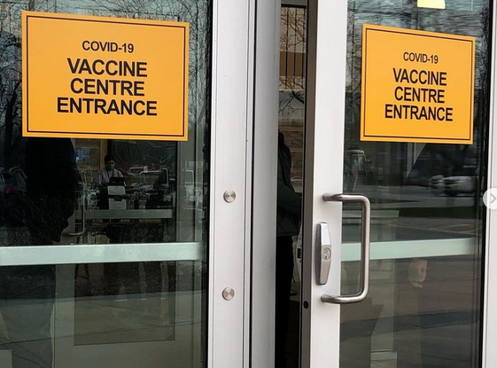
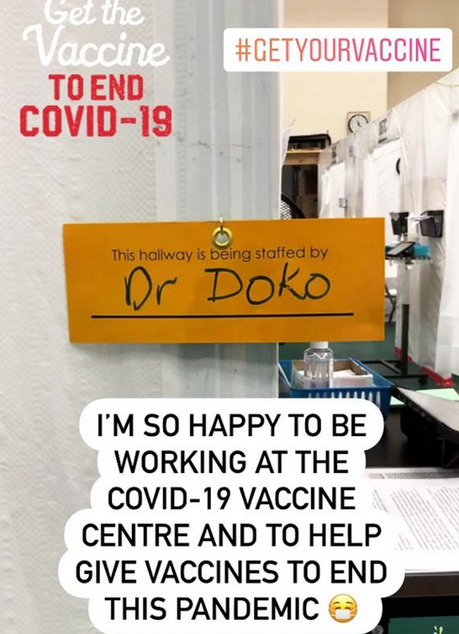
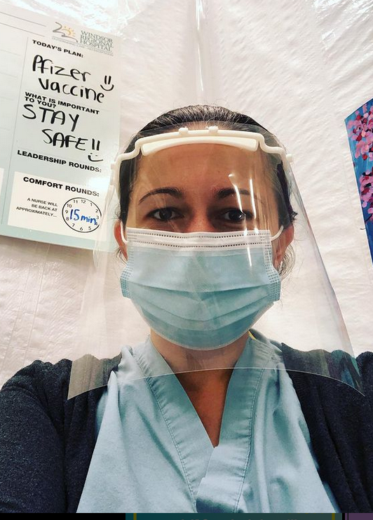
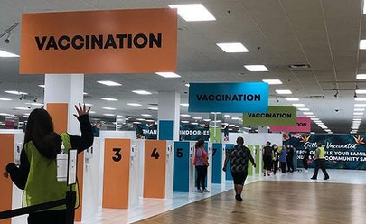
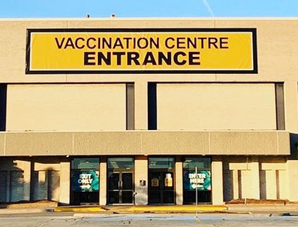
Working in COVID Vaccination Centres

Slide 21
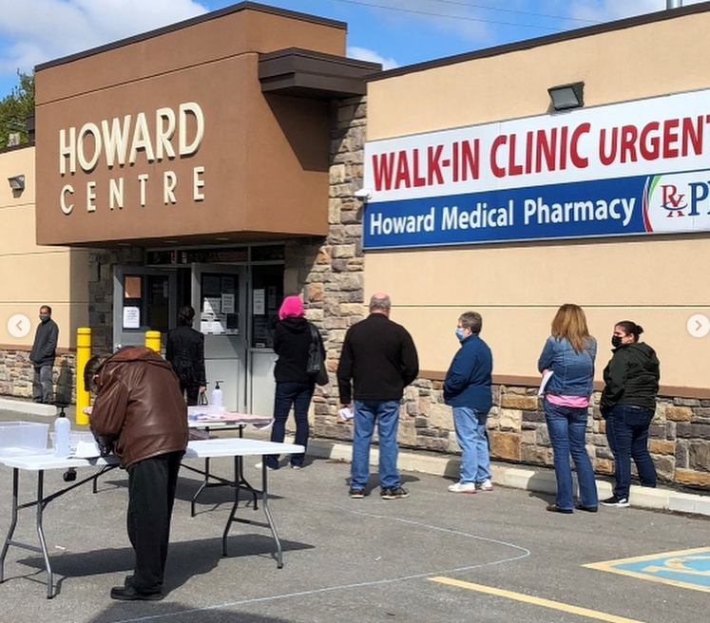
COVID Vaccine Pop-Up Clinics
Over 40 pop-up clinics
Including a Kids 5-11 Pop-up & 2 off-site Pop-ups for underserviced areas in our city
Over 6000 Vaccines Administered
Notes:
Blank Slide Template

Slide 22
COVID Vaccine Pop-Up Clinics
Notes:
Blank Slide Template

Slide 23
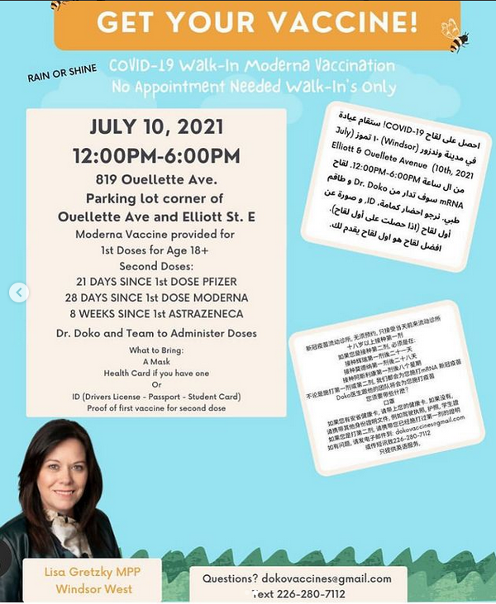
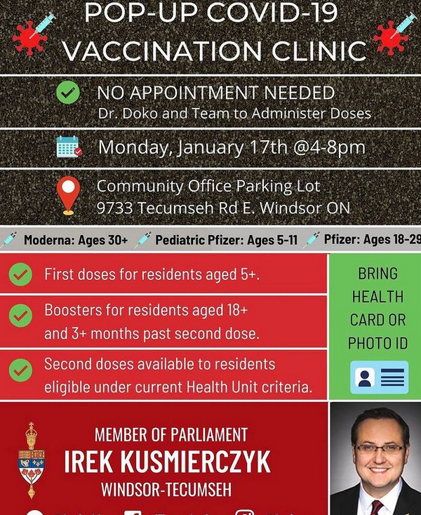
COVID Vaccine Pop-Up Clinics
Notes:
Blank Slide Template

Slide 24
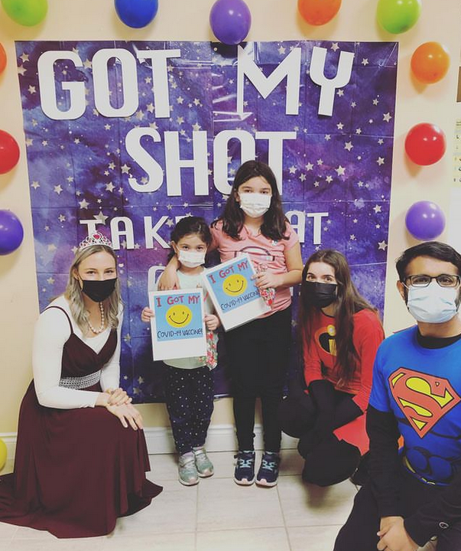
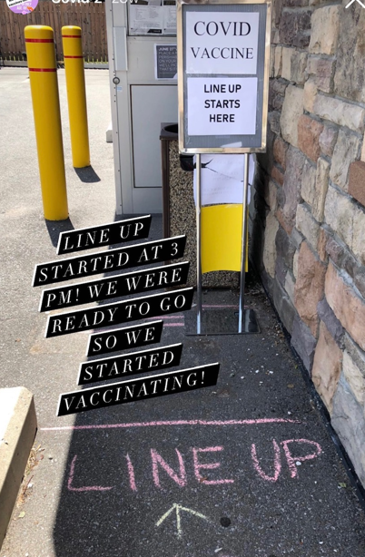
Notes:
Blank Slide Template

Slide 25
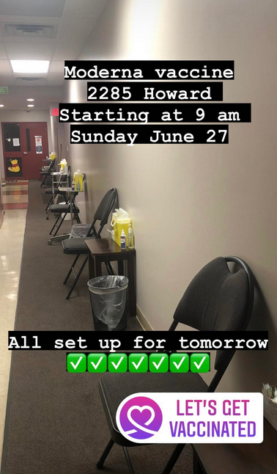
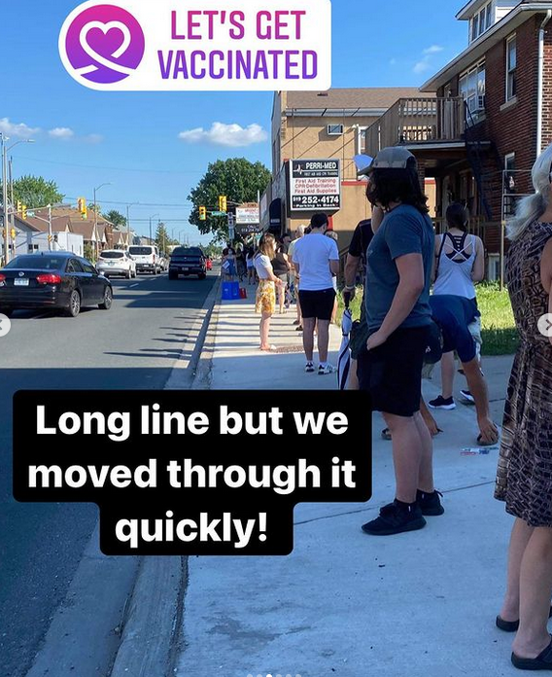
Notes:
Blank Slide Template

Slide 26
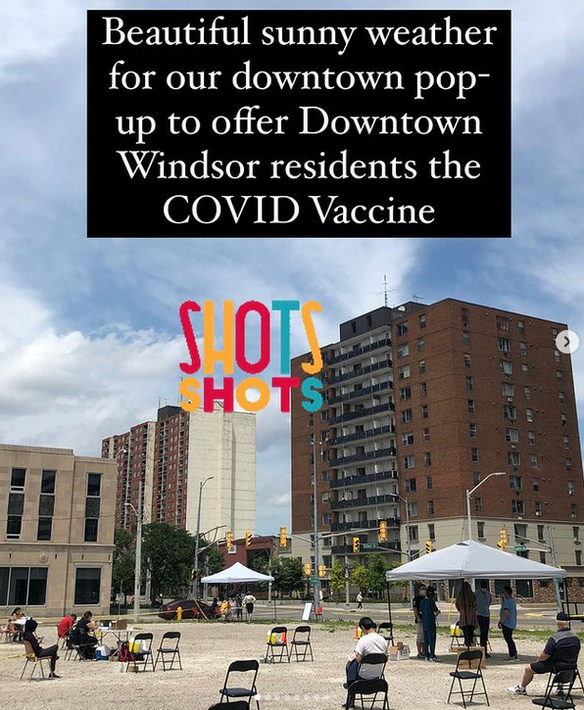
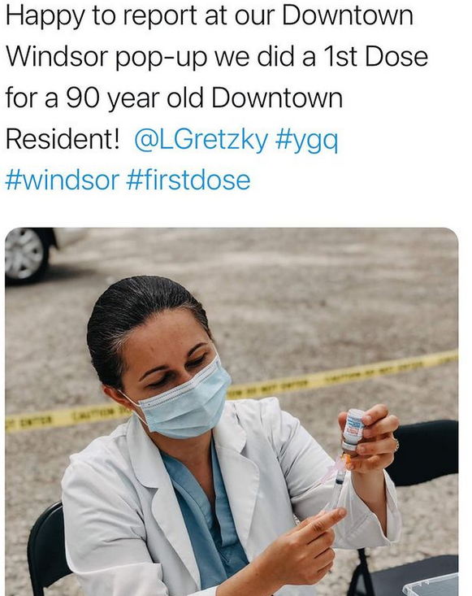
Notes:
Blank Slide Template

Slide 27
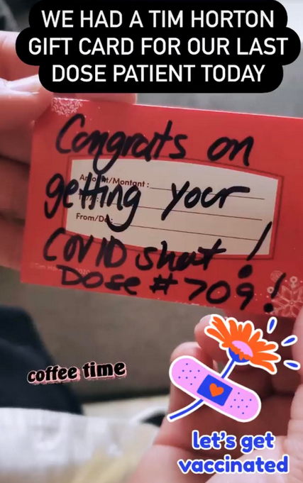
Notes:
Blank Slide Template

Slide 28
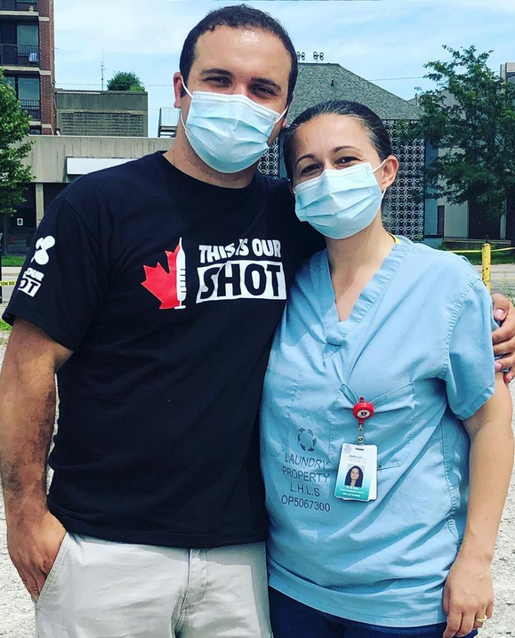
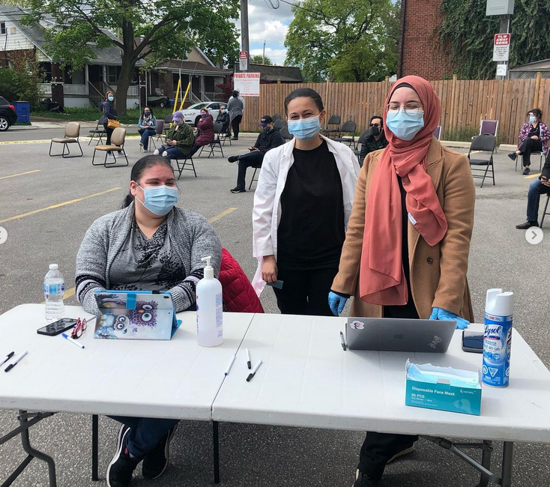
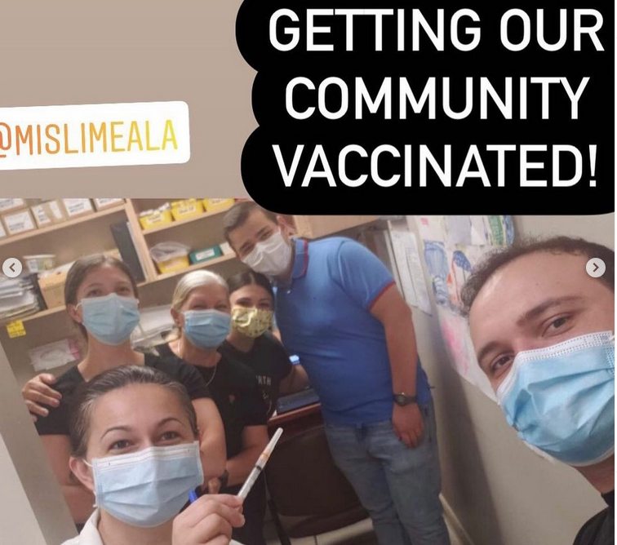
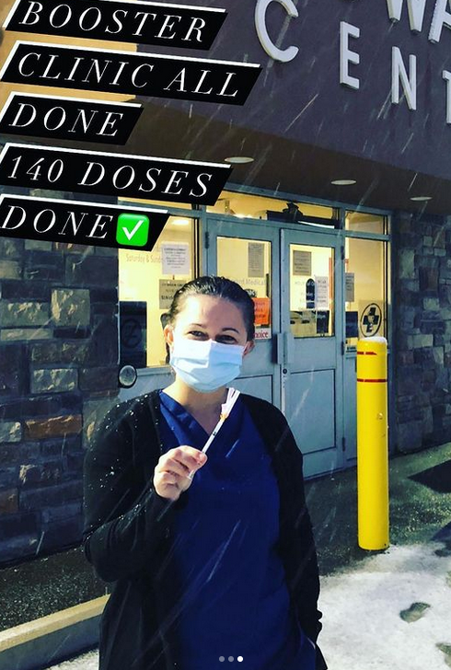
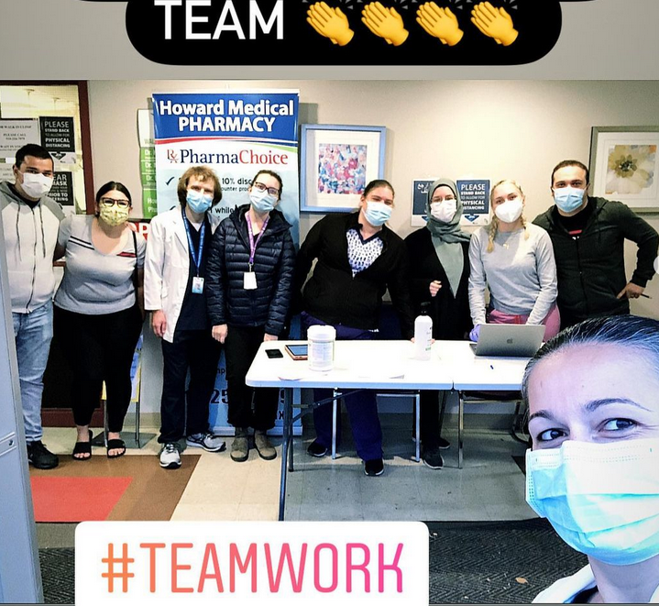
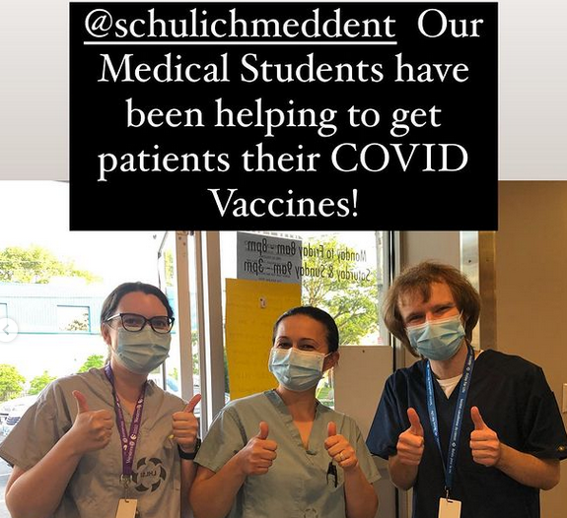
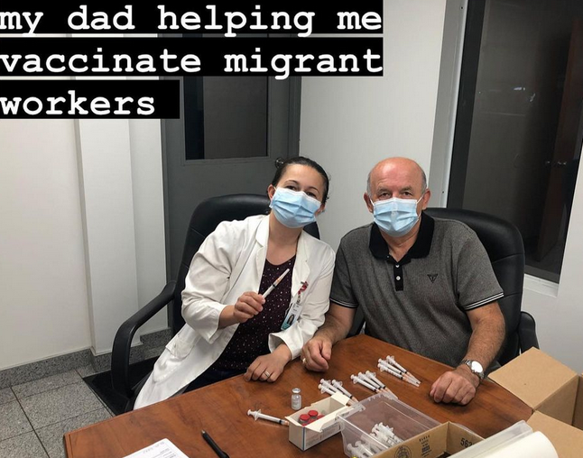
Notes:
Blank Slide Template

Slide 29
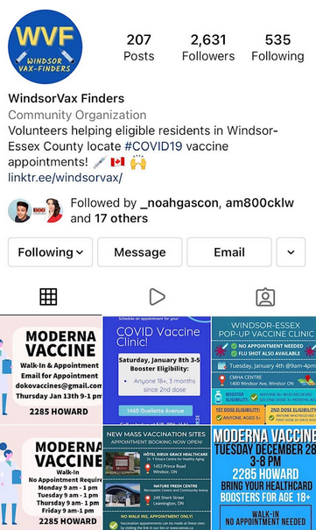
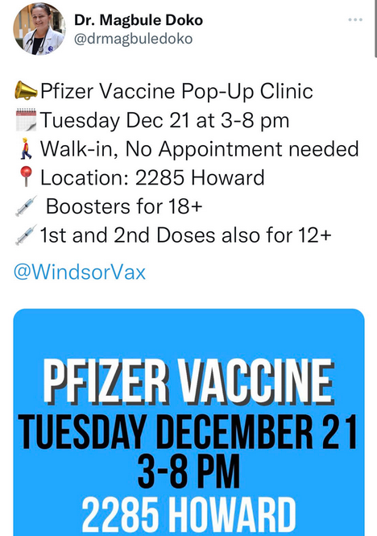
Notes:
Blank Slide Template

Slide 30
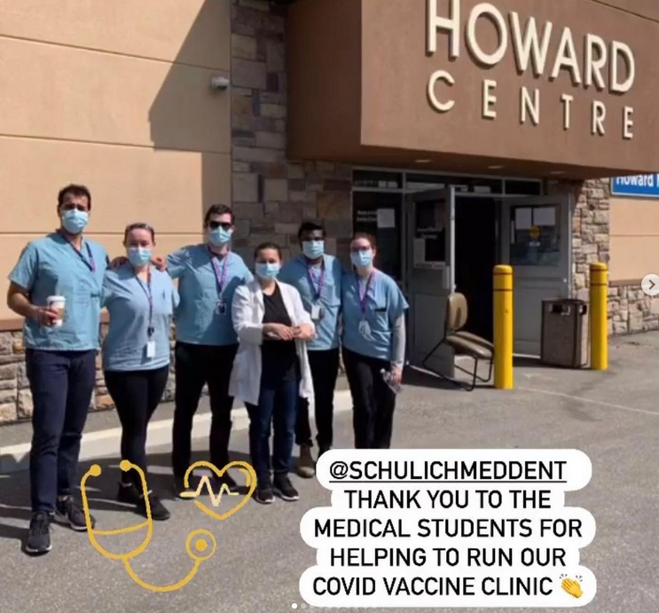
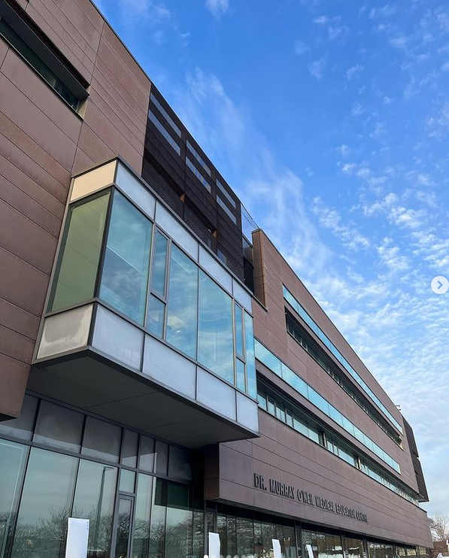
Teaching Medical Students

Slide 31
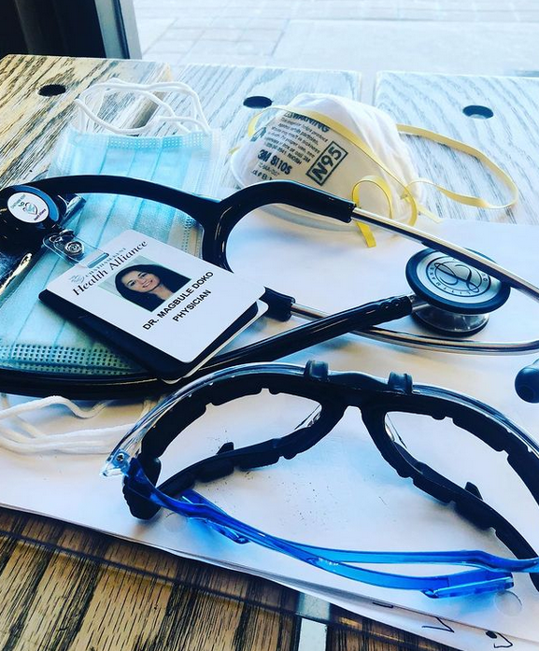
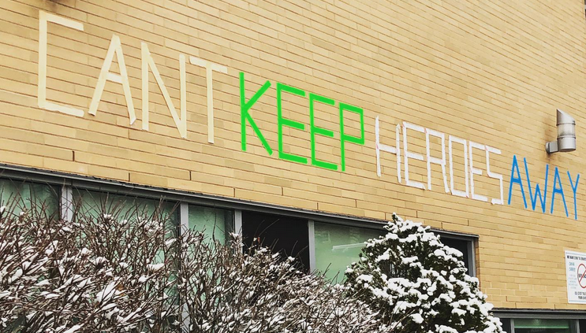
Working in Hospital
Need for physicians
24 hour COVID shift
Weekend work

Slide 32
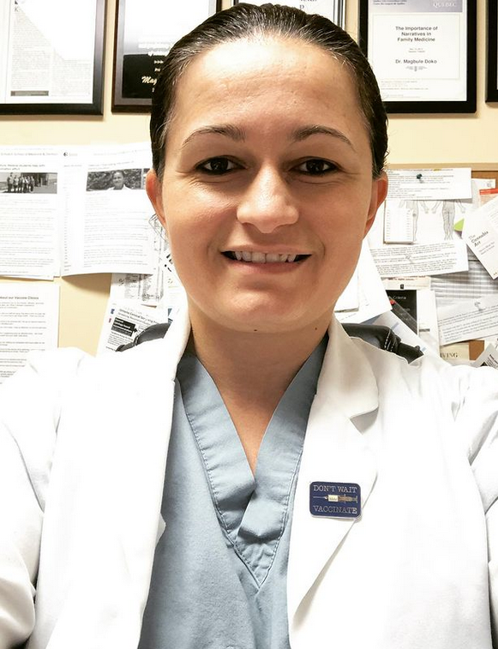
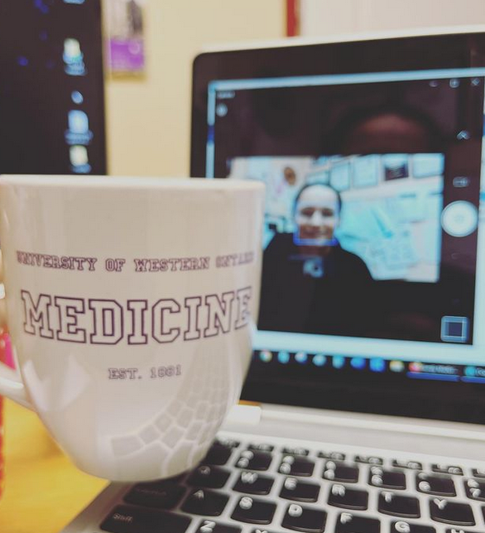
Online Interviewer & Examiner
Online interview for:
Medical school admissions
Family Medicine Residency interviews
Family Medicine CFPC Examiner

Slide 33
COVID PCR & Respiratory Virus Testing at our office
We had viral swabs
We could do testing for patients that were no longer eligible at COVID Centres
We followed up by telephone

Slide 34
Family Medicine work
During this time, I was still doing my Family Medicine work
Telephone visits
Essential in-person visits
Sick visits (cough/cold) – I would see at the car in parking lot
Offered Flu Shot clinics

Slide 35
As the Pandemic continued…
Ministry of Health offered guidelines to allowing more in-person visits
We offered more in-person visits for patients that screened negative for COVID
If screened positive then we would see them in hallway or at car
Then eventually, would see inside clinic with mandatory masking continued for all patients and staff
Transition during pandemic from full PPE -> N95 -> surgical mask

Slide 36
How did the Pandemic change Family Medicine?
Be even more comfortable with uncertainty
Virtual care integrated into patient care
Fear & Stress management
Online Learning, Meetings,
Interviews, Examinations
Expand Roles

Slide 37
Continue Integrating Virtual Care into your Family Practice
If you decide to continue to integrate it …
Patient may be nervous to come in clinic – anxiety or anxiety re contracting illness/COVID
Patient requests a virtual appointment
It may be your preferred method to contact patient for something that does not require in-person visit (ex. Med refills, lab result, mental health)
Use it to contact patient with an urgent result
Use it for close follow-up about a medical issue

Slide 38
Continue Integrating Virtual Care into your Family Practice
Scheduling
Pre-booked appointments
Cold calling
Before shift, during, or at end of shift
Call from office or use Cell line from home
Find balance that works for you

Slide 39
Continue Integrating Virtual Care into your Family Practice
Virtual Care in my practice:
All calls from office
In AM, through shift, and most at end of shift
Wed AM shift I will also catch up on calls
Cold calling
Med refills, lab results, diagnostic results, consult reviews
Will call something urgent that a patient leaves message with secretary
Still call my preventative care lists (divide work with secretary)
Will continue for now

Slide 40
Prepare your Family Practice for Future Pandemics
Stock up PPE
Remote Access – How could you go Remote quickly if required
Notes:
Blank Slide Template

Slide 41
Prepare your Family Practice for Future Pandemics
Monitor your own physical and mental health
Avoid burnout
Be resilient and be hopeful
Notes:
Blank Slide Template

Slide 42
Prepare your Family Practice for Future Pandemics
Reflect back on the COVID Pandemic
What can you do different in the event of future pandemics
Notes:
Blank Slide Template

Slide 43
Back to your List…
List of how you think Family Medicine has changed since the COVID Pandemic
Feel free to share your points

Slide 44
Closing Slide
Thank you!
Please fill out your session evaluation now!
#myfmf
FamilyMedicineForum
FamilyMedForum
FamilyMedForum

