Slide 1
Tips and Tricks to Expedite Cancer Diagnosis
Anna N. Wilkinson, MSc., MD, CCFP, FCFP
Associate Professor, University of Ottawa, Department of Family Medicine
Family Physician, The Ottawa Academic Family Health Team
GP Oncologist, The Ottawa Hospital Cancer Centre
Program Director, PGY-3 FP-Oncology
Regional Cancer Primary Care Lead for the Champlain Regional Cancer Program
Notes:
FP and GPO
Step 1 6:30
Step 2 14:30
Step 3 17:30
Step 4 24:55
Step 5 32:00
Step 6 42:30

Slide 2
Faculty/Presenter Disclosure
Faculty: Anna Wilkinson
Relationships with financial sponsors:
CFPC Grant for Breast Cancer Survivorship Tool/Oncology Briefs
Regional Cancer Primary Care Lead- Stipend
Consultant for Thrive Health
Canadian Breast Cancer Network- Honoraria

Slide 3
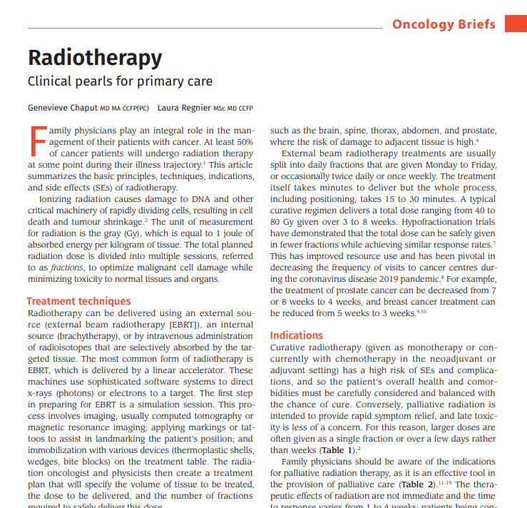
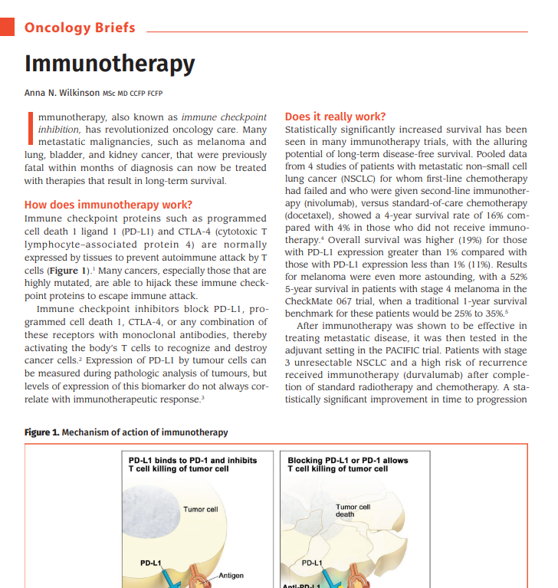
Oncology Briefs…..

Slide 4
6 Steps to Diagnosis of a Cancer
History
Initial Investig-ations
Staging
Physical Exam
Biopsy
General Health
Notes:
diagnose on average 1 cancer a month, but see many more patients with symptoms that might be cancer.
-need an approach to w/u cancer, to determine who should be investigated, avoid uncessary investigations, expedite diagnostic interval, dec risk of fracturing physician relationship when needed most,
-11% cancers dx Er
By following these 6 steps, you’ll get your patients diagnosed and into treatment sooner, preserving the doctor physician relationship at a time when its most needed. Most importantly, as time elapses, cancer progresses, so diagnosing cancer expeditiously means lower stage disease, with the very real outcome of improved survival.

Slide 5
Diagnostic Interval
Kanguru, L., Bikker, A., Cavers, D., Barnett, K., Brewster, D. H., Weller, D., & Campbell, C. (2017). Pathways to diagnosis of a second primary cancer: Protocol for a mixed-methods systematic review. BMJ open, 7(12).
Notes:
40% pts have cancer
30% die from cancer
-Fp’s dx most cancers. Av 1/month, but see many more pts with poss sx than that.
#relationship
Reduce anxiety
Real outcomes- Decreased diagnostic interval = earlier treatment and sig reduction in anxiety
Diagnostic interval: time from first clinical presentation -> first specialist visit.

Slide 6
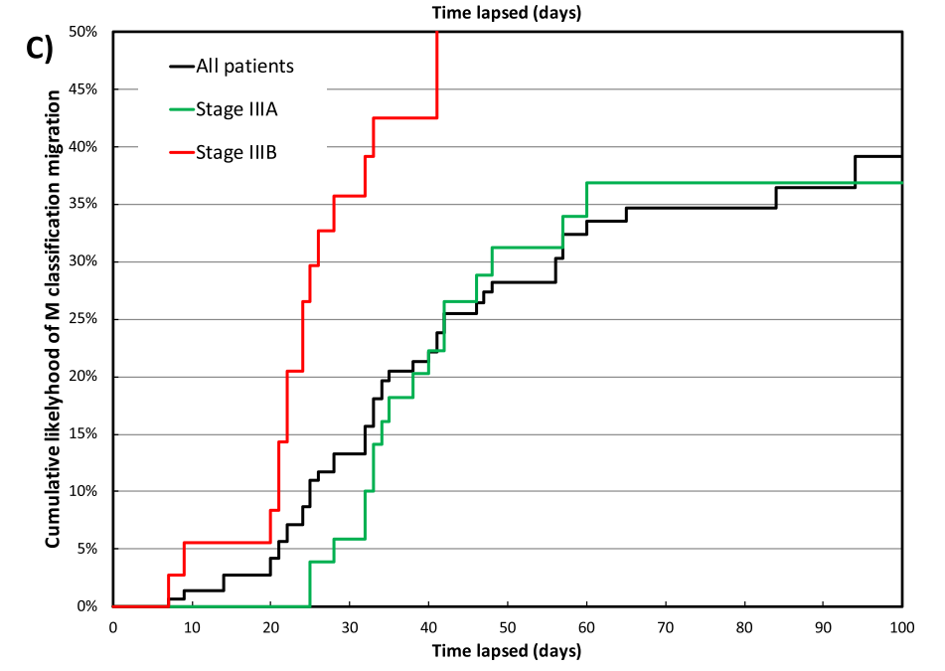
Time matters
Development of metastatic disease during interval between diagnosis and treatment start measured by PET
Bissonnette, J. P., Sun, A., Grills, I. S., Almahariq, M. F., Geiger, G., Vogel, W., ... & Mac Manus, M. (2021). Non-small cell lung cancer stage migration as a function of wait times from diagnostic imaging: a pooled analysis from five international centres. Lung Cancer.
Notes:
Stage 3B- 0% metastatic, by 40 days, 50% metastatic,
Decreased diagnostic interval = earlier treatment and sig reduction in anxiety.
Downstaging and survival benfi

Slide 7
What Patients want:
Take concerns seriously
Urgency
Advocacy
Knowing when to refer

Slide 8
Step 1. History
History
Initial Investigations
Staging
Physical Exam
Biopsy
General Health
Am I worried about this person?
Notes:
The hardest part about being a family doctor is knowing when you need to work someone up and when you don’t need to.
Who to work up??
Conserve resources
Incidental findings.

Slide 9
History
Establish “risk” of having malignancy
Red flags
Beware the “low-risk-but-not-no-risk”
Stratify risk with:
Obviously concerning symptoms
Re-presentation with same symptoms
Multiple symptoms concurrently
Family and personal medical history
Smoking, EtOH
Hamilton, W. (2010). Cancer diagnosis in primary care. British Journal of General Practice, 60(571), 121-128.
Del Giudice, M. E., Vella, E. T., Hey, A., Simunovic, M., Harris, W., & Levitt, C. (2014). Systematic review of clinical features of suspected colorectal cancer in primary care. Canadian Family Physician, 60(8), e405-e415.
Notes:
It all starts with the history. Some concerns obviously need work up, but it’s the low risk, but not no risk symptoms that are the most difficult to triage. Vague symptoms like abdominal pain and fatigue are challenging. Use your knowledge of the patient, including smoking, family history and other medical issues to help. Listen for red flags, like weight loss and systemic symptoms
Stratify risk

Slide 10
Yellow: PPV >1% Orange: PPV>2% Red: PPV>5% (20 fold risk of cancer diagnosis)
Hamilton, W. (2009). The CAPER studies: five case-control studies aimed at identifying and quantifying the risk of cancer in symptomatic primary care patients. British journal of cancer, 101(S2), S80-S86.
Notes:
Multiple sx give higher ppv.

Slide 11
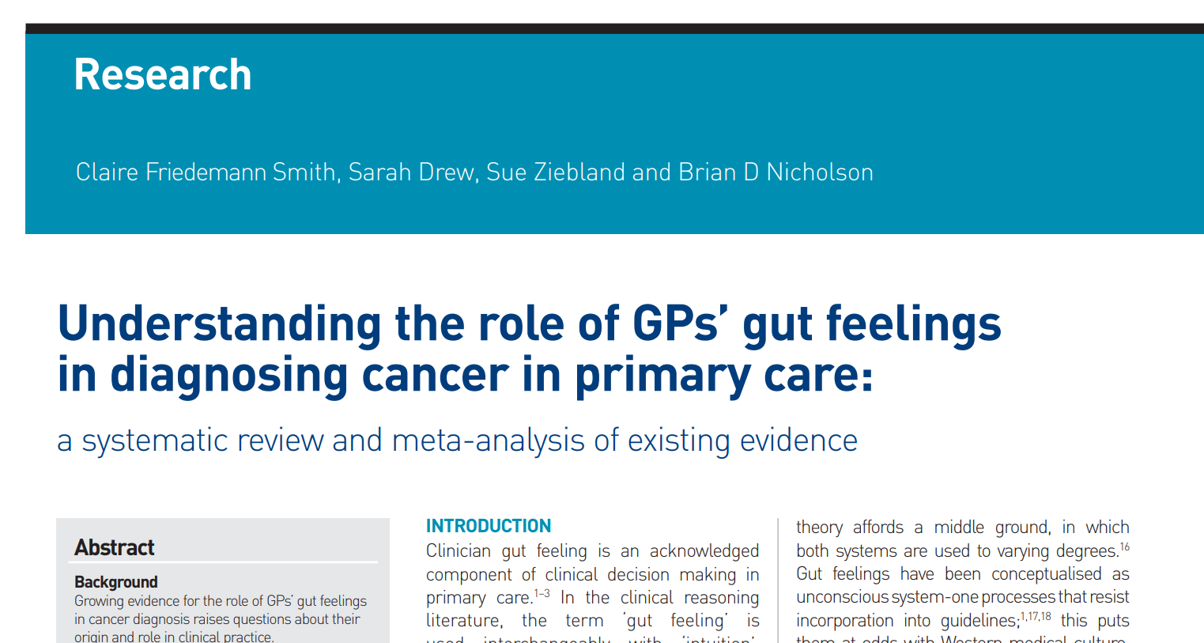
Trust your gut
Rapid ‘summing up’ of multiple verbal/nonverbal patient cues in the context of GPs’ knowledge and experience.
FP gut feeling for cancer dx = PPV 9.8!
Smith, C. F., Drew, S., Ziebland, S., & Nicholson, B. D. (2020). Understanding the role of GPs’ gut feelings in diagnosing cancer in primary care: a systematic review and meta-analysis of existing evidence. British Journal of General Practice, 70(698), e612-e621.
Notes:
Unconscious processes that combine Clinical judgement, experience
Familiarity
. Trust your gut. The PPV of an FP’s gut feeling for presence of cancer was 9.8.
Other trial- gut rules out 98%

Slide 12
-Same symptoms, multiple visits
-Multiple concurrent symptoms
-Not responding to therapy as you would expect
Notes:
Pearl: Be concerned about those who re-present with the same symptoms multiple times, or those patients with multiple concurrent symptoms. That’s always a red flag for me.
with patient

Slide 13
Case: H
H is a 56 yo women who comes to see you with increasing sharp epigastric pain over the last month She has been more constipated. She denies blood in her stools and weight loss. She tells you she’s just “not feeling right”.
PMHX: None
Meds: None
Family history- Father prostate cancer age 74
FIT test negative 2.5 years ago
Non smoker, social ETOH

Slide 14
Step 2. Physical Exam Any signs of cancer?
History
Initial Investigations
Staging
Physical Exam
Biopsy
General Health

Slide 15
Local signs of cancer
Complete physical exam, focused by history
Masses: breast, abdominal, soft tissue, nodal
Lymph nodes: Regional lymph node abnormalities can be lead you to primary

Slide 16
Signs of Metastatic Cancer
Masses
Jaundice
Effusions
Ascites
Hepatomegaly
Increased ICP
Cappell, M. S. (2017). Principles and practice of hospital medicine. McGraw-Hill Education Medical.

Slide 17
Concerning lymph nodes are those that are >2cm and hard/rubbery

Slide 18
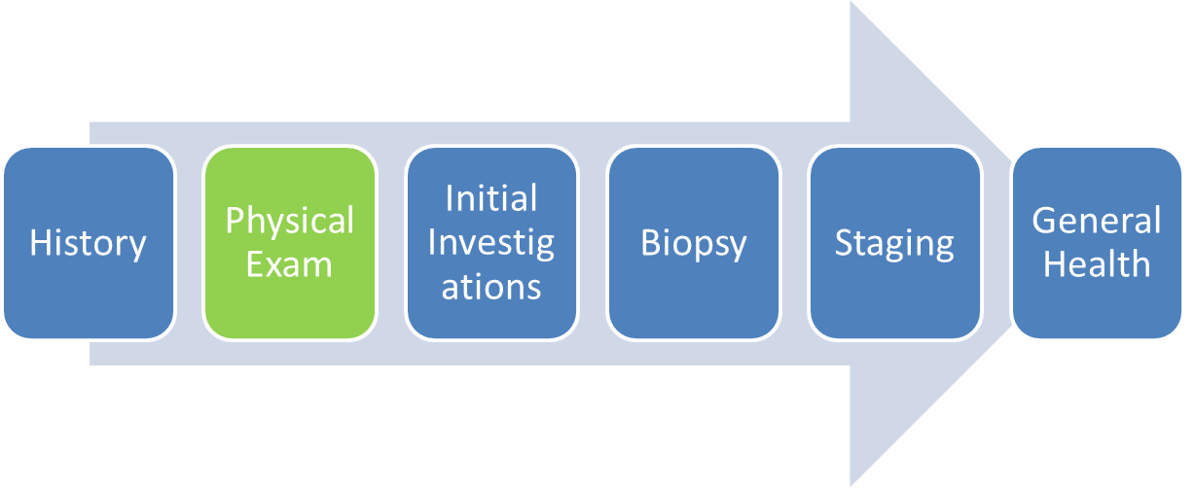
H
General: appears comfortable and well. No distress.
GI: non distended, mild epigastric tenderness, diffuse mild tenderness but no guarding, no rebound. No masses. Neg Murphy’s. Neg Rovsing and neg McBurney.
Given PPI and laboratory requisition

Slide 19
Step 3: Initial Investigations: Is there a Problem?
History
Initial Investigations
Staging
Physical Exam
Biopsy
General Health

Slide 20
Initial Investigations
Lab
Preliminary Imaging

Slide 21
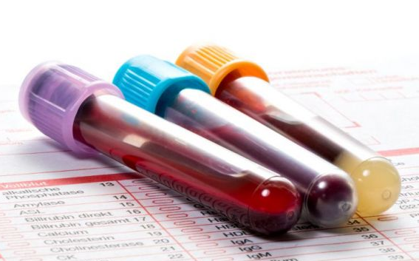
Lab
Look for laboratory abnormalities signaling cancer, metastases or paraneoplastic syndrome
Recommended Laboratory Workup for Diagnosis of Malignancy
Complete Blood Count
Creatinine
Electrolytes
Calcium, Magnesium, Phosphate
Liver function tests, including Albumin
International Normalized Ratio
Lactate dehydrogenase
Serum protein electrophoresis if clinically indicated
Tumour markers as appropriate
Cappell, M. S. (2017). Principles and practice of hospital medicine. McGraw-Hill Education Medical.
Notes:
If you’ve found something concerning on exam, or if there’s a history that has you worried, start with some lab work. Lab results can tell you a lot- like if your patient is anemic, if there are signs of paraneoplastic processes (like hyponatremia) or metastatic disease (liver dysfunction, hypercalcemia).

Slide 22
Tumour Markers
Tumour Marker | Tumour type
CEA | Colon, hepatocellular
CA 19-9 | Pancreatic, biliary tract
Urinary 5-HIAA | Neuroendocrine
CA 15-3 | Breast
CA 125 | Ovarian
PSA | Prostate
AFP | Hepatocellular, Germ cell
Β-HCG | Germ cell, Gestational trophoblastic
Thyroglobulin | Thyroid
Facilitate diagnosis when investigating specific malignancy
Should not be ordered indiscriminately
Can be helpful in the case of unknown primary
survivorship
Bigbee, W., & Herberman, R. B. (2003). Tumor markers and immunodiagnosis. Cancer medicine, 6.
Notes:
Tumour markers are substances produced by either cancer cells or the host in response to the presence of cancer. These markers are a heterogeneous group of molecules, including hormones (β-human chorionic gonadotropin), enzymes (prostate-specific antigen), proteins and glycoproteins (cancer antigen 125), and oncofetal antigens (carcinoembryonic antigen and α-fetoprotein). Tumour markers range widely in sensitivity and specificity for different cancers and can be elevated in benign conditions. They can facilitate diagnosis when ordered to investigate a specific malignancy or unknown primary tumour, but should not be ordered indiscriminately
⁷ Tumour markers can be useful to follow a known cancer to assess treatment response or during survivorship care for disease recurrence.

Slide 23
Document CBC, INR and Cr so you will be ready for biopsy and contrast

Slide 24
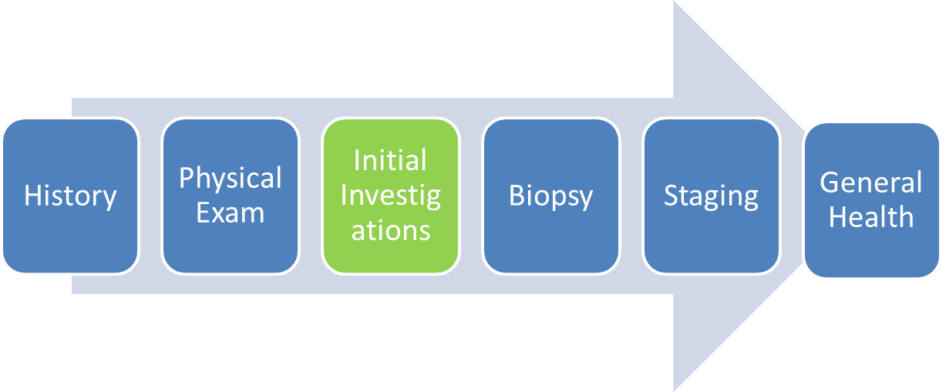
H
Hb: 86 g/L
last known value 123g/L 3 yrs prior
MCV 83, Fe 4 umol/L
ALP: 130 U/L; LD 363 U/L
All other LFT’s normal
Referred for endoscopy

Slide 25
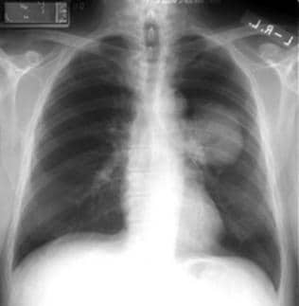
Preliminary Imaging
Is there something to biopsy?
Where is best place to biopsy?
Least invasive test with lowest radiation
exposure
Initial imaging depends on site:
Breast- Diagnostic mammogram, ultrasound
Thoracic- Chest XR
Abdomen- Ultrasound
Adenopathy- Ultrasound
Bird, J. R., Brahm, G. L., Fung, C., Sebastian, S., & Kirkpatrick, I. D. (2020). Recommendations for the Management of Incidental Hepatobiliary Findings in Adults: Endorsement and Adaptation of the 2017 and 2013 ACR Incidental Findings Committee White Papers by the Canadian Association of Radiologists Incidental Findings Working Group. Canadian Association of Radiologists Journal, 0846537120928349.
Notes:
Once you have a sense of where the cancer might be, you need to confirm with imaging. Choose the test with the lowest dose of radiation to start. For thorax, start with CXR; for abdomen: ultrasound; for breast: mammogram/u/s. For adenopathy, use ultrasound.
If you are really convinced there is a malignancy, a CT scan may be appropriate as a first investigation.
If CXR or abd u/s reveals a likely malignancy, definitive imaging with CT is required before biopsy.

Slide 26
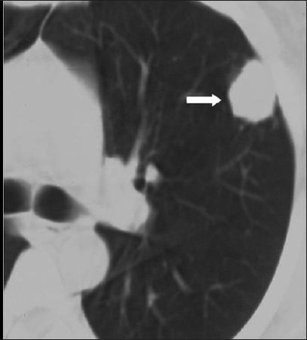
If very high suspicion of malignancy, can order CT as initial imaging
Need definitive imaging prior to biopsy

Slide 27
Know the Limits of your Tests!
Abdominal ultrasound for colon cancer
Sensitivity 79%
Specificity 92%
CXR for lung cancer
Sensitivity 77-80%

Slide 28
Always use contrast if you are suspecting malignancy
Notes:
Contrast increases visibility of vascular structures, and because cancers tend to be very vascular, malignant lesions will enhance to a greater degree than benign lesions.

Slide 29
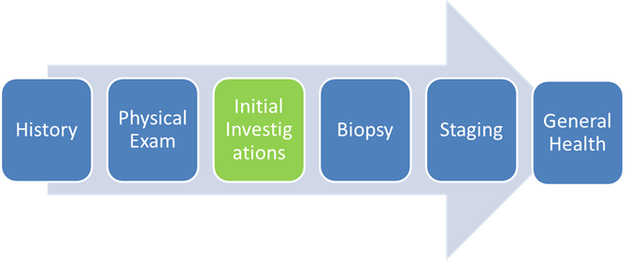
H- Endoscopy
Indication: abd pain, Fe def anemia
Imp: Normal EGD, gastric bx done.
Given elevated ALP and epigastric pain,
Abd us ordered

Slide 30
H- Ultrasound
############ SIGNIFICANT OR UNEXPECTED ############
############,,,,, RADIOLOGIC FINDING ,,,,############
1. Irregular mass within the right lower quadrant appearing to arise from the ascending colon is suspicious for malignancy.
2. Numerous hepatic lesions are suspicious for malignancy, likely metastatic.
3. Lymphadenopathy throughout the visualized abdomen as well as a possible peritoneal nodule involving the right pelvic sidewall.
4. Small volume of free fluid within the pelvis, unusual in a postmenopausal female.
These findings are highly suggestive of malignancy with lymphadenopathy, hepatic metastases, and possible peritoneal carcinomatosis. A CT of the abdomen and pelvis is recommended to further characterize.

Slide 31
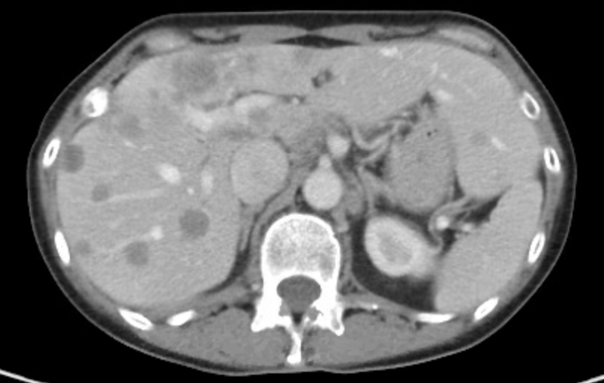
H- CT
CT ABDOMEN & PELVIS
WITH CONTRAST
IMPRESSION:
4.4 cm nearly occlusive annular mass of the ascending colon is likely the primary tumor. There is regional and distal nodal metastases including at the porta hepatis and celiac axis. There is extensive pan segmental liver metastases. There are small nodular deposits in the omentum.

Slide 32
H- Tumour Marker
CEA: 925 ug/L (normal < 5.2 ug/L))

Slide 33
Step 4. Biopsy What is it?
History
Initial Investigations
Staging
Physical Exam
Biopsy
General Health
Notes:
Need tissue to refer
If your initial imaging is suspicious for cancer, you can’t do anything more without a tissue diagnosis. The more tissue the better, as there needs to be enough for histology, immunohistochemistry and molecular diagnostics. This means a core biopsy is more desirable that a fine needle aspirate.
Ideally, you want to get tissue from the most accessible site, or the site that will give you the most diagnostic information. There are lots of ways to get tissue- percutaneously, or via a procedure such as a colonoscopy, endoscopy, bronchoscopy or mediastinoscopy. The way you get your biopsy depends on what your specialist resources are and whether the mass is easily accessible or not.
Some centers have a Diagnostic Assessment Centre to facilitate workup- if you do- use it- your patients will get expedited scans and biopsies.

Slide 34
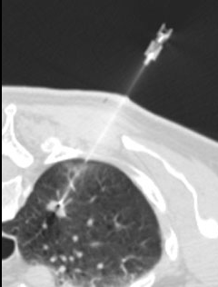
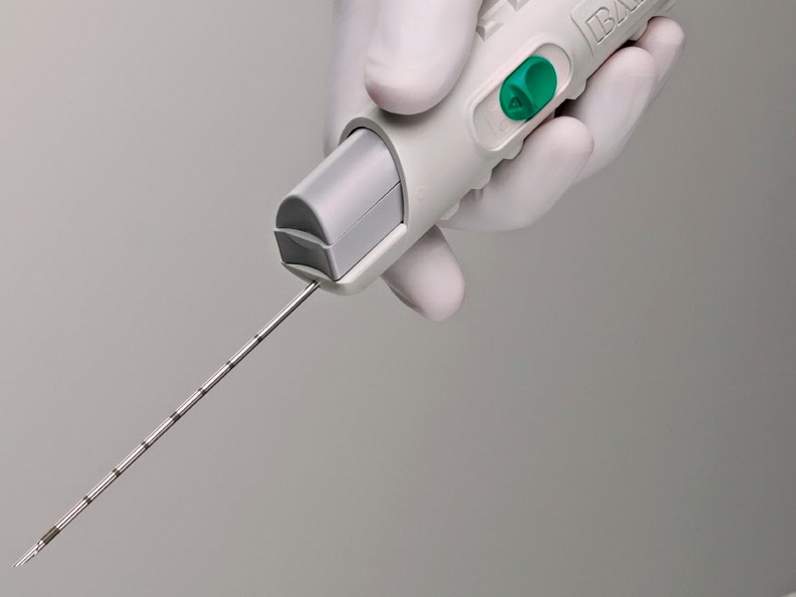
Biopsy
Tissue diagnosis!
Biopsy the most accessible site or the site that will give you the most information
More tissue is better
Notes:
immunohistochemistry and molecular diagnostics

Slide 35
Biopsy
Depends on local resources/expertise
Ways to biopsy:
Percutaneous
Procedure
Cytology from effusions/ascites
Excision of lymph nodes
Endoscopy
Colonoscopy
Bronchoscopy
Mediastinoscopy etc.…
Refer once you have pathology
Collins, L. G., Haines, C., Perkel, R., & Enck, R. E. (2007). Lung cancer: diagnosis and management. American family physician, 75(1), 56-63.
Notes:
Yield of pleural fluid is 46%

Slide 36
Cancer Assessment Centre
Co-ordinated diagnosis, workup and referrals for suspected cancers including:
Breast
Colorectal
Lung
Prostate
Esophageal
Also known as Diagnostic Assessment Program
Notes:
Prostate MRI: t high-quality studies, and now includes a recommendation for the use of multiparametric MRI (mpMRI) for biopsy-naïve men at elevated risk of clinically significant prostate cancer (CSPCa).
(PSA, age, ethnicity, family history), mpMRI results, biopsy results if applicable, etc.

Slide 37
Anticoagulation
Superficial skin procedures: don’t hold anticoagulation
Deep organ biopsy= hold anticoagulation
Antiplatelet= 5 days prior
DOAC= 3 days prior
Warfarin= 5 days prior until INR <1.8
Can consider bridging with LMWH or Thrombosis referral
www.thrombosiscanada.ca perioperative tool
Notes:
INR should be checked prior to procedure to ensure patients aren’t supratherapeutic if they are on Warfarin.
If your patient is going for a deep organ biopsy and is on anticoagulation, you need to hold anticoagulation if advisable. Skin procedures don’t need anticoagulation to be held, but an INR should be checked prior to procedure to ensure patients aren’t supratherapeutic if they are on Warfarin.
If your patient is on an antiplatelet agents, these should be held 5 days prior to bx, while DOACs should be held 3 days preprocedurally. Warfarin should be held 5 days prior to procedure, until INR is <1.8. If you prefer not to leave your patient anticoagulated for a long time, you can consider bridging with LMWH, or referring to Thrombosis.

Slide 38
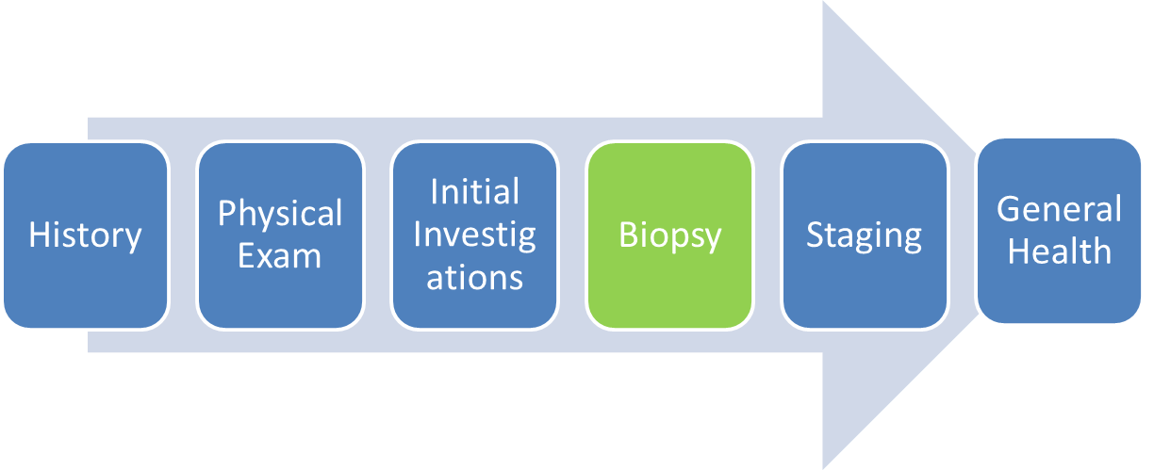
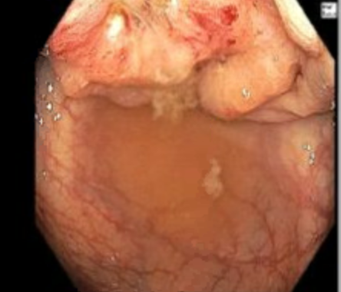
H- Colonoscopy
Indication: ?met colon ca on CT, for biopsy. ?obstruction
Imp: Hepatic flexure obstructive mass worrisome for malignancy. Biopsied.

Slide 39
H- Pathology
Colon, hepatic flexure mass, biopsy:
colonic mucosa with mild stromal edema and chronic inflammation
negative for dysplasia and carcinoma.

Slide 40
H- Repeat Biopsy
Colonoscopy repeated 2 weeks later.
Rebiopsied, endoscopically consistent with colon ca. 9cm colonic stent inserted.
Pathology:
Colon, hepatic flexure mass, biopsy:
Invasive adenocarcinoma, moderately-to-poorly differentiated.

Slide 41
Biopsy non diagnostic/normal but high
clinical suspicion:
-sampling error?
-rebiopsy or follow closely

Slide 42
Step 5. Staging Where is it?
History
Initial Investigations
Staging
Physical Exam
Biopsy
General Health
Notes:
-Staging: sites of metastases
where- impact re: resectabiliyt, possible treatments.
Having these investigations in process or completed when the patient sees the oncologist can expedite treatment.
If your biopsy shows cancer, the next step is staging. Staging investigations look at typical sites of metastases for cancers. By delineating exactly where the cancer is, the TMN stage can be determined, which ultimately dictates treatment options. Having these investigations in process or completed when the patient sees the oncologist can expedite treatment.
Think about where the cancer you have diagnosed is likely to spread, and order CT Chest/abd/pelvis and brain imaging accordingly. Also think about the symptoms your patient is having to guide imaging. MRI pelvis may be helpful in prostate or rectal cancers. Use contrast in any scans you order as long as renal function is adequate. PET scans, or functional imaging, can be ordered by oncologist in select indications to determine resectability of a tumour.

Slide 43
Staging
Expedite treatment by initiating staging investigations once you have pathology
Sites of imaging should be guided by:
Typical pattern of metastases for the cancer you have diagnoses
Any symptoms your patient has
Risk of spread of cancer (aggressivity)
Use contrast
Rawson, J. V., & Pelletier, A. L. (2013). When to order contrast-enhanced CT. American family physician, 88(5), 312-316

Slide 44
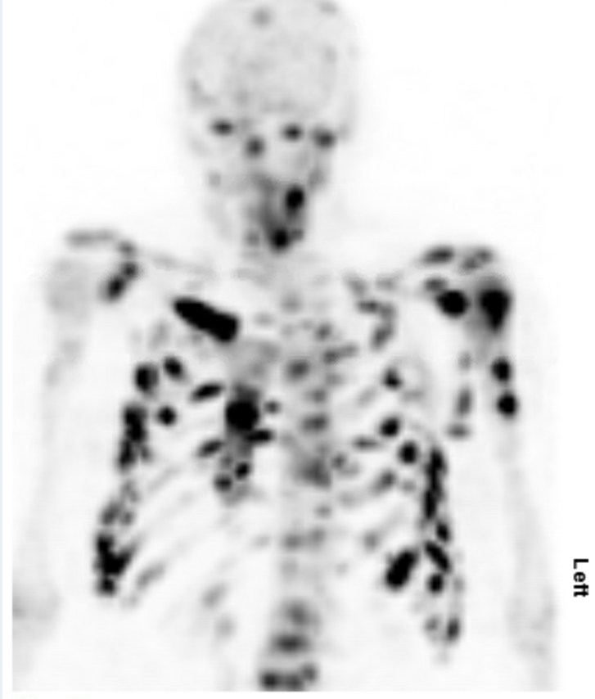
Which Cancers Go To Bone?
“Buy The Kid Long Pants”
Breast
Thyroid
Kidney
Lung
Prostate
Notes:
Colon doesn’t

Slide 45
How to Image Bones
XR
50% of bone must be destroyed
Good to r/o path #
Bone Scan
Shows osteoblastic activity. Not specific
Does not show osteosclerotic/lytic mets- false negatives with thyroid, renal cell
Non specific
CT
Good for cortical integrity
Test | Sensitivity | Specificity
XR | 44%
Bone Scan | 86% | 81%
CT | 73% | 95%
PET-CT | 90% | 97%
MRI | 91% | 95%
Yang HL, Liu T, Wang XM, Xu Y, Deng SM. Diagnosis of bone metastases: a meta-analysis comparing FDG PET, CT, MRI and bone scintigraphy. Eur Radiol. 2011;21:2604–2617.

Slide 46
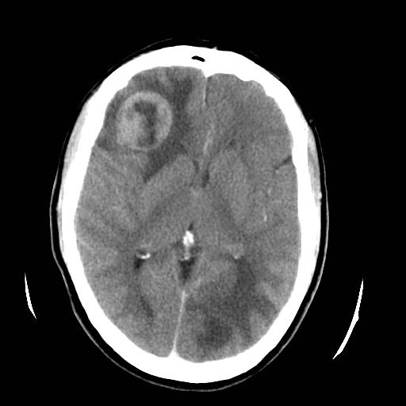
Which Cancers go to brain?
“Some Malignancies Really Love Brain”
Sarcoma
Melanoma
Renal
Lung
Breast
Cancer that rarely go to brain
Colon
Pancreas
Prostate (skull only)

Slide 47
MRI or CT brain?
CT
Easy to obtain
Good screening technique
MRI
Detects 2-3 times more lesions than CT
20% of pt with solitary lesion on CT have multiple lesions on MRI
Leptomeningeal disease
Cranial nerve involvement
Fink K and Fink J. Imaging of brain metastases.Surgical Neurology International, May, 2013, Vol.4(5), p.209
Notes:
contrast MRI detects 2-3 times as many lesions as contrast-enhanced CT, especially lesions that are less than 5 mm in diameter. In addition, approximately 20% of patients with solitary metastatic lesions on CT show multiple lesions on MRI.

Slide 48
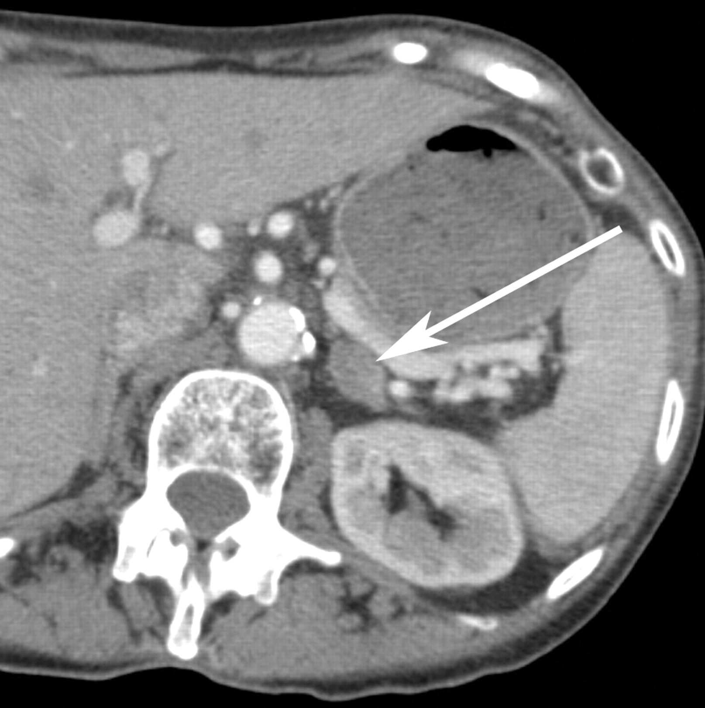
Recommended Staging for Common Cancers
Lung
CT Chest/Abd/Pelvis; Bone Scan; CT or MRI brain
Colon
CT Chest/Abd/Pelvis
National Comprehensive Cancer Network (2020, June). Colon Cancer. https://www.nccn.org/professionals/physician_gls/pdf/colon_blocks.pdf. Retrieved Aug 22, 2020.
.

Slide 49
Staging - Breast
Early-stage breast cancer does not need staging
Clinical stage 1-2, asymptomatic:
(tumour <5cm + < 3 nodes involved; or >5cm and no nodes)
No staging
Clinical stage 3
(tumour <5cm + >3nodes involved; or >5cm and nodal involvement)
CT Chest/Abd/Pelvis; Bone Scan
Cancer Care Ontario.(2019, Oct). Baseline Staging Imaging for Distant Metastasis in Women with Stage I, II, and III Breast Cancer. (https://www.cancercareontario.ca/sites/ccocancercare/files/guidelines/summary/pebc1-14v3s.pdf. Retrieved Aug 22, 2020.
National Comprehensive Cancer Network (2020, July). Prostate Cancer. https://www.nccn.org/professionals/physician_gls/pdf/prostate_blocks.pdf. Retrieved Aug 22, 2020

Slide 50
Staging - Prostate
Low risk prostate cancer does not need staging
Low Risk, asymptomatic
(tumour non palpable, or contained within ½ of one lobe; PSA <10; Gleason ≤6)
No staging
Intermediate or High Risk
(tumour confined to prostate, PSA 10-20, Gleason ≥7)
Bone Scan; CT or MRI abdomen
Notes:
Prostate MRI: t high-quality studies, and now includes a recommendation for the use of multiparametric MRI (mpMRI) for biopsy-naïve men at elevated risk of clinically significant prostate cancer (CSPCa).
(PSA, age, ethnicity, family history), mpMRI results, biopsy results if applicable, etc.

Slide 51
Staging- Melanoma
-No staging
-Can consider u/s of nodal basin if equivocal exam
-Treatment:
-Wide excision +/- sentinel node biopsy
No nodes
Localised
Palpable nodes/ satellite lesions
Regional
Distant mets
Stage 4
Stage 1 or 2
Stage 3
Metastatic
-Stage
-Treatment:
-Wide excision, completion lymph node dissection +/- immunotherapy +/ XRT
Notes:
Sentinel lymph node biopsy offered to
Higher risk Stage 1B (>1mm thick, + ulceration, high mitotic rates
Most important predictive factors: Breslow thickness, ulceration, mitotic rate.

Slide 52
PET Scan
Radiolabeled glucose uptake, highlights metabolically active tissue
Can be paired with CT to give anatomical information
2 main indications
r/o metastatic disease prior to planned curative surgery
Suspicion of tumour recurrence with increasing tumour markers (CEA, PSA, AFP) but no recurrence on imaging
Up to 20% of patients planned for surgery for lung cancer have occult met on PET
Goldfarb, L., Duchemann, B., Chouahnia, K., Zelek, L., & Soussan, M. (2019). Monitoring anti-PD-1-based immunotherapy in non-small cell lung cancer with FDG PET: introduction of iPERCIST. EJNMMI research, 9(1), 1-10.
Notes:
5 pet scans in ont
The funding for PET scans varies from province to province, and this test would really be ordered by an oncologist rather than an FP. But- the bottom line is that PET scans look at radiolabeled glucose uptake, and so highlight metabolically active tissues- in this case- cancers. PET scan is often paired with CT, to give anatomic information at the same time as metabolic information. PET scans are generally used for one of 2 reasons:
when there is a curative surgery planned- to make extra sure that there are no mets present before an invasive surgery is undertaken (i.e. lung, esophageal, h+N).
When there is suspicion of tumour recurrence because of increasing tumour markers (CEA, PSA, AFP) but no evidence of recurrence on imaging (i.e. colon, prostate, Germ cell).

Slide 53
No staging investigations needed for asymptomatic stage 1 and 2 breast cancer
Notes:
Clinical Stage 1-2 and asymptomatic
(tumour <5cm + < 3 nodes involved; or >5cm and no nodes)
No staging required
Clinical Stage 3
(tumour <5cm + >3nodes involved; or >5cm and nodal involvement)

Slide 54
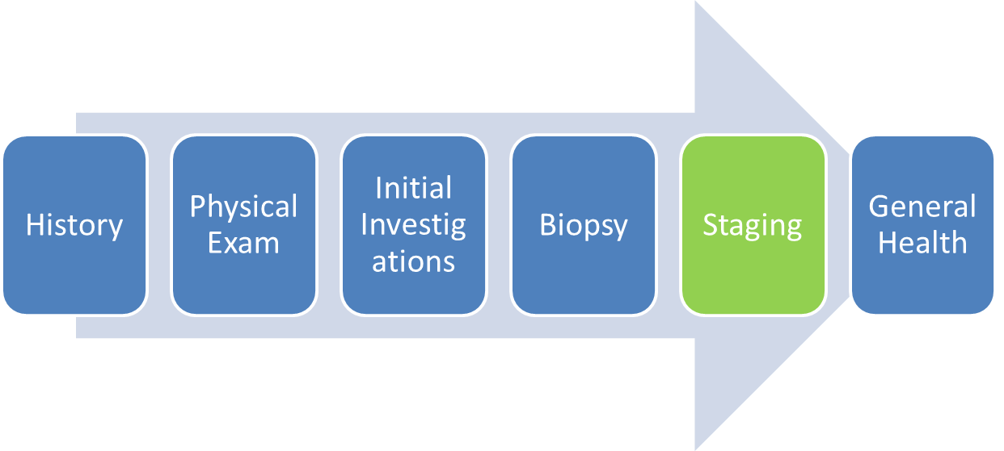
H- CT Thorax
INDICATION: Metastatic colon cancer, For staging.
LYMPH NODES & MEDIASTINUM: There are several precordial lymph nodes, largest measuring 7 mm in diameter. Additionally, there is a retrocrural node on the right side measuring 7 mm in width. There are several nodes around the cardioesophageal junction and a large lesion in the liver at that level. Internal mammary node on the right side measures 6 mm in width.
---------
IMPRESSION:
There are several clusters of mediastinal nodes near the diaphragm which are probably metastatic. Study is otherwise unremarkable.

Slide 55
Step 6. General Health Support + Prevention
History
Initial Investigations
Staging
Physical Exam
Biopsy
General Health
Notes:
Critical role is relationship and support.
Scared, confused.
There are a few key preventative issues to think about during a cancer diagnosis.
My most important take home message is to book regular appointments with your patient during workup- even as frequently as weekly or every 2 weeks. By seeing your patient regularly, you can make sue nothing is falling through the cracks and ensure there is a clear plan of action that both you and your patient are agreeable with. These regular appointments will also give you the opportunity to explain results as they come in, answer any questions and manage any symptoms your patient might have.

Slide 56
Support
Schedule regular f/u appointments
Share results
Answer questions
Address symptoms
Provide emotional support
Ensure timely investigations
Ensure appropriate management plan
National Center for Chronic Disease Prevention and Health Promotion (US) Office on Smoking and Health. The Health Consequences of Smoking—50 Years of Progress: A Report of the Surgeon General. Atlanta, GA: Centers for Disease Control and Prevention; 2014.
Taylan, E., & Oktay, K. H. (2017). Current state and controversies in fertility preservation in women with breast cancer. World journal of clinical oncology, 8(3), 241.
Dohle, G. R. (2010). Male infertility in cancer patients: review of the literature. International journal of urology, 17(4), 327-331.

Slide 57
Support
Advanced Care Planning

Slide 58
Smoking Cessation
Patients may be more open to smoking cessation in light of a new cancer diagnosis
Continued smoking increases risk of:
Treatment failure
Cancer mortality
Overall mortality
Recurrence
Development of new primary
Warren, G. W., Cartmell, K. B., Garrett-Mayer, E., Salloum, R. G., & Cummings, K. M. (2019). Attributable failure of first-line cancer treatment and incremental costs associated with smoking by patients with cancer. JAMA network open, 2(4), e191703-e191703.
Warren, G. W., Alberg, A. J., Cummings, K. M., & Dresler, C. (2020). Smoking cessation after a cancer diagnosis is associated with improved survival. Journal of Thoracic Oncology, 15(5), 705-708.
Notes:
Always think about supporting patients in smoking cessations- often a cancer diagnosis can be a strong impetus to change and patients may be open to smoking cessation when they were not previously.
substantial benefits associated with quitting smoking after a cancer diagnosis.
smoking cessation was associated with statistically significant reductions in overall mortality with a median reduction of 45%.

Slide 59
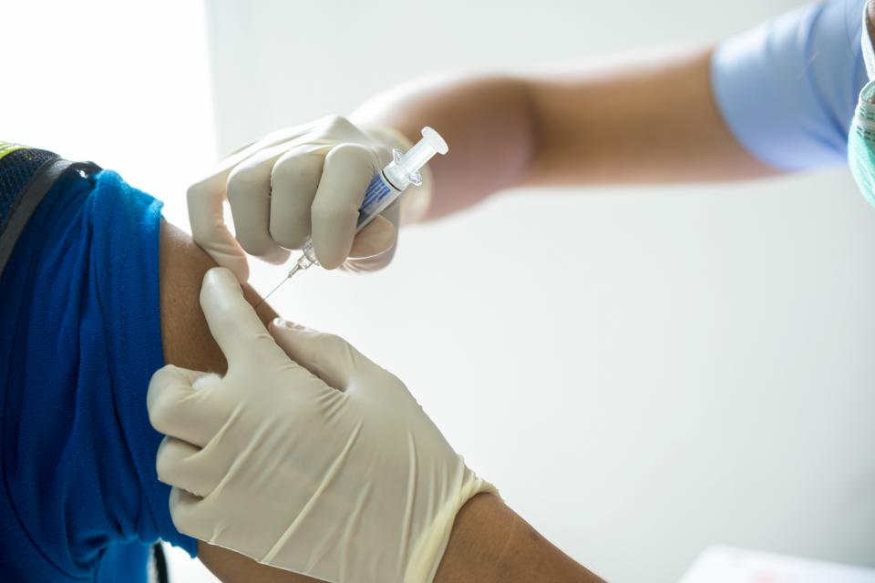
Vaccination
Ensure vaccinations are up to date
Live vaccinations (i.e. MMR, zoster vaccine live, influenza vaccine- live- Nasal) contraindicated during cancer therapy
Immune response to inactivated vaccines may be blunted- ideally give >2 weeks prior to starting chemotherapy
Notes:
Make sure vaccinations are up to date, as live vaccines are contraindicated during chemotherapy, and patients may not mount an adequate immune response to inactivated vaccines when they are on treatment.

Slide 60
Fertility
Only 40% of patients of reproductive age are referred to a fertility specialist
Refer early to fertility specialist to make time for discussion/procedures
Fertility is #1 concern after cancer treatment
Referral contributes to hope, improved coping
Taylan E, Oktay KH. Current state and controversies in fertility preservation in women with breast cancer. World J Clin Oncol 2017;8(3):241-8. 20.
Dohle GR. Male infertility in cancer patients: review of the literature. Int J Urol 2010;17(4):327-31. Epub 2010 Feb 22.
Notes:
ancer therapies, primarily radiation and chemotherapy, can cause premature ovarian failure in 15% to 40% of women younger than 30 years old, and in 49% to 100% of women older than 40.19 Men can develop impaired spermatogenesis after chemotherapy exposure at rates of up to 90%, depending on the chemotherapy drugs used.20 In
Chemotherapy usually causes at least a temporary period of amenorrhea owing to damage to developing preovulatory ovarian follicles.12 Resumption of menses generally occurs within 3–4 months but may take up to 2 years. However, if ovarian reserve has been depleted to the point of ovarian failure, menstruation does not resume.
Treatments: embryo/oocyte cryo

Slide 61
Fertility- Chemotherapy Impacts
Impaired Spermatogenesis
Up to 90% of men
Chemotherapy “ages” ovaries by 5-10 yrs
If ovarian reserve too depleted= Premature Ovarian Failure
15- 40% of women <30 yrs.
49-100% of women >40 yrs.
Notes:
Tamoxifen is teratogenic, or physiologically impossible with gnrh + AI
Endocrine therapy doesn’t impact ovarian function but causes childbearing delay
Temporary amenorrhea d/t damage to developing follicles
Resumption of menses within 3-4 months, may take up to 2 yrs

Slide 62
Fertility Options
Ovarian Suppression
Monthly GnRH agonist while on chemo
~15% of eggs protected
Egg/sperm freezing
Embryo freezing
Ovarian tissue freezing (not widely available)
https://fertilityaid.rethinkbreastcancer.com/decision-aid/
Warner, E., Glass, K., Foong, S., & Sandwith, E. (2020). Update on fertility preservation for younger women with breast cancer. CMAJ, 192(35), E1003-E1009.
Notes:
Ideally, start at least 1 wk before first chemotherapy treatment and continue until chemotherapy is completed (3–6 mo),
Prelim studies show no inc risk of breast cancer recurrence in preg after breast ca treatment;
Ovarian supression:Monthly injection of a gonadotropin-releasing hormone agonist to suppress ovulation and menstruation, Ideally, start at least 1 wk before first chemotherapy treatment and continue until chemotherapy is completed (3–6 mo), delay chemo 7-10 d until supression, Success rate: ~ 15% of eggs protected • Degree of fertility protection is unknown; however, the timing of premature ovarian failure is generally delayed In the largest meta-analysis to date, published in 2015, the premature ovarian failure rate among 1231 patients with breast cancer was reduced from 34% to 19% (odds ratio [OR] 0.36, 95% confidence interval [CI] 0.23– 0.57).33

Slide 63
Book regular appointments during a cancer workup

Slide 64
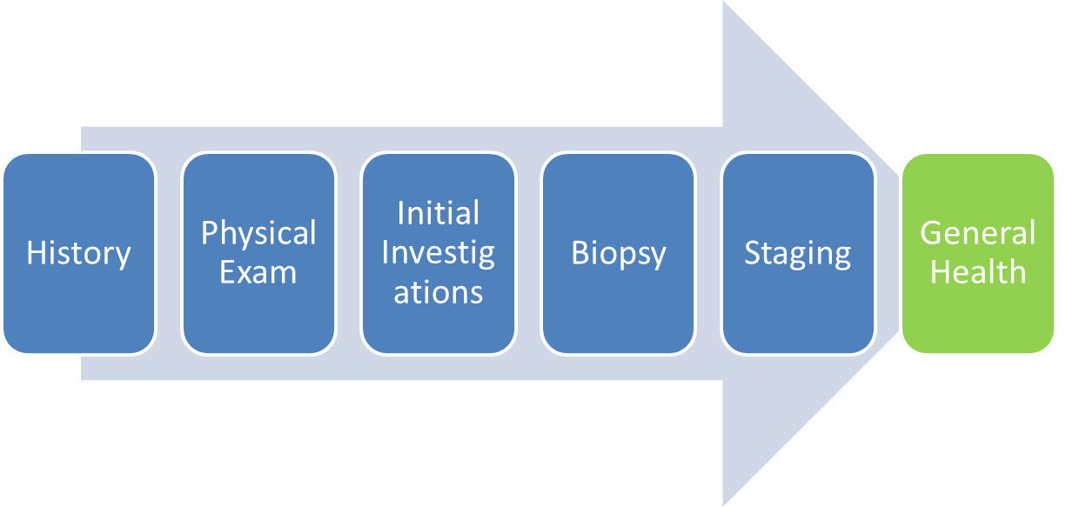
H
Regular follow up visits throughout diagnostic interval
Treated symptoms of bowel obstruction and pain
Arranged stenting for colonic lesion
Reviewed results of investigations as available
Discussed implications of diagnosis of metastatic colon cancer, including possibility of palliative chemotherapy
Advanced care planning
Provided support

Slide 65
History
Initial Investig-ations
Staging
Physical Exam
Biopsy
General Health
Decreasing the diagnostic interval:
Improving survival outcomes
Preserving patient-physician relationship
Supporting your patients
Notes:
-need an approach to w/u cancer, to determine who should be investigated, avoid uncessary investigations, expedite diagnostic interval, dec risk of fracturing physician relationship when needed most,
expeditiously means lower stage disease, with the very real outcome of improved survival.

