Slide 1
Choosing Wisely Canada LTC
Vivian Ewa MBBS CCFP (COE) MMedEd FCFP FRCP Edin
Section Chief-Seniors Care and Clinical Associate Professor,
Department of Family Medicine, University of Calgary
Sid Feldman MD CCFP (COE) FCFP
Division Head COE and Associate Professor,
DFCM, Temerty Faculty of Medicine, University of Toronto
Family Medicine Forum, Montreal, 2023
Notes:
Elliot

Slide 2
Faculty/Presenter Disclosure
Faculty: Vivian Ewa
Relationships with financial sponsors:
Any direct financial relationships including receipt of honoraria: None
Memberships on advisory boards or speakers’ bureau: None
Patents for drugs or devices: None
Other: financial relationships/investments:
- University of Calgary and Alberta Health Services salary for administrative roles.
www.choosingwiselycanada.org | @ChooseWiselyCA
Notes:
Need Vivian’s disclosures

Slide 3
Disclosure of Financial Support
Potential for conflict(s) of interest:
None
www.choosingwiselycanada.org | @ChooseWiselyCA

Slide 4
Mitigating Potential Bias
N/A
www.choosingwiselycanada.org | @ChooseWiselyCA
Notes:
Vivan

Slide 5
Faculty/Presenter Disclosure
Faculty: Sid Feldman
Relationships with financial sponsors:
Any direct financial relationships including receipt of honoraria: McMaster University (re Ontario Osteoporosis Strategy), OCFP
Memberships on advisory boards or speakers’ bureau:
Co-chair, Choosing Wisely Canada LTC Steering Committee- (Stipend-soon I hope?)
Osteoporosis Canada Scientific Advisory Council (unpaid)
Patents for drugs or devices: None
Other: financial relationships/investments:
Salary support: Baycrest Health Sciences, Temerty Faculty of Medicine U of T
Baycrest Global Solutions
www.choosingwiselycanada.org | @ChooseWiselyCA
www.choosingwiselycanada.org | @ChooseWiselyCA
Notes:
Elliot/Sid/Andrea

Slide 6
Disclosure of Financial Support
Potential for conflict(s) of interest:
None
www.choosingwiselycanada.org | @ChooseWiselyCA
Notes:
Elliot/Sid/Andrea

Slide 7
Mitigating Potential Bias
N/A
www.choosingwiselycanada.org | @ChooseWiselyCA
Notes:
Elliot/Sid/Andrea

Slide 8
Overview
Choosing Wisely Canada Overview
Choosing Wisely Canada Long Term Care Recommendations
a. Avoiding unnecessary hospital transfers
b. Antibiotics Wisely in LTC
c. Appropriate use of antipsychotics
www.choosingwiselycanada.org | @ChooseWiselyCA
Notes:
Sid

Slide 9
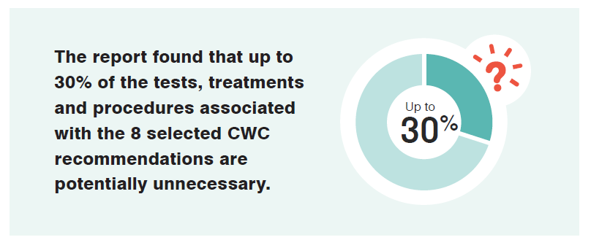
www.choosingwiselycanada.org | @ChooseWiselyCA
Notes:
Sid
CIHI used 8 of the CWC recommendations for common conditions.
This number of 30% potential unnecessary is consistent with other countries.
This is care that does not add VALUE, and can even be harmful to patients

Slide 10
An example of unnecessary care
www.choosingwiselycanada.org | @ChooseWiselyCA
Notes:
Sid

Slide 11
Notes:
Sid
Choosing Wisely’s patient/public facing campaign messaging has been ‘More Is Not Always Better’. The goals of the messaging and the public facing materials are to:
Promote the message that in medicine as it is in life, “more is not always better”
Educate patients about when they might need a particular test or treatment, and when they don’t
Encourage patients to talk with their doctor about unnecessary care
Posters available from CWC, please email info@choosingwiselycanada.org to receive More is Not Always Better materials

Slide 12
Choosing Wisely Canada is the national voice for reducing unnecessary tests and treatments in health care.
www.choosingwiselycanada.org | @ChooseWiselyCA
Notes:
Sid-add planetary health

Slide 13
What is unique about CWC?
Clinician led
Bottom-up approach
Evidence-based
Simple
www.choosingwiselycanada.org | @ChooseWiselyCA
Notes:
Sid

Slide 14
Choosing Wisely Canada in LTC
Long-term care settings are an area of interest for potential improvement (CIHI)
Increased complexity and comorbidities; limited life expectancy for some
more uncertainty with the stewardship of care
54% of LTC residents in Canada have dementia
www.choosingwiselycanada.org | @ChooseWiselyCA
Notes:
Sid
Additional notes: Temptation to overtreat in this setting, e.g. to risk avoiding community spread in the home

Slide 15
Barriers to Appropriate Care in LTC
Limited histories in cognitively impaired patients
Blunted febrile responses in older patients
Difficulty distinguishing infection from comorbidity mimickers
eg, pneumonia VS congestive heart failure and COPD
eg, venous stasis VS cellulitis
eg, altered mental status from dementia VS sepsis
Variability in access to imaging and laboratory testing
Off-site physicians
up to half of antibiotic prescriptions called in by phone
Nicolle ICHE 2000; Crnich Drugs Aging 2015; Katz Arch IM 1990
www.choosingwiselycanada.org | @ChooseWiselyCA
Notes:
Sid

Slide 16
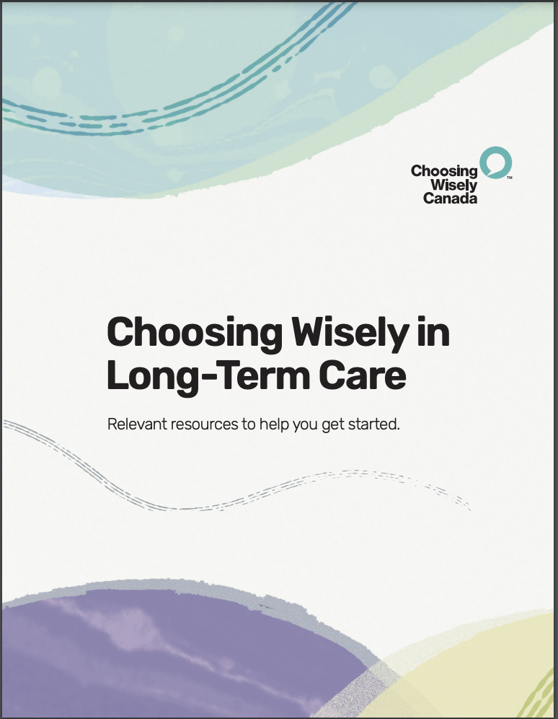
Check out the LTC Toolkit here:
https://choosingwiselycanada.org/long-term-care
www.choosingwiselycanada.org | @ChooseWiselyCA
Notes:
Sid

Slide 17
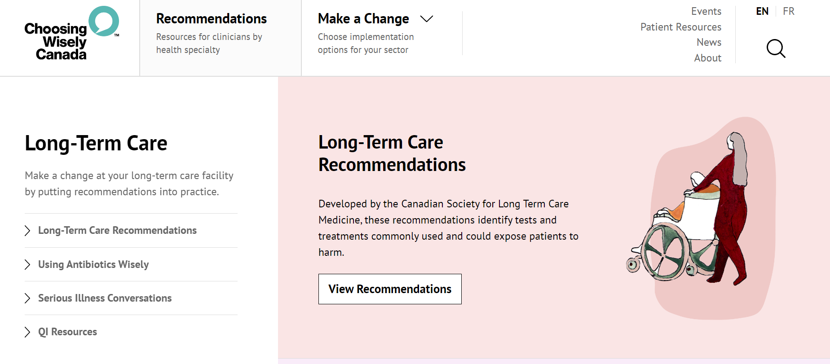
Notes:
Sid

Slide 18
Long-Term Care Recommendations: www.choosingwiselycanada.org/long-term-care/
www.choosingwiselycanada.org | @ChooseWiselyCA
Notes:
Sid

Slide 19
Notes:
Sid

Slide 20
Notes:
Sid

Slide 21
Hospital Transfers
Don’t send the frail resident of a nursing home to the hospital without reviewing goals of care and advance directives with the resident or substitute decision-maker, unless their urgent comfort and medical needs cannot be met in their care home.
www.choosingwiselycanada.org | @ChooseWiselyCA
Notes:
Vivian

Slide 22
Hospital Transfers
Canadian study noted that 47% were considered avoidable
Transfers to hospital may result in increased morbidity
Early Goals of Care conversations!
www.choosingwiselycanada.org | @ChooseWiselyCA
Notes:
Vivian
Transfers are to the ER which are usually unfamiliar and stressful environments
Hazards of unnecessary hospitalization include:
Delirium
Hospital acquired infection
Medication side effects
Sleep disturbances
Deconditioning

Slide 23
Hospital Transfers based on GoC
Speak Up Ontario:
Inform
Prepare
Illness
understanding
Make a Plan
Values
& Goals
https://www.advancecareplanning.ca/resource/essential-conversations-a-guide-to-advance-care-planning-in-long-term-care-settings/?gclid=CjwKCAjwzo2mBhAUEiwAf7wjkmbmFte_xQKEdR-adVTRqgvfnptvQSFxj7-qcChhg9IM5vTJpHyStxoCvQEQAvD_BwE
www.choosingwiselycanada.org | @ChooseWiselyCA
Notes:
Vivian- In Alberta- Conversations Matter; ACP toolkit to help healthcare professionals, patients and families/ carepartners engage in the discussions around GCD.

Slide 24
Hospital Transfers based on GoC
Conversations Matter (Alberta):
conversations-matter-guide-english (9).pdf
www.choosingwiselycanada.org | @ChooseWiselyCA
Notes:
Vivian- In Alberta- Conversations Matter; ACP toolkit to help healthcare professionals, patients and families/ carepartners engage in the discussions around GCD.

Slide 25
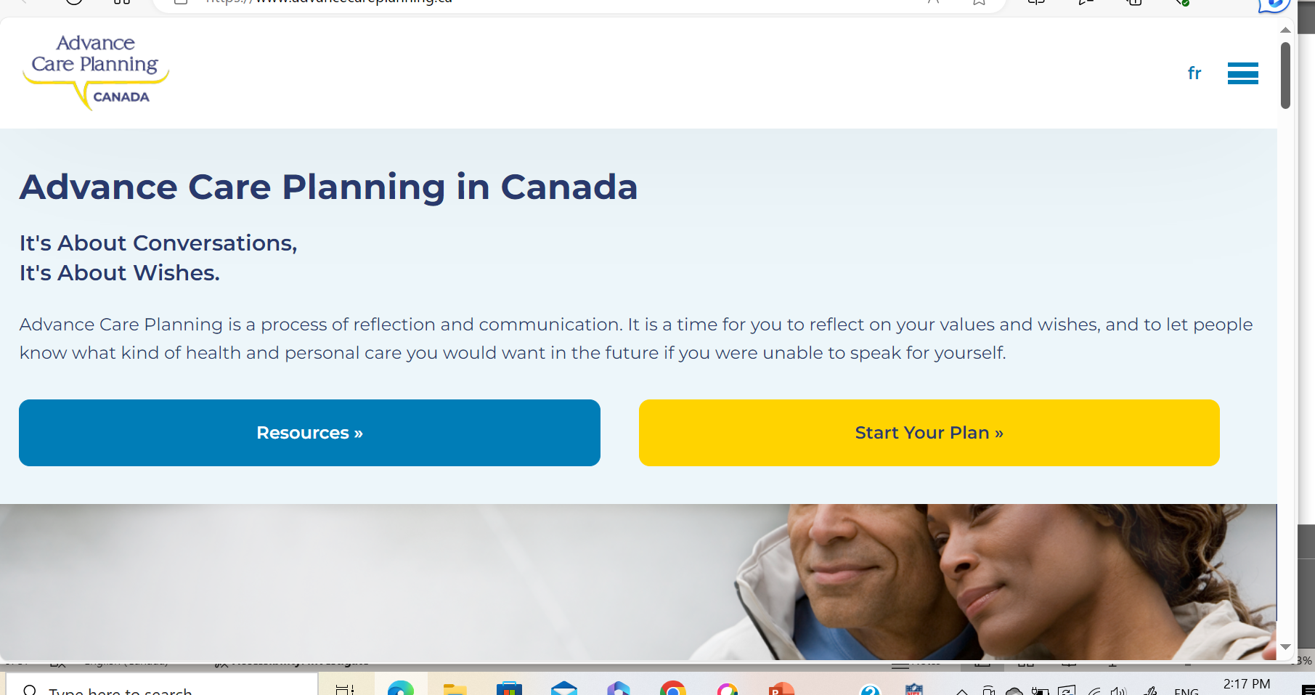
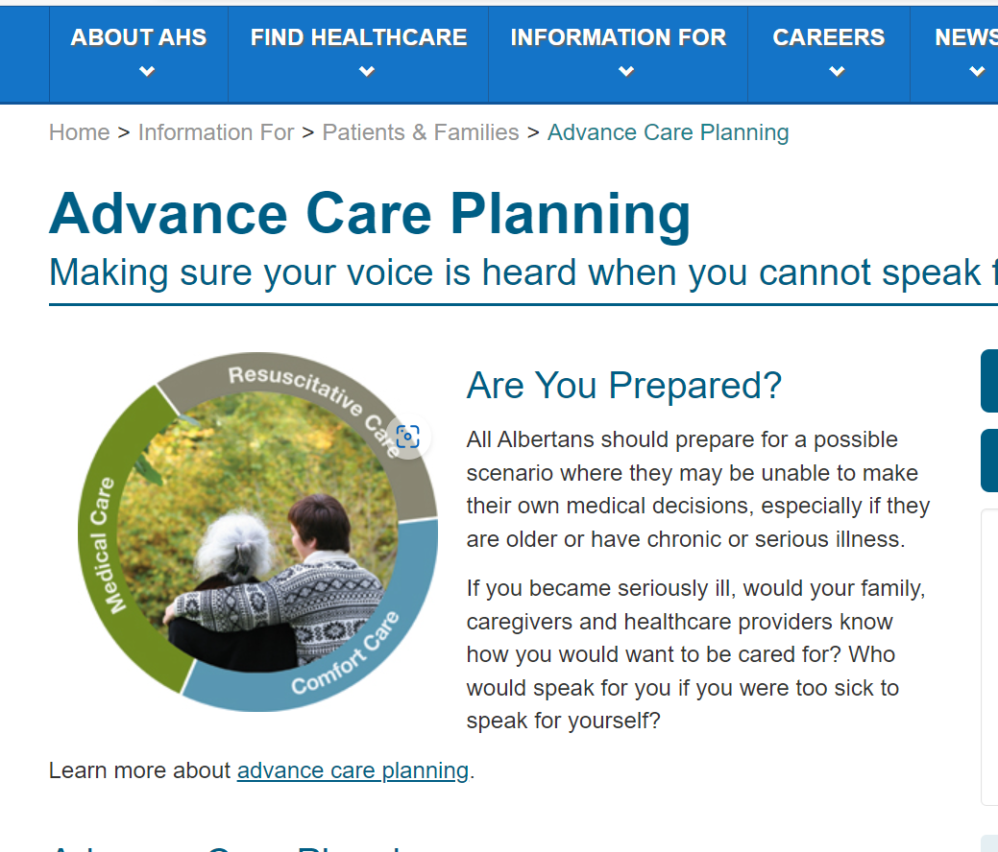
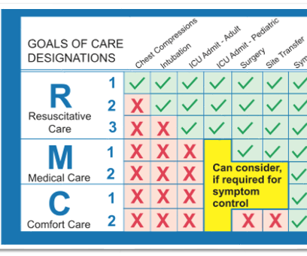
Notes:
Advance Care Planning | Alberta Health Services
Home - ACP in Canada | PPS au Canada (advancecareplanning.ca)

Slide 26
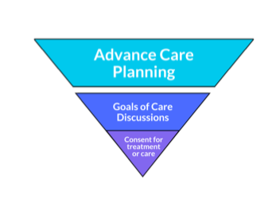
Choosing Wisely Canada - Serious Illness Conversation Guide “Time to Talk”
Set up the conversation
Assess understanding and preferences
Share prognosis
Explore Key Topics
Close the conversation
Document your conversation
Communicate with key clinicians
www.choosingwiselycanada.org | @ChooseWiselyCA
Notes:
Vivian
Time to Talk - Choosing Wisely Canada

Slide 27
Antipsychotics
Don’t use antipsychotics as first choice to treat behavioural and psychological symptoms of dementia.
www.choosingwiselycanada.org | @ChooseWiselyCA
Notes:
Sid

Slide 28
Antipsychotics
Canadian Institute for Health Information.
Potentially Inappropriate Use of Antipsychotics in Long-Term Care.
2021-2022; accessed October 18, 2023.
https://yourhealthsystem.cihi.ca/hsp/inbrief?lang=en#!/indicators/008/potentially-inappropriate-use-of-antipsychotics-in-long-term-care/;mapC1;mapLevel2;/
www.choosingwiselycanada.org | @ChooseWiselyCA
Notes:
Sid

Slide 29
Antipsychotics in BPSD
Commonly prescribed
Can cause serious harm, including increased risk of death
These medications should be limited to cases where non-drug measures have been tried and failed
Frequently review attempts at reduction or discontinuation to reduce harm
www.choosingwiselycanada.org | @ChooseWiselyCA
Notes:
Sid

Slide 30
https://choosingwiselycanada.org/toolkit/when-psychosis-isnt-the-diagnosis/
www.choosingwiselycanada.org | @ChooseWiselyCA
Notes:
Sid

Slide 31
Steps to avoid unnecessary antipsychotic use
Establish an inter-professional team
Agree on appropriateness criteria
Educate care staff as to reasons for responsive behaviours
www.choosingwiselycanada.org | @ChooseWiselyCA
Notes:
Sid
Agree on appropriateness criteria
Severe delusions/hallucinations
Behaviours that put others at risk of injury
Educate care staff as to reasons for responsive behaviours
Environmental
Medical/biological
Basic physical needs
Psychosocial

Slide 32
Steps to avoid unnecessary antipsychotic use
4. Inform and involve family
Establish a regular medication review process
Taper residents off potentially inappropriate antipsychotic
prescriptions
7. Implement supportive strategies
www.choosingwiselycanada.org | @ChooseWiselyCA
Notes:
Sid

Slide 33
Urinary Tract Infections
Don’t do a urine dip or urine culture unless there are clear signs and symptoms of a urinary tract infection (UTI).
www.choosingwiselycanada.org | @ChooseWiselyCA
Notes:
Vivian

Slide 34
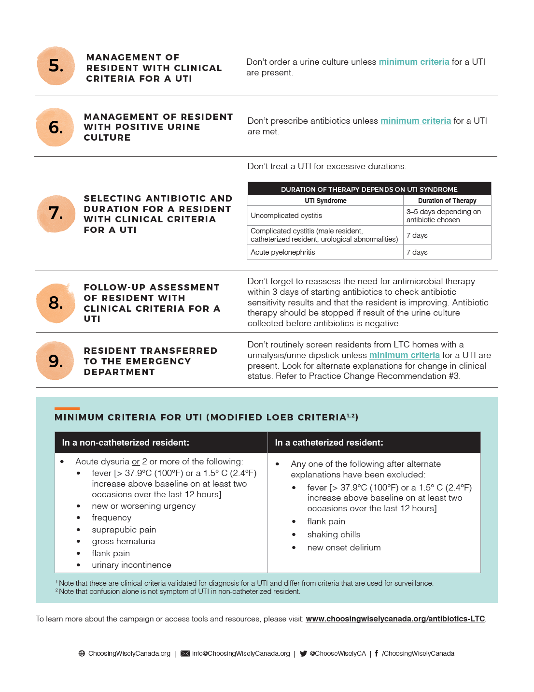
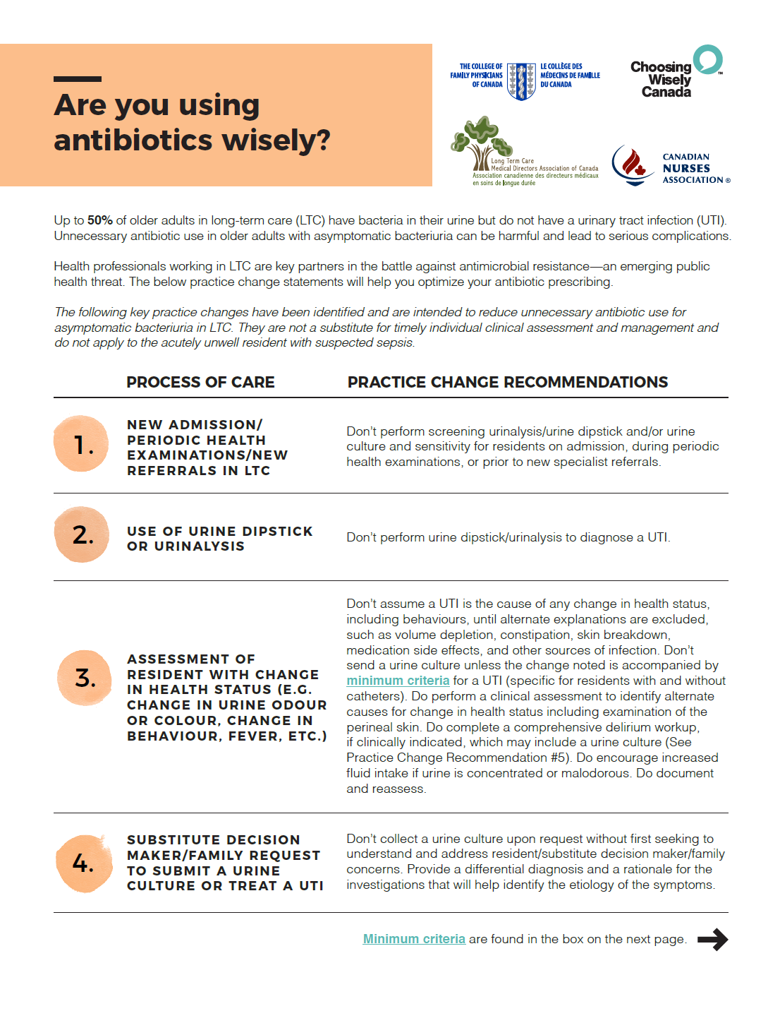
Antibiotics Wisely in LTC
www.choosingwiselycanada.org | @ChooseWiselyCA
Notes:
Vivian
GMHCS- only test urine if symptoms and signs clearly demonstrate a UTI.

Slide 35
Urine Cultures in LTC
This Photo by Unknown Author is licensed under CC BY-SA-NC
www.choosingwiselycanada.org | @ChooseWiselyCA
Notes:
Vivian
50% of those tested showing bacteria present in the absence of symptoms
Over-testing and over-treatment can lead to:
Diarrhea
C. difficile
Overuse of antibiotics contributes to increasing antibiotic-resistant organisms.
Premature Diagnostic Closure
Over-testing and treating asymptomatic bacteriuria with antibiotics can increase the risk of failure to consider other causes of changes in condition including viral illnesses such as COVID or Influenza.

Slide 36
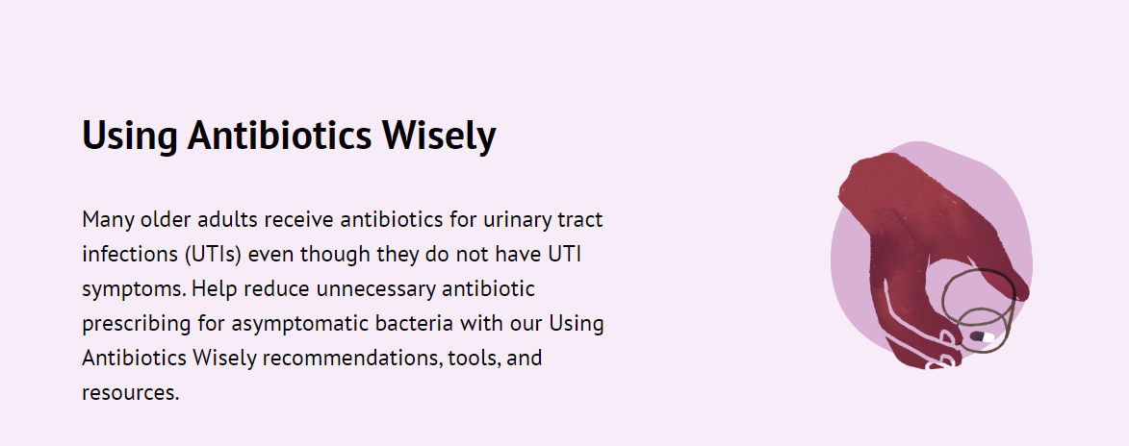
Reflect Before you Collect: Practice Change Recommendations for management of UTI in Long-Term Care
www.choosingwiselycanada.org | @ChooseWiselyCA
Notes:
Vivian

Slide 37
Practice Change Recommendations
www.choosingwiselycanada.org | @ChooseWiselyCA
Notes:
Vivian-
Referral to specialists- GMHCS/ Psychiatry

Slide 38
Practice Change Recommendations
www.choosingwiselycanada.org | @ChooseWiselyCA
Notes:
Vivian

Slide 39
Practice Change Recommendations
www.choosingwiselycanada.org | @ChooseWiselyCA
Notes:
Vivian

Slide 40
Practice Change Recommendations
www.choosingwiselycanada.org | @ChooseWiselyCA
Notes:
Vivian

Slide 41
Practice Change Recommendations
www.choosingwiselycanada.org | @ChooseWiselyCA
Notes:
Vivian

Slide 42
Resident and Caregiver resource choosingwiselycanada.org/wp-content/uploads/2017/06/UTIs-EN.pdf
www.choosingwiselycanada.org | @ChooseWiselyCA
Notes:
Vivian

Slide 43
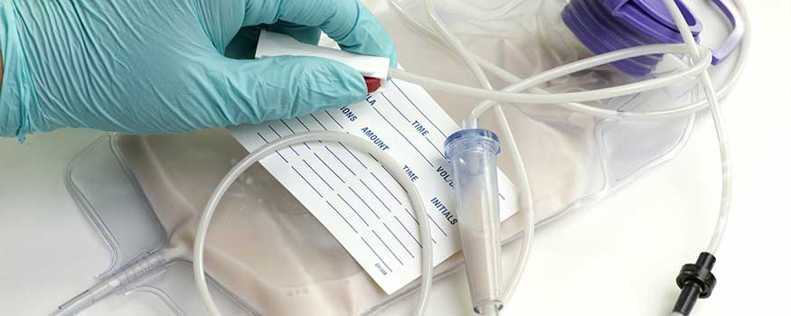
Feeding Tubes
Don’t insert a feeding tube in individuals with advanced dementia. Instead, assist the resident to eat.
www.choosingwiselycanada.org | @ChooseWiselyCA
Notes:
Sid

Slide 44
Feeding Tubes in advanced dementia
Feeding tubes do not prolong or improve quality of life in advanced dementia
Studies show that tube feeding does not make the patient more comfortable or reduce suffering
Feeding tubes are not without complications
www.choosingwiselycanada.org | @ChooseWiselyCA
Notes:
Sid
Tube Feeding causes:
Fluid overload
Diarrhea
Abdominal pain
Discomfort, agitation
Aspiration pneumonia, pressure ulcers

Slide 45
Caring for Persons with Advanced Dementia choosingwiselycanada.org/wp-content/uploads/2017/05/Feeding-tubes-EN.pdf
Review GCD* (provincial differences), Advance Care Plan/Wishes
Address other issues causing loss of appetite
Support feeding by hand
Dental care
*Goals of Care Designation
www.choosingwiselycanada.org | @ChooseWiselyCA
Notes:
Sid
Address other issues impacting loss of appetite
Constipation
Delirium
Depression
Medication side effects – sedation, dry mouth
Support feeding by hand
Finger foods, favorite foods
Support feeding by hand
Finger foods, favorite foods
Dental care
Oral pain, dentures, daily oral care

Slide 46
Long-Term Medications
Don’t continue or add long-term medications unless there is an appropriate indication and a reasonable expectation of benefit in the individual patient.
www.choosingwiselycanada.org | @ChooseWiselyCA
Notes:
Vivian

Slide 47
Long-Term Medications
Optimize medications
Seize opportunities to deprescribe
Consider impact on mobility, function, quality of life and GCD*
*Goals of Care Designation
www.choosingwiselycanada.org | @ChooseWiselyCA
Notes:
Vivian
Engage pharmacist colleagues in med rec and deprescribing.
Examples of medications that can be potentially deprescribed depending on health status and goals of care:
PPIs
Anti-hypertensives
Statins
Bisphosphonates
Antidiabetic medications – can consider target of A1C of 8.5% depending on frailty (Canadian Diabetes Association, 2018)
Keeping these medications can cause issues with mobility, function, quality of life, and mortality

Slide 48
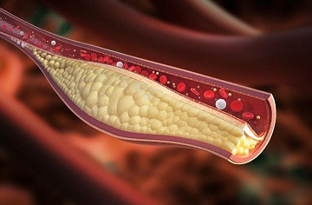
Screening and Routine Testing
Don’t order screening or routine chronic disease testing just because a blood draw is being done.
www.choosingwiselycanada.org | @ChooseWiselyCA
Notes:
Vivian

Slide 49
Screening and Routine Testing
Do not do these tests unless it adds to quality of life
Screening/routine testing could lead to harmful overtreatment in frail residents nearing end of life and misuse of resources
Individualized approach to screening based on frailty, goals of care, comorbidities, life expectancy, and patient preference
www.choosingwiselycanada.org | @ChooseWiselyCA
Notes:
Vivian

Slide 50
The Additional LTC Recommendation #7
Don’t hesitate to use virtual care to complement in-person visits in order to meet the needs of residents in long-term care during the COVID-19 pandemic.
www.choosingwiselycanada.org | @ChooseWiselyCA
Notes:
Vivian

Slide 51
Physical Presence and Virtual Care
At the beginning of COVID, regulatory boards and CMPA developed tools, renumeration changes, and policies to allow for virtual care to minimize the spread of the virus
It can be useful for non-urgent and administrative tasks, but in-person assessment should be considered for acute illness or change in condition
There should be procedures that include the availability and integration of appropriate hardware, software, privacy, and security
www.choosingwiselycanada.org | @ChooseWiselyCA
Notes:
Vivian
? Provinces still compensating for virtual care

Slide 52
A Virtual Care Innovation Example: LTC+
Virtual care innovation in the Greater Toronto Area
Linkages between LTC and hospital partners – including specialist consultation and allied health
www.choosingwiselycanada.org | @ChooseWiselyCA
Notes:
Vivian –rapid specialist link ***NEED NEW SLIDE***

Slide 53
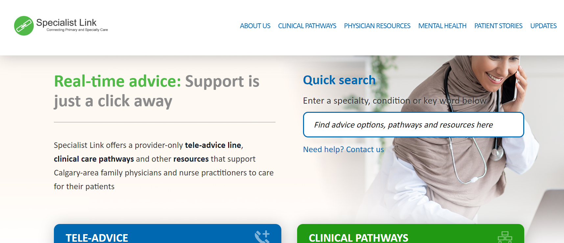
Alberta Specialist Link and e- referral programs
www.choosingwiselycanada.org | @ChooseWiselyCA
Notes:
Vivian

Slide 54
Physical Presence and Virtual Care
Telemedicine programs in nursing homes can reduce unnecessary emergency care, contribute to high quality medical care, thus decreasing hospitalization
Telemedicine should be integrated into primary care of the resident
www.choosingwiselycanada.org | @ChooseWiselyCA
Notes:
Vivian

Slide 55
Summary
Choosing Wisely is difficult in the long-term care setting but critically important
Helpful resources exist to support Choosing Wisely for advanced care planning in LTC
Using Antibiotics Wisely - Reflect before you collect
www.choosingwiselycanada.org | @ChooseWiselyCA
Notes:
Vivian
Virtual care can complement physical care

Slide 56
Discussion
“Choosing Wisely is good for the planet.”
Born K, Levinson W,
Medical Post 28 Oct 2022
https://choosingwiselycanada.org/news/patients-and-planet/?highlight=planet
Notes:
Sid- Add graphic Choosing Wisely Canada –Choosing wisely for patients and the planet.

Slide 57
References
Unnecessary Care in Canada. Choosing Wisely Canada. Canadian Institute for Health Information. 2017.
https://www.cihi.ca/en/unnecessary-care-in-canada
Levinson, W., & Huynh, T. Engaging physicians and patients in conversations about unnecessary tests and procedures: Choosing Wisely Canada. CMAJ, 2014. 186(5), 325-326.
https://www.ncbi.nlm.nih.gov/pmc/articles/PMC3956556/
Walker JD, Teare GF, Hogan DB, Lewis S, Maxwell CJ. Identifying potentially avoidable hospital admissions from Canadian long-term care facilities. Medical Care. 2009 Feb 1;47(2):250-4.
https://www.ncbi.nlm.nih.gov/pubmed/19169127
Advance Care Planning LTC COVID
https://www.speakupontario.ca/
Schneider LS, Dagerman K, Insel PS. Efficacy and adverse effects of atypical antipsychotics for dementia: meta-analysis of randomized, placebo-controlled trials. The American Journal of Geriatric Psychiatry. 2006 Mar 1;14(3):191-210.
https://www.ncbi.nlm.nih.gov/pubmed/16505124
High KP, Bradley SF, Gravenstein S, Mehr DR, Quagliarello VJ, Richards C, Yoshikawa TT. Clinical practice guideline for the evaluation of fever and infection in older adult residents of long-term care facilities: 2008 update by the Infectious Diseases Society of America. Clinical Infectious Diseases. 2009 Jan 15;48(2):149-71.
https://www.ncbi.nlm.nih.gov/pubmed/19072244

Slide 58
References
Hanson LC, Ersek M, Gilliam R, Carey TS. Oral feeding options for people with dementia: a systematic review. Journal of the American Geriatrics Society. 2011 Mar;59(3):463-72.
https://www.ncbi.nlm.nih.gov/pubmed/21391936
Dalleur O, Spinewine A, Henrard S, Losseau C, Speybroeck N, Boland B. Inappropriate prescribing and related hospital admissions in frail older persons according to the STOPP and START criteria. Drugs & aging. 2012 Oct 1;29(10):829-37.
https://www.ncbi.nlm.nih.gov/pubmed/23044639
Clarfield AM. Screening in frail older people: an ounce of prevention or a pound of trouble? J Am Geriatr Soc. 2010 Oct;58(10):2016-21. PMID: 20929471.
https://www.ncbi.nlm.nih.gov/pubmed/20929471
Johnson KL, Dumkow LE, Salvati LA, Johnson KM, Yee MA, Egwuatu NE. Comparison of diagnosis and prescribing practices between virtual visits and office visits for adults diagnosed with uncomplicated urinary tract infections within a primary care network. Infection Control & Hospital Epidemiology. 2020 Oct 29:1-6.
https://www.ncbi.nlm.nih.gov/pubmed/33118916/
Liu M, Maxwell CJ, Armstrong P, Schwandt M, Moser A, McGregor MJ, Bronskill SE, Dhalla IA. COVID-19 in long-term care homes in Ontario and British Columbia. CMAJ. 2020 Jan 1.
https://pubmed.ncbi.nlm.nih.gov/32998943/
Cai T, Tascini C, Novelli A, Anceschi U, Bonkat G, Wagenlehner F, Bjerklund Johansen TE. The Management of Urinary Tract Infections during the COVID-19 Pandemic: What Do We Need to Know?. Uro. 2022 Mar 11;2(1):55-64.
https://www.mdpi.com/1537576

Slide 59
References
Collins R, Charles J, Moser A, Birmingham B, Grill A, Gottesman M. Improving medical services in Canadian long term care homes. Canadian Family Physician. 2020 Oct 7.
https://www.cfp.ca/news/2020/10/07/10-07
Gillespie SM, Moser AL, Gokula M, Edmondson T, Rees J, Nelson D, Handler SM. Standards for the use of telemedicine for evaluation and management of resident change of condition in the nursing home. Journal of the American Medical Directors Association. 2019 Feb 1;20(2):115-22.
https://www.ncbi.nlm.nih.gov/pubmed/30691620/
Gillespie SM, Handler SM, Bardakh A. Innovation Through Regulation: COVID-19 and the Evolving Utility of Telemedicine. Journal of the American Medical Directors Association. 2020 Aug 1;21(8):1007-9.
https://www.ncbi.nlm.nih.gov/pubmed/32736843/
Unruh MA, Yun H, Zhang Y, Braun RT, Jung HY. Nursing home characteristics associated with COVID-19 deaths in Connecticut, New Jersey, and New York. Journal of the American Medical Directors Association. 2020 Jul 1;21(7):1001-3.
https://www.ncbi.nlm.nih.gov/pubmed/32674812/
Grabowski, David C., and A. James O’Malley. "Use of telemedicine can reduce hospitalizations of nursing home residents and generate savings for medicare." Health Affairs33.2 (2014): 244-250.
https://pubmed.ncbi.nlm.nih.gov/24493767/

