Slide 1


CFPC Learn In the Clinic:
Putting Evidence Into Audience Selected Cases
Drs. Jessica Kirkwood & Jennifer Young

Slide 2
Remembrance day, November 11, 2023

Slide 3
Faculty/Presenter Disclosure
Dr. Jennifer Young
  Grants/Research Support: N/A
  Speakers Bureau/Honoraria: OCFP, CFPC, PEER
  Consulting Fees: N/A
  Other: Part time Physician Advisor CFPC
Dr. Jessica Kirkwood
  Grants/Research Support: N/A
  Speakers Bureau/Honoraria: ACFP, CFPC, CPSS, MEME, PEER/PEIP
  Consulting Fees: N/A
  Other: Salaried employee of the UofA
Dr. Emélie Braschi
  Grants/Research Support: N/A
  Speakers Bureau/Honoraria: CFPC, PEER
  Consulting Fees: N/A
  Other: Part time Physician Advisor CFPC
Notes:
This slide must be visually presented to the audience AND verbalized by the speaker.

Slide 4
Mitigating Potential Bias
Presenters are asked to avoid recommending a specific organization’s product or services
Presenters are asked to avoid making personal recommendations and to present on evidence only
If a conflict of interest is presented, the presenter will be asked to avoid the topic of conflict
If a conflict of interest cannot be avoided, we will remove the presenter from the program and ask another presenter to present on the problematic portion of the content
The committee may also change the focus of the CPD activity so that the content is not about the supporting organization’s products or services (if that is the conflict)
Notes:
This slide must be visually presented to the audience AND verbalized by the speaker.

Slide 5
Objectives
Identify key features of quickly narrowing differential diagnoses on early presentations, including disease incidence.
Implement key aspects of diagnostic evaluation, including utility of differing diagnostic questions/exams/tests.
Formulate structured plans, including therapeutic interventions, for a wide variety of patient presentations.

Slide 6



A (very brief) day in the life of a family doctor
11:00: Ken Dosette (Polypharmacy)
11:15: Naomi Schiff (Driving and Dementia)
11:30: Mr. Ramakanta (Congestive Heart Failure)
1:00: Anna Ploidy (Prenatal Screening)
1:15: Farrah Lo Heavy (Menstrual Bleeding)
1:30: Norma Munroe (Insomnia treatment)
1:45: Liz Hall (C. Difficile reinfection)
14:00: Ana Flax (De-labelling penicillin allergy)
14:15: Mr. Ramakanta (Management Congestive Heart Failure)

Slide 7


Slide 8
Polypharmacy/Deprescribing
Ken Dosette

Slide 9

Mr Ken Dosette, 69
Last visit Ken was in for refills with his daughter. It seemed your medication list did not match Ken’s and he didn’t know which medications he is taking. You asked them to book the next available appointment and to come with all of his medications.
Today, his daughter Lori hands you a grocery-size plastic bag filled with medications.
Well, that’s quite the bag of medications.
Ya, I was talking to Lori on the way here. We’re wondering if there is any way to cut down all those pills.
It is a lot. Let’s start at the beginning and see which ones we can remove

Slide 10
There are many ways to approach deprescribing.
For example:
Medications causing harm should be stopped.
All other medications should have a clear indication:
  They make the patient feel better (pain, mood, sleep etc..)
  They decrease the risk of “hard outcomes” such as mortality, MI, strokes or fractures
Notes:
Example – are you prescribed anything you aren’t taking? – Free win!

Slide 11
Mr Ken Dosette, 69
Past Medical History: Hypertension, CAD (MI - 4 years ago), Prostatic hypertrophy, Squamous Cell Cancer (excised, age 62, 66), Osteoarthritis, Diabetes (type 2), COPD (ex smoker x 2 years), Depression.
Candesartan 16 mg OD | Citalopram 20mg
Carvedilol ER 20MG OD | Tamsulosin 0.4mg BID
Atorvastatin 40 mg OD | Tramacet 1-2 tabs QID, prn
Ezetimibe 10mg OD | Pantoprazole 40mg OD
ASA 81 mg OD | Zopiclone 7.5 mg hs prn
Clopidogrel 75mg OD | Salbutamol 1-2 puffs prn
Metformin 1000mg BID | Tiotropium 1 puff OD
Glyburide 5mg BID | Advair (Fluticasone 125/Salmeterol25) 2 puffs BID
Sitagliptin 100mg OD

Slide 12
Mr Ken Dosette, 69
Thanks, that’s helpful.
I am also looking at your last blood work and your bad cholesterol was about 1.6. That is really good!
I take my blood pressure like you ask me to. It’s usually around 115. The second number 60. The heart rate is also around 60.
Match the drug with the right approach:

Slide 13
Mr Ken Dosette, 69
Clopidogrel
ASA
Atorvastatin
Ezetimibe
Carvedilol
Candesartan
Match the drug with the right approach:
Stop as risk of harm
Could stop as limited benefits
Could stop as limited benefits
Continue
Continue
Continue

Slide 14
Mr Ken Dosette, 69
The Canadian Cardiovascular Society guideline recommends 6 months of Dual Anti-Platelet Therapy (DAPT) for most patients with stable angina who undergo percutaneous coronary intervention (PCI) and 1 year for patient with an Acute Coronary Syndrome (ACS).
In a 2019 systematic review, long term DAPT (>12 months) was associated with higher all cause mortality (OR 1.99) and increased major bleeding (OR 1.88).
Mr Dosette is on DAPT, had his MI 4 years ago and is at increased risk of bleeding. His Clopidogrel should be stopped
ASA
Continue
Clopidogrel
Stop as risk of harm

Slide 15
Mr Ken Dosette, 69
Systematic reviews show that in patients with CAD:
  Statins have a 16% relative reduction in total mortality
  ACEi/ARBs have a 14% relative reduction in total mortality
  Both interventions also reduce the risk of CVD (myocardial infarction and stroke)
Atorvastatin
Continue
Candesartan
Continue

Slide 16
Mr Ken Dosette, 69
Systematic-review, beta-blockers:
  Decreased mortality in the pre-perfusion era (before angiography with stenting post ACS) Relative Risk 0.86 (CI 0.79-0.94)
  Did not decrease mortality in the reperfusion era RR 0.98 (CI 0.92-1.05)
  After 3 years, there is no established role for beta-blockers post MI
RCT, patients who had an ACS in preceding 10 days, Ezetimibe + statin versus statin alone, at 7 years:
  No effect on mortality: 15.4% versus 15.3%
  Small decrease in the composite outcome including death from cardiovascular causes, MI or stroke: 20.4% versus 22.2% (p=0.003)
Ezetimibe
Could stop as limited benefits
Carvedilol
Could stop as limited benefits

Slide 17
Mr Ken Dosette, 69
Candesartan 16 mg OD | Citalopram 20mg
Carvedilol ER 20MG OD | Tamsulosin 0.4mg BID
Atorvastatin 40 mg OD | Tramacet 1-2 tabs QID, prn
Ezetimibe 10mg OD | Pantoprazole 40mg OD
ASA 81 mg OD | Zopiclone 7.5 mg hs prn
Clopidogrel 75mg OD | Salbutamol 1-2 puffs prn
Metformin 1000mg BID | Tiotropium 1 puff OD
Glyburide 5mg BID | Advair (Fluticasone 125/Salmeterol25) 2 puffs BID
Sitagliptin 100mg OD
Candesartan 16mg OD
Carvedilol ER 20mg OD
Atorvastatin 40mg OD
Ezetimibe 10mg OD
ASA 81 mg OD
Clopidogrel 75 mg OD

Slide 18
Ken Dosette, 69
Ok, let’s talk about your diabetes now. Your last A1C was 6.6, you’ve had some protein in the urine and your renal function is a little low, at 40.
I think I’m on 3 meds for diabetes: metformin, glyburide and sitagliptin.
What are your thoughts about his diabetes medications?
a) Stop or taper off Glyburide (Sulfonylurea)
b) Stop or taper off Sitagliptin (DPP-4 inhibitor)
c) Add Empagliflozin at a later visit (SGLT-2)
d) Stop all medications and switch to insulin to simplify

Slide 19
Mr Ken Dosette, 69
There are no cardiovascular or mortality benefits to using Glyburide and Sitagliptin for diabetes. Network meta-analysis examining all cause mortality, versus placebo:
  Sulfonylurea RR 1.10 (0.81-1.40)
  DPP4 RR 1.00 (0.96-1.10)
  SGLT2 inhibitor RR 0.68 (0.57-0.80)
Adverse events (RCT): Sulfonylurea increased incidence of >1 hypoglycemic events (38% on Glimepiride versus 11% on Linagliptin).
Cost of DDP-4 and SGLT-2 are comparable (around $300/ 3 months).
What are your thoughts about his diabetes medications?
a) Stop or taper off Glyburide (Sulfonylurea)
b) Stop or taper off Sitagliptin (DPP-4 inhibitor)
c) Add Empagliflozin at a later visit (SGLT-2)
d) Stop all medications and switch to insulin to simplify

Slide 20
Mr Ken Dosette, 69
Stopping Glyburide and Sitagliptin will likely increase Mr. Dosette’s HbA1C by perhaps 1.5 and another agent can be added later on (it could be immediate, shortly after stopping other drugs, or at next A1C in 3 months).
Given his Chronic Kidney Disease, empaglifozin would be a good choice. For every 100 patients with CKD treated with an SGLT2i for 5 years, ~3-4 fewer will develop end-stage kidney disease and ~3-4 fewer will die from any cause compared to placebo.
What are your thoughts about his diabetes medications?
a) Stop or taper off Glyburide
b) Stop or taper off Sitagliptin
c) Add Empagliflozin at a later visit
d) Stop all medications and switch to insulin to simplify

Slide 21
Mr Ken Dosette, 69
Insulin offers no CV benefits and is unlikely to be simpler.
What are your thoughts about his diabetes medications?
a) Stop or taper off Glyburide
b) Stop or taper off Sitagliptin
c) Add Empagliflozin at a later visit
d) Stop all medications and switch to insulin to simplify

Slide 22
To taper or not to taper?
There is often no good evidence behind tapering medications. Tapering may be considered if abrupt discontinuation causes symptoms. https://medstopper.com/ offers guidance.
It is important to find something that will work for the patient. Things to consider:
  possibility of medication errors (added complexity)
  dispensing fees (blister pack)
  fine motor skills required to split medications

Slide 23
Mr Ken Dosette, 69
How do you feel now about your medications? Less overwhelming?
Let’s keep going. We should have done this years ago... How about my puffers?
Candesartan 16 mg OD | Citalopram 20mg
Carvedilol ER 20MG OD | Tamsulosin 0.4mg BID
Atorvastatin 40 mg OD | Tramacet 1-2 tabs QID, prn
Ezetimibe 10mg OD | Pantoprazole 40mg OD
ASA 81 mg OD | Zopiclone 7.5 mg hs prn
Clopidogrel 75mg OD | Salbutamol 1-2 puffs prn
Metformin 1000mg BID | Tiotropium 1 puff OD
Glyburide 5mg BID | Advair (Fluticasone 125/Salmeterol25) 2 puffs BID
Sitagliptin 100mg OD
Candesartan 16mg OD
Carvedilol ER 20mg OD
Atorvastatin 40mg OD
Ezetimibe 10mg OD
ASA 81 mg OD
Clopidogrel 75 mg OD
Metformin 1000mg PO BID
Glyburide 5mg BID
Sitagliptin 100mg OD

Slide 24
Mr Ken Dosette, 69
Ken was hospitalized with a severe COPD exacerbation 3 years ago (while on just tiotropium) and got Advair (LABA/ICS) added at discharge. He had one moderate exacerbation 12 months ago but was managed as an outpatient.
There is no way I can climb stairs or run after my grandson. I’m still OK an flats though.
What are your thoughts about his puffers?
a) Add Roflumilast (PDE4 inhibitor)
b) Stop Tiotropium (LAMA)
c) Stop LABA/ICS combination puffer (Advair)
d) Stop both and switch to LABA/LAMA combination
(e.g Tiotropium/olodateral)

Slide 25
Mr Ken Dosette, 69
In patient with ≥1 exacerbation per year, triple therapy (LABA/LAMA/ICS), when compared to LAMA/LABA, reduces the risks of having ≥1 exacerbation per year but increases the risk of pneumonia (6.4% vs 3.9% on LAMA/LABA) and cost.
Mr Dosette had one exacerbation requiring hospitalization 3 years ago. Since then, he has had only one outpatient (moderate) exacerbation. Severe risk is classified as one hospitalized exacerbation or ≥2 managed as an outpatient in the last year. The benefit of exacerbation prevention with triple therapy for Mr Dosette is likely low over LAMA/LABA alone but carries pneumonia risk.
What are your thoughts about his puffers?
a) Add Roflumilast (PDE4 inhibitor)
b) Stop Tiotropium (LAMA)
c) Stop LABA/ICS combination puffer (Advair)
d) Stop both and switch to LABA/LAMA combination
(e.g Tiotropium/olodateral)

Slide 26
Mr Ken Dosette, 69
Roflumilast has a small benefit on COPD exacerbations (27.4% vs 31.7% on placebo), but increases psychiatric adverse events (NNH 28), weight loss (NNH 17), diarrhea and nausea.
A LAMA or LABA is the best initial long-acting therapy for COPD. Symptomatic patients on monotherapy, may benefit from LAMA/LABA combination and Ken has shortness of breath on moderate exertion.
What are your thoughts about his puffers?
a) Add Roflumilast (PDE4 inhibitor)
b) Stop Tiotropium
c) Stop LABA/ICS combination puffer (Advair)
d) Stop both and switch to LABA/LAMA combination
(e.g Tiotropium/olodateral)

Slide 27
Mr Ken Dosette, 69
I think we’ll have you come back to discuss the other ones. We’ve made lots of changes already.
Not having a whole breakfast of pills will make me feel like a young guy again!! That’s good for now but happy to cut more next time.
Candesartan 16 mg OD | Citalopram 20mg
Carvedilol ER 20MG OD | Tamsulosin 0.4mg BID
Atorvastatin 40 mg OD | Tramacet 1-2 tabs QID, prn
Ezetimibe 10mg OD | Pantoprazole 40mg OD
ASA 81 mg OD | Zopiclone 7.5 mg hs prn
Clopidogrel 75mg OD | Salbutamol 1-2 puffs prn
Metformin 1000mg BID | Tiotropium 1 puff OD
Glyburide 5mg BID | Advair (Fluticasone 125/Salmeterol25) 2 puffs BID
Sitagliptin 100mg OD
Candesartan 16mg OD
Carvedilol ER 20mg OD
Atorvastatin 40mg OD
Ezetimibe 10mg OD
ASA 81 mg OD
Clopidogrel 75 mg OD
Salbutamol 1-2 puffs prn
Metformin 1000mg PO BID
Tiotropium / Olodateral
Glyburide 5mg BID
Advair (LAMA/ ICS) 2 puffs BID
Sitagliptin 100mg OD
Tiotropium 1 puff OD

Slide 28

Mr Ken Dosette, 69
Plan:
  Stop: Ezetimibe, Clopidogrel, Glyburide, Sitagliptin, Tiotropium, Advair
  Taper off: Carvedilol
  Continue: Candesartan, Atorvastatin, ASA, Metformin
  Start: LAMA/LABA combination inhaler and empaglifozin (now or in a follow-up visit soon)
  You make a follow-up appointment to discuss the rest of his medications.

Slide 29
Driving and Dementia
Naomi Schiff

Slide 30
Ms Naomi Schiff, 75
Ms. Schiff is in with her husband. She was recently discharged from the Geriatric Rehab inpatient unit after a hip fracture. She was told to follow up with you regarding her driving.
Notes:
Famous F1 racer

Slide 31
Ms Naomi Schiff, 75
Ms. Schiff is in with her husband. She was recently discharged from the Geriatric Rehab inpatient unit after a hip fracture. She was told to follow up with you regarding her driving.
You will not believe it… It’s bad enough I get a hip fracture. Somehow, they thought my brain and my hip are connected. They asked me to draw clocks and other things.
Next thing you know, they tell me that I have dementia and that I shouldn’t drive until I see my family doctor. Here are the papers they gave me for you to fill out. I have a few others too.

Slide 32
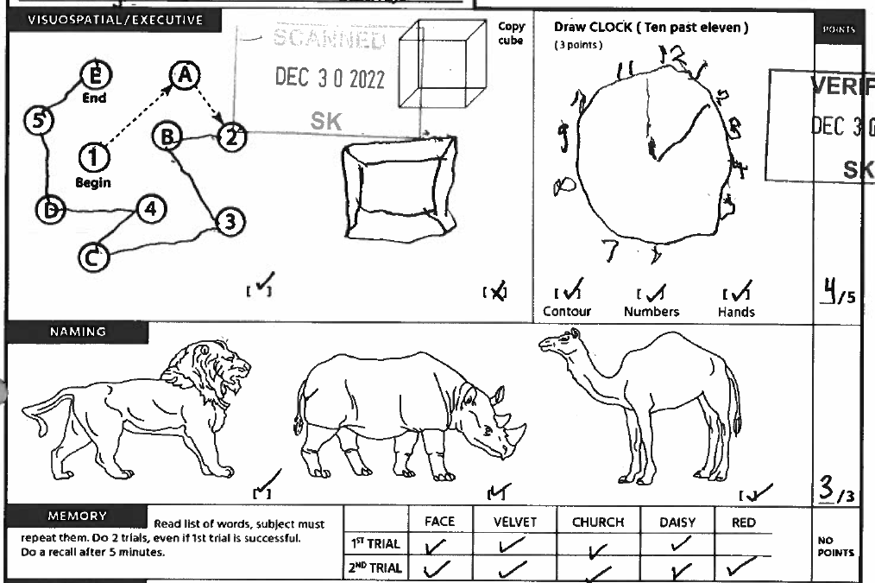
Ms Naomi Schiff, 75
Let’s see your MoCA
Score 22
(she has hand arthritis impacting her writing)

Slide 33
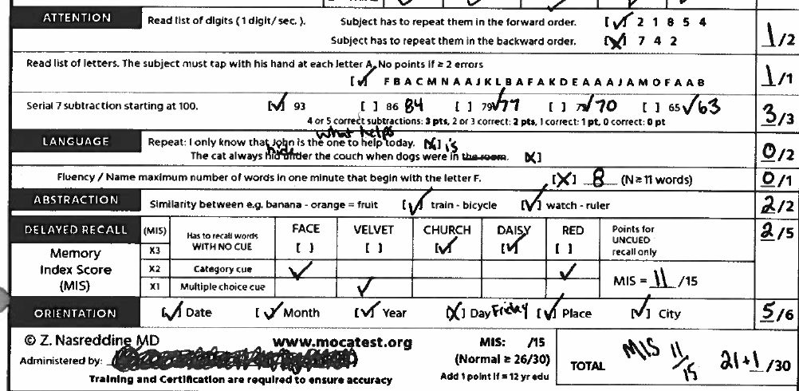
Ms Naomi Schiff, 75
MoCA, score 22
(she has hand arthritis impacting her writing)

Slide 34
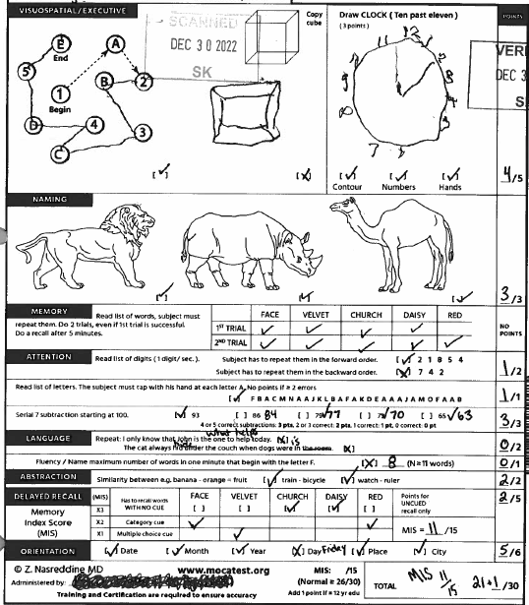
Ms Naomi Schiff, 75
MoCA, score 22
(she has hand arthritis impacting her writing)
Ms Schiff’s score shows cognitive dysfunction and she cannot drive:
True
False
We need more information

Slide 35
Ms Naomi Schiff, 75
Dementia is a diagnosis that requires cognitive impairment AND reduced level of function due to cognition.
Ms. Lombardi’s MoCA score (22/30) shows cognitive impairment. She requires a functional assessment to determine whether ADLs (Activities of Daily Living) or iADLS (instrumental Activities of Daily Living) are limited due to cognition.
The MoCA is helpful but not sufficient to diagnose dementia. Cochrane review, cut-off of 26/30 for the detection of dementia:
    Sensitivity: 94% (good to rule out dementia if the score is normal)
    Specificity: 60% (not great to rule in dementia if the score is low)
Ms Schiff’s score shows cognitive dysfunction and she cannot drive:
True
False
We need more information

Slide 36
Ms Naomi Schiff, 75
Driving is complicated, relying on good cognition, and functioning sensory, motor and visual systems.
To assess fitness to drive, there are no randomized controlled trials and cohort studies show conflicting results. As such:
  There is no one test or combination of tests that can be done in the clinic to reliably tell whether a patient is or isn’t fit to drive.
  For a given test, there are often no well validated cut-off points but the worse the result, the less likely the fitness to drive.
Some patients with mild cognitive impairment or mild dementia are able to continue driving, at least in the short term.
Ms Schiff’s score shows cognitive dysfunction and she cannot drive:
True
False
We need more information

Slide 37
Ms Naomi Schiff, 75
Let’s see. Can I ask Steve how things have been going at home?
Of course! I’m doing everything like I used to. Sometimes I need a little help to get dressed due to my arthritis….
What I really want to know is when can I get back to driving.
Which of the statements below would be enough to have you tell Ms. Schiff that she can’t drive anymore?
She can’t dress on her own due to her cognition
She can’t cook on her own due to her cognition
She needs help to cook AND take her medications due to her cognition
She has neck osteoarthritis and can’t move her neck from side to side

Slide 38
Ms Naomi Schiff, 75
CMA Drivers Guide:
Moderate or severe dementia is a contraindication to driving:
  Impairment in ≥2 iADL due to cognition (SHAFT mnemonic: Shopping, Housework/Hobbies, Accounting [banking, bills, taxes], Food preparation, Telephone/Tools/Transportation)
  Impairment in ≥1 ADL due to cognition (DEATH mnemonic: Dressing, Eating, Ambulation, Toileting/Transfers, Hygiene)
Which of the statements below would be enough to have you tell Ms. Schiff that she can’t drive anymore?
She can’t dress on her own due to her cognition
She can’t cook on her own due to her cognition
She needs help to cook AND take her medications due to her cognition
She has neck osteoarthritis and can’t move her neck from side to side

Slide 39
Driving is an iADL!
Things to look out for are changes in driving skills, getting lost while driving, car accidents, fender-benders in parking lots, tickets (going too slowly, failing to stop), being criticized by friends or family members.
There is little research evaluating the validity of family members’ worries regarding fitness to drive. However, for the assessment of cognitive dysfunction, collateral information is always important.

Slide 40
Ms Naomi Schiff, 75
The CMA guide recommends cognitive assessment (MMSE, Trail B and Clock drawing tests) with no specific cut-off points.
Clear abnormalities would likely be contraindications to driving.
Borderline results may warrant on-road testing. This may need to be repeated every 6-12 months as the dementia progresses.
Which of the statements below would be enough to have you tell Ms. Schiff that she can’t drive anymore?
She can’t dress on her own due to her cognition
She can’t cook on her own due to her cognition
She needs help to cook AND take her medications due to her cognition
She has neck osteoarthritis and can’t move her neck from side to side

Slide 41
Ms Naomi Schiff, 75
Other issues to consider:
  Physical inability to drive a car (weakness, coordination or sensory issues that impact ability to use the steering wheels, pedals or shoulder check)
  Visuospatial issues (visual acuity, visual fields)
  Conditions that could alter focus on the road or lead to loss of consciousness (seizures, cardiac arrythmia, hypoglycemia, alcohol…)
Which of the statements below would be enough to have you tell Ms. Schiff that she can’t drive anymore?
She can’t dress on her own due to her cognition
She can’t cook on her own due to her cognition
She needs help to cook AND take her medications due to her cognition
She has neck osteoarthritis and can’t move her neck from side to side

Slide 42
Ms Naomi Schiff, 75
You confirm that Ms. Schiff is able to do all her ADLs on her own. Her family has been helping her with iADLs but it is not clear if it is because of cognition. She does have a hard time lifting heavy pans due to her arthritis, but her fine motor skills are sufficient to use a steering wheel safely.
Sounds like you may have some mild memory issues. Did they do any other tests in rehab?
Yes, they did and I brought the test results with me. I’m not sure why this trail thing is relevant but whatever.

Slide 43
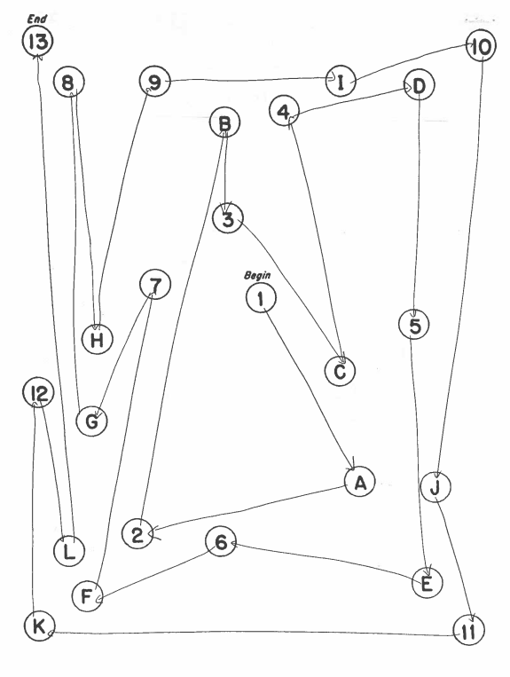
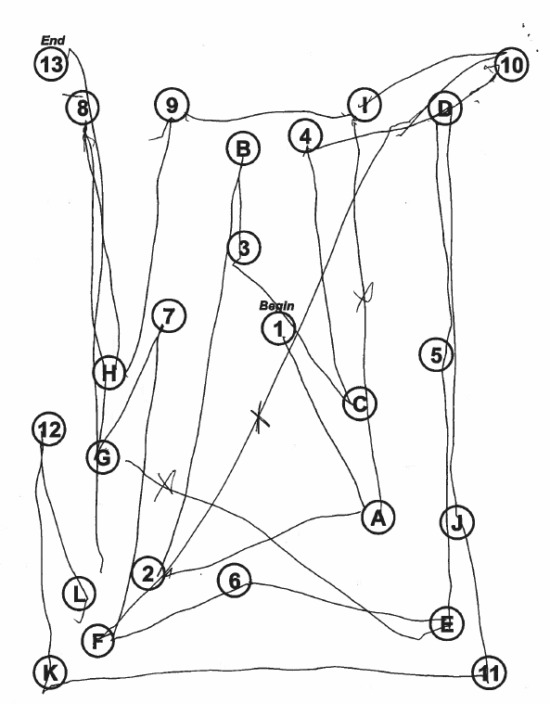
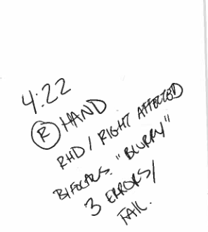
4 minutes
22 seconds
3 errors
Sample Trail B
Ms Schiff’s Trail B
Regarding Ms Schiff’s Trail B test, on the right (pick the false answer):
This test can’t be used in isolation to determine driving abilities
A score with 3 errors is a fail
A score of 4 minutes 22 seconds is a pass

Slide 44
Ms Naomi Schiff, 75
A score of >3minutes or ≥3 errors is a “fail” – the longer it takes and the more errors, the more certain that the patient is not safe to drive.
A score of 2-3 minutes or 2 errors is unclear.
A score of <2 minute and 0 or 1 error is a pass.
Regarding Ms Schiff’s Trail B test, on the right (pick the false answer):
This test can’t be used in isolation to determine driving abilities
A score with 3 errors is a fail
A score of 4 minutes 22 seconds is a pass

Slide 45
It’s not easy!
Most people will outlive their “driving expectancy” by 7-10 years, yet most don’t plan ahead for the day they won’t be able to drive. Addressing fitness to drive is one of the hardest jobs of primary care providers. The lack of a one size fits all approach makes it even more challenging. It is not uncommon for primary care providers to fear damaging the doctor-patient relationship and to negatively impact the patient’s quality of life.

Slide 46
Ms Naomi Schiff, 75
Well, Ms Schiff. I am sorry to say, but the trail test gives us some idea of how safe you will be on the road. I’m worried you shouldn’t be driving.
This makes no sense to me.
I know it feels weird. These tests tell us about your memory, your ability to switch tasks, to perceive relationships of objects in space, to concentrate. All important things on the road… It would be awful if something were to happen to you or someone else.
Ok, how about at least repeating them… I was all dopey when they did it. It was right after my surgery.

Slide 47
Ms Naomi Schiff
I just need you to know that while it is not my legal duty to report medical conditions that may affect driving, it is yours. I don't do on-road testing, of course. Let's re-do your testing and if there are still problems, I would have to suggest that you do an on-road assessment if you still want to drive. Unfortunately, you would have to pay for it…
The MMSE and MoCA have good test-retest reliability. A change of ≥ 5 points on the MMSE and 3 points on the MoCA would be needed to show a “real” change (improvement or deterioration). There is less data for Trail B. Delirium post surgery or narcotics could definitely impact cognition.

Slide 48
Ms Naomi Schiff
Plan:
  Ms Schiff agrees to stop driving for now
  You book a follow-up appointment to do a repeat MoCA and Trail B.

Slide 49
Congestive Heart Failure
Mr. Ramakanta

Slide 50
Mr Ramakanta, 75
You have been following Mr. Ramakanta since his heart attack 5 years ago. He is taking ASA, Atorvastatin 80mg and Amlodipine 5mg. He has never smoked.
I’m not sure what’s wrong but I can’t sleep at night. I wake up gasping for air.
How is your breathing during the day?
I’ve never been a high school athlete you know, but it has never been that bad. The nights are just awful. I’ve had to sleep in my wife’s lazy boy.

Slide 51
Mr Ramakanta, 75
Mr. Ramakanta’s symptoms have been worsening over the last 3 months. He has had no chest pain, cough, or fever. He has had no recent chest infections.
On further questioning he has been limiting his physical activity due to shortness of breath and he is now relying on his son to do the shopping.
He has never needed puffers in the past.
My wife, you know her, is pretty convinced I have sleep apnea. She suggested I ask you to give me one of those breathing machines.
Let’s examine you then we’ll see.

Slide 52
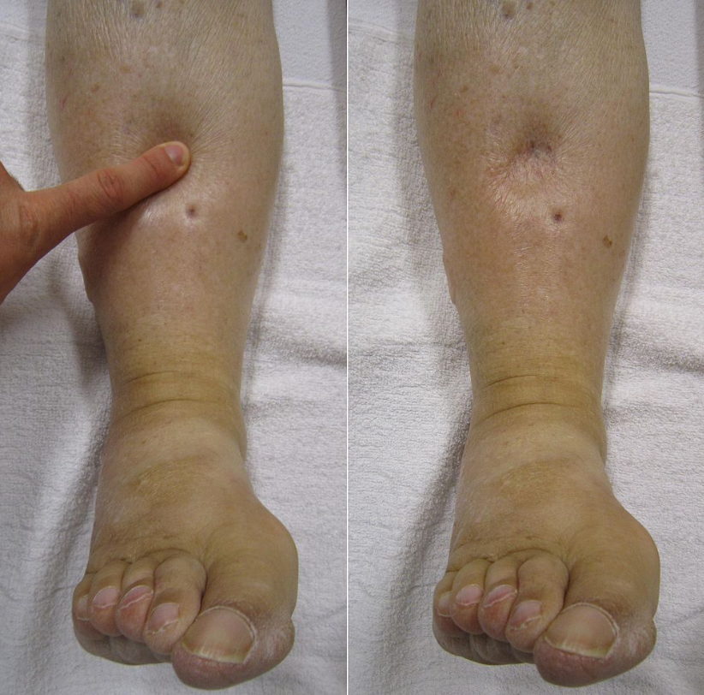
Mr Ramakanta, 75
Mr Ramakanta’s vitals are within normal limits. He looks well with no increased work of breathing.
Heart sounds are normal. He has bilateral basilar crackles.
He has 2+ bilateral pitting pedal edema, which was not present last time you saw him.
Heilman J., (Photographer), October 2010
Wikipedia contributors. "Edema." Wikipedia, The Free Encyclopedia.
Wikipedia, The Free Encyclopedia, 17 Nov. 2022. Web. 24 Nov. 2022.

Slide 53
Mr Ramakanta, 75
Mr Ramakanta’s vitals are within normal limits. He looks well with no increased work of breathing.
Heart sounds are normal. He has bilateral basilar crackles.
He has 2+ bilateral pitting pedal edema, which was not present last time you saw him.
Which of the following is the most useful to diagnose heart failure?
History of myocardial infarction
Initial clinical judgement
Peripheral edema
Orthopnea

Slide 54
Mr Ramakanta, 75
There is no single element of the history and physical examination that will lead to a diagnosis of heart failure with great certainty. Research is limited by the paucity of studies done in primary care.
For a given test, the higher the LR+, the more useful it is to make a diagnosis. LR+ of <5 are, at best, moderately useful.
Which of the following is the most useful to diagnose heart failure?
History of myocardial infarction LR+ = 3.1
Initial clinical judgement LR+ = 4.4
Peripheral edema LR+ = 2.3
Orthopnea LR+ = 2.2

Slide 55
Mr Ramakanta, 75
It is usually the constellation of signs and symptoms that makes one suspect the diagnosis of heart failure.
In a cohort of 122 patients with suspected heart failure in primary care, the prevalence of heart failure was ~30%. Most common alternate diagnoses were COPD, obesity, angina and venous insufficiency.
Which of the following is the most useful to diagnose heart failure?
History of myocardial infarction LR+ = 3.1
Initial clinical judgement LR+ = 4.4
Peripheral edema LR+ = 2.3
Orthopnea LR+ = 2.2

Slide 56
What about the JVP?
For patients seen in a cardiology office, the sensitivity of the JVP was only ~53%. The absence of an elevated JVP is therefore not useful to rule-out heart failure.
The test had better specificity (84%), however, in a cohort of patients presenting in the Emergency Room, inter-rater reliability was very poor (Kappa=0.08, with <0.40 consider poor).
It is not known how well the test performs in primary care.

Slide 57
Mr Ramakanta, 75
I’m worried that you may have heart failure. It can happen after a heart attack. Your heart can’t squeeze as well and you have fluid accumulating in your lungs and legs.
That doesn’t sound good. How do we find out?
Which test, if positive could support a diagnosis of heart failure?
Cardiac echocardiogram
12-lead ECG
BNP or NTproBNP if available
Chest X-Ray (CXR)
CBC, Creatinine, Electrolytes

Slide 58
Mr Ramakanta, 75
A cardiac echocardiogram is the most widely accepted method to identify systolic dysfunction (EF<40%).
Cardiac echocardiogram can assist in diagnosing diastolic heart failure (elevated left atrial pressure, impaired left ventricular relaxation, decreased compliance). However, diagnosing diastolic heart failure is often clinical without conclusive echocardiogram findings.
Which test, if positive could support a diagnosis of heart failure?
Cardiac echocardiogram
12-lead ECG
BNP or NTproBNP if available
Chest X-Ray (CXR)
CBC, Creatinine, Electrolytes

Slide 59
Mr Ramakanta, 75
BNP (and NTpro-BNP) can help rule-in and rule-out heart failure.
  For example, imagine we guess the chance of heart failure is ~30% (pre-test probability): the post-test probability is 3% with a BNP<50 (LR=0.08) and 65% with a BNP of >150 (LR=5).
A CXR can be useful to “rule in” or make the diagnosis of heart failure (specificity ~83%, sensitivity ~67%). Findings of importance are cardiomegaly, interstitial edema, pleural effusion, pulmonary vessel cephalization.
Which test, if positive could support a diagnosis of heart failure?
Cardiac echocardiogram
12-lead ECG
BNP or NTproBNP if available
Chest X-Ray (CXR)
CBC, Creatinine, Electrolytes

Slide 60
Mr Ramakanta, 75
ECGs provide other valuable information such as the heart rhythm, rate and QRS duration but findings not specific to heart failure
Other tests help rule out other non-cardiac diagnoses.
  Pulmonary Function Tests
  Lab: TSH, CBC to rule out anemia, Cr, urinalysis, AST, ALT to rule out edema from renal or liver failure
Which test, if positive could support a diagnosis of heart failure?
Cardiac echocardiogram
12-lead ECG
BNP or NTproBNP if available
Chest X-Ray (CXR)
CBC, Creatinine, Electrolytes

Slide 61
Mr Ramakanta, 75
Let’s do some blood-work, a CXR, an ECG and most likely a cardiac echocardiogram.
Are you sure?
I don’t feel that sick…
You are pretty short of breath sleeping and walking!
Which of the following are appropriate next steps?
Stop Amlodipine
Start Amiloride
Start Furosemide
Change ASA to Clopidogrel
Start Ezetimibe
Notes:
He is taking ASA, Atorvastatin 80mg and Amlodipine 5mg

Slide 62
Mr Ramakanta, 75
Amlodipine commonly causes peripheral edema. In a 2011 systematic review: 12% of patients on calcium channel blockers like amlodipine had peripheral edema versus 3.2% with placebo.
Which of the following are appropriate next steps?
Stop Amlodipine
Start Amiloride
Start Furosemide
Change ASA to Clopidogrel
Start Ezetimibe

Slide 63
Mr Ramakanta, 75
With dyspnea, orthopnea, basilar crackles and a history of heart attack, you have a high suspicion for heart failure. The peripheral edema could be caused by heart failure or the amlodipine.
Heart failure is a clinical diagnosis, and it is appropriate to treat symptoms of congestion while waiting for the investigations.
Furosemide is used first line, for example Furosemide 40mg PO daily. If Furosemide is working, patients should notice that they are urinating more.
Which of the following are appropriate next steps?
Stop Amlodipine
Start Amiloride
Start Furosemide
Change ASA to Clopidogrel
Start Ezetimibe

Slide 64
Mr Ramakanta, 75
There is evidence for Amiloride in decompensated hospitalized patients with heart failure, it would not be appropriate for the outpatient setting.
There is no need to change ASA to Clopidogrel or to add Ezetimibe.
Which of the following are appropriate next steps?
Stop Amlodipine
Start Amiloride
Start Furosemide
Change ASA to Clopidogrel
Start Ezetimibe

Slide 65
Mr Ramakanta, 75
Plan:
  You strongly suspect heart failure.
  You order BNP (if available), CBC, Cr, Na, K, TSH, a urinalysis, CXR and an ECG
    If BNP>50pg/mL you will order a cardiac ECHO
    BNP testing in the community in some provinces costs in the range of $80
  You stop Amlodipine
  You start Furosemide 40mg PO daily (morning)
  You make a follow-up appointment in 2-3 days with some repeat labs (Cr, K, Na). If the BNP<50pg/mL you will need to consider other etiologies for his symptoms.
  You ask him to go to the ER if his symptoms worsen

Slide 66
Annie Ploidy
Prenatal screening for Fetal Anomalies

Slide 67

Annie Ploidy, 36
Annie is a new patient to you. She has just let you know that she has a positive home pregnancy. Her last menstrual period was about 7 weeks ago. She is 36 years old, G3P1, with a three-year old at home.
She is otherwise healthy and has started on prenatal vitamins about 6 months ago.

Slide 68
Annie Ploidy, 36
There are the routine blood tests and we should talk about additional screening for genetic abnormalities.
Sure - I did the genetic blood test last time, but I figure I will just go for an amniocentesis this time.
Are there any people with chromosomal abnormalities in your family or in your husband’s?
No, there are not.

Slide 69
Annie Ploidy, 36
Which investigations are recommended for prenatal screening for aneuploidy and major congenital anomalies? (Choose all that apply)
Nuchal translucency at 11 to 14 weeks
Ultrasound at 18 weeks
Multiple Marker Screening in first and/or second trimester
Direct referral to either amniocentesis or chorionic villous sampling if age>= 35
It depends on what province you live in

Slide 70
Annie Ploidy, 36
First trimester ultrasound between 11-14 weeks is recommended.
Accurate dating
Nuchal translucency
Early identification of major fetal abnormalities and twins
Which investigations are recommended for prenatal screening for aneuploidy and major congenital anomalies? (Choose all that apply)
Nuchal translucency at 11 to 14 weeks
Ultrasound at 18 weeks
Multiple Marker Screening in first and/or second trimester
Direct referral to either amniocentesis or chorionic villous sampling if age>= 35
It depends on what province you live in

Slide 71
Ultrasound at 11-14 weeks:
A nuchal translucency of >3.5 mm is associated with increased risk of structural abnormalities as well as chromosomal abnormality and should be referred for genetic counselling with an offer for invasive prenatal testing.
Any fetal structural abnormality should be referred for genetic counselling with an offer for invasive prenatal testing.
Annie Ploidy, 36
Which investigations are recommended for prenatal screening for aneuploidy and major congenital anomalies? (Choose all that apply)
Nuchal translucency at 11 to 14 weeks
Ultrasound at 18 weeks
Multiple Marker Screening in first and/or second trimester
Direct referral to either amniocentesis or chorionic villous sampling if age>= 35
It depends on what province you live in

Slide 72
Annie Ploidy, 36
Second trimester ultrasound is required to rule out neural tube defects
  Additional fetal anatomy scan
Which investigations are recommended for prenatal screening for aneuploidy and major congenital anomalies? (Choose all that apply)
Nuchal translucency at 11 to 14 weeks
Ultrasound at 18 weeks
Multiple Marker Screening in first and/or second trimester
Direct referral to either amniocentesis or chorionic villous sampling if age>= 35
It depends on what province you live in

Slide 73
Annie Ploidy, 36
First trimester serum markers are most commonly free-beta Human Chorionic Gonadotrophin (ßhCG) and Pregnancy associated plasma protein-A (PAPP-A), Alpha Fetal Protein (AFP) and Placental Growth Factor (PGIF)
Second trimester serum markers are most commonly “QUAD” testing of AFP, free ßhCG, unconjugated estrogen (UE3), inhibin A
Which investigations are recommended for prenatal screening for aneuploidy and major congenital anomalies? (Choose all that apply)
Nuchal translucency at 11 to 14 weeks
Ultrasound at 18 weeks
Multiple Marker Screening in first and/or second trimester
Direct referral to either amniocentesis or chorionic villous sampling if age>= 35
It depends on what province you live in

Slide 74
Annie Ploidy, 36
Provinces vary significantly in programs for prenatal screening for aneuploidy including Multiple Marker serum test, Nuchal Translucency Ultrasound, and Cell-free DNA testing.
Nuchal translucency is provided either routinely, in some populations or in response to a positive first trimester Multiple Marker Serum screen.
Which investigations are recommended for prenatal screening for aneuploidy and major congenital anomalies? (Choose all that apply)
Nuchal translucency at 11 to 14 weeks
Ultrasound at 18 weeks
Multiple Marker Screening in first and/or second trimester
Direct referral to either amniocentesis or chorionic villous sampling if age>= 35
It depends on what province you live in

Slide 75
Annie Ploidy, 36
Screening Test | Sensitivity* for Trisomy 21
First trimester serum markers alone | 70
Nuchal translucency (NT) alone | 71
First trimester serum and NT | 87
First and second trimester serum | 85-87
First and second trimester serum and NT | 92-95
Second trimester serum alone (QUAD) | 74-83
*when Specificity set at 95% (=False Positive Rate set at 5%). Specificity can be “set” by moving the threshold for a positive test in a test that has a continuous value.

Slide 76
Annie Ploidy, 36
Age alone is considered poor minimum standard for referral for invasive fetal diagnostic testing. (SOGC 2017)
  11-14 week ultrasound and/or Multiple Marker serum screening advised (depending on province) as an initial test
Which investigations are recommended for prenatal screening for aneuploidy and major congenital anomalies? (Choose all that apply)
Nuchal translucency at 11 to 14 weeks
Ultrasound at 18 weeks
Maternal marker screening in first and/or second trimester
Direct referral to either amniocentesis or chorionic villous sampling if age>= 35
It depends on what province you live in

Slide 77
Annie Ploidy, 36
There are a bunch of blood tests that can be used at different times in pregnancy.
Yes, I had a look at them and couldn’t figure it out. I had a friend who just paid for a more accurate one?
Yes,
there is a relatively new test that you can pay for but it is sometimes funded by the province.

Slide 78
Annie Ploidy, 36
Which statements about cell free DNA (cfDNA) testing or Non-Invasive Prenatal Test (NIPT) are true:
Detects fetal DNA derived from the chorionic villi in maternal blood
It is best done after 10 weeks gestational age
Leads to fewer invasive procedures for prenatal diagnosis
Is too expensive in a publicly funded system
It can replace diagnostic testing (amniocentesis or chorionic villous sampling (CVS)).

Slide 79
Annie Ploidy, 36
cfDNA: detects circulating fetal DNA from the trophoblastic layer of the chorionic villi
fetal fraction of DNA is variable and increases with gestational age to about 10% at 11 weeks. Failed results (no-call) occur with lower fetal fraction, more common at earlier gestational age. Hence it is recommended to do this after 10 weeks gestational age.
Which statements about cell free DNA (cfDNA) testing or Non-Invasive Prenatal Test (NIPT) are true:
Detects fetal DNA derived from the chorionic villi in maternal blood
It is best done after 10 weeks gestational age
Leads to fewer invasive procedures for prenatal diagnosis
Is too expensive in a publicly funded system
It can replace diagnostic testing (amniocentesis or chorionic villous sampling (CVS)).

Slide 80
Annie Ploidy, 36
cfDNA testing can be cost effective if certain conditions apply (i.e.“contingent” approach): For example in Ontario, it is funded for:
  screen-positive result from multiple marker screening
  maternal age > 40 years at estimated due date
  concerning findings on fetal ultrasound
  previous pregnancy with aneuploidy
Which statements about cell free DNA (cfDNA) testing or Non-Invasive Prenatal Test (NIPT) are true:
Detects fetal DNA derived from the chorionic villi in maternal blood
It is best done after 10 weeks gestational age
Leads to fewer invasive procedures for prenatal diagnosis
Is too expensive in a publicly funded system
It can replace diagnostic testing (amniocentesis or chorionic villous sampling (CVS)).

Slide 81
Annie Ploidy, 36
Ontario cost analysis (2019) found that total cost of contingent cfDNA was slightly lower than that of traditional prenatal screening, mainly because of the reduced volume of diagnostic testing.
Cost of blood tests: cfDNA test ~$350-400 (ON)
  Multiple marker screening - $125-187 (ON)
Which statements about cell free DNA (cfDNA) testing or Non-Invasive Prenatal Test (NIPT) are true:
Detects fetal DNA derived from the chorionic villi in maternal blood
It is best done after 10 weeks gestational age
Leads to fewer invasive procedures for prenatal diagnosis
Is too expensive in a publicly funded system
It can replace diagnostic testing (amniocentesis or chorionic villous sampling (CVS)).

Slide 82
From Ontario data of 261,096 pregnancies between September 2016 and March 2019 cfDNA (using contingent approach)
Reduction of prenatal diagnostic testing from 4.4% (from a pre-cfDNA cohort) to 2.4%.
Women’s autonomy protected: Overall uptake of prenatal diagnostic testing (amnio or chorionic villous sampling) after cfDNA screen positive result was 65%. This indicates that 2/3 of women are choosing to go for invasive testing after a positive screen, and 1/3 are not.
Annie Ploidy, 36
 | Cell free DNA |  | Multiple Marker Screening
 | T21 | T18 | T21 | T18
Sensitivity | 99.8 | 94.4 | 86.3 | 76.8
Specificity | 99.8 | 99.9 | 99.8 | 99.8
Positive Predictive Value | 92 | 90.3 | 3.9 | 17.8
Negative Predictive Value | >99.9 | 99.9 | 99.8 | 99.9

Slide 83
cfDNA "is not a substitute for invasive for invasive testing" (SOGC 2017)
  Positive predictive value (PPV) decreases in lower prevalence populations (but same sensitivity and specificity).
Annie Ploidy, 36
 | Sensitivity | Specificity | Age 25 PPV | Age 40 PPV
T21 | 99.3 | 99.8 | 33 | 87
T18 | 97.4 | 99.8 | 13 | 68
T13 | 91.6 | 99.6 | 9 | 57
Adapted from SOGC 2017, data from Obstet gynecol 2014;126:e31-7

Slide 84
Annie Ploidy, 36
False positives are from placental mosaicism where the placenta (the source of the fetal DNA detected in the maternal circulation) may have a chromosomal abnormality but the fetus doesn’t.
Which statements about cell free DNA (cfDNA) testing or Non-Invasive Prenatal Test (NIPT) are true:
Detects fetal DNA derived from the chorionic villi in maternal blood
It is best done after 10 weeks gestational age
Leads to fewer invasive procedures for prenatal diagnosis
Is too expensive in a publicly funded system
It can replace diagnostic testing (amniocentesis or chorionic villous sampling (CVS)).

Slide 85
Annie Ploidy, 36
Too bad that more accurate test can’t just replace the amniocentesis. I was also reading that the miscarriage rate is high!
Miscarriage rate with chorionic villous sampling is 3% and amniocentesis is 1 %.
True/false

Slide 86
Annie Ploidy, 36
Miscarriage rate is quoted as 0.5-1% for amniocentesis and and 0.5-1.0% CVS (SOGC 2015) but a recent meta-analysis found it to be ~ 0.1% and ~ 0.2%
Amniocentesis <15 weeks has been associated with talipes equinus (club foot) so earlier invasive testing is CVS, done either transcervical or transabdominally, depending on expertise of operators.
Miscarriage rate with chorionic villous sampling is 3% and amniocentesis is 1 %.
True/false

Slide 87
Annie Ploidy, 36
After answering a few more of her questions, Annie says she will talk to her partner about proceeding.
She is pretty sure she is going to go ahead with serum testing, so you fill out the requisitions for routine prenatal blood work.
You fill out the ultrasound for nuchal translucency after 11 weeks and for the prenatal screening that applies to your area.
You tell her that she needs to arrange the screening blood test for the same day as the ultrasound.
She thanks you and is excited about proceeding with prenatal care under your guidance!

Slide 88
Heavy Menstrual Bleeding
Farrah Lo

Slide 89
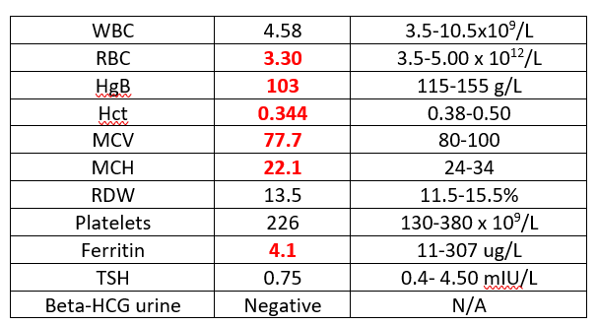
Farrah Lo, 27
Farrah returns after starting ferrous gluconate 300 bid 2 weeks ago to review her heavy menstrual bleeding. She has had heavy menses since menarche.
I must say, I started to feel a bit more energy taking the iron!
But I have my period now and I am going through a super tampon every few hours! I can’t take this anymore, I have had to leave work the last two days!

Slide 90
Farrah Lo, 27
From before you noted that Farrah had no remarkable PMH and no family history of celiac disease, colon cancer, other GI disorders. Her TSH was normal.
No, I haven’t noticed anything myself and I don’t know of anything in my family.
Have you ever had unexpected bleeding? Does anyone in your family have a bleeding disorder?
On exam: BP: 104/62 HR: 72

Slide 91
Farrah Lo, 27
What testing would be indicated?
Von Willebrand factor and antigen
Ultrasound
Nothing

Slide 92
Farrah Lo, 27
Von Willebrand Disease
  Prevalence in women with menorrhagia could be 10-18%
  Usually associated with other unusual bruising/bleeding.
  Difficult to diagnose, rely on a combination of clinical features and laboratory assessment of von Willebrand factor antigen (VWF:Ag), von Willebrand factor functional activity (VWF:Ac) or FVIII assay
    These serum markers fluctuate within the same woman at different phases of menstrual cycle
What further testing would be indicated?
Von Willebrand factor and antigen
Ultrasound
Nothing

Slide 93
Farrah Lo, 27
Though Heavy Menstrual Bleeding has been defined as >80ml/cycle, blood loss volume does not correlate with patient experience or poor iron status except at >120ml/cycle blood loss.

Slide 94
Farrah Lo, 27
Very limited data exists comparing desmopressin (von Willebrand specific treatment) to other treatments for menorrhagia
  One Cochrane review in patients with bleeding disorders found a single study (N=116) that showed better reduction in menstrual blood loss with tranexamic acid compared to desmopressin (p<0.0002)
Trials that examine treatment for menorrhagia do not routinely check for von Willebrand Disease but given its prevalence of 10-18% in women with menorrhagia, these women are likely included in the trials of management.
What further testing would be indicated?
Von Willebrand factor and antigen
Ultrasound
Nothing

Slide 95
Farrah Lo, 27
SOGC Guidelines for Abnormal Uterine Bleeding (2018)
If imaging is indicated, transvaginal ultrasound should be the first line imaging modality for abnormal uterine bleeding
Indications for imaging would be suspicion for uterine fibroids (unlikely in a 27 year old), adenomyosis, endometrial polyps, uterine arterial-venous malformation.
What further testing would be indicated?
Von Willebrand factor and antigen
Ultrasound
Nothing

Slide 96
Farrah Lo, 27
That sounds really bad. I think we have to look at helping you out right now with this heavy period.
YES PLEASE!!
Choose from below options for management of this period for Farrah:
Tranexamic acid 1 g tid for 5 days
Monophasic oral contraceptive q6h til bleeding stops then taper
Medroxyprogesterone 10 mg q4h til bleeding stops then taper
NSAIDs (eg ibuprofen, naproxen, mefenamic acid)
IV conjugated estrogen 25 mg q 4-6 h for 24 hours

Slide 97
Farrah Lo, 27
Tranexamic acid (usual dose 3-4 g per day)
  Reduces clinically detectable blood loss and sanitary items used compared to placebo (moderate quality evidence)
  Superior to oral progesterone or anti-inflammatories in reducing clinically detectable blood loss
Various high dose oral contraceptives have been used but not systematically studied so suggested dosing protocols are based on expert opinion
Choose from below options for management of this period for Farrah:
Tranexamic acid 1 g tid for 5 days
Monophasic oral contraceptive q6h til bleeding stops then taper
Medroxyprogesterone 10 mg q4h til bleeding stops then taper
NSAIDs (eg ibuprofen, naproxen, mefenamic acid)
IV conjugated estrogen 25 mg q 4-6 h for 24 hours

Slide 98
Farrah Lo, 27
Side effects of TXA
No difference compared to placebo
In large TXA trials for gastrointestinal bleeding and trauma, there has been no increase in thromboembolic or other adverse events. Avoid TXA in pts with history of thromboembolic event.
Choose from below options for management of this period for Farrah:
Tranexamic acid 1 g tid for 5 days
Monophasic oral contraceptive q6h til bleeding stops then taper
Medroxyprogesterone 10 mg q4h til bleeding stops then taper
NSAIDs (eg ibuprofen, naproxen, mefenamic acid)
IV conjugated estrogen 25 mg q 4-6 h for 24 hours

Slide 99
Farrah Lo, 27
High dose oral contraceptives of various dosing have been used but not systematically studied so suggested dosing protocols are based on expert opinion.
Side effects of high dose contraceptives are primarily nausea. There is a theoretical risk for thrombosis, so monitor for unilateral limb swelling.
Choose from below options for management of this period for Farrah:
Tranexamic acid 1 g tid for 5 days
Monophasic oral contraceptive q6h til bleeding stops then taper
Medroxyprogesterone 10 mg q4h til bleeding stops then taper
NSAIDs (eg ibuprofen, naproxen, mefenamic acid)
IV conjugated estrogen 25 mg q 4-6 h for 24 hours

Slide 100
Farrah Lo, 27
NSAIDs reduce relative mean menstrual blood loss by ~30%, and ~20-50% fewer sanitary products used than placebo
  Ibuprofen 1200 mg, Naproxen 500 mg bid, mefenamic acid 500 mg tid have been studied
  Typically used at onset and during menses
Choose from below options for management of this period for Farrah:
Tranexamic acid 1 g tid for 5 days
Monophasic oral contraceptive q6h til bleeding stops then taper
Medroxyprogesterone 10 mg q4h til bleeding stops then taper
NSAIDs (eg ibuprofen, naproxen, mefenamic acid)
IV conjugated estrogen 25 mg q 4-6 h for 24 hours

Slide 101
Farrah Lo, 27
Given that her vital signs are stable, she does not need to be sent to the ER for intravenous estrogen
  The dosing for IV estrogen is 25 mg q 4-6 hours for 24 hours
Choose from below options for management of this period for Farrah:
Tranexamic acid 1 g tid for 5 days
Monophasic oral contraceptive q6h til bleeding stops then taper
Medroxyprogesterone 10 mg q4h til bleeding stops then taper
NSAIDs (eg ibuprofen, naproxen, mefenamic acid)
IV conjugated estrogen 25 mg q 4-6 h for 24 hours

Slide 102
Farrah Lo, 27
This sounds like a plan for now, but how do I prevent it from happening again and again?
You are right.
There are a few options – were you looking to conceive any time soon?
Place the following in order of effectiveness for longer term management of menorrhagia:
No, I am not planning to get pregnant for a number of years
Tranexamic acid 1g tid with menses
Levonorgestrel containing IUD
NSAIDs with menses
Combined oral contraceptives
Long cycle progesterone (day 5-26)

Slide 103
Farrah Lo, 27
Levonorgestrol containing IUDs:
  Compared to other treatments (e.g., oral contraceptives):
    Blood loss with an IUD is reduced ~80% versus 25%;
    More women with an IUD are satisfied (75% versus 60%);
    More remain on treatment at 2 years (64% versus 38%)
Place the following in order of effectiveness for longer term management of menorrhagia:
Tranexamic acid 1g tid with menses
Levonorgestrel containing IUD
NSAIDs with menses
Combined oral contraceptives
Long cycle progesterone (day 5-26)

Slide 104
Farrah Lo, 27
Cochrane review (2022) comparing medical management of menorrhagia found:
Treatment | Mean blood loss decreased (mL)
Levonorgestrel IUD | -105.7
Antifibrinoloytics | -80.3
Long cycle progesterone | -77.0
NSAIDS with menses | -41.0
Combined oral contraceptives | No effect
I think I am leaning towards the IUD once this cycle settles down.
Perception of improvement – no certain superiority

Slide 105
Farrah Lo, 27
Let’s make a plan for Farrah
Tranexemic acid 1 g tid now and for 5 days
Continue ferrous gluconate
Give her a prescription for a Levonorgestrel containing IUD and plan to follow-up in 2 weeks for insertion.
Have her connect with your office if bleeding worsens, does not improve or go to ER if she begins to feel light-headed.

Slide 106
Insomnia Treatment
Norma Munroe

Slide 107

Norma Munro 78
Norma is a 78 year old with poor sleep for more than 3 months that is affecting her crosswords! She has controlled COPD, osteoarthritis of her knee and had tried OTC medications including melatonin that didn’t work.
Norma returns with her sleep diary.
I learned a lot doing this. I tried not to keep staring at the clock!
That is good – this helps both of us figure out the best way to help you.

Slide 108
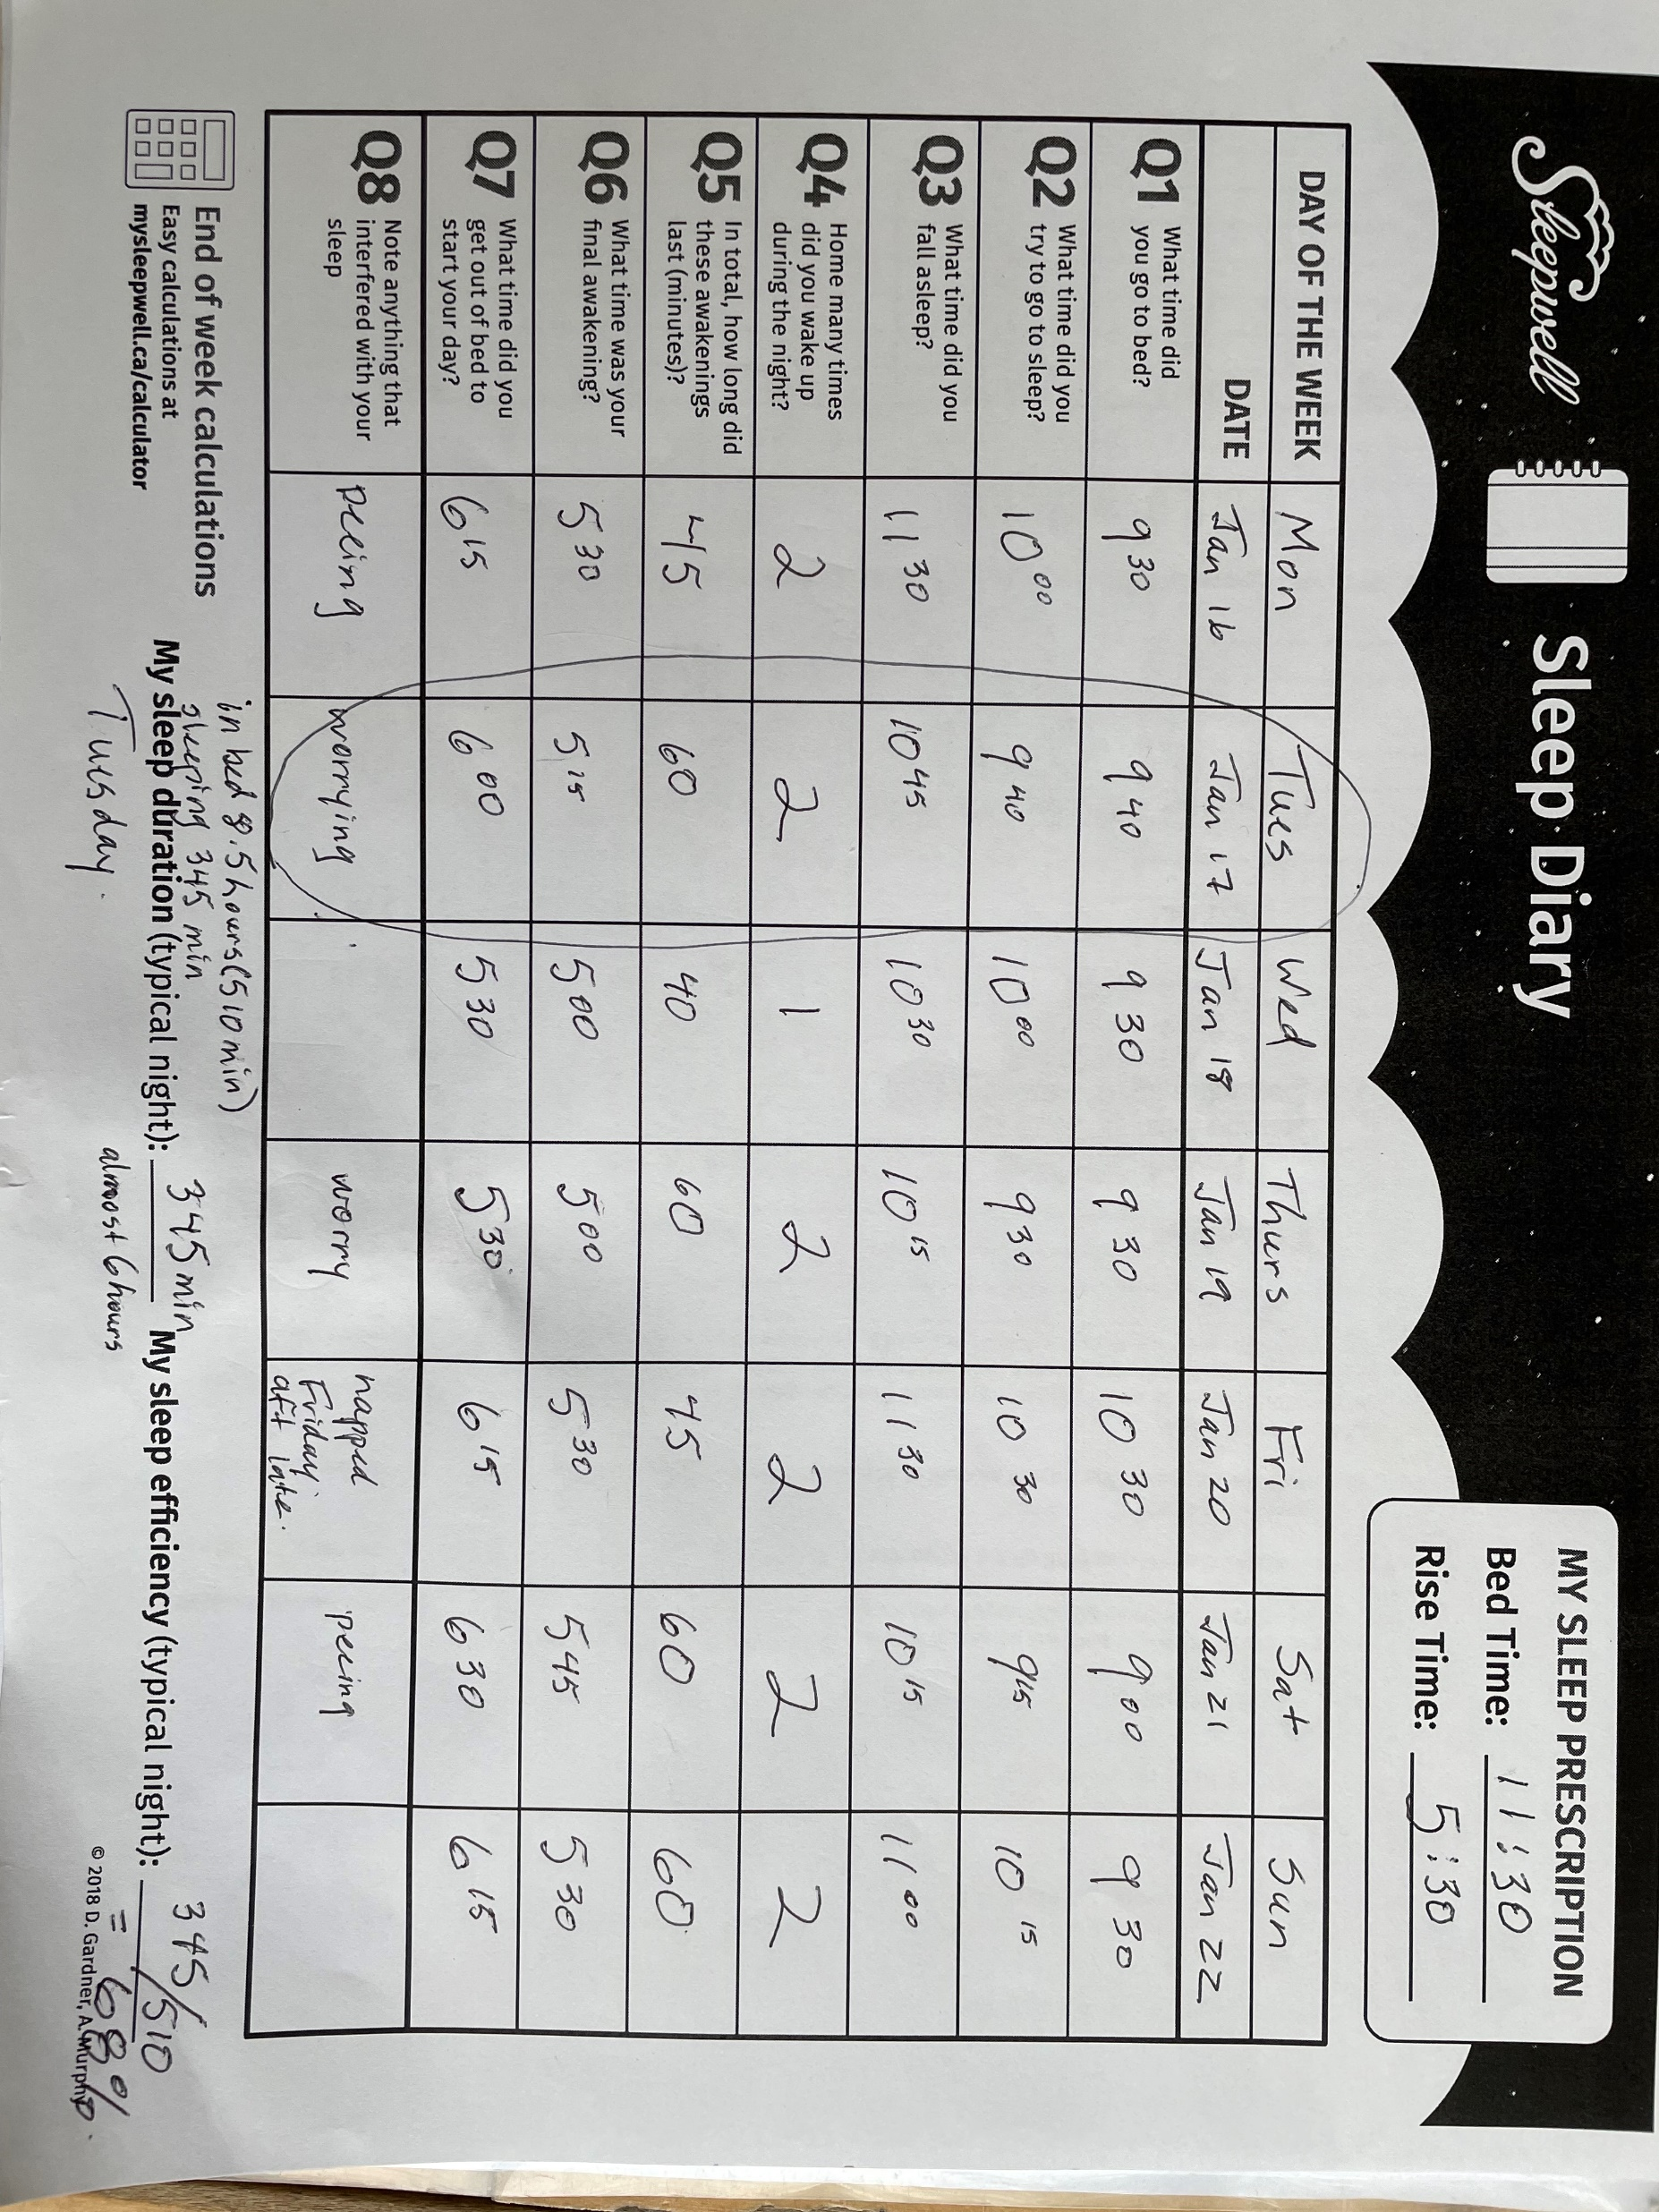

Slide 109
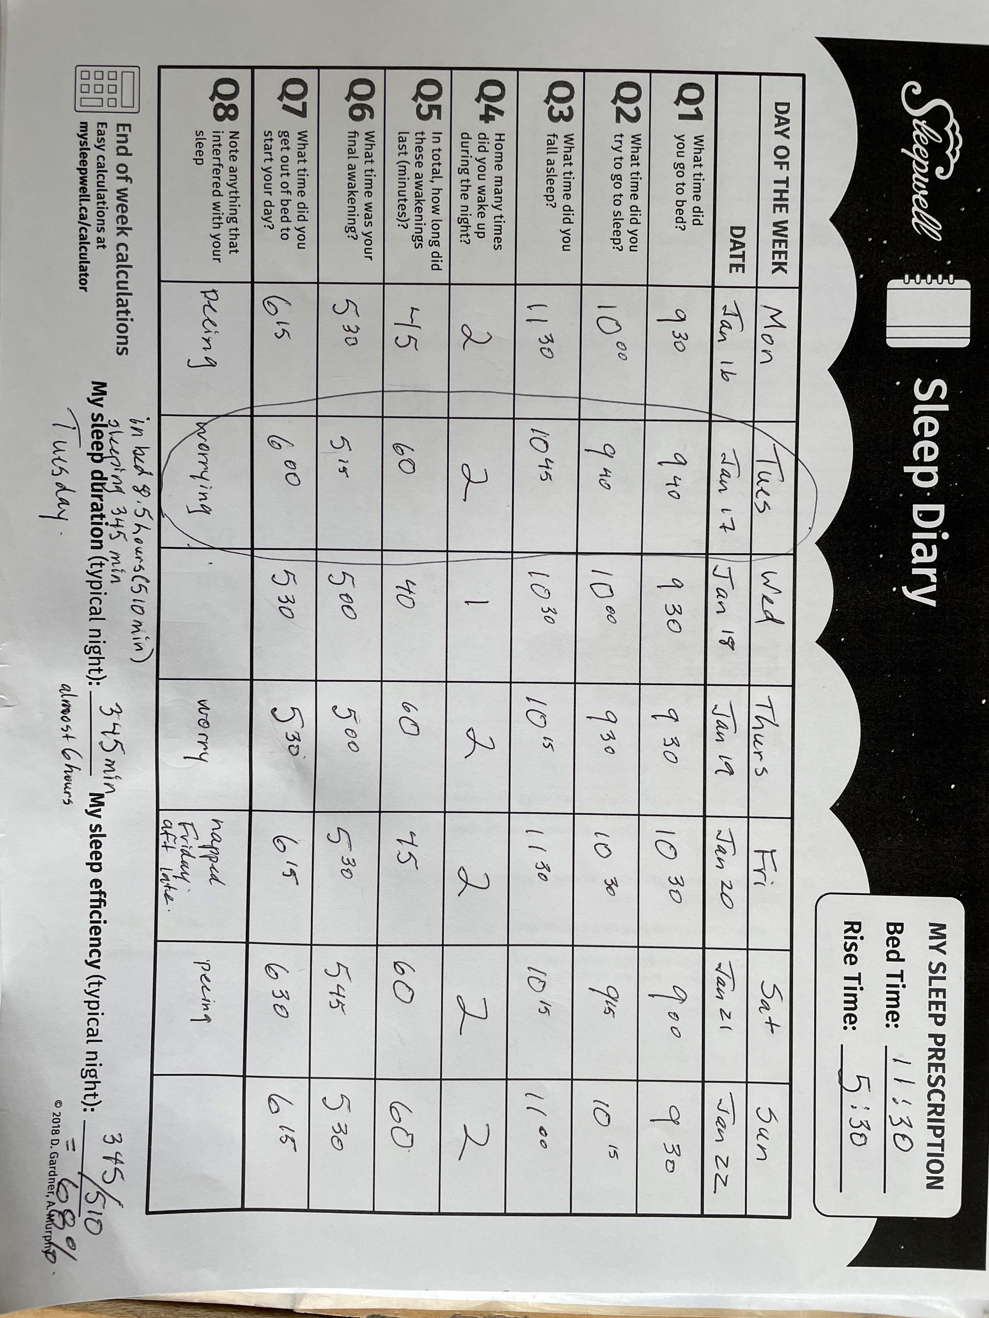
Norma Munro 78
So what do we do with this?
We will analyze this a bit later in our appointment!
Pick all that are true about sleep restriction as part of insomnia advice:
Sleep restriction consolidates fragmented sleep.
Sleep restriction is dangerous.
Sleep restriction is more effective than sleep hygiene alone.
Sleep restriction can help stop sleep medications.

Slide 110
Norma Munro 78
Sleep deprivation aims to consolidate fragmented sleep by reducing the time allowed in bed to enhance the endogenous sleep drive.
Pick all that are true about sleep restriction as part of insomnia advice :
Sleep restriction consolidates fragmented sleep.
Sleep restriction is dangerous.
Sleep restriction is more effective than sleep hygiene alone.
Sleep restriction can help stop sleep medications.

Slide 111
Norma Munro 78
  Example protocol (more at end of case):
  pick an average day and calculate total sleep duration
  set wake time and count back to sleep initiation time
  eliminate naps if possible
    If not, between 1-4 pm, maximum 45 minutes
Pick all that are true about sleep restriction as part of insomnia advice :
Sleep restriction consolidates fragmented sleep.
Sleep restriction is dangerous.
Sleep restriction is more effective than sleep hygiene alone.
Sleep restriction can help stop sleep medications.

Slide 112
Norma Munro 78
Sleep restriction compared to control (mostly sleep hygiene alone) Systematic Review of 7 RCTs :
  Sleep efficiency 79-87% with restriction versus 68-79% with sleep hygiene alone (around 10% more efficient sleep)
  Sleep latency (delay getting to sleep) 6-19 minutes faster than control
Pick all that are true about sleep restriction as part of insomnia advice :
Sleep restriction consolidates fragmented sleep.
Sleep restriction is dangerous.
Sleep restriction is more effective than sleep hygiene alone.
Sleep restriction can help stop sleep medications.

Slide 113
Norma Munro 78
Harms (1 high quality RCT 91 patients) by 6 months :
  Motor vehicle accidents – no difference
  Sleepiness- no difference
  Injuries - 14% vs 29% p<0.05 (less in sleep restriction)
Pick all that are true about sleep restriction as part of insomnia advice :
Sleep restriction consolidates fragmented sleep.
Sleep restriction is dangerous.
Sleep restriction is more effective than sleep hygiene alone.
Sleep restriction can help stop sleep medications.

Slide 114
Norma Munro 78
Stopping hypnotic medications: 53% with Sleep restriction therapy versus usual care 15%, NNT=3.
iCBT (insomnia CBT) improves sleep efficiency 10% versus z-drugs ~5% (Compared indirectly).
Pick all that are true about sleep restriction as part of insomnia advice :
Sleep restriction consolidates fragmented sleep.
Sleep restriction is dangerous.
Sleep restriction is more effective than sleep hygiene alone.
Sleep restriction can help stop sleep medications.

Slide 115
Norma Munro 78
Hmm that sounds complicated but it makes a bit of sense. But really, are there no pills that can help right away?
There are, but there are pro’s and con’s to them. especially as we get older.
Pick all that are true:
Z-drugs are effective with minimal side effects in RCTs.
Placebo response is about 25-75% to that of active medication.
Trazodone is effective and safer than other sedative-hypnotics.
Benzodiazepines result in more falls than other medication classes
Benzodiazepines have a clear association with dementia.

Slide 116
Norma Munro 78
Z drugs: (zopiclone, zolpidem)
  fall asleep faster 12-22 min, about 28 minutes more sleeping time, no change in perceived sleep quality
  Few side effects (all patients):
    dry mouth, metallic taste
    Inconsistent effect on verbal memory or attention
    No difference in falls
  Few studies in older patients, but Cochrane review (2018) found no significant adverse effects over 1-6 mo
Pick all that are true:
Z-drugs are effective with minimal side effects in RCTs
Placebo response is about 25-75% to that of active medication.
Trazodone is effective and safer than other sedative-hypnotics.
Benzodiazepines result in more falls than other medication classes.
Benzodiazepines have a clear association with dementia.

Slide 117
Norma Munro 78
Placebo improves sleep measures significantly in both subjective and objective (polysomnography) measures between 25-75% of an active medication.
For example, in one RCT, placebo improved total sleep time by 36 minutes and eszopiclone increased it by 72 minutes
Pick all that are true:
Z-drugs are effective with minimal side effects in RCTs.
Placebo response is about 25-75% to that of active medication.
Trazodone is effective and safer than other sedative-hypnotics.
Benzodiazepines result in more falls than other medication classes.
Benzodiazepines have a clear association with dementia.

Slide 118
Norma Munro 78
Trazodone has a “small” effect on short-term sleep quality and perhaps 0.3 less awakenings per night, trazodone does not have consistent benefits on sleep over placebo.
  falls – no difference compared to other sleep medications, more compared to no medication (retrospective observational data)
  Mortality (versus no antidepressant, observational) 12% versus 7%
Pick all that are true:
Z-drugs are effective with minimal side effects in RCTs.
Placebo response is about 25-75% to that of active medication.
Trazodone is effective and safer than other sedative-hypnotics.
Benzodiazepines result in more falls than other medication classes.
Benzodiazepines have a clear association with dementia.

Slide 119
Norma Munro 78
Benzodiazepines: Falls (from 2018 Systematic Review):
  Benzodiazepines OR 1.42
    Long acting (diazepam) 1.81
    Short acting (oxazepam, lorazepam) 1.27
  Antipsychotic OR 1.54
  Antidepressant OR 1.57
Pick all that are true:
Z-drugs are effective with minimal side effects in RCTs.
Placebo response is about 25-75% to that of active medication.
Trazodone is effective and safer than other sedative-hypnotics.
Benzodiazepines result in more falls than other medication classes.
Benzodiazepines have a clear association with dementia.

Slide 120
Norma Munro 78
Dementia:
Systematic Review 2022 –In observational trials, there is a weak association between benzodiazepine use and risk of dementia (Odds Ratio 1.33)
effects were no longer statistically different when focusing on studies of lower risk of bias.
It is unclear if benzodiazepines are a risk for the development of dementia, and causation is even less clear.
Pick all that are true:
Z-drugs are effective with minimal side effects in RCTs.
Placebo response is about 25-75% to that of active medication.
Trazodone is effective and safer than other sedative-hypnotics.
Benzodiazepines result in more falls than other medication classes.
Benzodiazepines have a clear association with dementia.

Slide 121
Norma Munro 78
Well if a drug is only going to give me that much better sleep and I might fall and break my hip, then I guess I am open to something else…
I guess we are going to use that sleep diary somehow?
Insomnia CBT is not possible for me in my practice.
True
False

Slide 122
Norma Munro 78
Access to iCBT, which is traditionally 4-6 sessions with a trained therapist is not accessible/practical for the vast majority of primary care providers.
BUT Shortened versions (eg 2-3 twenty-minute sessions) have been studied in primary care practices.
  Wakefulness after sleep reduced by half - 52%
    Symptom Questionnaires 56% improvement
  Better or much better quality of sleep after treatment 73% vs 35%
Insomnia CBT is not possible for me in my practice.
True
False

Slide 123
Norma Munro 78
But I am sure this poor sleep is going to cause dementia or something bad!
Insomnia CBT is not possible for me in my practice.
True
False

Slide 124
Norma Munro 78
A component iCBT is identifying dysfunctional beliefs about sleep.
  These can be more challenging in a time constrained family practice and was not included in brief intervention studies noted previously.
Validated list of dysfunctional beliefs include:
I need 8 hours of sleep
I need to catch up on sleep loss
There are bad consequences of insomnia on health
It is better to take sleeping pills
This list is available on Mysleepwell.ca where patients enter their own score.
Insomnia CBT is not possible for me in my practice.
True
False

Slide 125
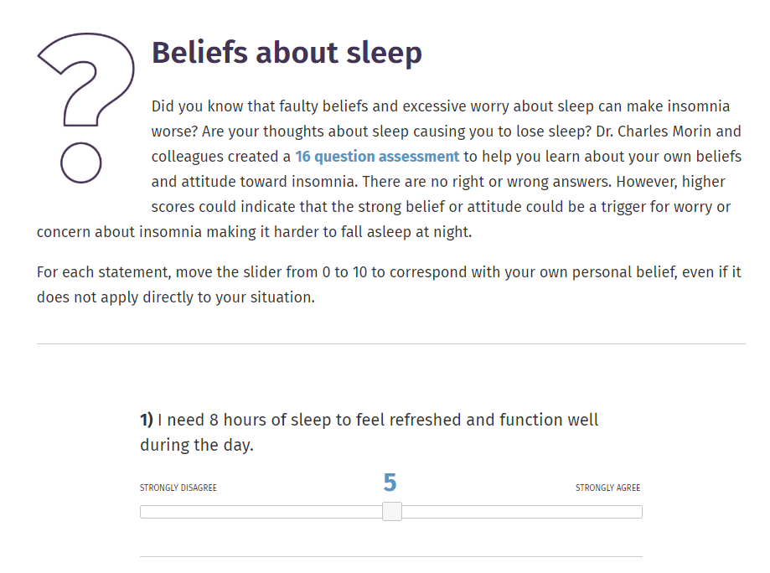
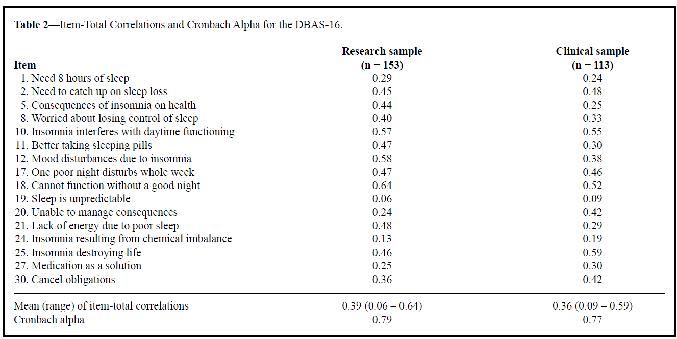
Norma Munro 78
“Insomnia Quiz”
Mysleepwell.ca
Validation of 16 items on insomnia quiz
https://mysleepwell.ca/

Slide 126
Norma Munro 78
Let’s make a plan for Norma:
1. Pick an average day
2. Calculate time asleep
3. Calculate sleep efficiency

Slide 127
Norma Munro 78
I know it seems really different, but all the studies show that this does work better than sleeping pills for most people!
This is really weird. Are you sure??
We are doing this so your body and brain learn to sleep when you are in your bed.

Slide 128
Norma Munro 78
Let’s make a plan for Norma:
1. Negotiate Rise Time – Norma figures 5:30 is okay
2. Bed time = rise time minus average sleep time, ie 11:30

Slide 129
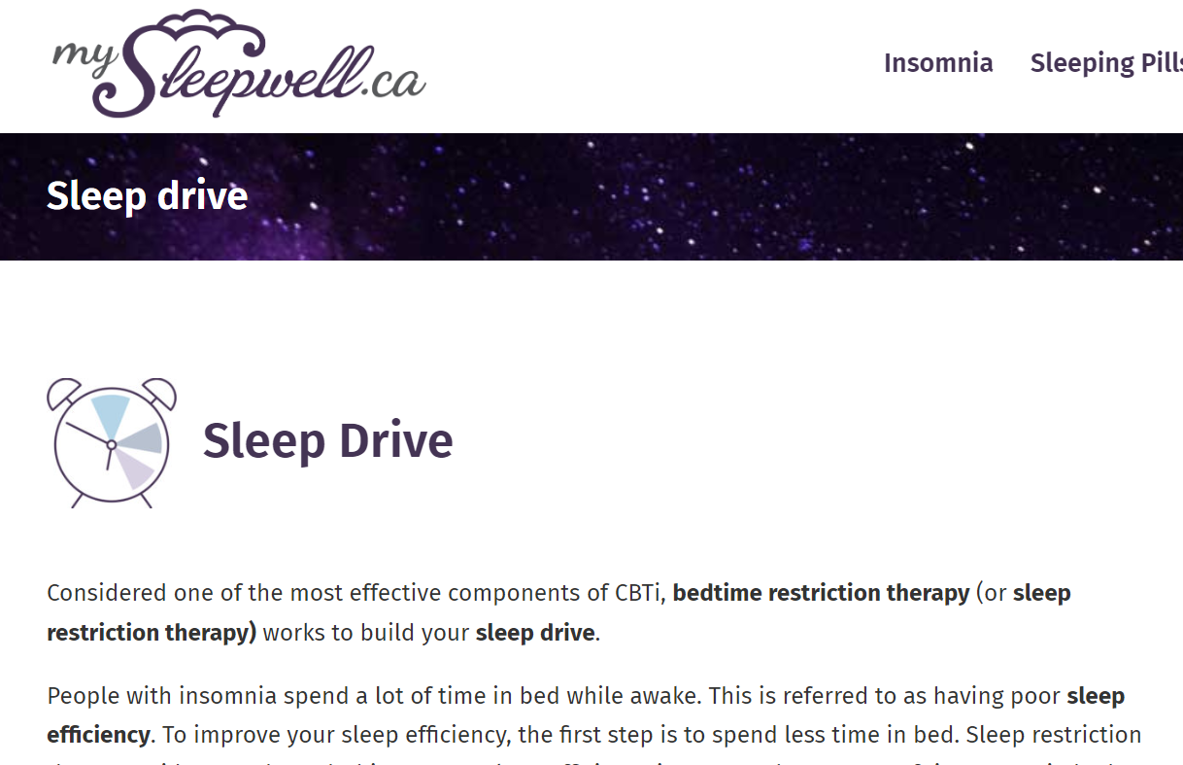
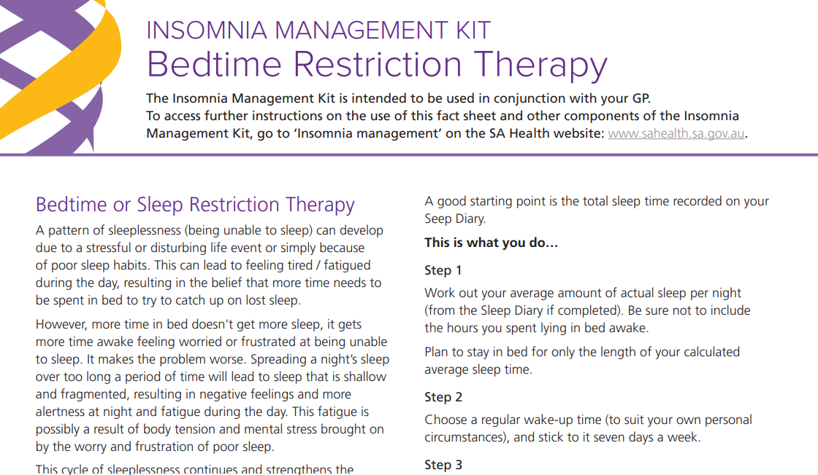
Screenshot from “mySleepwell.ca”
example of how to “prescribe”
sleep schedule

Slide 130
Norma Munro 78
Oh Gosh, what am I going to do til midnight??
I know it is a big change – but it works!
Find some things you need to get done, watch TV, do a puzzle.
How long do I have to do this before it fixes things?
You should start to notice better efficiency within the two weeks.
You will be tired initially, but the worst is usually the first 4 days.

Slide 131
Norma Munro 78
I want to see you in two weeks with two more weeks of a sleep diary.
Well, it sure looks like I have my work cut out for me! Wish me luck!

Slide 132
Recurrent C. Difficile infection
Liz Hall

Slide 133

Elizabeth (Liz) Hall, 65
Doctor!
I've been having to go to the washroom 3-4 times a day. I can't get out of the house anymore, it's just horrible!
Liz was treated for C. Difficile three months ago and recovered well.
Around the same time, you found she had diabetes (Hb A1C 7.1%). You’ve been titrating up her metformin and she has been on 1gm BID for almost a month.
Don’t tell me it's that C. difficile again......
Today, she looks well with normal vital signs.
Based on the limited information so far, it would be reasonable to stop her metformin to see if we can resolve her diarrhea, before testing for C. difficile,
True
False
Notes:
C Difficle was first described in 1935 by IVAN C. HALL, ELIZABETH O'TOOLE

Slide 134
Elizabeth (Liz) Hall, 65
A meta-analysis found the risk of diarrhea to be 14% with metformin versus 4% with placebo. An RCT with 1454 patients on metformin found diarrhea to be the most common adverse event, followed by abdominal discomfort and nausea.
Cohort studies show that asymptomatic C. difficile is common: 4-15% of healthy adults, and 56% of patients 1-4 weeks after being treated for C. difficile.
Due to the risk of false positive results, guidelines recommend testing only when there are no explanations for the diarrhea.
If Liz were positive for C. Difficile but her diarrhea resolved with stopping metformin, she should NOT be treated.
Based on the limited information so far, it would be reasonable to stop her metformin to see if we can resolve her diarrhea, before testing for C. difficile,
True
False
Notes:
C Difficle was first described in 1935 by IVAN C. HALL, ELIZABETH O'TOOLE

Slide 135
Elizabeth (Liz) Hall, 65
You decide that you should first ask Liz to stop her metformin when she says:
Oh, I should probably mention, I stopped taking Metformin almost a month ago.
Let’s test you for C. Difficile then!
Call me if your diarrhea worsens, you get a fever, abdominal pain or feels unwell.
If it’s positive, I’ll call in a prescription.
It was making me sick to my stomach so I stopped.
If positive for C. difficile, the most appropriate treatment for mild first recurrence is?
  Vancomycin 125mg PO QID x 14d
  Vancomycin 125mg PO QID x 10d followed by a test of cure
  Metronidazole 250mg PO TID x 10d
  Recommendation to take a probiotic of her choice
Notes:
C Difficle bacteria was first described in 1935 by IVAN C. HALL, ELIZABETH O'TOOLE. INTESTINAL FLORA IN NEW-BORN INFANTS
WITH A DESCRIPTION OF A NEW PATHOGENIC ANAEROBE, BACILLUS DIFFICILIS. Am J Dis Child. 1935;49(2):390-402.

Slide 136
Elizabeth (Liz) Hall, 65
Vancomycin oral for 10 days is first line for first presentation of C. difficile. [Fidaxomicin now first line for IDSA 2021]. Metronidazole is suggested only if patients are allergic to Vancomycin or can’t afford it.
13-21% of patients will have a recurrence. For a first recurrence, a 14 day course of Vancomycin is recommended. Fidoxamycin is also first line but it is much more expensive.
For subsequent recurrences, a Vancomycin prolonged taper would be used.
If positive for C. difficile, the most appropriate treatment for mild first recurrence is?
  Vancomycin 125mg PO QID x 14d
  Vancomycin 125mg PO QID x 10d followed by a test of cure
  Metronidazole 250mg PO TID x 10d
  Recommendation to take a probiotic of her choice
Notes:
C Difficle bacteria was first described in 1935 by IVAN C. HALL, ELIZABETH O'TOOLE. INTESTINAL FLORA IN NEW-BORN INFANTS
WITH A DESCRIPTION OF A NEW PATHOGENIC ANAEROBE, BACILLUS DIFFICILIS. Am J Dis Child. 1935;49(2):390-402.

Slide 137
Elizabeth (Liz) Hall, 65
Probiotics play no role for the treatment of C. Difficile
They have uncertain benefits for primary prevention: A Cochrane review from 2013 showed decreased incidence of C. Difficile but 2 more recent RCTs showed no difference.
It is uncertain if probiotics prevent secondary recurrence (repeat infection) due to the poor quality of the available evidence.
If positive for C. difficile, the most appropriate treatment for mild first recurrence is?
  Vancomycin 125mg PO QID x 14d
  Vancomycin 125mg PO QID x 10d followed by a test of cure
  Metronidazole 250mg PO TID x 10d
  Recommendation to take a probiotic of her choice
Notes:
C Difficle bacteria was first described in 1935 by IVAN C. HALL, ELIZABETH O'TOOLE. INTESTINAL FLORA IN NEW-BORN INFANTS
WITH A DESCRIPTION OF A NEW PATHOGENIC ANAEROBE, BACILLUS DIFFICILIS. Am J Dis Child. 1935;49(2):390-402.

Slide 138
Elizabeth (Liz) Hall, 65
As you glance through her medications, considering Metformin replacement, you notice she is on long-standing pantoprazole 40mg once a day.
It’s the yellow one, right? I am not sure why I am on it.
I noticed you take Pantoprazole. Do you know why?
I had terrible heartburn many years ago but haven’t really noticed it for a long time.
Select the wrong answer about deprescribing PPIs:
About 25% of patients with GERD can stop PPIs
About 30-50% of patients can decrease their dose
Most patients have a clear reason for taking PPIs
PPI use has been associated with C. difficile
Abruptly stopping PPI can cause rebound dypsepsia
Notes:
C Difficle bacteria was first described in 1935 by IVAN C. HALL, ELIZABETH O'TOOLE. INTESTINAL FLORA IN NEW-BORN INFANTS
WITH A DESCRIPTION OF A NEW PATHOGENIC ANAEROBE, BACILLUS DIFFICILIS. Am J Dis Child. 1935;49(2):390-402.

Slide 139
Elizabeth (Liz) Hall, 65
Cohort studies show that 40-65% of hospitalized patients and 40-55% of primary care patients in the UK and US lack a documented indication for taking PPIs
Select the wrong answer about deprescribing PPIs:
About 25% of patients with GERD can stop PPIs
About 30-50% of patients can decrease their dose
Most patients have a clear reason for taking PPIs
PPI use has been associated with C. difficile
Abruptly stopping PPI can cause rebound dypsepsia
Notes:
C Difficle bacteria was first described in 1935 by IVAN C. HALL, ELIZABETH O'TOOLE. INTESTINAL FLORA IN NEW-BORN INFANTS
WITH A DESCRIPTION OF A NEW PATHOGENIC ANAEROBE, BACILLUS DIFFICILIS. Am J Dis Child. 1935;49(2):390-402.

Slide 140
Elizabeth (Liz) Hall, 65
An RCT showed that with physician education, 30% patients stopped PPIs at 6 months (vs 19% with usual care), 50% reduced their dose
PPI use has been associated with C. Difficile infections: ranging from 1/10,000 in the community to 8-10% of hospitalized patients receiving antibiotics
In an RCT, 21% of asymptomatic volunteers randomized to starting then stopping PPI had dyspsesia / GERD at 12w vs 2% randomized to placebo
Select the wrong answer about deprescribing PPIs:
About 25% of patients with GERD can stop PPIs
About 30-50% of patients can decrease their dose
Most patients have a clear reason for taking PPIs
PPI use has been associated with C. difficile
Stopping PPI can cause rebound dypsepsia
Notes:
C Difficle bacteria was first described in 1935 by IVAN C. HALL, ELIZABETH O'TOOLE. INTESTINAL FLORA IN NEW-BORN INFANTS
WITH A DESCRIPTION OF A NEW PATHOGENIC ANAEROBE, BACILLUS DIFFICILIS. Am J Dis Child. 1935;49(2):390-402.

Slide 141
Elizabeth (Liz) Hall, 65
For patients with no history of Barrett’s esophagus, esophagitis, or bleeding GI ulcer and not taking NSAIDS, a recent deprescribing guideline recommends either decreasing the PPI to a lower dose or using the PPI as prn. Over the counter anti-acids and H2RA may be used
Notes:
C Difficle bacteria was first described in 1935 by IVAN C. HALL, ELIZABETH O'TOOLE. INTESTINAL FLORA IN NEW-BORN INFANTS
WITH A DESCRIPTION OF A NEW PATHOGENIC ANAEROBE, BACILLUS DIFFICILIS. Am J Dis Child. 1935;49(2):390-402.

Slide 142
Elizabeth (Liz) Hall, 65
For patients taking NSAIDS regularly, a PPI should be considered for gastro-protection if the patient has >2-3 risk factors (>65 years old, high dose NSAIDS, non-bleeding GI ulcer, on ASA, steroids or anti-coagulants)
Notes:
C Difficle bacteria was first described in 1935 by IVAN C. HALL, ELIZABETH O'TOOLE. INTESTINAL FLORA IN NEW-BORN INFANTS
WITH A DESCRIPTION OF A NEW PATHOGENIC ANAEROBE, BACILLUS DIFFICILIS. Am J Dis Child. 1935;49(2):390-402.

Slide 143
Elizabeth (Liz) Hall, 65
You thought you had told Liz that this likely came from her antibiotics but can not be sure.
You let her know they were the most likely cause.
This C. Difficile, someone told me that this probably started because of those antibiotics I was taking for dental abscess.
Let’s consider the risk of C. Difficile infections for each antibiotic. Which of the following has the lowest risk?
a) Macrolide
b) Trimethoprim-Sulfamethoxazole
c) Clindamycin
d) Cephalosporins, beta-lactams
e) Doxycycline

Slide 144
Elizabeth (Liz) Hall, 65
Cohort studies show that Clindamycin have the strongest association with C. Difficile (OR 16.8) whereas Doxycycline may not be associated (OR 0.92).
For patients who need antibiotics, but with a recent history of multiple recurrences or severe infections, Vancomycin PO may be considered as secondary prevention.
Let’s consider the risk of C. Difficile infections for each antibiotic. Which of the following has the lowest risk?
a) Macrolide – Odds Ratio 2.6
b) Trimethoprim-Sulfamethoxazole - Odds Ratio 1.8
c) Clindamycin – Odds Ratio 16.8
d) Cephalosporins, beta-lactams – Odds Ratio 5.5-5.7
e) Doxycycline – Odds Ratio 0.92

Slide 145
Elizabeth (Liz) Hall, 65
Plan:
  Liz’s A1C was 7.1% at the time of her diabetes diagnosis so you decide to stop her metformin.
  You ask Liz to book an appointment in 2 weeks or so to discuss diabetes management options.
  You send Liz for C. Difficile stool testing and let her know you will call in a prescription for Vancomycin 125mg PO QID x 14 days if she is positive.
    She is to call in the meantime if she is getting any worse.
  You suggest Liz try taking her PPI only if she has symptoms of heartburn or similar. At her diabetes visit in 2 weeks you will ask her how her prn use of pantoprazole is going.

Slide 146
De-labelling Penicillin Allergy
Ana Flax

Slide 147

Ana Flax, 30
Ana is a healthy woman with seasonal rhinosinusitis. She needs renewal of her fluticasone 2 puffs per nostril once daily.
I am noticing when it’s bad, even the nose spray is barely working. What do you think about Neti™ pots?
Select all true statements about nasal irrigation:
Hypertonic saline is better than isotonic saline
Nasal irrigation and nasal steroids cannot be used together
Symptoms improve by ~30% when compared to no treatment
Nasal irrigation sprays are as effective as nasal rinses
Nasal irrigation sprays are more tolerable than rinses

Slide 148
Ana Flax, 30
32.5% mean improvement of nasal symptoms scores with nasal irrigation
Tolerability of rinse vs spray: compliance at 8 weeks 79% vs 93% (Number needed to Harm 8)
Select all true statements about nasal irrigation:
Hypertonic saline is better than isotonic saline
Nasal irrigation and nasal steroids cannot be used together
Symptoms improve by ~30% when compared to no treatment
Nasal irrigation sprays are as effective as nasal rinses
Nasal irrigation sprays are more tolerable than rinses

Slide 149
Ana Flax, 30
Hypertonic saline and isotonic saline appear equivalent
Nasal irrigation and nasal steroids can be used together (used at separate times during the day)
For irrigation: nasal sprays are less effective than nasal rinses.
While some earlier evidence suggested improved Quality of Life, a recent systematic review found Quality of Life effects are uncertain
Select all true statements about nasal irrigation:
Hypertonic saline is better than isotonic saline
Nasal irrigation and nasal steroids cannot be used together
Symptoms improve by ~30% when compared to no treatment
Nasal irrigation sprays are as effective as nasal rinses
Nasal irrigation sprays are more tolerable than rinses

Slide 150
Ana Flax, 30
My friend was just in the emergency room and almost died because of her allergy to peanuts.
I had a rash after taking penicillin as a kid, and I was told that I was allergic. Do you have that on my chart?
Please pick the one false answer:
A penicillin allergy diagnosis in the chart is associated with patients receiving broader spectrum antibiotics
It has been associated with increased chance of MRSA and C. difficile
Up to 10% of the population has a label of penicillin allergy
About 10% of patients with “penicillin allergy” can take penicillin safely
“Delabeling” penicillin allergies is recommended by multiple organizations​

Slide 151
Ana Flax, 30
Up to 98% with a penicillin allergy label can take beta-lactams safely.
Cohort studies found “Penicillin allergic" patients were more likely to receive clindamycin and develop MRSA and C. Difficile (relative risk increases 3.89, 1.69, and 1.26, respectively).
About 10% of the population carry a label of pencillin allergy
Delabeling is recommended by Choosing Wisely, the CDC and the Canadian Society of Allergy and Clinical immunology.
Please pick the one false answer:
A penicillin allergy diagnosis in the chart is associated with patients receiving broader spectrum antibiotics
It has been associated with increased chance of MRSA and C. difficile
Up to 10% of the population has a label of penicillin allergy
About 10% of patients with “penicillin allergy” can take penicillin safely
“Delabeling” penicillin allergies is recommended by multiple organizations​

Slide 152

Ana Flax, 30
In the past, if a patient had a diagnosis of penicillin allergy and needed antibiotics, we would have considered a beta-lactam with a different side-chain. But, with the realization that up to 98% of patients with a penicillin label can take penicillin safely, the question now is:
“Is my patient really allergic to penicillin?”

Slide 153
Ana Flax, 30
It might help to know a little more about your allergy and rash.
My mom said
I had a rash as a kid when I was sick and got penicillin. That’s all I know about it.
I don’t think I’ve had Penicillin since.
Which of the following would make a “real” penicillin allergy more likely?
The allergy occurred five or fewer years ago​
The patient had anaphylaxis/angioedema​
The patient had severe cutaneous adverse reaction​
The allergy episode required medical treatments​
All of the above

Slide 154
Ana Flax, 30
Which of the following would make a “real” penicillin allergy more likely?
The allergy occurred five or fewer years ago​
The patient had anaphylaxis/angioedema​
The patient had severe cutaneous adverse reaction​
The allergy episode required medical treatments​
All of the above

Slide 155
Ana Flax, 30
A score <2-3 on the PEN-FAST can rule out penicillin allergy with a negative predictive value of ~100-96%, which is comparable to formal penicillin allergy skin-testing studies.
Which of the following would make a “real” penicillin allergy more likely?
The allergy occurred five or fewer years ago​ -2 points
The patient had anaphylaxis/angioedema​ - 2 points
The patient had a severe cutaneous adverse reaction​ - 2 points
The allergy episode required medical treatments​ - 1 point
The patient has a history of severe atopic dermatitis

Slide 156
Ana Flax, 30
Using the Pen Fast scoring system:
The allergy occurred five or fewer years ago​ -2 points
The patient had anaphylaxis/angioedema​ - 2 points
The patient had a severe cutaneous adverse reaction​ - 2 points
The allergy episode required medical treatments​ - 1 point
Ana has a score of zero (<3 being low risk). She can safely take beta-lactam antibiotics.
Some patients may need referral to an allergist or for skin test or oral challenge.
Note - Skin testing is cost effective in cases of possible allergy where things are uncertain.

Slide 157
Ana Flax, 30
Match the clinical scenario with the risk level with the recommended approach
Clinical scenario for a “Penicillin allergy” in an adult
Risk level and appropriate follow-up
Vague rash as a child
Anaphylaxis: urticaria, wheezing, vomiting 2 hours post first dose of antibiotic
Rash (including urticaria) and/or angioedema, received treatment as a child or adult
Severe delayed non IgE mediated reaction: organ dysfunction, skin desquamation, mucosal lesions

Slide 158
Ana Flax, 30
Match the clinical scenario with the risk level with the recommended approach
Clinical scenario for a “Penicillin allergy” in an adult
Risk level and appropriate follow-up
Vague rash as a child
Anaphylaxis: urticaria, wheezing, vomiting 2 hours post first dose of antibiotic
High risk: do not prescribe beta-lactam with similar side chains, refer to allergist for confirmation / re-evaluation
Rash (including urticaria) and/or angioedema, received treatment as a child or adult
Severe delayed non IgE mediated reaction: organ dysfunction, skin desquamation, mucosal lesions

Slide 159
Ana Flax, 30
Match the clinical scenario with the risk level with the recommended approach
Clinical scenario for a “Penicillin allergy” in an adult
Risk level and appropriate follow-up
Vague rash as a child
Anaphylaxis: urticaria, wheezing, vomiting 2 hours post first dose of antibiotic
High risk: do not prescribe beta-lactam with similar side chains, refer to allergist for confirmation / re-evaluation
Rash (including urticaria) and/or angioedema, received treatment as a child or adult
Severe delayed non IgE mediated reaction: organ dysfunction, skin desquamation, mucosal lesions

Slide 160
Ana Flax, 30
Match the clinical scenario with the risk level with the recommended approach
Clinical scenario for a “Penicillin allergy” in an adult
Risk level and appropriate follow-up
Vague rash as a child
Anaphylaxis: urticaria, wheezing, vomiting 2 hours post first dose of antibiotic
Intermediate risk: do not prescribe beta-lactam with similar side chains, refer for skin test or oral challenge
Rash (including urticaria) and/or angioedema, received treatment as a child or adult
Severe delayed non IgE mediated reaction: organ dysfunction, skin desquamation, mucosal lesions

Slide 161
Ana Flax, 30
Match the clinical scenario with the risk level with the recommended approach
Clinical scenario for a “Penicillin allergy” in an adult
Risk level and appropriate follow-up
Vague rash as a child
Anaphylaxis: urticaria, wheezing, vomiting 2 hours post first dose of antibiotic
High risk: do not prescribe beta-lactam with similar side chains, refer to allergist for confirmation / re-evaluation
Rash (including urticaria) and/or angioedema, received treatment as a child or adult
Intermediate risk: do not prescribe beta-lactam with similar side chains, refer for skin test or oral challenge
Severe delayed non IgE mediated reaction: organ dysfunction, skin desquamation, mucosal lesions

Slide 162
Ana Flax, 30
Match the clinical scenario with the risk level with the recommended approach
Clinical scenario for a “Penicillin allergy” in an adult
Risk level and appropriate follow-up
Vague rash as a child
Anaphylaxis: urticaria, wheezing, vomiting 2 hours post first dose of antibiotic
Contraindicated, do not ever administer any beta-lactam
Rash (including urticaria) and/or angioedema, received treatment as a child or adult
Severe delayed non IgE mediated reaction: organ dysfunction, skin desquamation, mucosal lesions

Slide 163
Ana Flax, 30
Match the clinical scenario with the risk level with the recommended approach
Clinical scenario for a “Penicillin allergy” in an adult
Risk level and appropriate follow-up
Vague rash as a child
Anaphylaxis: urticaria, wheezing, vomiting 2 hours post first dose of antibiotic
High risk: do not prescribe beta-lactam with similar side chains, refer to allergist for confirmation / re-evaluation
Rash (including urticaria) and/or angioedema, received treatment as a child or adult
Intermediate risk: do not prescribe beta-lactam with similar side chains, refer for skin test or oral challenge
Severe delayed non IgE mediated reaction: organ dysfunction, skin desquamation, mucosal lesions
Contraindicated, do not ever administer any beta-lactam

Slide 164
Ana Flax, 30
Match the clinical scenario with the risk level with the recommended approach
Clinical scenario for a “Penicillin allergy” in an adult
Risk level and appropriate follow-up
Vague rash as a child
Low risk: can prescribe any beta-lactam
Anaphylaxis: urticaria, wheezing, vomiting 2 hours post first dose of antibiotic
High risk: do not prescribe beta-lactam with similar side chains, refer to allergist for confirmation / re-evaluation
Rash (including urticaria) and/or angioedema, received treatment as a child or adult
Intermediate risk: do not prescribe beta-lactam with similar side chains, refer for skin test or oral challenge
Severe delayed non IgE mediated reaction: organ dysfunction, skin desquamation, mucosal lesions
Contraindicated, do not ever administer any beta-lactam

Slide 165
Ana Flax, 30
Plan:
  Refill Fluticasone 50mcg, 2 puffs each nares, once a day.
  Encourage to Ana to try nasal irrigation when her nasal steroid is controlling her symptoms adequately
  Reassure Ana that you don’t think that she has a true penicillin allergy.
  Don’t include penicillin allergy in her chart.
  Follow-up as needed.

Slide 166
Mr Ramakanta
Congestive Heart Failure Management

Slide 167

Mr Ramakanta, 75
1 month ago, Mr Ramakanta presented to your office with dyspnea and peripheral edema. You suspected heart failure and started him on Furosemide 40mg. His ECHO confirmed your suspicion: his ejection fraction was 35%.
Unfortunately, he worsened and was admitted for an exacerbation of heart failure shortly after. He was discharged 1 week ago.
NSTEMI 5 years ago
No other PMHx
He moved from Bangalore, South India, to Canada 5 years ago.
CBC: Hb 105, WBC 6, Plt 200
Cr: 103 (eGFR 61)
K 4.2
Na 134
Urinalysis: No protein

Slide 168
Mr Ramakanta, 75
I feel much better, but I still have a hard time chasing my grandson around when we look after him!
They told me to stop eating salt but the food tastes so bland. What do you think?
Which of the following is true?
Mr. Ramakanta should eat < 2gm of sodium per day
Reducing his sodium intake will decrease his chance of dying from heart failure
Reducing his sodium intake may improve his symptoms

Slide 169
Mr Ramakanta, 75
Systematic review. RCTs of patients with heart failure (HF) randomized to more or less sodium intake.
  9 RCTs (mean number of patient ~50 per trial). Insufficient data to meta-analyze cardiovascular mortality or hospitalizations.
  Outpatient studies; 3/7 showed possible improvement of signs and symptoms of heart failure with decreased sodium intake.
  Most RCTs look at very low sodium intake (for e.g. 1.5g/d) in conjunction with water restriction. It is not known whether patients with high sodium intake would benefit from reducing to levels that have been recommended (~2-3g/d).
Which of the following is true?
Mr. Ramakanta should eat < 2gm of sodium per day
Reducing his sodium intake will decrease his chance of dying from heart failure
Reducing his sodium intake may improve his symptoms

Slide 170
Mr Ramakanta, 75
How much sodium should he have?
For the general population, guidelines vary from recommending 2-3 g/d (Health Canada) to avoiding very high sodium intake (for eg >5g/d, European Guidelines)
For patients with heart failure, the Canadian CV Guidelines state that it is “controversial”, with no specific recommendations.
Which of the following is true?
Mr. Ramakanta should eat < 2gm of sodium per day
Reducing his sodium intake will decrease his chance of dying from heart failure
Reducing his sodium intake may improve his symptoms

Slide 171
Mr Ramakanta, 75
I really don’t use the salt shaker much…
Which of the following is true?
Processed food may account for the bulk of his sodium intake
Pulse based dishes (beans, peas, lentils) may account for the bulk of his sodium intake
Salt substitutes are dangerous and should not be used to decrease his sodium intake

Slide 172
Mr Ramakanta, 75
Indian cuisine is very diverse. In south India, a meal usually comprises rice/bread with vegetable and pulse-based dishes, all of which have added salt. Pulses comprise ~30% of total sodium intake due to added salt during cooking.
In a cohort of South Indians, the average sodium intake was ~4g. In fact, persons from Asia have among the highest sodium consumption. The average sodium intake among Canadians is 2.8g (it used to be 3.4g in 2004).
1 tablespoon of salt (13-28 g NaCl) is ~ 5-7g Na
Which of the following is true?
Processed food may account for the bulk of his sodium intake
Pulse based dishes (beans, peas, lentils) may account for the bulk of his sodium intake
Salt substitutes are dangerous and should not be used to decrease his sodium intake

Slide 173
Mr Ramakanta, 75
In European and Northern American countries, sodium comes mostly from processed foods, especially cereals and baked goods. All processed food have higher sodium content (e.g. canned soups, premade salad dressing, ham, salami, cottage cheese…)
Which of the following is true?
Processed food may account for the bulk of his sodium intake
Pulse based dishes (beans, peas, lentils) may account for the bulk of his sodium intake
Salt substitutes are dangerous and should not be used to decrease his sodium intake

Slide 174
Mr Ramakanta, 75
In an RCT, villages in rural in China were randomized to a salt substitute (75% NaCl and 25% KCl) or regular salt.Participants had a history of stroke or were >60 years old with high blood pressure.
Death from any cause reduced (RR 0.88) for salt substitute (39 vs 45 events per 1000 patient-years).
Adverse events attributed to hyperkalemia was similar in both groups (3.35 vs 3.30 events per 1000 person-years).
Which of the following is true?
Processed food may account for the bulk of his sodium intake
Pulse based dishes (beans, peas, lentils) may account for the bulk of his sodium intake
Salt substitutes are dangerous and should not be used to decrease his sodium intake

Slide 175
Mr Ramakanta, 75
This heart failure thing, is it a big deal? It was very scary being in the hospital…
True / False: The more symptomatic patients are, the higher the mortality from heart failure.

Slide 176
Mr Ramakanta, 75
HFrEF: Heart Failure reduced Ejection Fraction (EF<40%)
Mortality from HFrEF is elevated, especially for symptomatic patients.
Among patients on beta-blockers, ACEi and aldosterone antagonists (mean age ~65-year-old, mean EF ~25%):
  NYHA 2 (mild symptoms during ordinary activity): mortality 13% at ~2 years
  NYHA 3-4 (marked symptoms with walking 20-100m, symptoms at rest): mortality ~35% at 2 years
  The NYHA system is not perfect and only roughly predicts 6-minute walk distances or mortality. However, it remains widely used in RCTs.
True / False: The more symptomatic patients are, the higher the mortality from heart failure.

Slide 177
Mr Ramakanta, 75
Unfortunately, there are no well validated tool in primary care to estimate mortality and morbidity from heart failure.
Discussions around code status and advance care planning may be appropriate, especially if patients are symptomatic with minimal activity, have been hospitalized, have co-morbidities (COPD, frailty) or are not able to tolerate medical therapy.
This is not the case for Mr Ramakanta yet, but may be in the future.
True / False: The more symptomatic patients are, the higher the mortality from heart failure.

Slide 178
Mr Ramakanta, 75
Your blood pressure is 120/80, pulse 70. Your lungs are clear and the leg swelling is much better. Let’s see your medications
ASA 81mg PO daily
Atorvastatin 80mg PO daily
Furosemide 40mg PO BID
Candesartan 8mg PO daily
Bisoprolol 2.5mg PO daily
Mr. Ramakanta’s ejection fraction is 35-40%. He has mild symptoms. Which of the following is true?
Spironolactone is prescribed as commonly as ACEi/ARB
Spironolactone provides a similar mortality benefit as ACEi/ARB
The relative mortality benefit from Spironolactone is ~5%
Gynecomastia is an uncommon side-effect

Slide 179
Mr Ramakanta, 75
Relative reductions in mortality (no head-to-head trials)
  Aldosterone antagonist ~25%
  B-blockers ~19%
  ACE inhibitors ~23%
E.g.: For someone with a baseline mortality risk of 10% over 5 years, the risk would be decreased to ~7.5% (using a 25% relative risk reduction).
Mr. Ramakanta’s ejection fraction is 35-40%. He has mild symptoms. Which of the following is true?
Spironolactone is prescribed as commonly as ACEi/ARB
Spironolactone provides a similar mortality benefit as ACEi/ARB
The relative mortality benefit from Spironolactone is ~5%
Gynecomastia is an uncommon side-effect

Slide 180
Mr Ramakanta, 75
Aldosterone antagonists are less commonly prescribed than other agents despite their similar effect on mortality.
Spironolactone (12$ per month) should be used first line, if gynecomastia / breast pain (10% vs 1% in the placebo group), patients can be switched to eplerenone (100$/month).
Mr. Ramakanta’s ejection fraction is 35-40%. He has mild symptoms. Which of the following is true?
Spironolactone is prescribed as commonly as ACEi/ARB
Spironolactone provides a similar mortality benefit as ACEi/ARB
The relative mortality benefit from Spironolactone is ~5%
Gynecomastia is an uncommon side-effect

Slide 181
Mr Ramakanta, 75
They did warn me at the hospital that I will be taking a lot of pills. They were not kidding!
ASA 81mg PO daily
Atorvastatin 80mg PO daily
Furosemide 40mg PO BID
Candesartan 8mg PO daily
Bisoprolol 2.5mg PO daily
Which of the following would be reasonable? Pick all that apply
Start spironolactone and book a follow-up appointment in 1 month
Start spironolactone and book a follow-up appointment in 1 week
Start spironolactone and empagliflozin, follow-up in 1 week
Increase candesartan to 32mg and bisoprolol to 10mg, follow-up

Slide 182
Mr Ramakanta, 75
Standard pharmacological care for HFrEF include:
  an ACEi/ARB or sacubitril/valsartan (ARNI)
  a beta-blocker
  a mineralocorticoid receptor antagonist (MRA, eg spironolactone)
  a sodium glucose transport 2 inhibitor (SGLT2i, eg empagliflozin)
Which of the following would be reasonable? Pick all that apply
Start spironolactone and book a follow-up appointment in 1 month
Start spironolactone and book a follow-up appointment in 1 week
Start spironolactone and empagliflozin, follow-up in 1 week
Increase candesartan to 32mg and bisoprolol to 10mg, follow-up

Slide 183
Mr Ramakanta, 75
Heart failure carries a significant risk of hospitalization and mortality in the short-term (1-2 years).
Ideally, medication optimization should be reached within 3-6 months of diagnosis (4 agents at the maximum tolerated doses). Titration schedules should be personalized.
RCT: rapid up-titration of medications and close follow-up versus standard-of care
  At 90 days, more patients on target doses: ACEi/ARB (55% vs 2%), mineralocorticoid receptor antagonists (84% vs 46%), beta-blockers (49% versus 4%)
  Heart failure re-admissions or mortality lower at 15% versus 23%
  Adverse events were hypotension (5% vs <1%), hyperkalemia (3% vs 0%), renal impairment (3% vs <1%)

Slide 184
Mr Ramakanta, 75
Plan:
  Mr. Ramakanta is interested in decreasing his salt intake as long as food “still tastes good”. He will take daily walks with his wife.
  You continue
    ASA 81mg PO daily
    Atorvastatin 80mg PO daily
    Furosemide 40mg PO BID
    Candesartan 8mg PO daily
    Bisoprolol 2.5mg PO daily
  You start
    Spironolactone 12.5mg PO daily
    Mr. Ramakanta does not want to start any other medications for now
  You book a follow-up appointment in 2 weeks. You give him a requisition for Cr, K, Na.

Slide 185
Ken Dosette (Polypharmacy) References
Mehta et al., 2018 Canadian Cardiovascular Society/Canadian Association of Interventional Cardiology Focused Update of the Guidelines for the Use of Antiplatelet Therapy. Can J Cardiol. 2018 Mar;34(3):214-233.
Turgeon RD and Allan MG, Dual Antiplatelet Therapy Following Drug-Eluting Stent Placement: 3 Months, 1 Year or Forever? Tools for practice. 2016
Yin AHL., CCBYNC Open access Duration of dual antiplatelet therapy after percutaneous coronary intervention with drug-eluting stent: systematic review and network meta-analysis. BMJ 2019;365:l2222
Danchin et al., Angiotensin-Converting Enzyme Inhibitors in Patients With Coronary Artery Disease and Absence of Heart Failure or Left Ventricular Systolic Dysfunction An Overview of Long-term Randomized Controlled Trials. Arch Intern Med. 2006;166(7):787-796.
Wilt et al., Effectiveness of statin therapy in adults with coronary heart disease. Arch Intern Med. 2004 Jul 12;164(13):1427-36.
Bangalore et al., Clinical Outcomes with β-Blockers for Myocardial Infarction: A Meta-analysis of Randomized Trials. Am J Med. 2014 Oct;127(10):939-53.
Bockstall K, How Long Should We Continue Beta-Blockers After MI? Expert Analysis, American College of Cardiology, Jan 23 2017 https://www.acc.org/latest-in-cardiology/articles/2017/01/20/09/36/how-long-should-we-continue-beta-blockers-after-mi

Slide 186
Cannon CP et al., Ezetimibe Added to Statin Therapy after Acute Coronary Syndromes. N Engl J Med 2015; 372:2387-2397
Lee G et al., Comparative effectiveness of oral antidiabetic drugs in preventing cardiovascular mortality and morbidity: A network meta-analysis. PLoS One. 2017 May 25;12(5):e0177646.
Rosenstock J et al., Effect of Linagliptin vs Glimepiride on Major Adverse Cardiovascular Outcomes in Patients With Type 2 Diabetes. JAMA. 2019;322(12):1155-1166
Falk et al., Should a ‘flozin‘ be chosen? Part 2: SGLT2 inhibitors in patients with chronic kidney disease. Tools for Practice # 319
Dugre N et al., In COPD puffers, does three-of-kind beat a pair. Tools for practice # 238
Korownyk C and Allan M., Roflumilast – COPD relief at last? Tools for practice # 55
Allan M., McCormack J., What is the best puffer for initial therapy in COPD? Tools for practice # 66
Canadian Thoracic Society Clinical Practice Guideline on pharmacotherapy in patients with COPD – 2019 update of evidence. https://cts-sct.ca/wp-content/uploads/2019/10/CTS-COPD-Rx-2019-Guideline_Final.pdf

Slide 187
Naomi Schiff – Driving and Dementia References
Ismail Z. el al., Recommendations of the 5th Canadian Consensus Conference on the diagnosis and treatment of dementia. Alzheimers Dement. 2020 Aug;16(8):1182-1195
Sinnott C. et al., Consultations on driving in people with cognitive impairment in primary care: A scoping review of the evidence. PLoS One. 2018 Oct 15;13(10):e0205580.
Lee et al., A comparison of test-retest reliability of four cognitive screening tools in people with dementia. DISABILITY AND REHABILITATION. 2022, VOL. 44, NO. 15, 4090–4095
Creavin et al., Mini-Mental State Examination (MMSE) for the detection of dementia in clinically unevaluated people aged 65 and over in community and primary care populations. Cochrane Database Syst Rev. 2016 Jan 13;2016(1):CD011145.
Davis DH et al., Montreal Cognitive Assessment for the detection of dementia. Cochrane Database Syst Rev. 2021 Jul 13;7(7):CD010775.
Martin et al., Driving assessment for maintaining mobility and safety in drivers with dementia. ochrane Database Syst Rev. 2013 Aug; 2013(8): CD006222.
Molnar FJ et al., In-office evaluation of medical fitness to drive: practical approaches for assessing older people. Can Fam Physician. 2005 Mar;51(3):372-9.
Molnar FJ et al., Approach to assessing fitness to drive in patients with cardiac and cognitive conditions. Can Fam Physician. 2010 Nov;56(11):1123-9.
Determining medical fitness to operate motor vehicles. CMA Driver’s Guide 9.1 edition.

Slide 188
Mr. Ramakanta – First Line CHF Treatment References
Makani et al., Peripheral edema associated with calcium channel blockers: incidence and withdrawal rate – a meta-analysis of randomized trials. J Hypertens. 2011 Jul;29(7):1270-80.
JVP: Wang et al., Accuracy of Ultrasound Jugular Venous Pressure Height in Predicting Central Venous Congestion. Ann Intern Med. 2022 Mar;175(3):344-351.
JVP: Chaudhry A., Interrater reliability of hemodynamic profiling of patients with heart failure in the ED. Am J Emerg Med. 2008 Feb;26(2):196-201.
Ezekowitz et al., 2017 Comprehensive Update of the Canadian Cardiovascular Society Guidelines for the Management of Heart Failure. Can J Cardiol. 2017 Nov;33(11):1342-1433
King et al., Diagnosis and evaluation of heart failure. Am Fam Physician. 2012 Jun 15;85(12):1161-8.
Hobbs et al., Heart failure: Diagnosis of heart failure in primary care. Heart. 2010 Nov;96(21):1773-7.
Doust et al., The Role of BNP Testing in Heart Failure. Am Fam Physician. 2006;74(11):1893-1900
Cowie MR et al., Value of natriuretic peptides in assessment of patients with possible new heart failure in primary care. Lancet. 1997 Nov 8;350(9088):1349-53.
Dr. Ramakanta, the son of a farmer, is a famous cardiovascular surgeon from India. As per Wikipedia, he was once called “one of the safest heart surgeons in the world”!

Slide 189
Anna Ploidy- Prenatal Screening References
Audibert F, De Bie I, Johnson J et al. No. 348-Joint SOGC-CCMG Guideline: Update on Prenatal Screening for Fetal Aneuploidy, Fetal Anomalies, and Adverse Pregnancy Outcomes. J Obstet Gynaecol Can 2017;39(9):805e817.
Alldred_SK, Takwoingi_Y, Guo_B, Pennant_M, Deeks_JJ, Neilson_JP,et al. First trimester serum tests for Down's syndrome screening Cochrane Database of Systematic Reviews 2015, Issue 11.Alldred S, Takwoingi Y, Guo B et al. Fi First trimester ultrasound tests alone or in combination with first trimester serum tests for Down's syndrome screening.Cochrane Database of Systematic Reviews 2017, Issue 3. Art. No.: CD012600.Alldred SK, Takwoingi Y, Guo B, et al. First and second trimester serum tests with and without first trimester ultrasound tests for Down's syndrome screening. Cochrane Database of Systematic Reviews 2017, Issue 3. Art. No.: CD012599.Alldred_SK, Deeks_JJ, Guo_B et al .Second trimester serum tests for Down's Syndrome screening. Cochrane Database of Systematic Reviews 2012, Issue 6. Art. No.: CD009925.
Dougan S, Okun N, Bellai-Dussault K, et al. Performance of a universal prenatal screening
program incorporating cell-free fetal DNA analysis in Ontario, Canada CMAJ 2021 August 3;193:E1156-63. Health Quality Ontario. Noninvasive prenatal testing for trisomies 21, 18, and 13, sex chromosome aneuploidies, and microdeletions: a health technology assessment. Ont Health Technol Assess Ser [Internet]. 2019 Feb;19(4):1–166. Available from:http://www.hqontario.ca/evidence-to-improve-care/journal-ontario-health-technology-assessment-seriesGarcia-Perz L, Linertova R, Alvarez-de-la-Rosa M et al. Cost‑efectiveness of cell‑free DNA in maternal blood testing for prenatal detection of trisomy 21, 18 and 13: a systematic review. The European Journal of Health Economics (2018) 19:979–991.Akolekar R, Beta J Picciarelli G et al. Procedure-related risk of miscarriage following amniocentesis and chorionic villus sampling: a systematic review and meta-analysis. Ultrasound Obstet Gynecol 2015; 45: 16–26 Alfirevic_Z, Navaratnam_K, Mujezinovic_F. Amniocentesis and chorionic villus sampling for prenatal diagnosis. Cochrane Database of Systematic Reviews 2017, Issue 9. Art. No.: CD003252.

Slide 190
Farrah Lo – Heavy Menstrual Bleeding References
Shankar, M., Lee, C.A., Sabin, C.Aet al. von Willebrand disease in women with menorrhagia: a systematic review. BJOG: An International Journal of Obstetrics & Gynaecology,2004 111: 734-740
Singh S, Best C, Dunn S et al. Abnormal Uterine Bleeding in Pre-Menopausal Women. JOGC Vol 40:5. https://doi.org/10.1016/j.jogc.2018.03.007.
(UpToDateTM Accessed April 18, 2023)
Bryant-SmithAC, LethabyA, FarquharC, HickeyM. Antifibrinolytics for heavy menstrual bleeding. Cochrane Database of Systematic Reviews 2018, Issue 4
James A, Kouides P, Abdul-Kadir R et al. Evaulation and management of acute menorrhagiain women with and without underlying bleeding disorders: consensus from an international expert panel European Journal of Obstetrics & Gynecology and Reproductive Biology 158 (2011) 124–134
Bofill RodriguezM, DiasS, JordanV, et al. Interventions for heavy menstrual bleeding; overview of Cochrane reviews and network meta-analysis.Cochrane Database of Systematic Reviews 2022, Issue 5
Potter J, Sari Z, Lindblad A. How to Slow the Flow: NSAIDs for Heavy Menstrual Bleeding. Tools for Practice. April 5, 2021.
Potter J, Lindblad A. How to Slow the Flow II: Levonorgestrel intrauterine systems for heavy menstrual bleeding Tools for Practice Sept 19, 2022.

Slide 191
Norma Munroe (Insomnia) References
iCBT/sleep restriction: Allan M, Varughese J. Trouble Sleeping: Spend less time in Bed? Tools for Practice May 20, 2017 . Fernando A, Arroll B, Falloon K. A double-blind randomised controlled study of a brief intervention of bedtime restriction for adult patients with primary insomnia. J Prim Health Care.2013;5(1):5–10. Edinger JD, Arnedt JT, Bertisch SM, et al. Behavioral and psychological treatments for chronic insomnia disorder in adults: an American Academy of Sleep Medicine clinical practice guideline. J Clin Sleep Med. 2021;17:255-262. Winkler A, Rief W. Effect of placebo conditions on polysomnographic parameters in primary insomnia: a meta-analysis. Sleep.
2015;38:925-31. Fernando A 3rd, Arroll B, Falloon K. A double-blind randomized controlled study of a brief intervention of bedtime restriction for adult patients with primary insomnia. J Prim Health Care. 2013;5:5-10. Edinger JD, Sampson WS. A primary care “friendly” cognitive behavioral insomnia therapy. Sleep. 2003;26:177-82.
Morin CM; Vallières A; Ivers H. Dysfunctional Beliefs and At­titudes about Sleep (DBAS): Validation of a Brief Version (DBAS-16). SLEEP 2007;30(11):1547-1554.
MedicationsLindblad A, Allan M. Z-drugs for sleep: Should we “Catch Some Z’s”? Tools for Practice November 24, 2014. Lindbald A, Potter J. Still awake? Trazodone for Insomnia. Tools for Practice. November 15, 2021. Rösner_S, et al. Eszopiclone for insomnia.Cochrane Database of Systematic Reviews 2018, Issue 10.Seppala L, Mermelink B, de Vries M et al. Fall-Risk-Increasing Drugs: A systematic Review and Meta-Analysis II Psychotropics. https://doi.org/10.1016/j.jamda.2017.12.098. Ancoli-Israel Set al. A 12-week, randomized, double-blind, placebo-controlled study evaluating the effect of eszopiclone 2 mg on sleep/wake function in older adults with primary and comorbid insomnia. SLEEP 2010;33(2):225-234. AlDawsari A et al. Use of sedative-hypnotic medications and risk of dementia: A systematic review and meta-analysis. Br J Clin Pharmacol. 2022;88(4):1567-1589.

Slide 192
References Liz Hall (C. Difficile)
.
C. difficile prevalence: Lessa FC, Mu Y et al., Burden of Clostridium difficile infection in the United States. N Engl J Med 2015; (372):825-834
C. difficile colonization: Furuya-Kanamori, Marquess J et al., Asymptomatic Clostridium difficile colonization: epidemiology and clinical implications. BMC Infect Dis. 2015 Nov 14;(15):516
C. difficile colonization: Sethi AK, Al-Nassir WN et al., Persistence of skin contamination and environmental shedding of Clostridium difficile during and after treatment of C. difficile infection. Infect Control Hosp Epidemiol. 2010 Jan;31(1):21-7
C. difficile guidelines: Loo VG, Davis I et al., Association of Medical Microbiology and Infectious Disease Canada treatment practice guidelines for Clostridium difficile infection. Official Journal of the Association of Medical Microbiology and Infectious Disease Canada. 2018 (3.2) 71-92
Metformin Adverse events: Saenz A, Fernandez-Esteban I et al. Metformin monotherapy for type 2 diabetes mellitus. Cochrane Database Syst Rev. 2005 Jul 20;(3):CD002966.
Metformin Adverse events: Kahn SE, Haffner SM et al., Glycemic durability of rosiglitazone, metformin, or glyburide monotherapy. N Engl J Med 2006;(355):2427-43.
PPI deprescribing: Farrell B, Pottie K et al, Deprescribing proton pump inhibitors: Evidence-based clinical practice guideline. Canadian Family Physician May 2017, 63 (5) 354-64
PPI: Kolber MR and Nickonchuk T. How successful are attempts to stop PPIs and how can clinicians improve chances of success? Tools for practice. Alberta College of Family Physicians 2017 June 26. #190
Rebound dyspepsia with PPI: Reimer C, Sondergaard B et al., Proton-pump inhibitor therapy induces acid-related symptoms in healthy volunteers after withdrawal of therapy. Gastroenterology. 2009 Jul;137(1):80-7, 87.e1

Slide 193
References for Ana Flax
Huang E, Allan GM. “I got water up my nose.” From swimming accident to rhinosinusitis cure? [Publication on the Internet] Tools for Practice, Alberta College of Family Physicians 2016 Feb 1. #155. https://www.acfp.ca/wp-content/uploads/tools-for-practice/1454016118_tfp155salinenasalrinsefv.pdf
Head K, Snidvongs K, Glew S, Scadding G, Schilder AGM, Philpott C, Hopkins C. Saline irrigation for allergic rhinitis. CochraneDatabase of Systematic Reviews 2018, Issue 6. Art. No.: CD012597
Allergy Asthma Clin Immunol (2020) Nov 10;16(1):95
BMJ 2018;361:k2400
JAMA Intern Med. 2020;180(5):745-752

Slide 194
References Mr. Ramakanta
Food: Brown et al., Salt intakes around the world: implications for public health. International Journal of Epidemiology 2009;38:791–813
Food : Ravi S et al., Sodium Intake, Blood Pressure, and Dietary Sources of Sodium in an Adult South Indian Population. Ann Glob Health. 2016 Mar-Apr;82(2):234-42.
Na: Colin-Ramirez et al., Sodium Restriction in Patients With Heart Failure: A Systematic Review and Meta-Analysis of Randomized Clinical Trials. Circ Heart Fail. 2023;16:e009879
Na: Sodium intake among Canadians. Health Canada 2017. https://www.canada.ca/content/dam/hc-sc/documents/services/publications/food-nutrition/sodium-intake-canadians-2017/2017-sodium-intakes-report-eng.pdf
Na: Mahtani et al., Reduced Salt Intake for Heart Failure A Systematic Review. JAMA Intern Med. 2018;178(12):1693-1700
Na: Fact Sheet and Call to action on dietary sodium: Canada 2019 https://hypertension.ca/wp-content/uploads/2019/01/Sodium-Fact-Sheet-FINAL-Jan-23-2019.pdf
Turgeon R and Allan M. Aldosterone Antagonists in Heart Failure with Reduced Ejection Fraction (HFrEF)—No longer an afterthought. Tools for Practice # 104
McCormack J and Kolber M Target/higher dosing of medications in heart failure—is it necessary? Tools for practice # 174
Neal B et al., Effect of Salt Substitution on Cardiovascular Events and Death. N Engl J Med. 2021 Sep 16;385(12):1067-1077
Caraballo C., et al., Clinical Implications of the New York Heart Association Classification. Journal of the American Heart Association. 2019;8:e014240
Chang LL et al., Dietary Sodium Restriction in Patients with Heart Failure. N Engl J Med. 2023 Apr 27;388(17):1621-1623.
Mebezaa et al., Safety, tolerability and efficacy of up-titration of guideline-directed medical therapies for acute heart failure (STRONG-HF): a multinational, open-label, randomised, trial. Lancet. 2022 Dec 3;400(10367):1938-1952.
Ezekowitz JA et al., 2017 Comprehensive Update of the Canadian Cardiovascular Society Guidelines for the Management of Heart Failure. Canadian Journal of Cardiology Volume 33, Issue 11, November 2017, Pages 1342-1433

