Slide 1
NB: A family physician’s guide to non-binary gender diversity
Ted Jablonski MD CCFP FCFP
FMF Nov 2023 MONTREAL

Slide 2
COI – Presenter Disclosure
Presenter Disclosure
Presenter: Ted Jablonski MD CCFP FCFP
Relationships with financial sponsors:
•Any direct financial relationships, including receipt of honoraria /
Membership on advisory
boards or speakers’ bureaus:
Speaker’s Bureau, Advisory Board Honoraria (2021-2023) Bayer, Dr Ho’s, Jazz, Merck and media companies mdBriefCase,
Think Research
•Patents for drugs or devices: none
•Other:
Principal Investigator (2021 – 2023) none
Notes:
Where a faculty/presenter has no relationships to disclose, indicate Not Applicable under Relationships with Financial Sponsors.
Complete this slide for the primary presenter and ALL co-presenters if applicable.
Reminder: Disclosures made on your COI forms should match disclosures made on the COI slide.

Slide 3
COI – Disclosure of Financial Support
Disclosure of Financial Support
This program has received financial support from:
NONE
This program has received in-kind support from:
NONE
Potential for conflict(s) of interest:
Dr Jablonski has received NO financial support / in kind support for any of the content for this presentation
NO product will be discussed in this program that
Dr Jablonski has received financial support / in kind support for
Notes:
Where a program has received no external financial support (e.g., monies for food, logistics assistance such as registration, AV set-up, etc.), indicate No External Support.

Slide 4
COI – Disclosure of Financial Support
Mitigating
Pontential
Bias
Mitigating Potential Bias
Within the discussion of any medical diagnosis Dr Ted Jablonski will mention non-pharmacologic and pharmacologic therapies that are of use, compare and contrast them and discuss the pros and cons of each, presenting the information in the most non-biased way possible.
Off-Label use of any medication will be declared – ie. ALL MEDICATIONS in this presentation
Notes:
Where a program has received no external financial support (e.g., monies for food, logistics assistance such as registration, AV set-up, etc.), indicate No External Support.

Slide 5
What do I do when my patient presents with a gender identity that I may never have heard of? Do all gender diverse / non-binary persons require hormones? Need surgery?
What is available in 2023 and beyond and how does this all work if a binary transition is not desirable. As FP has become increasingly involved in the management of TGD medical transition, this group further challenges our understanding and expertise.

Slide 6
This session is going to give you a better understanding and approach to this NB patient population which is growing exponentially. Being "trans-friendly" is not enough. Expect to improve on your overall gender diverse medical competency.

Slide 7
OBJECTIVES :
Define gender diversity and non-binary gender identities
Evaluate the options of medical transition in non-binary persons
Develop a practical approach to supporting your gender diverse patients

Slide 8
BIO
Medical Director, Jablonski Health
Alberta lead for trans health e-referrals
Consultant to OASIS clinic – AHS Cancer survivors sexual health clinic
Associate Director, Student Advising and Wellness Hub, Cumming School of Medicine
Medical Lead Calgary Foothills PCN
Clinical Assistant Professor, University of Calgary, Department of Family Medicine

Slide 9
CHALLENGE?
What is your greatest clinical challenge, or put another way, what is the question that you must have explored and answered in this talk about non-binary gender diversity?

Slide 10
Notes:
An excellent primer – this slide is CRUCIAL to the understanding of Gender and thus TRANSGENDER (and why sexual preference is an entirely different concept and the term trans sexual is and should be phased out)
ENCOURAGE audience to use with their patients/ families in future
Term cis-gender could be explained at this point
Cis gender: denoting or relating to a person whose sense of personal identity and gender corresponds with their birth sex (gender assigned at birth).

Slide 11
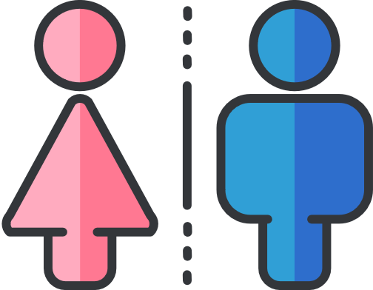
GENDER IDENTITY & SEX ASSIGNED AT BIRTH
GENDER IDENTITY
SEX ASSIGNED AT BIRTH
Each person's internal and individual experience of gender. It is their sense of being a woman, man, or non-binary.
Common Vernacular: agender, male, female, gender queer, transman, transwoman
A legal category assigned at birth as determined by a Doctor. Legal Sex categories include Male (M), Female (F) and Non-Binary (X).
Common Vernacular: Man, Woman, Non-Binary Person

Slide 12
ASSIGNED SEX at birth
Assigned male at birth AMAB
Assigned female at birth AFAB
Assigned Intersex at birth AIAB

Slide 13
GENDER IDENTITY
Cis* is a latin Prefix which means "on the same side of" ​Cis-Gender represents a people whose gender identity and sex assigned at birth are in alignment
Trans* is prefix represents the transition from one place to another. ​
This represents people whose gender identity and sex assigned at birth are in conflict.
Binary
Trans Identity
Non-Binary
Trans Identity
*a person whose gender identity falls outside of the categories of “Male” and “Female”.
*a person whose gender identity in binary categories (Man/ woman)
(Transmen, Transwomen)
(Genderqueer, Gender Fluid, Agender)

Slide 14
TRANSGENDER – (broader DEFINITION)
Umbrella term that describe people with diverse gender identities and gender expressions that do not conform to stereotypical ideas about what it means to be a girl/woman or boy/man in society. “Trans” can mean transcending beyond, existing between, or crossing over the gender spectrum. It includes but is not limited to people who identify as transgender, transsexual, cross-dressers or gender non-conforming (gender variant or gender-queer).
Trans identities include people whose gender identity is different from the gender associated with their birth-assigned sex. Trans people may or may not undergo medically sup­portive treatments, such as hormone therapy and a range of surgical procedures, to align their bodies with their internally felt gender identity.
Notes:
Re “at what age can someone be called transgender” –
Dr. Joe Raiche’s response:
I would say you could use the term transgender at any age, since it has more to do with how someone identifies and presents in the world (and not a clinical diagnosis per se, which would be gender dysphoria). There are definitely trans kids out there, and because the diagnosis in this age range is a bit of a hot topic right now, we can still use this term to capture this population.
If you’re unsure when describing pre-pubertal youth, than other terms like “gender creative” or “gender non-conforming” could be used, but there are no hard-and-fast age cutoffs before we (or the patient!) can use the term trans.

Slide 15
DSM 5 criteria
A marked incongruence between one’s experienced/expressed gender and assigned gender, of at least 6 months’ duration, as manifested by at least two of the following:
Incongruence between preferred gender and natal sex characteristics
Wish to prevent or remove natal sex characteristics
Desire for sex characteristics of alternative gender
Desire to be an alternative gender
Wants to be treated as an alternative gender
Have feelings and reactions of alternative gender
American Psychiatric Association. Diagnostic and statistical manual of mental disorders: DSM-5. (Arlington, Va. : American Psychiatric Publishing, c2013., 2013)
Notes:
DSM 5 criteria
A marked incongruence between one’s experienced/expressed gender and assigned gender, of at least 6 months’ duration, as manifested by at least two of the following:
Incongruence between preferred gender and natal sex characteristics
Wish to prevent or remove natal sex characteristics
Desire for sex characteristics of alternative gender
Desire to be an alternative gender
Wants to be treated as an alternative gender
Have feelings and reactions of alternative gender

Slide 16
Q&A
1
Then what is Gender Dysphoria?

Slide 17
Gender Dysphoria
Previously called Gender Identity Disorder (GID)
Gender dysphoria involves a conflict between a person's physical or assigned gender and the gender with which he/she/they identify
People with gender dysphoria may often experience significant distress and/or problems functioning associated with this conflict
Gender dysphoria is not the same as gender nonconformity (Gender variance, or gender nonconformity, is behavior or gender expression by an individual that does not match masculine and feminine gender norms)
Notes:
Previously called Gender Identity Disorder
Gender dysphoria is not the same as gender non-conformity
Gender dysphoria involves a conflict between a person's physical or assigned gender and the gender with which he/she/they identify. People with gender dysphoria may be very uncomfortable with the gender they were assigned, sometimes described as being uncomfortable with their body (particularly developments during puberty) or being uncomfortable with the expected roles of their assigned gender.
People with gender dysphoria may often experience significant distress and/or problems functioning associated with this conflict between the way they feel and think of themselves (referred to as experienced or expressed gender) and their physical or assigned gender.
Gender variance, or gender non-conformity, is behavior or gender expression by an individual that does not match masculine and feminine gender norms. People who exhibit gender variance may be called gender variant, gender non-conforming, gender diverse,gender atypical^{[1]} or genderqueer, and may be transgender or otherwise variant in their gender identity. In the case of transgender people, they may be perceived, or perceive themselves as, gender non-conforming before transitioning, but might not be perceived as such after transitioning. Some intersex people may also exhibit gender variance.

Slide 18
Q&A
1
What is NOT Transgender?

Slide 19
Transgender is NOT…..
Intersex (DSD)
Body Dysmorphic Disorder
Dissociative Disorders
Psychosis
Notes:
Also some trans patients often don’t want to be referred to as trans at all. Some prefer to be stealth (if that is even appropriate to say?) and just be referred to as either male or female.
Transvestites and cross-dressers are typically heterosexual males who wear traditionally feminine clothing. Transvestite has been labeled in the past to associate cross-dressing with sexual arousal, but that term has changed to transvestic fetishism.
Cross-dressers don’t always associate with the LGBTQ community and don’t see themselves as anything but straight/heterosexual. Drag queens and drag kings are not usually labeled as cross-dressers/transvestites. Why? Good question, actually. People that dress in drag tend to be gay and cross-dressers tend to be straight.
As with all labels, nothing is black and white and there is plenty of gray area. One person might identify as transgender but not as transsexual; another as cross-dresser and not transvestite.
There are also people who don’t identify as any gender. They are genderqueer and don’t feel part of the society norm of binary gender (male or female) and the stereotypes associated with each gender. Think of genderqueer as “gender free”; free of all gender labels and gender stereotypes, including clothes, roles and any society gender conformity

Slide 20
Gender identity
What is your current gender identity? (Check all that apply)
Male
Female
Female-to-Male (FTM) /Transgender Male / Trans Man / Trans masculine
Male-to-Female (MTF) /Transgender Female / Trans Woman / Trans feminine
Two spirit
Genderqueer, gender fluid, Non-binary,
Fem boy, Tom boy
Agender
Pangender
Additional Gender Category/(or Other), please specify ____________________
Decline to Answer
Notes:
An example of an “intake form” which is meant to be as inclusive as possible as used on a confidential medical chart
Regarding the use of name tags with “preferred pronouns” for public meetings / social functions
Maybe to underscore it is ok not to disclose this? Actually quite a few trans people don’t like to go around the room and identify their gender/pronouns.

Slide 21
Preferred non-binary patient pronouns are commonly “they, them” but not universally.
Preferred pronouns is patient’s choice.
No assumptions, JUST ASK.

Slide 22
ICD–11 is proposing a new diagnosis
Gender Incongruence
Will not be categorized as mental health condition by WHO
‘Significant distress or impairment’ has been removed from the list criteria

Slide 23
Non-binary / NB (Enby)
Although most people accept and identify with the genders they were assigned at birth, many people do not—the former are cisgender people and the latter are transgender people. Similarly, it’s common for trans folks to identify with a binary gender (trans men and trans women)—but for those of us who don’t see ourselves in this gender binary, we may identify with the term “non-binary”. In other words, a non-binary person is someone who does not identify exclusively or fully as a man or a woman.

Slide 24
Non-binary / NB (Enby)
“Non-binary” is an umbrella term for a variety of different gender identities. Some non-binary folks may identify as both a man and a woman, while others may fall outside these categories altogether.
For others, identifying as non-binary is a way to reconnect with culturally-rooted gender practices that had been tampered or erased by colonialism.

Slide 25
Non-binary / NB (Enby)
Non-binary people might express their identity through their physical appearance, name, or pronouns. Some non-binary people may change their bodies through hormones and/or surgery while others don’t find this desirable or necessary.
For some folks, being non-binary is not something they express through their appearance or behavior—rather, it’s a deeply personal and self-reflective experience (gender identity vs gender expression).

Slide 26
Non-binary / NB (Enby)
Although there’s been an increase in visibility for non-binary identities recently, it’s important to remember that there have always been gender identities and forms of expression that fall outside the mainstream binary.
Celebrating non-binary folks means celebrating that history and the wonderfully complex and varied community we have built.

Slide 27
FEMINIZING
https://www.mtfsurgery.net/

Slide 28
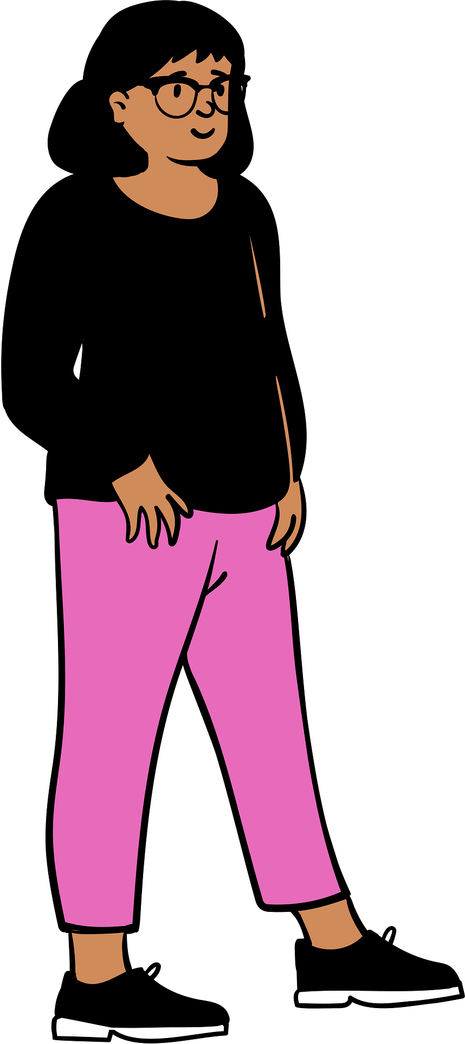
Patient Experiences
Erin Graham (40)
AMAB
Non-binary gender identity – trans feminine
They, them pronouns
Seeking HRT
Has been married for 13 years and has two kids

Slide 29
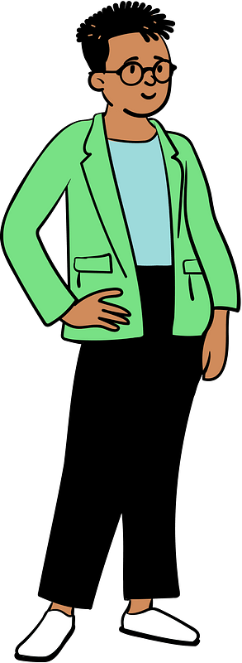
Patient Experiences
Terry (22)
AMAB
Non-binary gender identity – trans feminine
He/Him pronouns
Seeking counselling on gender issues
Has recently immigrate to Canada from Syria with his family

Slide 30
Feminizing

Slide 31
Feminizing Hormone Therapy
Overall aim:
+/- Reduce effects of endogenous testosterone (suppress testosterone)
+/- Induce feminine secondary sex characteristics (add in estrogen)
Some effects are reversible, some are non-reversible

Slide 32
HRT Planning Discussions
Readiness assessment:
Confirm presence of gender dysphoria + ability of patient to provide informed consent
Discuss transition goals - what is the goal?
Medical assessment to rule out contraindications and counsel as accurately as possible on safety
Include a discussion of right time/life circumstance - is it safe to do so? Is this a good time to cope with side effects? Supports if needed? Fertility preservation needs?
Informed consent discussion
Source: Sherbourne Health Center Guidelines for Gender Affirming Primary Care with Trans and Non-binary Patients: A Quick Reference Guide For Primary Care Providers

Slide 33
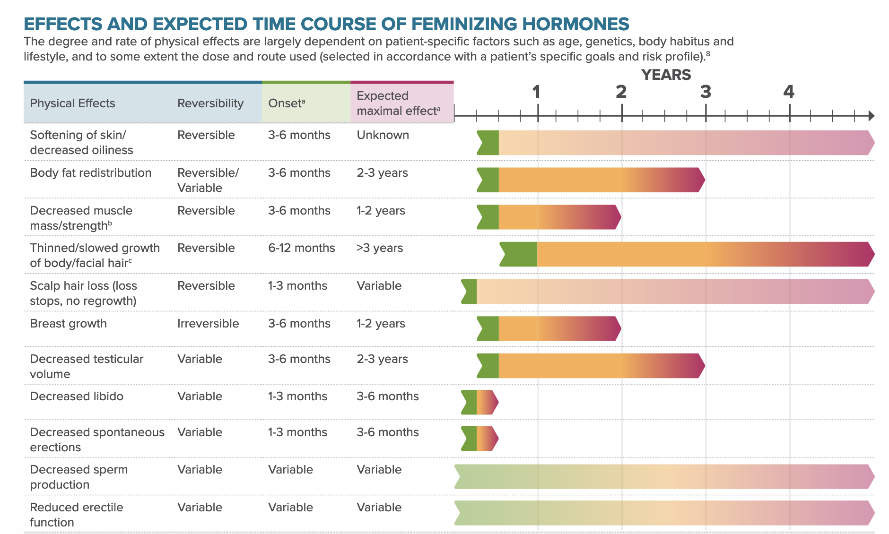
Feminizing Hormone Therapy: Effects
Source: Sherbourne Health Center Guidelines for Gender Affirming Primary Care with Trans and Non-binary Patients: A Quick Reference Guide For Primary Care Providers

Slide 34
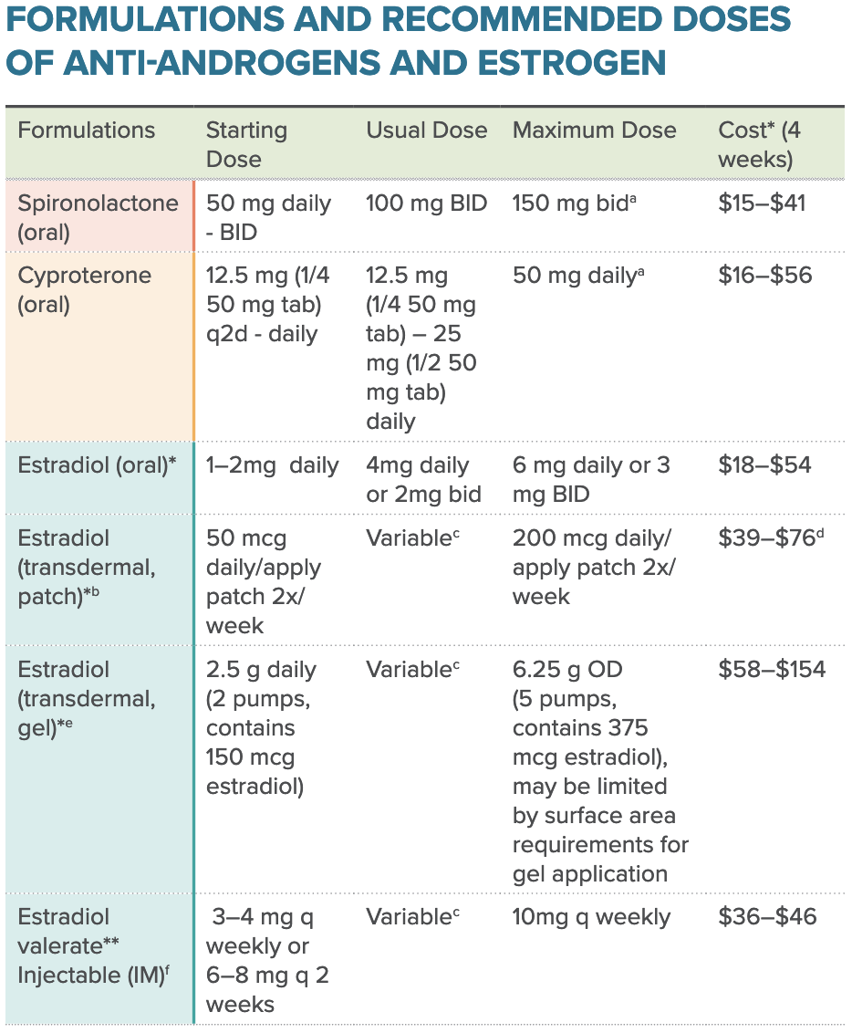
Feminizing Hormone Therapy: Medications & Dosing
Choose one anti-androgen + one formulation of estrogen
Consider stepwise initiation if concerned about side effects
Easy to get rx coverage, common drugs
Cyproterone covered under Alberta Human Services Blue Cross via special authorization, estrogen validate not covered
Source: Sherbourne Health Center Guidelines for Gender Affirming Primary Care with Trans and Non-binary Patients: A Quick Reference Guide For Primary Care Providers

Slide 35
Feminizing HRT: Safety & Monitoring
Baseline labs + q3 months in first year of treatment, q6months in 2nd year and subsequently depending on pt’s risk level and stability of dosing
Similar considerations to exogenous estrogen given for other indications:
VTE
lipids/glucose optimized before and during treatment if needed
Hepatic function
Smoking status
Transdermal dosing lower-risk than other routes of administration in patients with greater medical comorbidity profile

Slide 36
Surgical transition - Feminization
TOP - augmentation
Orchiectomy
BOTTOM
Feminizing face FFS / body
Tracheal shave
Vocal cord

Slide 37
NUANCES / Challenges
Subtle feminization only “I don’t want to pass”
“fem-boy” (feminization with no breast development)
Truly androgenous – “I want someone to be totally confused as to what gender I am”
”I want the best of both worlds” – breast augmentation surgery with fully functional penis

Slide 38
MASCULINIZING
https://thetranscenter.com/transmen/

Slide 39
Patient Experiences
Taib Haman (22)
AFAB
Non-binary Trans Masc
He/Him They/thempronouns
Seeking HRT (Testosterone) and Top surgery
Currently in school for journalism and smokes

Slide 40
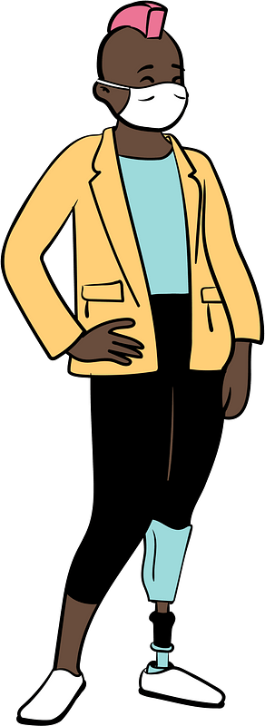
Patient Experiences
Quinn (35)
AFAB
Non-binary Masculine presenting
She/ Hers, They/Them pronouns
Had top surgery 4 years ago, on ”low dose” Testostserone and considering Hysterectomy
Sex Worker, non-contact cam based

Slide 41
Masculinizing

Slide 42
Masculinizing Hormone Therapy
Overall aim:
+/- Testosterone therapy to induce male secondary sex characteristics
Some effects are reversible, some are irreversible
Considerations for HRT planning the same for feminizing and masculinizing hormone therapy – what is the goal?
Different considerations for medical contraindications

Slide 43
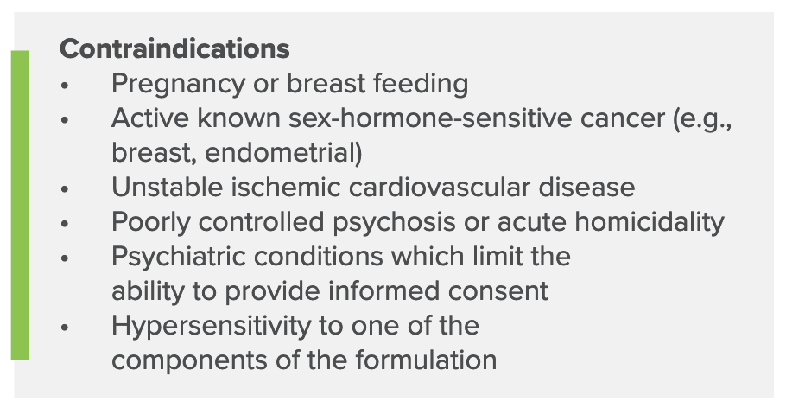
Masculinizing Hormone Therapy: Contraindications & Risks
Consider discussion around fertility preservation/family planning as part of HRT planning; less accessible than sperm banking
Source: Sherbourne Health Center Guidelines for Gender Affirming Primary Care with Trans and Non-binary Patients: A Quick Reference Guide For Primary Care Providers

Slide 44
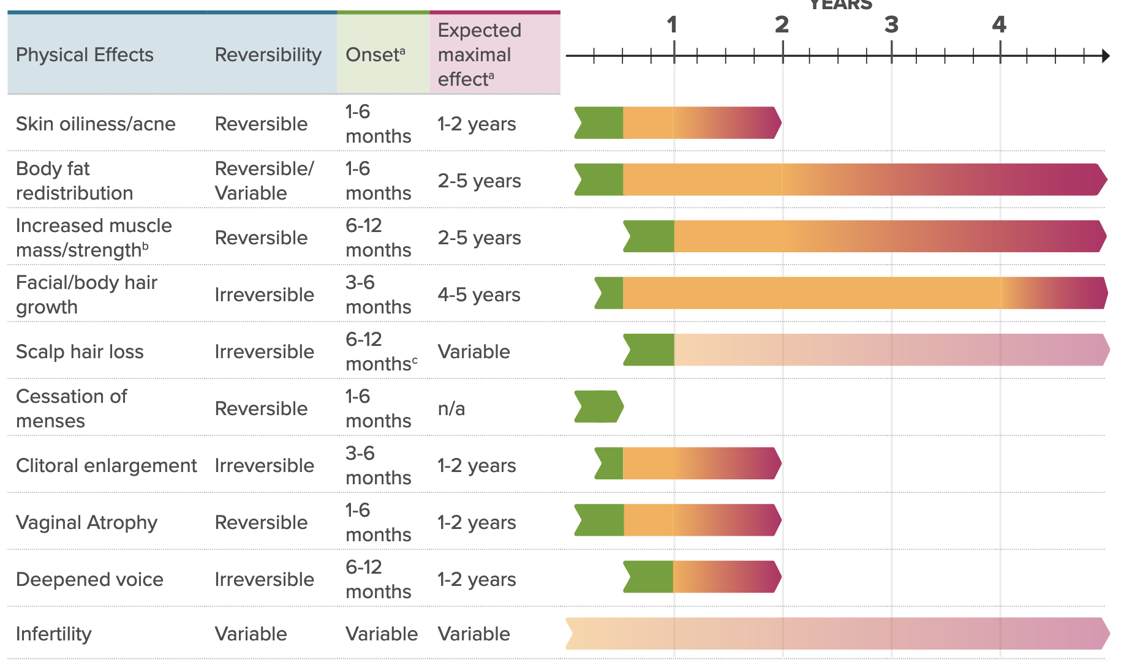
Masculinizing Hormone Therapy: Effects
Source: Sherbourne Health Center Guidelines for Gender Affirming Primary Care with Trans and Non-binary Patients: A Quick Reference Guide For Primary Care Providers

Slide 45
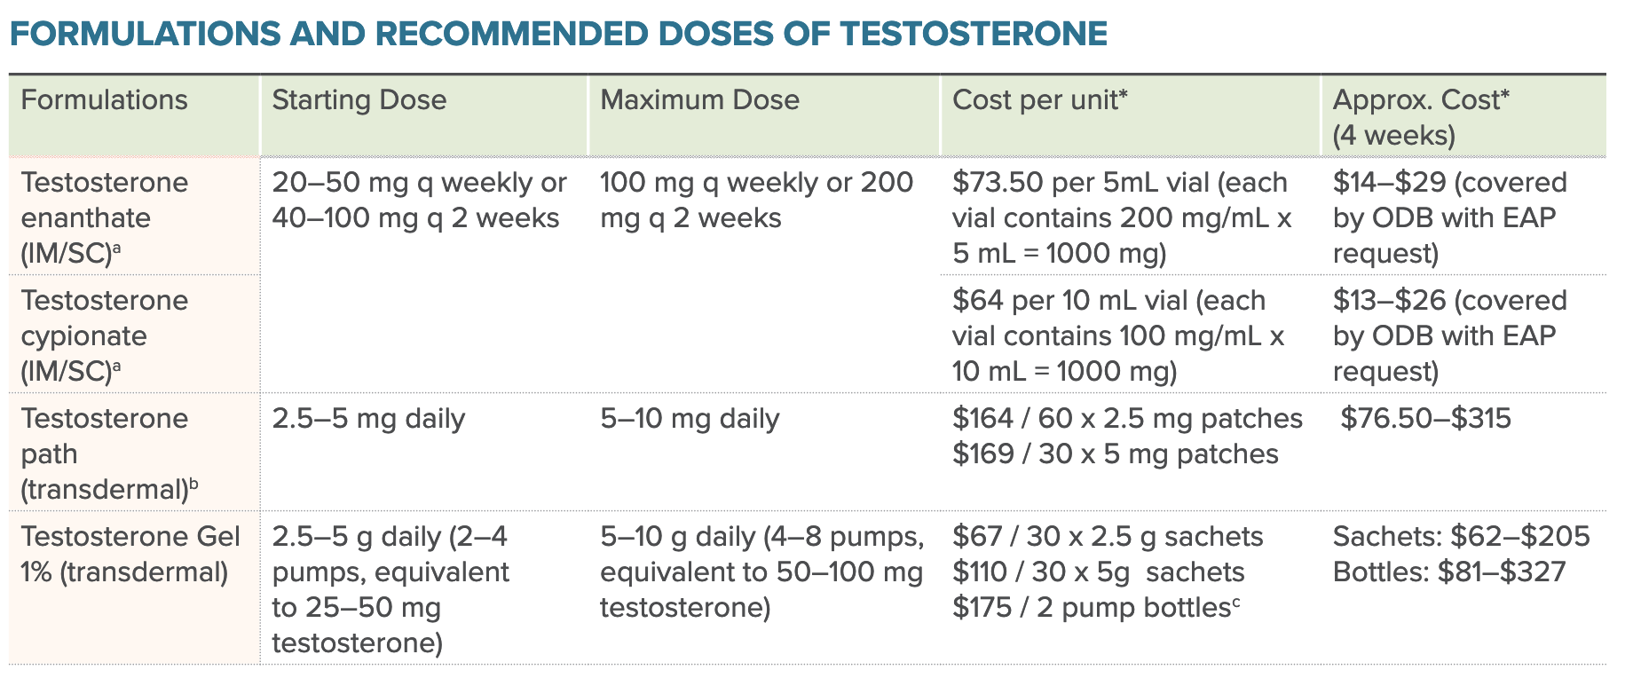
Masculinizing Hormone Therapy: Medications & Dosing
Injectable formulations more affordable/more often covered
If affordable, transdermal tx offers comparable effect
Source: Sherbourne Health Center Guidelines for Gender Affirming Primary Care with Trans and Non-binary Patients: A Quick Reference Guide For Primary Care Providers

Slide 46
Masculinizing HRT: Safety & Monitoring
Baseline labs + q3 months in first year of treatment, q6months in 2nd year and subsequently depending on pt’s risk level and stability of dosing
If on injections, timing of labs in relation to dose is important, different approaches - midweek vs trough vs both. Less important with transdermal tx as these are dosed daily
Considerations:
Monitoring for polycythemia, especially if smoking regularly
Supraphysiologic testosterone levels (use “male” lab reference range)
Optimizing lipids/glucose if indicated

Slide 47
Surgical transition – Masculinization
TOP (double mastectomy / male chest contouring)
Hysterectomy
BOTTOM (Metta/Phallo unlikely)
Masculinizing (facial/body)

Slide 48
NUANCES / Challenges
“Want to be stronger / more muscular”
“I really only want a lower voice and I’ll take some bottom growth – I don’t plan on long term T”
“I only want TOP surgery, no desire whatsoever for Testosterone”
Truly androgenous – “I want someone to be totally confused as to what gender I am”
”I have a LIST: I don’t want to go bald, I want some bottom growth, I don’t want acne, I don’t want any more periods, I’m considering TOP surgery… I just want to look more masculine”

Slide 49
RESOURCES
2SLGBTQ+ COMMUNITY
(in person/on-line)
ORGANIZATIONS (eg WPATH)
EDUCATIONAL (eg Rainbow Health)
MEDICAL (eg Sherbourne Guidelines)

Slide 50
Community RESOURCES Calgary, AB examples
Queer Education Foundation
Skipping Stone Foundation
Centre for Sexuality
Centre for Newcomers -Rainbow Railroad
Calgary Pride
Calgary Queer Arts Society
Calgary Outlink

Slide 51
Medical RESOURCES / References
https://www.rainbowhealthontario.ca/resource-library/qrg/
https://www.rainbowhealthontario.ca/product/4th-edition-sherbournes-guidelines-for-gender-affirming-primary-care-with-trans-and-non-binary-patients/
http://www.phsa.ca/transcarebc/Documents/HealthProf/Primary-Care-Toolkit.pdf
Chance Krempasky, Miles Harris, Lauren Abern, Frances Grimstad. Contraception across the transmasculine spectrum. American Journal of Obstetrics and Gynecology, Volume 222, Issue 2, 2020, Pages 134-143.

Slide 52
Surgical RESOURCES
GRS Montreal https://www.grsmontreal.com/en/home.html
many other websites
https://www.mtfsurgery.net/
https://thetranscenter.com/transmen/
https://www.transhealthcare.org/find-surgeon/
Local teams – FP, plastics, urology, gyne

Slide 53
TRANSGENDER HEALTH for Alberta
e – referrals
MD to MD consults

Slide 54
QUESTIONS / COMMENTS

Slide 55
THANKS

Slide 56
EVALUATION

