Slide 1



FMF 2023
Reaching out: relevant and accessible clinical preceptor faculty development
Add speaker name(s) here
Team Members: Wendy Graham*, Cheri Bethune*, Shabnam Asghari, Tayebeh Sohrabi, Alexandria Tobin
*Presenting

Slide 2
Presenter Disclosure
Presenter: Wendy Graham
Relationships with financial sponsors:
  Any direct financial relationships, including receipt of honoraria: CFPC-NL Chapter President (honoraria), NLMA FPRP/FPN (committee work - honoraria), patient recruitment for Sequence Bio (private genetic company - honoraria), research funding through Memorial University for the 6for6 Faculty Development Program.
  Membership on advisory boards or speakers’ bureaus: Not applicable.
  Patents for drugs or devices: Not applicable.
  Other: Full-time employee at Memorial University of Newfoundland.
Notes:
Where a faculty/presenter has no relationships to disclose, indicate Not Applicable under Relationships with Financial Sponsors.
Complete this slide for the primary presenter and ALL co-presenters if applicable.
Reminder: Disclosures made on your COI forms should match disclosures made on the COI slide.

Slide 3
Presenter Disclosure
Presenter: Cheri Bethune
Relationships with financial sponsors:
  Any direct financial relationships, including receipt of honoraria: NOAMA grant PI, CFPC clinician-educator (contractual).
  Membership on advisory boards or speakers’ bureaus: Not applicable.
  Patents for drugs or devices: Not applicable.
  Other: Not applicable.
Notes:
Where a faculty/presenter has no relationships to disclose, indicate Not Applicable under Relationships with Financial Sponsors.
Complete this slide for the primary presenter and ALL co-presenters if applicable.
Reminder: Disclosures made on your COI forms should match disclosures made on the COI slide.

Slide 4
Disclosure of Financial Support
This program has received financial support from the Faculty of Medicine, Memorial University of Newfoundland in the form of operational funding.
This program has received in-kind support from the Faculty of Medicine, Memorial University of Newfoundland in the form of logistical support.
Potential for conflict(s) of interest:
Wendy Graham is a full-time employee at Memorial University of Newfoundland.
Notes:
Where a program has received no external financial support (e.g., monies for food, logistics assistance such as registration, AV set-up, etc.), indicate No External Support.

Slide 5

Tiohtiá:ke/Montreal is situated on the traditional territory of the Kanien’kehà:ka, a place which has long served as a site of meeting and exchange amongst many First Nations including the Kanien’kehá:ka of the Haudenosaunee Confederacy, Huron/Wendat, Abenaki, and Anishinaabeg. We recognize and respect the Kanien’kehà:ka as the traditional custodians of the lands and waters on which we meet today.
Source: https://www.mcgill.ca/circ/land-acknowledgement

Slide 6
Learning Objectives
Describe best practices for distributed faculty development
Explore several models of successful distributed faculty development
Integrate and innovate in your own program using the principles of faculty development
Notes:
Other objectives from participants

Slide 7
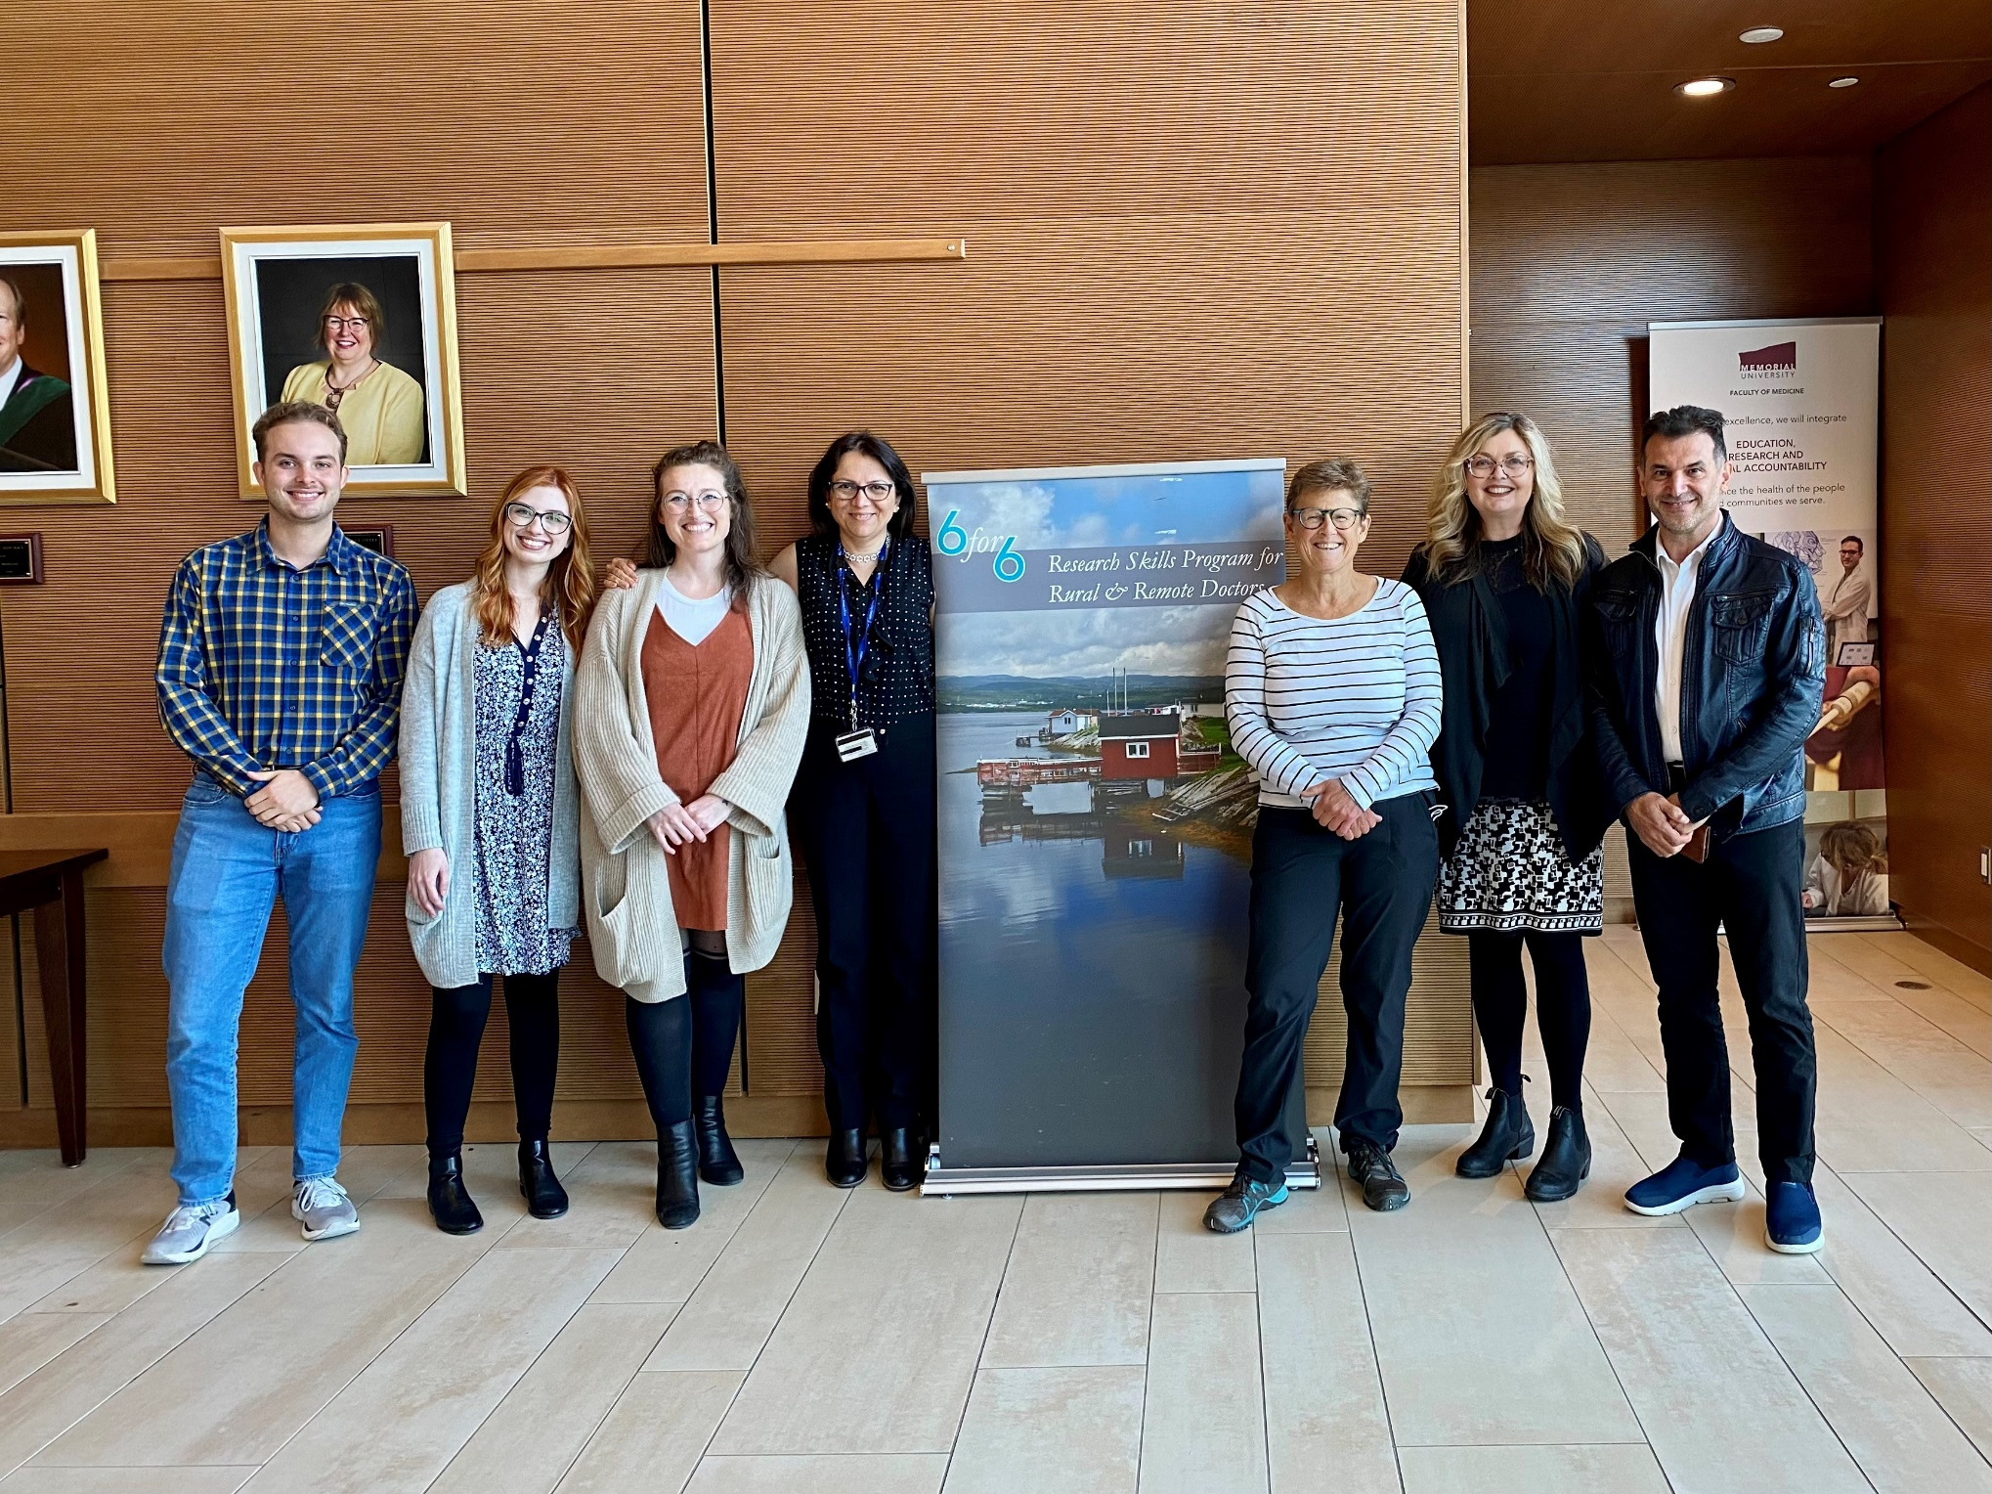

Our Team
And you?
Notes:
*This slide will look weird when out of presenter mode* it will load with the “Our team” text and picture. Advance slide once to get rid of these, then advance again to bring the “And you?” and mic picture up.

Slide 8

The Question…
How should medical schools address the faculty needs of community preceptors?
Notes:
Other objectives from participants

Slide 9
Activity 1
What framework does your faculty development program follow? Brainstorming activity.

Slide 10
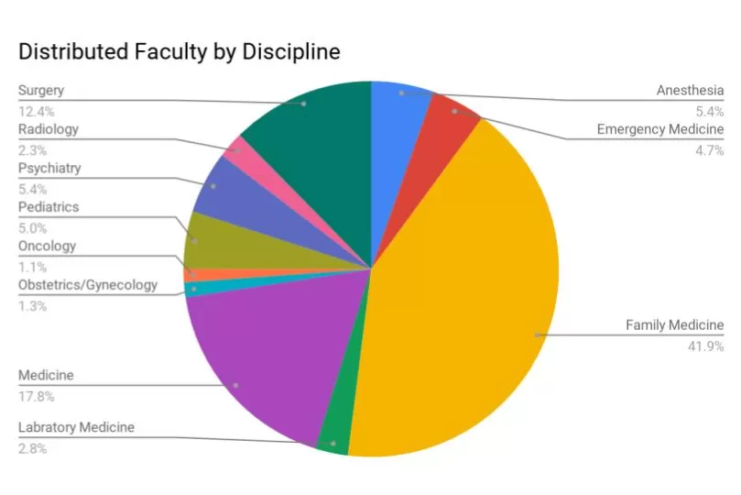
Distributed Faculty at Memorial University
Faculty holding clinical appointments in distributed teaching sites as of September 2019:
  259 in Newfoundland and Labrador
  42 in Prince Edward Island
  10 in Nunavut
These faculty are appointed over eleven clinical disciplines and provide rich learning experiences in rural and remote sites
Source: https://www.mun.ca/medicine/administrative-departments/distributed-medical-education/distributed-faculty/
Notes:
Other objectives from participants

Slide 11
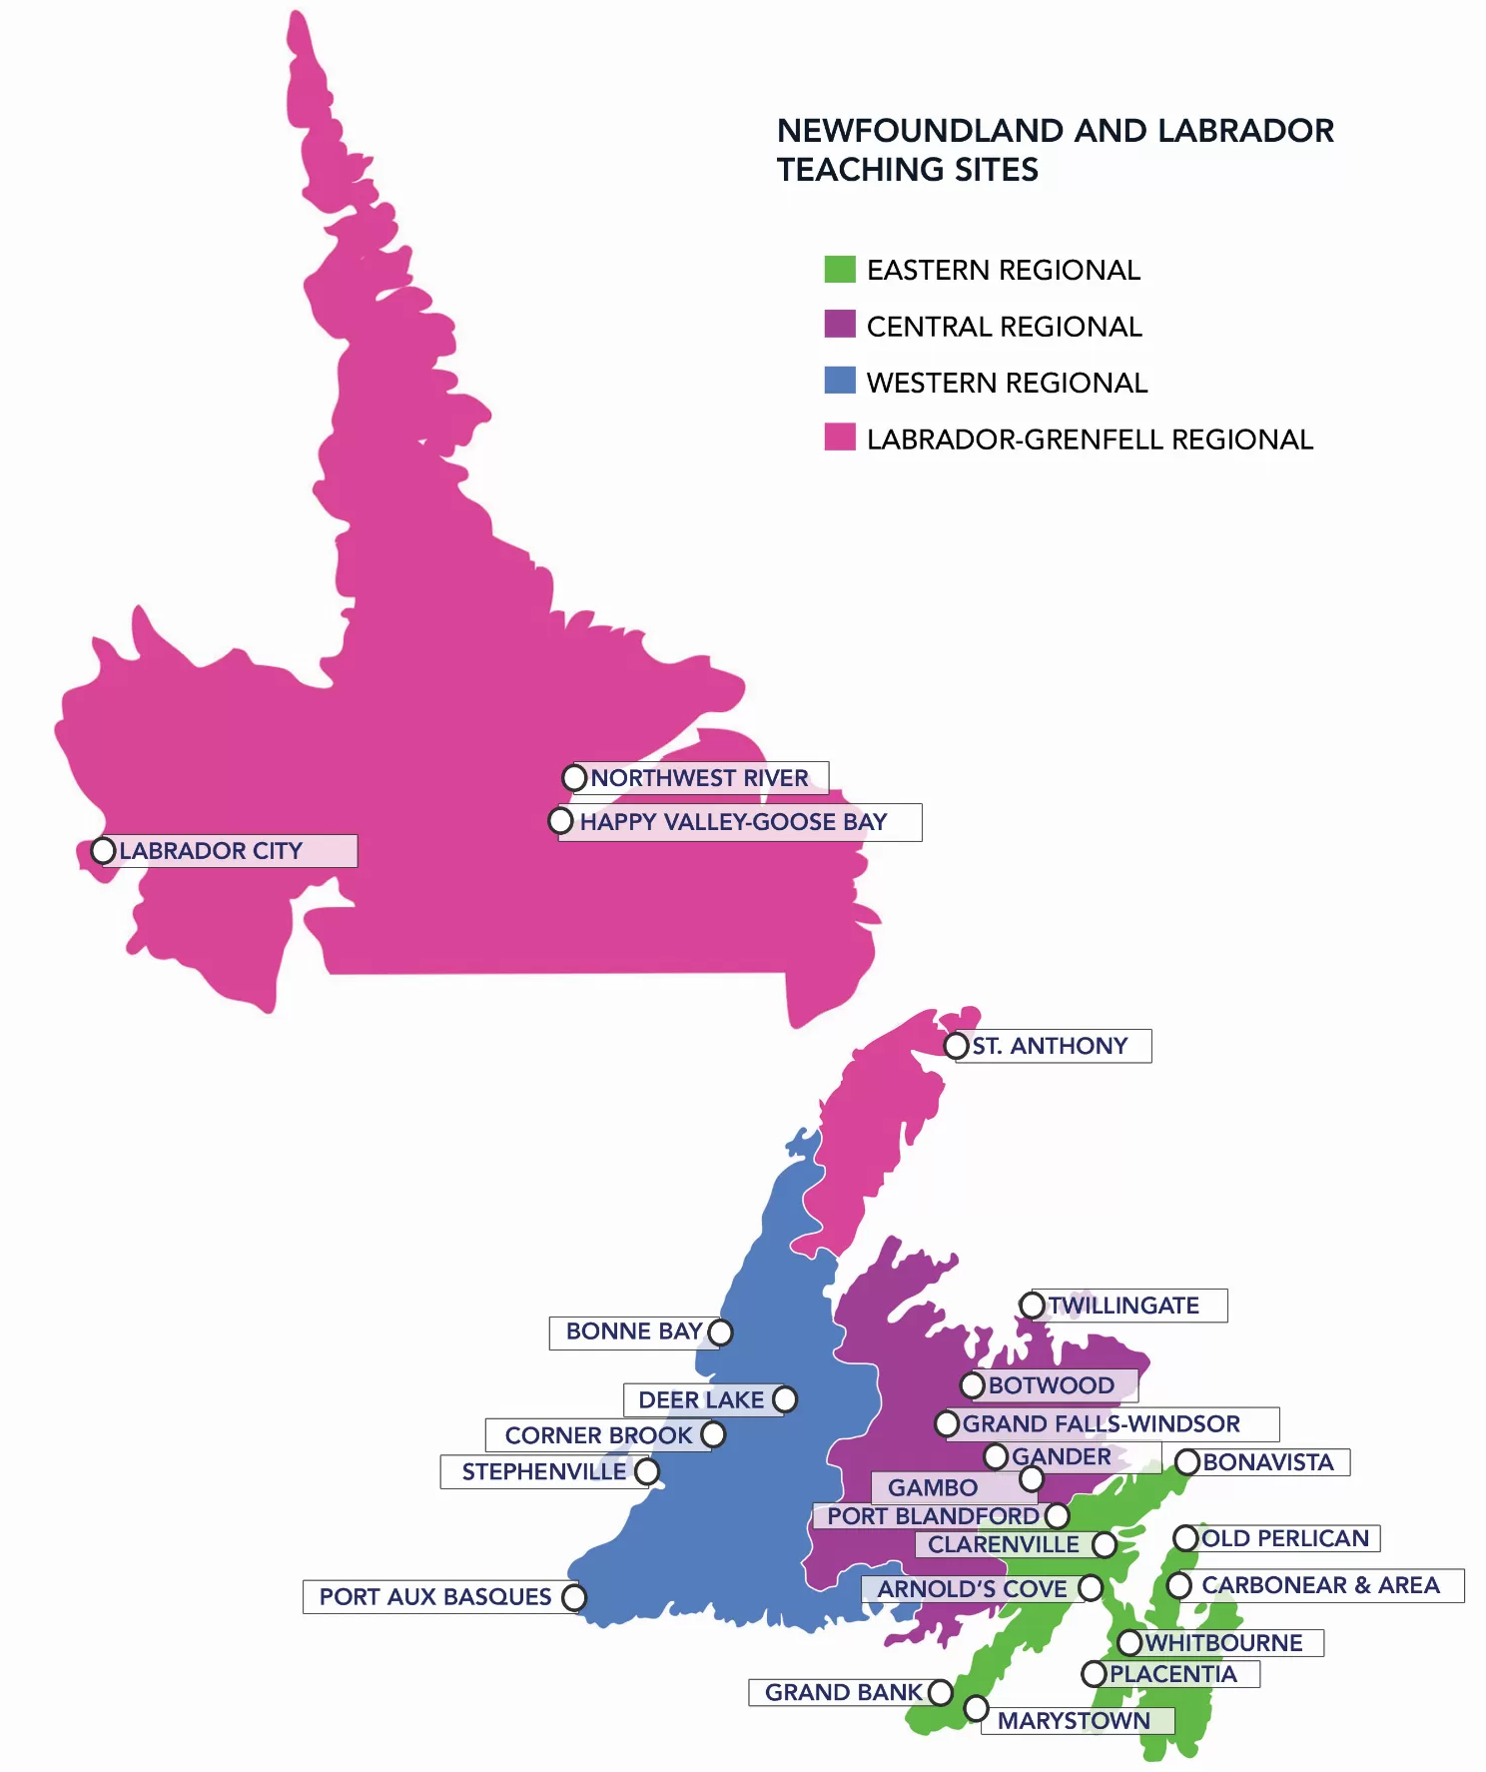
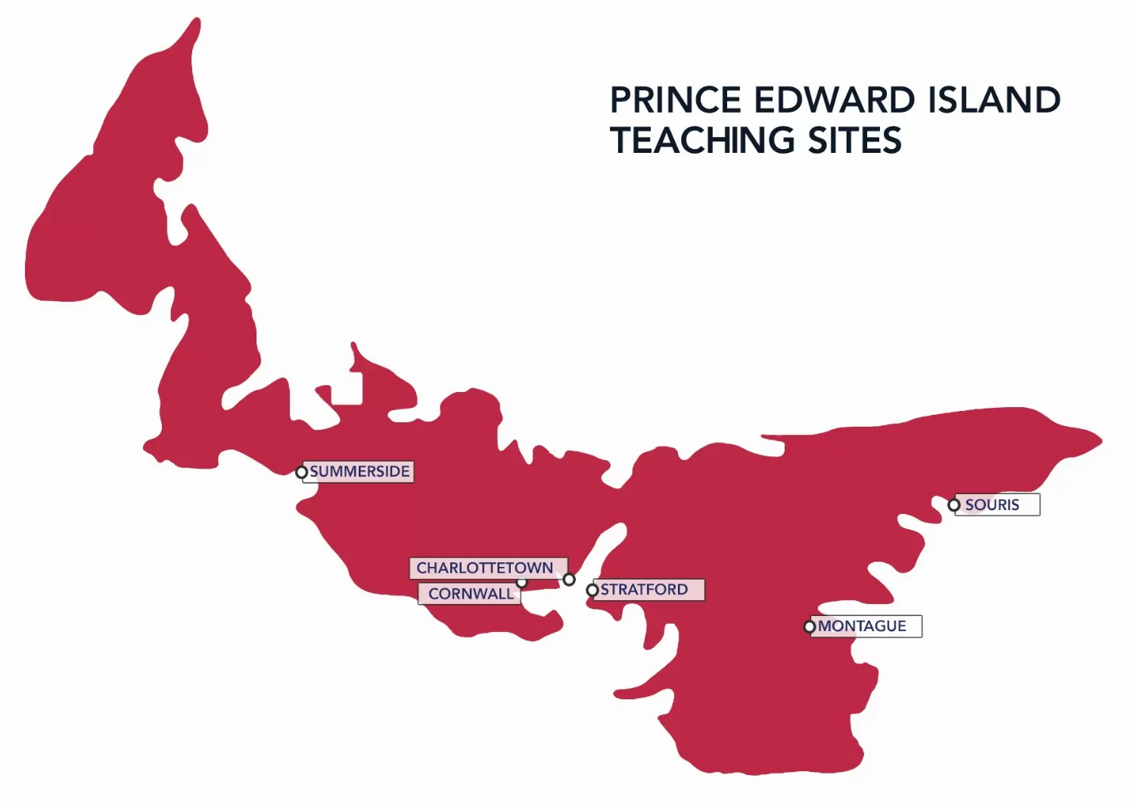
Memorial University Distributed Teaching Sites
Source: https://www.mun.ca/medicine/administrative-departments/distributed-medical-education/our-communities/

Slide 12
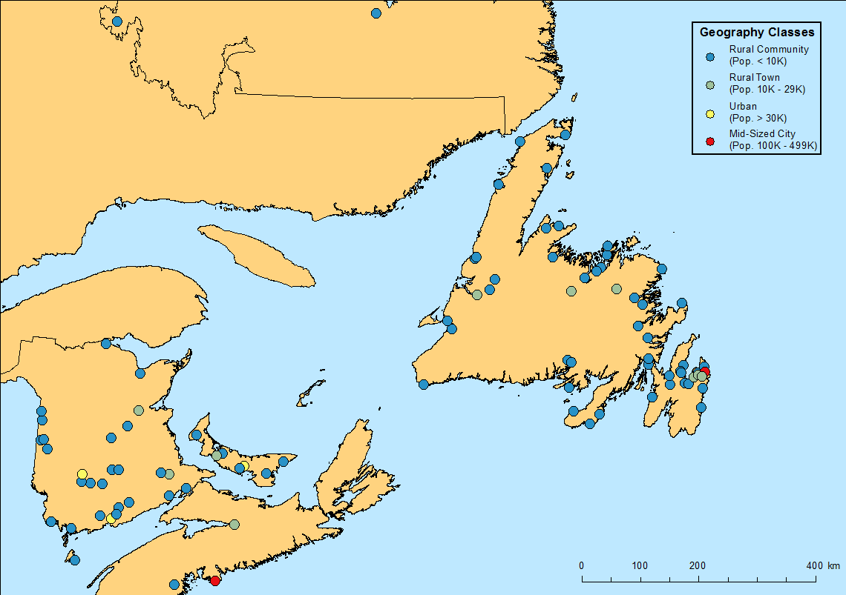
Distributed Preceptorship
Notes:
Slide hidden

Slide 13


Slide 14
Activity 2
What barriers does your program face for faculty development?
Notes:
Other objectives from participants, incorporate AAM here if needed. We won’t spend too much time on barriers since the next slide discusses.

Slide 15



Challenges to Distributed Faculty Development
Geography
Time constraints
Funding
Human resource challenges
X
Source: https://www.mun.ca/medicine/administrative-departments/distributed-medical-education/distributed-faculty/
Notes:
Other objectives from participants

Slide 16
Faculty Development – Scope
Faculty development initiatives often focus on teaching and instructional effectiveness (Steinert et al. 2006)
However, effective faculty development must address all faculty members’ roles (Steinert 2011), as defined by the CanMEDS-FM framework:
  Leader and manager
  Research and scholar
It is also important to note the role of faculty development in career development and organizational change (Steinert 2014)
Source: Steinert et al. 2006, Steinert & Mann 2006, Steinert, Naismith, & Mann, 2012, Steinert 2014.
Notes:
Other objectives from participants

Slide 17
Distributed Faculty Development – Best Practices
Steinert et al. (2012) identified several features of faculty development initiatives contributing to positive outcomes:
  Multiple instructional methods within single interventions
  Experiential learning and reflective practice
  Individual and group projects
  Peer support and the development of communities of practice
  Mentorship
  Institutional support
Source: Steinert, Naismith, & Mann, 2012.
Notes:
Other objectives from participants

Slide 18
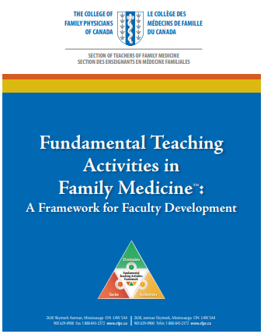
Distributed Faculty Development – Best Practices
The College of Family Physicians of Canada has prepared the Fundamental Teaching Activities in Family Medicine Framework: A Framework for Faculty Development, which includes three domains:
  Clinical Preceptor
  Teacher Outside the Clinical Setting
  Educational Leader
Source: Walsh et al. 2015
Notes:
Other objectives from participants
Cheri’s comment to include if time permits “the FTA document preamble discusses customization of FD and mapping the various offerings of FD at the individual, site and program level using the 4 squares. Should this be included in later activity which has participants making plans at each of these levels?”

Slide 19
CFPC – Teacher Outside the Clinical Setting
This domain describes effective practices for delivering educational sessions to learners outside the clinical setting:
  Understanding the nature and needs of the learners, the materials to be used, and teaching strategies to be employed
  Ensuring that the stated learning objectives are met
  Encouraging group engagement and interaction
  Reflection by the teacher to adjust and improve the session as needed
Source: Walsh et al. 2015
Notes:
Other objectives from participants

Slide 20
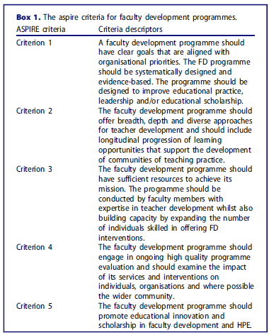
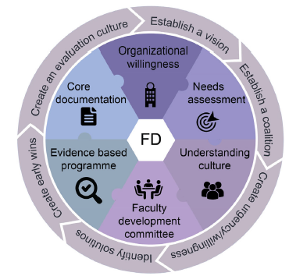
Association for Medical Education in Europe (AMEE) ASPIRE Criteria
The AMEE ASPIRE to excellence award criteria for faculty development programs provides a guide to evaluate existing faculty development programs, and also develop new initiatives
Source: Dijk et al. 2023
Notes:
Other objectives from participants

Slide 21


Slide 22


Models of Successful Faculty Development Initiatives – The 6for6 Program
Program objective: to establish and evaluate a longitudinal faculty development program that promotes a foundation of research activity
  6for6 is a research skills development program designed to enhance research competency and productivity among rural physicians
  The program is offered to six rural physicians over six weekends
  Faculty, mentors, guests, and peers engage in the curriculum and assist the rural physician in developing a research proposal or a writing project
  Thirty-eight (38) participants have completed the program to date, including an international participant from Nepal
Notes:
Other objectives from participants

Slide 23
Models of Successful Faculty Development Initiatives – The 6for6 Program Curriculum Development
Step 1
Identify problem & general needs assessment
(General NA = Ideal Approach – Current Approach)
Executive advisory committee
Step 6
Evaluation & feedback
Program evaluation surveys
Session surveys
Feedback from mentors,
RA, facilitators, etc.
Step 2
Targeted needs assessment
Literature review
Environmental scan
Focus group
Key informants (pan Canada)
Needs assessment surveys
Strategic planning session
Step 5
Implementation
Introduce curriculum
Administer curriculum
Address barriers to implementation
Step 3
Goals & objectives
Feedback gathered
Program planning committee
© Kern, D. E., Thomas, P. A., & Hughes, M. T. (Eds.) (2009). Curriculum Development for Medical Education: A Six-Step Approach, Second Edition. John Hopkins University Press: Baltimore, Maryland
Step 4
Educational strategies
Notes:
Other objectives from participants

Slide 24
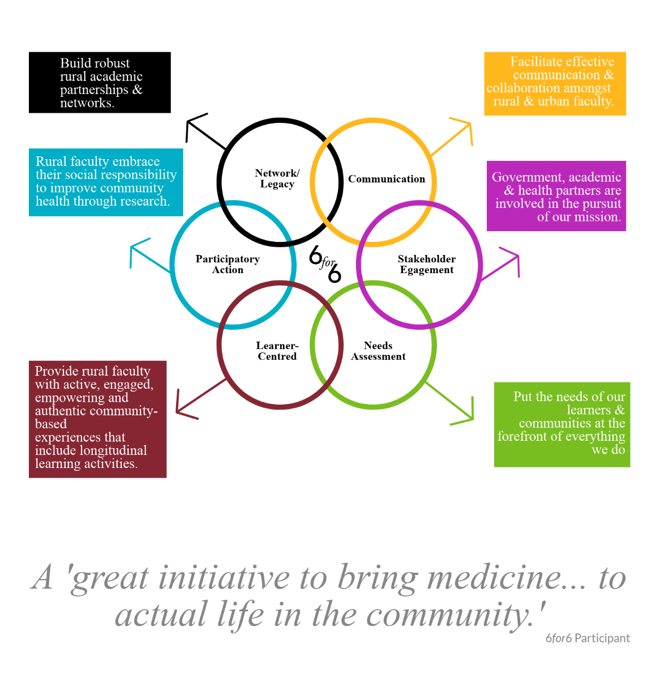
Our Six Principles

Slide 25

Models of Successful Faculty Development Initiatives – The 6for6 Program Framework
Blended learning model
  Didactic, web-based, case-based & mobile learning
  Audio/video podcasts
Synchronous and asynchronous learning methods
  6 structured, face-to-face sessions
  Self-paced eLearning activities
Curriculum
  Knowledge- and skill-building
  Development of research networks
Built-in time to work on research project
Notes:
Other objectives from participants

Slide 26
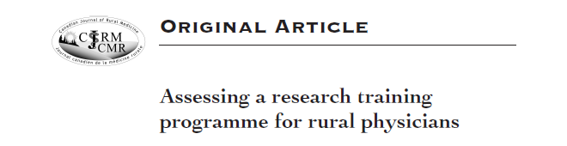
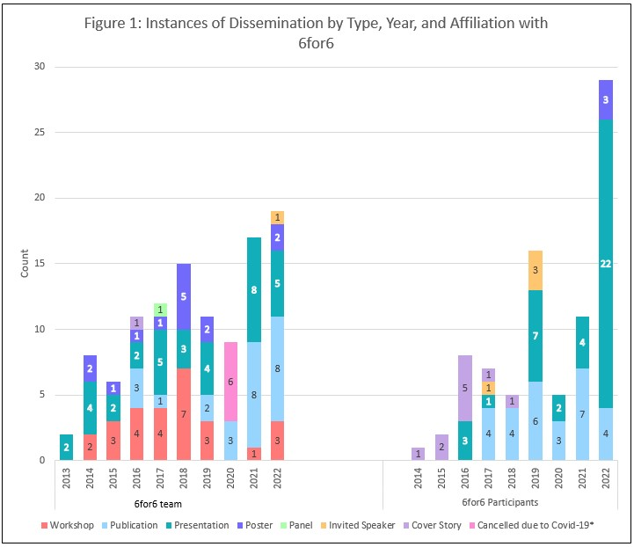
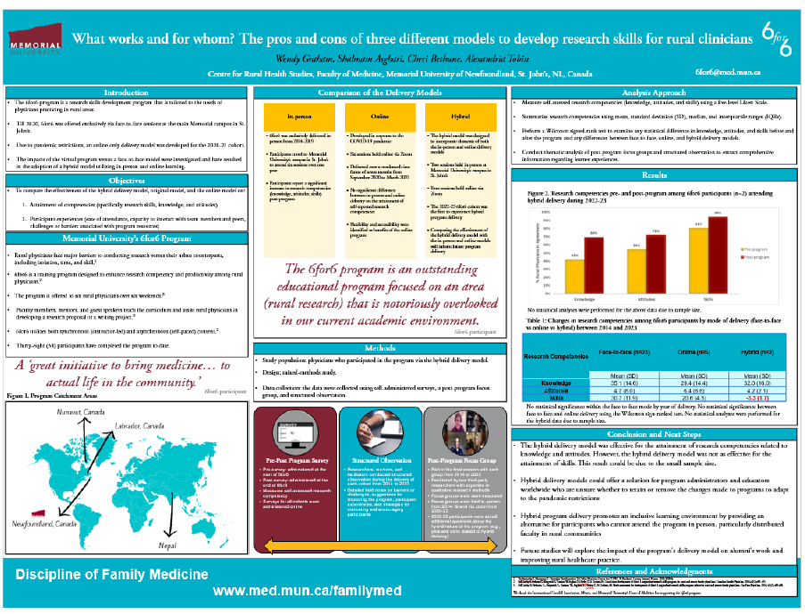

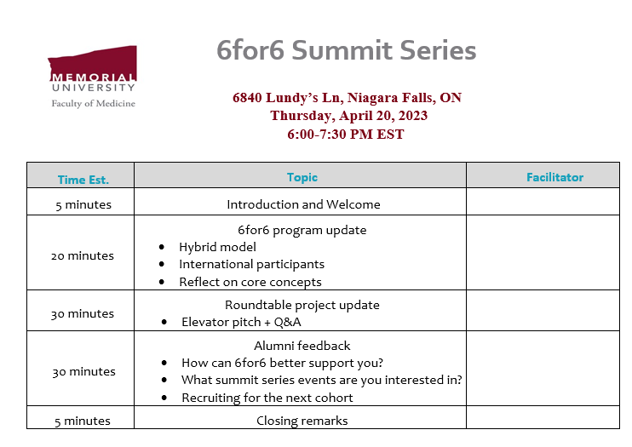
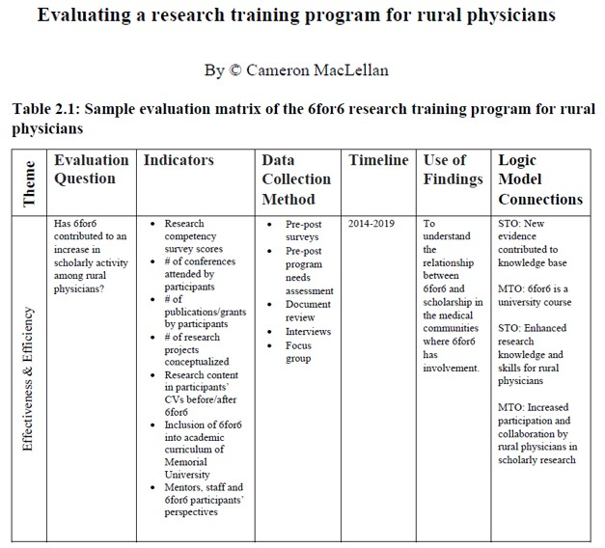
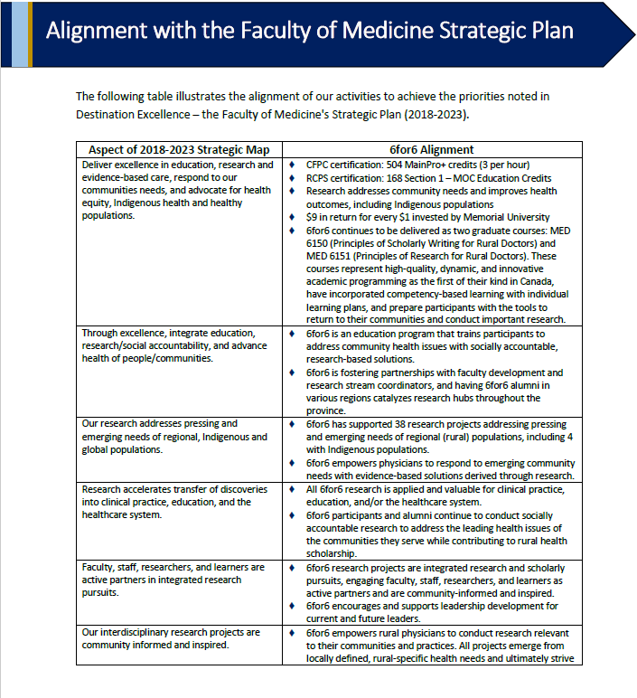
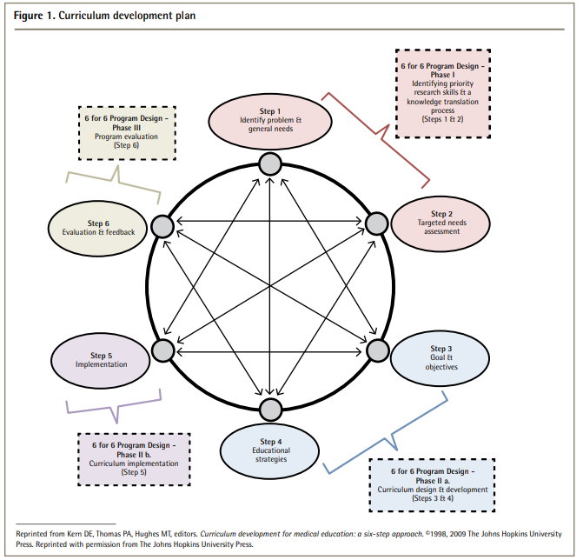
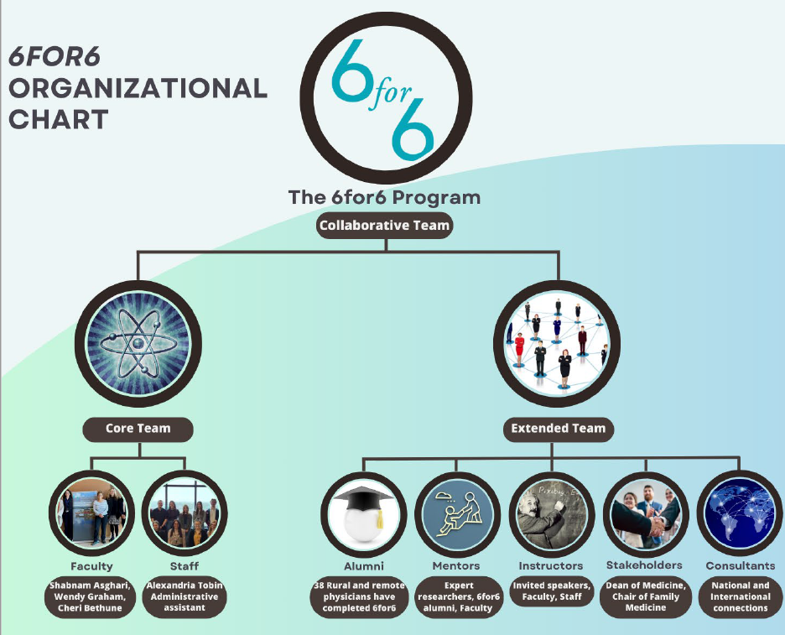
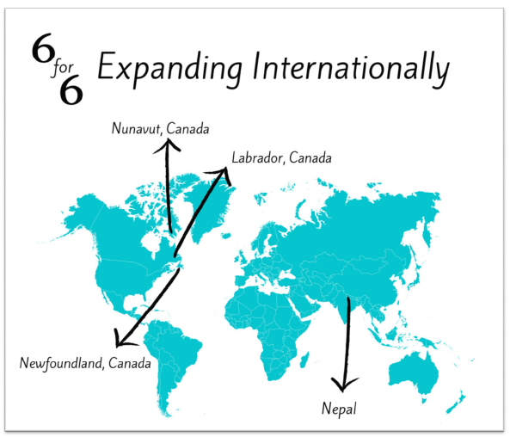

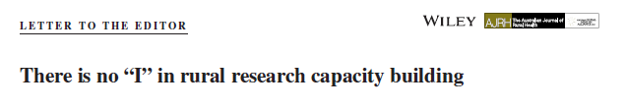
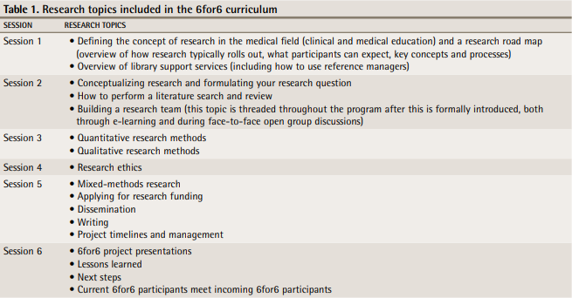
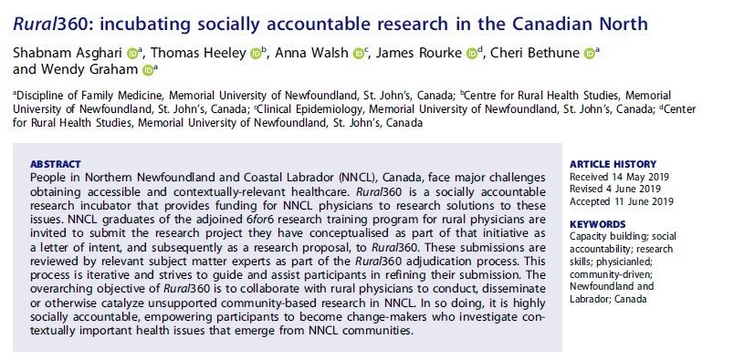
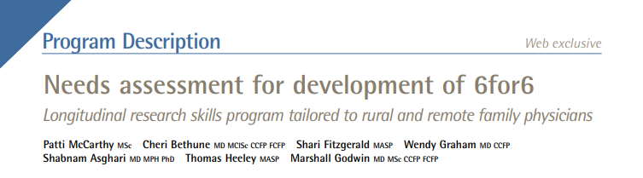

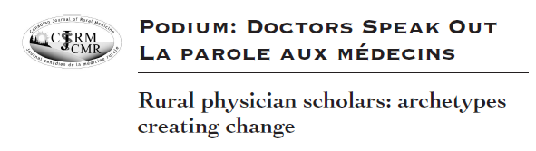
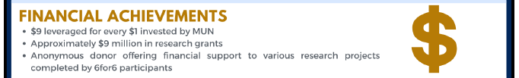
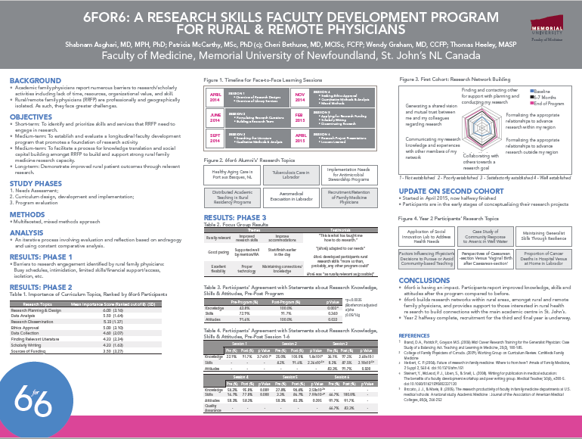
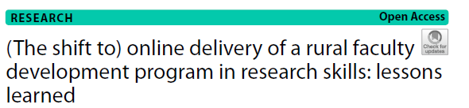

Activity 3: Alignment of the 6for6 program with the ASPIRE criteria
Source: Dijk et al. 2023
Notes:
*To edit: use animation pane and selection pane to hide items as needed* Other objectives from participants

Slide 27
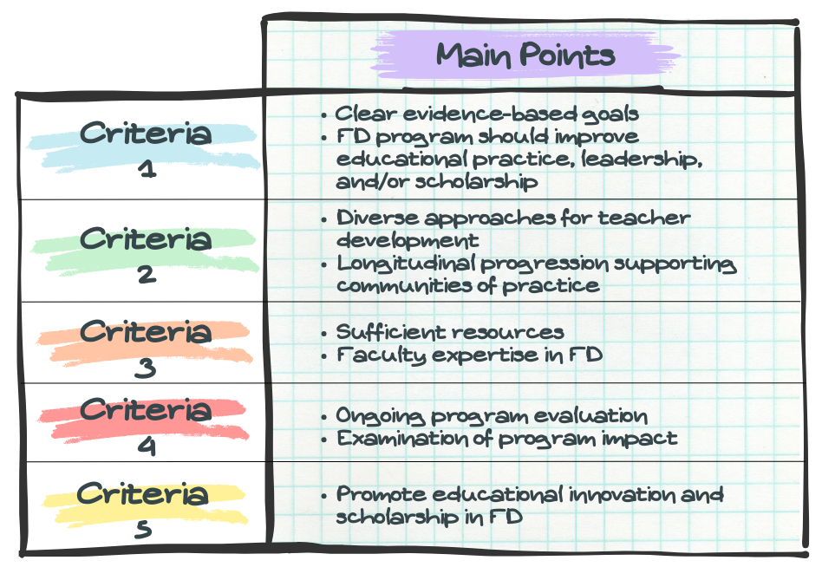
Final Activity
Use the ASPIRE criteria to evaluate your own faculty development program.
Source: Dijk et al. 2023
Notes:
Other objectives from participants

Slide 28




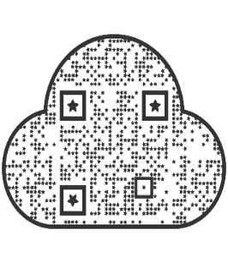
A Research Skills Program for Rural and Remote Doctors
We are recruiting for the 2024-2025 cohort! Please contact 6for6@mun.ca for more information
“I’m a different practitioner now... Scholarly work has woven itself into my life. I’m hooked.”
-6for6 participant
6for6 publication list
6for6 brochure

Slide 29




Closing Slide
Thank you!
Please fill out your session evaluation now!
#myfmf
FamilyMedicineForum
FamilyMedForum
FamilyMedForum

Slide 30
References:
https://www.mun.ca/medicine/administrative-departments/distributed-medical-education/distributed-faculty
https://www.mun.ca/medicine/administrative-departments/distributed-medical-education/our-communities/
Steinert, Y., Mann, K., Centeno, A., Dolmans, D., Spencer, J., Gelula, M., & Prideaux, D. (2006). A systematic review of faculty development initiatives designed to improve teaching effectiveness in medical education: BEME Guide No. 8. Medical teacher, 28(6), 497–526. https://doi.org/10.1080/01421590600902976
Steinert, Y., & Mann, K. V. (2006). Faculty development: principles and practices. Journal of veterinary medical education, 33(3), 317–324. https://doi.org/10.3138/jvme.33.3.317
Steinert, Y., Naismith, L., & Mann, K. (2012). Faculty development initiatives designed to promote leadership in medical education. A BEME systematic review: BEME Guide No. 19. Medical teacher, 34(6), 483–503. https://doi.org/10.3109/0142159X.2012.680937
Steinert, Y.. (2014). Faculty Development in the Health Professions: A Focus on Research and Practice. 10.1007/978-94-007-7612-8.
Walsh A, Antao V, Bethune C, Cameron S, Cavett T, Clavet D, Dove M, Koppula S. Fundamental Teaching Activities in Family Medicine: A Framework for Faculty Development. Mississauga, ON: College of Family Physicians of Canada; 2015.
Dijk, S. W., Findyartini, A., Cantillon, P., Cilliers, F., Caramori, U., O'Sullivan, P., & Leslie, K. M. (2023). Developing a programmatic approach to faculty development and scholarship using the ASPIRE criteria: AMEE Guide No. 165. Medical teacher, 1–14. Advance online publication. https://doi.org/10.1080/0142159X.2023.2259062

