Slide 1


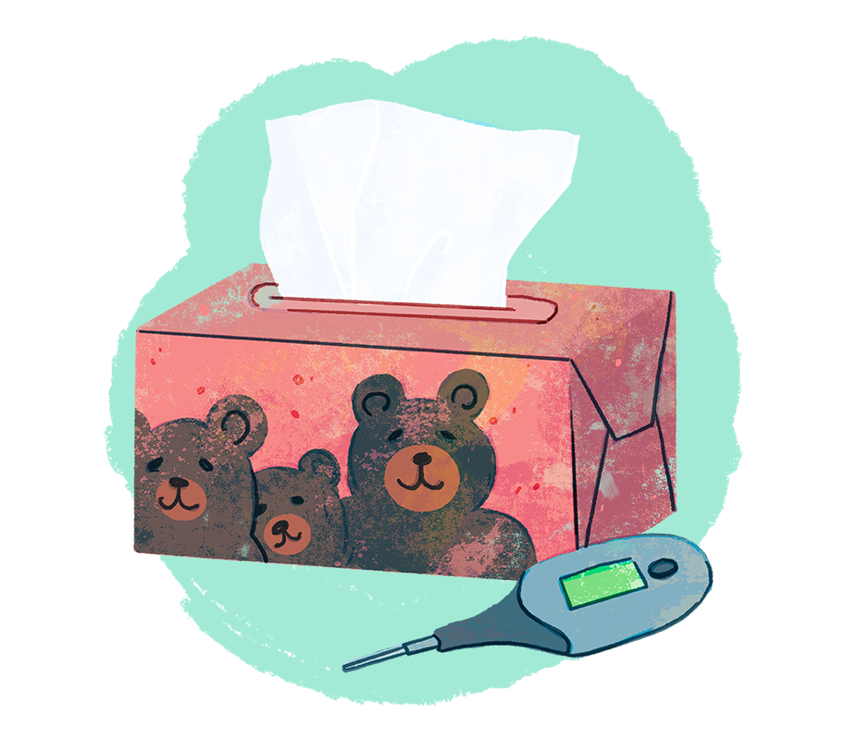
BRONCHIOLITIS: CREATING
A TOOLKIT FOR CHANGE
Presenter: Dr. Jennifer Young MD CCFP-EM
Family Medicine Forum
November 10, 2023
Comprehensive Family Physician, Collingwood ON
Part-time Physician Advisor CFPC
Notes:
Launched Nov 7
CPS, TREKK endorsed
CW booth
Antimicrobial awareness week
Op-Ed – local paper that is distributed,
CFP article December
End of year wrap up December cwc events
Uploaded into Pathways for BC docs

Slide 2
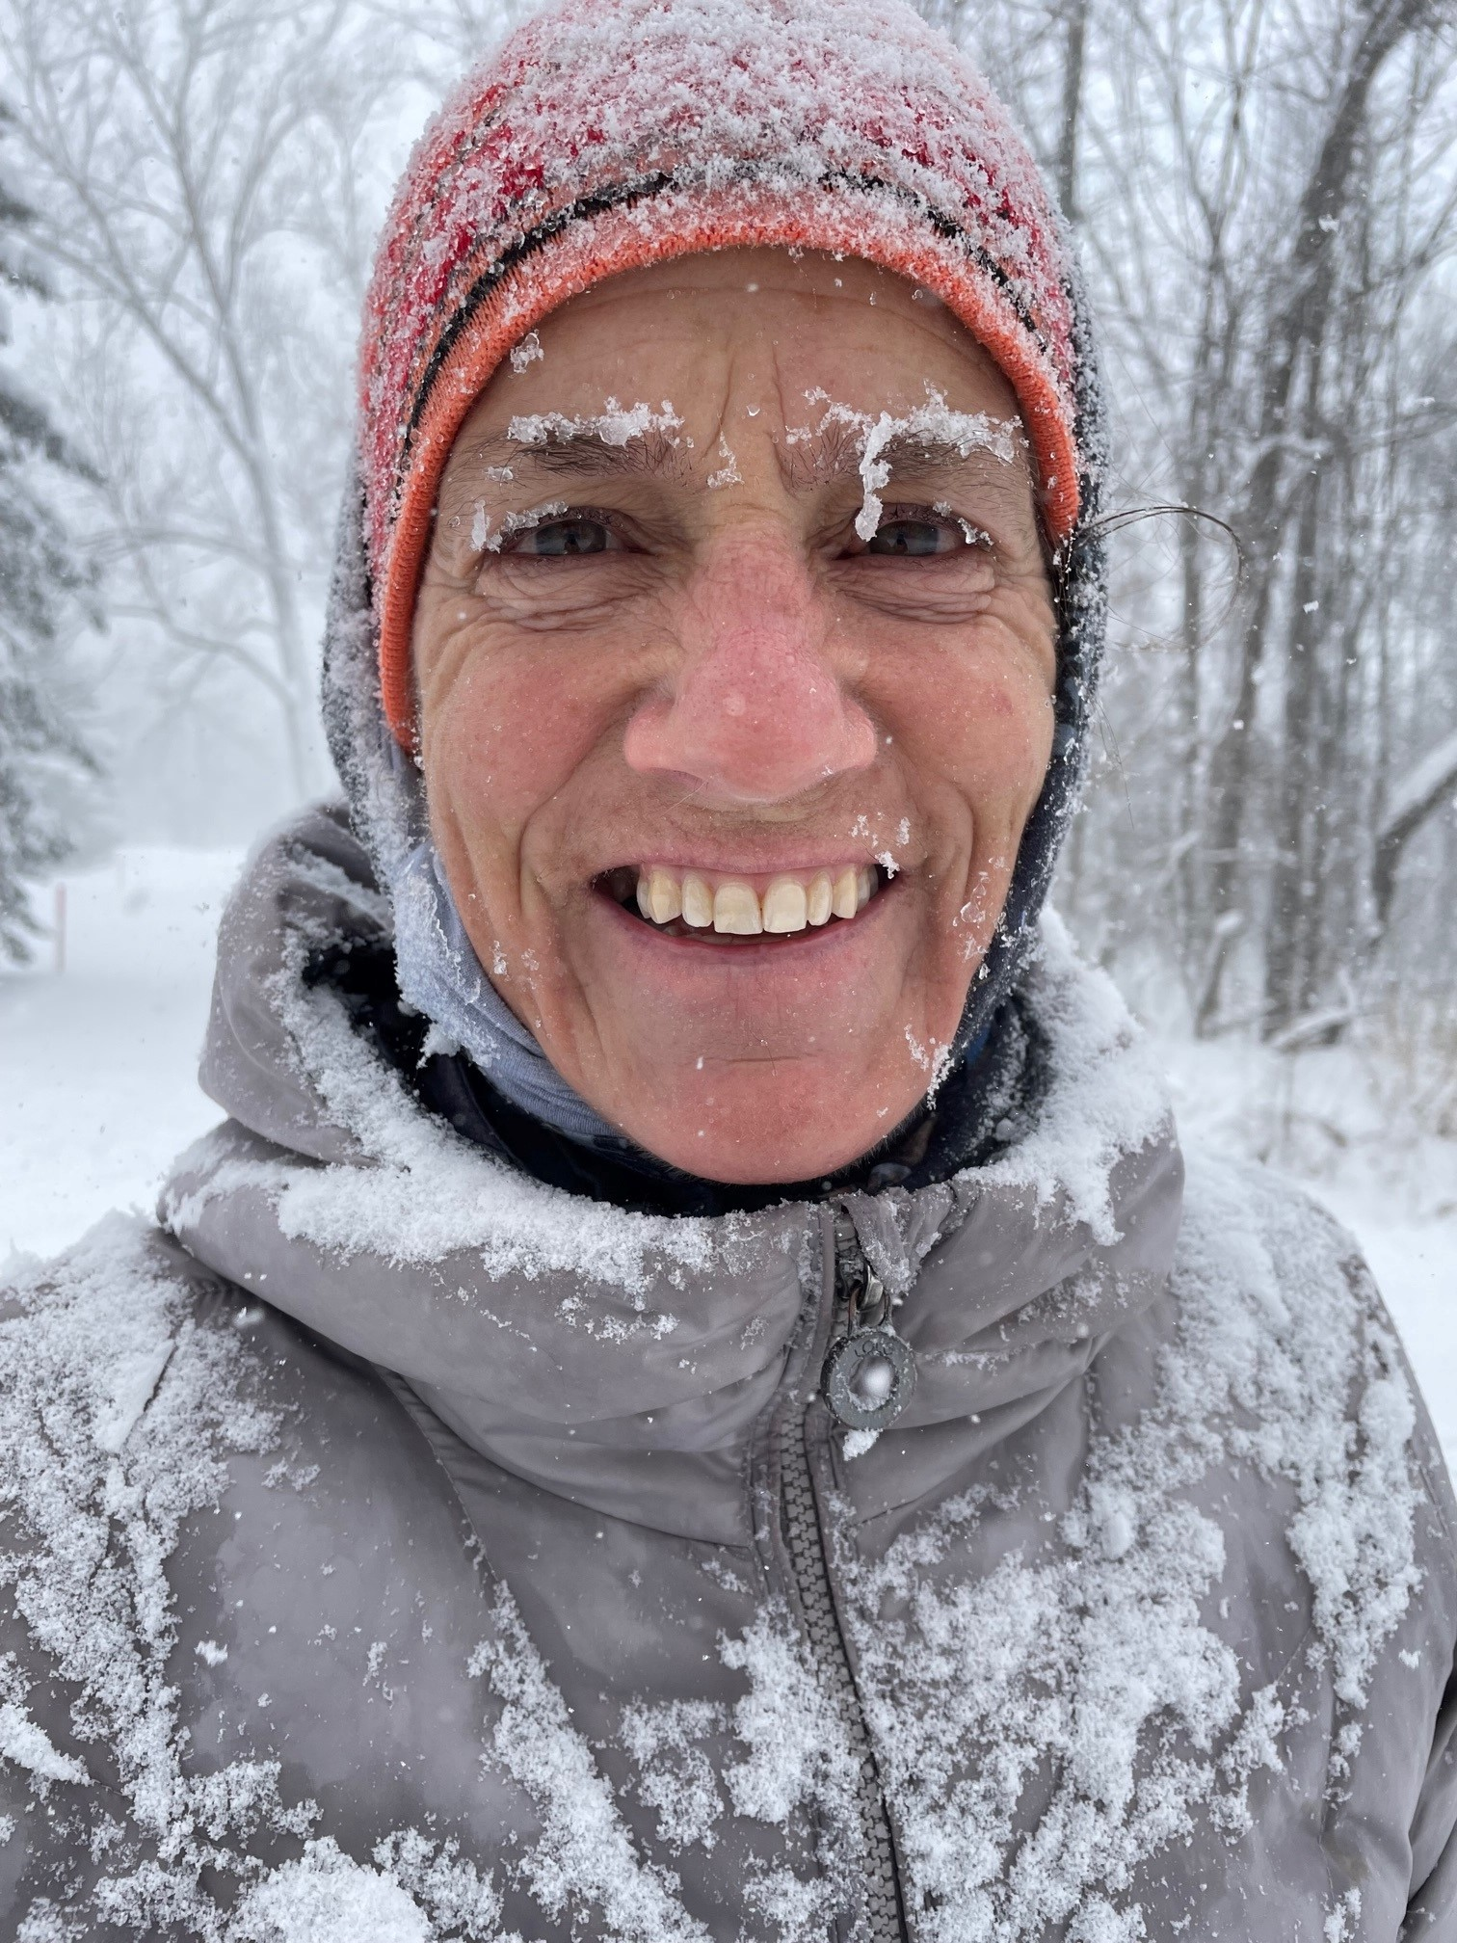
Presenter Disclosure
JENNIFER YOUNG, CCFP
CFPC Physician Advisor to Knowledge Expert and Tools Team
Relationships with Financial Sponsors: none
Any direct financial relationships including receipt of honoraria:
  Ontario College of Family Physicians honoraria as speaker
Membership on advisory boards or speakers’ bureau: none
Patents for drugs or devices: none
Other financial relationships or investments: Part-time physician advisor for CFPC
2

Slide 3
Objectives
Discuss the latest evidence for Less Is Best in Bronchiolitis management
Review barriers to reducing overuse and impactful change ideas
Introduce National Choosing Wisely Bronchiolitis Toolkit to empower clinicians and families
1
2
3

Slide 4


Baby B
6 m old in ED with runny nose, cough and
mild work of breathing
CXR: Perihilar infiltrates with ? R sided
early consolidation vs atelectasis
IV was attempted 3x times and ultimately
decision made for IM ceftriaxone
  Could this have been prevented?
  What can we do to improve the care we deliver in patients with bronchiolitis?

Slide 5
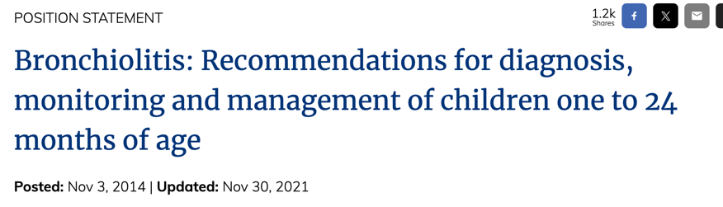



A Global Burden and So Many Guidelines..
But similar messaging about
REDUCING testing and treatments
vv
Notes:
Viral bronchiolitis is the most common cause of admission to hospital for infants in high – income countries. RSV accounts for 60-80% of bronchiolitis presentations..
- RSV global burden: annual Gboval RSV causing Acute LRTI in children ,5yrs = 33 million cases
3.6 million episodes of severe RSV LRTI requiing hospital admission/yr globally
Estimated 84,5000 – 125,200 deaths annually.
Li et al Lancet 2022
Pubmed search from 200 = over 11,000 articles on bronchiolitis.
Multiple international consensus guidelines available
2 decades of messaging on de-implementation, and we are still saying the same thing
Management recommendations based on high quality evidence advise support of hydration and oxygenation only
References:
TREKK Evidence Repository 2022_12_14_Bronchiolitis_ER_FINAL_v4.0.pdf (trekk.ca)
Dalziel SR, Haskell L, O'Brien S, Borland ML, Plint AC, Babl FE, Oakley E. Bronchiolitis. Lancet. 2022 Jul 30;400(10349):392-406
We are going to briefly discuss the evidence and rational behind a few of these statements today

Slide 6
Epidemiology of bronchiolitis
Age: typically <2 years old
Cause: viruses RSV accounts for 60-80%, rhinovirus 8-29%, others (example influenza, COVID)
adults >65 RSV infection in 3-7% healthy, 4-10% cardiopulmonary disease (4 yr prospective cohort)
Prevalence: >90% children age 2 have been infected
5% needing hospitalization
.
Lancet. 2022 Jul 30;400(10349):392-406
N Engl J Med. 2005;352(17):1749

Slide 7
Less is Best
NOT TO DO
Chest x-ray
Antibiotics
Viral testing
Continuous pulse oximetry
Steroids
Bronchodilators
TO DO
Hydration
Fever control
Oxygen for sats < 90%
Notes:
Reference: Trekk Evidence Repository (link: 2022_12_14_Bronchiolitis_ER_FINAL_v4.0.pdf (trekk.ca))

Slide 8
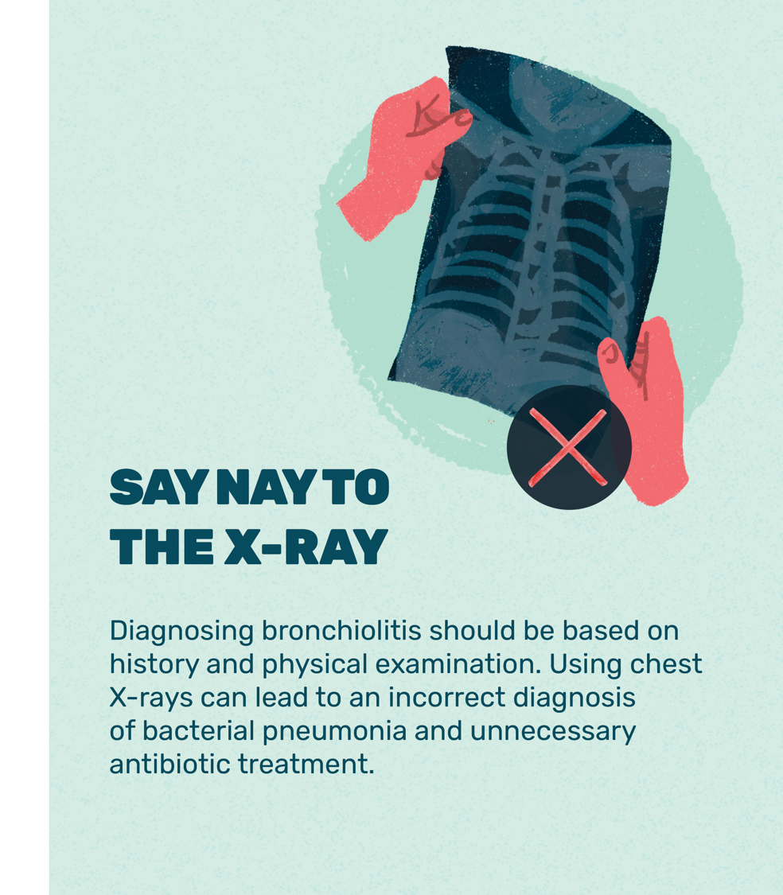
Double Harm of Chest X-Rays
Unnecessary radiation
  CXR often ordered as exam findings can
  be inconclusive with bronchiolitis
Unnecessary antibiotics use
  Infants undergoing CXR at least 10 times more likely to receive antibiotics
  False positive misinterpreted as pneumonia
  Prevalence of underlying secondary bacterial infection is low
  Antimicrobial resistance is EVERYONE’s problem
Emerg Med Australas 2018; 30: 389–97
Notes:
Only do an xray if there is
- significant hypoxia or severe WOB
- focal findings on lung exam
- a prolonged course of illness
(5 tests and treatments to question in Pediatric Emergency Medicine: CWC Nov 2022)
We do them a lot:
- Antibiotic use in bronchiolitis is around 25% (Salziel Lancet Seminar 2022)
Infants undergoing chest radiography are at least 10 times more likely to receive antibiotics (OR 10·9, 95% CI 8·9–13·3):
- Oakley E, Brys T, Borland M, et al. Medication use in infants admitted with bronchiolitis. Emerg Med Australas 2018; 30: 389–97
Antimicrobial resistance is everyone’s problem:
- UK government review of AMR published in 2014, if not controlled, it would lead to significant impact on health with 10 million AMR-related deaths annually and macroeconomic consequences with a cumulative economic loss of US$100 trillion by 2050
- In 2019: The World Health Organisatiation listed Anti-microbial Resistance as one of the top 10 global threats to public health.

Slide 9
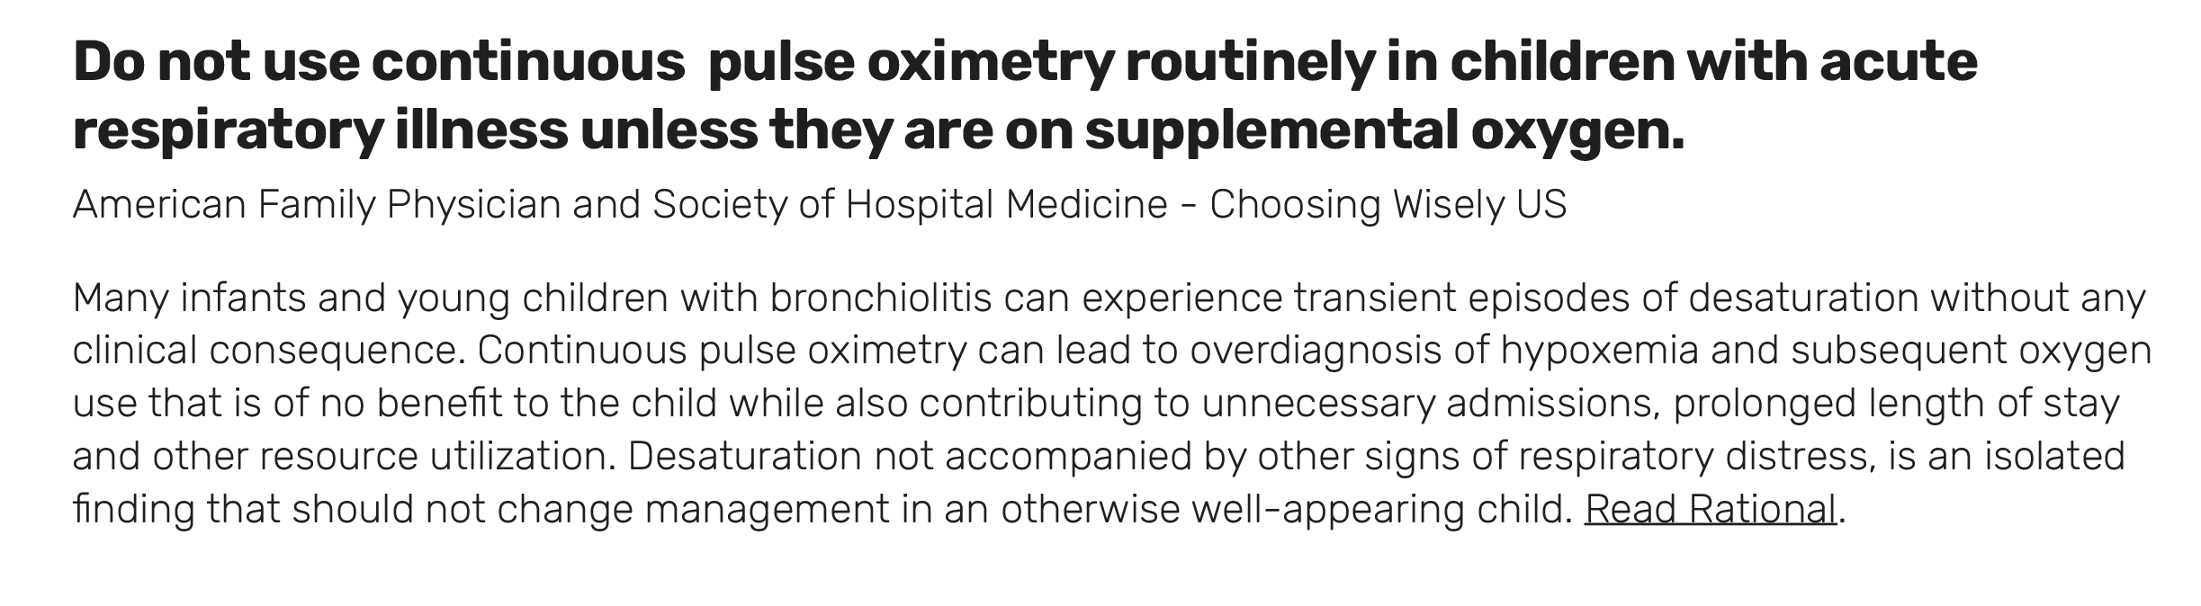
Pulse Oximetry
Continuous pulse oximetry leads to unnecessary hospitalizations and prolonged ED stay
Children with URTI have transient desaturations at home without consequences
JAMA 2014 Aug 20;312(7):712–8
JAMA Pediatr. 2016 Jun 1;170(6):602.
Notes:
Schuh S, Freedman S, Coates A, Allen U, Parkin PC, Stephens D, et al. Effect of Oximetry on Hospitalization in Bronchiolitis: A Randomized Clinical Trial. JAMA. 2014 Aug 20;312(7):712–8.
Principi T, Coates AL, Parkin PC, Stephens D, DaSilva Z, Schuh S. Effect of Oxygen Desaturations on Subsequent Medical Visits in Infants Discharged From the Emergency Department With Bronchiolitis. JAMA Pediatr. 2016 Jun 1;170(6):602.
For hospital based pediatricians.. A few reminders for this season..
- No evidence that O2 benefits outcomes unless hypoxic.
Marinating sats >91% prolongs LOS in hospital without benefit.
Intermittent compared with continuous monitoring with O2 sats target of 90% showed no difference in clinical outcomes and greater nursing satisfaction with intermittent monitoring.
Continuous pulse oximetry can lead to over diagnosis of hypoxemia and subsequent oxygen use that is of no benefit to the child while also contributing to unnecessary admissions, prolonged length of stay and other resource utilization. Desaturation not accompanied by other signs of respiratory distress, is an isolated finding that should not change management in an otherwise well-appearing child
Mahant S, Wahi G, Bayliss A, et al. Intermittent vs continuous pulse oximetry in hospitalized infants with stabilized bronchiolitis: a randomized clinical trial. JAMA Pediatr 2021; 175: 466–74
Image reference: Biology Dictonary (Oxygen Saturation - The Definitive Guide | Biology Dictionary)
Jama study
Importance Routine use of pulse oximetry has been associated with changes in bronchiolitis management and may have lowered the hospitalization threshold for patients with bronchiolitis.
Objective To examine if infants with bronchiolitis whose displayed oximetry measurements have been artificially elevated 3 percentage points above true values experience hospitalization rates at least 15% lower compared with infants with true values displayed.
Design, Setting, and Participants Randomized, double-blind, parallel-group trial conducted from 2008 to 2013 in a tertiary-care pediatric emergency department in Toronto, Ontario, Canada. Participants were 213 otherwise healthy infants aged 4 weeks to 12 months with mild to moderate bronchiolitis and true oxygen saturations of 88% or higher.
Interventions Pulse oximetry measurements with true saturation values displayed or with altered saturation values displayed that have been increased 3 percentage points above true values.
Main Outcomes and Measures The primary outcome was hospitalization within 72 hours, defined as inpatient admission within this interval or active hospital care for greater than 6 hours. Secondary outcomes included the use of supplemental oxygen in the emergency department, level of physician agreement with discharge from the emergency department, length of emergency department stay, and unscheduled visits for bronchiolitis within 72 hours.
Results Forty-four of 108 patients (41%) in the true oximetry group and 26 of 105 (25%) in the altered oximetry group were hospitalized within 72 hours (difference, 16% [95% CI for the difference, 3.6% to 28.4%]; P = .005). Using the emergency department physician as a random effect, the primary treatment effect remained significant (adjusted odds ratio, 4.0 [95% CI, 1.6 to 10.5]; P = .009). None of the secondary outcomes were significantly different between the groups. There were 23 of 108 (21.3%) subsequent unscheduled medical visits for bronchiolitis in the true oximetry group and 15 of 105 (14.3%) in the altered oximetry group (difference, 7% [95% CI, −0.3% to 0.2%]; P = .18).
Conclusions and Relevance Among infants presenting to an emergency department with mild to moderate bronchiolitis, those with an artificially elevated pulse oximetry reading were less likely to be hospitalized within 72 hours or to receive active hospital care for more than 6 hours than those with unaltered oximetry readings. This suggests that oxygen saturation should not be the only factor in the decision to admit, and its use may need to be reevaluated.

Slide 10
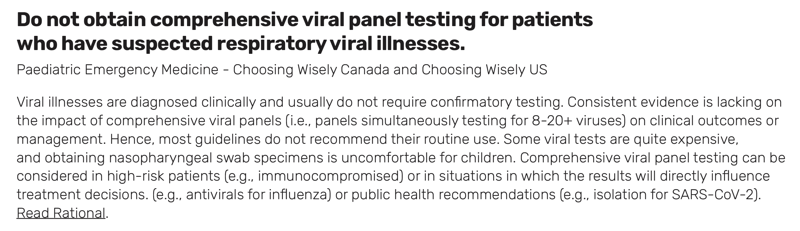

Respiratory Viral Testing
Expensive
Does not alter management
Uncomfortable

Slide 11
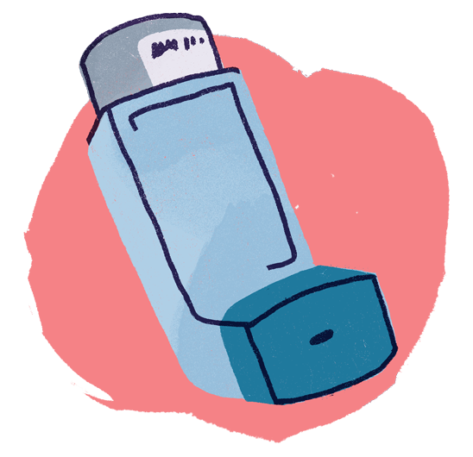
What About Salbutamol?
Salbutamol is for bronchoconstriction → doesn’t work in bronchiolitis (mucous obstruction is cause of wheezing)
Guidelines recommend against it
  CPS: not recommended if Dx is clear
  NICE: Do not use
  AAP: Should not, strong recommendation
  Australasian guidelines: Not in < 12 months
Well established evidence recommend against it
  Cochrane review 2014 – no reduction in LOS or admission
  Meta-analysis 2020 – no benefit in < 24 months
May consider if uncertain about diagnosis (eg older child, recurrent)

Slide 12
What About Steroids?
Dexamethasone, prednisone or inhaled glucocorticoids:
not associated with a clinically significant improvement in disease, as measured by reduction in clinical scores, rates of hospitalization and length of hospital stay
Cochrane Database of Systematic Reviews 2013, Issue 6. Art. No.: CD004878
N Engl J Med 2007;357:331-9.

Slide 13
A word about Immunization: Children
Palivizumab: Infants at high risk (<30-33 wk, lung disease of prematurity or any chronic lung disease besides cystic fibrosis, congenital heart disease, severe immunocompromise) or infants <36 weeks in remote communities
  4 doses monthly beginning RSV season
Nirsevimab: Canadian Agency for Drugs and Technologies in Health recommend tiered approach: (when available!)
  1) remote and <33 weeks OR cardiopulmonary disease
  2) Remote and <37 week, OR <33 wk OR cardiopulmonary
  3) Remote
Pregnancy: under review Health Canada
Notes:
Nirsevimab: RSV infections requiring medical attention: 1400pt 29-35 wk GA (avg age?) 2.6 vs 9.5%, hospitalizations 0.8 vs 7.1%
1400 pt >35 wk GA (avg age..) 1.2 vs 5 % hosp 0.6 vs 1.6%
During pregnancy:
Tiered: 1) remote and <33 weeks OR cardiopulm disease
2) Remote and <37 week, OR <33 wk OR cardiopulm
3) Remote

Slide 14
A word about Immunization: Adults
RSVPreF3 (Arexvy) :
Ontario first province to fund for adults >60 in group care settings
RCT of ~25,000 adults age 60+
lower respiratory infection due to RSV: 0.05% vaccinated versus 0.3% unvaccinated
high risk group: vaccinated 0.13% vs 0.74% unvaccinated
N Engl J Med 2023;388:595-608.
Notes:
AREXVY – 7/12,466=0.05% arexvy vs 40/12,494= 0.3% placebo. Severe RSV 1 case vaccinated vs 17 placebo
Adults RSV 11% outpt with URI
Avg hospitalization in prosp study >50 was 0.15% of population. SR of observational studies, mortality if hospitalized is 6-8%
Pregnancy – 6/3570 (0.2%) infants medically attended severe LRTI abrysvo and 33/3558 placebo (0.9%) at 90 d and 19 (0.5%) vs 62 (1.5%) NNImm=100 at 180 d

Slide 15
A word about Immunization: Adults
Pregnancy: RSVpreF (Abrysvo)
International RCT of 7,358 pregnant patients, immunized from 24-36 weeks’ gestation.
RSV severe lower respiratory tract illness in infants:
within 90 days of age: 0.2% vaccinated and 0.9% placebo
within 180 dayof age: 0.5% vaccinated vs 1.5% placebo
under review Health Canada, approved by CDC for administration between 32-36 weeks from September –January
N Engl J Med 2023;388:1451-64.
Notes:
AREXVY – 7/12,466=0.05% arexvy vs 40/12,494= 0.3% placebo. Severe RSV 1 case vaccinated vs 17 placebo
Adults RSV 11% outpt with URI
Avg hospitalization in prosp study >50 was 0.15% of population. SR of observational studies, mortality if hospitalized is 6-8%
Pregnancy – 6/3570 (0.2%) infants medically attended severe LRTI abrysvo and 33/3558 placebo (0.9%) at 90 d and 19 (0.5%) vs 62 (1.5%) NNImm=100 at 180 d

Slide 16
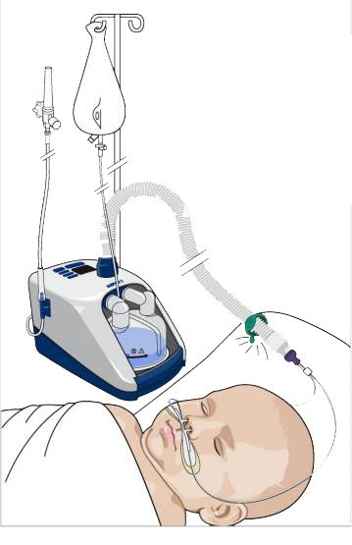
Heated High Flow Nasal Cannula (HHFNC) in Bronchiolitis
Early studies showed HHFNC may reduce ICU use, intubations
RCTs with ~2900 mild-moderate patients, found no benefit in ICU, oxygen duration, intubation, LOS
Long-term observational studies found either no change in outcomes or paradoxical increase in ICU use

Slide 17
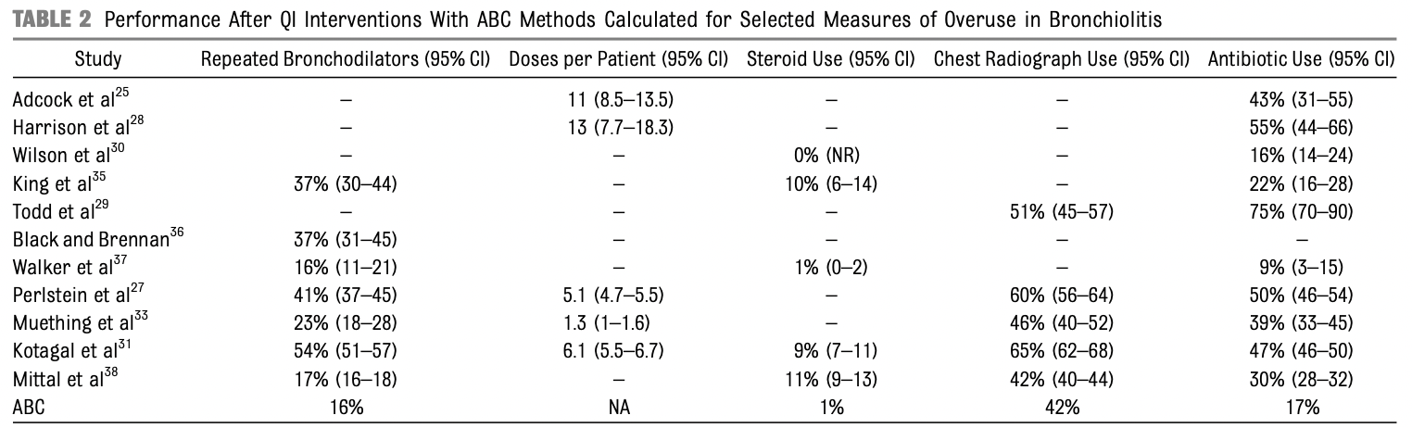
What Should We Aim For?
Ralston, S., Comick, A., Nichols, E., Parker, D., & Lanter, P. (2014). Effectiveness of quality improvement in hospitalization for bronchiolitis: a systematic review. Pediatrics, 134(3), 571–581.

Slide 18

What Drives Overuse?

Slide 19
Drivers of Overuse
Providers Survey
Desire to do something and help symptoms
Knowledge gaps
Therapeutic illusion
”Just in case”
J Hosp Med. 2021 Jan;16(1):23–30.
Perception of parental discomfort
Unclear local policies
Notes:
Semistructured interviews
Consolidated Framework for Implementation Research (CFIR),
Barriers, facilitators and contextual factors
12x hospitals in USA, physicians, bedside RNs,
Thematic saturation
Total 56 interviews

Slide 20
Knowledge Gaps
50% of RT & RNs believed SABA and steroids would improve WOB
  Compared to approx 1% of physicians
50% of RNs & 25% of MD felt that increasing O2 despite
no hypoxemia would improve WOB
Close to 70% of RNs who had infant already on O2
felt need to escalate to improve WOB compared to 36% if received infant not on O2
. Pediatrics. 2023 May 15;151(6):e2022059939.
Notes:
462 participants , vignets, survey
RT/RN greater perception of benefits of interventions than physicians
- 53.6% of RN and 41.8% of RT believed SABA extremely or somewhat likely to improve WOB compared to 1.9% of physicians
- similar % for steroids vs 0.9% of physician s
- suctioning – all felt was helpful, but RT/RN felt deep suctioning helpful
- > 50% of RN felt that increasing O2 and 23% of MD increase O2 even if no hypoxemia would be helping in WOB
Close to 70% of RNs who had infant already on O2 felt need to escalate to improve WOB compared to 36% if received infant not on O2
Explored community vs university and no difference
More RN/RT felt sats of 88% was unsafe
Abut half of all group wouldl apply O2 for comfort

Slide 21
Therapeutic Illusion
Tendency amongst pts & physicians to overestimate benefits of medical interventions and underestimate harms
Confirmation bias – cherry picking evidence to confirm what we hope/believe
Hoffman TC. Clinicians’ expectations of benefits & harms of Rx, screening and tests: systematic review JAMA Intern Med 2017
Notes:
Confirmation bias

Slide 22
What Are Caregiver Expectations?
No surprise – we are influenced by them:
  Study with viral diagnosis- if physicians thought the parent wanted antimicrobials, they were prescribed 52% of the time compared with 9% when they did not think the parent wanted an antimicrobial
Clear information about diagnosis
Advice on symptom relief
Safety net advice
Planned follow-up
Mangione-Smith et al. Pediatrics. 1999; 103 (4) 711-718.

Slide 23
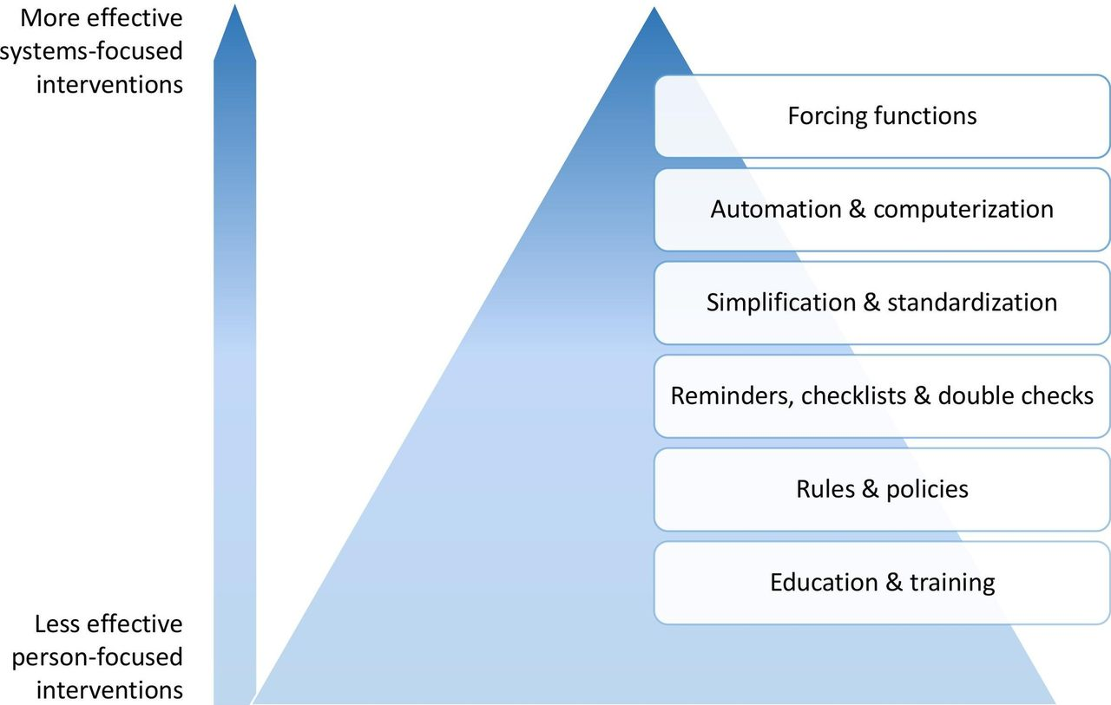

The hierarchy of intervention effectiveness (Adapted from the Institute for Safe Medication Practices25 and Patient safe Implementing effective safety solutions.43.
Christine Soong, and Kaveh G Shojania BMJ Qual Saf 2020;29:353-357
Copyright © BMJ Publishing Group Ltd and the Health Foundation. All rights reserved.
Notes:
The hierarchy of intervention effectiveness (Adapted from the Institute for Safe Medication Practices25 and Patientsafe Implementing effective safety solutions.43
Ok.. So we’ve all read the guidelines, but practise change does not really seem to be working.. How can we create and sustain meaningful change?
An example is CXR overutilization. Education and training is critical , but at the bottom of the hierarchy of intervention effectiveness. Telling people not to do a CXR is not as effective as a high-reliability intervention such as system redesign with an emphasis on processes.

Slide 24
Reducing Chest Radiographs in Bronchiolitis Through High-Reliability Interventions
High reliability most helpful in sustained change – Forcing Functions & automatisation
Lower reliability interventions (i.e. education) is needed but not enough for sustained change
Notes:
Reference: Frazier SB, Walls C, Jain S, Plemmons G, Johnson DP. Reducing Chest Radiographs in Bronchiolitis Through High-Reliability Interventions. Pediatrics. 2021 Sep;148(3)
This paper highlights a success using this methodology.
QI project to reduce CXR usage in bronchiolitis
Specific aim to reduce CXR’s from 42% (baseline) to <15% by March 2020.
They managed to reduce use to 18% and sustain it for 18months, using both education measures, plus forced change functions within their ordering system and EMR.
2012 – 2020: they had 122, 120 bronchiolitis encounters. Pre-implementation baseline = 42% mean CXR use.
- low reliability interventions such as education campaigns, did not lead to sustained change
Higher reliability interventions did:

Slide 25
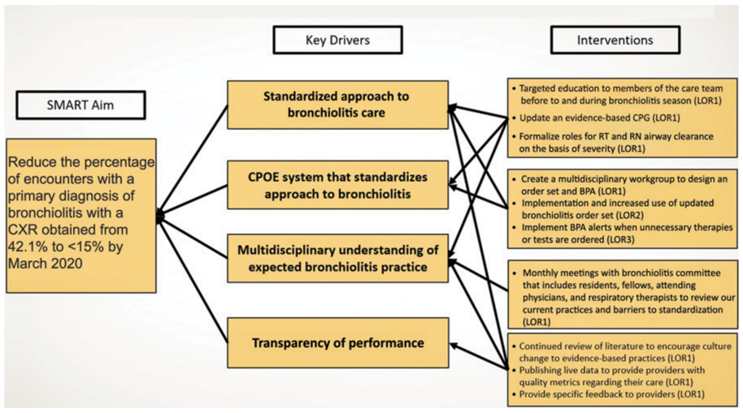

Slide 26
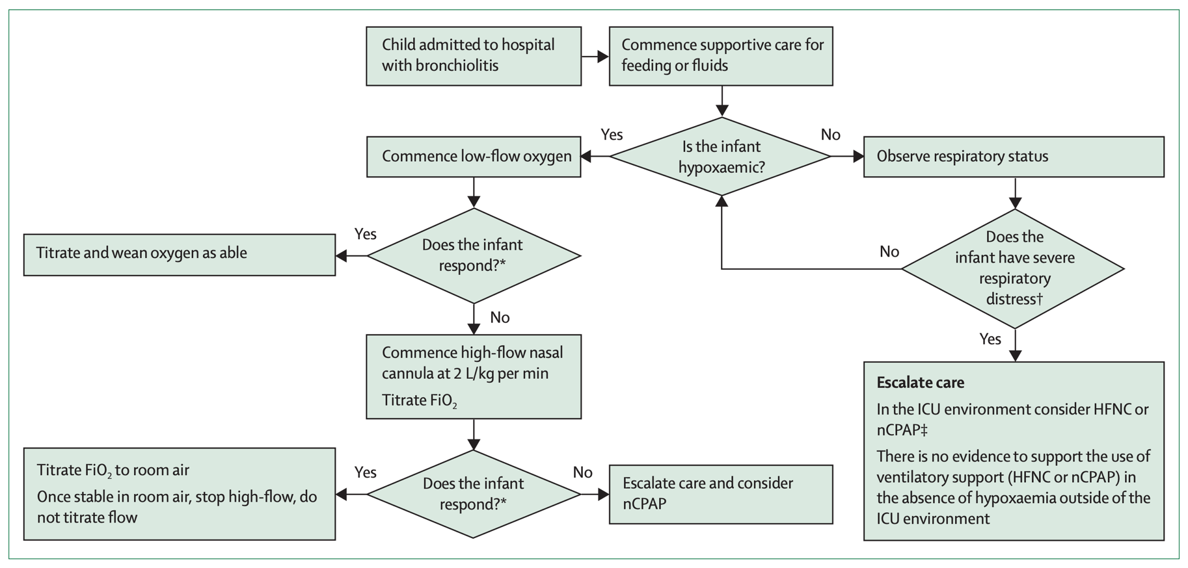
Simplification and Standardization
Evidenced based flow chart on HHFNC initiation
Dalziel SR, Haskell L, O'Brien S, Borland ML, Plint AC, Babl FE, Oakley E. Bronchiolitis. Lancet. 2022 Jul 30;400(10349):392-406
Notes:
Reference: Dalziel SR, Haskell L, O'Brien S, Borland ML, Plint AC, Babl FE, Oakley E. Bronchiolitis. Lancet. 2022 Jul 30;400(10349):392-406

Slide 27
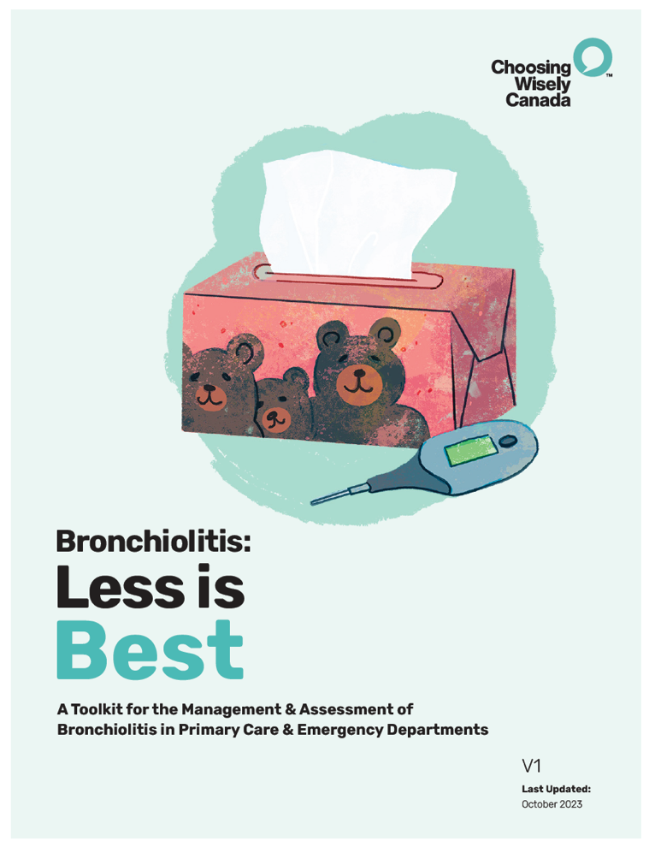
Resources to Address Barriers to Overuse
JUST LAUNCHED!
Website (Main) EN: https://bit.ly/cwc-pc-bronchiolitis
Toolkit EN: https://bit.ly/cwc-bronchiolitis
Website (Main) FR: https://bit.ly/cwc-pc-bronchiolite
Toolkit FR: https://bit.ly/cwc-bronchiolite
Notes:
Describe process of creating a toolkit with CWC
- working group
- Stakeholders and patient partners
-Networking and endorsements..

Slide 28
Committee Members
Olivia Ostrow, MD, FAAP
Pediatrics Lead, Choosing Wisely Canada
Pediatric Emergency Medicine, The Hospital for Sick Children
Guylène Thériault, MD, CCFP
Primary Care Co-Lead, Choosing Wisely Canada
J. A. Michelle Bailey, MSc., MD
Medical Director, Virtual Health, Alberta Health Services
Maria Jose Conejero, MD
Paediatric Hospitalist, Pontificia Universidad Catolica de Chile
Colleen Fox
Patient Family Advisory
Katie Gardner, MSc, MD, FRCPC
Pediatric Emergency Physician, IWK Health
Clinical lead, Choosing Wisely Nova Scotia
Zahra Hussein, MPH, MBA
Provincial Lead, Primary Care
Child Health BC, Provincial Health Services Authority
Marie-Pier Lirette, MBChB, MRCPCH, FAAP, FRCPC
Paediatric Emergency Physician,
The Hospital for Sick Children
Claire Seaton, MD, FRCPC
Pediatrician, BC Children’s Hospital
Jennifer Young, MD CCFP-EM
Family Physician, Collingwood, Ontario
Physician Advisor, College of Family Physicians of Canada
Karen Karagheusian, BSW, MPH
Project Manager, Choosing Wisely Canada

Slide 29



Supported and Reviewed By:

Slide 30
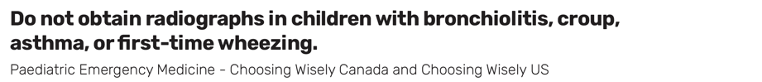
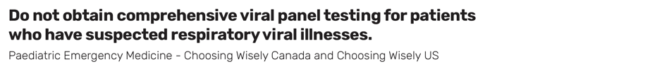
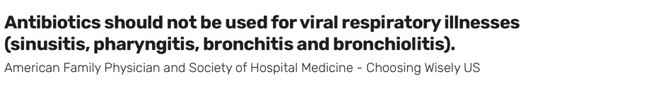
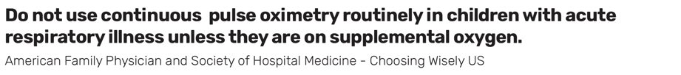
Recommendations

Slide 31
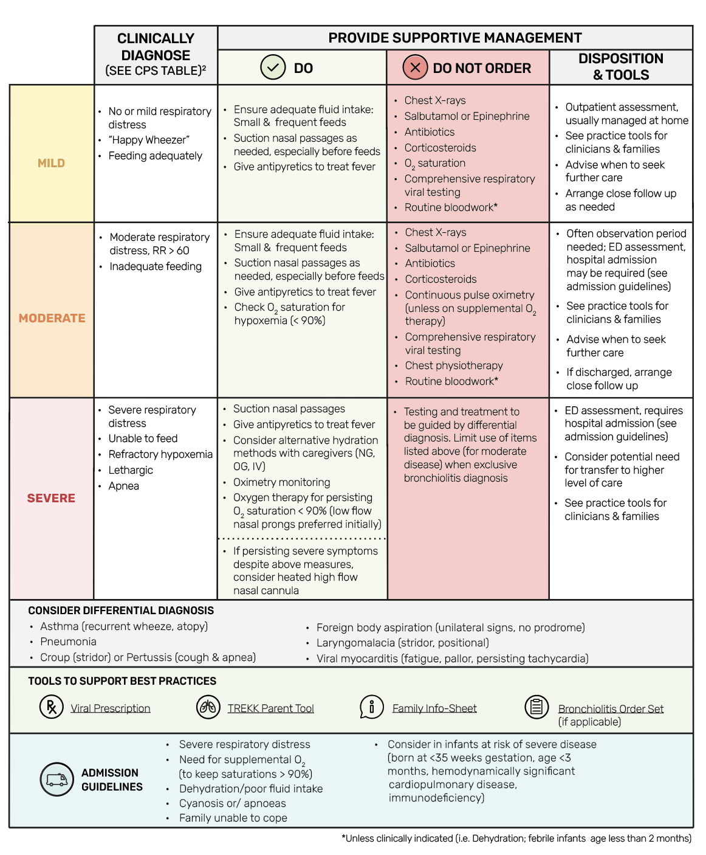
Bronchiolitis:
INITIAL ASSESSMENT
AND MANAGEMENT
Bronchiolitis is a clinical diagnosis. Tests DO NOT help make the diagnosis.
Consider in infants with upper respiratory illness prodrome (cough, rhinorrhea); wheezing and/or crepitations and increased work of breathing (grunting, nasal flaring, retractions) or respiratory rate.

Slide 32
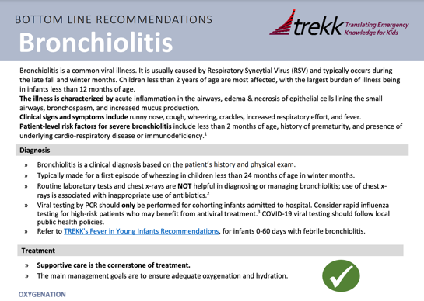





Choosing Wisely
Canada’s Toolkit
TREKK
(Bottom Line Recommendations
& Evidence Repository)
Resources
For Providers
Pedagogy (Online education from CPS)
Guidelines: CPS & AAP

Slide 33
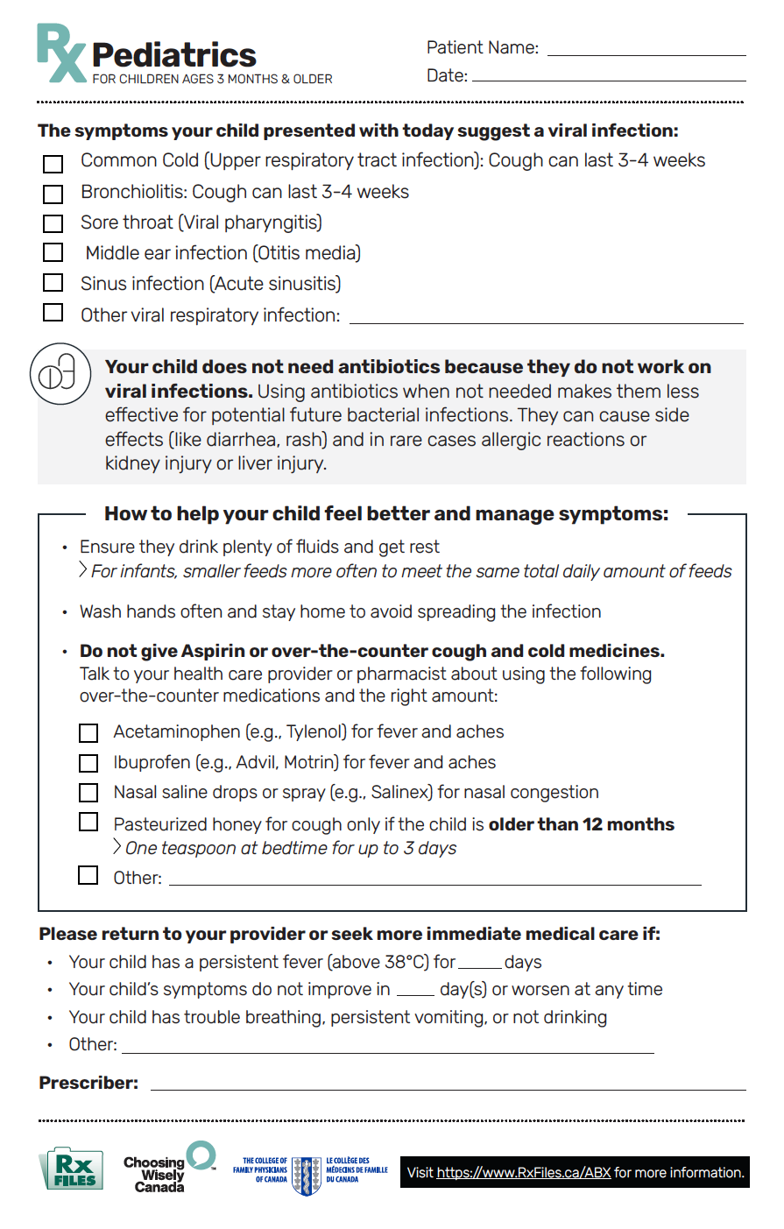
Pediatric
Prescription Pad
Viral prescription pads provides other ways to help relieve symptoms to avoid unnecessary antibiotic prescriptions.
Notes:
Tools to support practice change

Slide 34
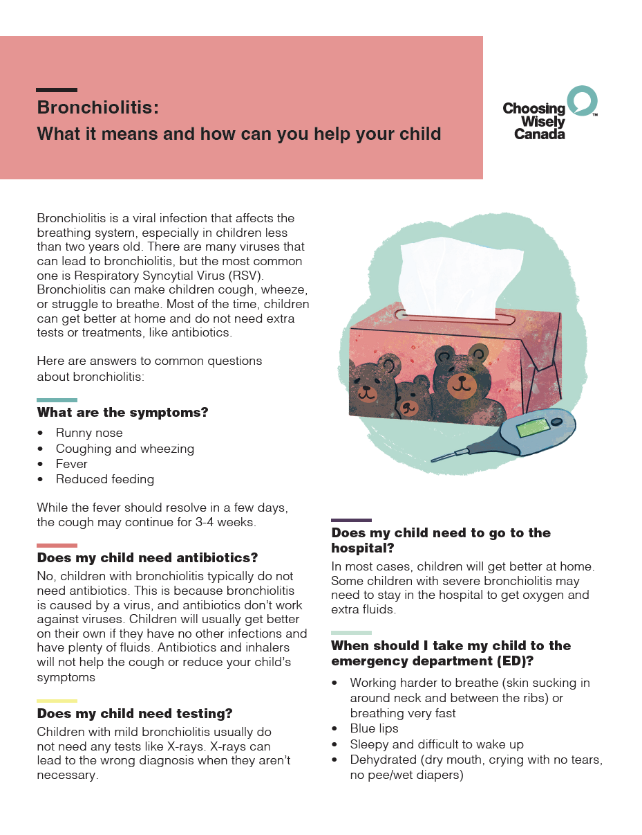
Family
Info-Sheet
Helps provide answers to common questions about bronchiolitis and when to seek further care if needed.
Notes:
Tools to support practice change

Slide 35
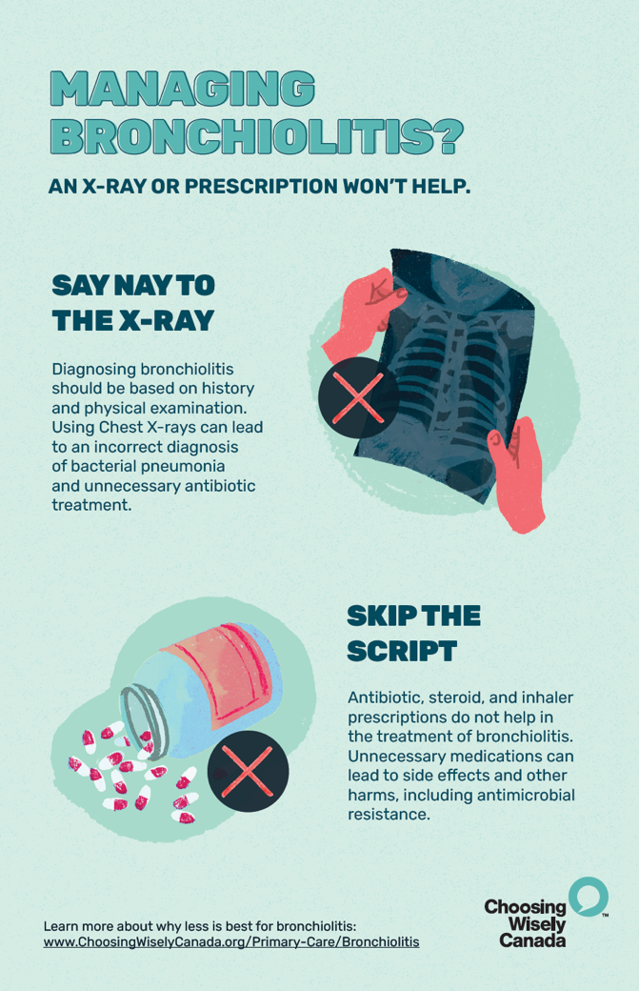
Posters/Screensavers for Clinicians
Posters/screensavers provide simple reminders about avoiding X-rays or prescriptions in the management of bronchiolitis.
Notes:
Tools to support practice change

Slide 36
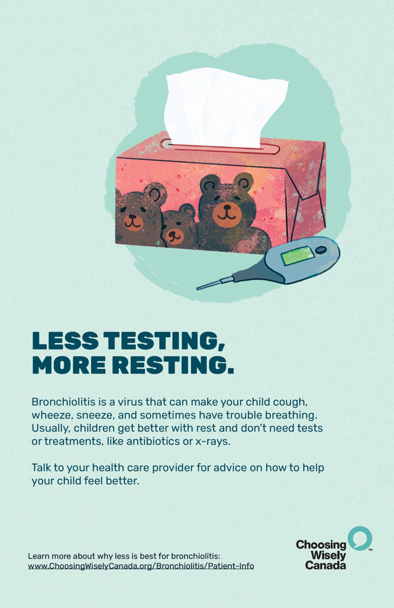
Posters/Screensavers for Patients
Simple messaging for caregivers about avoiding unnecessary tests for bronchiolitis.
Notes:
Tools to support practice change

Slide 37

THANK YOU!
Questions?
Website:
www.ChoosingWiselyCanada.org/
Primary-Care-Bronchiolitis
Email:
Info@ChoosingWiselyCanada.org

