Slide 1
Title Slide
Approach to Depression in Primary Care
Dr. Jon Davine

Slide 2
COI – Presenter Disclosure (1)
Presenter Disclosure
Presenter: Dr. Jon Davine
Relationships with financial sponsors:
Any direct financial relationships, including receipt of honoraria: Ontario College of Family Physicians, Touchstone Institute, McMaster University Continuing Education, CMEAway by Sea Courses, Pri-Med Canada/Humber River Hospital, University of Ottawa Dermatology, Peterborough FHT, Kitchener Waterloo Family Medicine
Membership on advisory boards or speakers’ bureaus: NO
Patents for drugs or devices: NO
Other: CAMH---Co-Editor of book, “Psychiatry in Primary Care”, Ontario Psychiatric Association---Treasurer
Notes:
Where a faculty/presenter has no relationships to disclose, indicate Not Applicable under Relationships with Financial Sponsors.
Complete this slide for the primary presenter and ALL co-presenters if applicable.
Reminder: Disclosures made on your COI forms should match disclosures made on the COI slide.

Slide 3
COI – Presenter Disclosure (2)
Disclosure of Financial Support
This program has NOT received financial support
This program has NOT received in-kind support
Potential for conflict(s) of interest:
Dr. Jon Davine has NOT received funding for this program
Notes:
Where a program has received no external financial support (e.g., monies for food, logistics assistance such as registration, AV set-up, etc.), indicate No External Support.

Slide 4
Objectives
Exposure to a brief differential diagnosis of the sad state
Learn how to choose, start, and increase antidepressant medication
Learn recent recommendations re augmentation techniques
Learn about ECT, TMS as treatment techniques

Slide 5
Differential Diagnosis

Slide 6
Sad State

Slide 7
Sad State – Differential Diagnosis
Rule out organic
Adjustment disorder with depressed mood
Unipolar depression
Bereavement
Bipolar disorder, depressed phase
Dysthymic disorder (persistent depressive disorder)
Postpartum Blues/Depression
Seasonal Affective Disorder

Slide 8
R/O Organic
TSH, CBC
Anything else where history and physical take you
Check re alcohol use– Choosing Wisely Canada says hold off on treatment and see if Etoh can be d/c’d

Slide 9
Adjustment Disorder with Depressed Mood
Usually within 3 months of a stressor
Usually goes away within 3 months of stressor getting dealt with
Can go on for years if stressor continues
Tx:
Counselling ONLY!!

Slide 10
Bereavement
Bereavement means grief after death of someone close to you
I would include breakup of significant relationship (JAMA)
Bereavement means you can have 2 months of SIGECAPS, and this is still normal bereavement
Treatment is counselling ALONE
After 2 months, graduates to depression
Then treatment is counselling PLUS medication
Risk factor is past history of depression
DSM-V took out bereavement exemption. I (and many others) totally disagree

Slide 11
Unipolar Depression
15% lifetime prevalence
10% men
20% women

Slide 12
Diagnosis – SIGECAPS
Low mood/irritable mood for at least 2 weeks, but I would say 3-4 weeks minimum
Sleep
Interests (and pleasure)
Guilt
Energy
Concentration
Appetite
Psychomotor agitation/retardation
Sex, Suicide

Slide 13
Important to Remember
r/o past depressive episodes
This has treatment implications: length of time

Slide 14
Depression Screen
“Have you ever had a period of sadness not for a day or two, not for a week or two, but for many weeks and months? You had no energy, no interest in things, and you weren’t eating or sleeping well. Has this ever happened to you?”

Slide 15
Recurrence and Treatment Length
1 episode: 50% recurrence rate
Treat for 6-9 months of feeling good, overall ~1 year
2 episodes: 70% recurrence rate
Treat for 12-18 months of feeling good
If 2 difficult episodes, treat indefinitely (possibly)
3 episodes: 90% recurrence rate
Treat indefinitely (possibly), at least 2 years
Thus, importance of “normal” bereavement.

Slide 16
Bipolar Disorder Type 2, Depressed Phase
Always screen for past hypomanic episodes
What looks like depression is actually bipolar type 2, depressed phase
Treatment:
Mood stabilizers NOT naked antidepressant

Slide 17
Hypomanic Screen
“Have you ever had a period or feeling better than good, not for an hour or an evening, but for days and days where you were unusually full of energy and had a decreased need for sleep? Has this ever happened to you?”

Slide 18
Postpartum Blues
50-60% of women, thus NORMAL!
Usually goes away within 7-14 days
Treatment:
Supportive counselling only

Slide 19
Postpartum Depression
SIGECAPS +
Within 30 days of delivery
No past psych history: 10% risk
Past depression : 50% risk
Treatment is meds PLUS counselling

Slide 20
Persistent Depressive Disorder (Dysthymic)
Chronic long term, low grade sadness.
Minimum 2 years, often all one’s adult life
Treatment:
Counselling alone. I add meds after a few months if counselling not working
In research data, trend to improve with meds, but not statistically significant

Slide 21
Seasonal Affective Disorder
Usually during winter months
Reverse neurovegetative features
Gets in way of one’s life
Treatment:
Light therapy, 2 weeks prior to onset and two weeks post usual end of symptoms
If light not successful, try antidepressant meds

Slide 22
Seasonal Affective Disorder

Slide 23
Treatment

Slide 24
Counselling
Stress diathesis model of depression
Counselling can decrease stress, and increase supports
Supportive therapy
Cognitive Behaviour Therapy (CBT)
Mind over Mood by Daniel Greenberger and Christine Padesky

Slide 25
Psychopharmacology
So you’ve ruled out organic, it’s not bipolar, it’s not an adjustment disorder,
You’re going to start meds

Slide 26
Combination Pharmacotherapy and Psychotherapy is More Effective than Either Alone
Response and Remission at Week 12 in Chronic Depression
90
85%
80
70
60
52%
55%
Percent
50
42%
40
30
24%
22%
20
10
0
Nefazodone + CBASP *
CBASP
Nefazodone
Response
p ≤ 0.001 combined vs. treatment nefazodone
p ≤ 0.001 combined treatment vs. psychotherapy
Remission
p ≤ 0.001 combined vs. treatment nefazodone
p ≤ 0.001 combined treatment vs. psychotherapy
Keller et. al. The New England Journal of Medicine, May, 2000
*Cognitive behavior and specific psychotherapy

Slide 27
Treating Depression is a Long-Term Enterprise
To Remission
Recovery
Getting Well
Staying Well
Relapse
Recurrence
Normality
×
Relapse
Symptoms
Progression
to Disorder
Response
X
Syndrome
Treatment Phases
Acute Phase
8-12 weeks
Maintenance Phase
≥ 6 months
Time
Depression is associated with high rates of relapse and recurrence
Adapted from Kupfer. 1991. Adapted from CANMAT Guidelines, June 2001.

Slide 28
SSRIs
Drug (Brand name) | Initial Dose (per day) | Range (per day)
Citalopram (Celexa) | 20 mg | 20-40 mg
Escitatalopram (Cipralex) | 10 mg | 10-20 mg
Fluoxetine (Prozac) | 20 mg | 20-60 mg
Fluvoxamine (Luvox) | 50 mg | 100-300 mg
Paroxitene (Paxil) | 20 mg | 20-60 mg
Sertraline (Zoloft) | 50 mg | 50-200mg

Slide 29
Other Antidepressants
SNRI
Venlafaxine (Effexor)
Range: 75-225 mg per day
Desvenlafaxine (Pristiq)
Range: 50 mg per day
Duloxetine (Cymbalta)
Range 30-60 mg per day
NaSSA (Noradrenergic and Serotonergic Specific Antidepressant)
Mirtazapine (Remeron)
Range: 15-45 mg per day

Slide 30
Other Antidepressants (2)
DNRI
bupropion (Wellbutrin)
Range: 150-300 mg per day

Slide 31
New Antidepressant
Vortioxetine (Trintellix) 10-20 mg./day
It is felt to function much as an SSRI

Slide 32
Even Newer Antidepressants
Vilazodone (Vibryd)
SSRI plus partial serotonin agonist (SPARI)
10 mg. po od x 7 days, then increase to 20 mg.
Range is 20-40 mg. With Food.
Levomilnacipran (Fetzima)
SNRI plius partial serotonin antagonist (SARI)
20 mg./ po od x 2 days then increase to 40 mg. po od
Range is 40-120 mg./day

Slide 33
Drugs with superior efficacy against comparators:
Escitalopram – level 1 evidence
Sertraline – level 1 evidence
Venlafaxine – level 1 evidence
Mirtazapine– level 1 evidence
Agomelatine– level 2 evidence
Citalopram—level 2 evidence
Suggested to use one of these as 2nd antidepressant if 1st drug not effective
(Canadian Network for Mood and Anxiety Treatment, (CANMAT) 2016)

Slide 34
Cipriani et al., Lancet. 373:764-758, 2009
Escitalopram and sertraline showed important differences with respect to efficacy and acceptability

Slide 35
Cipriani et al, February 21, 2018.
21 antidepressants
522 double blind trial
116,477 participants
Efficacy at 8 week
Acceptability—dropouts at 8 weeks
18 and over
Both genders

Slide 36
Cipriani, 2018
All antidepressants more effective than placebo (OR 1.37 (Reboxitene)---2.13 (Amitryptyline)
Head to Head:
7 showed greater efficacy:
Agomelatine, Amitryptyline,Escitalopram,Mirtazapine,Paroxitene, Venlafaxine,Vortioxetine

Slide 37
Cipriani, 2018
Head to Head:
More tolerable:
Agomelatine, Citalopram, Escitalopram,Fluoxetine,Sertraline,Vortioxetine

Slide 38
Overall Studies
Higher response, lower dropout:
Escitalopram, Mirtazapine, Paroxitene, Agomelatine,Sertraline

Slide 39
SSRIs
Drug (Brand name) | Initial Dose (per day) | Range (per day)
Citalopram (Celexa) | 20 mg | 20-40 mg
Escitatalopram (Cipralex) | 10 mg | 10-20 mg
Fluoxetine (Prozac) | 20 mg | 20-60 mg
Fluvoxamine (Luvox) | 50 mg | 100-300 mg
Paroxitene (Paxil) | 20 mg | 20-60 mg
Sertraline (Zoloft) | 50 mg | 50-200mg

Slide 40
Optimizing Dose
Increase dose q2-3weeks depending on response
Increment of increase = starting dose
If doing better, don’t adjust
Once they plateau, increase, unless back to normal
If comorbid anxiety, reduce starting dose and incremental increases of ½ the amount, increase q2-3 weeks

Slide 41
X-Crossover
For use when switching to a different antidepressant
Lower first drug by typical increment q7days
Start 2nd drug at half dose along with starting dose of first drug for 7 days
Increase second drug to full starting dose while discontinuing the 1st drug

Slide 42
Substitution
First Drug | Second Drug | Considerations
RIMA | MAOI | 48 hour washout period
RIMA | SSRI | 48 hour washout period (caution with paroxetine)
SSRI | SSRI | No washout period
SSRI | TCA | No washout period, Start TCA at lower dose
SSRI | MAOI | Two week washout, Five week washout for fluoxetine
SSRI | RIMA | Two week washout, Lilly recommends 5 weeks when switching fluoxetine to RIMA

Slide 43
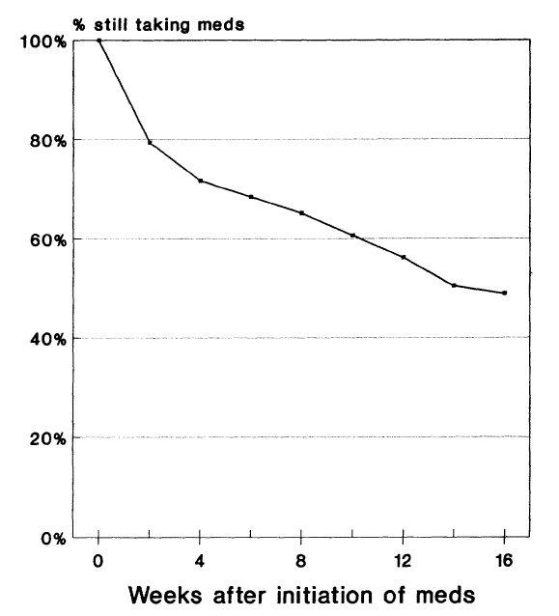
The issue of non-adherence
Early non-adherence is high among patients treated for depression
28% stop taking antidepressants during the first month, mostly during the first two weeks
44% stop taking antidepressants by the third month
Figure adapted from Keller et al. Medical Care, 1995, 33(1):66-74.

Slide 44
Compliance with Antidepressants in General Practice
Reasons for Drop Out & Time of Event
Proportion of respondents | Reason | Time of drop out | Potential MD strategies
35% | Feel better | 6.1 weeks | Reminder to stay on
30% | Side effects | 4.5 weeks | Ask/address side effects
17% | Other (e.g., fear of dependence) | 8 weeks | Explain antidepressants are non-addictive
15% | Told by doctor | 3.2 weeks | Stay on medication, if well
15% | Lack of Efficacy | 1-4 weeks | Remind efficacy begins later
“52% stopped taking their medication during a 12 week period. Two-thirds did not inform their GP” Psychoeducation makes a difference in improving response rates

Slide 45
Side Effects
GI upset (Give with meals)
Sedation (after supper)
Insomnia (after breakfast). Fluoxetine, Buproprion.
Agitation
Sexual (Mirtazapine, Wellbutrin have less).

Slide 46
Augmentation – Increasing Dose
For partial response
Defined as 25% of the usual range or greater
Go above the usual range
Often take meds one to two increments higher, as long as side effects are not a problem (except Escitalopram and Citalopram)

Slide 47
Augmentation – Adding a different agent
First-Line Options:
Aripiprazole – Level 1 2-15 mg.
Quetiapine—Level 1 150-300 mg.
Risperidone – Level 1 1-3 mg.
Second-line:
Lithium 600-1200 mg. (therapeutic)
Olanzapine (level 1) 2.5-10 mg.
Triiodothyronine 25-50 mcg.
Combination with bupropion 150-300 mg.
Combination with mirtazapine 30-60 mg.
Modafinil 100-400 mg.
Brexiprazole (level 1) 1-3 mg.

Slide 48
Augmentation Strategies – Atypicals
Options
Aripiprazole (Abilify) 2-4-6- up to 15 mg. po hs
Risperidone (risperdal) 0.5 – 1.0 – 1.5 – 2.0, up to 3.0 mg. po daily
Quetiapine (Seroquel) 50-100-150 mg po daily (150-300 mg.)

Slide 49
Combination Strategies
Second-line
Wellbutrin XL (bupropron)
150-300 mg po QAM
Mirtazapine
30-60 mg po QHS

Slide 50
ECT – Electroconvulsive Therapy
Highest rate of therapeutic success
No absolute contraindications
Chief side effects are cognitive
Memory impairment typically resolves in a few weeks after cessation of treatment
Rarely, more pervasive and persistent cognitive disruption
Method
Unilateral, non-dominant
Fewer side effects (e.g., cognition disruption)

Slide 51
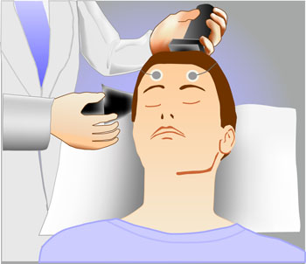
ECT – Indications
Non-response to antidepressant medication
Food refusal leading to nutritional compromise
Unable to tolerate antidepressant medications
Past response to ECT

Slide 52
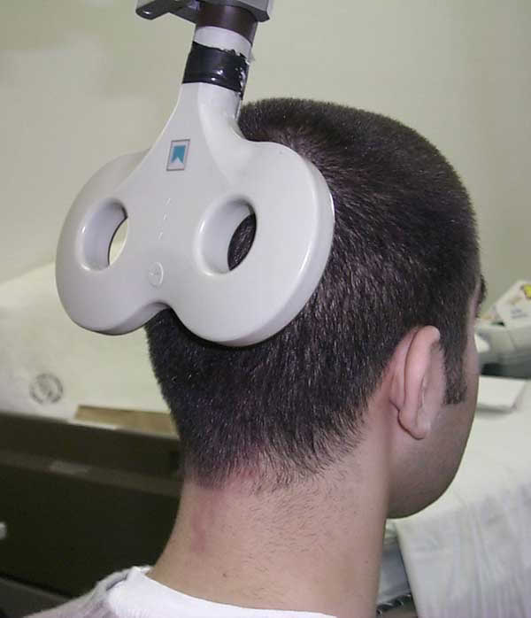
TMS
Transcranial Magnetic Stimulation
Has helped some people

Slide 53
TMS
Health Quality Ontario
Recommends TMS when ECT has failed or contraindicated
23 RCT’s TMS vs. sham, mean difference on Hamilton Depression Scale: 2.31
<3 (pre-specified clinically important treatment effect)
“marginally effective”
rTMS vs. ECT favoured ECT (Weighted mean difference 5.97) Risk ratio for remission and response were 2.20 and 1.72 favouring ECT

Slide 54
Pediatric Depression
Watch for decreased school performance
Use Fluoxetine (RCT evidence)
Increased suicidal ideation and behaviours (not completed suicides)
True in kids, not in adults
NNH-143

Slide 55
Patient Health Questionnaire (PHQ)
Self report
Does not replace clinical interview
Supports diagnosis and can follow treatment effects

Slide 56
Closing Slide
Thank you!
Please fill out your session evaluation now!
#myfmf
FamilyMedicineForum
FamilyMedForum
FamilyMedForum

