Slide 1


Cancer Screening Highlighting on Lung Cancer Screening​
Alan Kaplan, MD, CCFP(EM), FCFP, CPC(HC)
Chairperson, Family Physician Airways Group of Canada
Regional Primary Care Cancer Lead, Central Region

Slide 2

Faculty/Presenter Disclosure
Faculty: Alan Kaplan, MD, CCFP(EM), FCFP, CPC(HC)
Relationships with financial sponsors:
  Advisory Board: AstraZeneca, Behring, Boehringer Ingelheim, Cipla Covid, Eisai, GSK, Idorsia, Merck Frosst, Novartis, NovoNordisk, Respiplus, Pfizer, Sanofi, Teva, Trudell, Valeo
  Grants/Research Support: Boehringer Ingelheim, AstraZeneca, Novartis, Valeo
  Speakers Bureau/Honoraria: AstraZeneca, Behring, Boehringer Ingelheim, Cipla Covis, Eisai, GSK, MD Briefcase, Merck Frosst, Novartis, NovoNordisk, Respiplus, Pfizer, Sanofi, Teva, Trudell, Valeo
  Consulting Fees: N/A
  Patents: N/A
  Other: Sanofi
Potential for conflict(s) of interest:
  I have received payment/funding from the sponsor(s) supporting this program and/or organization whose product(s) are being discussed in this program

Slide 3
Disclosure Information
Disclosure of Financial Support:
This program has received no financial support
Potential for Conflict(s) of Interest:
I am a regional primary care cancer lead for the Central Region, employed by Cancer Care Ontario
Mitigating Potential Bias:
Lung Cancer Screening is accepted as one of Ontario’s cancer screening initiatives along with breast, colon and cervix

Slide 4
Learning Objectives
At the end of this program, participants will be able to:
Assess a patient for risk factors and symptoms of lung cancer
Determine the current lung cancer screening recommendations for patients at elevated risk
Refer patients who may have lung cancer to the appropriate diagnostic pathway
Assess and manage a patient with lung cancer presenting with dyspnea

Slide 5
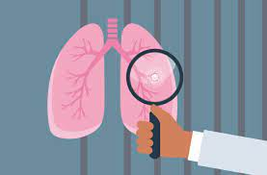


Lung Cancer is the Most Commonly Diagnosed Cancer with the Highest Mortality
Diagnosis:
  30,000 Canadians (2022)
  13% of all new cancer cases
  82 Canadians are diagnosed every day
Mortality:
  20,700 Canadians (2022)
  24% of all cancer deaths
  57 Canadians will die every day
  More deaths than colon, breast and prostate cancers combined
5-year survival (2015-17)
1
4
In:
Men
5-year survival (2015-17)
1
5
In:
Women
Canadian Cancer Society. “Colorectal Cancer Statistics.” Canadian Cancer Society, May 2022. https://cancer.ca/en/cancer-information/cancer-types/colorectal/statistics.
Canadian Cancer Statistics Advisory in collaboration with, the Canadian Cancer Society, Statistics Canada and the, and Public Health Agency of Canada. Canadian Cancer Statistics: A 2022 Special Report on Cancer Prevalence. Toronto, ON: Canadian Cancer Society, 2022. http://cancer.ca/Canadian-Cancer-Statistics-2022-EN.

Slide 6

Meet – Ronald
Background
  63 years old
  Married with three adult children
  Works in real estate
  Ex-smoker (37 pack year)
History
  COPD
  Hypertension
Reason for appointment
  In for follow-up
  Reviewed immunizations and cancer screening
    Prostate and colon cancer screening are up to date
    He has never heard of lung cancer screening

Slide 7


Ronald’s Medications, Exam and Labs
Medications
  Indacaterol/glycopyrronium 110/50 mcg once daily
  Rosuvastatin 10 mg qhs
  Ramipril 10 mg daily
Exam and labs
  BMI = 24 kg/m²
  BP = 128/78 mmHg
  HR = 78
  Breathing and vitals stable
  SpO2 = 96%
  eGFR = 73 mL/min
  LFT and CBC are normal

Slide 8



Other Relevant History
Smoking status
  Quit smoking 3 years ago
  37 pack-year history – Smoked regularly for 40 years of his life.
Patient discussion
  No new complaints
  Feels his breathing is good and feeling like he has had good energy in the last year

Slide 9

Interactive Question
Would Ronald be a candidate for lung cancer screening?
No, because he has quit smoking
No, due to his age
Yes, but chest x-ray only at this point
Yes, for low-dose CT imaging
I didn’t know they did lung cancer screening. Should I get it?
Notes:
Correct answer: Yes, for low-dose CT imaging
NB: only for ON, BC, QC, and MB/NS are coming soon

Slide 10
Interactive Question – What if Scenario
What if Ronald did not have COPD, CAD, had no lung cancer symptoms and had a 25-year pack year smoking history. Would he still be a candidate for low-dose CT lung cancer screening?
Yes
No
Notes:
Correct answer: yes

Slide 11

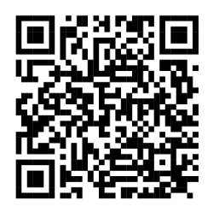
Lung cancer screening availability in Canada
Currently still limited, even in provinces where it is happening
Available in BC, Quebec and Ontario
Alberta program is still a pilot
Situation around the country: https://right2survive.ca/resource-centre/screening/

Slide 12
Lung Cancer Screening in Ontario
The Lung Cancer Screening Pilot for People at High Risk (the pilot) was launched in June 2017 to assess how to best implement organized lung cancer screening for people at high risk across Ontario - the pilot ended in March 2021
Selected screening sites are level 1 thoracic surgery centre hospitals with an on-site organized program for lung diagnostic assessment
Results of interim and final evaluations of the pilot will inform expansion of a provincial program
Organized lung cancer screening is still available at the hospitals that participated in the pilot as part of the Ontario Lung Screening Program
Notes:
Slide Objective: to provide an overview of the Ontario Lung Screening Program.
Level 1 Thoracic Surgery Centres:
The criteria for thoracic surgery centres are provided in Ontario Health (Cancer Care Ontario)’s Thoracic Surgical Oncology Standards. Specific requirements for level 1 centres include:
At least three thoracic surgeons
Surgical volumes of a minimum of 20 esophagectomy cases per unit per year and 150 pulmonary resections per unit per year (targets)
Dedicated thoracic surgical service with consolidated beds to ensure an appropriate level of nursing, physiotherapy and respiratory therapy expertise
How Pilot Sites were Chosen:
On March 31, 2016, a Request for Proposals was issued to hospitals interested in piloting lung cancer for people at high risk. The hospitals had to have a level 1 thoracic surgery centre with an organized program on-site for lung diagnostic assessment. An evaluation committee made up of Cancer Care Ontario (before it transitioned to Ontario Health) senior leaders and clinical experts from across Canada assessed the proposals.
Pilot site hospitals were chosen from the highest ranked proposals to ensure diversity based on geography, hospital type (academic vs. community) and service delivery model (single site vs. hub and spoke).
Lung Cancer Screening Pilot for People at High Risk (the pilot) Evaluation:
A final evaluation is being conducted and will be finalized in 2021. Evaluation findings will inform recommendations for the optimal design and implementation of a provincial lung cancer screening program for people at high risk in Ontario.
Learnings from the pilot will identify opportunities for improvement and will inform expansion of an organized lung cancer screening program.
The pilot evaluation will not be assessing whether or not LDCT is an effective tool for lung cancer screening.
Speaking Note Sources:
Sundaresan S, Langer B, Oliver T, Schwartz F, Brouwers M, Stern H, et al. Thoracic surgical oncology standards [Internet]. 2015 Mar [cited 2020 Sep]. Available from: https://www.cancercareontario.ca/sites/ccocancercare/files/guidelines/full/pebc17-1f_0.pdf

Slide 13
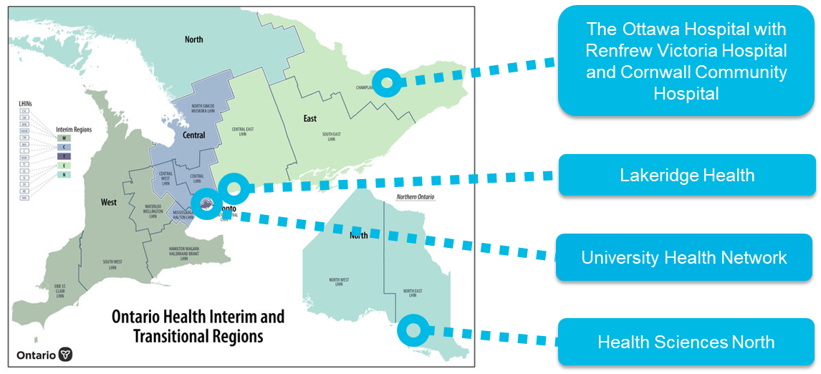
Ontario Lung Screening Program (OLSP) Site Locations
Notes:
Slide Objective: to identify current OLSP sites and their locations.

Slide 14
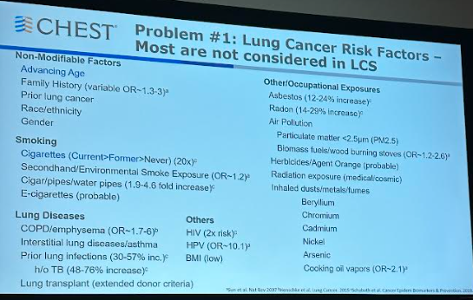
Who’s at Risk?
Tobacco Smoking
Other
Single greatest risk factor
~75-90% of all lung cancers are associated with tobacco use
10% of all smokers develop lung cancer
Relative risk of lung cancer death is 15 X higher in smokers than never smokers
10-25% of lung cancers are not related to tobacco use
Includes exposure to:
  Asbestos, other know carcinogens (e.g. radon, chromium, nickel)
  Dust or microscopic particles (e.g. wood dust, silica, diesel engine emission, chlorinated solvents)
  Lung disease (e.g. COPD, asthma, pulmonary fibrosis)
  Infections (e.g. TB, HPV, previous pneumonia)
  Occupations (miners, painters, iron and steel workers)
Other conditions (e.g. lupus, RA, scleroderma, diabetes, obesity)
Maghfoor I, Perry MC. Lung Cancer. Ann Saudi Med. 2005;25(1):1-12. doi:10.5144/0256-4947.2005.1. Bradley SH, Bhartia BS, Kennedy MP, Frank LK, Watson J. Investigating suspected lung cancer. BMJ. 2022;378:e068384. doi:10.1136/bmj-2021-068384. Cancer Care Ontario. “Referral of Suspected Lung Cancer by Family Physicians and Other Primary Care Providers,” January 6, 2019. 1Bradley SH, Bhartia BS, Kennedy MP, Frank LK, Watson J. Investigating suspected lung cancer. BMJ. 2022;378:e068384. doi:10.1136/bmj-2021-068384

Slide 15

Screening is NOT the Same as Case Finding
If symptoms or concern of lung cancer, then the next step is NOT lung cancer screening, but appropriate investigation of the problem.
This can include CT scan, but not necessarily low dose and likely will incorporate other testing

Slide 16
Why is Diagnosis Challenging?
About 1/3 of patients presented ≥ 3 times before referral
Hemoptysis is the single symptom that confers the highest risk of lung cancer
  It only presents in < 4% of cases
Cough and dyspnea are more common but are also ubiquitous
Percentage of Patients with Symptoms in Year prior to Lung Cancer Diagnosis (n=27,795)
Cough | 24.3%
Dyspnea | 16.3%
Chest pain | 8.2%
Fatigue | 3.8%
Hemoptysis | 3.8%
Weight loss | 3.0%
Appetite loss | 0.6%
Bradley, Stephen H., Bobby SK Bhartia, Martyn PT Kennedy, Lesleigh Kowalski Frank, and Jessica Watson. “Investigating Suspected Lung Cancer.” BMJ 378 (July 13, 2022): e068384. https://doi.org/10.1136/bmj-2021-068384.

Slide 17
Clinical Presentation – Symptoms Indicating Need for Chest X-Ray in People at Risk
Symptoms suspicious of
lung cancer:
  Hemoptysis
  New finger clubbing
  Suspicious lymphadenopathy
  Dysphagia
  Features suggestive of lung cancer that has metastasized elsewhere or other cancers that have metastasized to the lung
  Features suggestive of paraneoplastic syndromes
  Recurrent chest infections
  Unilateral wheeze
The following unexplained signs or symptoms:
  Cough
  Weight loss/loss of appetite
  Shortness of breath
  Chest, rib, or shoulder pain
  Abnormal chest signs
  Hoarseness
  Horner’s syndrome
  Thrombocytosis, anemia, and leukocytosis
Cancer Care Ontario. “Referral of Suspected Lung Cancer by Family Physicians and Other Primary Care Providers,” January 6, 2019.

Slide 18

Clinical Presentation Requiring Urgent Referral
Referral to Emergency Department:
  Stridor
  Massive hemoptysis (>600 mL of blood in 24 hours or 250 mL at one sitting)
  New neurological signs suggestive of brain metastases or cord compression
Indications for urgent chest CT and specialist referral:
  A chest X-ray suggestive or suspicious of lung cancer including:
    A nodule or mass
    Multiple pulmonary nodules
    Non-resolving pleural effusion
    Mediastinal or contralateral hilar adenopathy
    Interstitial infiltrates
    Slowly or non-resolving pneumonia or consolidation
    Fibroapical disease suggesting possible tuberculosis
    Unexplained elevated diaphragm
  A normal chest X-ray, but there is a high suspicion of lung cancer, based on clinical judgement
Screening recommendations can vary based on province/territory
Cancer Care Ontario. “Referral of Suspected Lung Cancer by Family Physicians and Other Primary Care Providers,” January 6, 2019.

Slide 19
Diagnosis Normally Occurs in Late Stages
Most lung cancers present with non-specific symptoms
  Hemoptysis is a feature in only 20%
Lung cancer has some of the poorest outcomes of all tumour types:
  5 year survivability = 10-20%
70%
of All Lung Cancers are Diagnosed in Late stages
Canadian Partnership Against Cancer. “Lung Cancer and Equity: A Focus on Income and Geography.” Accessed May 15, 2023. https://s22457.pcdn.co/wp-content/uploads/2020/11/Lung-cancer-and-equity-report-EN.pdf.
Neal, Richard D., Fei Sun, Jon D. Emery, and Matthew E. Callister. “Lung Cancer.” BMJ 365 (June 3, 2019): l1725. https://doi.org/10.1136/bmj.l1725.

Slide 20
Survivability Depends on Stage and Income Level
Canadian Partnership Against Cancer. “Lung Cancer and Equity: A Focus on Income and Geography.” Accessed May 15, 2023. https://s22457.pcdn.co/wp-content/uploads/2020/11/Lung-cancer-and-equity-report-EN.pdf.

Slide 21

If Referring for Possible Lung Cancer…
Full history: including all risk factors, signs or symptoms suspicious of lung cancer
Physical examination
All pre-existing imaging results: chest x-rays and CT scans
All relevant other medical conditions and current medications
Labs
  CBC with differential
  Renal function: Creatinine
  Liver function: ALT/AST, alkaline phosphatase (AP), total bilirubin, lactate dehydrogenase, albumin
  Electrolytes: calcium, sodium
Alberta Health Services. “PROVINCIAL LUNG CANCER (MEDICAL OR RADIATION ONCOLOGY) REFERRAL QUICK REFERENCE.” Accessed May 15, 2023. https://www.albertahealthservices.ca/assets/info/hp/arp/if-hp-arp-lung-cancer-qr.pdf. Cancer Care Ontario. “Referral of Suspected Lung Cancer by Family Physicians and Other Primary Care Providers,” January 6, 2019.

Slide 22
Could Screening Reduce Late Stage Diagnosis?

Slide 23
What is the Evidence for Low-Dose CT?
NLST Trial
Results
Rate of Positive Screen
24.2% with low-dose CT and 6.9% with radiography
Incidence of lung cancer
247 deaths per 100,000 PYs in low-dose CT and 309 deaths per 100,000 PYs in the radiography group
↓ lung cancer by 20% mortality in low-dose compared to radiography
Key Inclusion Criteria
55-74 years
30 pack-year history
If former smoker, quit in previous 15 years
Low-Dose CT
53,454 participants
Radiography (Chest X-ray )
Three screenings at 1-year intervals
Conclusion: Screening with the use of low-dose CT reduces mortality from lung cancer.
The National Lung Screening Trial Research Team. “Reduced Lung-Cancer Mortality with Low-Dose Computed Tomographic Screening.” New England Journal of Medicine 365, no. 5 (August 4, 2011): 395–409. https://doi.org/10.1056/NEJMoa1102873.

Slide 24


Evidence for Screening People at High Risk - Dutch-Belgian Randomized Lung Cancer Screening Trial (NELSON study)
RCT (N=15,000)
  12,500 men
  2500 women
It compared people at high risk of getting lung cancer who got screened with LDCT at four different time points to people who did not get screened
Men
Women
Screening with LDCT resulted - 24% reduction in lung cancer mortality at 10 years of follow-up
Screening with LDCT resulted - 33% reduction in lung cancer mortality at 10 years of follow up*
*This finding was not statistically significant.
de Koning H, van der Aalst C, de Jong P, Scholten E, Nackaerts K, Heuvelmans M, et al. Reduced lung-cancer mortality with volume CT screening in a randomized trial. N Engl J Med [Internet]. 2020 Feb [cited 2020 Apr];382(6):503–513
Notes:
Slide Objective: to describe the evidence in support of lung cancer screening for people at high risk.
Participants that were randomized to the screening group in the NELSON study had LDCT scans at baseline and 1, 3, and 5.5 years after randomization. A minimum follow-up period of 10 years was used for the majority of participants.
Like the National Lung Screening Trial, the findings from the NELSON trial show that lung cancer screening results in reduced risk of dying from lung cancer.
The trial showed that men at high risk of getting lung cancer who got screened with LDCT over approximately five and a half years (one baseline scan and additional scans at one, three and five-and-a-half years after baseline) had a 24 percent relative reduction in lung cancer mortality over 10 years, compared to men who were not screened at all.
Results from the small sample of approximately 2,500 female participants in the trial suggested an even greater benefit of screening for women (33 percent relative reduction in lung cancer mortality over 10 years), but this finding was not statistically significant.
Slide Content and Speaking Note Source:
7. de Koning H, van der Aalst C, de Jong P, Scholten E, Nackaerts K, Heuvelmans M, et al. Reduced lung-cancer mortality with volume CT screening in a randomized trial. N Engl J Med [Internet]. 2020 Feb [cited 2020 Apr];382(6):503–513. Available from: https://www.nejm.org/doi/full/10.1056/NEJMoa1911793

Slide 25
Benefits and Risks of Low-Dose CT Screening
Benefits
Diagnosis of lung cancer in early stage
Reduced mortality due to lung cancer
Potential Harms
Radiation exposure
High positivity rate
Stress and risks of invasive procedures from positive test
Overdiagnosis of lung cancer by up to 10-20%
  When implemented in high-risk patients, with patient and clinician education, it can significantly improve outcomes
Verma, Nupur, Markus Wu, and Stephan Altmayer. “Lung Cancer Screening: How We Do It and Why.” Seminars in Roentgenology, Lung Cancer Imaging, 55, no. 1 (January 1, 2020): 14–22. https://doi.org/10.1053/j.ro.2019.10.004.

Slide 26
Types of Screening
Organized Cancer Screening Programs
Are run centrally, use clear, consistent policies and processes Use scientific evidence to determine appropriate cancer screening guidelines Track and measure quality and performance
Opportunistic Screening
Ad-hoc screening activities Occurs outside of an organized cancer screening program, usually when people ask for a test or are offered a test by their primary care provider (PCP)
Notes:
Slide Objective: To explain the different types of screening.

Slide 27
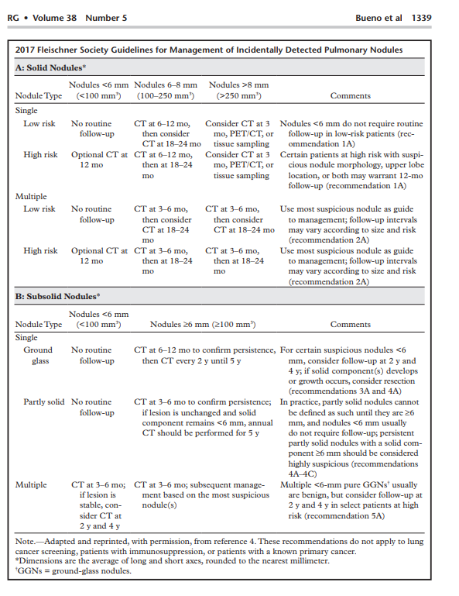
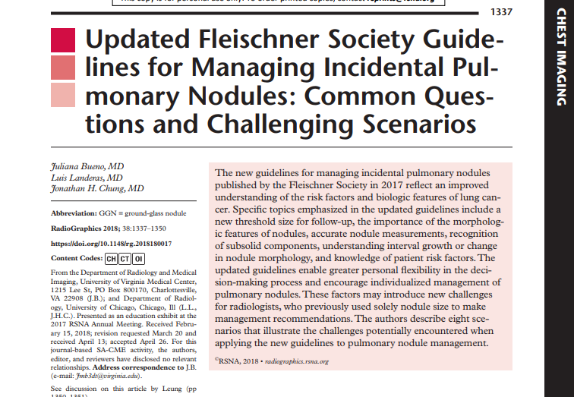
The Important Role of Screening Programs
You ready to keep track of all this?
Medicolegal implications?
Hard enough with incidentalomas…
So, let the screening programs do this!!

Slide 28
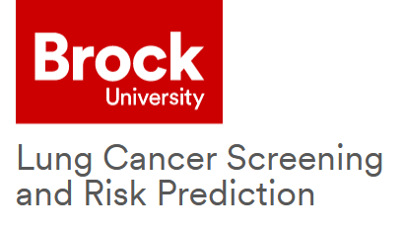

PLCOm2012 Risk Prediction Model for Lung Cancer
NLST criteria alone
  Had many false positives
  Included some low-risk patients
  Excluded some high-risk patients
PLCOm2012 model evaluated the 6-year risk of lung cancer occurring in smokers in the control arm of the Prostate, Lung, Colorectal and Ovarian Cancer Screening Trial (PLCO)
The model has been validated in many studies and populations to better predict lung cancer than NLST criteria
https://brocku.ca/lung-cancer-screening-and-risk-prediction/risk-calculators/?
Tammemägi, Martin C., Timothy R. Church, William G. Hocking, Gerard A. Silvestri, Paul A. Kvale, Thomas L. Riley, John Commins, and Christine D. Berg. “Evaluation of the Lung Cancer Risks at Which to Screen Ever- and Never-Smokers: Screening Rules Applied to the PLCO and NLST Cohorts.” PLOS Medicine 11, no. 12 (December 2, 2014): e1001764. https://doi.org/10.1371/journal.pmed.1001764. Jantzen, Rodolphe, Nicole Ezer, Sophie Camilleri-Broët, Martin C. Tammemägi, and Philippe Broët. “Evaluation of the Accuracy of the PLCOm2012 6-Year Lung Cancer Risk Prediction Model among Smokers in the CARTaGENE Population-Based Cohort.” Canadian Medical Association Open Access Journal 11, no. 2 (March 1, 2023): E314–22. https://doi.org/10.9778/cmajo.20210335. Tammemägi, Martin C., Mamta Ruparel, Alain Tremblay, Renelle Myers, John Mayo, John Yee, Sukhinder Atkar-Khattra, et al. “USPSTF2013 versus PLCOm2012 Lung Cancer Screening Eligibility Criteria (International Lung Screening Trial): Interim Analysis of a Prospective Cohort Study.” The Lancet Oncology 23, no. 1 (January 1, 2022): 138–48. https://doi.org/10.1016/S1470-2045(21)00590-8.

Slide 29

PLCOm2012 Risk Prediction Model Criteria
Four smoking variables
Seven non-smoking variables
Smoking intensity
Smoking duration
Quit time in former smokers
Current smoking status (current vs. former)
Age
Race/ethnicity (black and indigenous)
Socioeconomic circumstance estimated by education level
Body mass index
Personal history of cancer
COPD
Family history of lung cancer
Each province may have different screening but usually involves:
  55 to 74 years of age
  Current smoker
  PLCOm2012 risk of either ≥ 1.5% or ≥ 2.0%
(PLCOm2012 risk is commonly calculated by the lung cancer referral centre)
Tammemägi, Martin C., Timothy R. Church, William G. Hocking, Gerard A. Silvestri, Paul A. Kvale, Thomas L. Riley, John Commins, and Christine D. Berg. “Evaluation of the Lung Cancer Risks at Which to Screen Ever- and Never-Smokers: Screening Rules Applied to the PLCO and NLST Cohorts.” PLOS Medicine 11, no. 12 (December 2, 2014): e1001764. https://doi.org/10.1371/journal.pmed.1001764.

Slide 30
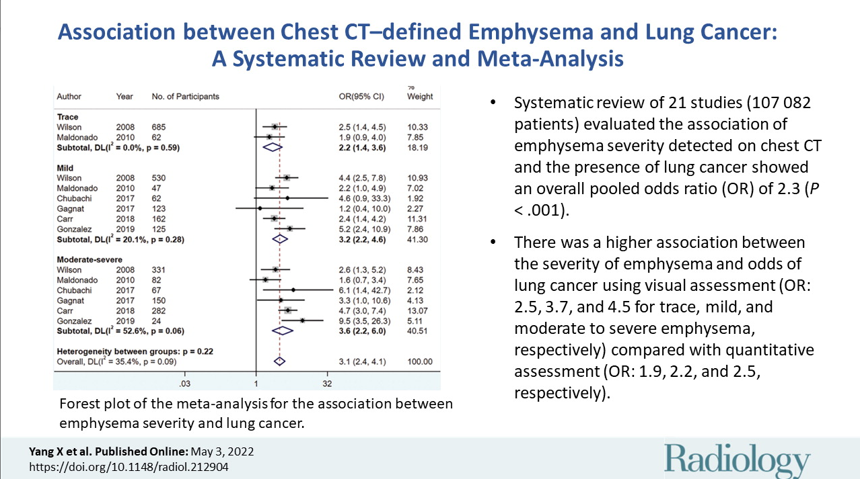
Emphysema increases the risk

Slide 31
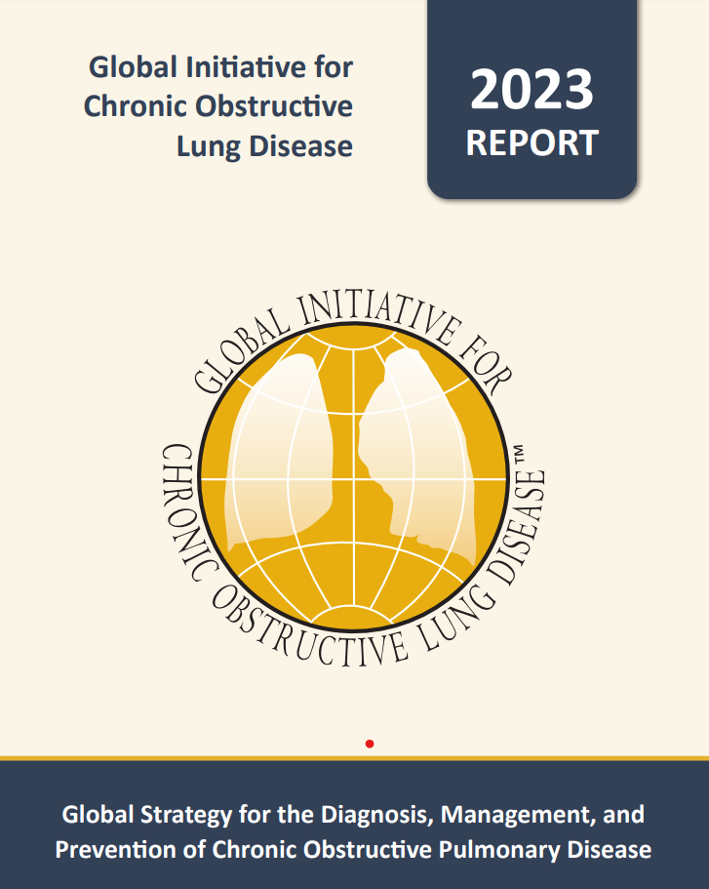
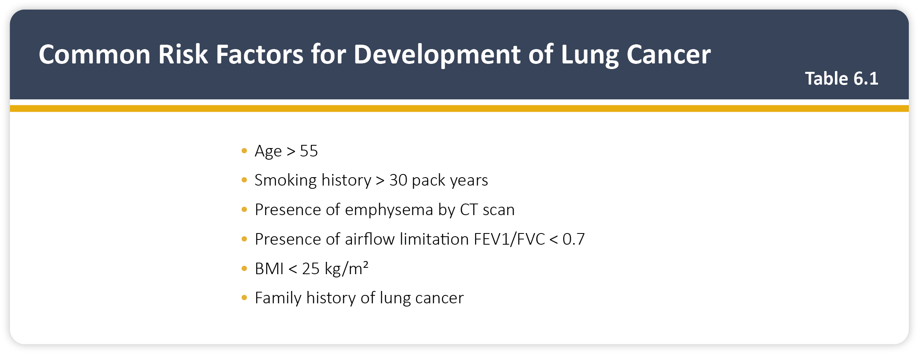
Teaching
Slide Set

Slide 32
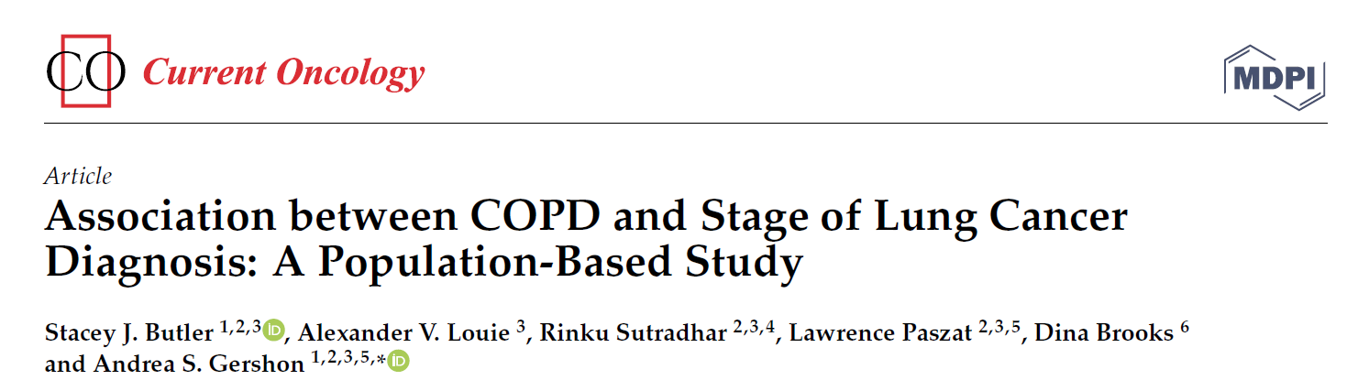
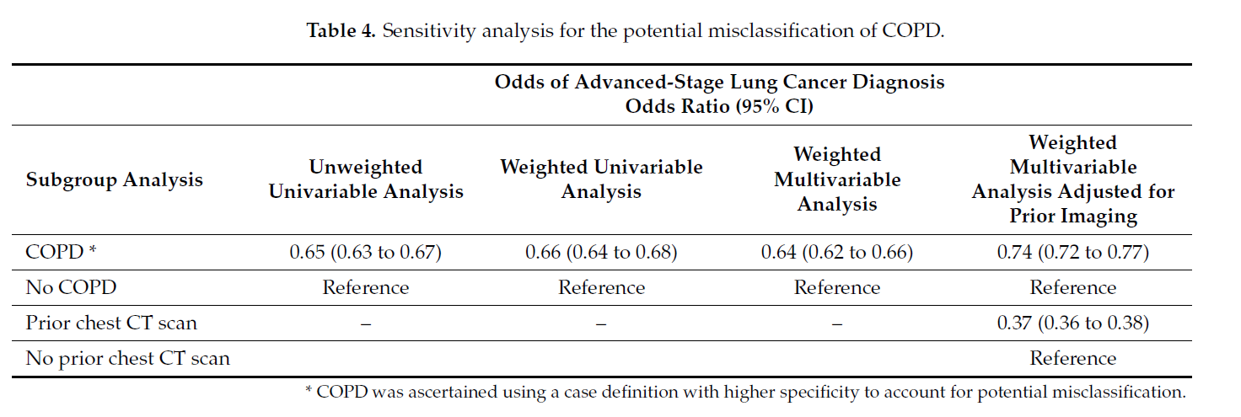
Good news wrt COPD is:
Curr. Oncol. 2023, 30(7), 6397-6410; https://doi.org/10.3390/curroncol30070471

Slide 33
LDCT
LDCT uses much less radiation than a diagnostic CT¹⁰ and does not require contrast
Participants get their screening result and next steps within 2 weeks of their scan
The standardized lung cancer screening radiology report includes:
Screening results*: | Incidental findings**:
Size and characteristics of lung nodules Next steps for screening based on Lung-RADS® score *Responsibility of the OLSP site to manage | Abnormalities unrelated to lung cancer seen on LDCT (e.g., aortic aneurysm, osteoporosis) **Responsibility of the referring physician to manage
Notes:
Slide Objective: to provide introductory detail on the low-dose computed tomography (LDCT) scan and radiology reports.
The amount of radiation someone is exposed to through an LDCT scan for lung cancer screening is several times that of a chest X-ray, much less than that of a diagnostic chest computed tomography (CT) scan and approximately the same as one year of natural background radiation (radiation from the sky and the ground, and through breathing, eating and drinking).
NOTE FOR THE PRESENTERS:
The target is for radiology reports to be completed and signed off so that results can be communicated within 2 weeks of the scan day. Participants will be notified over the phone of their screening result and next steps. If report sign-off is expected to take longer than 2 weeks of the scan day due to extenuating circumstances (e.g., emergency cases), the participant will be notified of the delay.
Cornwall Community Hospital will use an alternate delivery model that will enable evaluation of screening operations in a small hospital with only one CT scanner. They will provide evening screening appointments throughout the week.
Smoking cessation counselling may occur on the scan day.
The next LDCT appointment will be booked at the time that results are communicated (not applicable for people referred for diagnostic assessment).
Speaker Note Sources:
Radiologyinfo.org [Internet]. Radiological Society of North America, Inc.; c2021. Radiation Dose in X-Ray and CT Exams [reviewed 2019 Mar; cited 2020 May]. Available from: http://www.radiologyinfo.org/en/info.cfm?pg=safety-xray
Canadian Nuclear Safety Commission [Internet]. Government of Canada; 2013. Natural background radiation [modified 2020 Nov; cited 2020 May]. Available from: http://nuclearsafety.gc.ca/eng/resources/fact-sheets/natural-background-radiation.cfm
Slide Content Sources:
10. Radiologyinfo.org [Internet]. Radiological Society of North America, Inc.; c2021. Radiation Dose in X-Ray and CT Exams [reviewed 2019 Mar; cited 2020 May]. Available from: http://www.radiologyinfo.org/en/info.cfm?pg=safety-xray

Slide 34

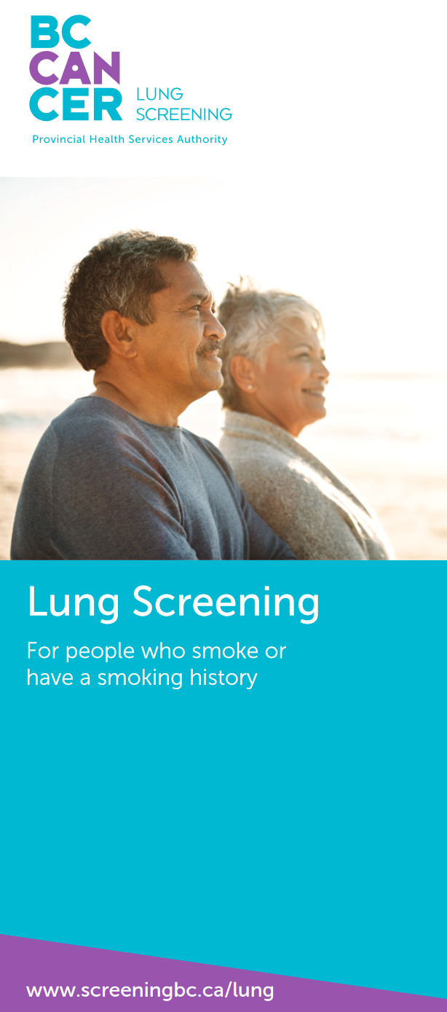
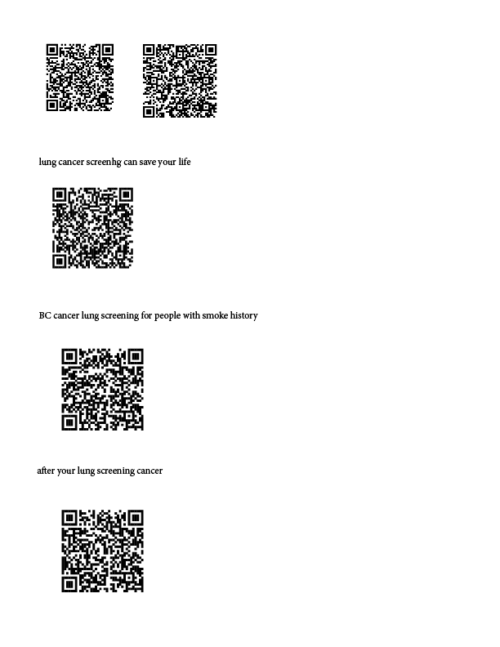

Importance of Shared-Decision with Patient
https://screeningforlife.ca/wp-content/uploads/ALCSP_PatientBrochure_final_proof_2022_08_11.pdf
http://www.bccancer.bc.ca/screening/Documents/Lung-Screening-Brochure.pdf
http://www.bccancer.bc.ca/screening/Documents/Lung-Screening-Results-Brochure.pdf

Slide 35
Potential Risks of Lung Cancer Screening
LDCT scans give off a small amount of radiation¹⁰
  Although the amount of radiation is low, there is a small chance that the extra radiation from many LDCT scans over time could cause cancer
False-positive results may cause stress and anxiety, and lead to unnecessary diagnostic assessments with the risk of complications (e.g., bronchoscopy, needle biopsy, thoracotomy, thoracoscopy)
Screening can lead to over-diagnosis (i.e., identifying a cancer that would not have caused someone harm if they had not been screened)
Notes:
Slide Objective: to highlight the potential harms of lung cancer screening.
Radiation Exposure:
LDCT scans give off a small amount of radiation. The amount of radiation someone is exposed to through an LDCT scan for lung cancer screening is several times that of a chest X-ray, much less than that of a diagnostic chest CT scan and approximately the same as one year of natural background radiation (radiation from the sky and the ground, and through breathing, eating and drinking). For people who are at high risk of getting lung cancer, the benefits of finding cancer early are probably greater than the risks of getting a small amount of radiation from the test.
False-Positives:
The false-positive rate observed in the National Lung Screening Trial (NLST) was high (24.2% of scans were classified as positive; across three rounds of screening, 96.4% of positive scans did not lead to a diagnosis of cancer), which is of concern because false-positive results may lead to unnecessary follow-up procedures. It is important to note that the definition of a positive scan in the NLST was quite broad (included any non-calcified nodule ≥4 millimeters) and the NLST did not use a standardized follow-up algorithm for nodules; therefore, not all scans that were defined as positive resulted in an action other than recall for a subsequent routine screen.
The Ontario Lung Screening Program (OLSP) uses different criteria from the NLST to classify scans as positive. In the OLSP, nodules are being followed up in accordance with Lung-RADS®, which standardizes the classification and follow-up of lung nodules detected by screening. Only LDCT scans resulting in a Lung-RADS® score of 3 or higher are considered positive. These scores lead to follow-up such as a repeat short interval (e.g., one, three or six months) LDCT scans or potentially more complex diagnostic procedures (i.e., biopsy, surgery) that exposes participants to a greater risk of harm. By using Lung-RADS®, the false-positive rate in the OLSP is expected to be lower than that in the NLST.
Over-Diagnosis:
The use of Lung-RADS® may also help to reduce the potential for over-diagnosis because the management algorithm takes into account nodule characteristics associated with a lower likelihood of progressing to a clinically significant cancer (e.g., ground glass nodules are monitored for growth, but previously these nodules were likely to be removed surgically).
For more information on Lung-RADS®, visit acr.org/Quality-Safety/Resources/LungRADS
Speaking Note Sources:
Radiologyinfo.org [Internet]. Radiological Society of North America, Inc.; c2021. Radiation Dose in X-Ray and CT Exams [reviewed 2019 Mar; cited 2020 May]. Available from: http://www.radiologyinfo.org/en/info.cfm?pg=safety-xray
Canadian Nuclear Safety Commission [Internet]. Government of Canada; 2013. Natural background radiation [modified 2020 Nov; cited 2020 May]. Available from: http://nuclearsafety.gc.ca/eng/resources/fact-sheets/natural-background-radiation.cfm
American College of Radiology [Internet]. Reston (VA): American College of Radiology. Lung CT Screening Reporting & Data System (Lung-RADS) [cited 2020 May]. Available from: https://www.acr.org/Clinical-Resources/Reporting-and-Data-Systems/Lung-Rads
American College of Radiology [Internet]. Reston (VA): American College of Radiology. Lung-RADS Version 1.1 Assessment Categories [2019; cited 2020 May]. Available from: https://www.acr.org/-/media/ACR/Files/RADS/Lung-RADS/LungRADSAssessmentCategoriesv1-1.pdf?la=en
Aberle D, Adams A, Berg C, Black W, Clapp J, Fagerstrom R, et al. Reduced lung-cancer mortality with low-dose computed tomographic screening. N Engl J Med. 2011 Aug;365(5):395–409.
Slide Content Sources:
10. Radiologyinfo.org [Internet]. Radiological Society of North America, Inc.; c2021. Radiation Dose in X-Ray and CT Exams [reviewed 2019 Mar; cited 2020 May]. Available from: http://www.radiologyinfo.org/en/info.cfm?pg=safety-xray

Slide 36

Smoking Cessation
Smoking cessation is an important component of lung cancer screening
Quitting or reducing smoking lowers the patient’s lung cancer risk
A concern is a negative screen, could validate their smoking is not associated with harm
  Important to encourage all smokers to quit
Many different resources to support the patient’s quitting journey

Slide 37
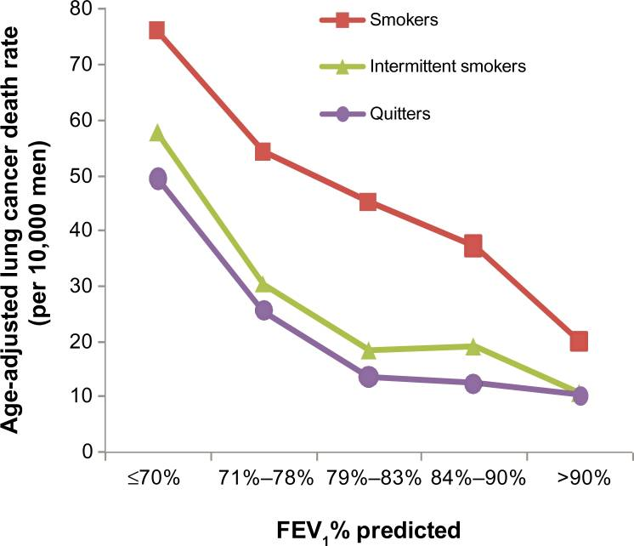
Smoking and Lung cancer risk
The relation of lung function and lung cancer mortality in men according to smoking status in the MRFIT Study
Wu. J, Sin. D, Improved patient outcome with smoking cessation: when is it too late? Journal: International Journal of Chronic Obstructive Pulmonary Disease Volume: 6 Issue: 1; 259-267

Slide 38
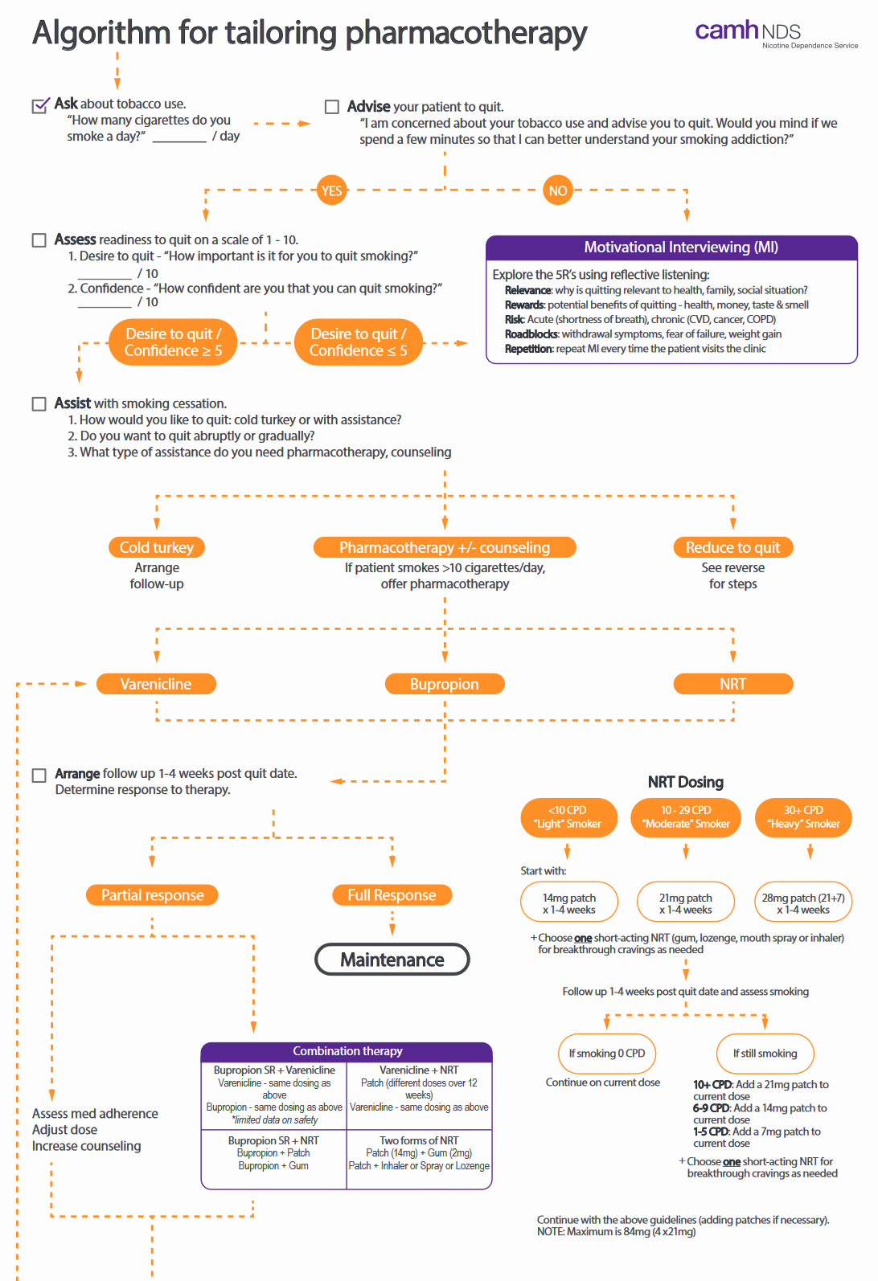
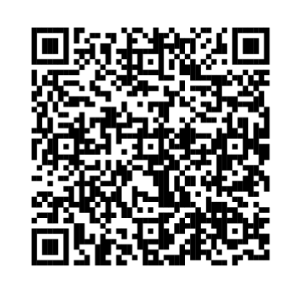



CAN-ADAPTT Guidelines
for Smoking Cessation
Most effective strategy is a combination of counselling (including smoking cessation programs) and pharmacotherapy
Pharmacotherapy options:
  Varenicline
  Bupropion
  Combination nicotine replacement therapy: Patch + short-acting
Can reduce to quit
NRT dosing can be adjusted higher if the patient experiences withdrawal or can’t reduce tobacco use
https://www.nicotinedependenceclinic.com/en/teach/Documents/Pharmacotherapy%20Algorithm%20JAN2018%20updated.pdf

Slide 39
Reporting of Lung Cancer Screening Results
The lung results are clearly laid out for the PCP in the report
You do NOT have to do anything other than make the first referral,
the program will take over from here!!
Lung-RADS® - standardize lung cancer screening CT reporting and management recommendations
Lung RADS® | Categorization | Management
Category 0 | Incomplete | Additional lung cancer screening CT images and/or comparison to prior chest CT needed LDCT in 1-3 months if inflammatory or infectious process suspected
Category 1 | Negative | LDCT in 12 months
Category 2 | Benign | LDCT in 12 months
Category 3 | Probably benign | LDCT in 6 months
Category 4A | Suspicious | Double read LDCT in 3 months
Category 4B | Very suspicious | Refer for further clinical evaluation
Category 4X | Very suspicious | Refer for further clinical evaluation
ACR. Lung-RADS® v2022. https://www.acr.org/-/media/ACR/Files/RADS/Lung-RADS/Lung-RADS-2022.pdf

Slide 40
Role of the Primary Care Clinician in Lung Cancer Screening
01
Patient identification
  Patients who meet provincial/territorial criteria for low-dose CT screening
Patient discussion and education
  Benefits and harms of lung cancer screening
  Through shared-decision process, determine if screening is appropriate
Referral
  Referral of eligible patients to testing centres
Discussion of results and ensuring adherence to follow-up by screening program
  Patients with negative results will maintain ongoing screening
  If positive, the patient will be referred for further diagnostic testing
Dealing with incidental findings
02
03
04
05

Slide 41
Actionable Incidental Findings
Incidental Findings: Findings beyond the target finding of a lung nodule. Can be in the lung parenchyma but more often in surrounding anatomy captured on the CT scan.
Implication: Often unknown to the radiologist without additional clinical information.
May be clinically irrelevant, may be relevant but already known to the PCP and under investigation or surveillance.
Actionable: Findings that (if previously unknown) require follow-up or further investigation
Recommendations have been developed for most common actionable incidental findings:
  Indeterminate renal nodule or mass
  Indeterminate hepatic nodule(s) or mass
  Emphysema
  Breast nodule or asymmetry
  Coronary artery calcification (CAC)
  Thyroid nodules
Notes:
Slide Objective: Demonstrate the radiologist approach to the discovery of actionable incidental findings discovered during their LDCT.
Incidental Findings:
It is the responsibility of the referring physician to ensure appropriate follow up or management of incidental findings. Incidental findings will be included in the radiology report that is sent to referring physicians and primary care providers (if different). If there is an actionable incidental finding, the screening navigator will then send an ADDITIONAL communication to referring physicians (not necessarily primary care providers) to remind them about the incidental findings. By signing the OLSP referral form, referring physicians confirm that they are responsible for incidental findings. However, primary care providers should follow up with patients (or the referring physician) regarding incidental findings, as appropriate.
Physician will be requested to confirm receipt of notification regarding actionable incidental findings.
Speaking Note: When reading a participant’s LDCT, a radiologist may make note of incidental findings that require further action or investigation discovered. During the first few years of the pilot, the most commonly reported actionable incidental findings were tabulated, and experts were consulted to determine whether these incidental findings did indeed require further investigation in the context of this lung cancer screening population.
In order to determine if action is needed, experts were consulted to determine if standardized recommendations could be developed

Slide 42
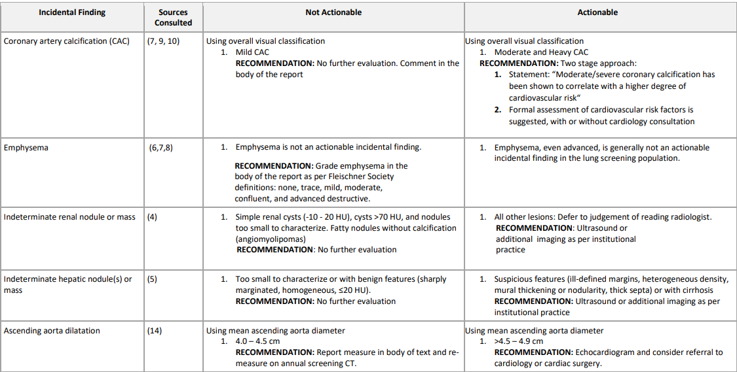
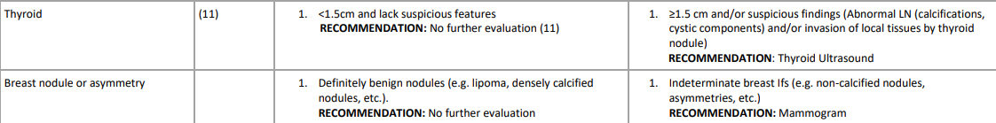
Incidental findings recommendations
www.cancercareontario.ca/sites/ccocancercare/files/guidelines/full/IFRecommendationsDocument.pdf

Slide 43
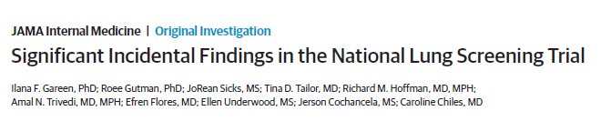
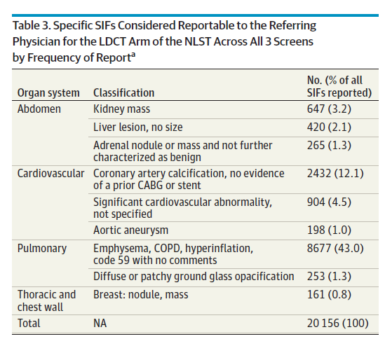
Gareen IF, Gutman R, Sicks J, Tailor TD, Hoffman RM, Trivedi AN, Flores E, Underwood E, Cochancela J, Chiles C. Significant Incidental Findings in the National Lung Screening Trial. JAMA Intern Med. 2023 Jul 1;183(7):677-684. doi: 10.1001/jamainternmed.2023.1116. PMID: 37155190; PMCID: PMC10167600.

Slide 44


Managing Ronald
Clinical considerations
  63-year-old with 37-pack year history - Smoked regularly for 40 years of his life.
  Also has COPD which is component of PLCOm2012 risk calculation
  Candidate for low-dose CT screening referral
Clinician course of action
  Reviews benefits and risk of screening
  Reviews that risk is still elevated even though he quit smoking 3 years ago
  Ronald would like to be screened, and clinician refers to lung cancer screening center

Slide 45
How are we doing?
Newer program in Canada
USA more established
Similar improvements, when screened, but..
Adherence
Racial inequities

Slide 46
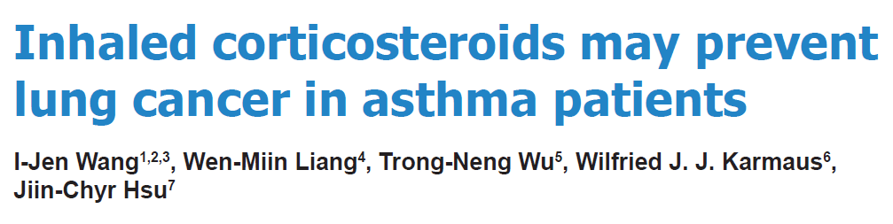
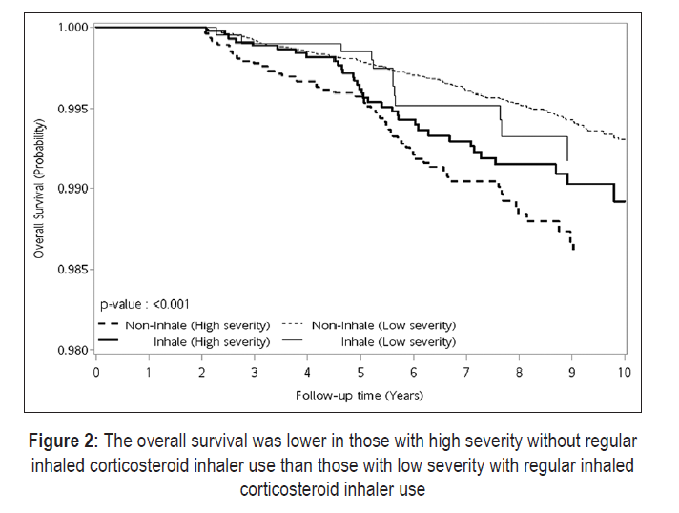
How about ICS use in treating Asthma?
Patients with documented history of tobacco use were excluded from the analyses.
Asthmatics were categorized into a mild and a severe asthma group
Survival lower if more severe and untreated than less severe and treated with regular ICS
For patients with asthma, regular ICS use might have a protective effect against LUNG CANCER (especially if associated with renal diseases, stroke, and hyperlipidemia)
Mechanism?
Allergic respiratory inflammation promotes the recruitment of circulating tumor cells in mice¹.
So….ADHERENCE!!
Wang IJ, Liang WM, Wu TN, Karmaus WJJ, Hsu JC. Inhaled corticosteroids may prevent lung cancer in asthma patients. Ann Thorac Med. 2018 Jul-Sep;13(3):156-162. doi: 10.4103/atm.ATM_367_17. PMID: 30123334; PMCID: PMC6073787.
1. Taranova AG, Maldonado D 3rd, Vachon CM, Jacobsen EA, Abdala‑Valencia H, McGarry MP, et al. Allergic pulm
onary inflammation promotes the recruitment of circulating tumor cells to the lung. Cancer Res 2008;68:8582‑9.

Slide 47

Lung Cancer summary
Lung cancer is the leading cause of cancer-related death in Canada
Most lung cancer cases are diagnosed in late stages and associated with poor prognosis
Most patients are asymptomatic or with ubiquitous symptoms making early diagnosis difficult
Low-dose CT screening can be considered for high-risk patients aged 50-74 years who use(d) tobacco

Slide 48
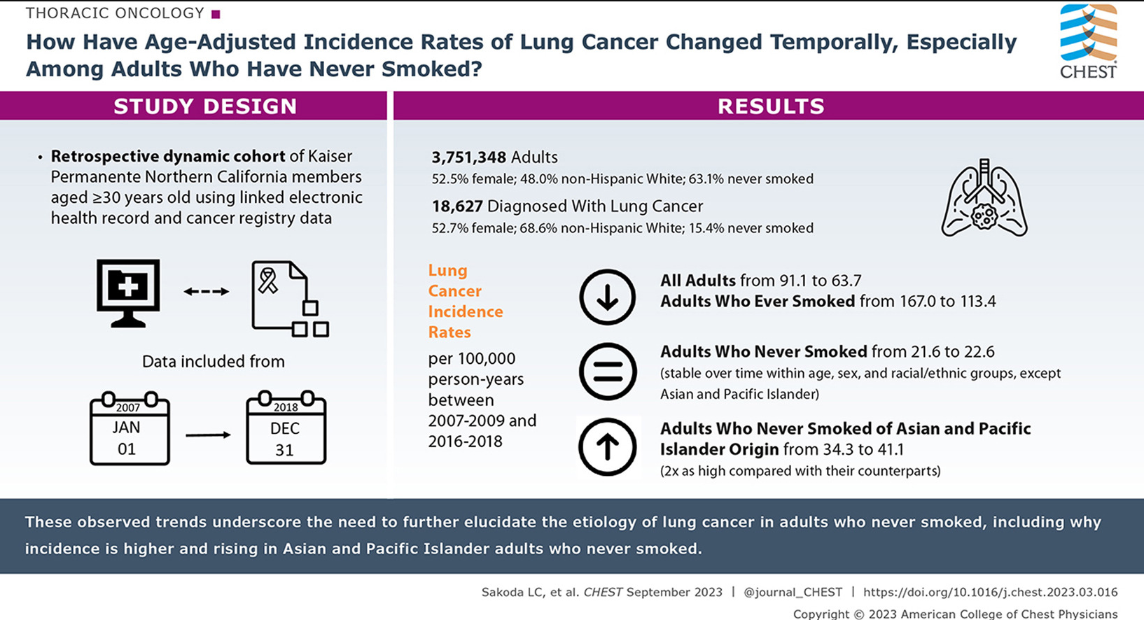
BUT!!
Lung Cancer in Never Smoker rates are rising, so we still have to be wary!!

Slide 49
Quick Highlights from other Cancer screening programs
Breast
Colon
Cervix

Slide 50

Breast Density Notification *NEW*
Breast density describes the amount of fibroglandular tissue in the breast in relation to fatty tissue
Density is important because
  Breast cancer is more difficult to detect in dense tissue on mammograms
  Risk of developing breast cancer is higher for women with dense breasts

Slide 51
BI-RADS Density Categories
    Category A – the breasts are almost all fatty (not dense) tissue
Category B – the breasts mainly have non-dense tissue with some scattered areas of fibroglandular (dense) tissue
Category C – the breasts are heterogeneously dense (a mixture of fatty and dense tissue)
Category D – the breasts are extremely dense (almost entirely dense breast tissue)

Slide 52
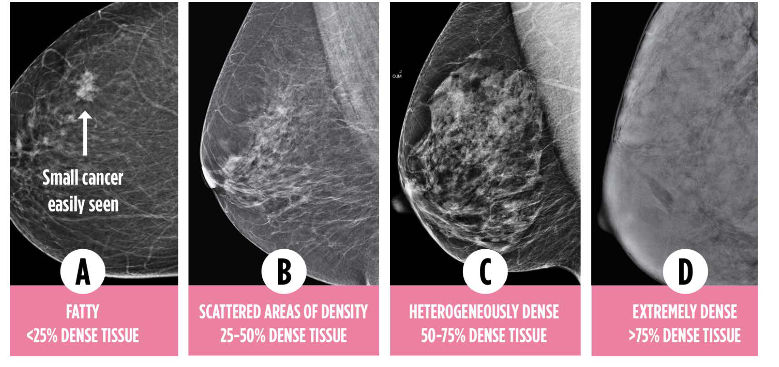
Breast Density Update

Slide 53
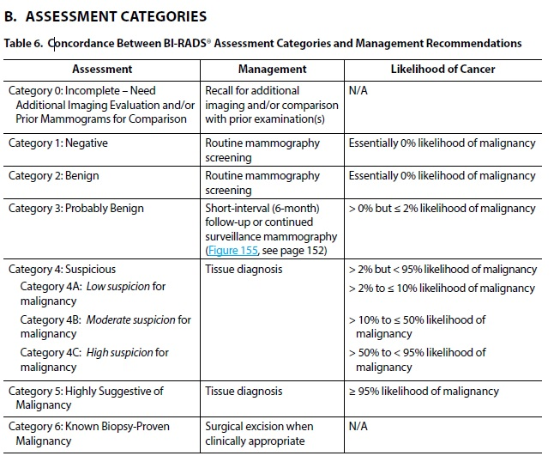
BI-RADS Assessment Categories

Slide 54
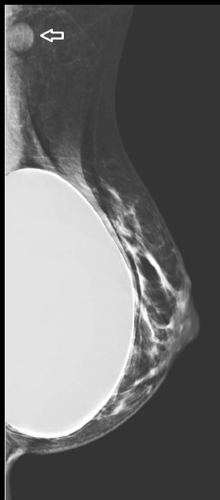
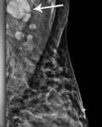
Mammogram, we ask about COVID shots

Slide 55
Inclusion of patients that are ‘new’ to the OBSP in Ontario
People with breast implants who screened outside the program and were excluded from the OBSP may receive invitation letters if they become eligible for breast screening (based on their date of birth and screening history) before October 16.
Two-Spirit, trans and nonbinary people currently participating in the OBSP may receive normal result or recall letters based on their screening history. (regardless of what sex the Ministry of Health has on file for them)
Notes:
Prior to October 16, 2023, people who are being screened in the OBSP will be able to receive normal result, recall and recall reminder letters,. However, because Ontario Health uses data from the Ministry of Health and other clinical sources to identify who is eligible to receive OBSP invitation letters and these sources use binary sex information (i.e., male/female), Ontario Health remains unable to accurately identify all Two-Spirit, trans and nonbinary people who are eligible for OBSP invitation letters.

Slide 56

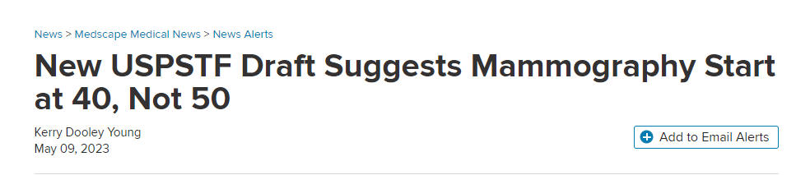
Controversies
Two major factors prompted the change.
One is that more women are being diagnosed with breast cancer in their 40s.
The other is that a growing body of evidence showing that Black women get breast cancer younger, are more likely to die of breast cancer, and would benefit from earlier screening¹.
1. Chen T, Kharazmi E, Fallah M. Race and Ethnicity–Adjusted Age Recommendation for Initiating Breast Cancer Screening. JAMA Netw Open. 2023;6(4):e238893. doi:10.1001/jamanetworkopen.2023.8893

Slide 57
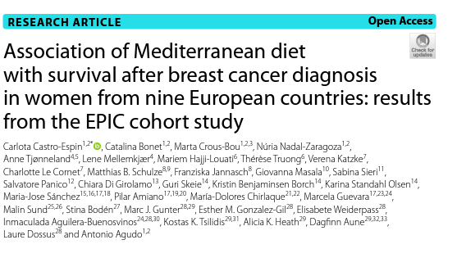
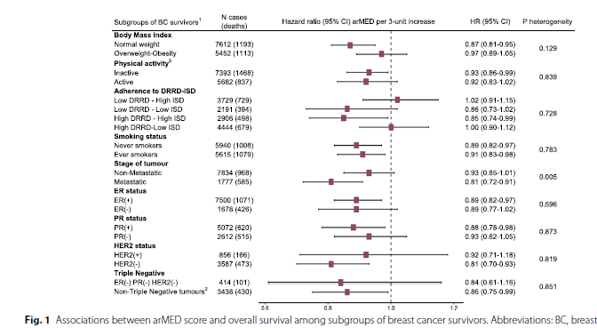

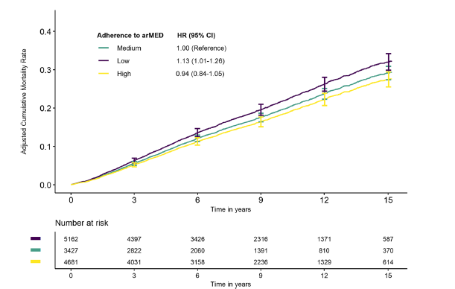
You may find this interesting?
Low compared to medium adherence to arMED score was associated with a 13% higher risk of all‑cause mortality (HR 1.13, 95%CI 1.01–1.26)

Slide 58

Colorectal (CRC) Cancer Screening
Canada has one of highest rates of CRC in world
When caught early, ~90% chance of cure
Stage I & II good prognoses, estimated 5-year relative survival:
  Stage I - 96%
  Stage II – 87%
Notes:
Third most common cancer

Slide 59
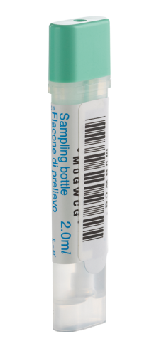

What is FIT?
At-home screening test for CRC (FIT checks for presence of occult blood in the stool)
One sample
Tube design for easy sampling
Automated test processing
Quantitative result

Slide 60
Impact of Regular Screening with FIT
HRA detection increased over multiple rounds of screening with FIT ¹⁴
Importance of regular screening with FIT
HRA
CRC
Cumulative detection rate per 1,000 screened
5 rounds of FIT
Time since first screening test (years)
Notes:
Slide objective: To demonstrate that over multiple rounds of screening with FIT, detection for advanced adenoma improves
ANIMATION -1) arrows indicating where FIT was repeated (timed animation), 2) blue call out box
Speakers notes:
This is another study looking at the performance of FIT for detecting CRC and HRA over multiple screening rounds or episodes, addressing the gap in the previous study
The cumulative detection rate after five rounds of FIT is similar to primary screening with colonoscopy, supporting the need to account for the cumulative sensitivity of repeated FITs when evaluating the test’s efficacy.
After 5 rounds of screening, the cumulative CRC and advanced adenoma detection rates were 8.5% per 1000 screened (95% CI 7.8 to 9.2) and 58.9% per 1000 screened (95% CI 56.9 to 61.0)
Repeated FIT significantly reduces the burden of colorectal disease while facilitating an efficient use of colonoscopy resources.
Additional study information:
Study: cohort study over 5 rounds of screening in Italy
Population: 50 to 69-year-olds repeatedly screened with the FIT (round 1 n=123 347, round 2 n=96129, round 3 n=78770, round 4 n=63069, round 5 n=50441, round 6 n=29891)
Outcomes of interest: the FIT positivity rate, the CRC and advanced adenoma detection rate and the FIT’s positive predictive value (PPV) for advanced neoplasia, at each round of screening and (2) the cumulative CRC and advanced adenoma detection rate after five rounds of FIT.
FYI only -- New additional supportive data:
A population-based study (n=5 417 699) of a Taiwanese organized CRC screening program where biennial FIT is implemented suggests that those who had at least one screening with FIT (52.3% has at least 2 screens with FIT) had reduced incidence of advanced stage CRC (adjusted relative risk=0.66, 95% CI 0.63 to 0.70) and CRC mortality (adjusted relative risk=0.6095% CI 0.57 to 0.64). Suggesting 34% significant reduction of advanced-stage CRCs and 40% reduction of death from CRC.²
Slide Sources:
Zorzi M, Hassan C, Capodaglio G, Fedato C, Montaguti A, Turrin A, Rosano A, Monetti D, Stocco C, Baracco S, Russo F. Long-term performance of colorectal cancer screening programmes based on the faecal immunochemical test. Gut. 2018 Dec 1;67(12):2124-30.
Speakers notes sources:
Chiu HM, Jen GH, Wang YW, Fann JC, Hsu CY, Jeng YC, et al. Long-term effectiveness of faecal immunochemical test screening for proximal and distal colorectal cancers. Gut. 2021 Jan 24.

Slide 61
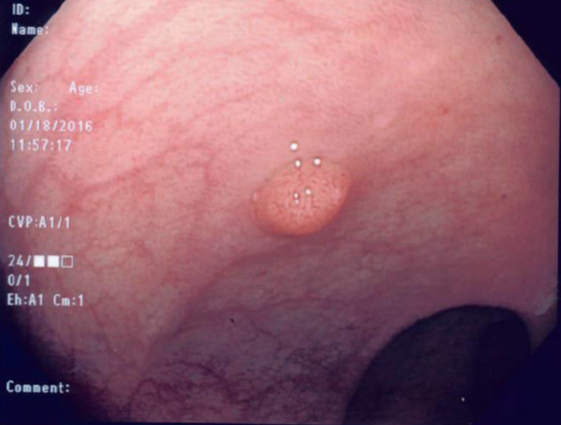
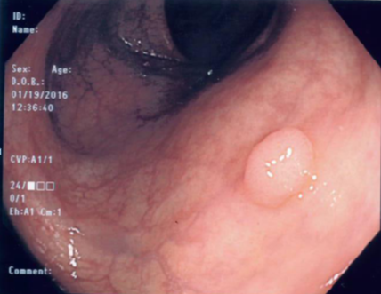
Low Risk Adenomas (LRAs)
1–2 tubular adenomas <10 mm in diameter with no high-grade dysplasia
Notes:
Slide objective: To define and show the appearance of low risk adenomas
Speakers Notes:
LRAs are defined as 1 to 2 tubular adenomas <10mm in diameter with no high-grade dysplasia.
Of note, 30% of people >50 undergoing colonoscopy will have LRAs – these are very common

Slide 62
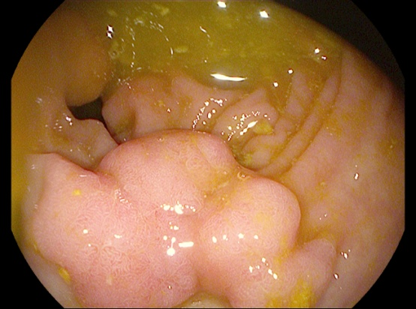
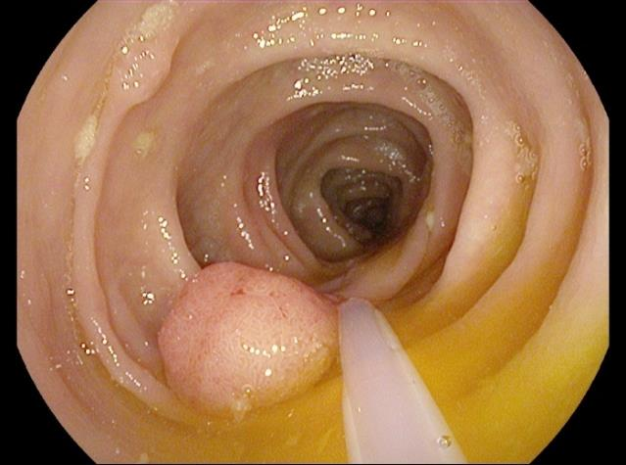
HRAs
Tubular adenoma ≥10 mm, adenoma with villous histology, adenoma with high-grade dysplasia, or >3 LRAs
Notes:
Slide Objective: To define and demonstrate the appearance of high risk adenomas
Speakers Notes:
HRAs are defined as either tubular adenoma ≥10mm, 3 or more adenomas, adenoma(s) with villous histology or adenoma with high-grade dysplasia
Note that sessile serrated polyps >=10mm or sessile serrated polyps with dysplasia are also considered high risk polyps, but they are not high risk “adenomas”

Slide 63
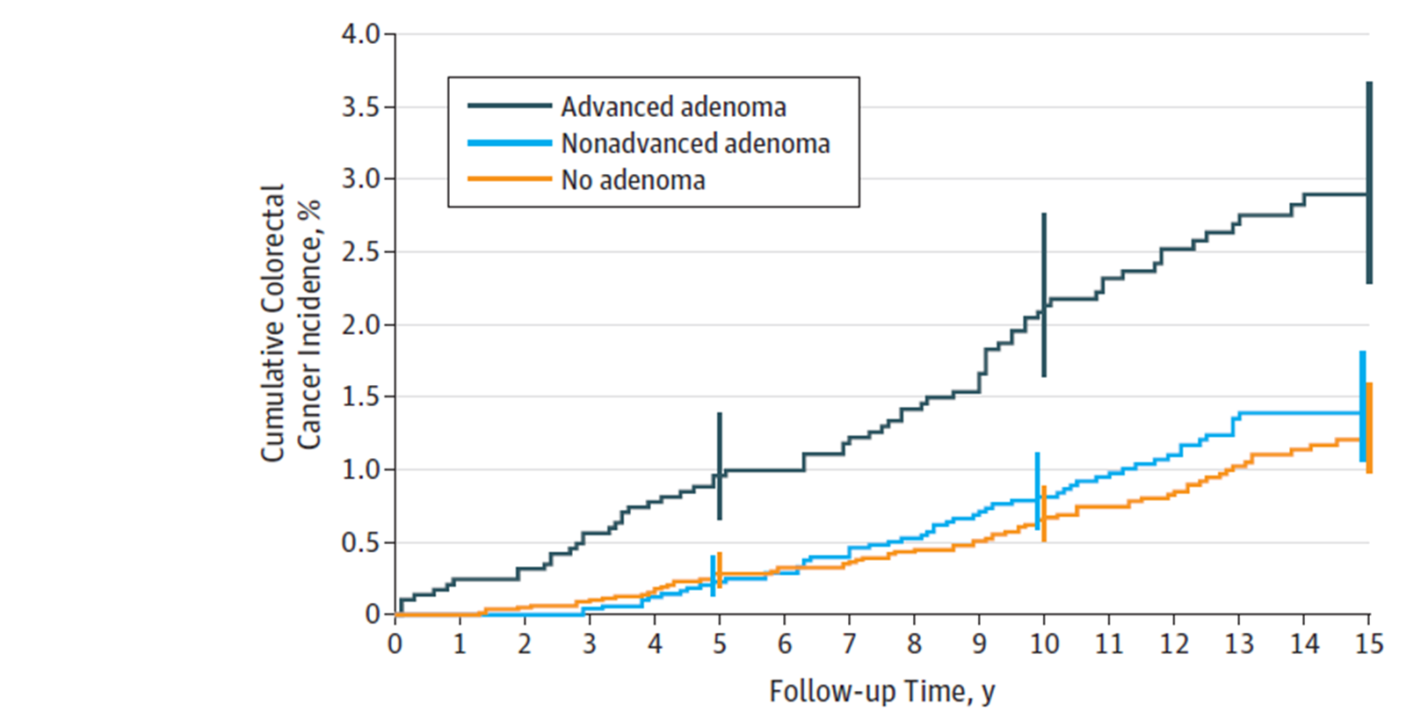
Risk of CRC and CRC Mortality After Colonoscopy
Surveillance should only target those with HRA
Among people with prior LRAs (non-advanced):¹²
No difference in mortality risk compared to those with normal colonoscopy
HRA
LRA
No adenoma
Notes:
Slide Objective: Demonstrate that there is no significant difference in CRC risk or CRC-related death between people with low risk (non-advanced) adenomas and no adenomas at initial colonoscopy, therefore colonoscopic surveillance not required
ANIMATION- call out box
Speakers notes:
CRC incidence rates per 10 000 person-years of observation were 20.0 (95%CI, 15.3-24.7; n = 70) for HRA, 9.1 (95%CI, 6.7-11.5; n = 55) for LRA, and 7.5 (95%CI, 5.8-9.7; n = 71) for no adenoma.
Participants with HRAwere significantly more likely to develop CRC compared with participants with no adenoma (rate ratio [RR], 2.7 [95%CI, 1.9-3.7]; P < .001)
There was no significant difference in CRC risk between participants with LRA compared with no adenoma (RR, 1.2 [95% CI, 0.8-1.7]; P = .30)
Compared with participants with no adenoma, those with HRA were at significantly increased risk of CRC death (RR, 2.6 [95%CI, 1.2-5.7], P = .01), but mortality risk in participants with LRA was not significantly different (RR, 1.2 [95%CI, 0.5-2.7], P = .68)
Additional study information (Click et al., 2018):
Study type: Cohort study with long term follow up (13 years)
Population: Multicenter, prospective cohort study of participants in the Prostate, Lung, Colorectal, and Ovarian (PLCO) Cancer randomized clinical trial of flexible sigmoidoscopy (FSG). 154 900 men and women aged 55 to 74 years enrolled in PLCO of whom 15 935 underwent colonoscopy following their first positive FSG screening result
Outcomes of interest: CRC incidence and mortality within 15 years of baseline colonoscopy
This study is particularly relevant as it uses people with normal colonoscopy findings as the comparator, rather than the general population and fills an important gap in the evidence (most studies compared to the general population in the systematic review). Furthermore, this study used a longer follow up time (15 years) than previous studies
Definition:
Relative Risk: Ratio of the probability of an event occurring in an exposed group versus the event happening in a non-exposed group. E.g., difference in CRC risk between participants with nonadvanced adenoma compared with no adenoma
Non-advanced adenomas: as any number of tubular polyps <10 millimeters without high grade dysplasia
Figure title:
Cumulative Colorectal Cancer Incidence by Adenoma Status among Participants 55-74 Years Enrolled in the Prostate, Lung, Colorectal, and Ovarian Cancer Randomized Clinical Trial
Figure footnote:
Error bars indicate 95% CIs at the given time point. Median time of follow-up was 13.6 years (interquartile range [IQR], 10.3-15.0) for advanced adenoma, 13.1 years (IQR, 9.9-15.0) for non-advanced adenoma, and 12.5 years (IQR, 9.7-15.0) for no adenoma. P values for pairwise comparisons (log-rank test) were P < .001 for advanced adenoma vs no adenoma, P < .001 for advanced adenoma vs non-advanced adenoma, and P = .32 for non-advanced adenoma vs no adenoma.
Slide Sources:
Click B, Pinsky PF, Hickey T, Doroudi M, Schoen RE. Association of colonoscopy adenoma findings with long-term colorectal cancer incidence. JAMA 2018; 319(19):2021-2031.
As FYI only - other relevant sources:
Lee JK, et al. Long-term risk of colorectal cancer and related death after adenoma removal in a large, community-based population. Gastroenterology 2019. doi.org/10.1053/j.gastro.2019.09.039
He X, et al. Long-term risk of colorectal cancer after removal of conventional adenomas and serrated polyps. Gastroenterology 2019. doi.org/10.1053/j.gastro.2019.06.039

Slide 64
Yield: FIT+ vs. Average Risk Colonoscopies
# Screened
100,000
1.8 Million
18x with FIT
Average Risk Colonoscopy
FIT+
Colonoscopy
# Scoped
100,000
100,000
# CRCs
400
8,000
20x with FIT
# HRAs
10,000
45,000
4.5x with FIT
FIT+ is HIGH YIELD:¹⁵ same number of colonoscopies • more people screened • more cancers and HRAs detected
Source: Ernst Kuipers. The Dutch bowel cancer screening program: relevant lessons for Ontario. Presentation delivered on December 6, 2017.
Notes:
Slide objective: To compare relative diagnostic yield for screening with FIT vs Colonoscopy
Speaker Notes:
This slide shows the relative diagnostic yield of FIT compared to colonoscopy assuming 100,000 individuals were scoped with each screening modality
For the same number of colonoscopies:
FIT increases the number of CRCs detected by 20 times
FIT increases the number of high risk adenomas detected by 4.5 times
FIT increases the number of people screened by 18 times
Compared to average risk screening with colonoscopy
Therefore, many more individuals could be screened for every 100,000 scopes, maximizing use of colonoscopy resources and minimizing risk to patients
Additional Information:
Diagnostic yield = number of scopes x positive predictive value (PPV)*
CRC – PPV =0.4% (scope); 8% (FIT)
HRA– PPV = 10% (scope); 45% (FIT)
Next, the number required to screen was calculated in order to get 100,000 scopes (100,000/positivity rate (5.5%)** = 1.8 million)
*Assumption used for PPV (CRC & HRA) for FIT and average risk colonoscopy was drawn from estimates from the Dutch bowel cancer screening program
** Positivity rate for FIT reflects a quantitative positive FIT threshold that allows Ontario to reap the benefits associated with a more sensitive fecal-based test, while also mitigating the risk of over demand and under supply of colonoscopy volumes in the system with FIT
To calculate the number required to screen in order to get 100,000 scopes: 100,000/0.075 (7.5% positivity rate) = 1.3 million
To calculate the number required to be invited in order to get 100,000 scopes: 100,000/(0.075 positivity *participation rate)
Slide Source:
Source for assumption used for PPV (CRC & AA) for FIT and average risk colonoscopy:
Kuipers E. The Dutch bowel cancer screening program: relevant lessons for Ontario. Presentation delivered on December 6, 2017.
Note:
Lower threshold used in Netherlands should mean more false positives → underestimate of yield relative to what we would expect in Ontario
The estimates presented on this slide are based on data from the Dutch bowel cancer screening program and are higher than what is anticipated in Ontario, which may be reflective of the Dutch population. However, the principle remains the same: FIT is still expected to outperform colonoscopy with respect to CRC and HRA yield

Slide 65
Colon cancer detection rate for hospital-based colonoscopies by indication (Ontario)
Colonoscopy indication | 2018 | 2019 | 2020 | 2021
Abnormal FIT | -- | 5.02% | 4.73% | 5.14%
Abnormal guaiac fecal occult blood test (gFOBT) | 3.92% | 3.88% | -- | --
Symptomatic | 1.66% | 1.58% | 1.80% | 1.64%
Other screening (average risk) | 0.44% | 0.49% | 0.65% | 0.54%
Family history | 0.38% | 0.31% | 0.34% | 0.34%
Surveillance | 0.40% | 0.40% | 0.49% | 0.40%
Abnormal FIT colonoscopies detect more colorectal cancers (CRC) than other indications (i.e., symptomatic, family history, surveillance)

Slide 66
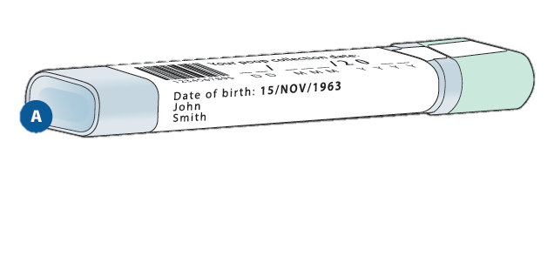
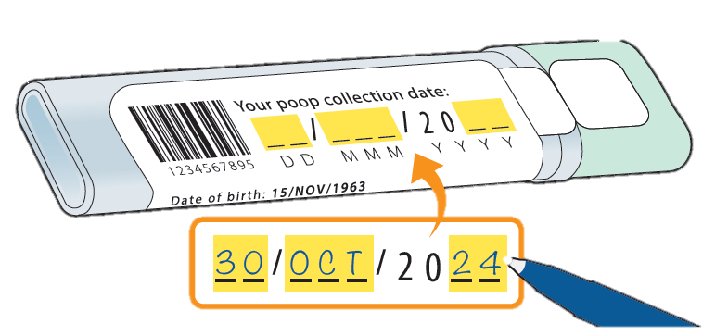
Common Problems with Returned FIT Kits Since FIT launch: Specimen Collection Date
Returned specimens are often missing the collection date
Pre-labeled device
Patient to complete
NEW: Yellow highlighting on FIT label to emphasize completion of ‘specimen collection date’
Results are invalid if LifeLabs is unable to confirm the collection date and the result is below the positivity threshold
Notes:
Slide objective: Common problems with returned kits
ANIMATION- 1) call out box
Speakers Notes:
The FIT device comes pre-labeled with patient identifiers: patient name and date of birth
Patients will still need to record the date of sample collection; patients need to fill out the area in yellow
This will help reduce the number of patients who might need to repeat the FIT test due to an invalid result

Slide 67

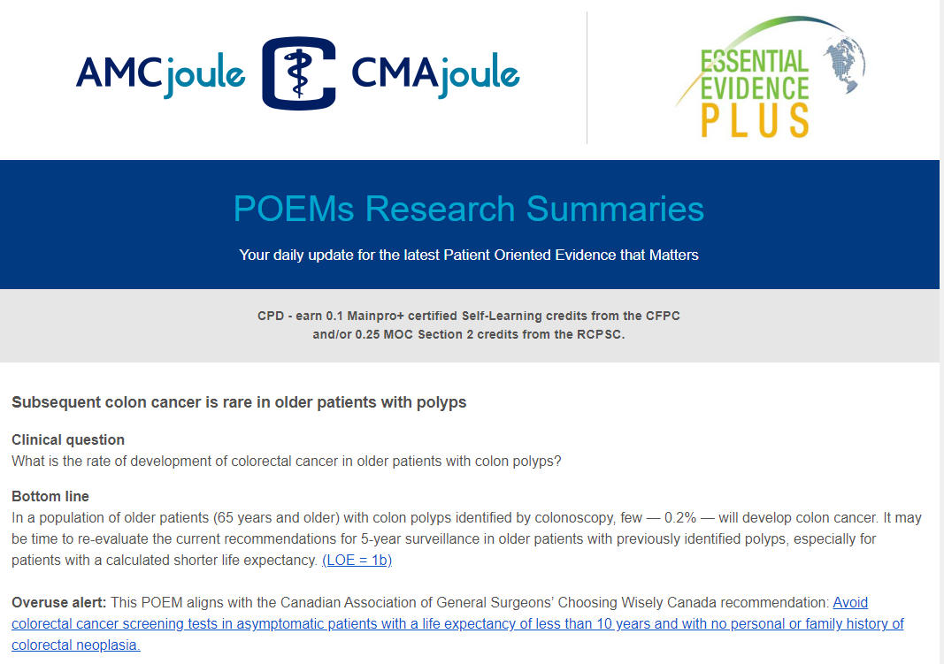
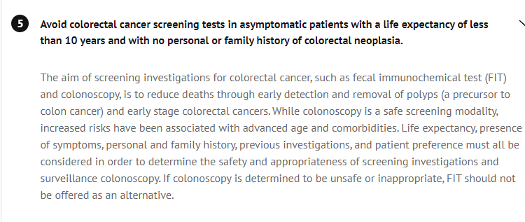
Controversies?

Slide 68
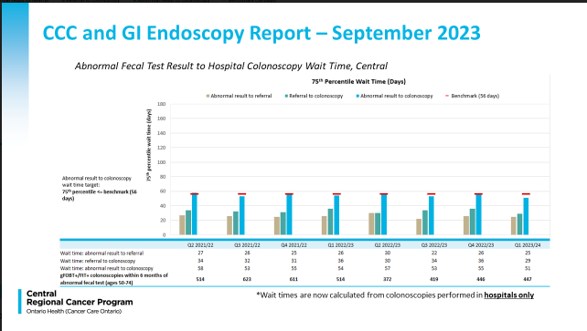
Do not procrastinate; it has to be done, so do it! ☺
Grey bar
How long
it takes to
refer from PC
>20 days!!!

Slide 69
About HPV
HPV infections are common
  80% of sexually active people will have at least one HPV infection in their lifetime
There are 100 subtypes of HPV and about 13 subtypes are known to be oncogenic (cancer-causing or high-risk)
  Subtypes 16 and 18 are of particular concern
Persistent infection with oncogenic subtypes of HPV is the main cause of cervical cancer
Notes:
Subtypes 16/18 detected in ~70% of cervical cancers
Among oncogenic HPV subtypes, the risk of high-grade cervical dysplasia varies and is particularly high for subtype 16. One study estimated a cumulative seven-year risk of high-grade cervical dysplasia or cervical cancer (defined in the study as CIN3+) of 22% for infections with HPV subtype 16, compared to <5% risk for subtype 51. (1)
Only cell changes due to persistent infections with oncogenic or high-risk HPV subtypes have the potential to lead to high grade pre-cancers in the cervix and eventually cancer.
The rest of the HPV subtypes, including those that cause genital warts, are considered low-risk or non-oncogenic HPV subtypes. While infection with low-risk HPVs can lead to low-grade cell changes in the cervix, they never progress to cancer.
References:
Koutsky L. Epidemiology of genital human papillomavirus infection. American Journal of Medicine 1997 May;102(5A):3-8.
Demarco M, Hyun N, Carter-Pokras O, Raine-Bennett TR, Cheung L, Chen X et al. A study of type-specific HPV natural history and implications for contemporary cervical cancer screening programs. EClinicalMedicine. 2020; 25(22):100293.)

Slide 70
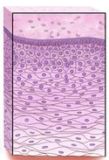
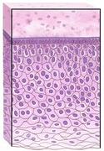
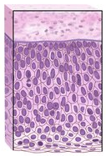
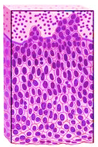

Cervical cancer natural history
It takes 15 to 20 years for persistent infection with oncogenic HPV subtypes to develop into cervical cancer
Normal
HPV infection
Pre-cancer
Cancer
Low-grade
High-grade
Notes:
Typically, it takes 15 to 20 years for persistent infection with oncogenic HPV subtypes to develop into cervical cancer. The nature of HPV and the long progression from infection to cancer makes cervical cancer almost completely preventable with vaccination pre-exposure, regular screening and follow-up of abnormal screening results.
References:
World Health Organization. Cervical Cancer [Internet]. 2019 [cited 2022 Sep 22]. Available from: https://www.who.int/health-topics/cervical-cancer#tab=tab_1

Slide 71
Test performance: HPV test vs. cytology
 | HPV Test | Cytology
One-time sensitivity* (range) | 96.1% (94.2–97.4%) | 53.0% (48.6–57.4%)
One-time specificity** (range) | 90.7% (90.4–91.1%) | 96.3% (96.1–96.5%)
Detects | Oncogenic subtypes of HPV in the cervix | Abnormal cell changes in the cervix
Interpretation | Objective and reproducible | Subjective
*Sensitivity: the effectiveness of a screening test in detecting pre-cancer and cervical cancer in people who have pre-cancer and cervical cancer
**Specificity: the effectiveness of a screening test in indicating a normal result in people who do not have that pre-cancer and cervical cancer
Notes:
Slide Objective: To review evidence supporting the HPV test in screening over cytology testing
The HPV test looks for the presence of oncogenic HPV subtypes in cervical cells. By comparison, cytology detects abnormal cervical cell changes that are primarily caused by HPV infection. When comparing HPV testing to cytology for the purposes of cervical screening, HPV testing has been found to be more sensitive, and therefore more effective than cytology at identifying people who are at higher risk of developing pre-cancer and cervical cancer.
However, unlike cytology, HPV testing cannot detect the presence or absence of cervical cell changes. As a result, it is a less specific test than cytology.
Reference:
10. Program in Evidence-Based Care. Cervical Cancer Screening for Average Risk Women. 2017 (unpublished)
11. Sensitivity/Specificity - Cuzick J, Clavel C, Petry KU, Meijer CJ, Hoyer H, Ratnam S, et al. Overview of the European and North American studies on HPV testing in primary cervical cancer screening. Int J Cancer 2006;119:1095-101.
12. Reproducibility - Stoler MH, Schiffman M. Interobserver reproducibility of cervical cytologic and histologic interpretations: realistic estimates from the ASCUS-LSIL triage study. JAMA 2001;285:1500-5 https://onlinelibrary.wiley.com/doi/epdf/10.1002/ijc.21955

Slide 72
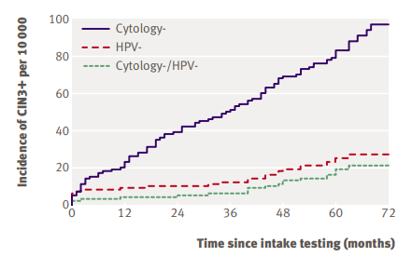
Rationale for a 5-year screening interval for average risk patients
Key take-aways:
The risk of high-grade cervical dysplasia 5 years after a negative HPV test is lower than the 3-year risk after a normal cytology result
It is safe to be screened with the HPV test in 5 years
Ref: BMJ 2008;377:a1754¹⁵
Notes:
https://www.bmj.com/content/337/bmj.a1754
Dillner J, Rebolj M, Birembaut P, Petry KU, Szarewski A, Munk C, et al. Long term predictive values of cytology and human papillomavirus testing in cervical cancer screening: joint European cohort study. BMJ. 2008;337:a1754.
Speaking notes:
The figure is Kaplan-Meier plots of cumulative incidence rate for CIN3+ for women according to baseline test results in first 72 months of follow-up, excluding Denmark and Tübingen
This article from Dillner et al. demonstrates that HPV testing is safe over a long (up to 6 year) interval compared to cytology testing alone
The graph pulled from the article highlights the cumulative incidence for CIN3+ for women in the 72 months since their “normal” screening test, stratified by different screening methods
With cytology only, after a normal cytology result, the incidence of CIN3+ is much greater over time compared to a negative HPV test or to a negative cytology and HPV co-test
As well, this graph shows that co-testing does not add significant safety over five years compared to HPV testing alone
Overall, evidence shows that people with a negative HPV test result have a very low risk of developing high grade cervical dysplasia or cervical cancer in the years following a negative HPV test

Slide 73
Referral to colposcopy
People at elevated risk of pre-cancer and cervical cancer are referred to colposcopy
The OCSP’s criteria for referral to colposcopy is an immediate risk of pre-cancer and cervical cancer that is ≥6%
Notes:
The elevated risk screening population consists of people with screening results that require direct referral to colposcopy. The elevated risk screening population is defined based on an immediate risk of pre-cancer and cervical cancer after a positive screening test result.
The OCSP’s risk threshold for the elevated risk population is greater than or equal to 6%. This risk was selected based on the OCSP’s cytology-based screening recommendations, published literature and input from expert panel members
Note: Cervical pre-cancer is defined as HSIL or AIS histology results

Slide 74
Immediate risks of pre-cancer & cervical cancer
HPV subtype | Cytology | Immediate risk of cervical pre-cancer & cancer (%)
HPV 16 | Normal | 5.3-8.1
 | ASCUS | 9.0-16.1
 | LSIL | 11-13.0
 | ASC-H | 28
 | AGC | 36
HPV 18 | Normal | 2.9-3.0
 | ASCUS | 2.9-3.5
 | LSIL | 3.1-6.5
 | ASC-H | 15
 | AGC | 33
HPV-positive (other) | AGC | 5.4%
Notes:
The elevated risk screening population is defined as people with an immediate risk of cervical pre-cancer and cervical cancer of greater than or equal to 6%.
people with HPV-positive (18) with normal or atypical cells of undetermined significance (ASCUS) cytology results are included in the elevated risk screening population even though they do not meet the risk threshold for referral to colposcopy. HPV 18 infections are a significant risk factor for glandular disease (AIS and invasive adenocarcinoma), which is harder to detect with cytology. As a result, with support from the expert panel, the OCSP has included these screening results in the elevated risk screening population.

Slide 75
People at elevated risk are referred to colposcopy
HPV status | Reflex cytology result
HPV-positive (16/18) | Any cytology result
HPV-positive (other) | High-grade cytology results defined by ASC-H, LSIL-H, HSIL, AGC, AIS, SCC, ACC, or ACC-E
HPV-positive (regardless of subtype) at the 2-year follow-up screening | Any cytology result
Note: Any visible cervical abnormalities or abnormal symptoms must be investigated, consider referral to a specialist (i.e., colposcopist, gynecologist or gyne-oncologist)
Notes:
People who are HPV-positive (type 16/18) with any cytology result require direct referral to colposcopy
People who are HPV-positive (other) with high-grade cytology results (HSIL, ASC-H, AGC, AIS) require direct referral to colposcopy
If a person’s repeat test is HPV-positive in 2 years, they should be referred directly to colposcopy regardless of the HPV subtype or cytology result
Symptoms suggestive of cervical cancer include, but are not limited to, abnormal vaginal bleeding or discharge, bleeding after intercourse and pelvic pain
It is important to do the HPV test at the 2 year interval to give the participant a chance to clear the infection and if HPV negative, participant returns to low risk.
HPV positive at the 2 year mark confirms they have not cleared the infection and are therefore higher risk and must be referred to colposcopy.

Slide 76
HPV test for oncogenic types of HPV
HPV- negative
HPV-positive
Reflex cytology
(performed automatically by the lab on all positive specimens)
HPV-positive (other)
HPV-positive (type 16/18,
regardless of cytology result
Cytology= Normal/NILM, ASCUS, LSIL
Cytology= ASC-H, LSIL-H, HSIL, AGC (all subcategories), AIS, SCC, ACC, ACC-E
Repeat HPV test at 2 years & reflex cytology
(performed automatically by the lab on all specimens)
Refer to colposcopy
HPV-negative
HPV-positive, regardless of cytology result
Return to HPV testing every 5 years (or 3 year if immunocompromised) or cease screening if cessation criteria have been met
Notes:
Immunocompromised people follow the same pathway but return to HPV testing every 3 years instead of 5 years

Slide 77
Immunocompromised population
People living with HIV/AIDS
People requiring long-term immunosuppressive medication (either continuously or at frequent intervals)
Organ transplant recipients (solid organ transplant or allogeneic stem cell transplants)
People living with systemic lupus erythematosus, regardless of treatment
People with congenital (primary) immunodeficiency
People living on dialysis with renal failure

Slide 78
Rationale for a 3-year screening interval for immunocompromised people
People who are immunocompromised may be at higher risk of pre-cancer and cervical cancer
  immunosuppression may impair a person’s ability to clear an HPV infection
Notes:
Based on expert panel feedback and some literature, the OCSP concluded that people who are immunocompromised have a higher risk of pre-cancer and cervical cancer than people at average risk.
Therefore, a screening interval between two- and five-years was considered. The OCSP selected a screening interval of three years based on input from an expert panel, jurisdictional scan data and the precautionary principle (i.e., when there are potential harms, scientific uncertainty must be resolved in favor of prevention).
References:
Moscicki A-B, Flowers L, Huchko MJ, Long ME, MacLaughlin KL, Murphy J, et al. Guidelines for Cervical Cancer Screening in Immunosuppressed Women Without HIV Infection. J Low Genit Tract Dis. 2019 Apr;23(2):87–101.

Slide 79
What is ‘new’?
Breast density readings will guide your screening advice
CRC screening means FIT in MOST
  Do not do low risk colonoscopies!
HPV testing is new, and MUCH more to come (this was JUST a teaser!!)
  Timing is still unclear, late next year??

Slide 80
What about HIGH RISK Breast Screening?
Less than 1% of women in the general population are estimated to be at high risk
High risk patients have >25 to 85% lifetime risk of developing breast cancer

Slide 81
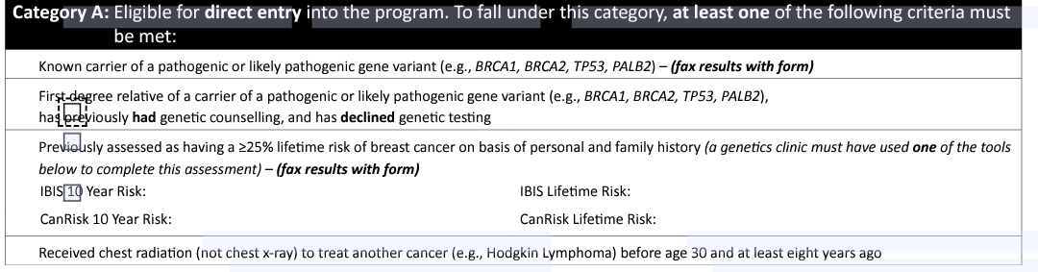
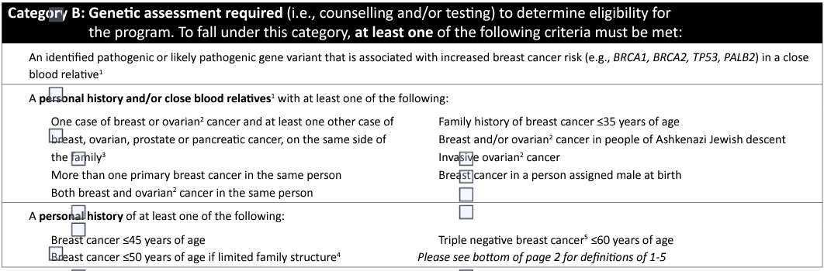
OBSP High Risk Breast Cancer Screening Program
Women age 30-69 at high risk for breast cancer: annual screening MRI and mammogram
Notes:
High risk women between ages 30 to 69
Include hx of pancreatic cancer, hx of triple negative breast cancer

