Slide 1
Veteran Care:
Beyond “thank you for your service”
Family Medicine Forum November 10, 2023

Slide 2
Brent Wolfrom MD CCFP FCFP
Family Physician
Kingston Ontario
Department of Family Medicine
Queen’s University

Slide 3
Burton McCann MD JD CCBOM FCFP FACOEM
Assistant Professor
Department of Family Medicine
Dalhousie University
Chair
Occupational Medicine MIG
College of Family Physicians of Canada
Medical Consultant
Veterans Affairs Canada

Slide 4


Land Acknowledgement
We acknowledge that the lands on which we are hosting this meeting include the traditional territories of many nations. The CFPC recognizes that the many injustices experienced by the Indigenous Peoples of what we now call Canada continue to affect their health and well-being. The CFPC respects that Indigenous people have rich cultural and traditional practices that have been known to improve health outcomes. I invite all attendees to reflect on the territories you call home as we commit ourselves to gaining knowledge; forging a new, culturally safe relationship; and contributing to reconciliation.
Notes:
-add personalized statement with relationship to land.

Slide 5

Indigenous Veterans
While exact statistics are difficult to determine, the rate of Indigenous participation in Canada's military efforts over the years has been impressive. These determined volunteers were often forced to overcome many challenges to serve in uniform, from learning a new language and adapting to cultural differences, to having to travel great distances from their remote communities just to enlist. The challenges they faced often extended to their post-service life. Many Indigenous war Veterans would not receive equal treatment compared to other Canadian Veterans.
https://www.veterans.gc.ca/eng/remembrance/people-and-stories/indigenous-veterans
2021 Census 23,000 indigenous Veterans (slightly higher percentage than in general Canadian population)

Slide 6
Presenter Disclosure
Dr. Brent Wolfrom and Dr. Burton McCann were both members of the subject matter expert group for the CFPC Best Advice Guide: Resources and Considerations in Providing Care to Veterans, 2nd Edition.
Otherwise none to Declare
Notes:
This slide must be visually presented to the audience AND verbalized by the speaker.

Slide 7
Contributors
Dr. Brent Wolfrom MD CCFP FCFP,
Department of Family Medicine, Queen’s University.
Dr. Jim Thompson MD CCFP(EM) FCFP, Assistant Professor, Department of Family Medicine, Dalhousie University; Adjunct Associate Professor, Department of Public Health Sciences, Queens University.
Dr. Heather MacKinnon MSc MD, MSM CD, Family Physician, Halifax.
Dr. Burton McCann MD JD CCBOM FCFP FACOEM, Assistant Professor, Department of Family Medicine, Dalhousie University.

Slide 8
Outline
“Veteran” = Former CAF Member
Recognize Veterans in your practice.
Integrate Veteran lived experience and cultural competence into your patients care.
Apply Veteran care tools and resources.
Notes:
The word “veteran” has different meanings for different people. In this presentation, we mean a former CAF member with even one day of service, since all can be eligible for VAC benefits and services.
But many former members might not identify themselves as “veterans” for a variety of reasons owing to the length or type of their service.
So rather than asking if a person is a “veteran”, it is better to ask if they have ever been in the military.

Slide 9
Recognizing Veterans in Your Practice
Have you ever had any Canadian military service?
When did you release from the Canadian Armed Forces (CAF)?
Have you recently moved into this community?
How has your release from the CAF been for you? For your family?
Can you tell me a little bit about your military service? Were you deployed? How many postings did you have and where to?
What kind of occupation did you have in the CAF? Did you experience any unusual occupational exposures through service?

Slide 10
Canadian Veteran Population
Living in general population:.
  Almost ½ million adult Canadians.
  Proportionately Much higher in certain areas.
All ages, not just old age: most release to the civilian workforce.
Approximately13% identify as female.
Operational service:
  Second World War and Korean War.
  More than 70 special duty areas and operations worldwide since then:
    Peacekeeping operations prior to 1990s.
    Increased operational tempo since 1990 including Somalia, Balkans, Persian Gulf, Afghanistan, Libya, Iraq and many others.
Notes:
As of March 31, 2020 there are about 630,000 living Canadians who have served in Canada’s military, about 3% of the adult population or almost 1 in 30.
Today’s CAF Veterans have served across the world since the Korean War in more than 70 special duty areas or operations, including the peacekeeping era prior to the 1990s, and many deployments in the period of increased operational tempo since 1990.
More than 40,000 CAF personnel deployed in support of the Afghanistan mission, the largest combat operation since the Second World War.

Slide 11
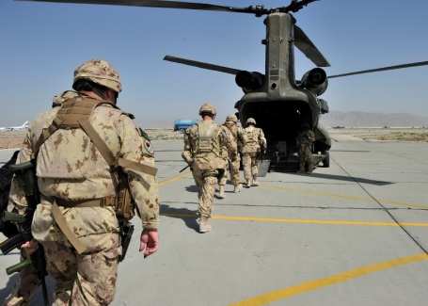
Afghanistan Cohort
41,600
2001 to 2013
Notes:
Almost 42,000 CAF members deployed to Afghanistan from October 2001 to March 2014.
This is the largest single group of Canadian Veterans who served in support of a combat mission since WW2, and their number is about 50% larger than the number of Canadians who served in Korea in the 1950s.
Most are not yet post-military – about 20% are released and 80% are still serving.
But in the early going we are finding that those who have released are experiencing higher than average levels of difficulty in transition to civilian life and higher levels of mental health conditions than other CAF Veterans, which is not surprising given the high demands of that engagement.

Slide 12
Health Care for Serving Personnel and Veterans
Serving Personnel:
  Royal Canadian Medical Services.
  Reserve personnel: publically funded provincial health care systems when part time in home communities.
  Eligible for VAC programs and services.
Families:
  Publically funded provincial health care systems.
  CAF and VAC support programs.
Veterans:
  Publically funded provincial health care systems.
  VAC pays for and facilitates access to health care and rehabilitation services.
Notes:
CAF provides direct health services for serving Regular Force personnel, and for Reserve personnel when they are on operations.
The publically funded provincial health care systems provide direct care for Reserve personnel in their home communities, for family members, and for Veterans.
VAC does not provide direct health care services, rather it pays for and facilitates access to services.

Slide 13
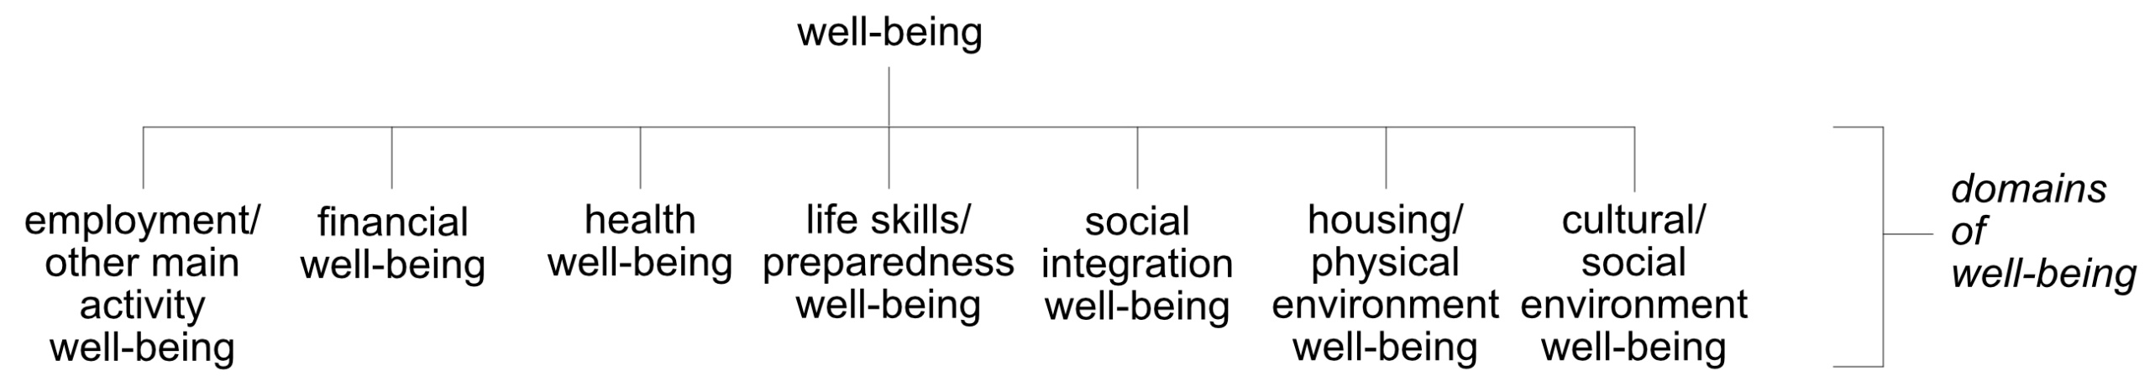
Canadian Veteran Well-being Construct
(Programs, services, values)
Thompson, Vogt, Pedlar: Success in life after service: A perspective on conceptualizing the well-being of military Veterans. J Mil Vet Fam Health. 2022.
Notes:
VAC’s well-being construct includes more than only the Veteran’s internal perception of their psychological well-being.
VAC supports both internal and external well-being across many areas of life (= domains of well-being).
Factors in all these domains influence well-being in the others. You are familiar with the determinants of health, for example. But the determinants of employment or social integration also draw on all these domains, including health.
This is a very useful way of getting to know patients who are Veterans, by asking how they are doing in these different areas of life. Clinicians cannot do much about well-being in areas other than health, but they can refer their Veteran clients to others who can.

Slide 14
Veteran Health Issues??

Slide 15
Examples of Occupational Health Issues
--Hearing loss and tinnitus:
  Thompson et al. JMVFH. November 2016
--Musculoskeletal disorders.
--Chronic pain.
--Mental health problems:
  Thompson et al. JMVFH. February 2016
--Asbestos on ships.
--Mefloquine
https://www.nationalacademies.org/ocga/briefings-to-congress/assessment-of-long-term-health-effects-of-antimalarial-drugs-when-used-for-prophylaxis
https://www.canada.ca/en/department-national-defence/corporate/reports-publications/health/surgeon-general-task-force-report-on-mefloquine.html
--LGBTQ Purge
https://www.tvo.org/video/documentaries/the-fruit-machine-feature-version
--Military Sexual Trauma
https://atlasveterans.ca/knowledge-hub/military-sexual-trauma-mst/military-sexual-trauma-resources/
--1990-91 Persian Gulf War multisymptom illnesses:
  http://www.healthquality.va.gov/guidelines/MR/cmi/CMISinglePageOpt31Aug15.pdf
--Herbicides in the Vietnam era:
  http://www.forces.gc.ca/en/about-reports-pubs/herbicides-gagetown.page
--Depleted Uranium:
  http://www.Veterans.gc.ca/pdf/Reports/scientific-advisory/2013-du-Veterans.pdf
Notes:
Military and Veterans’ occupational health is a specialized field.
This slide lists just a very few of the many military occupational health concerns that you have probably heard about.
Canada’s military physicians and the physicians at Veterans Affairs Canada have 150 years of collective experience dealing with the occupational health concerns of military personnel and Veterans.

Slide 16
Research on Veteran Well-being
Life After Service Studies:
  Surveys in 2010, 2013, 2016 and 2019 of the well-being of CAF Veterans who released from service since 1998.
  Large samples, nationally representative.
  Not just those participating in VAC programs.
  Regular and Reserve Force.
  LASS has been replaced by the Canadian Veteran Health Survey (2022). Results being analyzed right now and should be published soon
DND/CAF transition studies.
University studies.
Veteran: Any former member of the Canadian Armed Forces who successfully underwent basic training and is honourably discharged
Notes:
Veterans Affairs in collaboration with the Department of National Defence and Statistics Canada have conducted three major surveys of health and well-being in Canadian Armed Forces Veterans who released since 1998, in the Life After Service Studies program of research.
The sample sizes were very large and the surveys are considered representative of those populations.
Both Regular and Reserve Force Veterans were included.
These studies for the first time provided comprehensive pictures of the well-being of Canadian Veterans living in the general population, not just those participating in VAC programs, with a focus on health.
By the way, when we say “Veteran”, we mean a former member of the Canadian Armed Forces with any amount of service, since even recruits and officer cadets can be eligible for VAC services.
The evidence base is growing rapidly: DND/CAF and university researchers have also been conducting research on transitioning CAF members and their families.

Slide 17
Overall Findings
Most doing well in terms of mental health, employment, income, life satisfaction and adjustment to civilian life.
Veterans have the same health issues as other Canadians.
  Regular Force and Class C (deployed) Reservist Veterans have chronic physical and mental health problems, chronic pain and related disability at prevalences of double or more the Canadian general population.
  Reserve Class A/B (non-deployed) Veterans on average not much different from adults in the Canadian general population.
Many transitioning CAF members have trouble finding civilian family physicians/general practitioners = added adjustment stress.
Notes:
The majority of these recently released CAF Veterans were doing well.
A majority had good mental health.
Most were employed.
Unemployment rate was the same as the general population.
Rate of low income was lower than the general population.
However a significant number of Regular Force and deployed Reserve Force Veterans had chronic physical and mental health problems and related disability, and well-being problems are more prevalent in some subgroups of Veterans.
Almost 40% of non-deployed Reserve Veterans were released as recruits and on the whole that population had rates of health problems similar to healthy young adults in the general population.

Slide 18
Life After Service Survey 2019
Compared to Veterans who released between 1998 and 2015, those who released more recently (between 2015 and 2018) had higher rates of:
  difficult adjustment (47% vs 37%)
  medical release (49% vs 28%)
  anxiety (30% vs 20%)
  depression (33% vs 24%)
  not being in the labour force (43% vs 36%)
Compared to earlier LASS surveys, LASS 2019 noted increases in Veteran rates of:
  retirement
  non-labour force activities
  participation in VAC programs (39% in 2010 vs 52% in 2019)
Compared to Canadians of comparable age and sex, Regular Force Veterans:
  were less likely to experience low income (6% vs 12%)
  were twice as likely to report chronic pain (51% vs 22%)
  had similar rates of unemployment (both about 5%)
  had higher rates of chronic health conditions such as back problems (45% vs 22%); arthritis (35% vs 20%); depression (26% vs 7%); anxiety (21% vs 6%); and post-traumatic stress disorder (24% vs 1%)
  experienced regular activity limitations more often (31% vs 10%)
  were less likely rate their health as “very good or excellent” (39% vs 60%)

Slide 19
Prevalence of
Chronic Health Conditions
Regular Force Veterans LASS 2013
Notes:
The red bars on the left are self-reported diagnosed chronic mental health conditions, the blue bars are chronic physical health conditions.
The most common mental health condition is depression, followed by PTSD and then by anxiety disorders.
The most common physical health conditions are chronically painful ones like arthritis, back problems and migraine, but hearing loss is prevalent in military Veterans too, at rates higher than shown here because the self-report measure that we used considerably underestimates the prevalence of audiometric hearing loss. All of these can be very distressing for people, leading to mental health problems. Conversely mental health problems can also lead to some physical health problems.
Note that the prevalence rates of chronic mental and physical health disorders were considerably higher in these Veterans than in the general Canadian population after adjusting for age and sex differences between the populations.
These findings clearly support the great strides that have been made in the past 15 years by VAC, CAF Health Services and DND to support mental health and well-being in CAF personnel and Veterans.
The surveys showed us that the majority of Veterans with health and disability problems in this population are obtaining assistance in VAC programs.
This slide is just one of many mental health findings from the surveys that we have published in more than two dozen reports and academic papers, and we are continuing to analyze the data.

Slide 20
Prevalence of Disability
Health-Related Activity Limitations (blue):
Long-term physical or mental condition or health problem reduces amount or kind of activity in home, work, school, other.
Assistance with Activities of Daily Living (red):
Because of physical or mental health condition or problem, needed assistance with at least one BADL or IADL.
Compared to General Population:
Thompson et al. Disability correlates in CAF Regular Force Veterans. Dis Rehab. 2014.
Notes:
So given the higher prevalences of health problems in these Veterans, then it is not surprising then that their prevalence of health-related activity restrictions is higher than in the general population after adjusting for differences in age and sex, as you can see in this slide.
For example, 35% of Regular Force Veterans who were working experienced health-related activity limitations at work compared to about 12% in the general population: that middle pair of bars on this graph.
Not all of those will have experienced work disability, meaning restricted participation in work roles, because their health problems were diagnosed an treated to minimize impairment, they were adaptively coping with their impairments, and most importantly they were accommodated by having social and physical environmental barriers reduced.
But some will be experiencing work disability and could be struggling to remain employed or could be employed in unsatisfactory ways.
Note that red bar: Nearly one in five or 18% of the Veterans needed help with at least one basic or instrumental activity of daily living compared to about 5% of the adjusted general population.

Slide 21
Comorbidity of Physical and Mental Health Conditions
Odds of having activity limitations four times higher in those with both physical and mental health conditions than either one alone.
Thompson et al. Disability correlates in CAF Regular Force Veterans. Dis Rehab. 2014.
Notes:
To my mind physical and mental health are part of one inseparable human experience, so I struck by this finding when we teased out the correlation between activity limitations and each of the two types of health problems separately and together using regression modelling.
The odds of having activity limitations were four times higher in those with both a mental and a physical health condition than the odds of having only one or the other.
A synergy index calculated confirmed that the odds of having limitations when both types of conditions are present simultaneously is more than the sum of having either alone.
Viewed another way, even though 20% had co-occurring physical and mental health conditions in this Veteran population, that comorbidity disproportionately accounted for 55% of the odds of having activity limitations in this population.
Clearly, the co-occurrence of mental and physical health conditions is very significant with respect to disability in Veterans.
This finding in Veterans replicates the same finding in the Canadian civilian population reported by a team of epidemiologists analyzing the Canadian Community Health Survey.
This is cross-sectional data, meaning a snapshot in time, so we cannot draw conclusions about causality in these statistical associations, but it makes sense that if a person is trying to live with a physical impairment then life can be more difficult if they are also dealing with a mental health problem, or vice-versa.

Slide 22
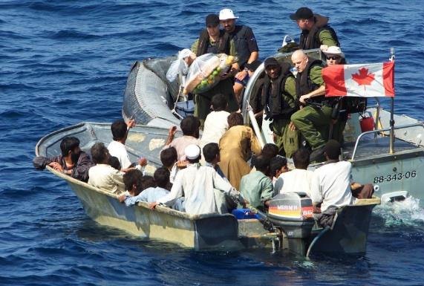
Personal and Environmental Factors
Correlated with Activity Limitations
Increasing age
Women
Non-degree post-secondary education
Low income
Junior non-commissioned member rank
Deployment
Low social support
Low mastery
High life stress
Weak sense of community belonging
Regular Force, LASS 2010, Multivariable regression modelling
Notes:
This slide identifies sub-groups with a higher likelihood of activity limitations after adjusting for mixed effects of multiple factors together.
Increased age, non-degree education, low income and junior non-commissioned member rank had independent associations with activity limitations in ways that you might expect.
The association with elevated life stress was quite strong, almost 4 times the odds of those with no stress. We don’t know from this cross-sectional survey whether this was contributory or secondary to having activity limitations, but we also found that coping variables were also associated with disability: low social support, low mastery meaning feeling a poor sense of control over one’s life, and a weak sense of community belonging.
This suggests that providing social supports and rehabilitation counselling could play important roles in mitigating disability in these Veterans, in addition to the usual rehabilitation interventions and reduction of social and environmental barriers.
Deployment outside Canada of 30 days or more was associated with higher odds of disability, not surprisingly, since high-demand deployment carries a higher risk of illness and injury that can have chronic health effects.

Slide 23
Hearing Problems by Age: Ask all Veterans
Notes:
Self-reported hearing problems were three times more prevalent in the under-50 age group of CAF Veterans than in the Canadian general population. Of greater concern, self-report tends to underestimate audiogram measure of hearing loss by 5-9 times.
This is quite significant, because hearing health treatment-seeking is low in younger people for several reasons:
Invincibility or the belief that hearing loss is an old persons’ problem.
Insidious onset – they fail to realize they have hearing loss.
Stigma. People will wear glasses but won’t wear hearing aids.
Health healthcare system barriers to accessing screening and treatment.
Not understanding the potential value of early treatment.
There is emerging evidence now that earlier hearing aid treatment of hearing impairment can have a beneficial effect on the nervous system with age, the way physical exercise prevents muscle atrophy.
And on the horizon, some researchers are even forecasting the use of urgent pharmacologic treatments for acute hearing loss following an episode of acute acoustic trauma.

Slide 24
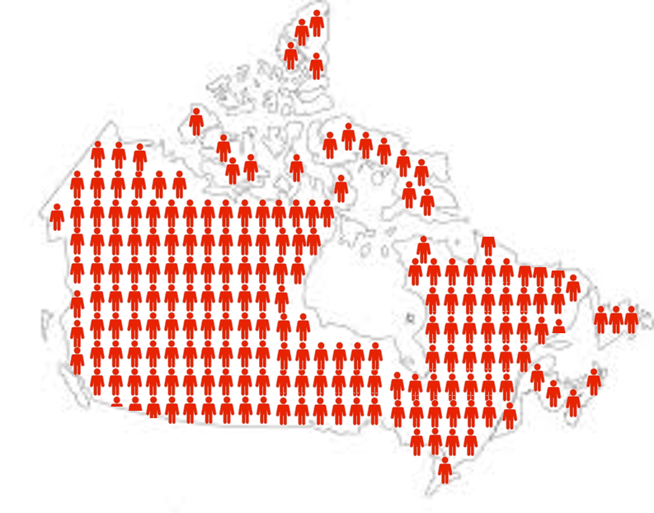
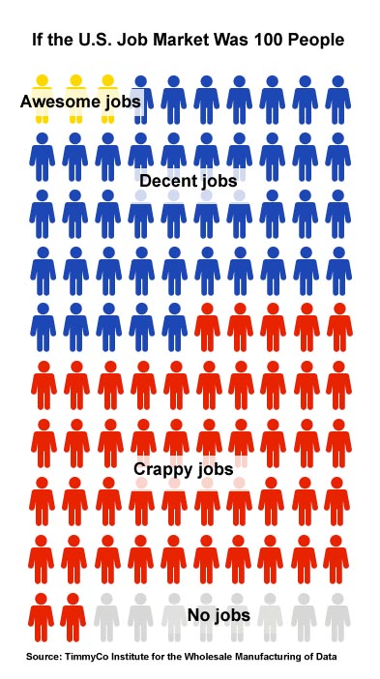
Mental Health by the Numbers
With a VAC disability for a mental health condition
32%
Total VAC Clients:
(45,918 Clients)
142,033
Includes Veterans, CAF and RCMP
(does not include survivors)
Of these,
70%
( 32,271 Clients)
have a VAC disability for PTSD
VAC Statistics - Facts and Figures December 2021

Slide 25

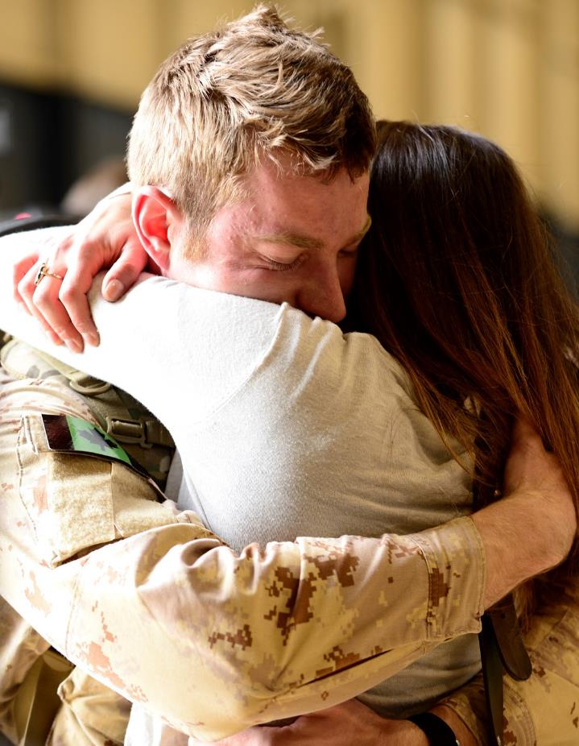
Mental Health Services
Veterans receiving VAC disability benefits for psyschological diagnoses increased significantly in recent years.
Swift access to medical support key to recovery.
Case management.
OSI clinics.
OSISS peer support.
PTSD Coach Canada.
VAC Assistance Service.
Toll-free: 1-800-268-7708
Notes:
Veterans with a disability benefit for a mental health condition increased from 10% in 2009 to 15% in 2014. (Source: VAC Mental Health Statistics)
Quality services in place
Case management
OSISS peer support
OSI clinics
VAC Assistance Service
PTSD Coach Canada
a mental health condition increased from 10% in 2009, to 15% in 2014. (Source: VAC Mental Health Statistics)
Quality services in place
Case management
OSISS peer support
OSI clinics
VAC Assistance Service
PTSD Coach Canada
OSI clinics
VAC Assistance Service
PTSD Coach Canada

Slide 26
VAC Network of Operational Stress Injury Clinics
Veterans Affairs Canada Operational Stress Injuries Clinics Network (OSIC)
BC OSIC
Vancouver, BC
Satellite service site: Victoria
Ste. Anne’s OSIC
Sainte-Anne-de-Bellevue, QC
Satellite service site:
Montreal South Shore
Quebec OSIC
Quebec, QC
Satellite service site:
CIUSSS Saguenay
Lac St-Jean
Edmonton OSIC
Edmonton, AB
Carewest OSIC
Calgary, AB
Satellite service
site: Red Deer
Deer Lodge OSIC
Winnipeg, MB
Satellite service site:
Saskatoon, SK
Royal Ottawa OSIC
Ottawa, ON
Satellite service sites:
Arnprior and Kingston
Fredericton OSIC
Fredericton, NB
Satellite Service
site: Stratford, PE
St. Joseph’s OSIC
London, ON
Satellite service sites:
Toronto and Hamilton
Nova Scotia OSIC
Dartmouth, NS
Satellite service site:
Cape Breton
Notes:
Mental health services and supports available through Veterans Affairs Canada:
Eleven Operational Stress Injury Clinics (10 out-patient) and eleven satellite service sites provide specialized, evidence-based, interdisciplinary assessment and treatment services for operational stress injuries.
The clinics are operated by the provinces but are funded by the department.
Services are provided to Veterans, Canadian Armed Forces members and Royal Canadian Mounted Police members, and their families.

Slide 27
VAC Support for Veterans with Mental Health Conditions
With
Service Related
Condition(s)
Without
Service Related
Condition(s)
Case Management
Operational Stress Injury Clinic
Operational Injury Social Support Services (OSISS)
Pastoral Outreach
VAC Assistance Service (up to 20 sessions)
Mental Health First Aid (Veteran specific)
Clinical Care Manager Services
Registered Community Mental Health Service Providers
Community Residential In-patient Treatment Programs
Online Support
- OSI Connect Mobile
- PTSD Coach Canada
- OSI Resource for Caregivers

Slide 28
Brent Wolfrom MD CCFP FCFP
Family Physician
Kingston Ontario
Department of Family Medicine
Queen’s University

Slide 29
Reserve Force
Canada has approximately 27,000 Reserve Force members.
  Part time CAF members who usually have other full time employment.
  They obtain their care from civilian health care providers and need family physicians when not on bases or deployment.
  Soldier job may ≠ civilian job.

Slide 30
Reserve Force
In contrast to Regular Force members they often lack:
  Deliberate close follow up after deployments, stressful events, work place injuries, etc.
  Military culture or “family”.
  Observation from a chain of command, or employer who could recognize common warning signs.
  Access to CAF health services .
As many are young and healthy they may not have a family physician

Slide 31
Families
The majority of soldiers spouses are female
Challenges faced include:
  Frequent moves
  Fragmented care
  Missed appointments and investigations
  Uncoordinated preventions and screening
  Many bases are in isolated locations
Notes:
Access to a family MD is difficult for military families thus Veterans families have often had inconsistent care for many years
We know that CoC improves health outcomes and reduces system costs

Slide 32
Families
Children of deployed parents are:
  Less likely to attend routine well child appointments
  More likely to seek medical care for behavioural concerns (11% increase)
  More likely to be prescribed pharmacotherapy for anxiety (17%) or depression (10%)
  More twice as likely to be admitted for suicide attempt
  Resource: CPFC Best Advice Guide: Caring for Military Families in the Patient's Medical Home
  https://patientsmedicalhome.ca/resources/best-advice-guides/best-advice-guide-caring-military-families-patients-medical-home/
Notes:
All percentages are increases from non-military comparators
Injury-related hospital admissions of military dependents compared with similarly aged nonmilitary insured infants, children, and adolescents
Pressley, Joyce C. PhD, MPH; Dawson, Patrick MPH; Carpenter, Dustin J. MPH
Journal of Trauma and Acute Care Surgery: October 2012 - Volume 73 - Issue 4 - p S236–S242
doi: 10.1097/TA.0b013e31827035f2
Larson, M., Mohr, B., Adams, R., Ritter, G., Perloff, J., Williams, T., . . . Tompkins, C. (2012). Association of Military Deployment of a Parent or Spouse and Changes in Dependent Use of Health Care Services. Medical Care, 5
Anne Rowan-Legg, Caring for children and youth from Canadian military families: Special considerations, Paediatrics & Child Health, Volume 22, Issue 2, 1 May 2017, Pages e1–e6, https://doi.org/10.1093/pch/pxx0210(9), 821-828. Retrieved from http://www.jstor.org/stable/41714565

Slide 33
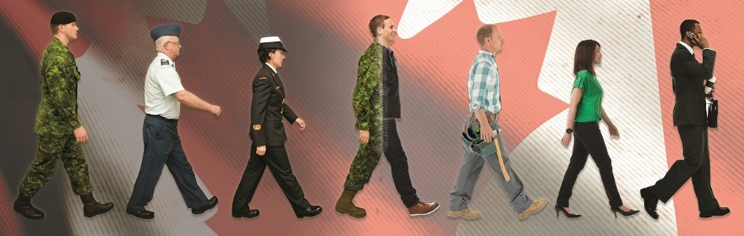
Service and Research
Focus: Transition
Critical Early Years Window
Notes:
We know much less about the critical period from a few months prior to release from service to a few years after, so that is where we are focusing our research attention now.
This new research work will address important gaps in knowledge about what happens to CAF Veterans undergoing military-civilian transition, and identifying supports that are effective in setting them up for good well-being in life after service.

Slide 34
Transition/Access to Primary Care
Primary care is associated with improved health outcomes.
Serving CAF members are accustomed to excellent access to well coordinated care, however:
  A formalized system for transition to civilian care upon release is lacking.
  There is a shortage of family physicians in Canada.

Slide 35
Proportion of Veterans reporting a regular medical doctor, by year of release
Survey on Transition to Civilian Life: Report on Regular Force Veterans 2011
Notes:
Surveyed in 2010.
vs 80% for Canadian population
Less likely to have a family doctor if younger, or if healthier, or soon after release.
More likely to have a family doctor if: have health problems, older or been out of service longer.
Transition to life after service is stressful, and much more so when military families cannot find a family doctor or general practitioner.

Slide 36
The Myths
Most Veterans have PTSD.
VAC/CAF will provide primary care after release from the CAF.
Assumption that all illness is service-related.
Exposure to combat = chronic mental health symptoms. ie. the “broken” stereotype.
The “hero” stereotype.

Slide 37
Pearls – What have we learned?
Veterans generally are very appreciative, motivated and adherent patients.
Veteran patients can access very helpful resources through insurance and VAC forms, physicians can invoice VAC for forms.
Linkages with nearby base clinics can ease the transition to civilian medicine and avoid gaps in care.
Understanding the cultural context and evolution in identity is vital.
Comorbidity of physical health problems or chronic pain is common in those with mental health conditions.

Slide 38
Military Cultural Context
More than a job – unlimited liability, on call 24/7.
Culture spreads to family members as well.
Social circles often are comprised largely of other CAF members.

Slide 39
Culture
Language
Rituals
Roles
Customs
Relationships
Values
Interactions
Boundaries
Expectations
Important identity equity deserving/seeking groups:
Women
2SLGBTQI+
Indigenous, Black & racialized peoples
Various subcultural origins
Different kinds of male and female identities
Veterans are all different
Every Veteran’s journey is unique

Slide 40
Cultural Context
Warrior Culture | Health Care Culture
Collectivism | Individualism
External locus of control | Internal locus of control
Emotional suppression | Emotional expression
Pain: Increased tolerance | Pain: Earlier identification and reduction
Strength focused | Illness focused
Self sacrifice | Self care
Grounded in the past | Need for change
Lunasco TK1, Goodwin EA, Ozanian AJ, Loflin EM. One Shot-One Kill: a culturally sensitive program for the warrior culture. Mil Med. 2010 Jul;175(7):509-13.

Slide 41
Veteran Cultural Context
Loss of military “family”
Geographical instability may have impacted upon approach to forming relationships
Reasons for release from the CAF

Slide 42
Suggestions to build rapport with your Veteran patients
What was your trade?
Where were you posted?
Where did you deploy?
Do you have any service related illness/injuries? If so are you a VAC client?
Ask the person what recognition works for them.

Slide 43
Barriers and Solutions to change????

Slide 44
Barriers to Change in Veterans Health
Access and transition to civilian primary care.
Identifying who/where Canadian Veterans are.
Military literacy of civilian care providers.
Clash of cultures.

Slide 45
Solutions
Within your own practice:
  Identify your Veteran patients.
  Linkages with base clinics or Veterans groups if you are accepting new patients.
  Make the clinic a ”safe zone” for Veterans and their families.
System level
  Increased identification and coordination for current and future Veterans.

Slide 46
What can you do right now?
Accept members into your practice who are releasing from the CAF ,
Ask current patients about service and record in their chart.
Remember that Veterans have the same health issues as the general population.
Refer to VAC for possible service-related illness/injury.
Express interest and appreciation for their service.

Slide 47
Conclusion
Family Physicians and General Practitioners have important roles in supporting the well-being of Canadian military Veterans.
Predict
Prevent
Dx
Treat
Outcomes

Slide 48
Resources
CAF/DND website: http://www.forces.gc.ca/en/caf-community-health-services/index.page
VAC telephone: 1-866-522-2122 (toll-free) Monday to Friday, 8:30 to 4:30, local time
VAC website: http://www.Veterans.gc.ca/eng/
Veterans Transition Network Supports https://vtncanada.org/resources
Canadian Institute for Military and Veteran Health Research:
https://cimvhr.ca
Chronic Pain Center of Excellence for Canadian Veterans:
https://www.veteranschronicpain.ca
Center of Excellence on PTSD and Related Mental Health Conditions, renamed the Atlas Institute for Veterans and Families atlasveterans.ca
U.S. Department of Veterans Affairs practice guidelines: http://www.healthquality.va.gov/
CAF-VAC Joint Suicide Prevention Strategy: https://www.canada.ca/en/department-national-defence/corporate/reports-publications/caf-vac-joint-suicide-prevention-strategy.html

Slide 49
Resources Continued
  CPFC Best Advice Guide: Caring for Military Families in the Patient's Medical Home https://patientsmedicalhome.ca/resources/best-advice-guides/best-advice-guide-caring-military-families-patients-medical-home/
  Veteran and Family Health Reference Guide VAC QR Guide for Vet meeting HCP V14 2021OSI changes no crops (d26wgh18tyxdzi.cloudfront.net)
  Veteran Health Reference Guide for Health Care Providers Meeting with Veterans VAC QR Guide for HCP meeting Vet V16 2021 OSI changes no crops (d26wgh18tyxdzi.cloudfront.net)
  uOttawa Médecine familiale - Family Medicine – YouTube My Patient is a Veteran podcast series

Slide 50


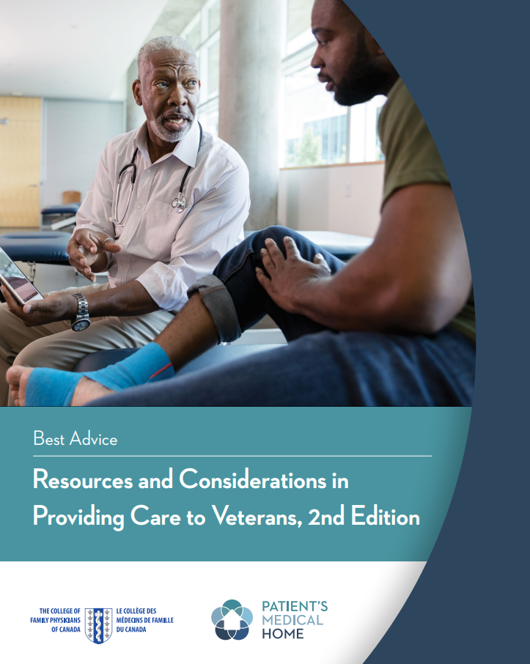

Resources and Considerations in Providing Care to Veterans, 2nd Edition
MIG: Occupational Medicine
The purpose of this guide is to highlight special considerations for care providers in caring for the Veteran population, including contextualizing the information within the CFPC’s Patient’s Medical Home vision for the future for family practice in Canada
Notes:
https://www.dropbox.com/sh/enlhwaklq9j3aze/AADYCNOsu606tfzU7kAdnfMka?dl=0&preview=Clinical+Snippets+eBook+(English).pdf

Slide 51


The Member Interest Groups Section connects members across Canada who have similar practice interests to foster professional peer connections and to explore issues that affect family medicine.
22 different member interest groups
Interested in joining? Update your CFPC member profile or email us at migs@cfpc.ca

Slide 52

Member Interest Groups at the CFPC
2SLGBTQ+ Health | Enhanced Surgical Skills | Mental Health
Addiction Medicine | Family Practice Anesthesia | Occupational Medicine
Cancer Care | GI & Digestive Health | Palliative Care
Child & Adolescent Health | Global Health | Physician Wellness & Resilience
Chronic Pain | Health Care of the Elderly | Prison Health
Dermatology | Health & Environment | Sport & Exercise Medicine
Developmental Disabilities | Hospital Medicine
Emergency Medicine | Maternity & Newborn Care
Notes:
Stephanie

Slide 53


Occupational Medicine MIG includes
Veteran Health
Notes:
Stephanie

Slide 54





MiGroups
Visit http://cfpc.timedright.com to follow along!
Discussions
Content
Events
Messaging and profile
A secure, online platform for family physicians to connect with one another in their area of interest. Email us at migs@cfpc.ca if you have trouble joining.

Slide 55

Notes:
Stephanie

Slide 56
EMAILS
Brent Wolfrom brent.wolfrom@queensu.ca
Burton McCann dbmccann@dal.ca

