Slide 1



Title Slide
Tackling Barriers to Access in Primary Care
Allison Paige MD, CCFP
Assistant Professor
Site Medical Lead, Kildonan Medical Centre
Associate Director of Quality Improvement, DFM
University of Manitoba
Apple Qin MBA
Improvement Specialist
Practice Facilitator, DFM
University of Manitoba

Slide 2
COI – Presenter Disclosure (1)
Presenter Disclosure
Presenter: Allison Paige
Relationships with financial sponsors:
  Any direct financial relationships, including receipt of honoraria: ICEBM, ACFP, University of Manitoba CPD program
  Membership on advisory boards or speakers’ bureaus: None
  Patents for drugs or devices: None
  Other: University of Manitoba, Shared Health Manitoba
Notes:
Where a faculty/presenter has no relationships to disclose, indicate Not Applicable under Relationships with Financial Sponsors.
Complete this slide for the primary presenter and ALL co-presenters if applicable.
Reminder: Disclosures made on your COI forms should match disclosures made on the COI slide.

Slide 3
COI – Presenter Disclosure (1)
Presenter Disclosure
Presenter: Apple Qin
Relationships with financial sponsors:
  Any direct financial relationships, including receipt of honoraria: None
  Membership on advisory boards or speakers’ bureaus: None
  Patents for drugs or devices: None
  Other: University of Manitoba, Shared Health Manitoba
Notes:
Where a faculty/presenter has no relationships to disclose, indicate Not Applicable under Relationships with Financial Sponsors.
Complete this slide for the primary presenter and ALL co-presenters if applicable.
Reminder: Disclosures made on your COI forms should match disclosures made on the COI slide.

Slide 4
COI – Presenter Disclosure (2)
Disclosure of Financial Support
This program has received financial support from Shared Health in the form of project funding.
No in-kind support.
Potential for conflict(s) of interest:
No payment/funding has been received from Shared Health.
Shared Health does not benefit from the sales of any products that will be discussed in this program.
Notes:
Where a program has received no external financial support (e.g., monies for food, logistics assistance such as registration, AV set-up, etc.), indicate No External Support.

Slide 5

Learning objectives
Explore how change management, quality improvement, and team building concepts can improve patient access;
Recognize the value of team-based care in access improvement;
Describe lessons learned from the pilot workshops.

Slide 6

Mentimeter – What are some key barriers to patient access?

Slide 7
Health care system performance rankings
Call for action
 | AUS | CAN | FRA | GER | NETH | NZ | NOR | SWE | SWIZ | UK | US
OVERALL RANKING | 3 | 10 | 8 | 5 | 2 | 6 | 1 | 7 | 9 | 4 | 11
Access to Care | 8 | 9 | 7 | 3 | 1 | 5 | 2 | 6 | 10 | 4 | 11
Care Process | 6 | 4 | 10 | 9 | 3 | 1 | 8 | 11 | 7 | 5 | 2
Administrative Efficiency | 2 | 7 | 6 | 9 | 8 | 3 | 1 | 5 | 10 | 4 | 11
Equity | 1 | 10 | 7 | 2 | 5 | 9 | 8 | 6 | 3 | 4 | 11
Health Care Outcomes | 1 | 10 | 6 | 7 | 4 | 8 | 2 | 5 | 3 | 9 | 11
Source: Eric C. Schneider et al., Mirror, Mirror 2021 — Reflecting Poorly: Health Care in the U.S. Compared to Other High-Income Countries (Commonwealth Fund, Aug. 2021)

Slide 8

Call for action
1 in 5 adults don’t have a regular family doctor or nurse practitioner.
Source: More than 6.5 million adults in Canada lack access to primary care - Healthy Debate

Slide 9
Call for action
Manitoba has the fewest family
physicians per 100,000 individuals in Canada.
Source: Canadian Institute for Health Information. Supply, Distribution and Migration of Physicians in Canada, 2022 — Data Tables. Ottawa, ON: CIHI; 2023.

Slide 10

Partnership
Mission
To bring Manitobans together to create equitable, safe, accessible,
trusted and sustainable pathways to care.
Leading provincial planning.
Delivering provincial services.
Valuing all voices.
Source: Shared health mission

Slide 11
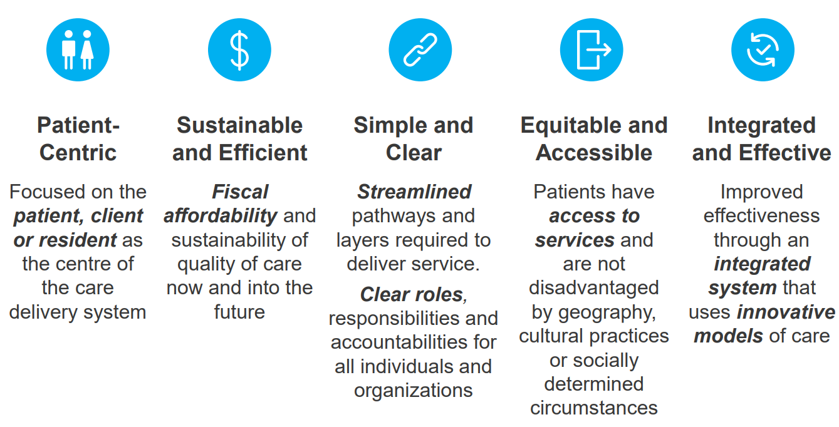
Manitoba’s Clinical and Preventive Services Plan
(2019)
Partnership
Source: Manitoba's Clinical and Preventive Services Plan

Slide 12

Partnership
Improve access to primary care in Manitoba
Department of Family Medicine
University of Manitoba
Shared Health Manitoba
Access Improvement Model
AIM

Slide 13
Environmental scan
1
2
3
4
5
Review Advanced Access (AA) program evaluation
Review Clinical and Preventative Services Plan (CPSP)
Analyze current state of access to primary care
Develop stakeholder engagement strategy
Research
latest developments in Advanced Access (AA) methodology

Slide 14
Environmental scan
Key findings
A shift in approach involving continuous quality improvement, change management, and team building.
1
2
A need for ongoing support to clinics for continued quality improvement work.
A need to develop high-functioning teams as part of access improvement training and supports.
3
4
Flexibility in training to accommodate different clinical structures.
5
A need for a customizable training curriculum for each participating clinic.

Slide 15
Environmental scan
Key features
Customized training to improve individual clinical patient access
Practice facilitation
and
mentored project
Continuous and ongoing support
Saturn
Saturn is the ringed planet and a gas giant
Quality improvement, change management, team building
Virtual training with in-person option
Flexible schedule

Slide 16

Development of AIM
Teams
The Working Group
The Advisory Committee

Slide 17
Development of AIM
Resources
QI content expert
Two practice facilitators
Continous and ongoing support

Slide 18
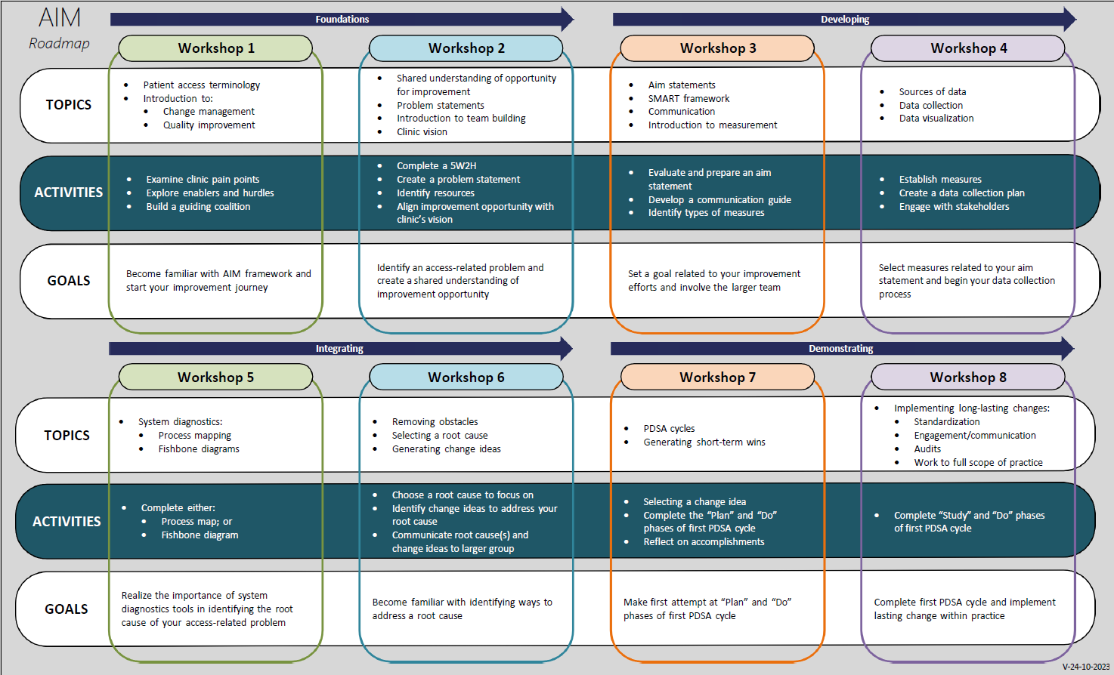
Development of AIM

Slide 19
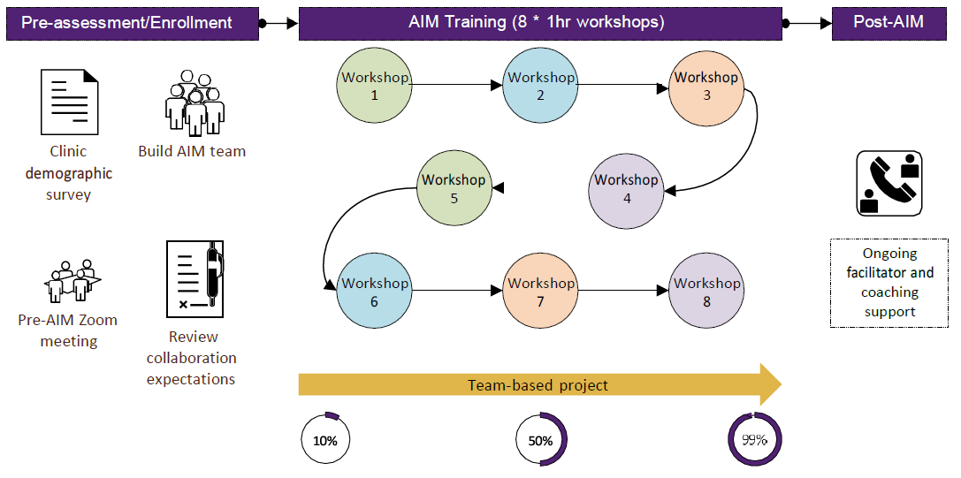
Overview of AIM
Development of AIM

Slide 20
Three pillars in AIM

Slide 21
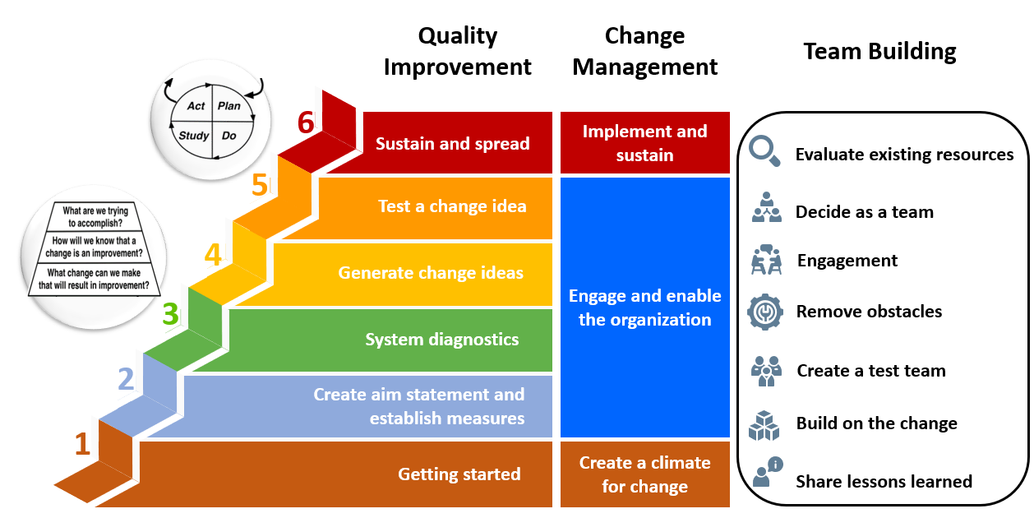
Three pillars in AIM

Slide 22
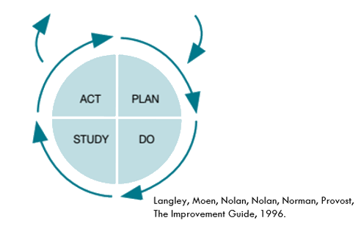
The Model for Improvement (MFI)
Three pillars in AIM
1. Quality Improvement
What are we trying to accomplish?
How will we know if a change is an improvement?
What changes can we make that could result in an improvement?
Start with small changes!

Slide 23

Time for fun!!

Slide 24
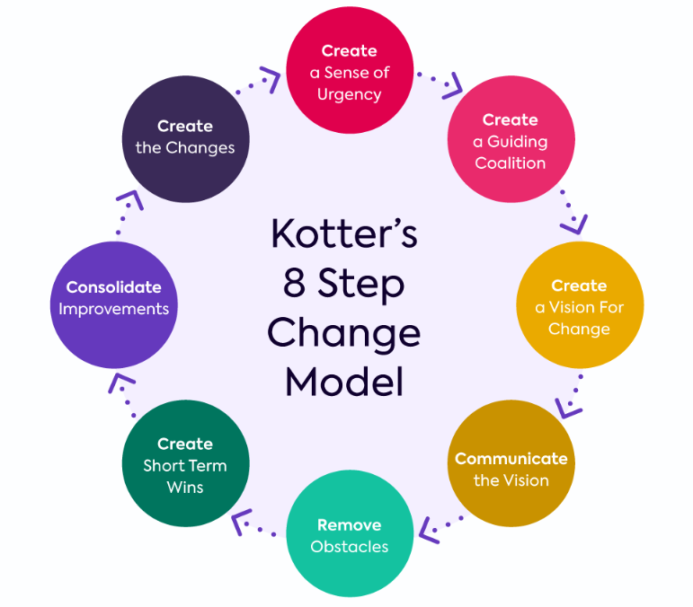
Three pillars in AIM
2. Change Management
Source:How to Successfully Implement Kotter’s 8 Step Change Model

Slide 25
Kotter’s change management model
Three pillars in AIM
2. Change Management
Create urgency
Build a coalition
Create a vision
Create a climate for change
Engage and enable the organization
Implement and sustain

Slide 26
Kotter’s change management model
Three pillars in AIM
2. Change Management
Communicate vision
Empower others
Create quick wins
Engage and enable the organization

Slide 27
Kotter’s change management model
Three pillars in AIM
2. Change Management
Build on the change
Embed the change
Implement and sustain

Slide 28

Team building roadmap
Three pillars in AIM
2. Team Building
Evaluate existing resources
Decide as a team
Engagement
Team mapping
Remove obstacles
Create a test team
Build on the change
Share lessons learned

Slide 29
1st Pilot clinic
Pilot clinics
AIM statement:
By October 31, 2023, we will increase the number of appointments offered within 3 days of the request by
100% for all primary care patients calling…
Root cause:
No-shows
Change idea:
Patient reminder calls
PDSA #1 – Draft rubrics
PDSA #2 – Document current protocol
PDSA #3 – Standardized the process
…
Primary Care Clinic
+ Walk-in Connected Care clinic
Urban
Direct Ops
7 members participated in AIM

Slide 30
2nd Pilot clinic
Pilot clinics
AIM statement:
We want to reduce the volume of patients who don’t get same day appointments including phone/walk-in from 15
patients to 10 patients a day by Oct 1st, 2023.
Primary Care Clinic
+ Hospital
Rural
Direct Ops
3 members participated in AIM

Slide 31
Pilot clinics
Lessons learned
Flexibility in the training schedule is necessary.
Practice facilitation is vital to the success of the training.
Multidisciplinary teamwork and open discussion are greatly valued.
Rural clinics have fewer resources than urban ones; face greater participation challenges.

Slide 32
Pilot clinics
Pilot feedback
Overall objectives are not clear.
Provide more clarity as to how every concept, exercise, and homework interconnects with one another.
Workshops and homework are time intensive.
Develop integrated visual to introduce all three pillars’ roadmap.
Rearrange the flow of workshops and add explanations for interconnectivity.
Condense content and convert homework to in-class exercise.

Slide 33
Recruitment channels
Recruitment
1
Contact clinics interested in quality improvement training.
AIM
2
Reach out to clinics through the Regional Health Authority.
3
Active promotions through newsletters on various partners' platforms.

Slide 34
Challenges in recruitment
Recruitment
1
2
3
Many clinics are stressed and reluctant to take on more work.
Recruiting fee-for-service clinics is harder.
Time commitment is the biggest concern.

Slide 35
Outlook of AIM
Build a community of practice
AIM Quality Improvement day
Dashboard sharing project
Sharing success and case study
Learning session including team mapping, process mapping…
Community
Of
Practice

Slide 36



For more information, please contact:
AIM@umanitoba.ca

Slide 37




Closing Slide
Thank you!
Please fill out your session evaluation now!
#myfmf
FamilyMedicineForum
FamilyMedForum
FamilyMedForum

