Slide 1
Supporting Mentorship for New Leaders in Family Medicine
Alison Baker, MSc, MD, CCFP, FCFP, DRCPSC(CE)
Molly Whalen-Browne, MD, MSc, DTM&H, CCFP
Deborah Kopansky-Giles, BPHE, DC, FCCS, MSc
Viola Antao MD, CCFP, MHSc, FCFP
Family Medicine Forum November 10, 2023

Slide 2
Credit: CFPC Indigenous Health Committee

Slide 3
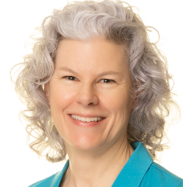
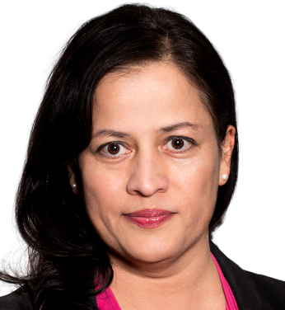
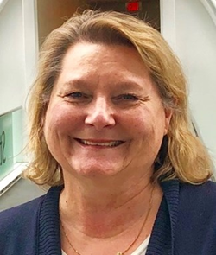
Presenter Disclosure
We have no conflicts to declare with respect to this presentation
This program has received no financial support or in-kind support.
There are no potential conflicts of interest.
No product or program receiving financial support will be discussed in this session.
Alison Baker, Viola Antao, Molly Whalen-Browne, Deborah Kopansky-Giles

Slide 4
Agenda
Welcome
Introduction to Mentoring
Strategies, enablers, barriers to good mentorship
Case-based application of strategies
Take Aways:
Commitment to Change Statement
Resources and tip sheets

Slide 5
Ice breaker
POLLS:
Do you have a mentor?
Are you a mentor?
Do you want a mentor?
Do you have a leadership role?
www.menti.com - Enter this code: (QR code too)

Slide 6
Ice breaker
WORD CLOUD
What would be an important quality for a mentor to have?
www.menti.com - Enter this code: (QR code too)

Slide 7
Learning Objectives
By the end of this session, you will be able to:
Identify enablers and barriers to a successful mentoring relationship
Propose potential next steps to address your mentorship needs
Respond to your leadership challenges by strengthening and diversifying your mentoring relationships.

Slide 8
Mentorship
“If I have seen further it is by standing on the shoulders of giants.”
Isaac Newton
“The delicate balance of mentoring someone is not creating them in your own image, but giving them the opportunity to create themselves.”
Steven Spielberg

Slide 9
Impact
Impact
Clinician
Consider your future career trajectory
Could a mentor make a difference?
Faculty who reported their mentorship as high quality had a decreased likelihood of being stalled in rank and an increased likelihood of high job satisfaction.
Family member
Teacher
Leader
Scholar
Walensky P. et al. The impact of active mentorship: results from a survey of faculty in the Department of Medicine at Massachusetts General Hospital. BMC Medical Education volume 18, Article number: 108 (2018)

Slide 10
What is mentorship?
A relationship where an individual takes a special interest in helping another person develop into a successful professional
A trusted counselor or guide (Webster)

Slide 12
Think about your own experience as a mentor or mentee.
What was successful?
Pair up with a person at your table and share your experiences.
Share your conversation with others at your table

Slide 14
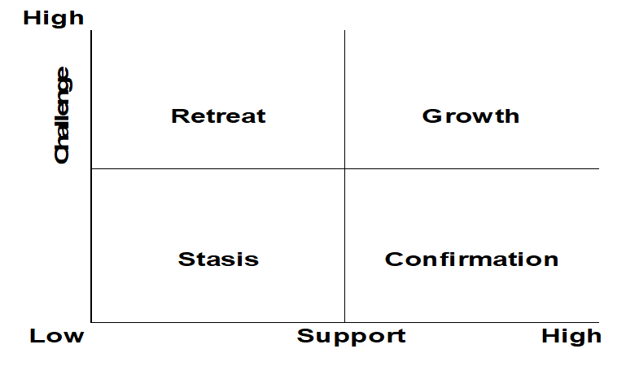

Slide 15
Characteristics to avoid
Not for mentor’s self-interest or gain

Slide 16
Career Development Tools

Slide 17
Case Discussion
Leadership/Mentorship
Educational Role/Mentorship
You have a new leadership position that requires you to support the other team members.
Several of them don’t seem very receptive to your ideas, advice, and guidance.
You are keen to help them, but something is going wrong.
Your new role in education is exciting but challenging.
You are not sure where to start with the problems you are facing.
You have identified several different people who might be helpful in different ways.

Slide 18
Report Back
Do these cases resonate with you?
What do you see as the challenges?
Any thoughts on next steps?

Slide 19
Leadership/Mentorship
Educational Role/Mentorship
You have a new leadership position that requires you to support the other team members.
Several of them don’t seem very receptive to your ideas, advice, and guidance.
You are keen to help them, but something is going wrong.
Your new role in education is exciting but challenging.
You are not sure where to start with the problems you are facing.
You have identified several different people who might be helpful in different ways.
Do these cases resonate with you?
What do you see as the challenges?
Any thoughts on next steps?

Slide 20
Snowball
What did you learn today that will help you in your mentor or mentee role?
Write your answer on the piece of paper provided
Scrunch it up into a ball
Toss the ball into the centre
Pick someone else’s ball and read it to the group

Slide 21
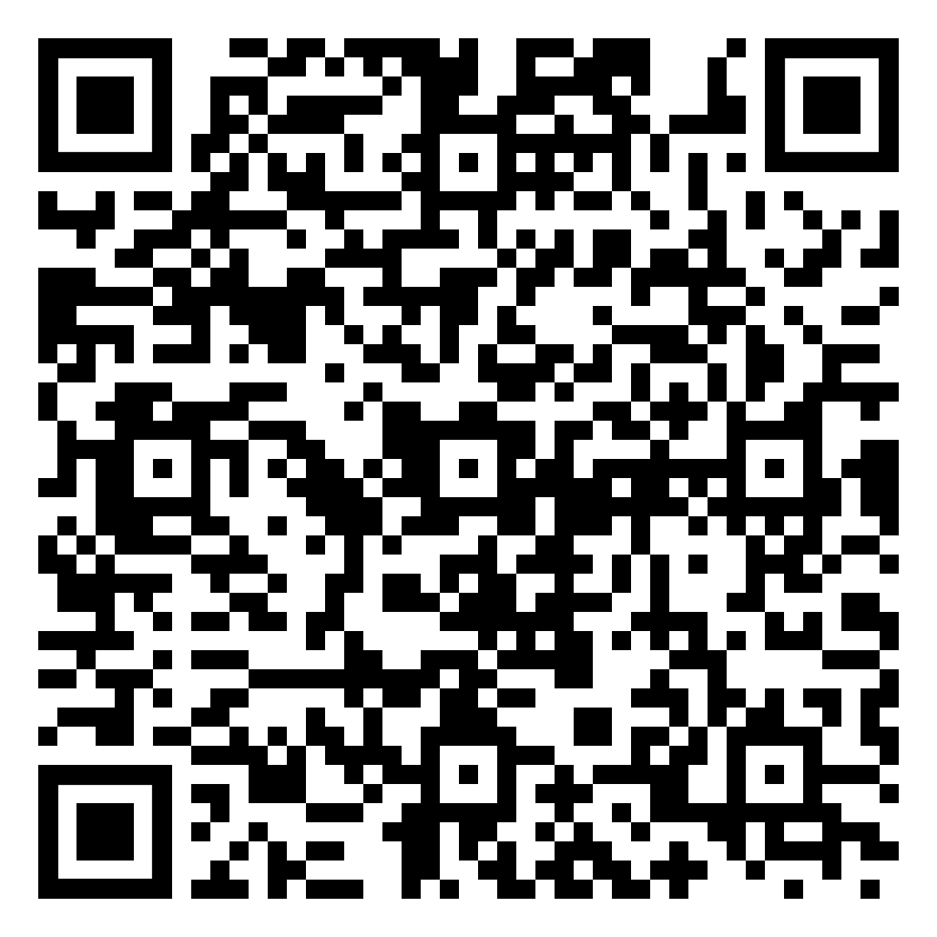
Takeaways
Commitment to Change Statement:
Identify one thing you can do to advance your mentorship skills or help you find a mentor.
Pick a date in your calendar about 3 months from now (February 2024) to check in with yourself as to whether you’ve made progress on your goal.
If you would like a reminder from us, please share your email on the Google Form using this QR code:
Please find resources on our tip sheet.
CtC reminder email

Slide 22
Takeaways – Tip Sheets
https://www.uottawa.ca/faculty-medicine/family/faculty/climb-mentorship-program
Notes:
Here’s a great resource from the University of Ottawa

Slide 23
Resources
Wooltorton E, Tobin D. CLIMB faculty mentorship program/Residents as mentors (RAMs) program. University of Ottawa. Available at: https://www.uottawa.ca/faculty-medicine/family/faculty/climb-mentorship-program
Harolds JA. Quality and safety in health care, part XLIX: mentoring, coaching, and burnout. Clin Nucl Med. 2019;44:566-7. PMID 31158104
Toh YP, Karthik R, Teo CC, Suppiah S, Cheung SL, Krishna L. Toward mentoring in palliative social work: a narrative review of mentoring programs in social work. Am J Hosp Palliat Care. 2018;35:523-31. PMID 28641444
Thomas-Maclean R, Hamoline R, Quinlan E, Ramsden VR, Kuzmicz J. Discussing mentorship: an ongoing study for the development of a mentorship program in Saskatchewan. Can Fam Physician. 2010;56:e263-72. PMID 20631262
Feldman MD, Arean PA, Marshall SJ, Lovett M, O’Sullivan P. Does mentoring matter: results from a survey of faculty mentees at a large health sciences university. Med Educ Online. 2010;15. PMID 20431710
Hernandez-Lee J, Pieroway A. Mentorship for early career family physicians: is there a role for the First Five Years in Family Practice Committee and the CFPC? Can Fam Physician. 2018;64:861-2. PMID 30429184
Seehusen D, Rogers T, Al Achkar M, Chang T, Coaching, Mentoring, and Sponsoring as Career Development Tools. Family Medicine VOL. 53, NO. 3 • MARCH 2021
Straus, S. E., Johnson, M. O., Marquez, C., & Feldman, M. D. (2013). Characteristics of successful and failed mentoring relationships: a qualitative study across two academic health centers. Academic medicine : Journal of the Association of American Medical Colleges, 88(1), 82–89. https://doi.org/10.1097/ACM.0b013e31827647a0

Slide 24
Closing Slide
Please fill out your session evaluation now!
FamilyMedicineForum
Click this button in the agenda:
Click this button on the app:
@FamilyMedForum
FamilyMedForum
#MyFMF #FMF2023

